Slide 1

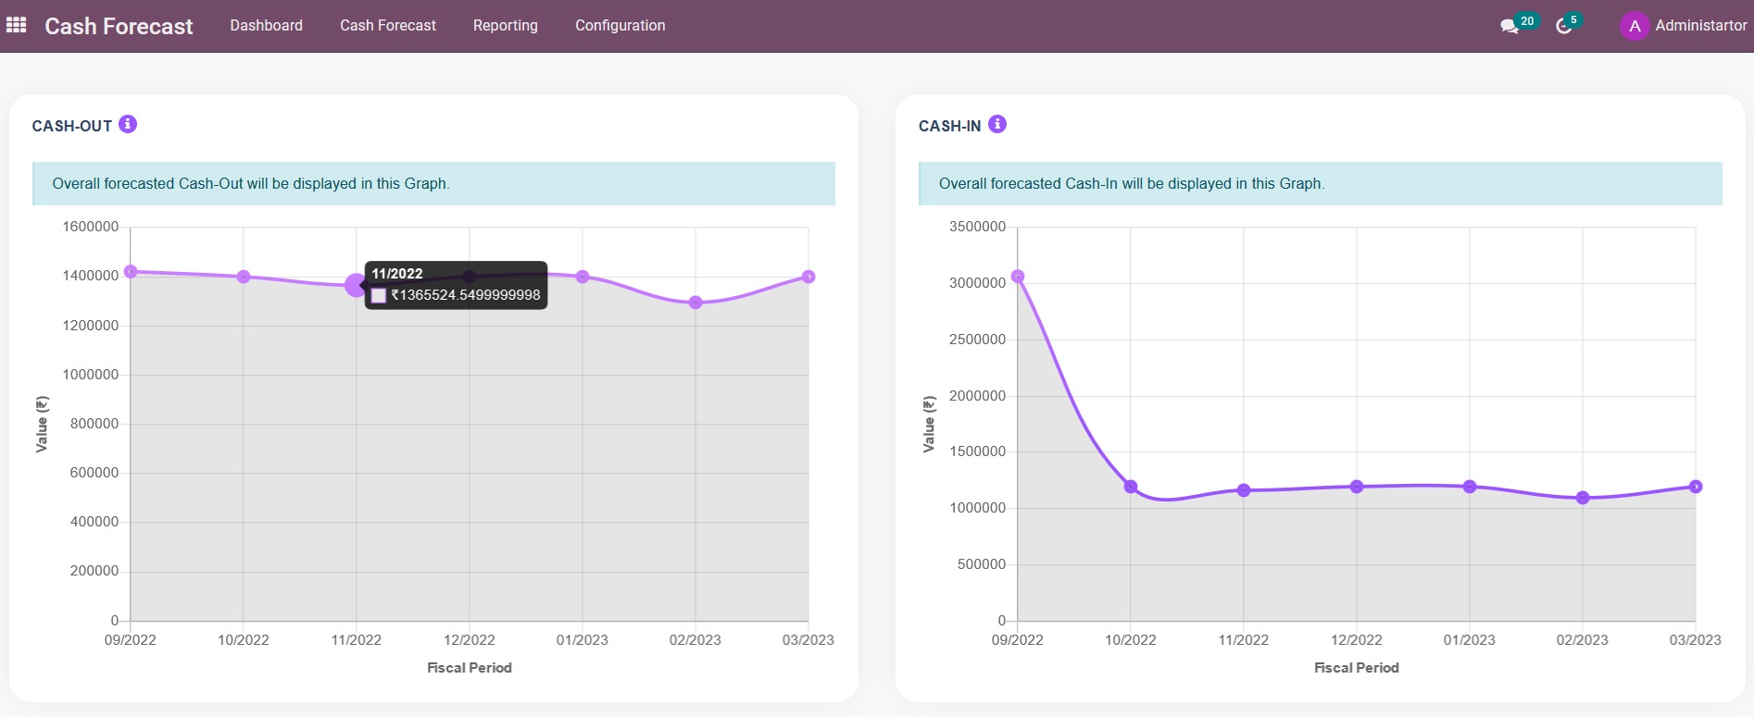


Slide 2
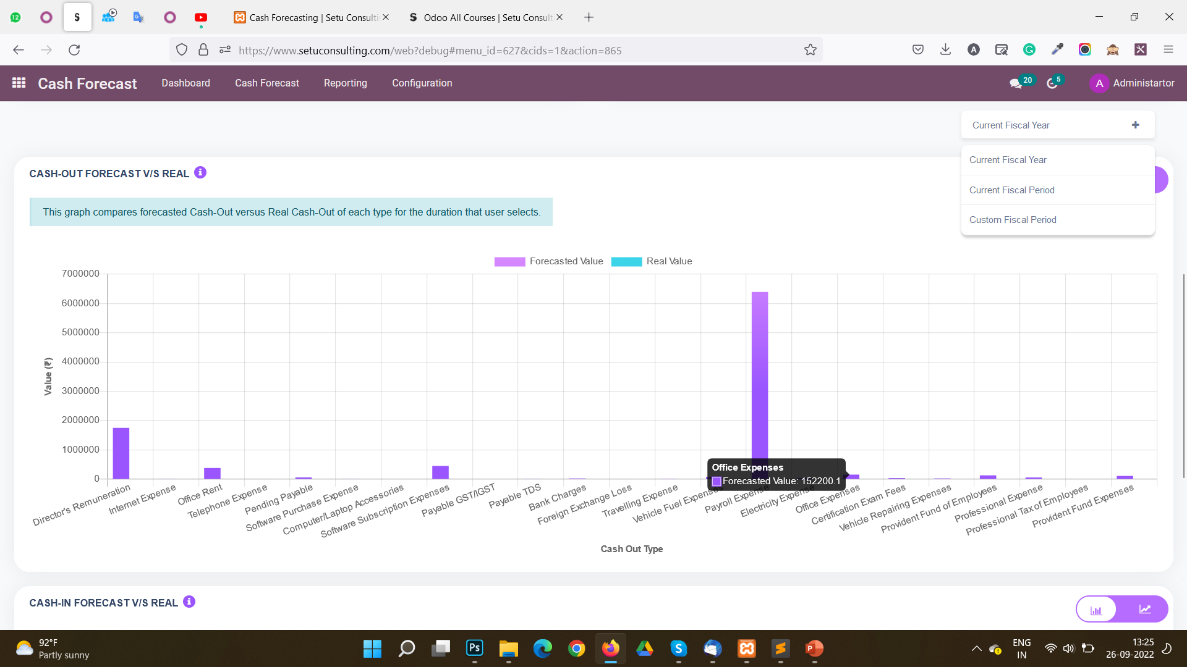

Slide 3
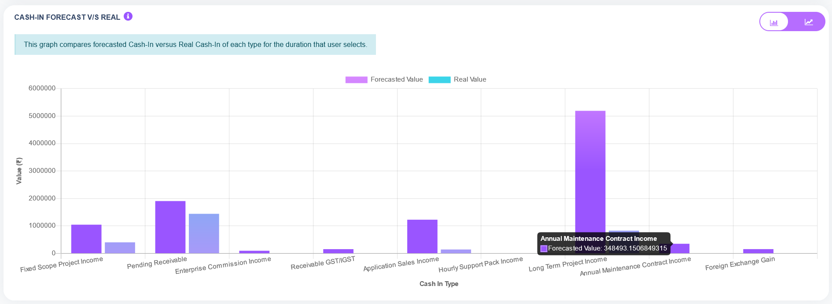
CASH FORECAST

Slide 4
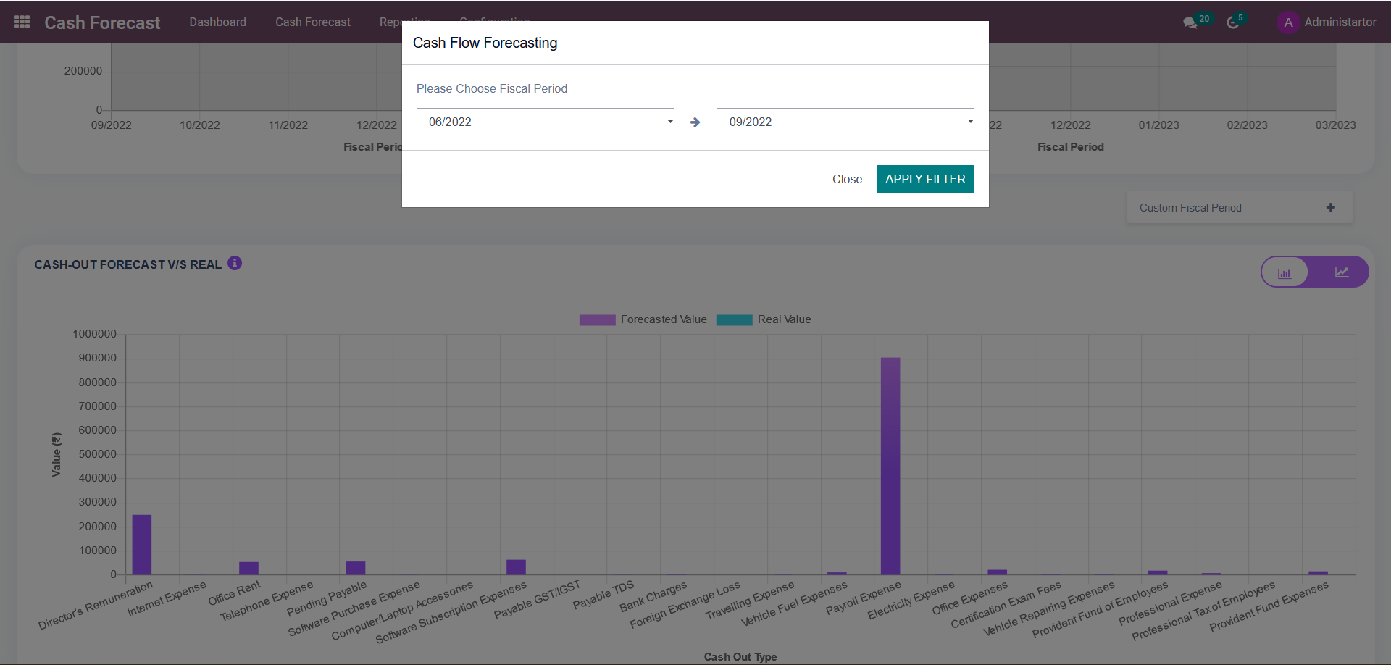

Slide 5
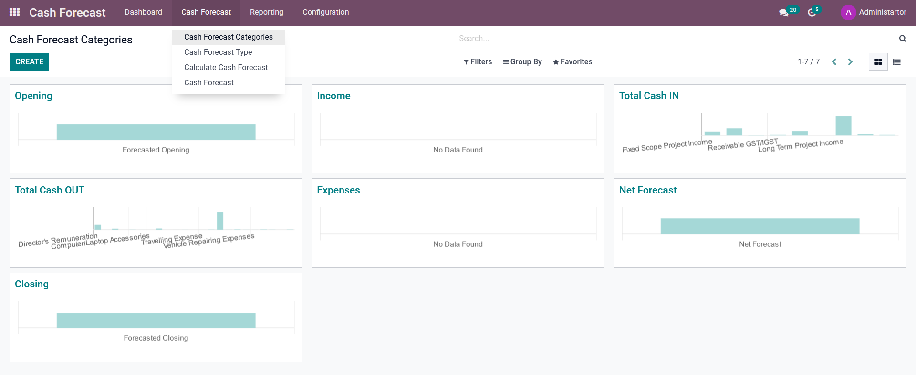
CASH FORECAST

Slide 6
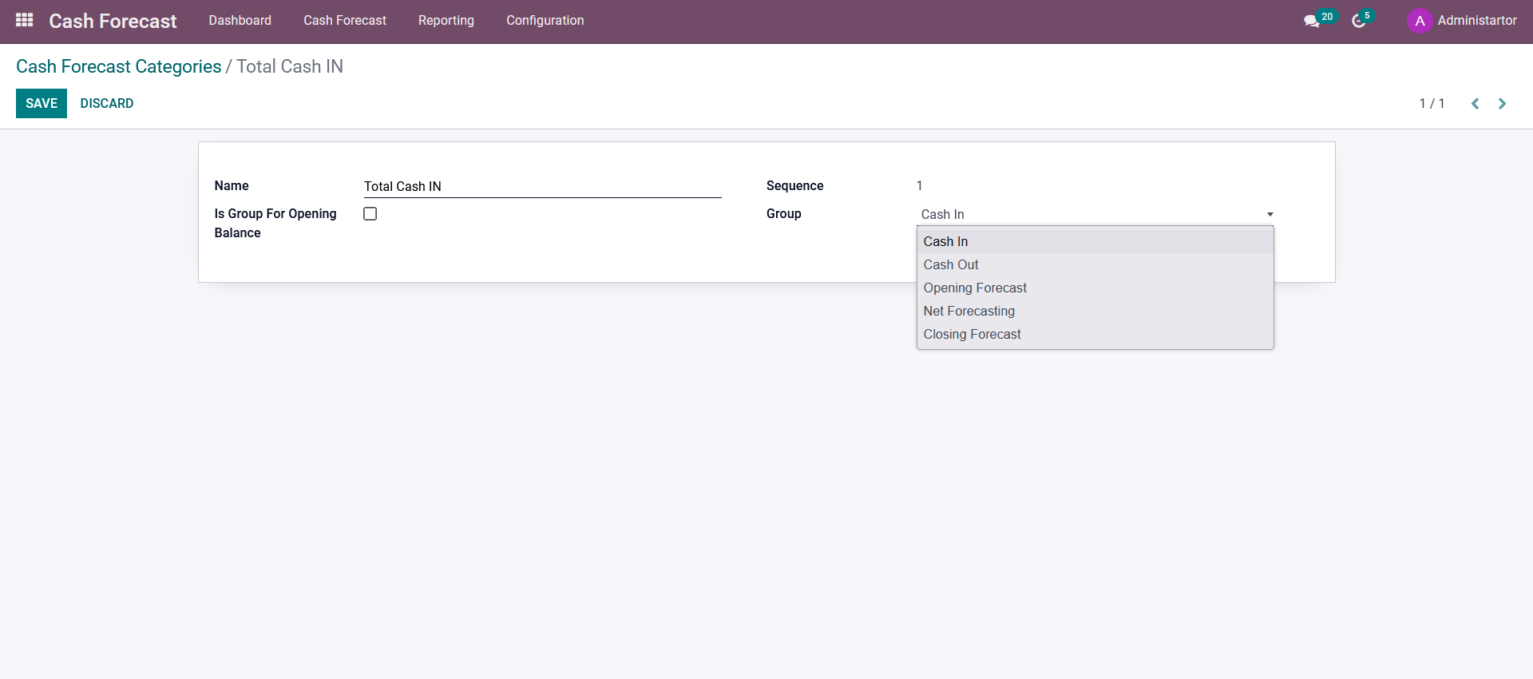
CASH FORECAST
Create Cash Forecast Category
Select Group from the list

Slide 7
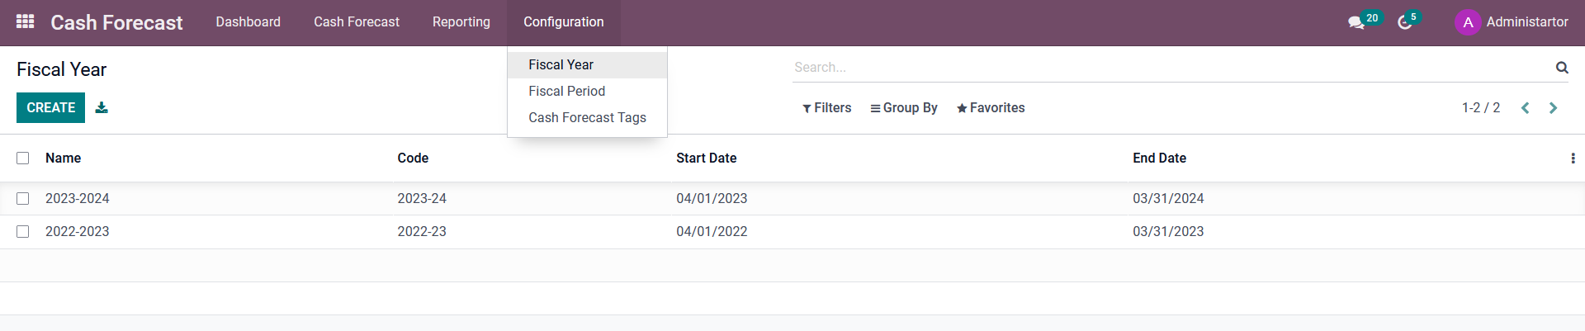
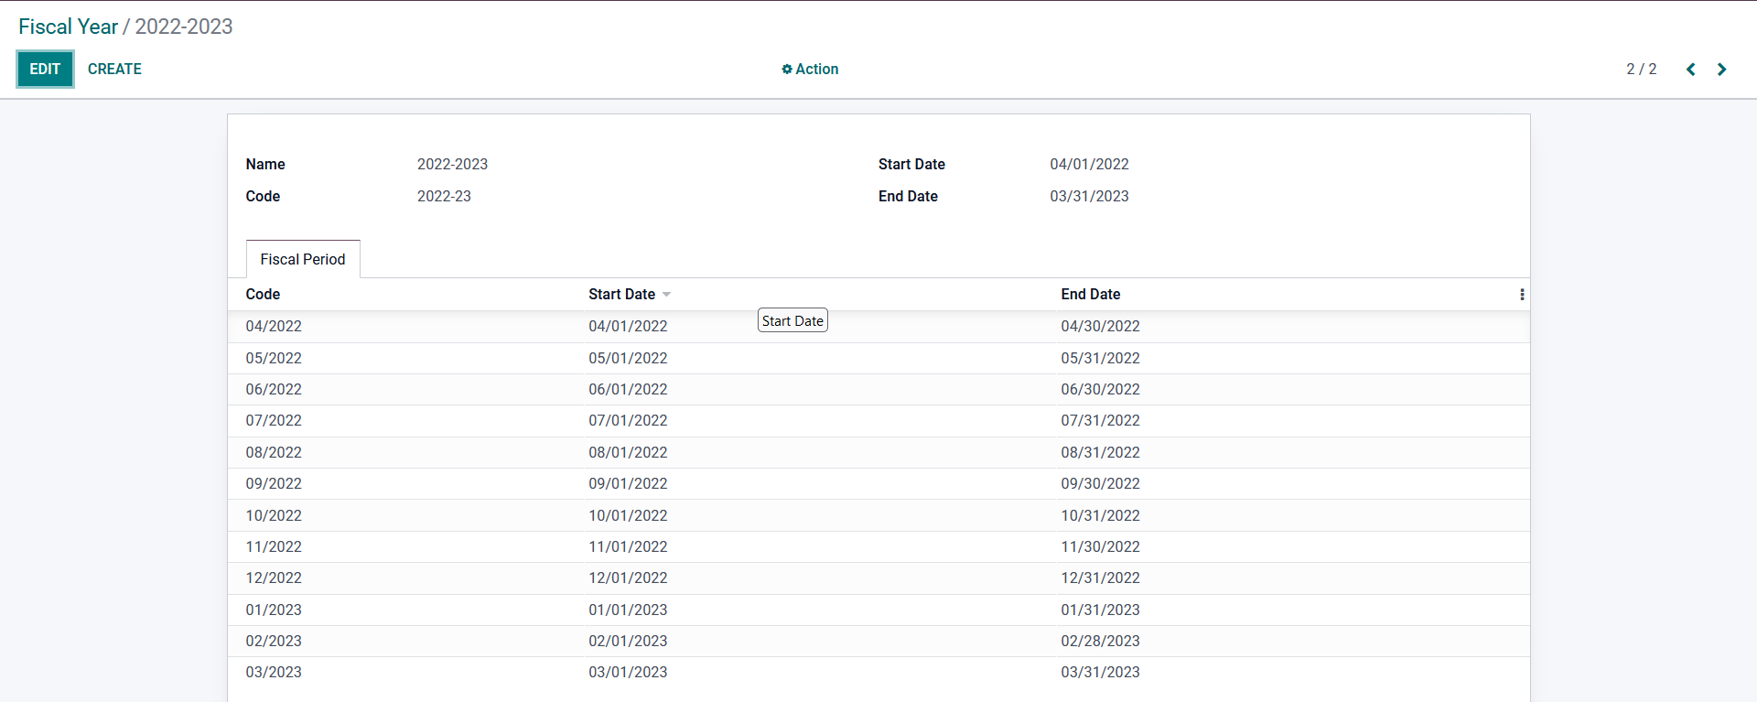
CASH FORECAST

Slide 8
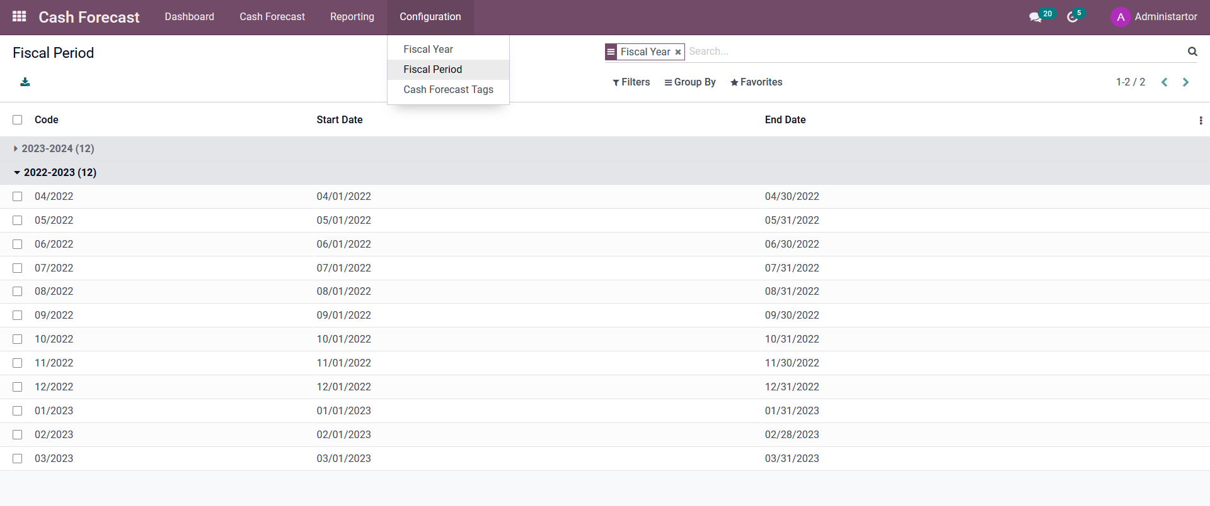
CASH FORECAST

Slide 9
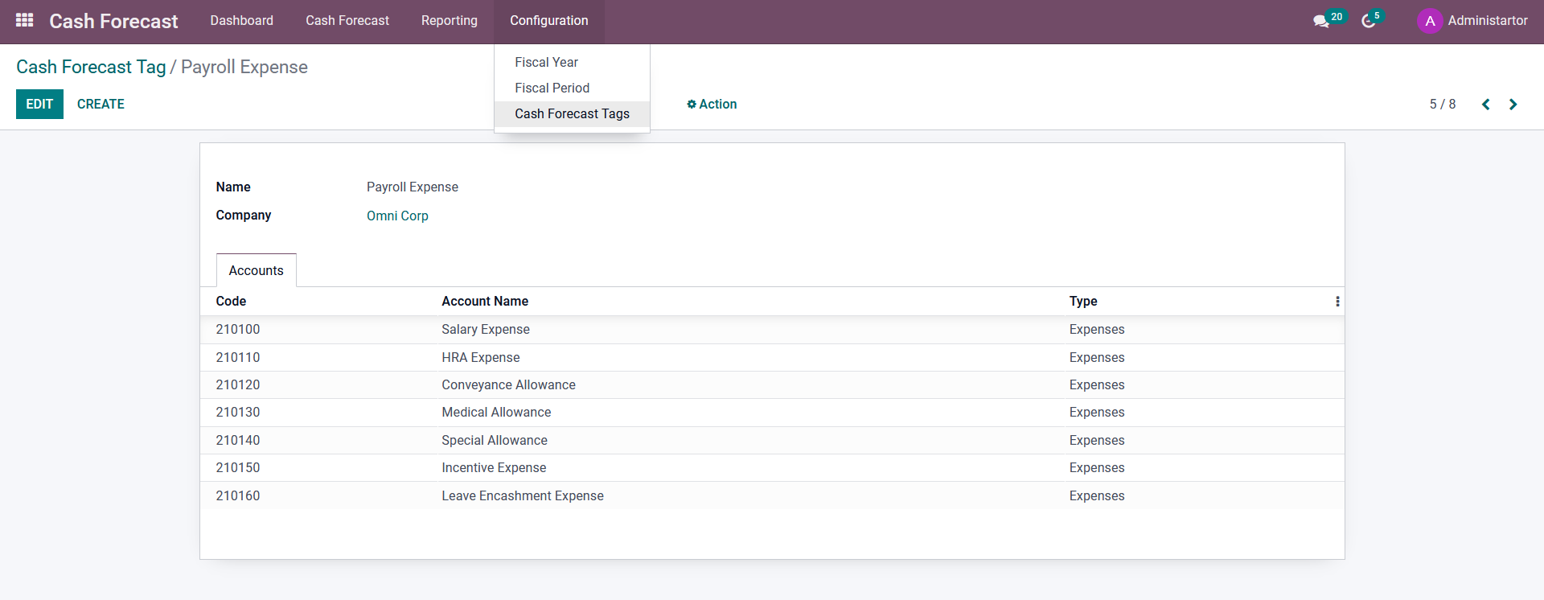
CASH FORECAST

Slide 10
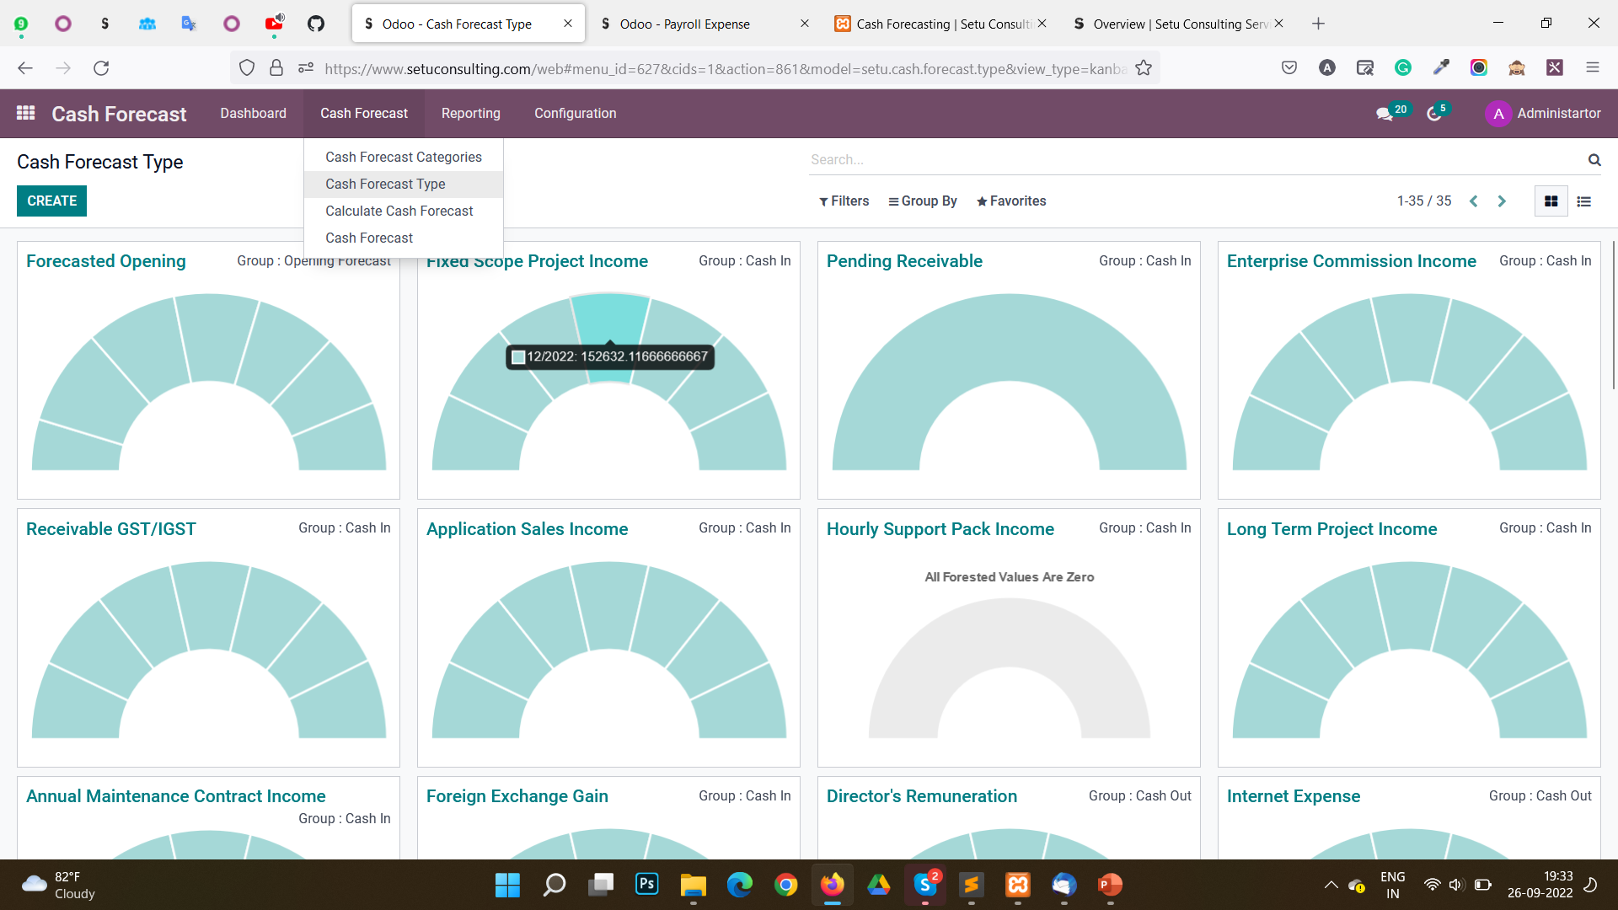
CASH FORECAST

Slide 11
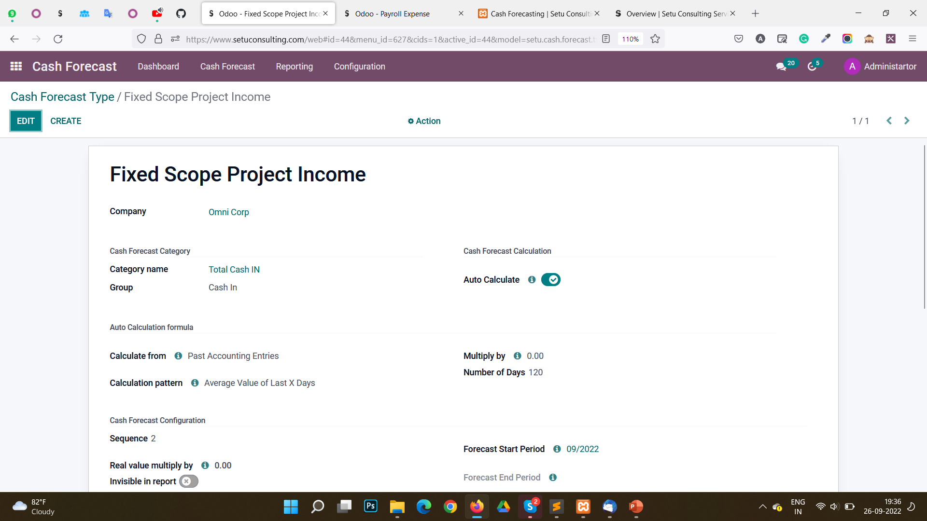
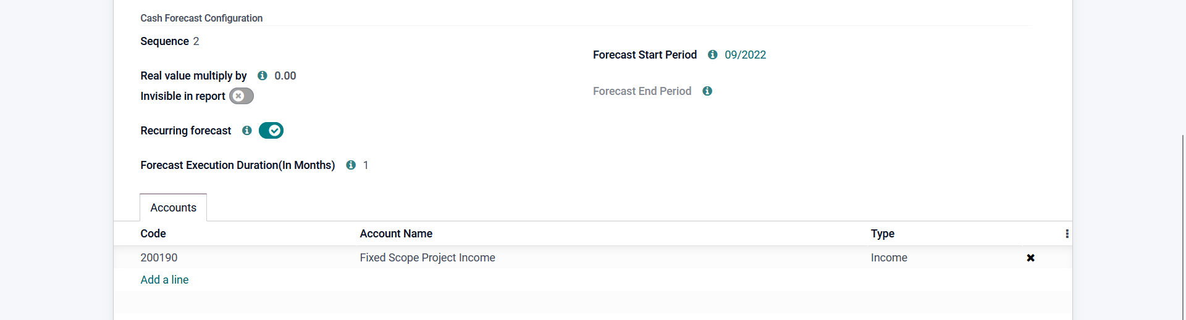
CASH FORECAST
Select Cash Forecast to which this
Cash Forecast Type belongs
Enable this option to auto calculate Cash Forecast
Select Accounts which you want to consider while calculating this cash forecast type

Slide 12
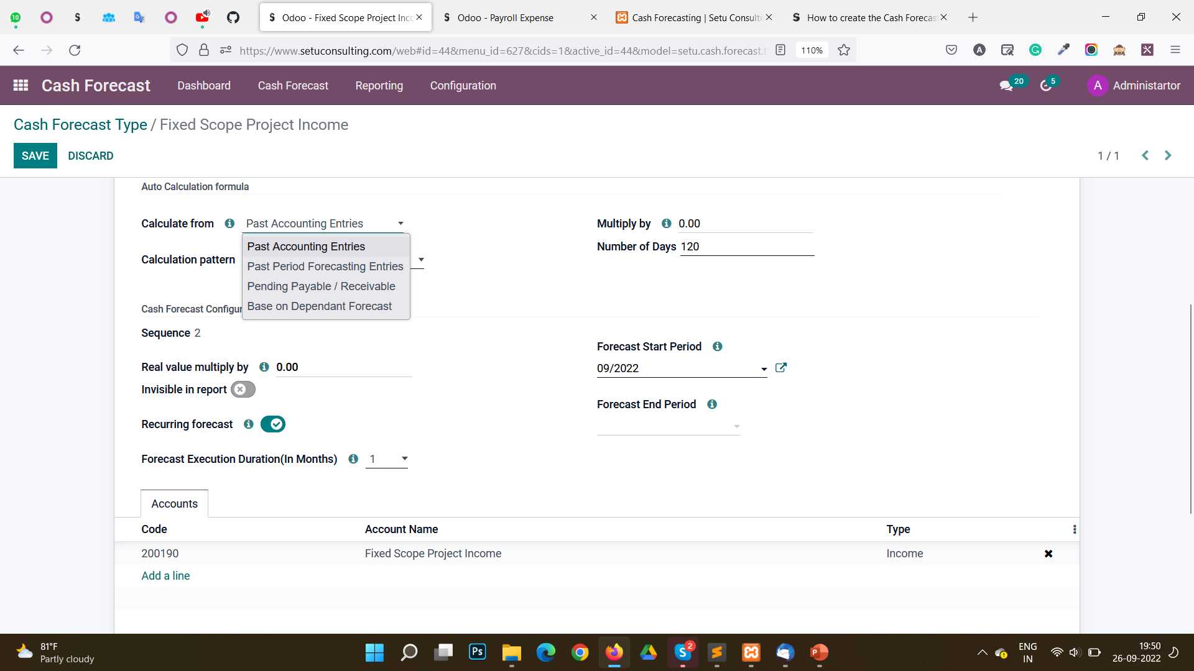
CASH FORECAST
Select any one option from drop down list on basis of which Cash Forecast Type should be auto calculated

Slide 13
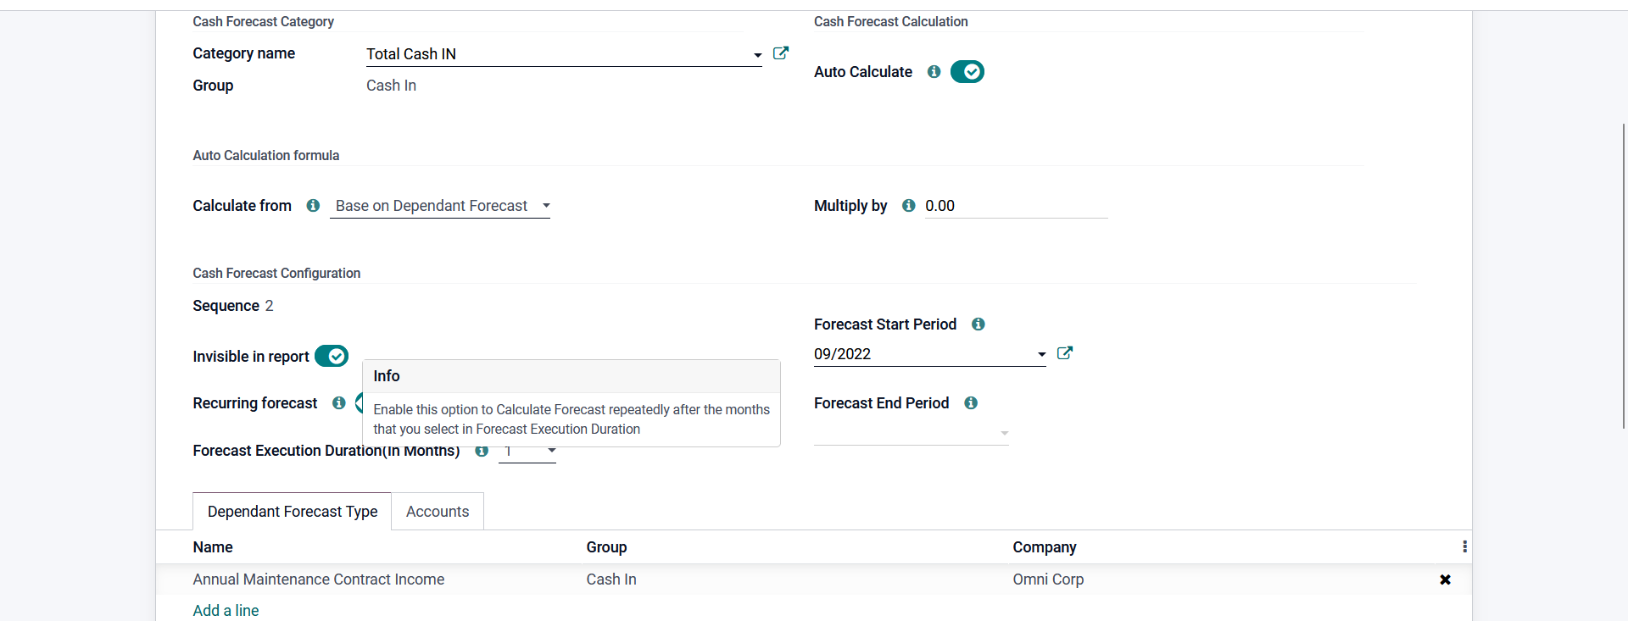
CASH FORECAST
If Base on Dependent Forecast option selected, This Tab will be enabled where you need to select Cash Forecast Type already created, on which Cash Forecast of this current Type that you are creating is dependent

Slide 14
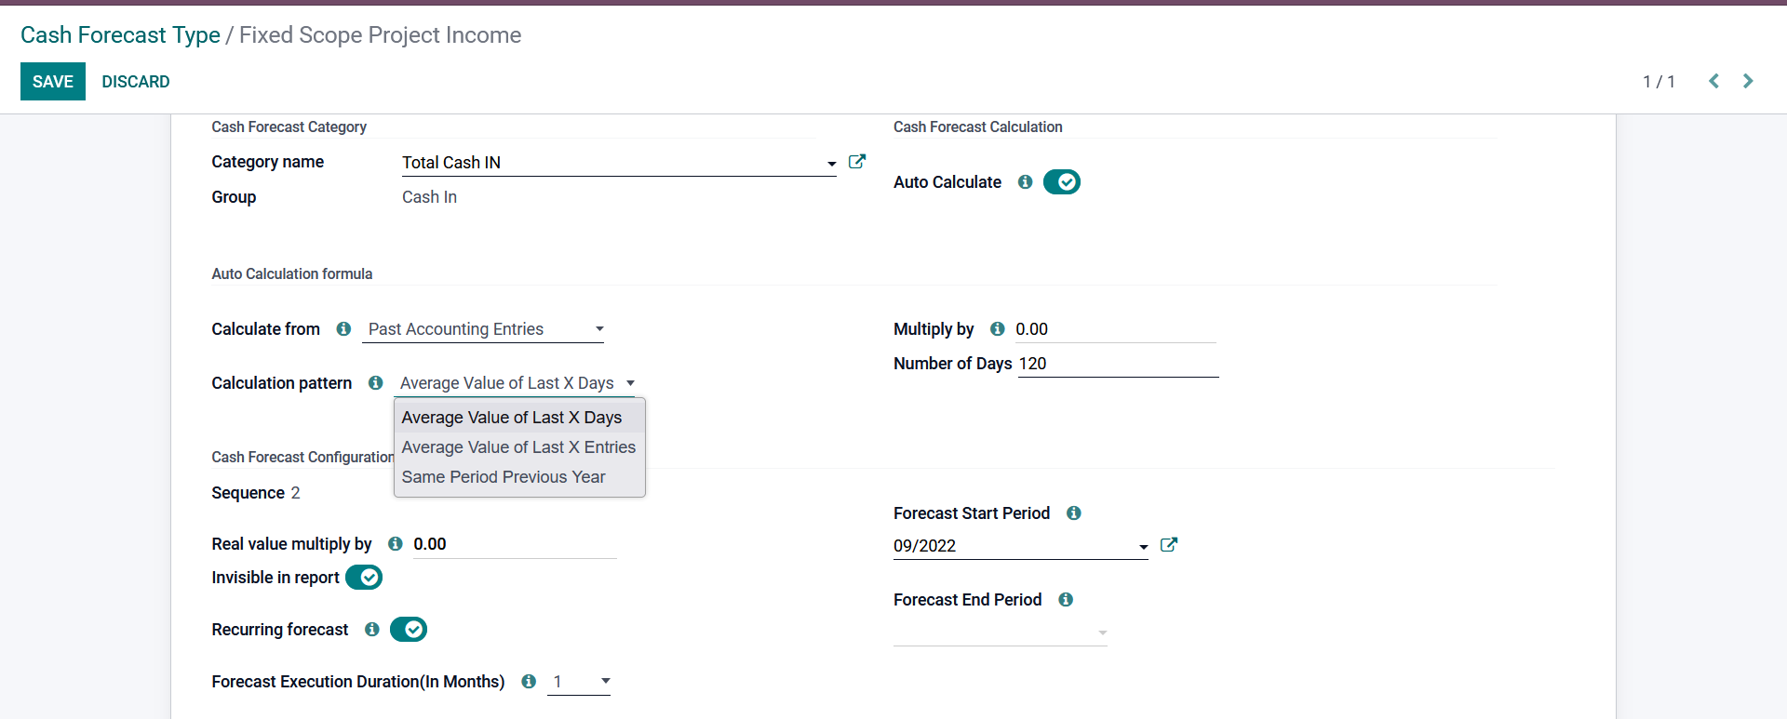
CASH FORECAST
This option is enabled only for Past Sales and Past Accounting entries of the drop-down list of Calculate from option

Slide 15
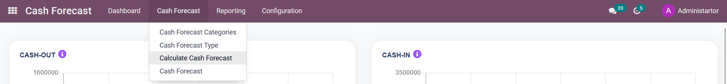
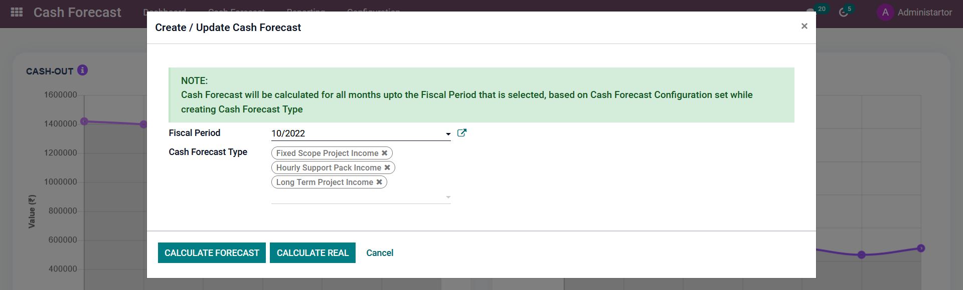
CASH FORECAST

Slide 16
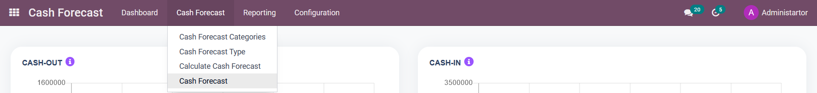
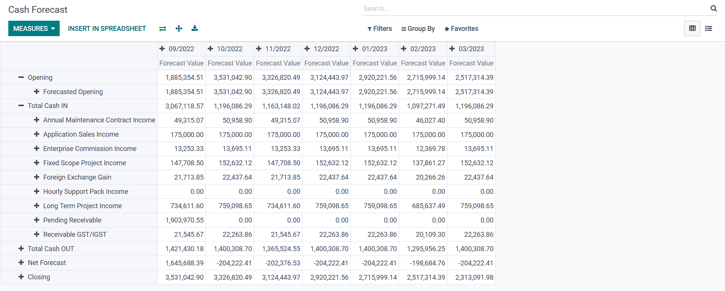
CASH FORECAST

Slide 17
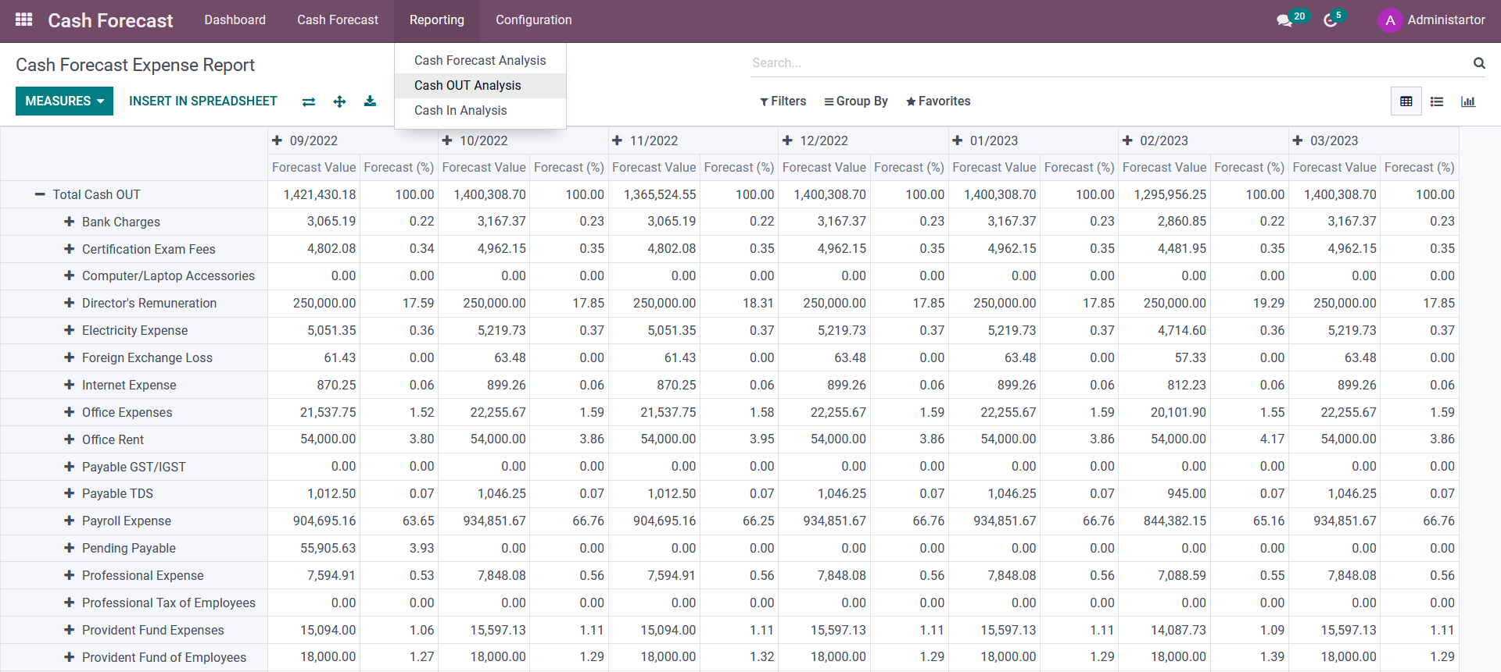
CASH FORECAST

Slide 18
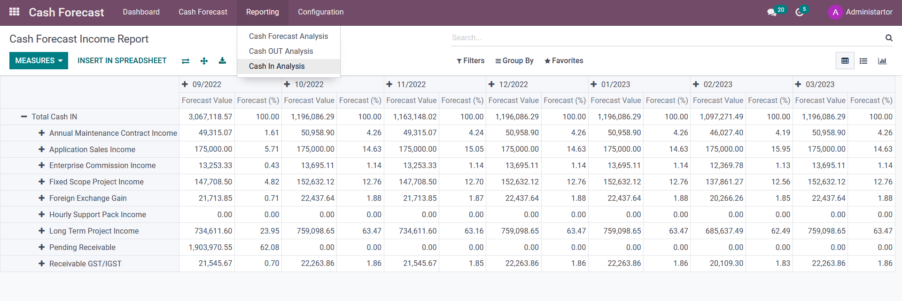
CASH FORECAST

