Slide 1

Simple Instance Cloud Manager

Slide 2

Introduction:
What is Cloud Instance Manager??
It is a tool or service that helps businesses manage their cloud infrastructure i,e virtual machine.
Why Cloud Instance manager?
1.Automation
2.Scalability
3.Less time consumption

Slide 3
Problem Statement:
1)Instance Data (CRUD Operations):The system allows user to create,read,update and delete
instances of virtual machines
2)Launch New instances: User can launch new virtual machines by providing specific details
Such as the operating system,hardware specification
3)Monitor instance Status: The system allows user to check the status of their virtual machines
whether the system is running or not

Slide 4
Operations to be performed:
Creating an instance manager
Launching an instance manager
Monitoring the status
Updating the instance id
Deleting the id

Slide 5
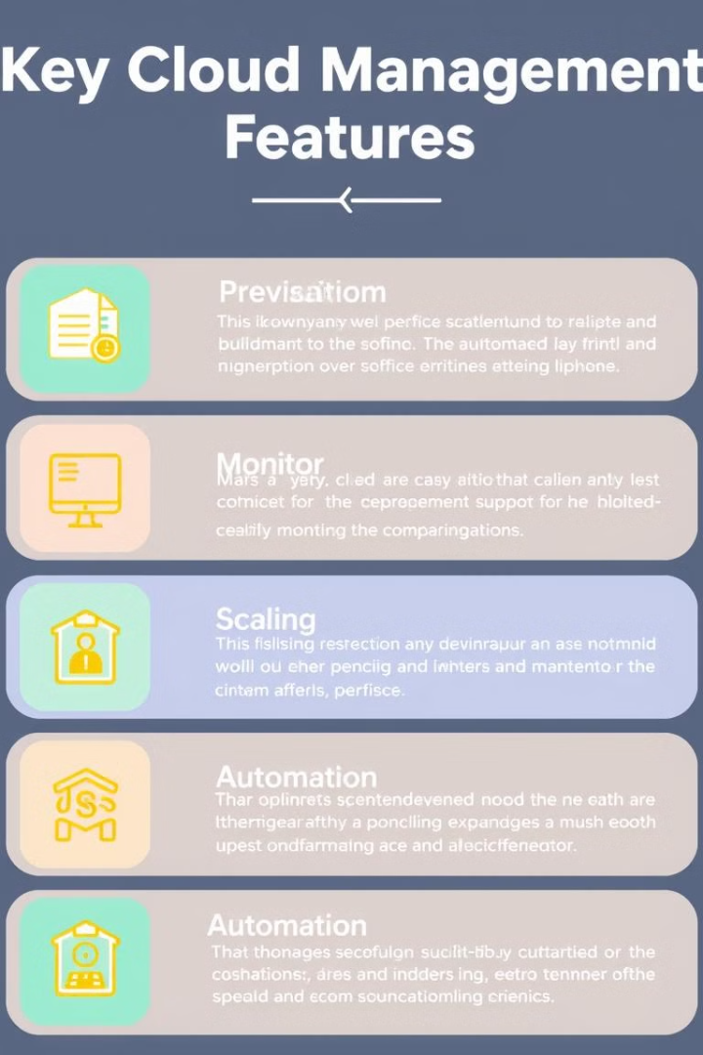
Key Features
The Simple Instance Cloud Manager empowers users with essential features for streamlined cloud management.
1
Automated Instance Creation
2
Real-time Monitoring and Alerts
Quickly deploy instances with pre-configured settings, saving time and effort.
Stay informed about instance performance and receive notifications of potential issues.
3
Effortless Scaling
4
Advanced Security Features
Seamlessly adjust instance resources to accommodate fluctuating demands.
Protect your instances with built-in security measures and customizable access controls.

Slide 6




Application
The Simple Instance Cloud Manager is ideal for a wide range of applications, empowering individuals and businesses to achieve their cloud goals.
Web Hosting
Host websites and web applications with ease, ensuring scalability and reliability.
Data Storage and Backup
Securely store and back up data in the cloud, providing redundancy and peace of mind.
Software Development
Quickly deploy and manage development environments for faster and more efficient coding.

Slide 7
THANK YOU

