Slide 1
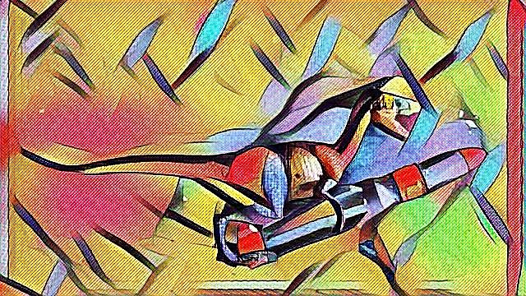
RexR Tool v1.0
Input
Patient ID:
7686
Patient Surname:
Wandl
Output: Client information
Patient Age:
10
Gender:
F
Tissue disease:
T-ALL
# white blood cells:
100
RUN

Slide 2
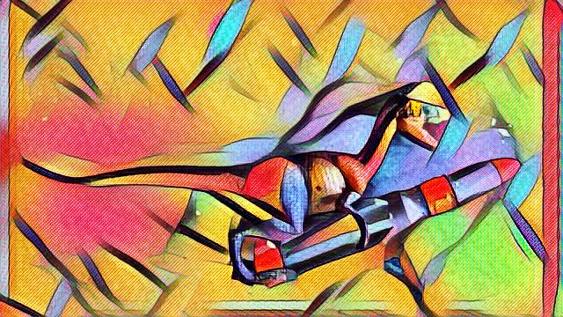
RexR Tool v1.0
Output: Algorithm
Algorithm Name:
Support Vector Machine
Accuracy Ratio:
70%
Please indicate which drivers you want to include in the prediction:
Genetic Drivers:
Re-RUN
Patient Drivers:
Output: Treatment
Treatment advice:
Low Treatment
Probability of survival:
90%
Treatment period:
(in months)
10
Export

