Slide 1
NBA Prediction Model
CS777 Final Project
Brian Ramm
2/27/2024

Slide 2

Objective
Create a model that predicts NBA games using only information known prior to the game starting
Use this model to make predictions and bets on every game and compare results with a sports book
Ensure that the model is repeatable at a larger scale and works regardless of the season

Slide 3

Data and Preprocessing
3 Data Sources Combined:
Log of all NBA games and results
Betting odds of NBA games
Player Statistics from every game
Filter to one row per game for all regular season games with correct betting odds from 2007 – 2016 and normalize the season year
Use Count Vectorizer for the 300 NBA players that appeared in the most games in our sample data
Create two feature vectors for home and away teams

Slide 4
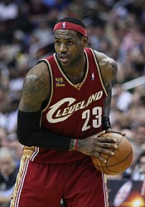
Logistic Regression Model Feature Analysis
A great way to check if our logistic regression model
We expect the best players in the league to have the best coefficients
Lebron!
Player | Win Coefficient
LeBron James | 1.80
Rudy Gobert | 1.24
Chris Paul | 1.13
Jimmy Butler | 1.12
Chauncey Billups | 1.09
Otto Porter Jr. | 1.07
CJ McCollum | 1.05
Jae Crowder | 1.05
Paul George | 0.86
Dirk Nowitzki | 0.86

Slide 5
Win Loss Prediction Results on Test Set
SVM Model:
--Contingency matrix--
TP: 698 FP: 331
FN: 240 TN: 386
----------------------
Accuracy = 0.655
F1 = 0.710
Logistic Regression Model:
--Contingency matrix--
TP: 693 FP: 326
FN: 245 TN: 391
----------------------
Accuracy = 0.655
F1 = 0.708

Slide 6
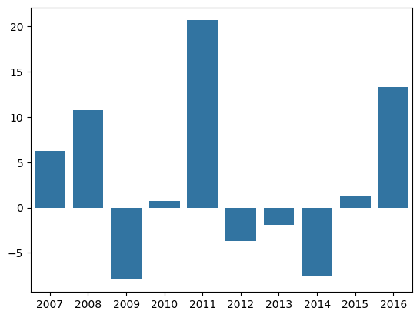
Profit by Season
Simple Prediction based betting strategy
Total Profit | 31.92
Standard Dev. | 9.41

Slide 7
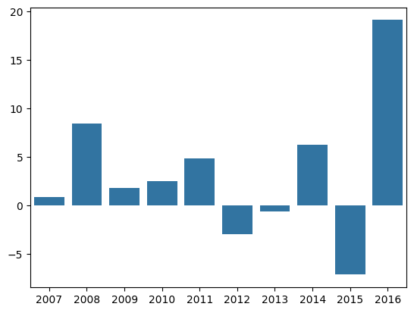

Profit by Season
Probability vs. Odds based betting strategy
Total Profit | 33.16
Standard Dev. | 7.15

Slide 8

Conclusion
This is an effective idea for predicting NBA games!
With some additional fine-tuning and research on features to add then this could be a valuable tool for modeling NBA results
Would need to keep testing with different train/test iterations to ensure consistency
The data for training the model is relatively easy to find so this I might explore some web scraping tools to continue this project with up-to-date NBA games

