Slide 1

Note: The data and information in this document is reflective of a hypothetical situation and client. This document is to be used for KPMG Virtual Internship purposes only.
Sprocket Central Pty Ltd
Data analytics approach
[Division Name] - [Engagement Manager], [Senior Consultant], [Bramuel Aswani]

Slide 2
Note: The data and information in this document is reflective of a hypothetical situation and client. This document is to be used for KPMG Virtual Internship purposes only.
Agenda
Introduction
slide 3
Data Exploration
Slide 4-14
All visuals based on previous customers datasets
Model Development
slide-15
Interpretation
slide-16

Slide 3
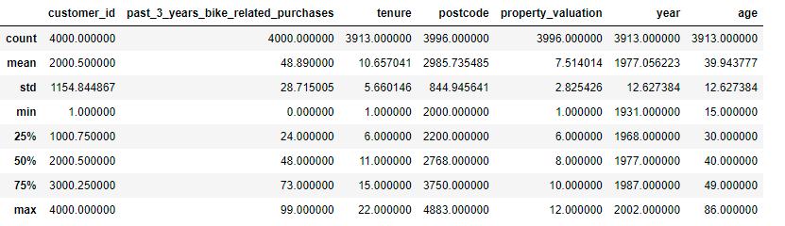
Note: The data and information in this document is reflective of a hypothetical situation and client. This document is to be used for KPMG Virtual Internship purposes only.
Introduction
Summary Statistical Information From Old Customers Data
The following are the general statistics from Customer Address and Customer Demographic, the counts, the means, minimum, maximums etc. from our numerical data entries
Place any supporting images, graphs, data or extra text here.

Slide 4
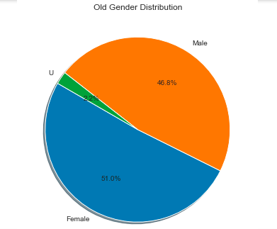
Note: The data and information in this document is reflective of a hypothetical situation and client. This document is to be used for KPMG Virtual Internship purposes only.
Data Exploration
Gender Distribution In Old Customers Dataset.
Female gender is slightly higher in numbers (2040) compared to male gender(1872)
The U-sex are insignificantly lower(88)
Our team is going to use this information on gender to determine how the gender distribution in our new customers dataset should be targeted with at most precision .
Place any supporting images, graphs, data or extra text here.

Slide 5
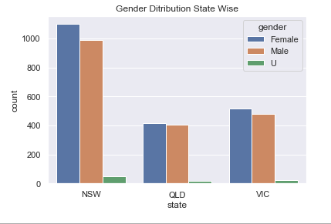
Note: The data and information in this document is reflective of a hypothetical situation and client. This document is to be used for KPMG Virtual Internship purposes only.
Data Exploration
Gender Distribution State Wise .
From all states female are higher than males
Our team is going to use this information on gender to determine how the gender distribution by state in our new customers dataset should be targeted .
Place any supporting images, graphs, data or extra text here.

Slide 6
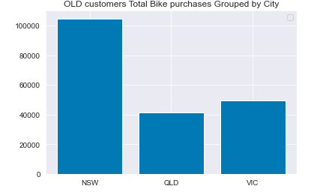
Note: The data and information in this document is reflective of a hypothetical situation and client. This document is to be used for KPMG Virtual Internship purposes only.
Data Exploration
Total Bike Purchases Grouped By State
Grouped by state the total bike purchases for the past 3 years and summed them by State.
Most of the customers comes from NSW
QLD and VIC relatively equal
Using this we are going to look into new customers bike purchases by state then compare with this and give advice on how to handle the new customers state wise
Place any supporting images, graphs, data or extra text here.

Slide 7
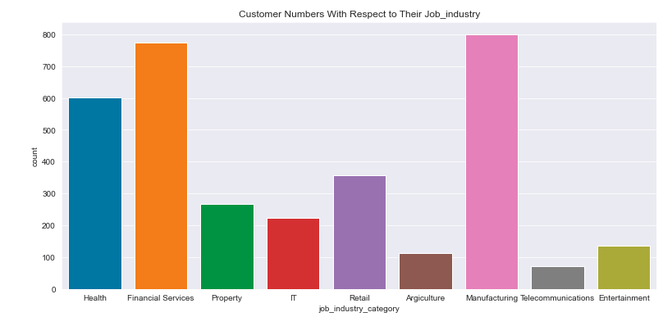
Note: The data and information in this document is reflective of a hypothetical situation and client. This document is to be used for KPMG Virtual Internship purposes only.
Data Exploration
Customer Distribution In Job Industry Category
High numbers in the Financial and manufacturing industries
Fewer numbers from telecommunications and Agriculture industries
Our team is going to take a keener look into new customers job industry and compare by industry then give advice on likelihood of those new customers adding value to the Sprocket
Place any supporting images, graphs, data or extra text here.

Slide 8
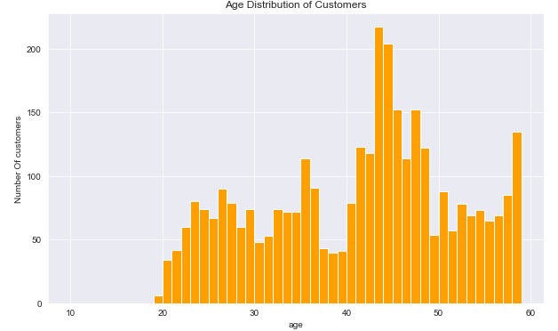
Note: The data and information in this document is reflective of a hypothetical situation and client. This document is to be used for KPMG Virtual Internship purposes only.
Data Exploration
Age Distribution In Customers
Ages as per year 2021 and placed on a histogram.
Most of the customers are aged between 42-48Years
Similar approach is going to be applied to new customers list and compare in order to determine what age bracket in the new customers to give priority.
Place any supporting images, graphs, data or extra text here.

Slide 9
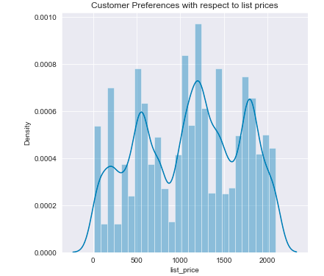
Note: The data and information in this document is reflective of a hypothetical situation and client. This document is to be used for KPMG Virtual Internship purposes only.
Data Exploration
Distribution in Customer’s Price List Preferences
Most customers prefer 1200-1300 prices.
Price list is slightly uniformly distributed across different prices
Our team is going to look into the price list distribution for the new customers and compare with this to determine the ones to give more priority by price list choices
Place any supporting images, graphs, data or extra text here.

Slide 10
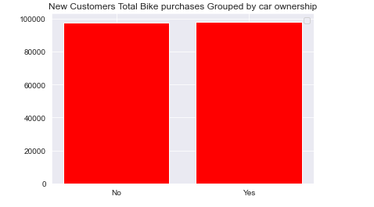
Note: The data and information in this document is reflective of a hypothetical situation and client. This document is to be used for KPMG Virtual Internship purposes only.
Data Exploration
Bike purchases grouped By Car Ownership
Total bike purchases is relatively equal for car owners and non car owners
This suggest car ownership amongst customers do not affect their bike purchases
Place any supporting images, graphs, data or extra text here.

Slide 11
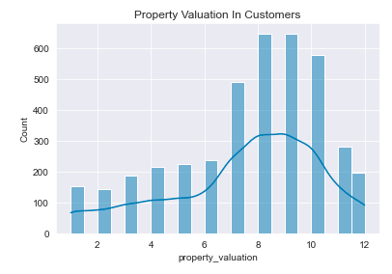
Note: The data and information in this document is reflective of a hypothetical situation and client. This document is to be used for KPMG Virtual Internship purposes only.
Data Exploration
Distribution In Property Valuation In Customers
Most customers have property valuation between 7 and 11
Our team is going to look into new customers data with similar approach in order to target those customers in the same range in property valuation as this
Place any supporting images, graphs, data or extra text here.

Slide 12
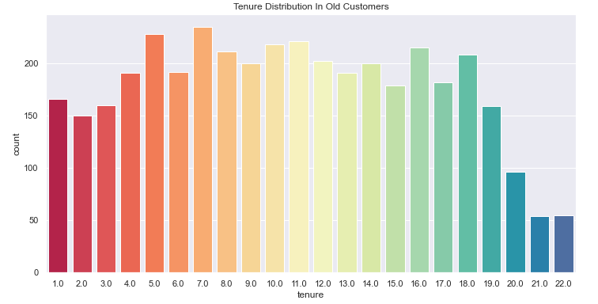
Note: The data and information in this document is reflective of a hypothetical situation and client. This document is to be used for KPMG Virtual Internship purposes only.
Data Exploration
Tenure Distribution In Old Customers
Lowest Customer numbers with tenure of 21 and 22
Tenure of 7.0 is the highest in numbers
Similar approach is going to be applied to new customers list and compare in order to pick out customers having favorable tenures as old customers list
Place any supporting images, graphs, data or extra text here.

Slide 13
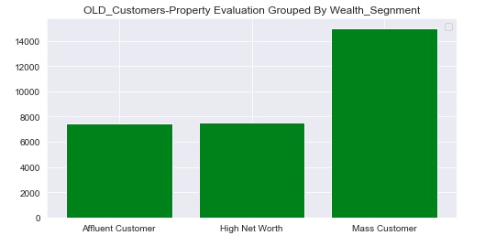
Note: The data and information in this document is reflective of a hypothetical situation and client. This document is to be used for KPMG Virtual Internship purposes only.
Data Exploration
Property Valuation Grouped By Wealth Segment In Customers
Mass customers have highest total property valuation
Affluent and High net worth customers have relatively equal total property valuation
Our team is going to use this relationship and compare to the new customers to determine the customers to give priority
Place any supporting images, graphs, data or extra text here.

Slide 14
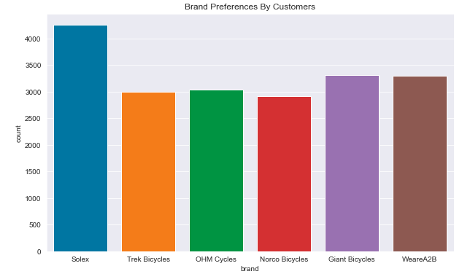
Note: The data and information in this document is reflective of a hypothetical situation and client. This document is to be used for KPMG Virtual Internship purposes only.
Data Exploration
Brand Preferences In Old Customers
Solex brand sold highest over 4000 customers
The other five brands sold relatively at the same level averagely 3000 customers
We are going to use this to determine what possible brands our new customers are likely to go for
Place any supporting images, graphs, data or extra text here.

Slide 15
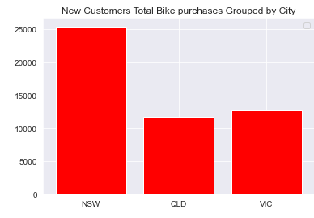
Note: The data and information in this document is reflective of a hypothetical situation and client. This document is to be used for KPMG Virtual Internship purposes only.
Model Development
Total Bike Purchases Grouped By state
Data insights from new and old customers will be placed side by side for comparisons e.g.
Graph one represents old while graph two new customers
Looking at the two graphs, NSW tops in both
Other features such as age, gender, state wise, bike purchases, wealth segment from both customer datasets placed alongside each other for comparisons
Then interpretations will be made in the interpretation stage
Place any supporting images, graphs, data or extra text here.

Slide 16
Note: The data and information in this document is reflective of a hypothetical situation and client. This document is to be used for KPMG Virtual Internship purposes only.
Interpretation
Feature Variations Explainability
Here, different features will be compared in the two datasets
Possible explanations on why this is high or this is low will be given
All sought of information will be extracted from the visualizations
Data driven insights from features such as ages, state wise, wealth segment, gender wise will be looked into
Lastly, some customers will be high and low in different features, we cant choose to give priority in accordance to all features so our team Is going to derive better mechanism to effectively priorities and select across all desired features from our new customers, for instance customer id 10 falls in the best gender category but also same customers falls in the worst property valuation. How will you select this customer? This what our team going to look into keenly

Slide 17
Note: The data and information in this document is reflective of a hypothetical situation and client. This document is to be used for KPMG Virtual Internship purposes only.
Appendix

Slide 18
Note: The data and information in this document is reflective of a hypothetical situation and client. This document is to be used for KPMG Virtual Internship purposes only.
Appendix

