Slide 1

.crash course
Christina Protopapadaki, Filip Jorissen & Bram van der Heijde
Christina.Protopapadaki@bwk.kuleuven.be Filip.Jorissen@mech.kuleuven.be,
Bram.vanderHeijde@kuleuven.be
October 13, 2016

Slide 2
Modelica crash course
What is Modelica ?
Syntaxis, language concepts and model structuring
Modelica tools
Use of IDEAS library
Getting started (tutorials, reference docs, libraries, software implementations, ...)
➔ To get you started with Modelica!

Slide 3
 | Agenda
13:00 - 13:15 | What is modelica? Where do I find information?
13:15 - 13:45 | Theory + Dymola + style guide
13:45 – 14:00 | Version control
14:00 – 14:30 | What is IDEAS?
14:30 - 15:30 | IDEAS: SimpleHouse Hands-on
15:30 - 16:30 | Advanced topics
16:30 - 17:00 | Demo IDEAS Building model (optional)

Slide 4
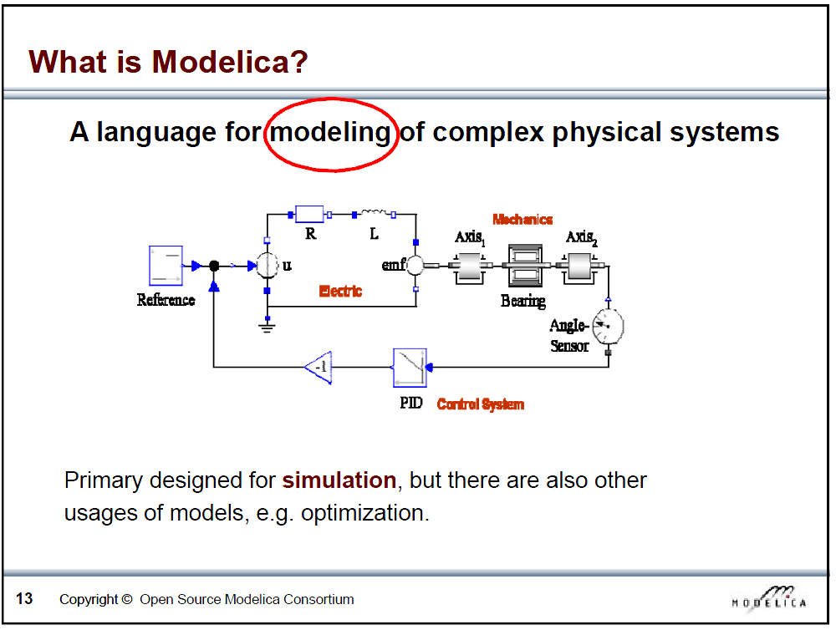
Slide from Peter Fritzson, Introduction to Object-Oriented Modeling, Simulation and Control with Modelica, Tutorial for Modelica Conference 2011, Dresden

Slide 5
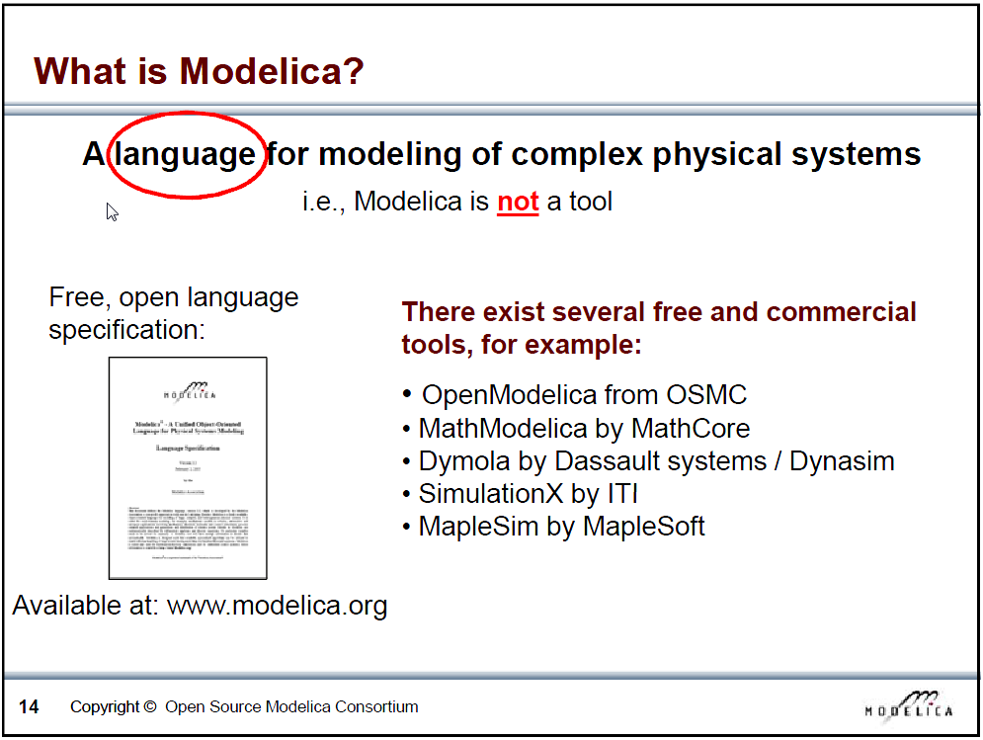
Slide from Peter Fritzson, Introduction to Object-Oriented Modeling, Simulation and Control with Modelica, Tutorial for Modelica Conference 2011, Dresden

Slide 6
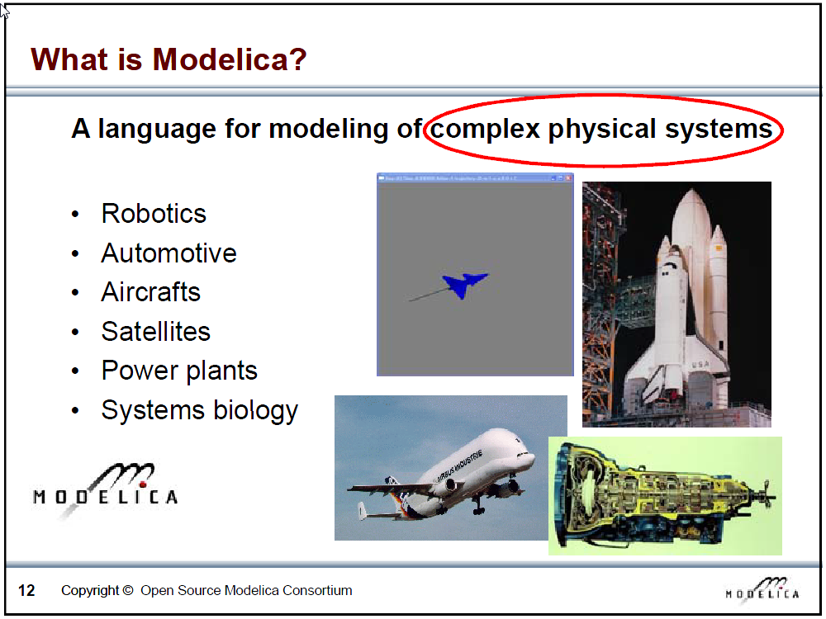
Slide from Peter Fritzson, Introduction to Object-Oriented Modeling, Simulation and Control with Modelica, Tutorial for Modelica Conference 2011, Dresden

Slide 7
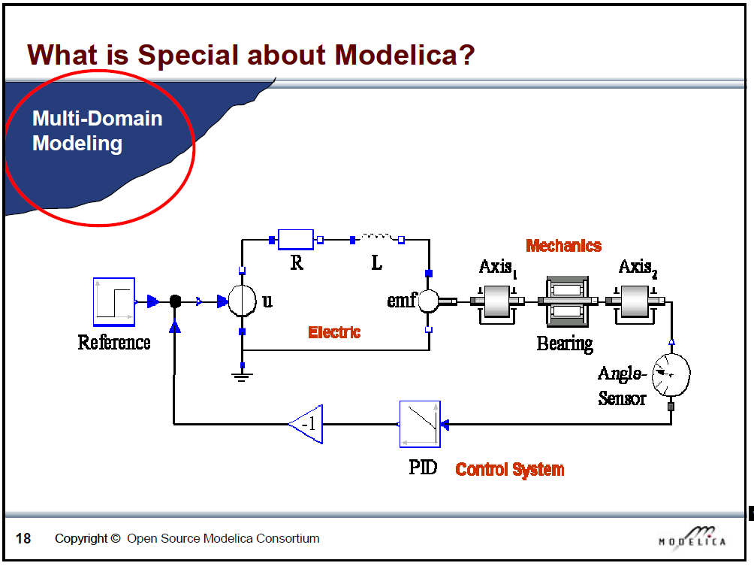
Slide from Peter Fritzson, Introduction to Object-Oriented Modeling, Simulation and Control with Modelica, Tutorial for Modelica Conference 2011, Dresden

Slide 8
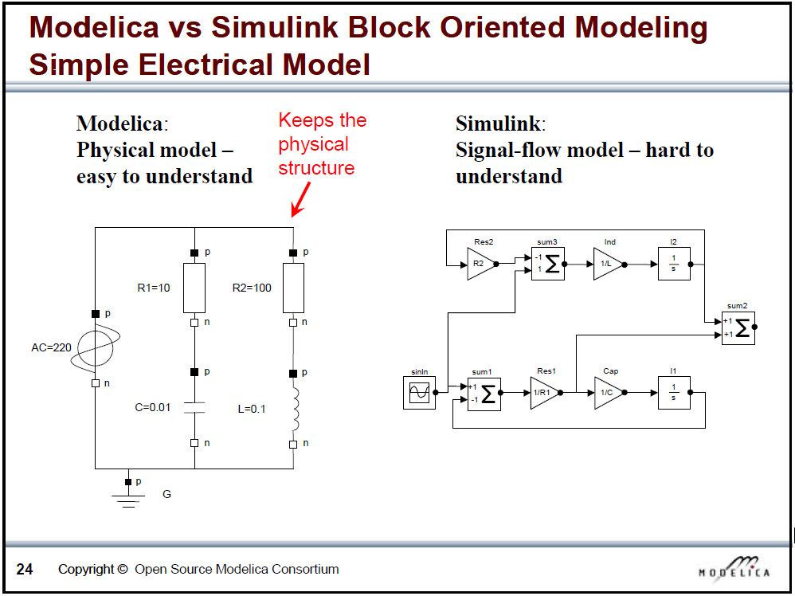
Slide from Peter Fritzson, Introduction to Object-Oriented Modeling, Simulation and Control with Modelica, Tutorial for Modelica Conference 2011, Dresden

Slide 9

What is Modelica
Modelica is a language for modeling of physical systems
open source
object oriented
Acausal modeling (equation based)
multi-domain
primarily for simulation, but usable for optimization
small and large models (> 100 000 equations)
many model libraries (free and commercial)
textual and graphical modeling

Slide 10
How does Modelica work?

Slide 11
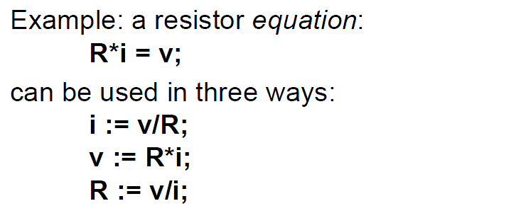
Equations
Arithmetic operators
*, /, +, -, ^ (use . for element-wise)
Derivatives
der(x) = x ~
Slide from Peter Fritzson, Introduction to Object-Oriented Modeling, Simulation and Control with Modelica, Tutorial for Modelica Conference 2011, Dresden

Slide 12
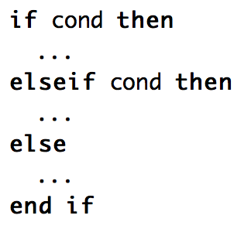

Logical operators, control flow
Logical
and, or, not
Conditional
If, elseif, else
Loops
for

Slide 13
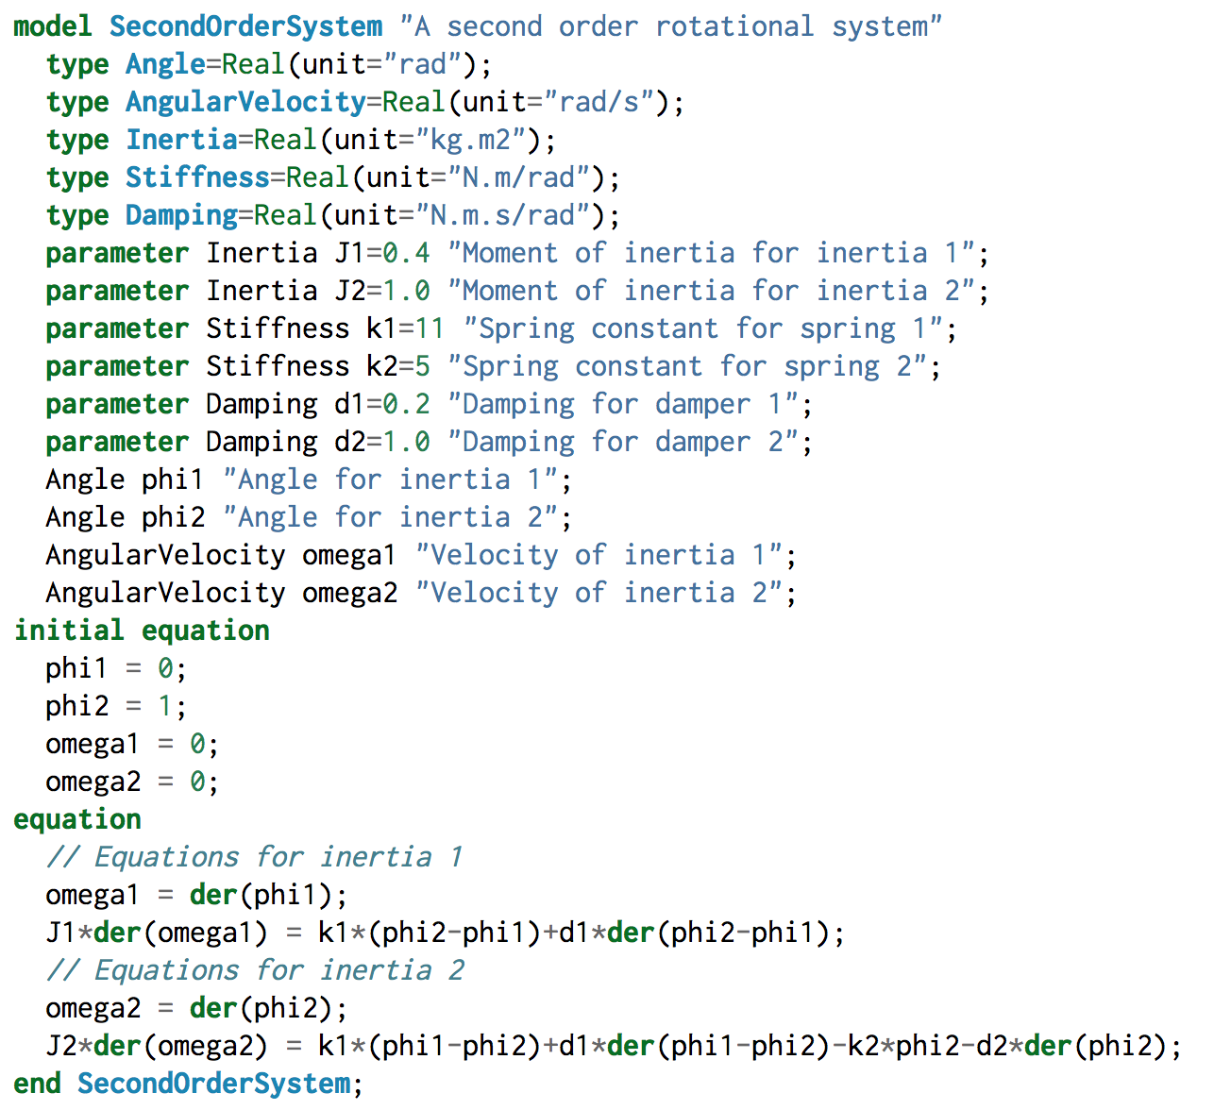
Models
From M. Tiller, Modelica by Example, http://book.xogeny.com

Slide 14
Comments
Very important!
Comments regarding components, parameters, variables
“this is a comment”
Can show up in graphical interface
Line comments
// This is a comment on one line
/* This is a comment over multiple lines */

Slide 15
Slide from Peter Fritzson, Introduction to Object-Oriented Modeling, Simulation and Control with Modelica, Tutorial for Modelica Conference 2011, Dresden

Slide 16
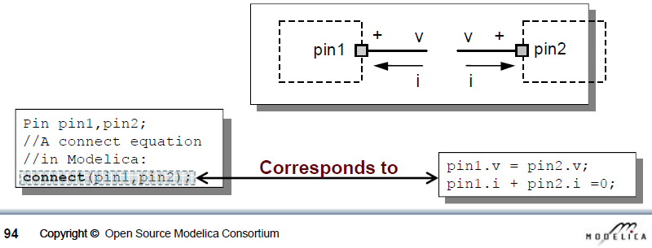
Connectors
Usually
Signal in out
Fluid flow (mass flow rate, pressure, enthalpy)
Heat flow (heat flow rate, temperature)
flow variable, potential variable
Slide from Peter Fritzson, Introduction to Object-Oriented Modeling, Simulation and Control with Modelica, Tutorial for Modelica Conference 2011, Dresden

Slide 17
Components
Instances of a model
model name usually Capitalized, instance not
Wall innerWall(res = 200, A = 10)
public variables and parameters can be accessed with dot notation, e.g.:
heatPort.Qflow
wall.res
Protected variables/params cannot be accessed
Don’t show up in simulation results

Slide 18
Inheritance
Model inherits from other model
Variables, parameters, equations
partial model
Code can be managed more easily
Example

Slide 19
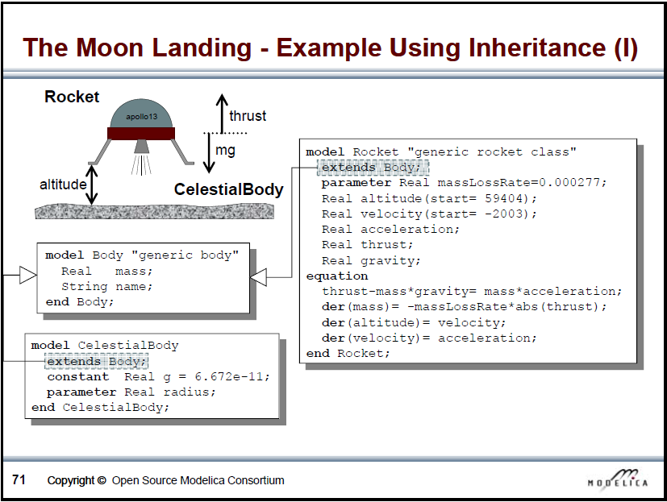
Slide from Peter Fritzson, Introduction to Object-Oriented Modeling, Simulation and Control with Modelica, Tutorial for Modelica Conference 2011, Dresden

Slide 20
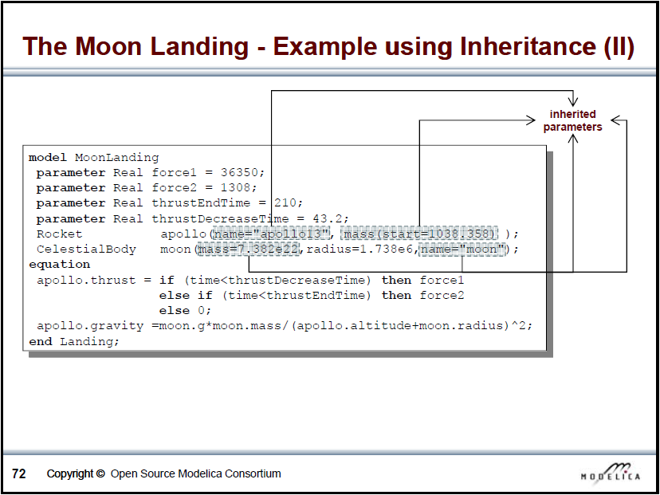
Slide from Peter Fritzson, Introduction to Object-Oriented Modeling, Simulation and Control with Modelica, Tutorial for Modelica Conference 2011, Dresden

Slide 21
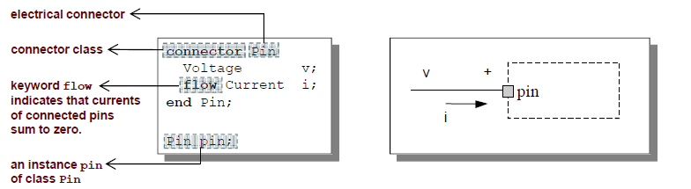
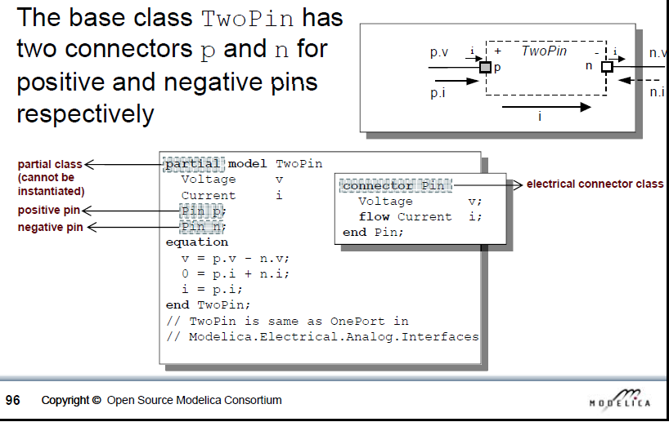
Inheritance and connectors
Slides from Peter Fritzson, Introduction to Object-Oriented Modeling, Simulation and Control with Modelica, Tutorial for Modelica Conference 2011, Dresden

Slide 22
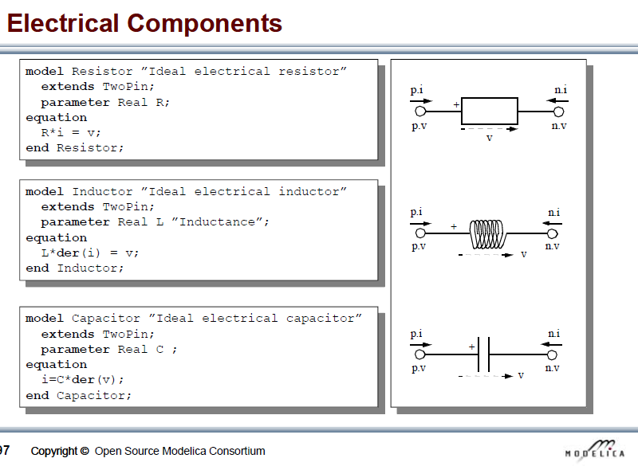
Slide from Peter Fritzson, Introduction to Object-Oriented Modeling, Simulation and Control with Modelica, Tutorial for Modelica Conference 2011, Dresden

Slide 23
Language constructs from Lib.Introduction
Keywords: model, parameter, type, equation
start value
boolean
non-linear system, nb eq = nb var
conditional statement

Slide 24
Language constructs from task: eq. based
Type of variables
Type of equations (thermal resistance, capacitance, Kirchhoff-rules, ... ) (see picture)
Loop construction
Remarks:
use start values instead of initial eq.
ones(n)
pre-made types (Modelica.SIunits)
use “dummy variables” to split code (Q_flows)
time
protected vs public
give formula after declaration of variable
checkModel: what happen if synthax incorrect or what happen if eq. missing?

Slide 25
Language constructs from task: object-based
Open the different object (resistor, ...)
Modelica standard library
extends
object.Q_flow, direction of flow
connect: potential variable (= in connector), flow variable (sum = 0 in connector).
partial
real expression, each, connect, annotation

Slide 26
Language constructs
Classes and instances
Connectors
Inheritance
partial model
Extends
Use external data

Slide 27
Exercise 1
See exercise sheet

Slide 28
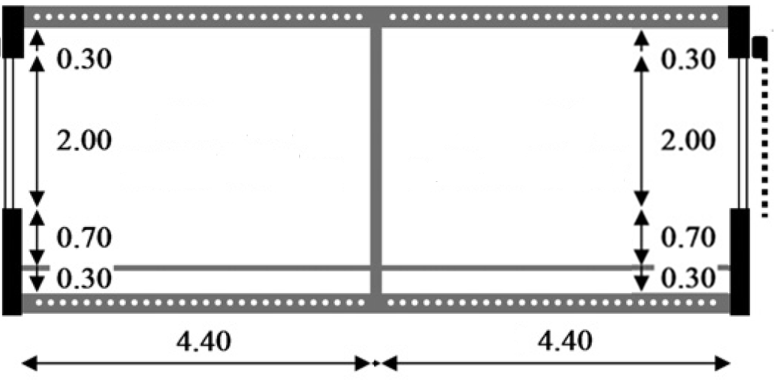
Exercise 2
IDEAS demo
Low energy office building with 2 thermal zones & floor heating
→Simulate for 1 month, check indoor temperatures & heat demand
*In the back and front as well as above and below there are other offices which maintain the same temperature.
NORTH
(depth: 2.7m)
SOUTH
(depth: 2.7m)
Notes:
10’ - JModelica (demo)
5’ - Tutorials and reference documentation (slides)
30’ - Libraries: MSL and own libraries (dymola demo)
10’ - simman and pymosim (python demo)
5’ - Coding conventions (slides)
5’ - Dymola licenses at TME (slides)
1u05 min

Slide 29
Exercise 2
IDEAS demo
Low energy office building with 2 thermal zones & floor heating
Envelope
Materials (to model, optional)
Tile: λ=1.4 W/mK, c=840 J/kgK, ρ=2100 kg/m³
Screed: λ=0.6 W/mK, c=860 J/kgK, ρ=1100 kg/m³
Concrete: λ=1.7 W/mK, c=840 J/kgK, ρ=2400 kg/m³
Windows
Glazing: Saint Gobain Clima Plus Futur (U = 1.4 W/m²K, g = 0.755)
Frame: U-value=2.5 W/m²k , fraction of the window: f=0.15
Infiltration: n₅₀=12 ACH (ventilation indirectly included)
Geometry: use internal dimensions (not completely right)
 | Composition (out→in or propsBus b→a)
Floor (to model) | Tile (d=0.01m) | Screed (0.06)* | PUR (0.04) | Concrete (0.20) | Plaster (0.02)
Exterior wall | Brick (0.10) | MW (0.16) | Brick (0.14) | Plaster (0.02)
Interior wall | Plaster (0.02) | Brick (0.10) | Plaster (0.02)
* Floor heating tube is situated at position 2 (between Screed and PUR)
Notes:
10’ - JModelica (demo)
5’ - Tutorials and reference documentation (slides)
30’ - Libraries: MSL and own libraries (dymola demo)
10’ - simman and pymosim (python demo)
5’ - Coding conventions (slides)
5’ - Dymola licenses at TME (slides)
1u05 min

Slide 30
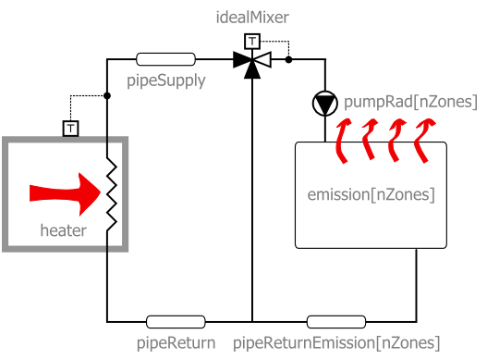
Exercise 2
IDEAS demo
Low energy office building with 2 thermal zones & floor heating
Heating system (use IDEAS heating systems)
Radiators (no floor heating)
Floor heating

Slide 31
Exercise 2
IDEAS demo
Low energy office building with 2 thermal zones & floor heating
Ideas for playing around
Change parameters heating (heating curve, type of heater)
Change parameters structure (insulation, windows, materials)
Add internal gains according to schedule
Night temperature set back
Add shading blinds to south windows (+ shading schedule)
More realistic office occupancy profiles
Add ventilation system
Different water set temperature per zone (tough)
Add a thermal zone (tougher)
Include pressure drops (toughest)

Slide 32
How does Dymola work?

Slide 33
Modelica environments
Commercial software tools
Dymola (Dassault Systèmes, Sweden)
MathModelica (MathCore, Sweden)
SimulationX (ITI, Germany)
MapleSim (Maplesoft, Canada)
Free and open source tools
OpenModelica (Open Source Modelica Consortium, Sweden and other countries)
JModelica (Modelon, Sweden)

Slide 34
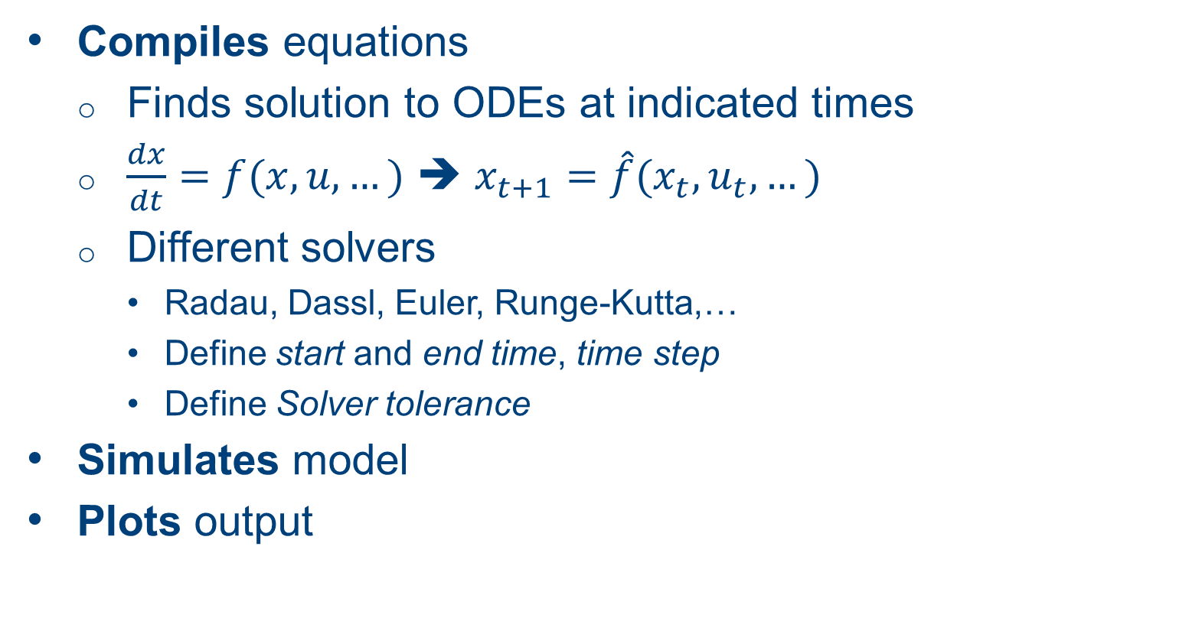
What does Dymola do?
Compiles equations
Finds solution to ODEs at indicated times
$\frac{dx}{dt}=f(x,u,…)$ ➔ $x_{t+1}=\hat{f}(x_{t},u_{t},…)$
Different solvers
Radau, Dassl, Euler, Runge-Kutta,…
Define start and end time, time step
Define Solver tolerance
Simulates model
Plots output

Slide 35
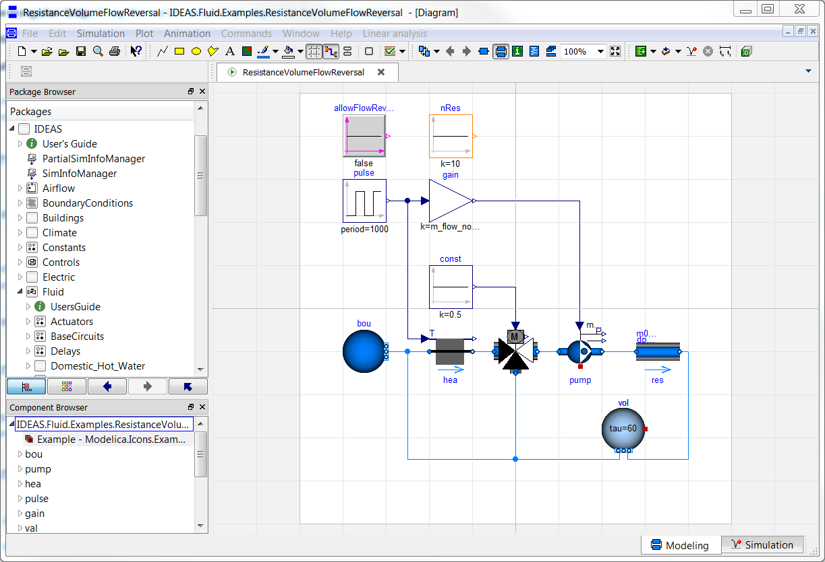
Graphical user interface

Slide 36
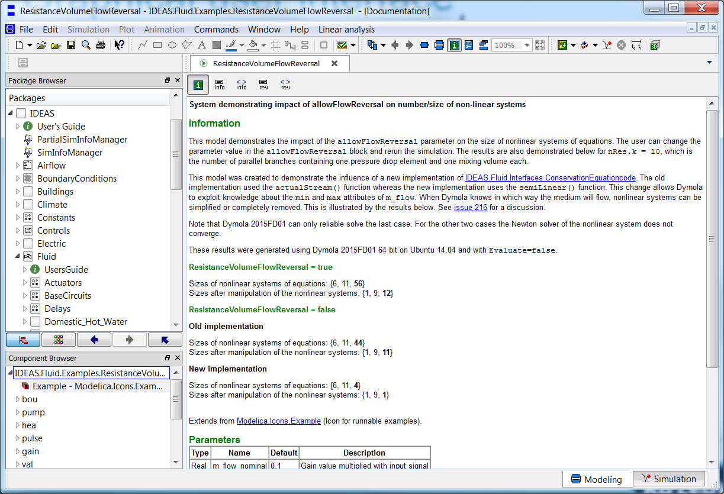
Graphical user interface

Slide 37
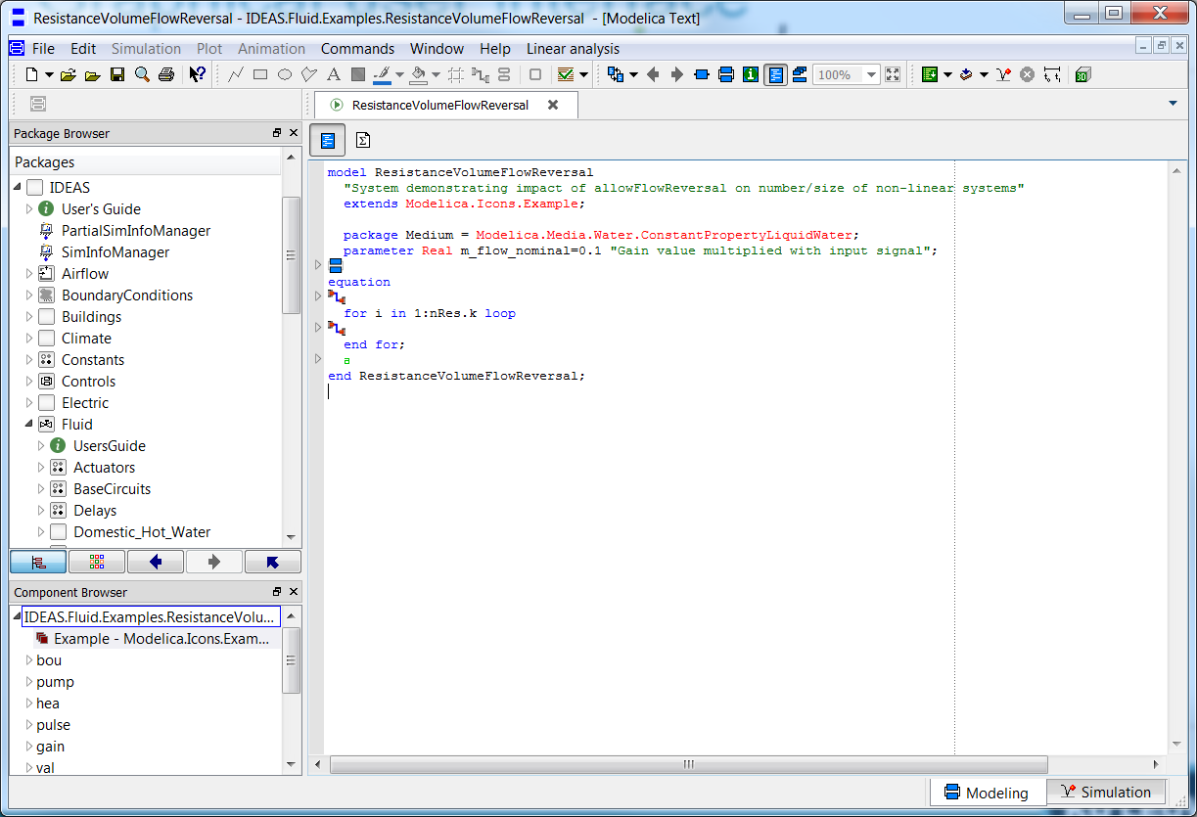
Graphical user interface

Slide 38
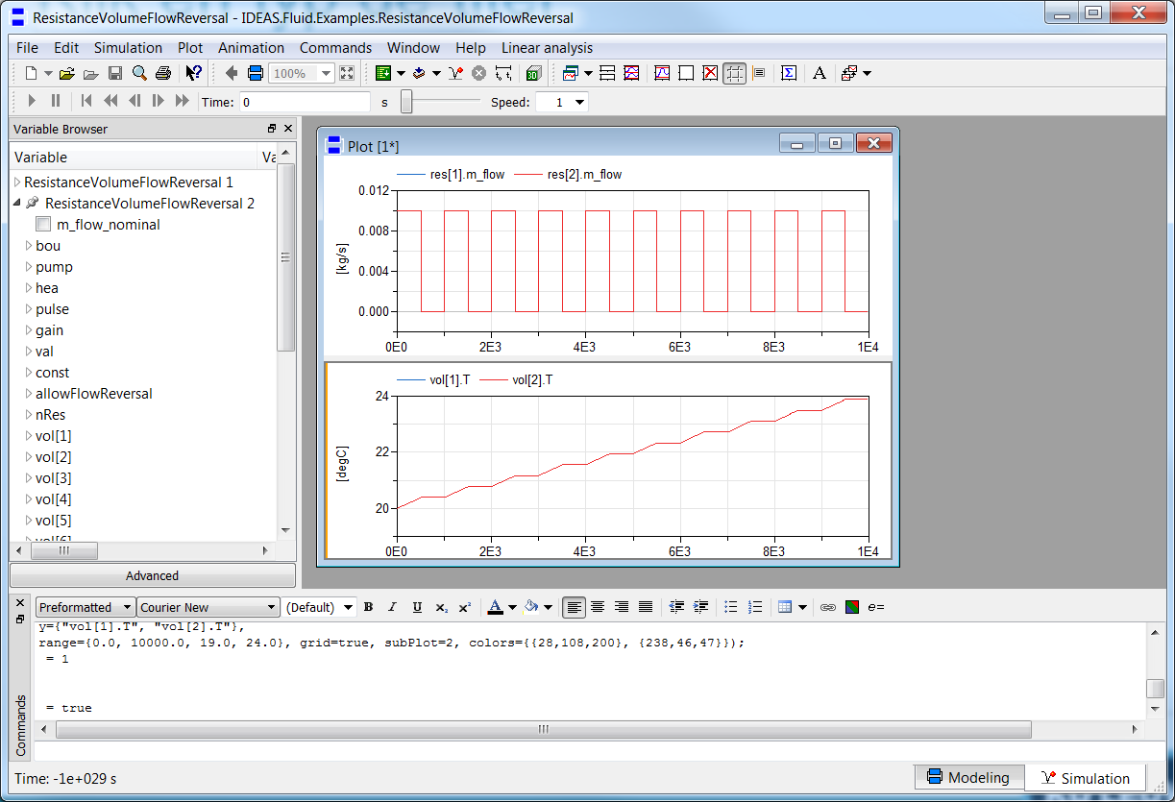
Graphical user interface

Slide 39
Interface with other programs
Scripting
Parameter variation
Parallel simulations
Optimal control
Python scripts using BuildingsPy
Nice for plotting
http://simulationresearch.lbl.gov/modelica/buildingspy/
MATLAB
Built-in with Dymola

Slide 40
Websites
General
www.modelica.org
www.openmodelica.org
www.jmodelica.org
http://www.claytex.com/tech-blog/
Modelica language
http://modref.xogeny.com/ !!!
http://book.xogeny.com/ !!!
KUL modeling conventions
https://docs.google.com/document/d/1MaNKTdLz-YPpEEH3Eg12ECzG0ErK-rIK9IHd6gsBp7Q/edit?usp=sharing
Libraries:
https://github.com/open-ideas --> IDEAS + Crash Course
https://simulationresearch.lbl.gov/modelica --> look at Buildings.Examples.Tutorial
Annex 60: https://github.com/iea-annex60/modelica-annex60
Dymola user guide
Volume 1 & 2: C:\Program Files (x86)\Dymola 2017\Documentation\Dymola User Manual Volume 1 or via Dymola > help.

Slide 41
Fora
http://www.openmodelica.org/index.php/forum
http://www.jmodelica.org/forum
www.stackoverflow.com (tag Modelica)
And last but not least: https://groups.google.com/d/forum/modelicans

Slide 42
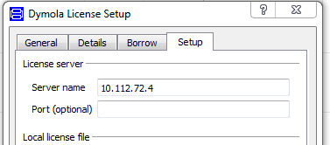
Use of Dymola with KULeuven license
Access to a floating licence (on the building physics server).
Connected physically (cable) to the building physics or mech network
Open Dymola and go to help>licence..
Enter 10.112.72.4 and follow instructions
More information on Modelicans (google groups)

Slide 43
Break
Time to activate and borrow your license!

