Slide 1

WELCOME
PocketSmart AI
Your Smart Budget and Recommendations

Slide 2
SRIDEVI ARTS AND SCIENCE COLLEGE
Krishnapuram — 601204
Team ID :
Roll Number | Name
222503938 | Ramya B
222503929 | Kavitha G
222503940 | Rubha Sri K
222503935 | Ponni M
2

Slide 3

Project Details — Introduction
PocketSmart AI is a web-based smart planning assistant that helps people make better financial decisions for everyday needs.
It offers three planners — Home, Party and Jewellery — each giving personalized AI budget recommendations.
Introduction
The user enters a few simple details and instantly receives a clear, category-wise budget plan.
Section 1 of 4
3

Slide 4

Project Details — Objectives
Help users plan their spending within a fixed budget using AI recommendations.
Provide one simple platform for home, party and jewellery planning.
Objectives
Collect requirements through easy forms and return an instant budget breakdown.
Section 2 of 4
Keep the interface clean, fast and easy to use for everyone.
4

Slide 5

Project Details — System Architecture
Input Layer — user fills the planner form: size, type, rooms, budget, style, location and needs.
Processing Layer — Flask backend with AI logic splits the total budget across categories.
Architecture
Output Layer — shows the plan summary and category-wise budget breakdown.
Section 3 of 4
Interface Layer — responsive web pages for the landing page, forms and results.
5

Slide 6

Project Details — Technology Stack
Python with Flask as the web framework and backend server.
HTML and CSS for the landing page, planner forms and result screens.
Tech Stack
AI-based recommendation logic that divides budgets by category.
Section 4 of 4
Built in VS Code and run locally at 127.0.0.1:5000.
6

Slide 7

Project Output — Key Features
Landing page with three planners: Home, Party and Jewellery.
Home Planner form: size, type, rooms, style, location, budget and needs.
Features Built
AI-generated plan summary with a category-wise budget breakdown.
Main capabilities of the app
Clean, card-based interface with easy navigation.
7

Slide 8
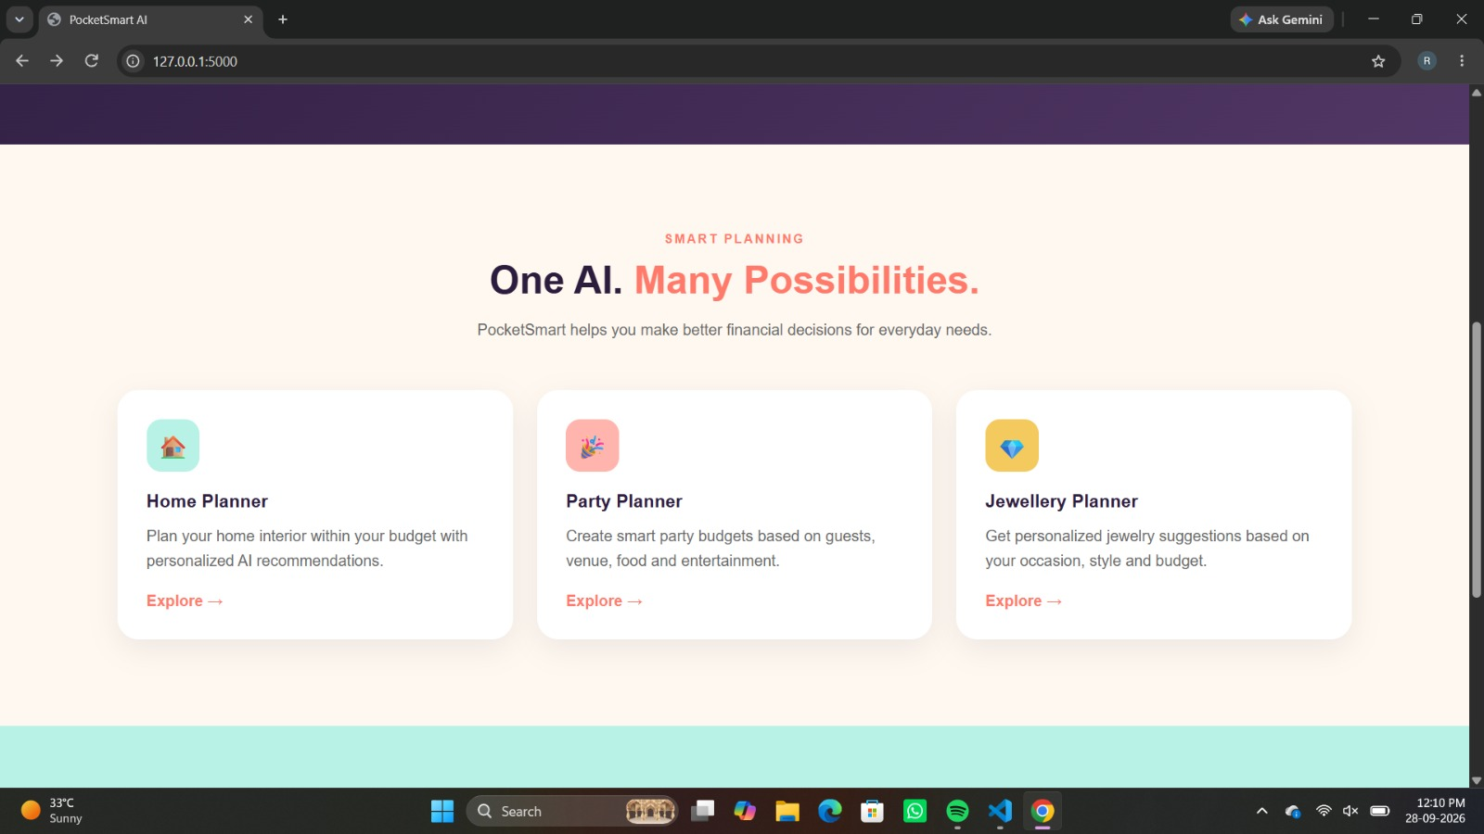
Project Output — Home Page
Home Page
Landing page with all three planners
8

Slide 9
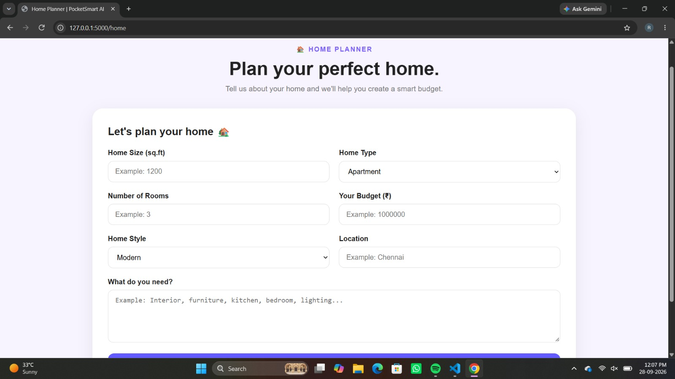
Project Input — Home Planner Form
Input
User enters home details and budget
9

Slide 10
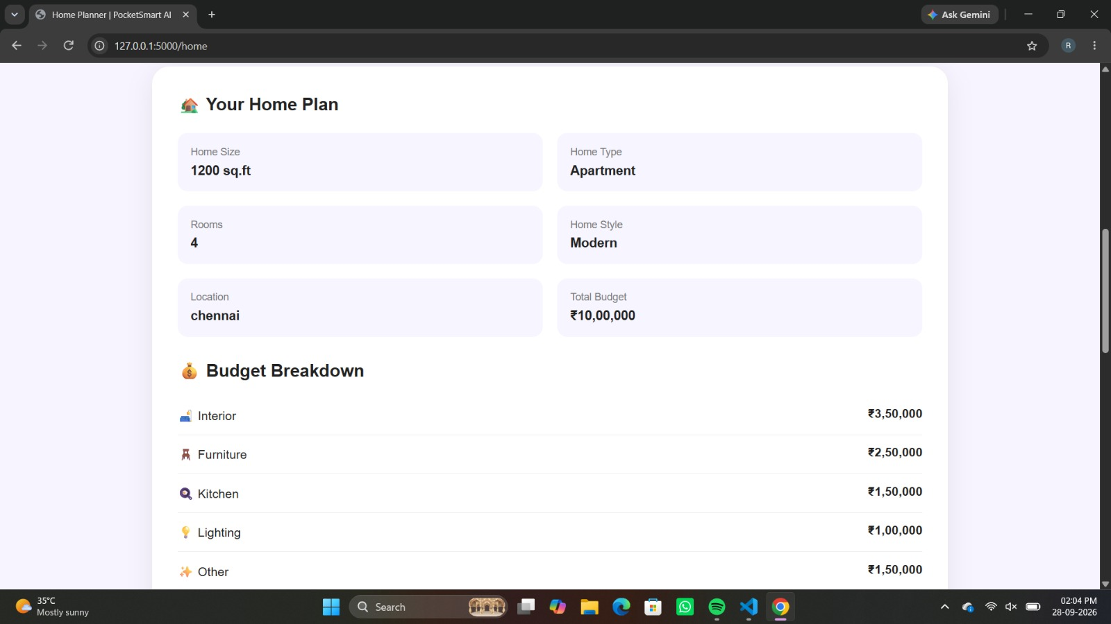

Project Output — Your Home Plan
Output
Generated plan with budget breakdown
10

Slide 11
Project Output — Results & Conclusion
All planners load correctly and accept user inputs through simple forms.
For a budget of ₹10,00,000, the Home Plan split money across Interior, Furniture, Kitchen, Lighting and Other.
Conclusion
Results appear instantly as a clear, easy-to-read budget breakdown.
Summary of results
Future work: more planner types, regional language support and smarter personalization.
11

Slide 12
Thank You
Sridevi Arts and Science College — Krishnapuram

