Slide 1
Climbing in Washington (According to Mountain Project)
Brandon Bullard
EconS 523

Slide 2
Overview
What is the Objective?
Understand and describe characteristics of climbing in Washington by leveraging data from Mountain Project.
What is Mountain Project
MP is a website and mobile app used by climbers:
To log climbs and share opinions
As a forum to discuss climbing topics
To understand a region, crag, or route of interest

Slide 3
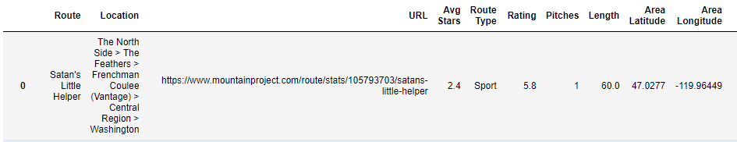
Available Data
MP grants access to CSV’s containing the following information:

Slide 4
Objectives
Gather additional data
Create web scraper to grab # of votes, and # of ticks.
Clean + Exploratory Data Analysis
Find and impute/remove outliers
Describe min, max, mean, etc.
Observe relationships
Which region has the highest concentration of ‘hard’ routes?
What is the average length of a sport route versus trad?

Slide 5
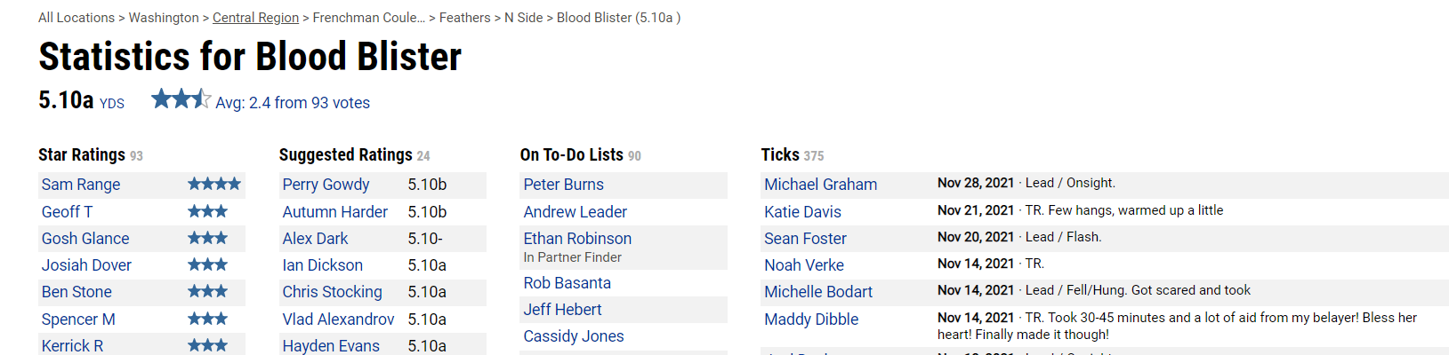
Step 1: Get more data (MP stats page)

Slide 6
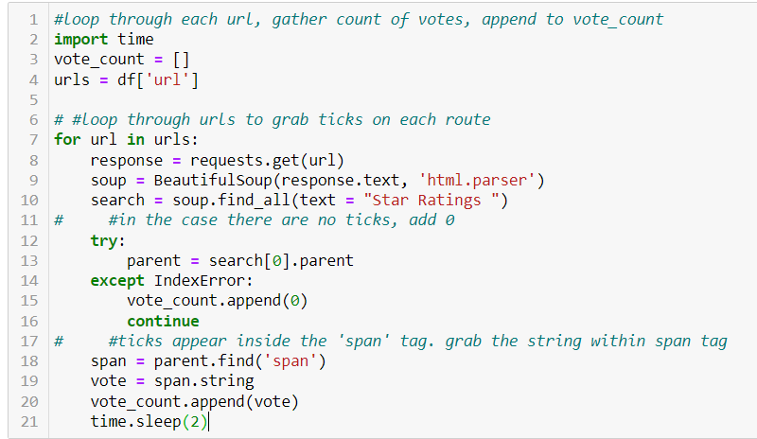
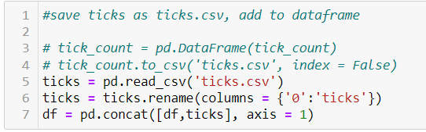
Step 1: Get more data (web scraper)

Slide 7
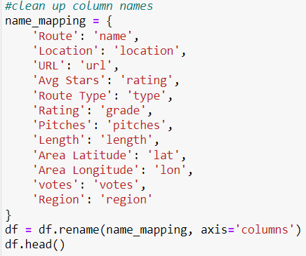
Step 2: Clean data
Rename column names

Slide 8
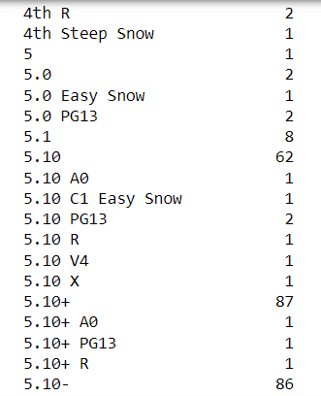
Step 2: Clean data
Clean up ‘grades’ column
‘grades’ has information on grade AND protection.
Grade = Yosemite decimal system (5.0, 5.5, 5.10a)
Protection = degree of safety (PG13, R, X)
Goal: Identify Yosemite decimal system
and protection information, separate columns.

Slide 9

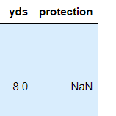

Step 2: Clean data
Collect yds information using reg exp
Collect protection information using reg exp
Add to data frame:

Slide 10
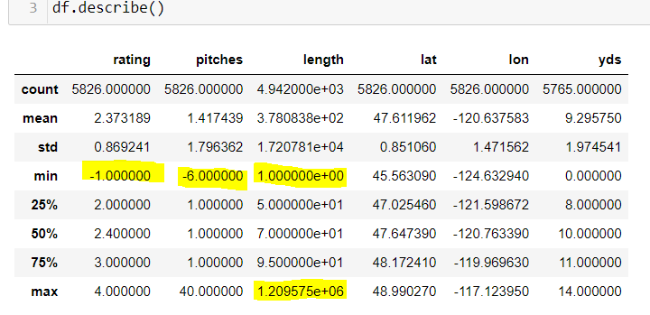
Step 2: Clean data
Outlier detection
Negative rating
Negative pitches
1 ft tall route?
1,209,575 ft route?

Slide 11

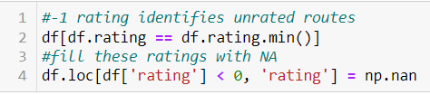

Step 2: Clean data

Slide 12
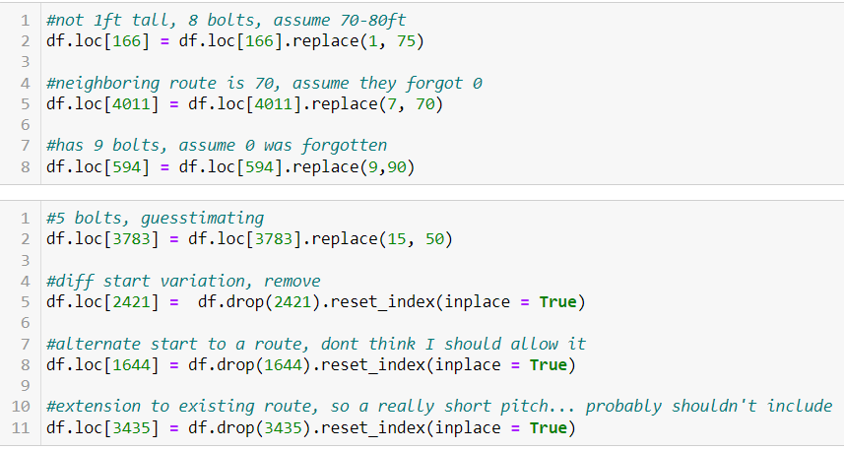
Step 2: Clean data
What’s up with the routes under 20 ft?

Slide 13
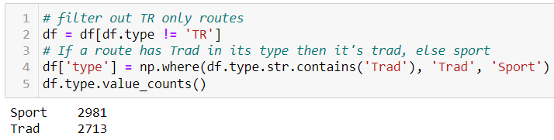
Step 2: Clean data
‘type’ column describes whether route is sport, trad, top rope, alpine, etc.
Some are mixed and/or labeled as top-rope and trad
Reduce ‘type’ category to either ‘sport’ or ‘trad’. Remove top rope only.

Slide 14
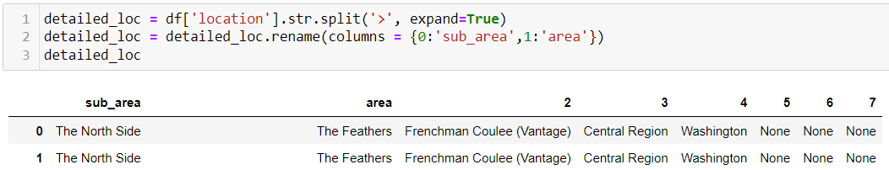
Step 2: Clean data
Finally, clean up location column

Slide 15
Step 2: Clean data
In review:
Renamed columns to consistent lowercase format
Separated grades into YDS and protection columns. Removed climbs with aid grades, 4th class and lower
Condensed ‘type’ column into either sport or trad routes.
Identify outliers, remove and impute data with respect to route height, rating, pitches.

Slide 16
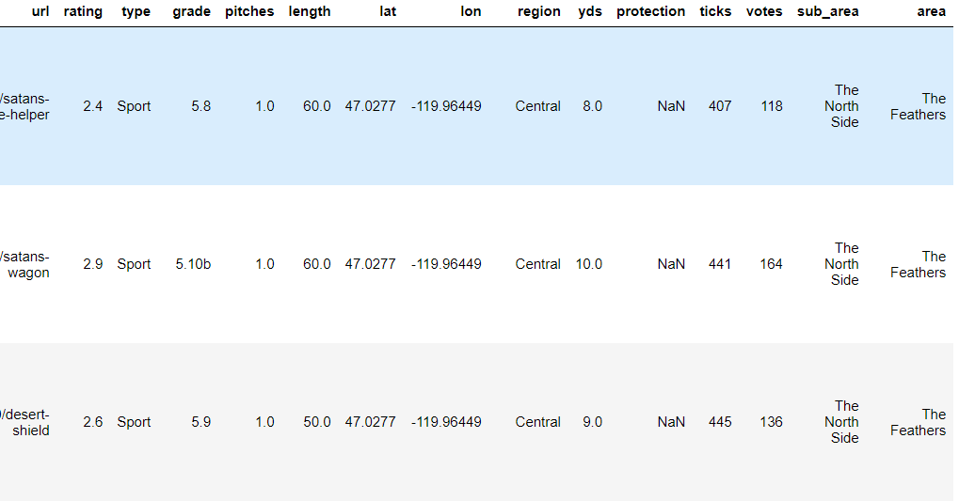
Finished DF

Slide 17
Step 3: EDA
Goal: find and describe interesting trends in the data.
What are the most popular regions and grades?
Which region has the highest concentration/avg rating of sport/trad climbs?
Are sport or trad climbs rated higher on average?

Slide 18
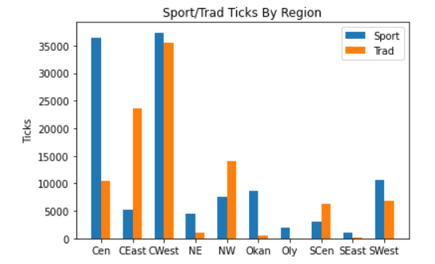
Step 3: EDA

Slide 19
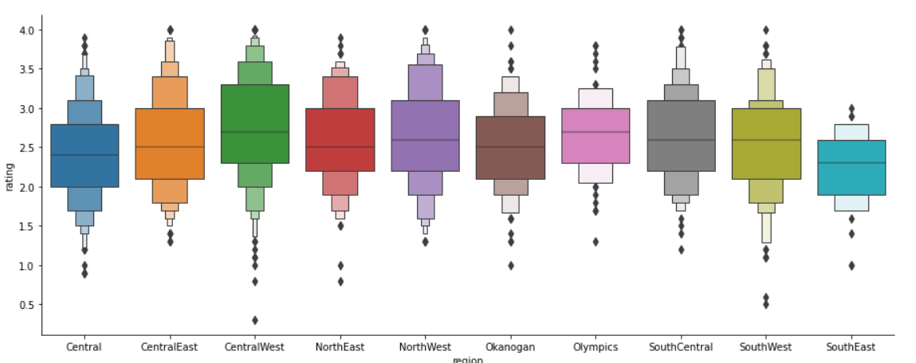
Step 3: EDA

Slide 20
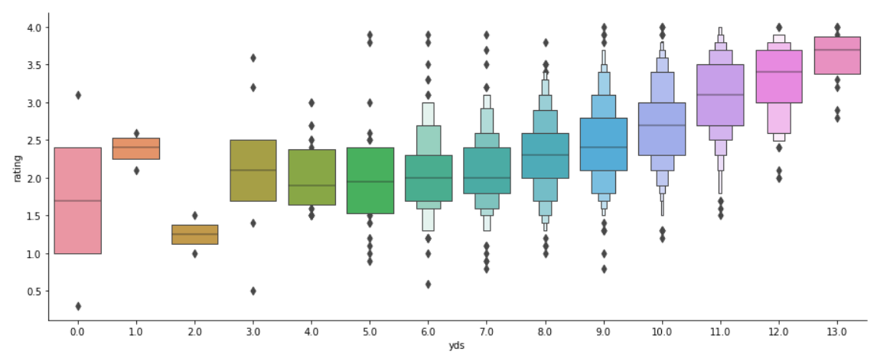
Step 3: EDA

Slide 21
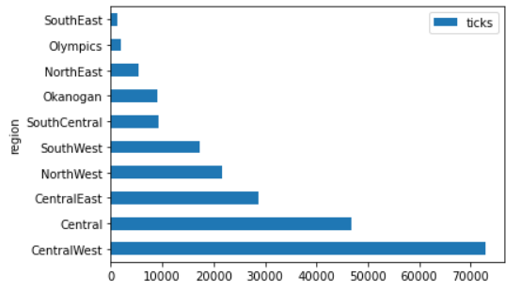
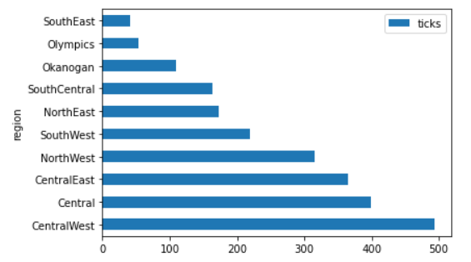






Step 3: EDA
Left: Sum of route ticks per region.
Right: Count of routes per region

Slide 22
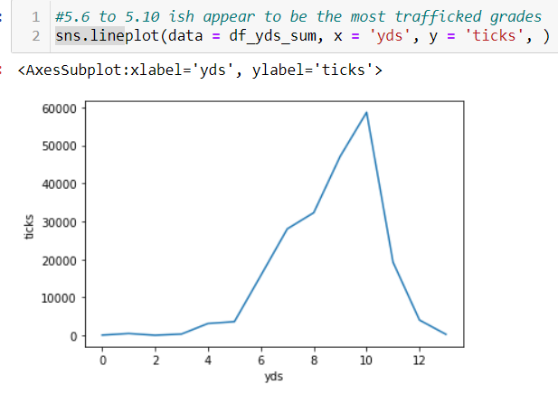
Step 3: EDA

Slide 23
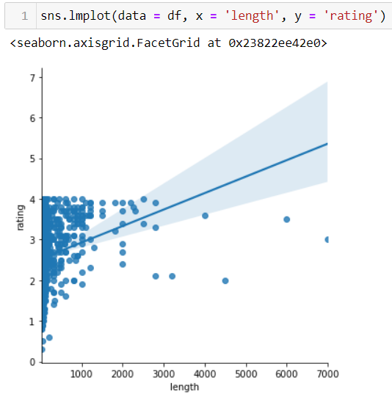
Step 3: EDA

Slide 24
Reference
https://github.com/jnd18/mountain-project-eda/blob/master/rrg-and-nrg.ipynb
Many of the cleaning functions and were inspired by a similar project in 2019

Slide 25
Future Work
Natural language processing of comments, forums.

