Slide 1
Image Processing Feature Abstraction
Brandon Cuadrado, 109237297

Slide 2
Project Objectives
Feature Set Abstraction
Allow high level concepts to be abstracted into intuitively manageable features.
Interface
Provide machine-agnostic web-based interface for performing high-level image processing techniques.
Extensible Architecture
Feature-based architecture allows for abstraction of other image editing data into similarly compartmentalized structures.

Slide 3
Methodology

Slide 4
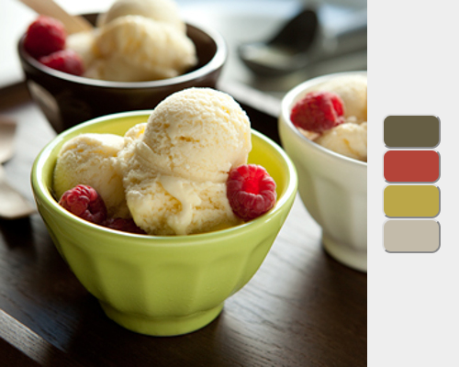
Palette Extraction
Modified K-Means Clustering algorithm
Input:
16 x 16 x 16 histogram
Each dimension represents a color channel
Get mean of each bin
Size of palette - k
Output:
Palette of colors of size k

Slide 5
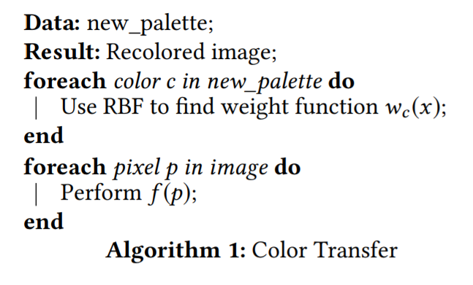


Color Transfer
$$f\left(x\right)=\sum_{i}^{k}{w_{i}\left(x\right)f_{i}\left(x\right)}$$
$$\sum_{i}^{k}{w_{i}\left(x\right)=1}$$
For each color c in the new palette
Use RBFs to determine the weight function $w_{c}\left(x\right)$
For each pixel p in the image
Perform $f\left(p\right)$

Slide 6
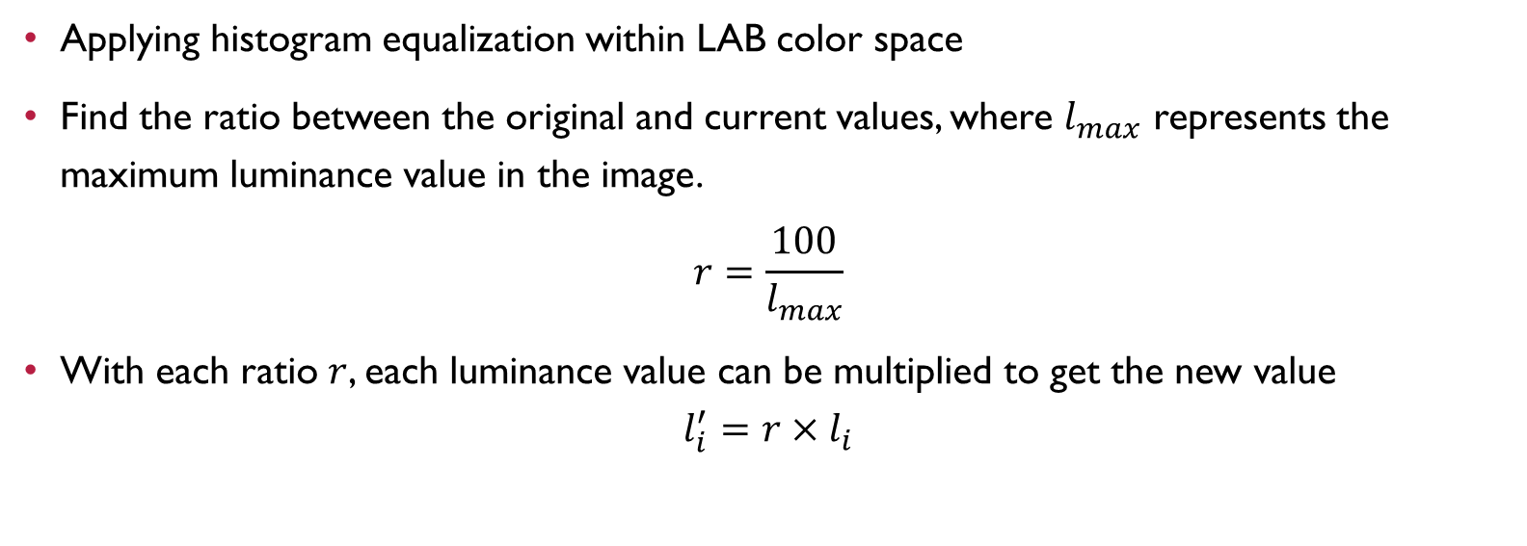
Image Enhancement
Applying histogram equalization within LAB color space
Find the ratio between the original and current values, where $l_{max}$ represents the maximum luminance value in the image.
$$r=\frac{100}{l_{max}}$$
With each ratio $r$, each luminance value can be multiplied to get the new value
$$l_{i}^{′}=r×l_{i}$$

Slide 7
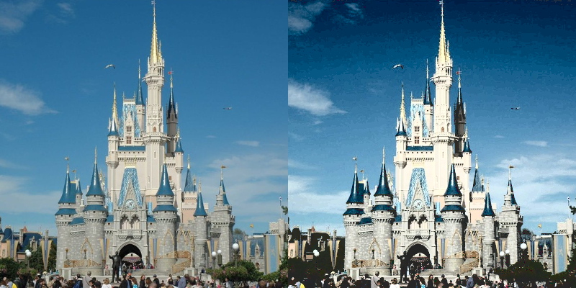
Image Enhancement

Slide 8
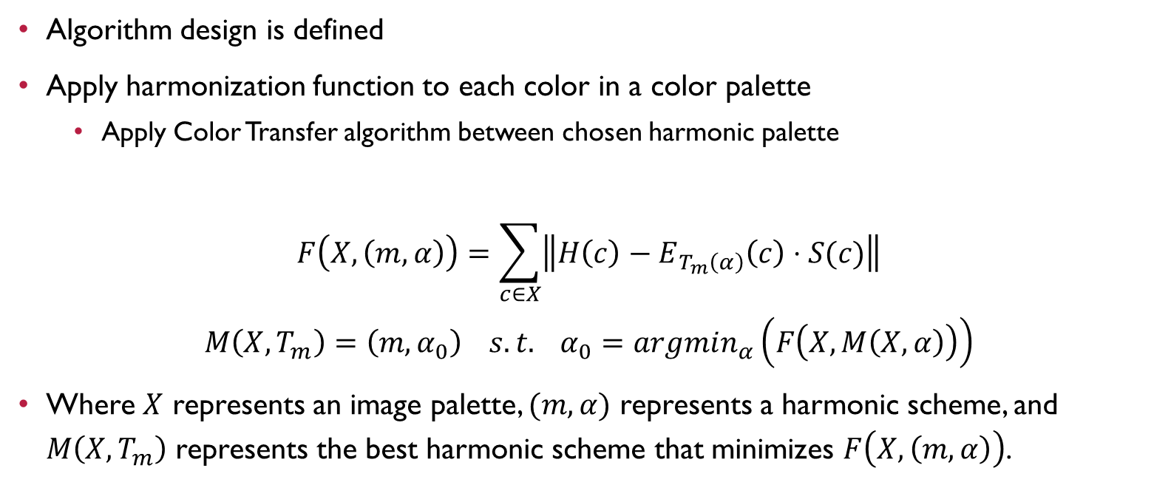
Color Harmonization
Algorithm design is defined
Apply harmonization function to each color in a color palette
Apply Color Transfer algorithm between chosen harmonic palette
$$F\left(X,\left(m,α\right)\right)=\sum_{c∈X}{\left\|H\left(c\right)−E_{T_{m}\left(α\right)}\left(c\right)⋅S(c)\right\|}$$
$$M\left(X,T_{m}\right)=\left(m, α_{0}\right) s.t. α_{0}=argmin_{α}\left(F\left(X,M\left(X,α\right)\right)\right)$$
Where $X$ represents an image palette, $(m,α)$ represents a harmonic scheme, and $M\left(X, T_{m}\right)$ represents the best harmonic scheme that minimizes $F\left(X, \left(m,α\right)\right)$.

Slide 9
Implementation

Slide 10
Architecture – Image Class
Image.cs
Static CurrentImage object
OriginalPixels list for easy reversion
Feature List
Pixels list for current iteration
RBF model
Current Palette
List of Segments (unused in current iteration)

Slide 11
Architecutre – Pixel Class
Pixel.cs
Position and Color
Each with their own C# Class
Color.cs
Initialized in RGB or Lab
Automatic calculation between color spaces

Slide 12
Architecutre - Tools
ColorTransfer.cs
Handles arithmetic on pixels for color transfer algorithm
Harmonization.cs
Handles arithmetic on palettes for determining optimal harmonic schemes
Unimplemented
HistogramEqualization.cs
Handles arithmetic on pixels for equalization in Lab color space
PaletteManager.cs
Handles arithmetic on pixels to determine image palette
SIFT.cs -- unused

Slide 13
Evaluation

Slide 14
Improvements
Luminance mapping
The change in luminance in Lab color space has been refactored in an attempt to present semantically-consistent color transitions within an image
Tech stack
The Microsoft visual Web Development Stack is used to enhance communication between front and back-end in an intuitive way. This increases efficiency from the previous iteration.
Extensible architecture
Architecture introduced extends toward other features to e abstracted within scope of palette-based transformations.

