Slide 1
Test-Driven Development Using React.js and ES2018
copyright 2019, Chris Minnick
version 3.2, May 2019
Notes:
Welcome to test driven development with react.

Slide 2
Contents
Chapter 0: Introduction and React QuickStart - 4
Chapter 1: Development Ecosystem - 16
Node.js - 19
Git - 30
Command Prompt - 37
Chapter 2: Reproducible Builds - 39
NPM - 42
Chapter 3: Static Code Analysis - 49
Configuring ESLint - 51
Browser Development Tools - 56
Chapter 4: Test-Driven Development - 57
Assertions - 64
Jasmine - 67
Karma - 79
Chapter 5: Modularity - 81
CommonJS - 83
RequireJS - 84
ES6 Modules - 85
Chapter 6: Building and Refactoring – 89
Building the dist directory – 90
Webpack – 91
Chapter 7: ES2015 (ES6) - 96

Slide 3
Contents
Chapter 8: The Document Object Model (DOM) - 142
Chapter 9: Introduction to React.js – 153
Virtual DOM – 159
React Development Process - 169
Props vs. State - 175
Chapter 10: JSX - 181
What is JSX? - 182
Using JSX - 183
Chapter 11: React Components – 192
Pure Functions - 197
Styles in React - 210
Forms – 214
Life-Cycle Methods – 223
Composition - 230
Testing React Components – 237
React Router - 254
Chapter 12: Flux and Redux - 237
Flux - 258
Redux - 264
Chapter 13: Advanced Topics - 297
Server-side React - 298
Using React with Other Libraries - 299
Optimizing React Performance - 300

Slide 4
Introduction
Objectives
Who am I?
Who are you?
Daily Schedule
Course Schedule and Syllabus

Slide 5
About Me

Slide 6
Introductions
What's your name?
What do you do?
JavaScript level (beginner, intermediate, advanced)?
What do you want to know at the end of this course?
What do you like to do for fun?
Favorite food?
Notes:
Please answer these questions!

Slide 7
Daily Schedule
08:30 - 10:30
15 minute break
10:45 - 12:00
1 hour lunch break
1:00 - 2:00
15 minute break
2:15 - 3:15
15 minute break
3:30 - 4:30
Notes:
This is just a rough estimate. We may take breaks at different points, depending on where we are with the material. But, in general, we'll take a break in the morning, a break for lunch, and a couple breaks in the afternoon.

Slide 8
The Big Picture
Topics Covered in this Course
Professional Front-End Development
Modern JavaScript
React.js
Notes:
These are the big topics we'll be covering. If this is shorter than a 3-5 day class, we'll spend less time on the first part and do the other two more together than we would in a longer course.

Slide 9
Lab 0: Course Homepage
https://watzthisco.github.io/tdd-react-labs-v3.x/
This is the homepage for the course, which contains links to further reading on topics covered in the course.
Please bookmark and check it out as you have time
If you find an article that should be there, post it to the course issues
https://github.com/watzthisco/tdd-react-labs-v3.x/issues

Slide 10
Professional Front-End Development
Four best practices
Version control
“Be safe"
Automation
“Be lazy"
Reproducible build
“Be verifiable"
Test-Driven Development
“Be flexible"
Notes:
To elaborate on what I mean by Professional Front End development. These are what I consider to be the foundations of software development in general. These basic practices are still relatively new to front-end coding, partly because the languages and tools we're working with aren't as mature as what we have for other types of development, but also because of the very different skill-set that's traditionally been required for doing front end development.
Just to be clear, when we're talking about front-end development, we're talking about writing the front end logic and user interface that consumes and presents data from a web server.
We'll talk in more detail about each of these 4 foundational principles in a moment.

Slide 11
What's New in JavaScript (aka ECMAScript)?
ES2015 (aka ES6) introduced many new features, including:
Arrow functions
Classes
Block-scoped binding constructs (let and const)
Iterators
Modules
Promises
Since 2015, a new version is released annually
React uses the new syntax (classes, modules, etc)

Slide 12
What is React.js?
A Library for Building User Interfaces
Created by Facebook
Open sourced in 2014
Abstracts the Document Object Model (Virtual DOM)
Implements one-way data flow
Component-based
Can be rendered on the server
Plays well with other libraries / frameworks
Notes:
React is more than just a library for building user interfaces. It's really a new way to think about building web applications. Once you understand the principles of it, it's actually surprisingly simple. One of the great things about react, and about ES6 too, is that you don't have to buy into it completely. You can start out using it pretty quickly by integrating it with your existing code, and then you can do more with it as you become more proficient. React's architecture makes it easy to reason about and easy to gradually refactor. This is one of the main things I want to demonstrate in this course -- it's very normal in React to start out with components that are poorly optimized and poorly designed and then to gradually make them better.

Slide 13
What is React NOT?
React is not a framework.
React doesn't have AJAX capabilities.
React has no data layer.
Notes:
React itself is concerned only with the View -- the V in MVC. It doesn't have a data layer, so you'll need to bring in something else to handle operations such as Ajax.
At first, you may be surprised at how React seems to violate every rule of front end development that we've created over the years -- React freely mixes display logic together with style and business logic for example. You'll see, however, that this mixing isn't what it appears to be and it actually makes great sense and makes development of applications easy, and even fun.

Slide 14
When can you use React?
Complex single-page applications (SPAs) can be built entirely using React.
React can be used as a substitution for views in a traditional MV* framework.
React can generate static HTML on the server.
React can be used to create native mobile apps.
React Native
Notes:
React can and is used to build large applications as well as small. It can also be used to just render the View for another framework, although many people who start out working with it this way find that they need the framework less and less.
React can also be used to generate static HTML on the server, and it can be used to create native mobile apps using React Native.

Slide 15
Who Uses React?
AddThis
Angie's List
Airbnb
Atlassian
BBC
Codecademy
Coursera
Dropbox
Expedia
Facebook
IMDb
Imgur
Instagram
Intuit
Liberty Mutual
Lyft
Netflix
NFL
OkCupid
Paypal
Reddit
Salesforce
Squarespace
Tesla Motors
The New York Times
Trulia
Trunk Club
Twitter
Uber
Visa
WhatsApp
Wired
Wix
Wolfram Alpha
Wells Fargo
WordPress
Yahoo
Zendesk
and many more!
Notes:
These are some of the companies that are using React today. It's become extremely popular in a very short time.

Slide 16
React QuickStart
Objectives
Install CreateReactApp
Create a React App
Test and Run a React App with CRA

Slide 17
What is CreateReactApp
Creates React App with No Build Configuration
Simplifies setup for single-page apps and learning
Sacrifices flexibility for simplicity
Not a substitute for understanding the tools, but great when you just want to write React code quickly
Other options offer more flexibility, less simplicity
nwb
Neutrino

Slide 18
Getting Started with CreateReactApp
Create Your App
npx create-react-app my-react-app
Start It
cd my-react-app
npm start
Go to http://localhost:3000 in browser

Slide 19
Lab – Exploring CreateReactApp
Before we get into how to configure the necessary tools for React manually and before you learn how React works, try to complete the following challenges.
Change the default ‘Welcome to React’ message.
Create a new file named Footer.js in the src directory
Type the code below into Footer.js
import React from 'react'; function Footer(){ return (<p>this is the footer.</p>) } export default Footer;
Add the following to App.js (under the other import statements)
import Footer from './Footer.js';
Add the following inside the <div> in App.js
<Footer />

Slide 20
Lab – Exploring React
Using what you learned from creating Footer.js, make Header.js and Content.js to replace code in App.js.
Your finished return statement in App.js should match this:
return (
<div className="App">
<Header />
<Content />
<Footer />
</div>
);

Slide 21
Lab – Testing React
Make copies of App.test.js for Footer.js, Header.js, and Content.js
Modify the contents of the new files to test the new components.
Run your tests by entering the following in the command line
npm test

Slide 22
Chapter 1: Development Ecosystem
Objectives:
Configure your IDE
Use Node.js as a development tool
Use NPM to install and manage packages
Use Git for version control
Use command line dev tools
Notes:
Front end developers work primarily with JavaScript, CSS, and HTML. In recent years, the emphasis has shifted away from HTML and CSS, and today React makes it possible for someone who only has a basic understanding of HTML and CSS to build complex appliations -- as long as they have the JavaScript skills, of course.

Slide 23
Code Editors and IDEs
MS Visual Studio Code
JetBrains WebStorm
Atom (atom.io)
Adobe Brackets
Eclipse
Emacs
IntelliJ IDEA
Netbeans
Sublime Text
vi/Vim
Notes:
Today, there are plenty of code editors and IDEs available for JavaScript development. Purists still maintain that vi or eMacs are all you need, but with so many different libraries and tools involved in modern front-end development, professional developers should take advantage of the advanced features of a full IDE. One of the best ones available is WebStorm, and that's what we'll be using in this course. We don’t endorse any particular code editor, however, and we encourage developers to experiment with as many IDEs as they can.

Slide 24
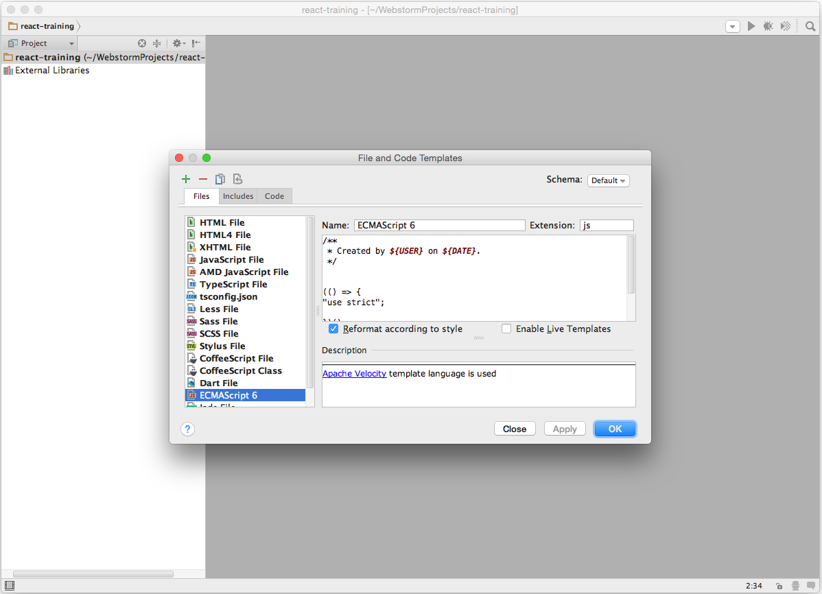
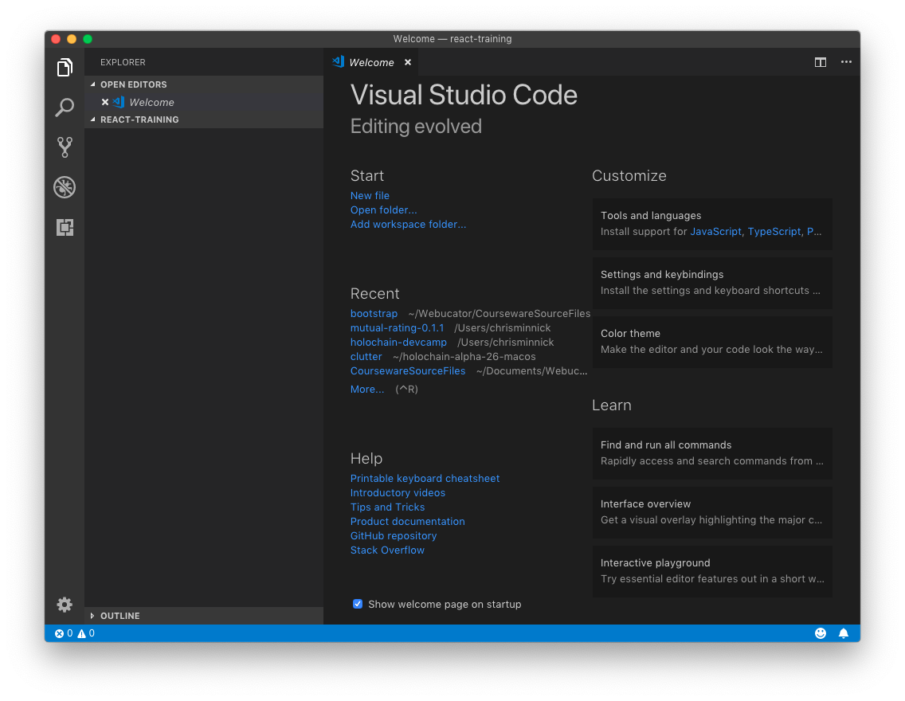
Lab 1: Installing WebStorm or Visual Studio Code
Notes:
You can download a 30-day trial version off WebStorm from http://www.jetbrains.com/webstorm. This lab is optional. The goal is to just set up a new empty project directory and select ES6 syntax highlighting.

Slide 25
Node.js
Objectives
Install Node
Test node and get started using npm

Slide 26
What is Node.js?
JavaScript runtime
Built on Google Chrome's V8 JavaScript engine
Open-source
Event-driven
Non-blocking
Never waits
Single-threaded
Can handle thousands of concurrent connections with minimal overhead
No buffering
Used on the server as well as for development automation
Notes:
Node started its life as a way to run javascript on the server. However, it's become an essential tool for managing modules, running tools, and automating front-end development.
Node.js allows you to run JavaScript from the command line.

Slide 27
How is Node.js Different?
JavaScript is single-threaded
A Node application has one event loop, and gives you the benefit of multithreading with async operations
Can handle thousands of concurrent connections with minimal overhead
No buffering
Node applications never buffer data.
Data is output in chunks.
Non-blocking
Node doesn't wait for data to be returned from APIs.
While it's possible to write blocking code in Node.js, it's discouraged.

Slide 28
A Simple Node.js Example
const http = require('http');
const hostname = '127.0.0.1';
const port = 3000;
const server = http.createServer((req, res) => {
res.statusCode = 200;
res.setHeader('Content-Type', 'text/plain');
res.end('Hello World\n');
});
server.listen(port, hostname, () => {
console.log(`Server running at http://${hostname}:${port}/`);
});

Slide 29
EventEmitter
Node is event driven.
EventEmitter is a class that lets you listen for events and assign actions when those events occur.
Very loose way of coupling different parts of your application together.
var EventEmitter = require("events").EventEmitter;
var ee = new EventEmitter();
ee.on("someEvent", function () {
console.log("event has occured");
});
ee.emit("someEvent");

Slide 30
Modules Overview
Node uses CommonJS for loading modules
Original name was ServerJS
Provides a way to import dependencies in JavaScript when used outside the browser (such as server side or in desktop applications)
module.exports
Encapsulates code into a module
require
Imports a module into JavaScript code

Slide 31
CommonJS Example
foo.js
var circle = require('./circle.js');
console.log('Area of circle: ' + circle.area(4));
circle.js
exports.area = function(r){
return Math.PI * r * r;
}

Slide 32
Front-end Node
Node has become an essential part of front end development.
It's used by:
Package installers
Task runners
Testing frameworks
CSS compilers
JS Transpilers
Web servers
Web browsers (PhantomJS)
and more!

Slide 33
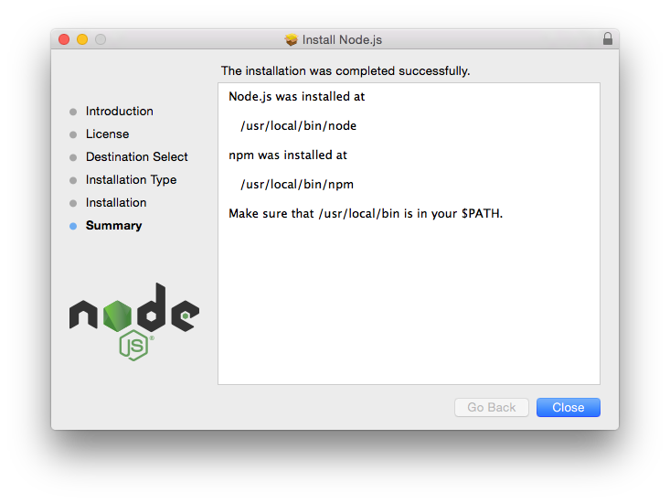
Lab 2 - Getting Started with Node.js

Slide 34
Git
Objectives
Learn about how Git works
Learn a typical Git workflow
Install Git
Use the most common Git commands

Slide 35
What is Version Control?
Essential component of any development workflow
Records changes to files over time
Allows recalling of specific versions
Makes collaboration possible
Makes software development safer

Slide 36
History of Git
From 2002 - 2005, the Linux Kernel used the proprietary BitKeeper VCS.
In 2005, after a falling out with BitKeeper's developer, they decided to create their own VCS.
Goals
Speed
Simple design
Strong support for non-linear development
Fully distributed
Able to handle large projects

Slide 37
What is Git?
Version Control System (VCS)
Different from SVN, CVS, etc
Other VCS: store list of changes
Git: store a snapshot of files at time of commit
Doesn't restore unchanged files
Nearly every operation is local
Generally only adds data
It's difficult to do something that can't be un-done.
Notes:
Git thinks about its data as a stream of snapshots. When you commit, git stores a snapshot of what the files look like. If something hasn't changed, git doesn't store the file again, just a reference to the previous identical file it has already stored.
Most operations in Git only need local files and resources to operate. You have the entire history of the project on your local disk, which makes operations much faster.
Also, there's very little you can't do if you're offline.

Slide 38
3 States of Git
Git has three states that your files can reside in:
Committed
Data stored in your local repo
Modified
Data changed but not committed
Staged
File is marked to go into your next snapshot
Notes:
The Git directory (repository) is where Git stores the metadata and object database for your project. This is the most important part of Git, and it is what is copied when you clone a repository from another computer.
The working directory is a single checkout of one version of the project. These files are pulled out of the compressed database in the Git directory and placed on disk for you to use or modify.
The staging area is a file, generally contained in your Git directory, that stores information about what will go into your next commit. It’s sometimes referred to as the “index”, but it’s also common to refer to it as the staging area.

Slide 39
Git Workflow
Modify files
Stage the files
Adds snapshots to the staging area
Git add
Git add is dual-purpose: it tells git to track new files and it stages changes to existing files.
Commit
Stores a snapshot permanently in your Git directory
Git commit
You can also skip the staging area by using the -a option with git commit. This will automatically stage all tracked files before doing the commit.

Slide 40
Lab 3 - Version Control With Git

Slide 41
Command Prompt
Objectives
Use a Unix-style command prompt
Get familiar with basic commands
Notes:
The command prompt is absolutely required for front-end development, so it's important that you get comfortable with it.

Slide 42
Know Your Shell
Bash shell
Terminal (Mac)
Git bash (Windows)
You can use the windows command prompt, but it has its own non-standard commands, so using a bash emulator is recommended.
cd = change directory
./ = current directory
../ = up one directory
ls = list files
ls -la = long list format and don't hide files starting with .
pwd = print working directory
mkdir = create a new directory
cp [source] [dest] = copy
mv [source] [dest] = move, or rename
rm = remove files or directories
help = get bash commands
-help = get help with a command
Notes:
The command prompt for MacOS is called Terminal. It's located inside Applications > Utilities
On Windows, use git bash so that the Unix commands in this course will work correctly.

Slide 43
Chapter 2: Reproducible Builds
Objectives
Understand the role of build tools
Learn about build automation
Configure and use npm
Notes:
A reproducible build is the series of steps that you take to create a working version of your software. This should be documented and automated as much as possible. It's far easier to build in automation from the beginning than it is to add it in later on.

Slide 44
Why Automate Your Build?
First step in creating culture of Continuous Delivery and DevOps
Continuous Delivery
Teams produce software in short cycles, ensuring that software can be reliably released at any time.
DevOps
Emphasizes communication and collaboration of developers and IT and creates culture of rapid and reliable releases.

Slide 45
Build Requirements
Return helpful error messages
Platform independent
Dependency resolution
Command-line processing
Self-documentation
Simple
Notes:
A build tool should fail on error and return good error messages. It should run on any platform and not require special configuration or different commands for different operating systems. Dependency resolution refers to the ability for the steps in the build to depend on other steps happening first.

Slide 46
npm
Installs, publishes, and manages node programs
Is bundled and installed with Node
Allows you to install Node.js applications from the npm registry
Written in JavaScript

Slide 47
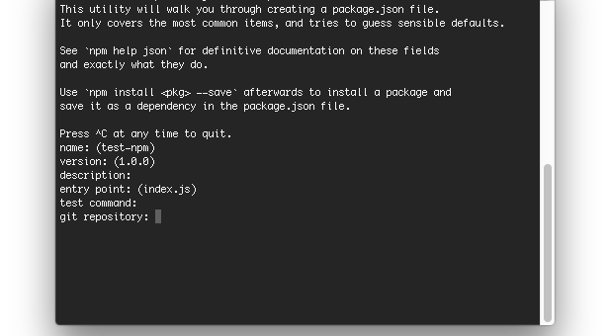
Lab 4 – Initialize npm
Notes:
npm stores information about the packages installed in your project in package.json. Run npm init to create a package.json file.

Slide 48
node_modules
Two ways to install npm packages
Locally
Globally
When you install packages locally, they're put into the node_modules directory in your current directory.
You should always run npm install from the same directory as your package.json file, which should be at the root of your project.
Run npm update to update local packages
Run npm outdated to find out which packages are outdated.
Notes:
Important note: This isn't an issue at this point, but if you're working on Windows, you're going to run into a problem sooner or later. Modules that have long chains of dependencies can create long file paths, which can break on Windows. Running npm dedupe usually fixes the problem. Other possible solutions: http://gsferreira.com/archive/2015/07/reduce-the-path-length-of-a-node-js-project/

Slide 49
package.json
Manages locally installed npm packages
Documents packages your project depends on
Specifies the versions of each package your project can use
Makes your build reproducible
Package versions are specified using Semantic versioning (semver)
Semver ranges:
~ : patch release - 1.0.x
^ : minor release - 1.x
* : major release - x

Slide 50
Npm Install
Is used to download and install a package
-g: install globally
--save: Package will appear in your dependencies
--save-dev: Package will appear in your devDependencies
--save-optional: Package will appear in your optionalDependencies
--save-exact: Saved dependency will be configured with an exact version rather than the default range operator.

Slide 51
Lab 5 – Using npm as a Build Tool

Slide 52
Lab 6 - Managing External Dependencies
Create a script called version-check to check the node version
Compare node version against version listed in package.json
Fail with helpful message if wrong version is installed
Make the default task dependent on version

Slide 53
Chapter 3: Static Code Analysis
Objectives
Learn about Lint tools
Use ESLint
Configure ESLint
Manual testing with a local web server

Slide 54
Lint tools
JSLint
Created by Douglas Crockford
Highly opinionated (like Mr. Crockford)
Flags style that conflicts with "The Good Parts" according to D.C.
JSHint
More control
Doesn't flag style issues by default
ESLint
Allows developers to create their own rules ("Pluggable")
"Agenda free" - doesn't promote any particular style
Notes:
Linting tools look at your code and look for errors and bad practices.
The first linting tool for JavaScript is JSLint, which was created by Douglas Crockford.
JSLint flags a lot of style issues that Crockford thinks are bad.
JSHint was created in order to give more control over which style issues are checked for.
ESLint is a new tool that is highly customizable and features plugins for many different styles, libraries, and frameworks -- including React and JSX.

Slide 55
Configuring ESLint
Two ways
Configuration comments
embed configuration info in JS files with comments
/* eslint eqeqeq: "off", curly: "error" */
Configuration files
.eslintrc file

Slide 56
ESLint: What Can Be Configured?
Environments
Where is the code running?
Includes predefined global variables for each environment.
Globals
Specify additional globals your scripts use.
Rules
Enable rules at different levels.

Slide 57
ESLint Rules
3 Levels
"off" or 0
Rule not applied.
"warn" or 1
Warn but don't exit.
"error" or 2
Error and exit.
Example rules
{ "rules": { "eqeqeq": "off", "curly": "error", "quotes": ["error", "double"] } }

Slide 58
Lab 7 - Automate Linting
Install ESLint into project
Test it
Create an npm script called "lint"
Make lint task a dependency of default build task

Slide 59
Lab 8 - Configure a Local Web Server
Install http-server
Add webserver task to package.json

Slide 60
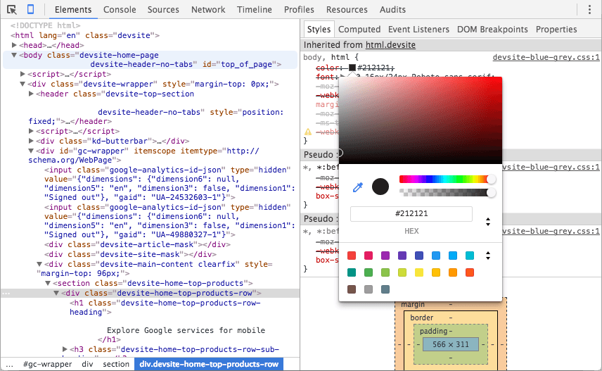
Browser Development Tools
Using Chrome Developer Tools
Using IE F12 Developer Tools

Slide 61
Chapter 4: Test-Driven Development
Objectives
Learn the TDD Steps
Write Assertions
Understand exception handling in JS
Create tests with Jasmine
Automate cross-browser testing
Notes:
In this section, we'll start talking about test-driven development and automated testing.
The key with Test-Driven Development is to work in very small increments.
1. check that the code does was its supposed to do
2. group tests into suites
3. cross browser test automation

Slide 62
Goal of TDD
Clean code that works.

Slide 63
The TDD Cycle
Red
write a little test that doesn't work.
Green
make the test work, as quickly as possible.
don't worry about doing it right.
Refactor
eliminate duplication created in making the test work.

Slide 64
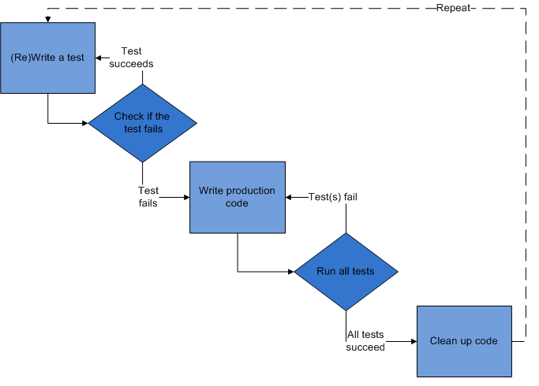
TDD Steps
Write a test
Check that test fails
Write code
Run test - passes!
Refactor
Repeat

Slide 65
Red
Write the story.
Invent the interface you wish you had.
Characteristics of a good tests:
Each test should be independent of the others.
Any behavior should be specified in only one test.
No unnecessary assertions
Test only one code unit at a time
Avoid unnecessary preconditions

Slide 66
Green
Get the test to pass as quickly as possible.
Three strategies:
Fake it
Do something, no matter how bad, to get the test to pass.
Use an obvious clean solution.
But don't try too hard!
Triangulation
only generalize code when you have two examples or more.
When the 2nd example demands a more general solution, then and only then do you generalize.

Slide 67
Refactor
Make it right.
Remove duplication.
Improve the test.
Repeat.
Add ideas or things that aren't immediately needed to a todo list.

Slide 68
Assertions
Expression that encapsulates testable logic
Assertion Libraries
Chai, should.js, expect.js, better.assert
Examples
expect(buttonText).toEqual('Go!'); // jasmine
result.body.should.be.a('array'); // chai
equal($("h1").text(), "hello"); //QUnit
assert.deepEqual(obj1, obj2); //Assert

Slide 69
JavaScript Testing Frameworks
Jasmine
Mocha
doesn't include its own assertion library
QUnit
from JQuery
js-test-driver
YUI Test
Sinon.JS
Jest

Slide 70
JS Exception Handling
function hello(name) {
return "Hello, " + name;
}
let result = hello("World");
let expected = "Hello, World!";
try {
if (result !== expected) throw new Error
("Expected " + expected + " but got " +
result);
} catch (err) {
console.log(err);
}
Notes:
By using JavaScript's built-in try throw catch, you can write assertions and throw errors if the test of the assertion doesn't pass. If it doesn't, you can fix the code until the test passes. This test will fail. (node ./src/trythrowcatch.js). You could write an assertion function to simplify this, or you can use an assertion library that already exists.

Slide 71

Jasmine Overview
Objectives
Write test suites
Create specs
Set expectations
Use matchers
Notes:
Jasmine is a Behavior-driven Development framework that includes its own assertion library.

Slide 72
How Jasmine Works
Suites describe your tests
Specs contain expectations
describe("A suite is just a function", function() {
var a;
it("and so is a spec", function() {
a = true;
expect(a).toBe(true);
});
});

Slide 73
Test Suites
Created using the describe function
Contain one or more specs
2 params
Text description
Function
describe("Hello", function() {
...
}

Slide 74
Specs
Created using the it or test function
they're the same thing
Contains one or more expectations
expectations === assertions
describe("Hello", function() {
it("Concats Hello and a name", function() {
var expected = "Hello, World!";
var actual = hello("World");
expect(actual).toEqual(expected);
});
});

Slide 75
Expectations
AKA assertions
Made using expect function,
Takes a value
Chained to a Matcher
Takes the expected value
expect(actual).toEqual(expected);

Slide 76
Matchers
expect(fn).toThrow(e);
expect(instance).toBe(instance);
expect(mixed).toBeDefined();
expect(mixed).toBeFalsy();
expect(number).toBeGreaterThan(number);
expect(number).toBeLessThan(number);
expect(mixed).toBeNull();
expect(mixed).toBeTruthy();
expect(mixed).toBeUndefined();
expect(array).toContain(member);
expect(string).toContain(substring);
expect(mixed).toEqual(mixed);
expect(mixed).toMatch(pattern);

Slide 77
TDD vs. BDD
Test-Driven Development
Behavior-Driven Development
Focused on being useful for programmers
Focused on documentation for non-programmers
Features, not results
More verbose
Notes:
The difference between TDD and BDD is subtle and it's mostly in language. TDD is designed for programmers to test software, while BDD helps design and document it. Neither style is better than the other and the choice depends on your framework, what you're comfortable with, and other factors.

Slide 78
TDD Example
suite('Counter', function() {
test('tick increases count to 1',
function() {
var counter = new Counter();
counter.tick();
assert.equal(counter.count, 1);
});
});

Slide 79
BDD Example
describe('Counter', function() {
it('should increase count by 1 after calling tick',
function() {
var counter = new Counter();
var expectedCount = counter.count + 1;
counter.tick();
assert.equal(counter.count, expectedCount);
});
});

Slide 80
Lab 9 – Get Started with Jasmine
Install jasmine
Jasmine init
Create a test suite

Slide 81
Lab 10 - TDD Practice
We need more features!!! Pick at least one feature from the following list and implement it using TDD. Break up the feature into smaller units as needed.
It gives an appropriate hello for the time of day
Good morning!
Good afternoon!
Good evening!
It displays a login message if no name is provided
It speaks German to Germans
It refuses to say hello after the 4th time the function is called.

Slide 82
Automated Cross-browser Testing
Front-end code runs in browsers
Browsers are all slightly different
Automated testing in Node isn't enough
Manual cross-browser testing is tedious
Karma can run tests in actual browsers
Notes:
Jasmine is great for creating and running test suites, but so far we've only been testing our code against whatever version of node we have installed. In reality, your front-end code is going to be running inside browsers, which all have different levels of support for JavaScript -- and especially for ES6.
In order to test front-end code in the real environments where we'll be running it, we need to run it in browsers.
You could do this by opening and running the files in a browser manually. Or, you can use a test runner to automate the process. In this section, you'll learn how to use Karma to run your jasmine tests in multiple browsers.

Slide 83

Karma
A test runner for JavaScript
Test on real devices
Testing Framework Agnostic
How it works
Spawns a web server
Executes source code against test code for each browser connected
Results are displayed on the command line
Preprocessors can be configured to do work to files before they get served to browsers.
Can launch browsers automatically, or you can do it manually
Notes:
Karma works by starting a server that browsers can connect to. Karma can then serve tests to the browsers to be run in the browser. Another similar test runner is testem.

Slide 84
Lab 11 - In-browser Testing with Karma
Install karma
Run karma
Integrate karma into your build
Testing with multiple browsers / devices

Slide 85
Chapter 5: Modularity
Objectives
Explain modularity
Learn different methods of using modules in JS
Understand methods of front-end module management

Slide 86
Why is Modularity Important?
Individual modules can be tested
Allows distributed development
Enables code reuse
Reduce coupling
Increase cohesion

Slide 87
CommonJS
Modularity for JavaScript outside of the browser
Node.js is a CommonJS module implementation
uses require to include modules
export an anonymous function
hello.js
module.exports = function () {
console.log("hello!");
}
app.js
var hello = require("./hello.js");
export a named function
hello.js
exports.hello = function () {
console.log("hello!");
}
app.js
var hello = require("./hello.js").hello;

Slide 88

RequireJS
File and module loader for in-browser use
Can also be used in other environments (like Node)
Uses Asynchronous Module Loading (AMD)
index.html
<script data-main="scripts/main" src="scripts/require.js">
</script>
main.js
require(["purchase"],
function(purchase){
purchase.purchaseProduct();
});
purchase.js
define(["credits","products"], function(credits,products) {
return {
purchaseProduct: function() {
…

Slide 89
ES6 Modules
Named export
lib.js
export function square(x) {
return x * x;
}
main.js
import {square} from 'lib';
Default export
myFunc.js
export default function() {
…
};
main.js
import myFunc from 'myFunc';
Compromise between AMD and CommonJS
compact syntax
support for asynchronous loading
2 Types
named exports
multiple per module
default exports
1 per module

Slide 90
Front-end Modules
Modules that will be part of the deployed code
Examples include: jQuery, React, Modernizr, Backbone
Can be managed "manually" or using npm
Notes:
We've worked with modules in our development environment using NPM, but how do you manage front-end modules that will be part of your deployed code?

Slide 91
Manage Modules Manually
To manage front-end modules manually, download them to your src directory.
Important to keep them separate from your source code
A common approach is to use a 'vendor' directory.
Notes:
The most straight-forward way to manage front-end dependencies is to just download them into your src directory. The most important thing is to keep these dependencies separate from your source. It's common to put them into a 'vendor' directory.

Slide 92
Front End Package Management with npm
Manage packages with npm
Port to browser using webpack

Slide 93

Chapter 6: Building and Refactoring
Objectives
Use Webpack to build your production files
Integrate Webpack into the automated build

Slide 94
Building the dist directory
Use webpack to bundle everything
Use babel to convert ES6 code to ES5
Use run webpack and create the dist directory.

Slide 95
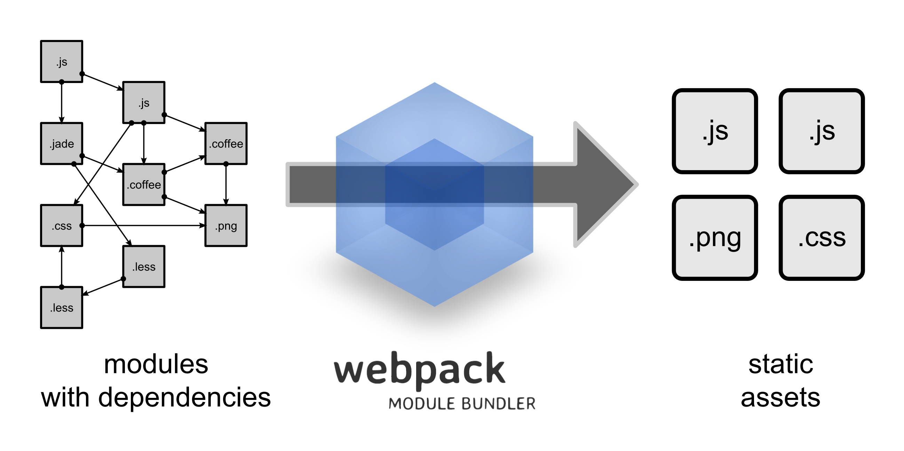
webpack

Slide 96
How webpack Works
Treats all assets as modules.
Loads modules using most module styles (CommonJs, AMD, ES6) and creates a 'bundle'.
Uses loaders to transform non-JS resources into JS
Loaders transform individual files
Plugins extend webpack's capabilities
Plugins work on the entire bundle

Slide 97
Lab 12: Deploying with Webpack
Notes:
Now that we have automated linting and testing, the next step is to automate the building of what will actually go on the server. You never want to serve your source files directly. You need to process them, minify them, and bundle them first. You can automate this process with webpack

Slide 98
Lab 13: README Update and Refactoring

Slide 99
Chapter 7: ES2015 (ES6) and Beyond
Objectives
Learn what's new
Use arrow functions and block-scoped variables
Create generator functions
Use classes and modules
Transpile ES6 code to ES5 with Babel

Slide 100
Variable Scoping with const and let
const creates constants
"immutable variables”
Cannot be reassigned new content
The assigned content isn't immutable, however,
If you assign an object to a constant, the object can still be changed.
let creates block-scoped variables
Main difference between let and var is that the scope of var is the entire enclosing function.
Redeclaring a variable with let raises a syntax error
No hoisting
Referencing a variable in the block before the declaration results in a ReferenceError.
Notes:
The first new things in ES6 that we'll be talking about are const and let. Unlike variables defined using the var keyword, these new es6 keywords create block-scoped variables. They have some other important differences as well.
Const creats immutable variables -- that is, once you assign a value to a const, the value can't be changed.
Let creates block-scoped variables (variables that are private to their enclosing curly braces, as opposed to having function scope as javascript up to this point

Slide 101
let vs. var
var
let
var a = 5;
var b = 10;
if (a===5) {
var a = 4;
var b = 1;
}
console.log(a); // 4
console.log(b); // 1
let a = 5;
let b = 10;
if (a===5) {
let a = 4;
let b = 1;
}
console.log(a); // 5
console.log(b); // 10
Notes:
Here's an example that demonstrates the difference between scoping with let and var.

Slide 102
Block-scoped Functions
ES5
ES6
(function () {
var foo = function () {
return 1;
}
console.log(foo()); // 1
(function () {
var foo = function() {
return 2;
}
console.log(foo()); // 2
})();
console.log(foo()); // 1
})();
{
function foo () { return 1; }
console.log(foo()); // 1
{
function foo () {
return 2;
}
console.log(foo()); // 2
}
console.log(foo()); // 1
}
Notes:
In ES5, we used iffe and function expressions to block-scope function definitions. In ES6, we can create block-scoped function definitions using brackets.

Slide 103
Arrow Functions
aka "fat arrow" functions
A more concise syntax for writing functions
ES5 (old way)
function increment(v){
return v+1;
}
Arrow function
increment = (v) =>{v+1};

Slide 104
Arrow Function Parameters
Surround parameter names with parentheses
(param1,param2,param3) => { statements }
Parentheses are optional when there's only one parameter name
singleParam => { statements }

Slide 105
Arrow Functions (cont.)
More intuitive handling of current object context.
ES6
this.nums.forEach((v) => {
if (v % 5 === 0)
this.fives.push(v);
});
ES5
var self = this;
this.nums.forEach(function (v) {
if (v % 5 === 0)
self.fives.push(v);
});
Notes:
Arrow functions are always anonymous functions, meaning the only way to assign a name to them is to assign the function to a variable. Arrow functions also handle the this keyword more intuitively, which eliminates the need for the pre-ES6 hack shown here in order to refer to the object that a function is inside.

Slide 106
Default Parameter Handling
ES6
function myFunc (x, y = 0, z = 13) {
return x + y + z;
}
ES5
function f (x, y, z) {
if (y === undefined)
y = 0;
if (z === undefined)
z = 13;
return x + y + z;
};

Slide 107
Rest Parameter
Aggregation of remaining arguments into single parameter of variadic functions.
function myFunc (x, y, ...a) {
return (x + y) * a.length;
}
console.log(myFunc(1, 2, "hello", true, 7));
http://jsbin.com/pisupa/edit?js,console

Slide 108
Spread Operator
Spreading of elements of an iterable collection (like an array or a string) into both literal elements and individual function parameters.
var params = [ "hello", true, 7 ];
var other = [ 1, 2, ...params ];
console.log(other); // [1, 2, "hello", true, 7]
console.log(MyFunc(1, 2, ...params));
var str = "foo";
var chars = [ ...str ]; // [ "f", "o", "o" ]
http://jsbin.com/guxika/edit?js,console

Slide 109
Template Literals
String Interpolation
var customer = { name: "Penny" }
var order = { price: 4, product: "parts", quantity: 6 }
message = `Hi, ${customer.name}. Thank you for your order of ${order.quantity} ${order.product} at ${order.price}.`;
http://jsbin.com/pusako/edit?js,console
Notes:
Template literals are enclosed by the back-tick (` `) (grave accent) character instead of double or single quotes.

Slide 110
Template Literals (cont)
Raw String Access
Allows you to access the raw template string content (without interpreting backslashes)
function tag(strings, ...values) {
console.log(strings.raw[0]);
// "string text line 1 \\n string text line 2"
}
tag`string text line 1 \n string text line 2`;
http://jsbin.com/donibif/edit?js,console
Notes:
You can also access raw strings, without interpretted backslashes.

Slide 111
Enhanced Object Properties
Property Shorthand
Shorter syntax for properties with the same name and value
ES5
obj = { x: x, y: y};
ES6
obj = { x,y };
Notes:
ES6 has a consise syntax for setting properties that have the same name and value. In this case, which part --the name or the value-- do you think the x and y in the ES6 code refers to? It's actually the value. Can you think of a way to check this?

Slide 112
Enhanced Object Properties
Computed names in object property definitions
let obj = {
customer: "Nigel",
[ "order" + getOrderNum() ]: 10
};
http://jsbin.com/wejuqe/edit?js,console

Slide 113
Method notation in object property definitions
ES6
ES5
obj = {
foo (a,b) {
},
bar (x,y) {
}
};
obj = {
foo: function(a, b) {
},
bar: function(x, y) {
}
};

Slide 114
Array Matching
Intuitive and flexible destructuring of Arrays into individual variables during assignment
var list = [ 1, 2, 3 ];
var [ a, , b ] = list; // a = 1 , b = 3
[ b, a ] = [ a, b ];
http://jsbin.com/yafage/edit?js,console

Slide 115
Object Matching
Flexible destructuring of Objects into individual variables during assignment
var { a, b, c} = {a:1, b:2, c:3};
console.log(a); // 1
console.log(b); // 2
console.log(c); // 3
http://jsbin.com/kuvizu/edit?js,console

Slide 116
Symbol Primitive
A unique and immutable data type.
May be used as an identifier for object properties.
Examples:
var sym1 = Symbol();
var sym2 = Symbol("foo");
var sym3 = Symbol("foo"); // Symbol("foo") !== Symbol("foo")
Well-known Symbols
Built-in symbols, for example Symbol.iterator, which returns the default iterator for an object.
Notes:
each call to Symbol creates a new symbol. In the 2nd and 3rd examples, foo is not coerced into a symbol. "foo" is just an optional description.

Slide 117
User-defined Iterators
Customizable iteration behavior for objects
In order to be iterable, an object must implement the iterator method -- the object, or one of the objects up its prototype chain) must have a property with a Symbol.iterator key.
var myIterable = {}
myIterable[Symbol.iterator] = function* () {
yield 1;
yield 2;
yield 3;
};
[...myIterable] // [1, 2, 3]

Slide 118
For-Of Operator
Convenient way to iterate over all values of an iterable object
let fibonacci = {
[Symbol.iterator]() {
let pre = 0, cur = 1
return {
next() {
[ pre, cur] = [cur, pre + cur]
return { done: false, value: cur }
}
}
}
}
for (let n of fibonacci) {
if (n > 1000)
break;
console.log(n);
}
http://jsbin.com/nururoz/edit?js,console

Slide 119
Creating and Consuming Generator Functions
A generator is a special type of function that works as a factory for iterators.
function* idMaker(){
var index = 0;
while(true)
yield index++;
}
var gen = idMaker();
console.log(gen.next().value); // 0
console.log(gen.next().value); // 1
http://jsbin.com/pozite/edit?js,console

Slide 120
Class Definition
ES6 introduces more OOP-style classes
Can be created with Class declaration or Class expression

Slide 121
Class Declaration
class Square {
constructor (height, width) {
this.height = height;
this.width = width;
}
}

Slide 122
Class Expressions
Can be unnamed
var Square = class {
constructor(height,width) {
this.height = height;
this.width = width;
}
};
Or named
class Square {
constructor(height, width) {
this.height = height;
this.width = width;
}
};

Slide 123
Class Inheritance
class Rectangle extends Shape {
constructor (id, x, y, width, height) {
super (id, x, y);
this.width = width;
this.height = height;
}
}
class Circle extends Shape {
constructor (id, x, y, radius) {
super (id, x, y);
this.radius = radius;
}
}

Slide 124
Beyond ES2015
ES2016
aka ES7
New Features
Exponentiation operator (**)
Array.prototype.includes
ES2017
aka ES8
New Features
async/await
ES.Next
Dynamic name for upcoming version

Slide 125
Advanced JavaScript Topics
this, promises, map

Slide 126
"use strict"
Introduced with ES5
Tells browsers to check for common errors and bad practices at run time
Opts in to restricted variant of JavaScript
To invoke:
put "use strict;" before any other statements
Can also be invoked for functions:
function myStrictFunction(){
'use strict';
…
}
Is implied in ES6 Modules and Classes
Is redundant in properly written ES6 code.

Slide 127
Understanding this
Allows functions to be reused with different context.
Which object should be focal when invoking a function.

Slide 128
4 Rules of this
Implicit Binding
Explicit Binding
New Binding
Window Binding

Slide 129
What is this?
When was function invoked?
We don't know what this is until the function is invoked.

Slide 130
Implicit Binding
this refers to the object to the left of the dot.
var author = {
name: 'Chris',
homeTown: 'Detroit',
logName: function() {
console.log(this.name);
}
});
author.logName();
Notes:
In this case, this.name is the same as author.name.

Slide 131
Explicit Binding
.call, .apply, .bind
var logName = function() {
console.log(this.name);
}
var author = {
name: 'Chris',
homeTown: 'Detroit"
}
logName.call(author);
Notes:
With explicit binding, you can remove the method from an object and use call to indicate the context. In this case, when logName.call is invoked, this.name refers to author.name.

Slide 132
Explicit Binding with .call
Calls a function with a given this value and the arguments given individually.
var logName = function(lang1) {
console.log(this.fname + this.lname + lang1);
};
var author = {
fname: "Chris",
lname: "Minnick"
};
var language = ["JavaScript","HTML","CSS"];
logName.call(author,language[0]);
Notes:
The first parameter of call is the context. Here, we're saying that the logName function should be run in the context of the author object. After that, you can pass in parameters. We're passing in the first element of an array. The passed parameters are then available, as they normally would be, inside the function, and the properties of the author object are also available, by using the this keyword.

Slide 133
Explicit binding with .apply
Calls a function with a given this value and the arguments given as an array
logName = function(food1,food2,food3) {
console.log(this.fname + this.lname);
console.log(food1, food2,
food3);
};
var author = {
fname: "Chris",
lname: "Minnick"
};
var favoriteFoods= ['Tacos','Soup','Sushi'];
logName.apply(author, favoriteFoods);
Notes:
.apply allows you to bind a function to an object and pass an array to the function, as shown here. We create a function called logName that take 3 parameters. We then create an object called author that has 2 properties and we define an array called favoriteFoods. By using .apply, we run logName in the context of the author object and we pass it the favoriteFoods array, which gets expanded for each of the 3 parameters of the function.

Slide 134
Explicit Binding with .bind
Works the same as .call, but returns new function rather than immediately invoking the function
logName = function(food) {
console.log(this.fname +" " + this.lname +
"\'s Favorite Food was " + food);
};
var person = {
fname: "George",
lname: "Washington"
};
var logMe = logName.bind(person,"Tacos");
logMe();
http://jsbin.com/xikuzog/edit?js,console

Slide 135
new Binding
When a function is invoked with the new keyword, then this keyword inside the object is bound to the new object.
var City = function (lat,long,state,pop) {
this.lat = lat;
this.long = long;
this.state = state;
this.pop = pop;
};
var sacramento = new City(38.58,121.49,"CA",480000);
console.log (sacramento.state);

Slide 136
window Binding
What happens when no object is specified or implied
this defaults to the window object
var logName = function() {
console.log(this.name);
}
var author = {
name: 'Chris',
homeTown: 'Detroit"
}
logName(author); //undefined(error in 'strict' mode)
window.author = "Harry";
logName(author); // "Harry"

Slide 137
Array.map()
Array.map()
Creates a new array with the results of calling a provided function on every element in this array.
Syntax
var new_array = arr.map(callback)
Parameters passed to the callback
currentValue
The current element being processed
index
The index (number) of the current element
array
The array map was called upon

Slide 138
Promises

Slide 139
What Are Promises?
An abstraction for asynchronous programming
Alternative to callbacks
A promise represents the result of an async operation
Is in one of three states
pending – the initial state of a promise
fulfilled – represents a successful operation
rejected – represents a failed operation

Slide 140
Promises vs. Event Listeners
Event listeners are useful for things that can happen multiple times to a single object.
A promise can only succeed or fail once.
If a promise has succeeded or failed, you can react to it at any time.
readJSON(filename).then(success,failure);

Slide 141
Why Use Promises?
Chain them together to transform values or run additional async actions
Cleaner code
Avoid problems associated with multiple callbacks
Callback Hell
Christmas Tree
Tower of Babel
Etc

Slide 142
Demo: Callback vs. Promise
Callback
fs.readFile('text.txt', function(err, file){ if (err){ //handle error } else { console.log(file.toString()); } });
Promise
readText('text.txt') .then(function(data) { console.log(data.toString()); }, console.error );

Slide 143
Using Promises
const fs = require('fs');
function readFileAsync (file, encoding) { return new Promise(function (resolve, reject) { fs.readFile(file, encoding, function (err, data) { if (err) return reject(err); resolve(data); }) }) }
readFileAsync('myfile.txt')
.then(console.log, console.error);

Slide 144
Async / Await
Simplifies using promises.
async function f() {
return 1;
}
An async function always returns a promise.
f().then(alert);
You can use the await keyword inside an async function to wait until the promise resolves.
async function getUser() {
let response = await fetch('http://someurl.com/user.json');
let user = await response.json();
return user;
}

Slide 145

Babel
Babel converts ES6 code into its equivalent ES5 so that it will run in today's browsers.

Slide 146
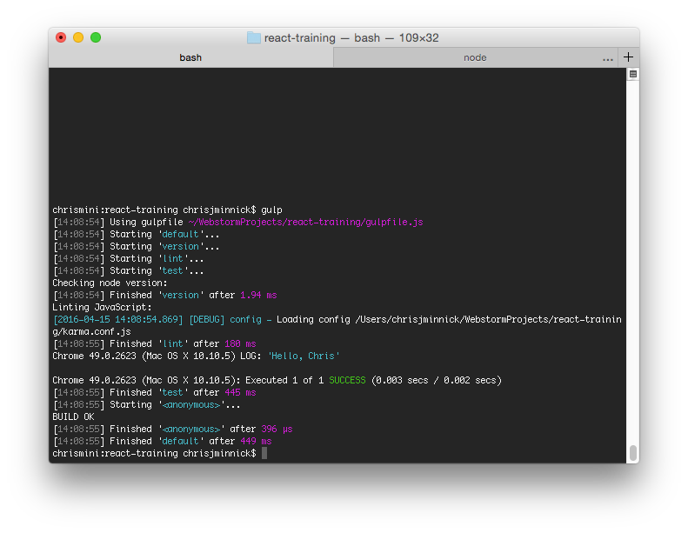
Lab 14: Transpiling with Babel

Slide 147
Lab 15: Converting to ES6
export function greet(name) { return "Hello, " + name; };
import * as sayHello from './sayHello.js';

Slide 148
Chapter 8: The Document Object Model
Objectives
Understand how the DOM works
Select DOM nodes
Manipulate the DOM with JavaScript

Slide 149
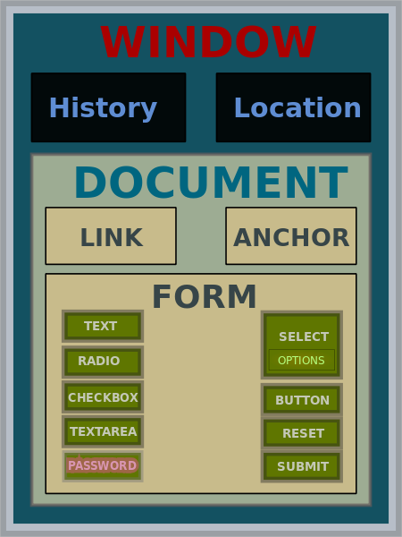
What is the DOM?
JavaScript API for HTML documents
Represents elements as a tree structure
Objects in the tree can be addressed and manipulated using methods.
JohnManuel [GFDL (http://www.gnu.org/copyleft/fdl.html) or
CC BY-SA 3.0 (http://creativecommons.org/licenses/by-sa/3.0)],
via Wikimedia Commons

Slide 150
Understanding Nodes
DOM interfaces that inherit from Node
Document
Element
CharacterData
Text
Comment
DocumentType
Nodes inherit properties from EventTarget

Slide 151
EventTarget
An interface implemented by objects that can receive events (aka event targets)
Examples:
Element
Document
Window
Many event targets support setting event handlers.

Slide 152
DOM Events
Things that happen in the DOM
abort
beforeinput
blur
click
compositionend
compositionupdate
dblclick
error
focus
focusin
focusout
input
keydown
keyup
load
mousedown
mouseenter
mouseleave
mousemove
mouseout
mouseover
mouseup
resize
scroll
select
unload
wheel

Slide 153
Other Events
Many interfaces implement events or inherit events.
Visit http://developer.mozilla.org/en-US/docs/Web/Events.

Slide 154
Element
Interface for elements within a Document
Inherits properties and methods from Node and EventTarget
Most common properties:
innerHTML
attributes
classList
id
tagName
Most common methods
getElementById
addEventListener
querySelectorAll

Slide 155
Manipulating HTML with the DOM
You can get and set properties of HTML elements with JavaScript through the DOM
//starting HTML and DOM Element
<p id="favoriteMovie">The Matrix</p>
<script>
getElementById("favoriteMovie")
.innerHTML = "The Godfather";
</script>
//updates DOM, which updates the browser
<p id="favoriteMovie">The Godfather</p>

Slide 156
Manipulating HTML with the DOM
<ol id="favoriteSongs">
<li class="song"></li>
<li class="song"></li>
<li class="song"></li>
</ol>
<script>
var mySongs=document
.querySelectorAll("#favoriteSongs .song");
mySongs[0].innerHTML = "My New Favorite Song";
</script>

Slide 157
Manipulating HTML with JQuery
<ol id="favoriteSongs">
<li class="song"></li>
<li class="song"></li>
<li class="song"></li>
</ol>
<script>
$("#favoriteSongs .song").first()
.html("My New Favorite Song");
</script>

Slide 158
Manipulating HTML with React
<div id="favoriteSongs"></div>
<script>
class FavoriteSongs extends React.Component({
render() {
return (
<ol>
<li className="song">{this.props.song}</li>
<li className="song"></li>
<li className="song"></li>
</ol>
);
}
});
ReactDOM.render(<FavoriteSongs song="My New Favorite Song" />, document.getElementById('favoriteSongs'));
</script>

Slide 159

Chapter 9: Introduction to React.js
Objectives
Understand React
Explore the Virtual DOM
Explain one-way data binding
Create React Components
Manage state

Slide 160
What is React.js?
A JavaScript library for building UIs
Wraps an imperative API (DOM) with a declarative one
Is comperable to Angular Directives
Can be plugged into a framework's component technology
Doesn't have to be used with MVC

Slide 161
Imperative API vs. Declarative API
Imperative
Focuses on the steps to complete a task
Example:
Walk to the stairs
Walk down stairs
Go to the kitchen
Open refrigerator
Take out salami, cheese, mustard
Put salami, cheese, mustard on bread
Declarative
Focuses on what to do without saying how
Bring me a sandwich.
Notes:
If you want to instruct your robot to make you a sandwich, there are two ways you can ask it. If your robot knows how to make a sandwich, you can use a declarative approach and simply say "Bring me a sandwich." The robot knows the steps it must do to bring you a sandwich and you don't car how the robot does it, as long as you get a sandwich. If the robot doesn't know how to make a sandwich, you can't use the declarative approach to requesting a sandwich. Instead, you'll need to give imperative instructions.

Slide 162
Imperative vs. Declarative Screen Updates
Imperative
Change the greeting to: "Dear Mr. Smith,”
Change the beginning of the first paragraph to "We are pleased to”
Changing the closing to "Sincerely,”
Declarative
Make it look like this:
Dear Mr. Smith,
We are pleased to inform you that you have been selected!
Sincerely,
The Management

Slide 163
Key Points
One-way data flow
A component can't modify properties passed to it.
Virtual DOM
Manages HTML DOM updates
JSX
Easy XML template language.
Not just for browser output
Architecture can apply to native apps, canvas

Slide 164
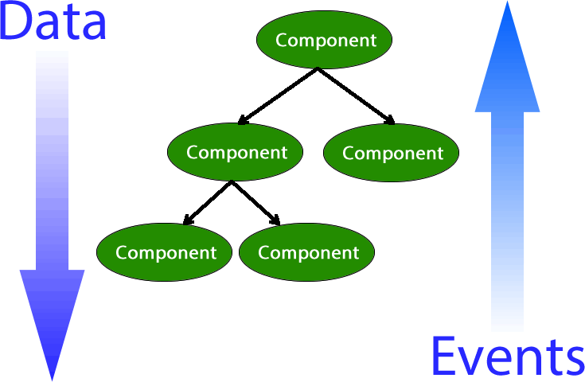
One-way Data Flow
Each UI element represents one component
All data flows from owner to child
Notes:
React takes a different approach to updating the UI than other libraries and frameworks. Traditionally, the way we implement a dynamic UI is to use two-way binding. In two-way binding, changes to the state of the user interface components (html) trigger changes in the model and vice-versa.
In one-way data flow (aka one-way data binding), as implemented by React, the only way to update the user interface is by using the render() function. In other words, typing into an input field in a React application doesn't actually do anything to the input field. It triggers a function in a component which causes the browser to be updated and the text to appear in the input field.
The benefit of one-way data flow is that it makes it much easier to understand what's going on in your applications. You can think of every change to the user interface as being a complete refresh of the browser window, even though this isn't necessary because of React's Virtual DOM.

Slide 165
Virtual DOM
Virtual DOM is updated (in memory) as the state of the data model changes.
React calculates the difference between the Virtual DOM and the real DOM.
React updates only what needs to be updated in the DOM.
Batches changes
Notes:
The virtual dom is what makes React performant. Without it, the browser DOM would update with each change, which would be pretty distracting. For example, imagine if the whole page refreshed each time you typed a letter into an input. This is what's happening in the virtual dom, but it happens in-memory and is very fast. The difference between this re-render of the virtual dom and the previous render of the virtual dom is calculated by React and the minimal changes to the browser DOM are made.

Slide 166
Virtual DOM vs. HTML DOM
Virtual DOM is a local and simplified copy of the HTML DOM
(It's an abstraction of an abstraction)
The goal of the Virtual DOM is to only re-render when the state changes.
This makes it more efficient than direct DOM manipulation.
Developers can write code as if the entire tree is being re-rendered.
This makes it easier to understand.
Behind the scenes, React/Virtual DOM works out the details and creates a patch for the HTML DOM, which causes the browser to re-render the changed part of the scene.

Slide 167
State Machines
React thinks of UIs as being simple state machines.
A state machine has:
An initial state or record of something stored someplace
A set of possible input events
A set of new states that may result from the input
A set of possible actions or output events that result from a new state

Slide 168
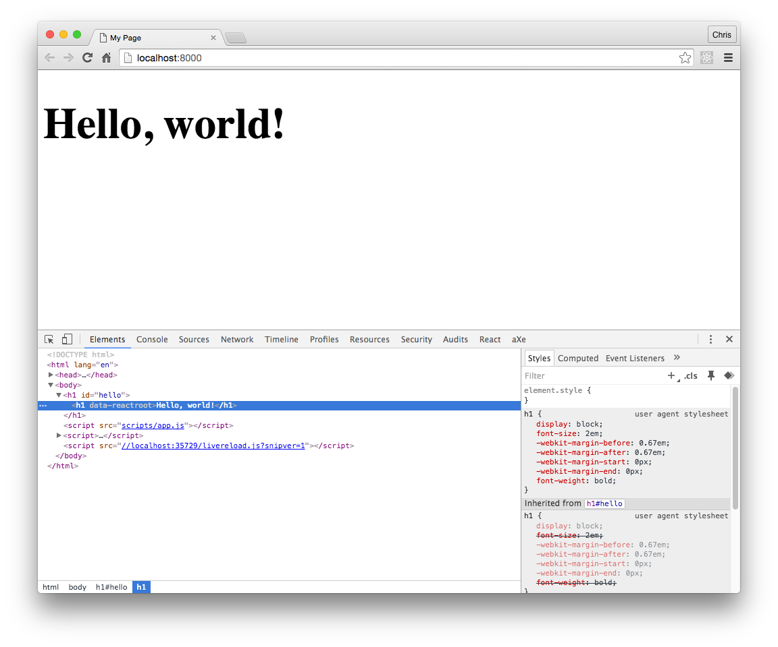
Lab 16, Part 1: Hello React!

Slide 169
Understanding Components
Created by extending React.Component
Returns a single element OR an Array of elements (as of v16)
May contain nested elements, however.
You can have multiple instances of components
For example, you might have components called NavButton or Invitee
An element describes a component and tells React what you want to see on screen.
Components should be reusable as well as composable.

Slide 170
React.render()
fn(d) = V
Give the function data and you get a View.
Return value must
be a single element:
return (<div><p><em></em></p></div>); = correct
return (<div></div><p></p>); = error
or a fragment
return (<> <h1>this is cool</h1> <h2>this too</h2> as of React 16.2<> );
or an array with unique key values
return [ <li key="1">item 1</li> <li key="2">item 2</li> ];
or a string
return "this is totally valid too";
Notes:
The basic pattern behind everything that happens in react is that a function takes data and generates a view. Every component is required to have a render method.

Slide 171
ReactDOM
React package for working with the DOM
Generally only needed at the top level of your application.
Methods
findDOMNode
render
unmountComponentAtNode
Removes a mounted component from the DOM and cleans up its event handlers and state.
react-dom/server
For rendering static markup on the server.
ReactDOMServer.renderToString()
ReactDOMServer.renderToStaticMarkup()
Notes:
Prior to v0.14 (October 2015), ReactDOM was part of React. Its only job is to serve as the glue between React and the DOM.

Slide 172
ReactDOM.findDOMNode
findDOMNode(component)
If the component has been mounted, returns the corresponding native browser DOM element

Slide 173
ReactDOM.unmountComponentAtNode
Removes a mounted component from the DOM and cleans up its event handlers and state
React.unmountComponentAtNode
(document.getElementById('container'));

Slide 174
ReactDOM.render
ReactDOM.render(reactElement, domContainerNode)
Renders a reactElement into the DOM in the supplied container
Replaces any existing DOM elements inside the container node when first called
Later calls using DOM diffing algorithm for efficient updates

Slide 175
React Development Process
Break the UI into a component hierarchy
Build a static version in React using props
Props pass data from parent to child
Identify the minimal representation of UI state
Identify where your state should live
Add inverse data flow

Slide 176
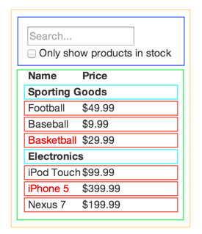
Step 1 - Break up the UI
var PRODUCTS = [
{category: 'Sporting Goods', price: '$49.99', stocked: true, name: 'Football'},
{category: 'Sporting Goods', price: '$9.99', stocked: true, name: 'Baseball'}
];
Notes:
First, make a mockup of your UI. Then, draw boxes around each component and sub-component. Follow the single responsibility principle: each component should do only one thing. If it does more than one thing, it probably should be split into subcomponents.
Your UI should map to your data model. If you're using JSON data, this should be easy. Each component should be one piece of the data model.

Slide 177
Step 2 - Static Version
Render the UI from the data model with no interactivity
Goal is to have a library of reusable components that render the data model
class ProductCategoryRow extends React.Component({
render () {
return (
<tr>
<th colSpan="2">
{this.props.category}
</th>
</tr>
);
}
});

Slide 178
Step 3 - Minimal UI State
Is it state?
Is it passed from the parent via props?
Probably not state
Does it change over time?
Might be state
Can you compute it based on any other state or props in your application?
Probably not state

Slide 179
Step 4 – Where Should Your State Live?
For each piece of state:
Identify every component that renders something based on that state.
Find a common owner component
The common owner or a component higher in the hierarchy should own the state.
If you can't find a common owner, create a new component higher up in the hierarchy just for holding the state.

Slide 180
Step 5 – Add Inverse Data Flow
Use a function to update state in components higher up in the hierarchy.

Slide 181
Props vs. State
Props
State
Passed to the child within the render method of the parent
Immutable
Better performance
State of the parent becomes prop of child
Mutable
Notes:
You can think of props as options passed to components. Components should never modify props.
Instead, state should be modified and passed to child components, where it becomes props.
State should never be accessed by child components.
Most components should simply take data from props and render it.
In a well-designed app, you should have more stateless components than stateful ones.

Slide 182
Setting Initial State
class MyComponent extends React.Component {
constructor() {
this.state = { /* some initial state */ }
}
Notes:
The constructor function runs when a class is instantiated. Therefore, this is the place where we can initialize the state for a component. Generally, you'll only set the initial state in one component, typically the highest level (or container) component. When this state object changes, it will cause ReactDOM to re-render the component (and it's children) in the virtual DOM and then calculate the updates that are required in the browser DOM and make them.

Slide 183
super()
Used for calling methods on the parent.
ES6 classes must call super() if they are subclasses.
If you don't have a constructor, you don't need to call super(). React will automatically make this.props available to the subclass.
If you want to use this.props in your constructor, you need to call super(props) in the constructor.

Slide 184
Using super()
class App extends React.Component {
render() {
return(
<GameContainer
game="Pac-Man"
username="Chris" />
);
}
}

Slide 185
Using super() (cont)
class GameContainer extends React.Component {
constructor(props) {
super(props);
this.state = {
currentGame: props.game,
playerName: props.username
}
}
render() {
return(<div>Welcome to
{this.state.currentGame},
{this.state.username});
}
}

Slide 186
Lab 16, Parts 2-3: Your first component

Slide 187
Chapter 10: JSX
Objectives
Know how to write JSX
Use React with JSX
Use React without JSX

Slide 188
What is JSX?
Preprocessor that adds XML syntax to JavaScript.
Takes XML input and produces native JavaScript.

Slide 189
JSX is not exactly HTML
You can use HTML entities within JSX text
<div>&copy; all rights reserved</div>
React will not render properties on HTML elements that don't exist in the HTML spec.
preface custom properties with data-
<div data-custom-attribute="foo" />
Arbitrary attributes are supported on custom elements
<x-my-component custom-attribute="foo" />

Slide 190
JSX is not exactly HTML (cont)
XML syntax required
Elements must be closed
Attributes use DOM property names
className instead of class
Attributes become props in the child
React components start with upper-case
HTML tags start with lower-case

Slide 191
Using React with JSX
class LoginBox extends React.Component{
render() {
return (
<div>
<label>Log In <input type="text" id="username"
placeholder={this.props.placeholderText} />
</label>
</div>
);
}
};
ReactDOM.render(<LoginBox placeholderText="Enter Your Email" />, document.getElementById("login"));
Notes:
When you use html tags in JSX, you're not actually writing HTML -- instead, you're instantiating React components that get rendered to HTML. For example, the div tags here are actually using the React div component.
You don't need to always return basic HTML. You can return a tree of components containing react components as well as HTML elements.
Inside the React.render method, you can access props (and run any JavaScript) inside of curly braces. For example, to access the placeholderText prop passed in from the ReactDOM.render method here, you use {this.props.placeholderText}.
ReactDOM.render instantiates the root component, starts the framework, and injects the markup into the DOM element indicated by its second argument.

Slide 192
Using React without JSX
...
render() {
return React.createElement("div",null,
React.createElement("label",null,"Log In",
React.createElement("input",
{ type: "text", id: "username" })
)
);
}
});
ReactDOM.render(React.createElement(LoginBox, null), document.getElementById("login"));
Notes:
You can use plain JavaScript instead of JSX, although JSX syntax makes your views much easier to write and easier to visualize -- especially when nesting elements.

Slide 193
Expressions in JSX
Use curly braces around JavaScript expressions to include them in JSX.
return(
<HelloWorld
name={this.props.firstname +
this.props.lastname} />
<div>
{isLoggedIn ? <Logout /> : <Login />}
</div>;
);
Notes:
Example: http://jsbin.com/logudef/1

Slide 194
Expressions in JSX
class Logout extends React.Component{
render() {
return (<div>logout</div>);
}
};
class Login extends React.Component{
render() {
return(<div>login</div>);
}
};
class Container extends React.Component{
render() {
return(
<div>
{this.props.isLoggedIn ? <Logout /> : <Login />}
</div>);
}
};
ReactDOM.render(<Container isLoggedIn={false} />, document.getElementById("app"));

Slide 195
Precompiled JSX
Two ways to use JSX
Compile to JavaScript during build
Use Babel
Serve JSX and compile in the browser
Use JSXTransformer
Intended only for prototypes
Deprecated
Notes:
Before it can be rendered by ReactDOM, JSX must be converted to JavaScript. This is done during the building of your application by Babel. Facebook created a JSXTransformer that will do the transform in the browser, but this method is not recommended for production sites since it adds a step to the rendering process.

Slide 196
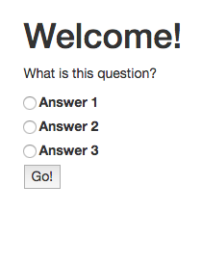
Lab 17 - HTML to JSX
Convert an HTML mockup to static React components

Slide 197
Chapter 11: React Components
Objectives
Understand component life-cycle
Use events and dispatching
Communicate between components
Test React components

Slide 198
Creating Components
Two techniques
React.createClass
React.Component
React.Component is the ES6 way.
React.createClass is deprecated as of v15.5.0.

Slide 199
React.createClass
createClass(object specification)
Creates a component, given a specification.
Implements a render method
render method is required.
render returns one single child.
Can be a virtual representation of a DOM component or another component that you've created
may have a deep child structure
Is still available for React 16+ as create-react-class

Slide 200
React.Component
Base class for React Components when defined using ES6 classes.
class HelloMessage extends React.Component {
render() {
return <div>Hello {this.props.name}</div>;
}
}
ReactDOM.render(<HelloMessage name="Ann" />, mountNode);

Slide 201
React.createElement
createElement(
string/ReactClass type,
[object props],
[children …]
)
Create and return a new ReactElement of the given type.
Type argument can be an HTML tag name string ('div', 'span', etc.), or a React Class (created via React.createClass).
JSX gets compiled to React.createElement
Notes:
If you're using JSX, you may not have much need for React.createElement, but this is what's used behind the scenes.

Slide 202
Communication Between Components
Parent to Child
pass props
Ref functions
Call a method in a child component from the parent component
this.refs.<ref name>.<function name>

Slide 203
props
Props are passed from the parent component to its children
JSX attributes become a single object in the child.
Parent:
<Hello name="Chris" />
Child:
class Hello extends React.Component {
render() {
return (<h1>Hello, {this.props.name}</h1>);
}
}

Slide 204
Communication Between Components (cont.)
Child to Parent
Callback Functions
Parent passes a function to a child
<MyChild myFunc={this.handleChildFunc.bind(this)} />
Child calls the function
this.props.myFunc();
Event Bubbling
Parent can capture DOM events that happen in children.
class ParentComponent extends React.Component {
render() {
return (
<div onKeyUp={this.handleKeyUp.bind(this)}>
// Any number of child components can be added here.
</div>
);
}
handleKeyUp(event) {
// This function will be called for the 'onkeyup' event in any <input/>
// fields rendered by any of my child components.
}
}

Slide 205
Communication Between Components (cont.)
Between Siblings
Use a parent component.
Any to Any
Observer Patterns
Components subscribe to messages.
Other components publish messages to subscribers.
Subscribe in componentDidMount
Unsubscribe in componentWillUnmount
Can use a library such as EventEmitter (https://github.com/Olical/EventEmitter)
Context
Provides data to an entire subtree
https://facebook.github.io/react/docs/context.html
Global Variables
Best not to use.

Slide 206
Using refs
refs can be used to get access to a DOM node or to an instance of a component.
...
update(e){
this.setState(
{message:this.refs.message.value}
);
}
...
render(){
return(
<div>
<input type="text" ref="message"
onChange={this.update.bind(this)} />
</div>
);
}

Slide 207
Ref Callback
A special attribute you can attach to any component
Takes a callback function
The callback will be executed immediately after the component mounts or unmounts.
When used on an HTML element, the ref callback receives the underlying DOM node as its argument.

Slide 208
Communicating Parent > Child with Ref
class TheChild extends React.Component {
myFunc() {
return 'hello';
}
}
class TheParent extends React.Component {
render() {
return (
<TheChild ref='foo' />
);
}
componentDidMount() {
var x = this.refs.foo.myFunc();
// x is now 'hello'
}
}
Notes:
Ref functions are another way to communicate with a child from a parent.
Simply write a method in the child component, and call that method from the parent component using this.refs.<ref name>.<function name>. A simple example:

Slide 209
React.createRef
As of React 16.3, you can create refs using React.createRef
class MyComponent extends React.Component {
constructor(props) {
super(props);
this.myRef = React.createRef();
}
render() {
return <div ref={this.myRef} />;
}
}

Slide 210
When to Use Refs
Managing focus, text selection, or media playback.
Triggering imperative animations.
Integrating with third-party DOM libraries.
Avoid using refs for anything that can be done declaratively.

Slide 211
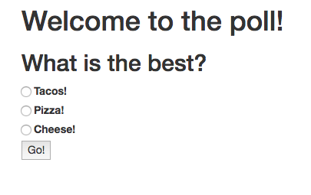
Lab 18: Passing Props

Slide 212
Styles in React
Facebook recommends using inline styles, set using JavaScript.
Pass styles into JSX using objects containing style properties.
Properties are camelCased versions of the CSS properties.
var headingStyle = {
color: "blue",
textTransform: "uppercase"
};
return (<h1 style={headingStyle}>
Welcome!</h1>);

Slide 213
Styled Components
import styled from 'styled-components';
Call styled.[object] function, passing in style info using Tagged Template Literal Notation.
const Title = styled.h1`
font-size: 1.5em;
text-align: center;
color: palevioletred;
`;
<Title>This is a styled component</Title>

Slide 214
Styles in React
Other ideas
Radium
Resolves nested objects and allows use of media queries and other complicated styling needs.
CSS Modules
Create separate style modules and import and use them in components.
Use a CSS library (Bootstrap) for layout, inline for presentation.
How to do CSS in React is still very much being worked out.
Lots of opinions
Big question: Should we even need to know CSS?

Slide 215
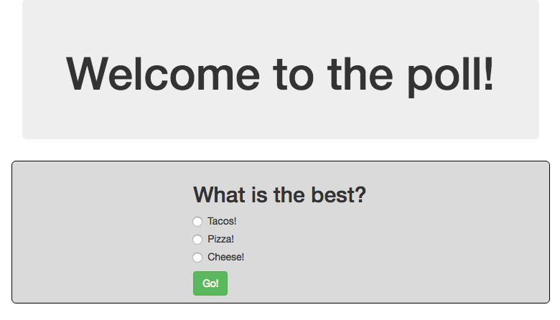
Lab 19: Style in React

Slide 216
Forms
Objectives
Use Controlled Components
Use Uncontrolled Components

Slide 217
Forms Have State
They are different from other native components because they can be mutated based on user interactions.
Properties of Form components
value
supported by <input> and <textarea>
checked
supported by <input type="checkbox | radio" />
selected
supported by <option>
<textarea> should be set with value attribute, rather than children in React

Slide 218
Form Events
Form components allow listening for changes using onChange
The onChange prop fires when:
The value of <input> or <textarea> changes.
The checked state of <input> changes.
The selected state of <option> changes.

Slide 219
Controlled Components
A controlled <input> is one with a value prop.
User input has no effect on the rendered element.
To update the value in response to user input, you can use the onChange event.
Controlled vs. Uncontrolled Demo:
https://goo.gl/wMMbVc

Slide 220
Uncontrolled Components
An <input> without a value property is an uncontrolled component.
render() {
return <input type="text" />;
}
User input will be reflected immediately by the rendered element.
Maintains its own internal state

Slide 221
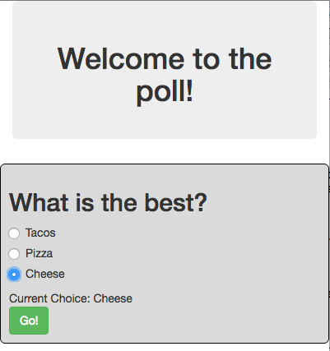
Lab 20: Controlling the Form

Slide 222
Component Design

Slide 223
F.I.R.S.T.
React Components should be:
Focused
Independent
Reusable
Small
Testable

Slide 224
Single Responsibility
A component should only do one thing.
If it ends up growing, it should be decomposed into smaller subcomponents.
A responsibility is a "reason to change."
Single responsibility makes components more robust.
"A class should have only one reason to change.
-Robert C. Martin

Slide 225
When a component is a result of props alone (no state), it can be written as a pure function.

Slide 226
Pure Functions
Pure functions always return the same result given the same arguments.
Pure function's execution doesn't depend on the state of the application.
Pure functions don't modify the variables outside of their scope (no side effects).

Slide 227
Function Comparison
slice()
splice()
var toppings = ['cheese','pepperoni','mushrooms'];
toppings.slice(0,2);
// ["cheese", "pepperoni"]
toppings.slice(0,2);
// ["cheese", "pepperoni"]
toppings.slice(0,2);
// ["cheese", "pepperoni"]
Always returns the same result given the same arguments
Doesn't depend on the state of the application
Doesn't modify variables outside its scope
It's a Pure Function!
var toppings = ['cheese','pepperoni','mushrooms'];
toppings.splice(0,2);
// ["cheese", "pepperoni"]
toppings.splice(0,2);
// ["mushrooms"]
toppings.splice(0,2);
// []
Not Pure!
Notes:
With a non-pure function, the state matters in what result is produced.

Slide 228
Benefits of Pure Functions
Easy to test
Easy to reason about
Easy to reuse
Easy to reproduce the results
Notes:
Pure functions make thinking about your program easier because you don't have to know the current state when the function is called. You know that each time the function is called with the same arguments, you'll get the same result.
This also makes pure functions easy to test because you don't need to mock and assert the state of your app before each test. You just give them input and assert the output.
They're also easy to reuse

Slide 229
React.PureComponent
If your Component returns the same result given the same props and state, use React.PureComponent
PureComponent does a shallow state and prop comparison and doesn't update if the component is unchanged.
May give a performance boost
class MyComponent extends React.PureComponent {
...
}

Slide 230
Stateless Functional Components
If your component only has a render method and optional props, you can just create a normal JavaScript function.
function HelloWorld(props){ return ( <p>Hello {props.name}</p> ); }
reactDOM.render(<HelloWorld name='Chris' />, document.getElementById("app"));

Slide 231
React.memo
Works the same as React.PureComponent, but for functional components.
const MyComponent = React.memo(
function MyComponent(props) {
...
});

Slide 232
Lab 21: Refactoring the App

Slide 233
Component Life-Cycle Events
2 Categories
Mount / Unmount
When component receives new data

Slide 234
Life-Cycle Methods
Methods of components that allow you to hook into views when specific conditions happen.

Slide 235
Mount/Unmount
Mount and unmount methods are called when components are added to the DOM (Mount) and removed from the DOM (Unmount).
Each is invoked only once in the lifecycle of the component
Used for:
establish default props
set initial state
make AJAX request to fetch data for component
set up listeners
remove listeners

Slide 236
Mount/Unmount Life-Cycle Methods
constructor
componentDidMount
componentWillUnmount

Slide 237
Data Life-Cycle Methods
getDerivedStateFromProps
shouldComponentUpdate
getSnapshotBeforeUpdate
componentDidUpdate

Slide 238
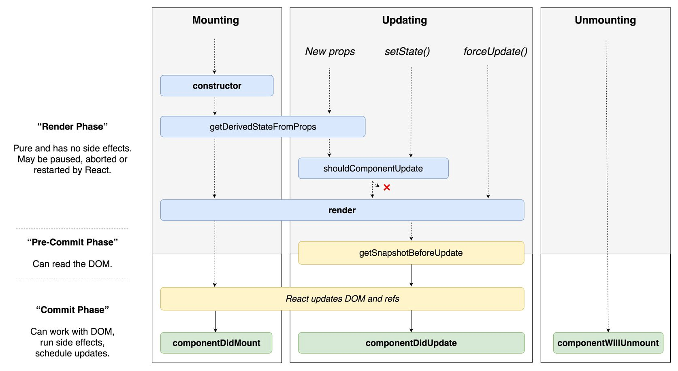
Component Life Cycle

Slide 239
Events
SyntheticEvent
A cross-browser wrapper around the browser's native event
Same interface as browser's native event
class ShareButton extends Component ({
onButtonClick (evt) {
alert("wow!");
}
render () {
return (
<div onClick={this.onButtonClick}>Share!</div>
);
}
});

Slide 240
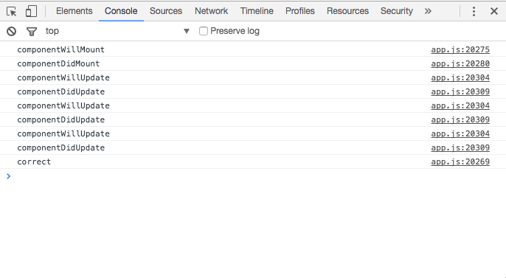
Lab 22: Life Cycle and Events

Slide 241
Higher Order Functions
A function that can take another function as an argument and/or that returns a function as a result.
const multiplyBy = (multiplier) => (number) => number * multiplier
const double = multiplyBy(2); // returns (number) => number * 2
double(10) // returns 20

Slide 242
Higher Order Components
A function that takes (wraps) a component and returns a new component.
Allow us to abstract over actions, not just values.
const EnhancedComponent = higherOrderComponent(WrappedComponent);

Slide 243
Context API
Context allows parents to pass data implicitly to children, no matter how deep the component tree is.

Slide 244
Using Context with Provider
const ColorContext = React.createContext('color');
class ColorProvider extends React.Component {
render(){
return (
<ColorContext.Provider
value={'red'}>
{ this.props.children }
</ColorContext.Provider>
)
}
}
class Parent extends React.Component {
render(){
return (
<ColorProvider>
<Child />
</ColorProvider>
);
}
}

Slide 245
Render Props
Allows you to use props to share code between two components.
class App extends React.Component {
getChildContext() {
return {
color: 'red'
}
}
render() {
return <Button />
}
}
App.childContextTypes = {
color: React.PropTypes.string
}
// Hook 'Color' into 'App' context
class Color extends React.Component {
render() {
return this.props.render(this.context.color);
}
}
Color.contextTypes = {
color: React.PropTypes.string
}
class Button extends React.Component {
render() {
return (
<button type="button">
{/* Return colored text within Button */}
<Color render={ color => (
<Text color={color} text="Button Text" />
) } />
</button>
)
}
}
class Text extends React.Component {
render(){
return (
<span style={{color: this.props.color}}>
{this.props.text}
</span>
)
}
}
Text.propTypes = {
text: React.PropTypes.string,
color: React.PropTypes.string,
}

Slide 246
Composition
Composition is combining smaller components to form a larger whole.

Slide 247
Reusable Components
Break down the common design elements (buttons, form fields, layout components, etc.) into reusable components with well-defined interfaces.
The next time you need to build some UI, you can write much less code.
This means faster development time, fewer bugs, and fewer bytes down the wire.

Slide 248
Presentational Components
Components that just output presentation
Contain no logic

Slide 249
Container Components
Wrap presentational components
Contain the logic and state

Slide 250
PropTypes
Allows you to add type to props
Useful for debugging, documentation
Types:
array
object
string
number
bool (not boolean)
func (not function)
node
element

Slide 251
Using PropTypes
import React from 'react';
import PropTypes from 'prop-types';
class Component extends React.Component {
...
}
Component.propTypes = {
name: PropTypes.string.isRequired,
size: PropTypes.number.isRequired,
color: PropTypes.string.isRequired,
style: PropTypes.object
};
Notes:
As of React 15.5.0, PropTypes is a separate package. Install prop-types, (npm install prop-types --save-dev) and import the package before using. Proptypes only display when using the development build of React.

Slide 252
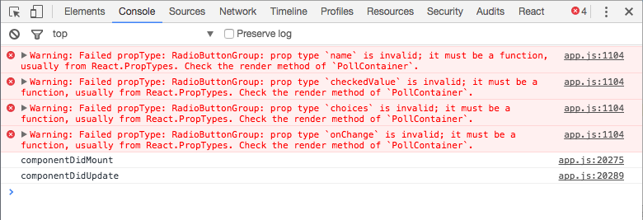
Lab 23: PropTypes

Slide 253
Testing React Components
Objectives
Learn about different rendering modes
Learn about Jest
Write Unit Tests with Jest

Slide 254
What to Test in a React Component
Does it render?
Does it render correctly?
Test every possible state / condition
Test the events
Test the edge cases

Slide 255
Jest
Facebook's Testing Framework
Runs any tests in __tests__ directories, or named .spec.js, or named .test.js
Simulates browser environment with jsdom
Vastly improved and simplified in recent versions

Slide 256
Mocking
Mock Function - erase the implementation of a function
Manual Mocking - stub out functionality with mock data
Timer Mocking - swap out native timer functions

Slide 257
Mock Function
const mockCallback = jest.fn();
forEach([0, 1], mockCallback);
// The mock function is called twice
expect(mockCallback.mock.calls.length).toBe(2);
// The first argument of the first call to the function was 0
expect(mockCallback.mock.calls[0][0]).toBe(0);
// The first argument of the second call to the function was 1
expect(mockCallback.mock.calls[1][0]).toBe(1);

Slide 258
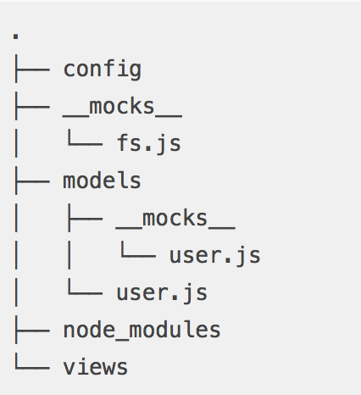
Manual Mock
Ensures tests will be fast and reliable by mocking external data and core modules.
Define in a __mocks__ subdirectory adjacent to the module

Slide 259
Manual Mocks (cont)
Recommended practice is to create an automatic mock and then override it.
See https://github.com/facebook/jest/tree/master/examples/manual_mocks for examples of manual mocks and tests that use them.

Slide 260
Automocking
Disabled by default, but can be used on a per-module basis
jest.mock(moduleName)
Enable automock by default in jest.config
automock:true

Slide 261
Snapshot Testing
Renders a components
Creates a "snapshot file" on first run
Compares subsequent runs with first and fails test if different.

Slide 262
Sample Snapshot Test
import React from 'react';
import Link from '../Link.react';
import renderer from 'react-test-renderer';
it('renders correctly', () => {
const tree = renderer.create( <Link page="http://www.facebook.com">Facebook</Link>
).toJSON();
expect(tree).toMatchSnapshot(); });

Slide 263
TestUtils
renderIntoDocument()
mockComponent()
isElement()
isElementOfType()
isDomComponent()
isCompositeComponent()
isCompositeComponentWithType()
findAllInRenderedTree()
more...
NOTE: TestUtils has been moved into react-dom as of v15.5.0 (April 2017)

Slide 264
TestUtils Example
Old (pre-15.5.0):
import TestUtils from 'react-addons-test-utils';
New (15.5.0):
import TestUtils from 'react-dom/test-utils';

Slide 265
Enzyme
Testing utility for React, created by AirBnB
3 render modes
shallow
render just the component
mount (Full Rendering)
For testing where you have components that require the full lifecycle in order to test.
Need to run in a browser environment.
render
renders react components to static HTML
To use, pass a React component into a mode method.
const wrapper = shallow(<PollSubmitButton />);

Slide 266
Shallow Rendering
Renders just a single component, regardless of where it is in the hierarchy.
Allows you to isolate components for testing.
Ensure that your tests are indirectly asserting on behavior of child components.

Slide 267
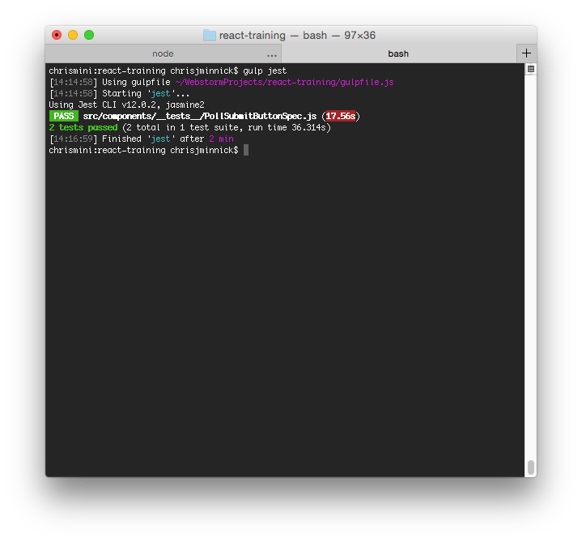
Lab 24: Testing React Components

Slide 268
Lab 24.5: Testing with Jest and Enzyme
npm install --save-dev enzyme enzyme-adapter-react-16
Put this at the top of your test files
import { shallow, mount, render } from 'enzyme';
Create src/setupTests.js with the following code:
// setup file
import { configure } from 'enzyme';
import Adapter from 'enzyme-adapter-react-16';
configure({ adapter: new Adapter() });
Add this to package.json
"jest": { "setupTestFrameworkScriptFile": "<rootDir>/src/setupTests.js" }

Slide 269
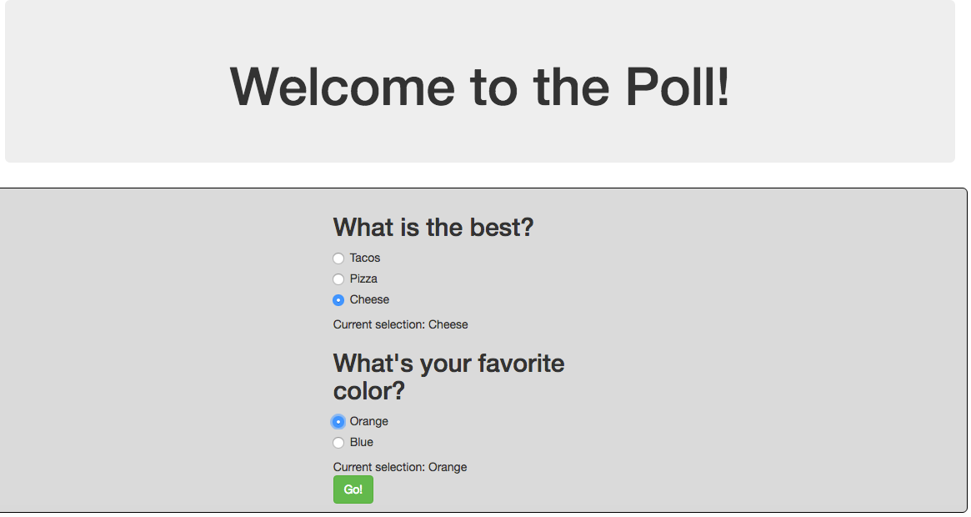
Lab 25: Multiple Components
Display a list of questions and track the state of each group of radio buttons separately.

Slide 270
React Router
Declarative way to do routing
Maps components to URLs
Dynamic routing (as of v4)
Routing takes place as the component is rendering
Not in a configuration
Almost everything in React Router is a component

Slide 271
Using React Router
Import the version of React Router for your target environment (i.e. DOM or Native), plus other components
import { BrowserRouter, Route, Link } from 'react-router-dom'
Render the Router
ReactDOM.render((
<BrowserRouter> <App/> </BrowserRouter> ), holder)
Use <Link> to link to a new location (in <App> in this case)
<Link to="/dashboard">Dashboard</Link>
Render a Route (also in <App>)
<Route path="/dashboard" component={Dashboard}/>

Slide 272
Router Rendering Example
index.js
import { BrowserRouter } from 'react-router-dom';
ReactDOM.render((
<BrowserRouter>
<App/>
</BrowserRouter>
), holder)
Use BrowserRouter when you have a server
Use HashRouter if you're using a static file server.

Slide 273
Route Matching
Route
Compares the value of the path prop to the current location's pathname.
Renders the component specified by the component prop.
Can be used anywhere you want to render based on location.
Switch
Can be (optionally) used for grouping Routes. Will iterate through a group and stop when a match is found.

Slide 274
Navigation
<Link>
Creates links in your application.
Inserts an <a> in your HTML
<NavLink>
Can be styled as "active" when it matches the current location.
<Redirect>
Forces navigation

Slide 275
Lab 26: React Router 3.x
Use React Router to change the UI based on the URL

Slide 276
Lab 27: React Router 4.x
Use React Router to change the UI based on the URL

Slide 277
Chapter 12: Flux and Redux
Objectives
Understand the Flux pattern
Explain Redux's architecture
Create Redux actions
Write pure functions
Use Reducers
Use Redux with AJAX

Slide 278
Flux
Flux isn't a library or module.
It's a design pattern.
npm install flux installs Facebook's dispatcher.
It's possible to use Flux design principles without Facebook's module.

Slide 279
Flux Flow
Some sort of interaction happens in the view.
This creates an action, which the dispatcher dispatches.
Stores react to the dispatched action if they're interested, updating their internal state.
Stateful view component(s) hear the change event of stores they're listening to.
Stateful view component(s) ask the stores for new data, calling setState with the new data.

Slide 280
Flux Action
An action in flux is what's made when something happens.
In other words, when you click on something, that's not an action
it creates an action. Your click is an interaction.
Actions should have (but aren't required to have) a type and a payload. Most of the time they will have both, occasionally they'll just have a type.

Slide 281
Flux Dispatcher
Broadcasts actions when they happen and it lets things tune in to those broadcasts
Instead of an onClick function using a callback passed to it to set the state of your application, you have it (onClick) use the dispatcher to dispatch a specific action for anyone who's interested to listen for.

Slide 282
Flux Stores
Represents the ideal state of your application
If a user enters something into a form, it dispatches an action. If the store is listening for this action, it will update its internal state accordingly.
Stores don't contain any public setters, just public getters. The only ones who can change the data in a store is the store itself when it hears an action from the dispatcher that it's interested in.

Slide 283
EventEmitter
Stores emit change events that don't contain data.
If the view is listening for the particular store's change event, the view should ask the store for the new data that will bring the view back into sync, call setState, and re-render.

Slide 284
Redux
An implementation of Flux
Stores state of the app in an object tree in a single store
The state tree can only be changed by emitting an action
Specify how the actions transform the state tree using pure reducers

Slide 285
Stores & Immutable State Tree
The biggest difference between Flux and Redux is that Redux has a single store.
Redux has a single store with a single root reducing function.
Split the root reducer into smaller reducers to grow the app.
Trace mutations by replaying actions that cause them.

Slide 286
Redux Actions
Payloads of information that send data from the application to the store.
Actions are the only way to mutate the internal state.
Use store.dispatch() to send them to the store.
const ADD_TODO = 'ADD_TODO'
{
type: ADD_TODO,
text: 'Build my first Redux app'
}

Slide 287
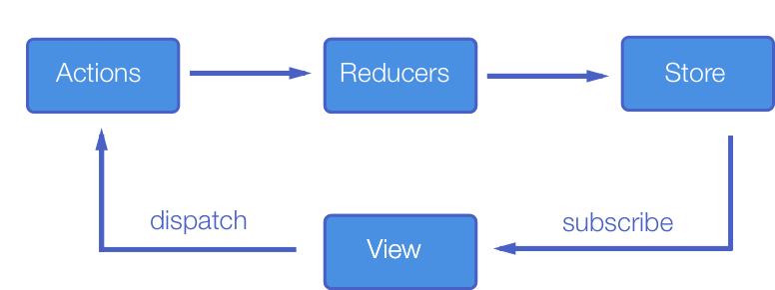

Slide 288
Reducers
Specifies how the application's state changes in response to something happening (an action).
A pure function that takes the previous state and an action, and returns the next state.
(previousState, action) => newState

Slide 289
Things You Should Never do in a Reducer
Mutate its arguments
Perform side effects like API calls and routing transitions
Call non-pure functions

Slide 290
Reducer Composition
The fundamental pattern of building Redux apps
Split up reducer functions using child reducers.
Workflow
Write top-level reducer to handle a particular function.
Break up the top-level reducer into a master reducer that calls smaller reducers to separate concerns.

Slide 291
Reducer Composition Example
function checkedValue(state = [], action) {
switch (action.type) {
case ‘SELECT_ANSWER’:
return state
.slice(0,action.index)
.concat([action.value])
.concat(state.slide(action.index+1));
default:
return state;
}
}
export default checkedValue;
function question(state = [], action) {
return state;
}
export default questions;

Slide 292
Reducer Composition Example (cont)
Combine reducers
const rootReducer = combineReducers({
questions,
checkedValue
});
Export default rootReducer;

Slide 293
Redux Store
Holds the application state
Allows access to state via getState()
Allows state to be updated via dispatch(action)
Registers listeners via subscribe(listener)
Handles unregistering of listeners via the function returned by subscribe(listener)

Slide 294
Redux Store Design
Many applications use data that is relational or "nested"
let orders = [
{
id:1,
customer:{id:20,name:"Wilma",address:""},
items:[{id:10,name:"Toaster",price:20}
}
]
Relational data mapped to objects can be complex and cause repetition.

Slide 295
Redux Store Design
Solution: Normalize part of your store, and treat it like a database.
Data normalization:
Each type of data gets its own "table" in the state.
Each "data table" should store the individual items in an object, with the IDs of the items as keys and the items themselves as the values.
Any references to individual items should be done by storing the item's ID.
Arrays of IDs should be used to indicate ordering.

Slide 296
Normalized Redux Store Example
{
orders : {
byId : {
"order1" : {id : "order1", customer : "customer1",
items: ["item1","item2"]},
"order2" : {id : "order2", customer : "customer1",
items: ["item1","item6"]}
},
allIds : ["order1", "order2"] },
customers : {
byId : {
"customer1" : { ... }
...
}

Slide 297
Benefits of Normalizing Store
Each item is defined in only one place
Simplifies Reducer logic (flatter structure)
Simplifies logic for retrieving and updating items
Because each data type is separated, updates to a single type of data require fewer components to be re-rendered

Slide 298
Redux Pros and Cons
Redux Pros
Redux Cons
Declarative
Immutable state
Mutation logic separate from views
Great for testing
More complicated than just using plain react components

Slide 299
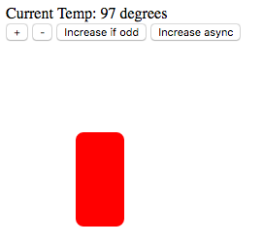
Lab 28: Redux Thermometer
Starting with the Redux counter example app (which is in the 'counter' folder inside the Redux examples that come with Redux), convert it into a thermometer / thermostat app with a graphical output.

Slide 300
Lab 29: Implementing Redux
Implement Redux to change the state of the radio buttons in the Poll Application.

Slide 301
React AJAX Best Practices
Four Ways
Root Component
Best for small apps and prototypes.
Container Components
Create a container component for every presentational component that needs data from the server.
Redux Middleware
Thunk Middleware
Saga
Relay
Good for large applications
Declare data needs of components with GraphQL
Relay automatically downloads data and fills out the props

Slide 302
What is Redux Middleware?
a third-party extension point between dispatching an action, and the moment it reaches the reducer.
Action
Reducer
Middleware

Slide 303
What is Middleware Good For?
Logging actions
Reporting errors
Dispatching new actions
Asynchronous requests

Slide 304
Using Redux Form
Higher order form for simplifying using forms with Redux.
Step 1:
import { createStore, combineReducers } from 'redux'
import { reducer as formReducer } from 'redux-form'
const rootReducer = combineReducers({
// ...your other reducers here
// you have to pass formReducer under 'form' key,
// for custom keys look up the docs for 'getFormState'
form: formReducer }
)

Slide 305
Redux Form, Step 2
import React from 'react'
import { Field, reduxForm } from 'redux-form'
let ContactForm = props => {
const { handleSubmit } = props
return <form onSubmit={handleSubmit}>
{/* form body*/}</form>
}
ContactForm = reduxForm({
// a unique name for the form
form: 'contact' })(ContactForm)
export default ContactForm

Slide 306
Redux Form, Step 3
Add <Field /> Components
let ContactForm = props => {
const { handleSubmit } = props
return (
<form onSubmit={handleSubmit}>
<div>
<label htmlFor="firstName">First Name</label>
<Field name="firstName" component="input" type="text" />
</div>
<button type="submit">Submit</button>
</form> )
}

Slide 307
Redux Form, Step 4
React to Submit
import React from 'react'
import ContactForm from './ContactForm'
class ContactPage extends React.Component {
submit = values => {
// print the form values to the console
console.log(values) }
render() {
return <ContactForm
onSubmit={this.submit} />
}
}

Slide 308
Thunk
Allows you to write action creators that return a function instead of an object.
Can be used to delay the dispatch of an action, or to dispatch only if a certain condition is met.
When an action creator returns a function, that inner function will get executed by the Thunk middleware.
The inner function receives the store methods dispatch and getState() as parameters.
On success, the Thunk action calls a standard action.

Slide 309
Thunk Example
//store.js
import { createStore, applyMiddleware, compose } from "redux";
import thunkMiddleware from "redux-thunk";
import rootReducer from "../reducers";
const createStoreWithMiddleware =
compose( applyMiddleware(thunkMiddleware) )(createStore);
export default function configureStore(initialState) {
const store = createStoreWithMiddleware(rootReducer);
return store;
}

Slide 310
Thunk Example (cont)
//actionCreators.js
export function receiveQuestions(data) { return { type: 'RECEIVE_QUESTIONS', questions: data.poll.questions, }; } export function fetchQuestions() { return dispatch => { fetch('data/data.json') .then(response => { const data = response.json(); dispatch(receiveQuestions(data)); }) .catch(error => dispatch({ type: 'FETCH_FAILED', error })
); }; }

Slide 311
Redux Saga
Useful for complex async operations.
Uses generator functions to complete actions in series.
redux-saga.js.org/docs/introduction/BeginnerTutorial.html

Slide 312
Using Sagas
//install redux-saga
npm install --save redux-saga
//dispatch an action
class UserComponent extends React.Component {
...
onSomeButtonClicked() {
const { userId, dispatch } = this.props;
dispatch({
type: 'USER_FETCH_REQUESTED',
payload: {userId}});
}
... }

Slide 313
Using Sagas (cont)
// create a "worker" saga to do the async action
import { call, put, takeEvery, takeLatest } from 'redux-saga/effects';
import Api from '...';
// worker Saga: will be fired on USER_FETCH_REQUESTED actions
function* fetchUser(action) {
try {
const user = yield call(Api.fetchUser, action.payload.userId);
yield put({type: "USER_FETCH_SUCCEEDED", user: user});
} catch (e) {
yield put({type: "USER_FETCH_FAILED", message: e.message});
}
}

Slide 314
Using Saga (cont)
// create a listener saga to listen for the event
function* mySaga() {
yield takeEvery("USER_FETCH_REQUESTED", fetchUser);
}
/* Alternatively you may use takeLatest.
function* mySaga() {
yield takeLatest("USER_FETCH_REQUESTED", fetchUser);
}
*/
// export mySaga
export default mySaga;
Notes:
The first function starts fetchUser on each dispatched `USER_FETCH_REQUESTED` action. Allows concurrent fetches of user.
The second way does not allow concurrent fetches of user. If "USER_FETCH_REQUESTED" gets dispatched while a fetch is already pending, that pending fetch is cancelled and only the latest one will be run.

Slide 315
Using Saga (cont)
// Connect Saga to the store, using middleware
import { createStore, applyMiddleware } from 'redux';
import createSagaMiddleware from 'redux-saga';
import reducer from './reducers';
import mySaga from './sagas';
// create the saga middleware
const sagaMiddleware = createSagaMiddleware();
// mount it on the Store
const store = createStore( reducer, applyMiddleware(sagaMiddleware) );
// then run the saga
sagaMiddleware.run(mySaga);
// render the application

Slide 316
Demo: Authentication with React and JWT
git clone https://github.com/watzthisco/react-jwt-authentication-example
cd react-jwt-authentication-example
npm install
npm start

Slide 317
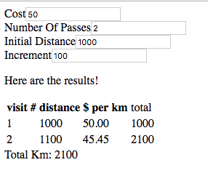
Lab 30: SwimCalc App

Slide 318
Relay and GraphQL
Objectives
Retrieve data with Relay

Slide 319
What is Relay?
Framework for building data-driven react applications
Simpler than Flux, but may also be used with Flux
Use GraphQL as a query language.

Slide 320
GraphQL
Data query language and runtime
Declarative
Compositional
Strongly Typed

Slide 321
GraphQL Example
Query
Response
{ user(id: 3500401) { id, name, isViewerFriend, profilePicture(size: 50) { uri, width, height } } }
{ "user" : { "id": 3500401, "name": "Jing Chen", "isViewerFriend": true, "profilePicture": { "uri": "http://someurl.cdn/pic.jpg", "width": 50, "height": 50 } } }

Slide 322
Relay Pros and Cons
Relay Pros
Relay Cons
Even more declarative
No custom getter logic
Tight server integration
Requires GraphQL server
Much more complexity
Less flexible

Slide 323
Chapter 13: Advanced Topics
Objectives
Server-side React
Using React with Other Frameworks / Libraries
Performance Issues

Slide 324
Accessibility and REact

Slide 325
Semantic HTML
HTML tags reinforce meaning of the data
<header>, <nav>, <main>, <form>, <footer>, etc.
<div> doesn't convey meaning, but is sometimes necessary for hooking scripts and styles into.
React.Fragment element can be used to group components without adding extra elements
import React, {Fragment} from react;
...
function ListItem({ item }) {
return (
<Fragment>
<dt>{item.term}</dt>
<dd>{item.description}</dd>
</Fragment>
); }

Slide 326
Accessible Forms
Every form control should have a <label>
<label htmlFor="namedInput">Name:</label> <input id="namedInput" type="text" name="name"/>
Notify users of errors
If form focus is interrupted (such as by a modal), use Refs to set focus programatically
Insure that all functionality can be accessed using keyboard events

Slide 327
Testing Accessibility
Use the ESLINT accessibility plugin
eslint-plugin-jsx-a11y
is installed and activated by default with create-react-app
Use The Accessibility Engine to test accessibility in the browser
https://www.deque.com/axe/

Slide 328
Server-side React
Allows you to pre-render components' initial state on the server
Methods:
renderToString
Returns an HTML string
Send the markup down on the initial request for faster page loads and to allow search engines to crawl your pages for SEO purposes.
renderToStaticMarkup
Works the same as renderToString, but doesn't add in the extra React DOM elements
Good for using React as a static page generator

Slide 329
Using React with Other Libraries
Use the lifecycle events to attach logic from other libraries.
componentDidMount
Attach code that will run when the component is loaded.
Can be used similarly to jQuery's $(document).ready()
componentDidUpdate
Attach code that will run when a component updates.

Slide 330
Performance Optimization
Production bundle
Perf object
shouldComponentUpdate()
Notes:
React is fast, even without doing any optimizations. However, there are some things you can do to optimize it even further. At the very least, you should make sure to always use the production version of React for deployed code. Beyond that, the main way to optimize React rendering is to specifically tell it not to re-render certain components.

Slide 331
Render Caching
A technique for making web pages load faster on subsequent visits.
Encapsulate load state so that no server call is required to render the initial view
Make all API calls before render()
Cache locally in the unload handler
Restore the last known state on load
Render the last known state in react using ReactDOM.hydrate
Notes:
https://css-tricks.com/render-caching-for-react/

Slide 332
ReactDOM.hydrate
import {render, hydrate} from "react-dom"
if (window.hasRestoredState) {
hydrate(<MyPage />, renderTarget);
} else {
render(<MyPage />, renderTarget);
}

Slide 333
Development vs. Production
Development build
Uncompressed.
Displays additional warnings that are helpful for debugging.
Contains helpers not necessary in production
~669kb
Production build
Compressed.
Contains additional performance optimizations.
~147kb

Slide 334
Perf Object
Indicates expensive parts of your app.
Only available in development mode.
Notes:
The Perf object is available in development mode by requiring 'react-addons-perf'. To use it, start measuring with Perf.start(), stop it with Perf.stop() and then use the other methods to find out the results.

Slide 335
Perf Object Methods
Methods
start() and stop()
Start and stop measurement
Records operations in-between
printInclusive(measurements)
Prints the overall time taken
Defaults to the measurements from the last recording
Outputs a nice-looking table
printExclusive(measurements)
Doesn't include time taken to mount components, process props, etc.
printWasted(measurements)
"Wasted" time is spent on components that didn't render anything
printOperations(measurements)
Prints the underlying DOM manipulations

Slide 336
Optimization Techniques
Use shouldComponentUpdate hook to add optimization hints to React's diff algorithm
shouldComponentUpdate: function() {
// Let's just never update this component again.
return false;
},
Use keys
Unique identifier created with key attribute.

Slide 337
Hooks
reactjs.org/hooks

Slide 338
Why Use Hooks?
Stateful classes need to be written with class syntax
Classes can be confusing.
Reusing logic is not possible

Slide 339
Stateful Components with Class
Import React from 'react';
export default class Hello extends React.Component {
constructor(props) {
super(props);
this.state = {
name: 'World',
}
this.handleChange = this.handleChange.bind(this);
}
handleNameChange(e) {
this.setstate({
name: e.target.value
});
}
render() {
return(
<input type="text"
value={this.state.name}
onChange = {this.handleChange} >
);
}
}

Slide 340
What are Hooks?
Functions provided by React that let you hook into React features from function components.
Must be at the top level of the component
not inside a condition
Hook examples
useState – Hooks into state
useContext – Hooks into Context
useEffect – Hooks into lifecycle methods. Runs after initial render and after every update (by default).

Slide 341
useState Hook
import React, { useState } from 'react';
export default function Hello(props) {
const [name, setName] = useState('World');
function handleChange(e) {
setName(e.target.value);
}
return(
<input type="text"
value={name}
onChange={handleNameChange} />
);
}

Slide 342
useContext Hook
import React, { useState, useContext } from 'react';
import { ThemeContext } from './context';
export default function Hello(props) {
const theme = useContext(ThemeContext);
const [name, setName] = useState('World');
function handleChange(e) {
setName(e.target.value);
}
return(
<section className={theme}>
<input type="text"
value={name}
onChange={handleChange}
/>
</section>
)
}

Slide 343
useEffect Hook
import React, { useState, useEffect } from 'react';
export default function Hello(props) {
const [name, setName] = useState('World');
useEffect(() = {
document.title = 'Hello' + ' ' + name;
return ()=>{
// optionally return a function
// to clean up after the effect,
// such as by removingEventListener or timer set
// in the effect
});
...

Slide 344
Custom Hooks
Start with 'use' by convention.
Create a function outside of the component function.
Use the function inside the component.

Slide 345
Custom Hook Example
export default function Hello(props) {
const [name, setName] = useState('World');
useDocumentTitle(name);
...
}
function useDocumentTitle(title){
useEffect(() = {
document.title = title;
}
}

Slide 346
Should you convert everything to Hooks?
Probably not right now (Q1 2019).
Hooks are not yet released (as of 16.7).
You can try out hooks now with the alpha version.

Slide 347
Using Pre-built Components
Thousands of React components are shared via npm
Searchable through databases like React-Components.com.

Slide 348
Further Study
Dan Abramov's 30 Free Redux Videos
Wes Bos’s Redux Course (https://learnredux.com/)

Slide 349
Where to go for help?
React Documentation
Stackoverflow

Slide 350
Disclaimer and Copyright
Disclaimer
WatzThis? takes care to ensure the accuracy and quality of this courseware and related courseware files. We cannot guarantee the accuracy of these materials. The courseware and related files are provided without any warranty whatsoever, including but not limited to implied warranties of merchantability or fitness for a particular purpose. Use of screenshots, product names and icons in the courseware are for editorial purposes only. No such use should be construed to imply sponsorship or endorsement of the courseware, nor any affiliation of such entity with WatzThis?.
Third-Party Information
This courseware contains links to third-party web sites that are not under our control and we are not responsible for the content of any linked sites. If you access a third-party web site mentioned in this courseware, then you do so at your own risk. We provide these links only as a convenience, and the inclusion of the link does not imply that we endorse or accept responsibility for the content on those third-party web sites. Information in this courseware may change without notice and does not represent a commitment on the part of the authors and publishers.
Copyright
Copyright 2018, WatzThis?. All Rights reserved. Screenshots used for illustrative purposes are the property of the software proprietor. This publication, or any part thereof, may not be reproduced or transmitted in any form by any means, electronic or mechanical, including photocopying, recording, storage in an information retrieval system, or otherwise, without express written permission of WatzThis, PO BOX 161393, Sacramento, CA 95816. www.watzthis.com
Help us improve our courseware
Please send your comments and suggestions via email to info@watzthis.com

