Slide 1

POLYMORPHISM
& Rexford apewah
By CALVIN KORTEY DUA

Slide 2
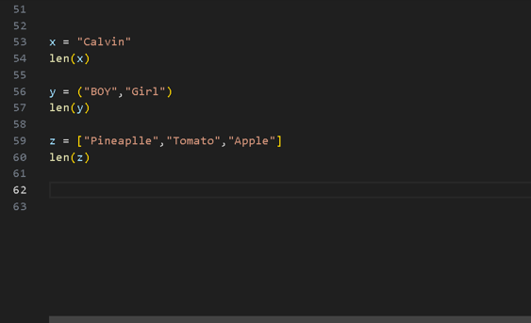
Definition
The word Polymorphism can be divided into two words that is Poly which means many and morphism which means forms.
In programming, it refers to methods/functions/operators with the same name that can be executed on many objects or classes.
Or the ability of a variable, function or object to take on multiple forms
eg; the len( ) function, it returns the number of element for strings, tuples, dictionaries etc.
Our focus in going to be on polymorphism in “ Object Oriented Programming”.

Slide 3
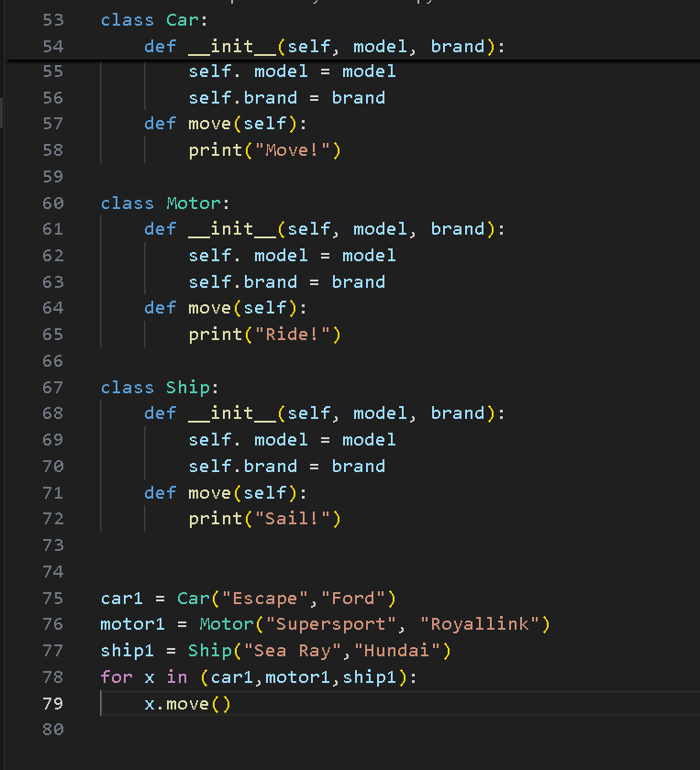
Class Polymorphism
Polymorphism is often used in Class methods, where we can have multiple classes with the same method name.
For example, say we have three classes: Car, Motor, and Bicycle, and they all have a method called move():

Slide 4

THANK YOU

