Slide 1




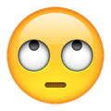


MojiSem
Ori n M🔛toya
Noa Naaman
Hannah Provenza
МИР

Slide 2
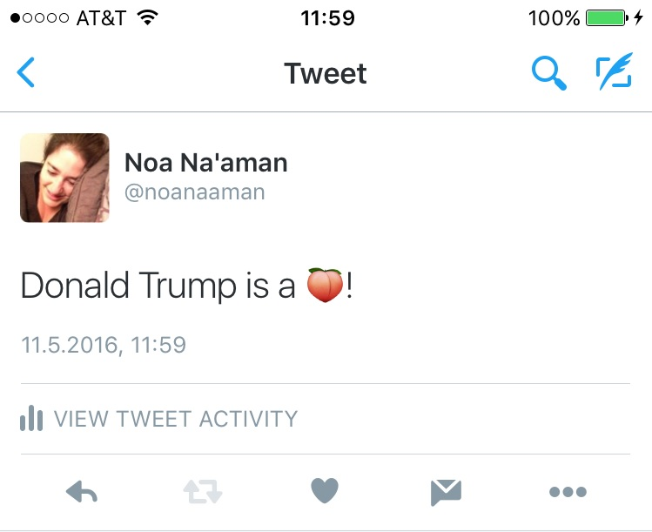
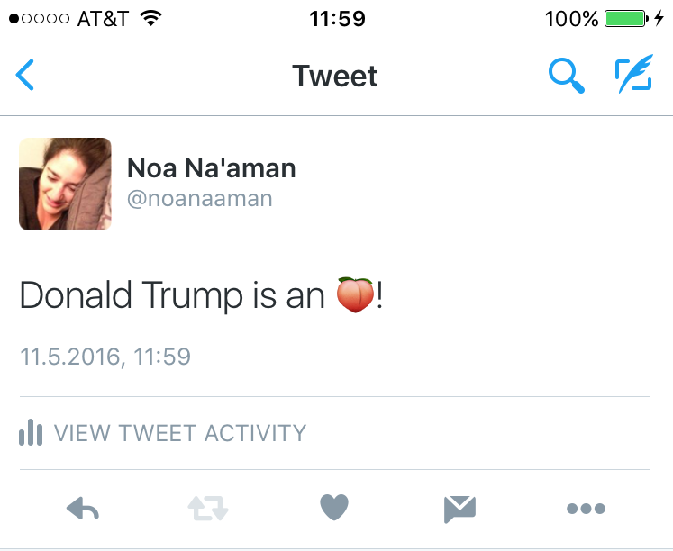
Task
Reading tweets is important
Emojis are a major part of social media
Emojis are new (2010), so most NLP tools aren’t handling them
Skip tweet
Drop the emojis
It could be easy!

Slide 3
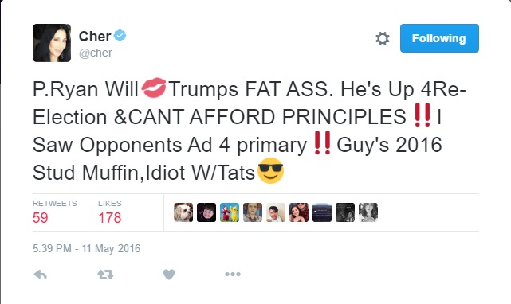

Task
Emojis turn written text into a form of multi-modal communication
User intent and sentiment are harder to extract
But what about easier cases?
Twitter limits to 140 characters
Using emojis is faster
Maybe we can identify the emojis that can be replace with text without losing meaning

Slide 4



Guidelines
Tag set:
Multi-modal
Content words
Functional words/characters
Start with the easy ones
Can the tweet be understood without the emoji at all?
Try reading it out loud
Others will be MM by default
Topic
Attitude
Gesture

Slide 5
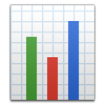
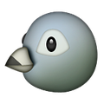



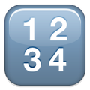


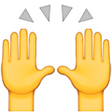
Collecting data
Collected data with open source package TweePy
Used list of Unicode ranges to filter incoming tweets for only those that contain at least one emoji
Only tweets in English
We can’t filter for all emoji at once (limit on the number of concurrent filters)
Instead, we selected tweets by to ensure a wide range of emojis were represented in our limited space, and to eliminate retweets
Therefore our data does not accurately reflect the distribution of emojis.
By the :
6 datasets
60-115 tweets in each dataset
567 tweets total
At least 1 emoji per tweet

Slide 6
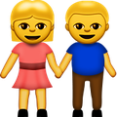

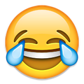
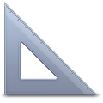

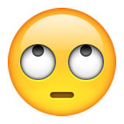
Inter-Annotator Agreement
Fleiss’ kappa
The question of spans is trivial, so annotators should be annotating the same items
Some data sets have two annotators and some have four
Selecting from three possible labels for each item
We used a Python script with an XML processor and the NLTK metrics package to compute our scores
We did have to throw out data for the occasional unfinished or accidentally skipped emoji but this was less of a problem with each successive dataset.
Segmentation: Krippendorff’s alpha
Scores around .9
Content Agreement
Annotators know how to identify parts of speech, so they’re good at this
Stellar agreement scores outside of the first week (as high as 1.00 for multiple datasets)
Multimodal Agreement
Multimodal communication may be inherently ambiguous
Could be a gesture (smile), an attitude (happy), or a topic (my good mood)
In fewer words, MM agreement was not as good.
But that’s part of what we wanted to learn from this project!
Overall Agreement
Moderate agreement scores

Slide 7
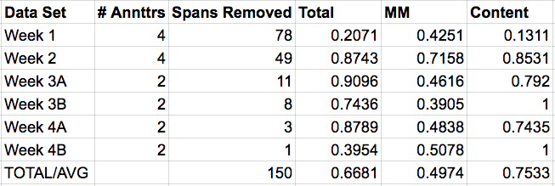

IAA Numbers

Slide 8



Adjudication process
Week 1 needed a lot of work
Matching to final DTD
Disagreement
Annotators not always following the guidelines
Changes to guidelines for week 2:
Out of scope
Co-reference
Split sequences
More examples
Week 2-4 adjudication more straightforward
Gave us for future improvements to guidelines:
Spans
MM types should be defined better
Even more examples

Slide 9
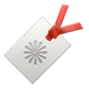

Gold standard
775 tagged emoji spans in 567 tweets
MM: 686
Content: 51
Functional: 38
Processing the files for ML algorithms took some work
Getting the tags we wanted to use
Handling spans
UnixToDos fun

Slide 10
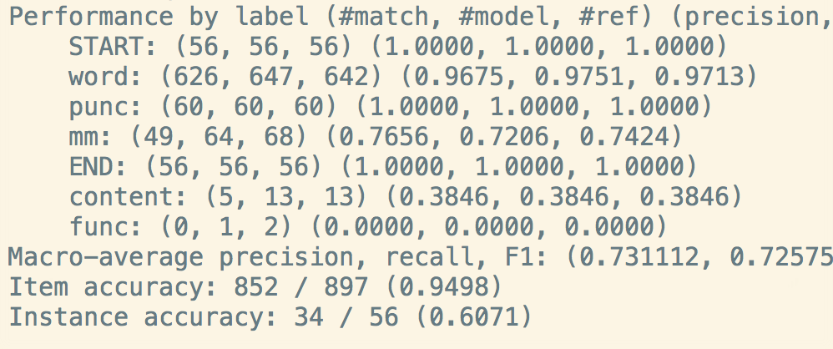
Hidden Markov Model tagger

Slide 11
Hidden Markov Model tagger: Hmm...

Slide 12
Hidden Markov Model tagger: Hmmmmmmm...

Slide 13
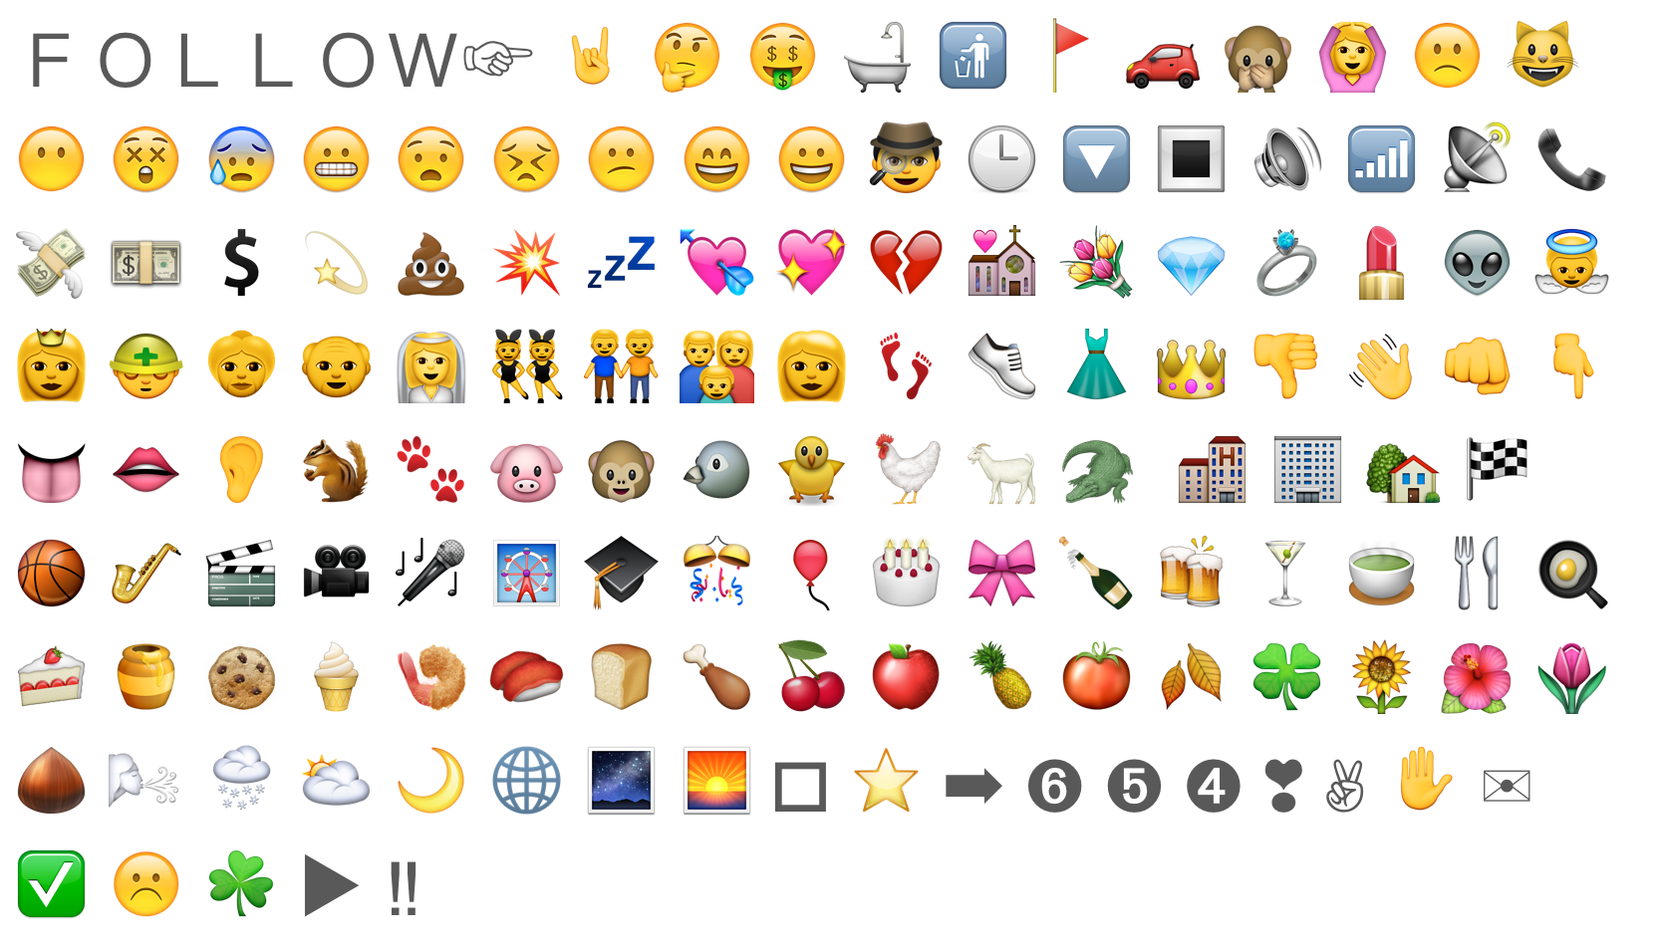
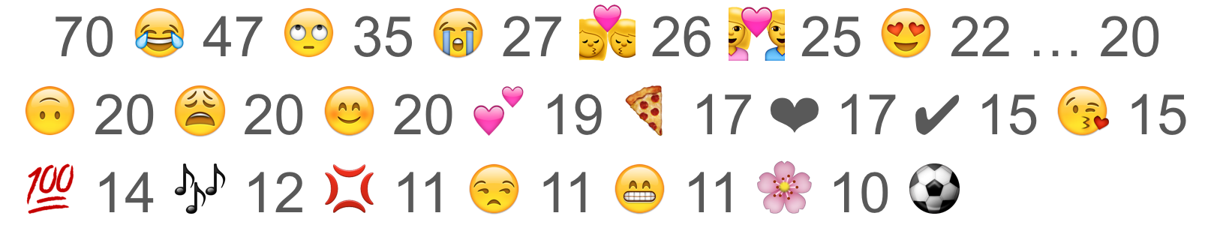
Sparseness of data
878 total occurrences of emoji characters
~300 different characters annotated
23 occurred more than 10 times:
135 things occur once:

Slide 14
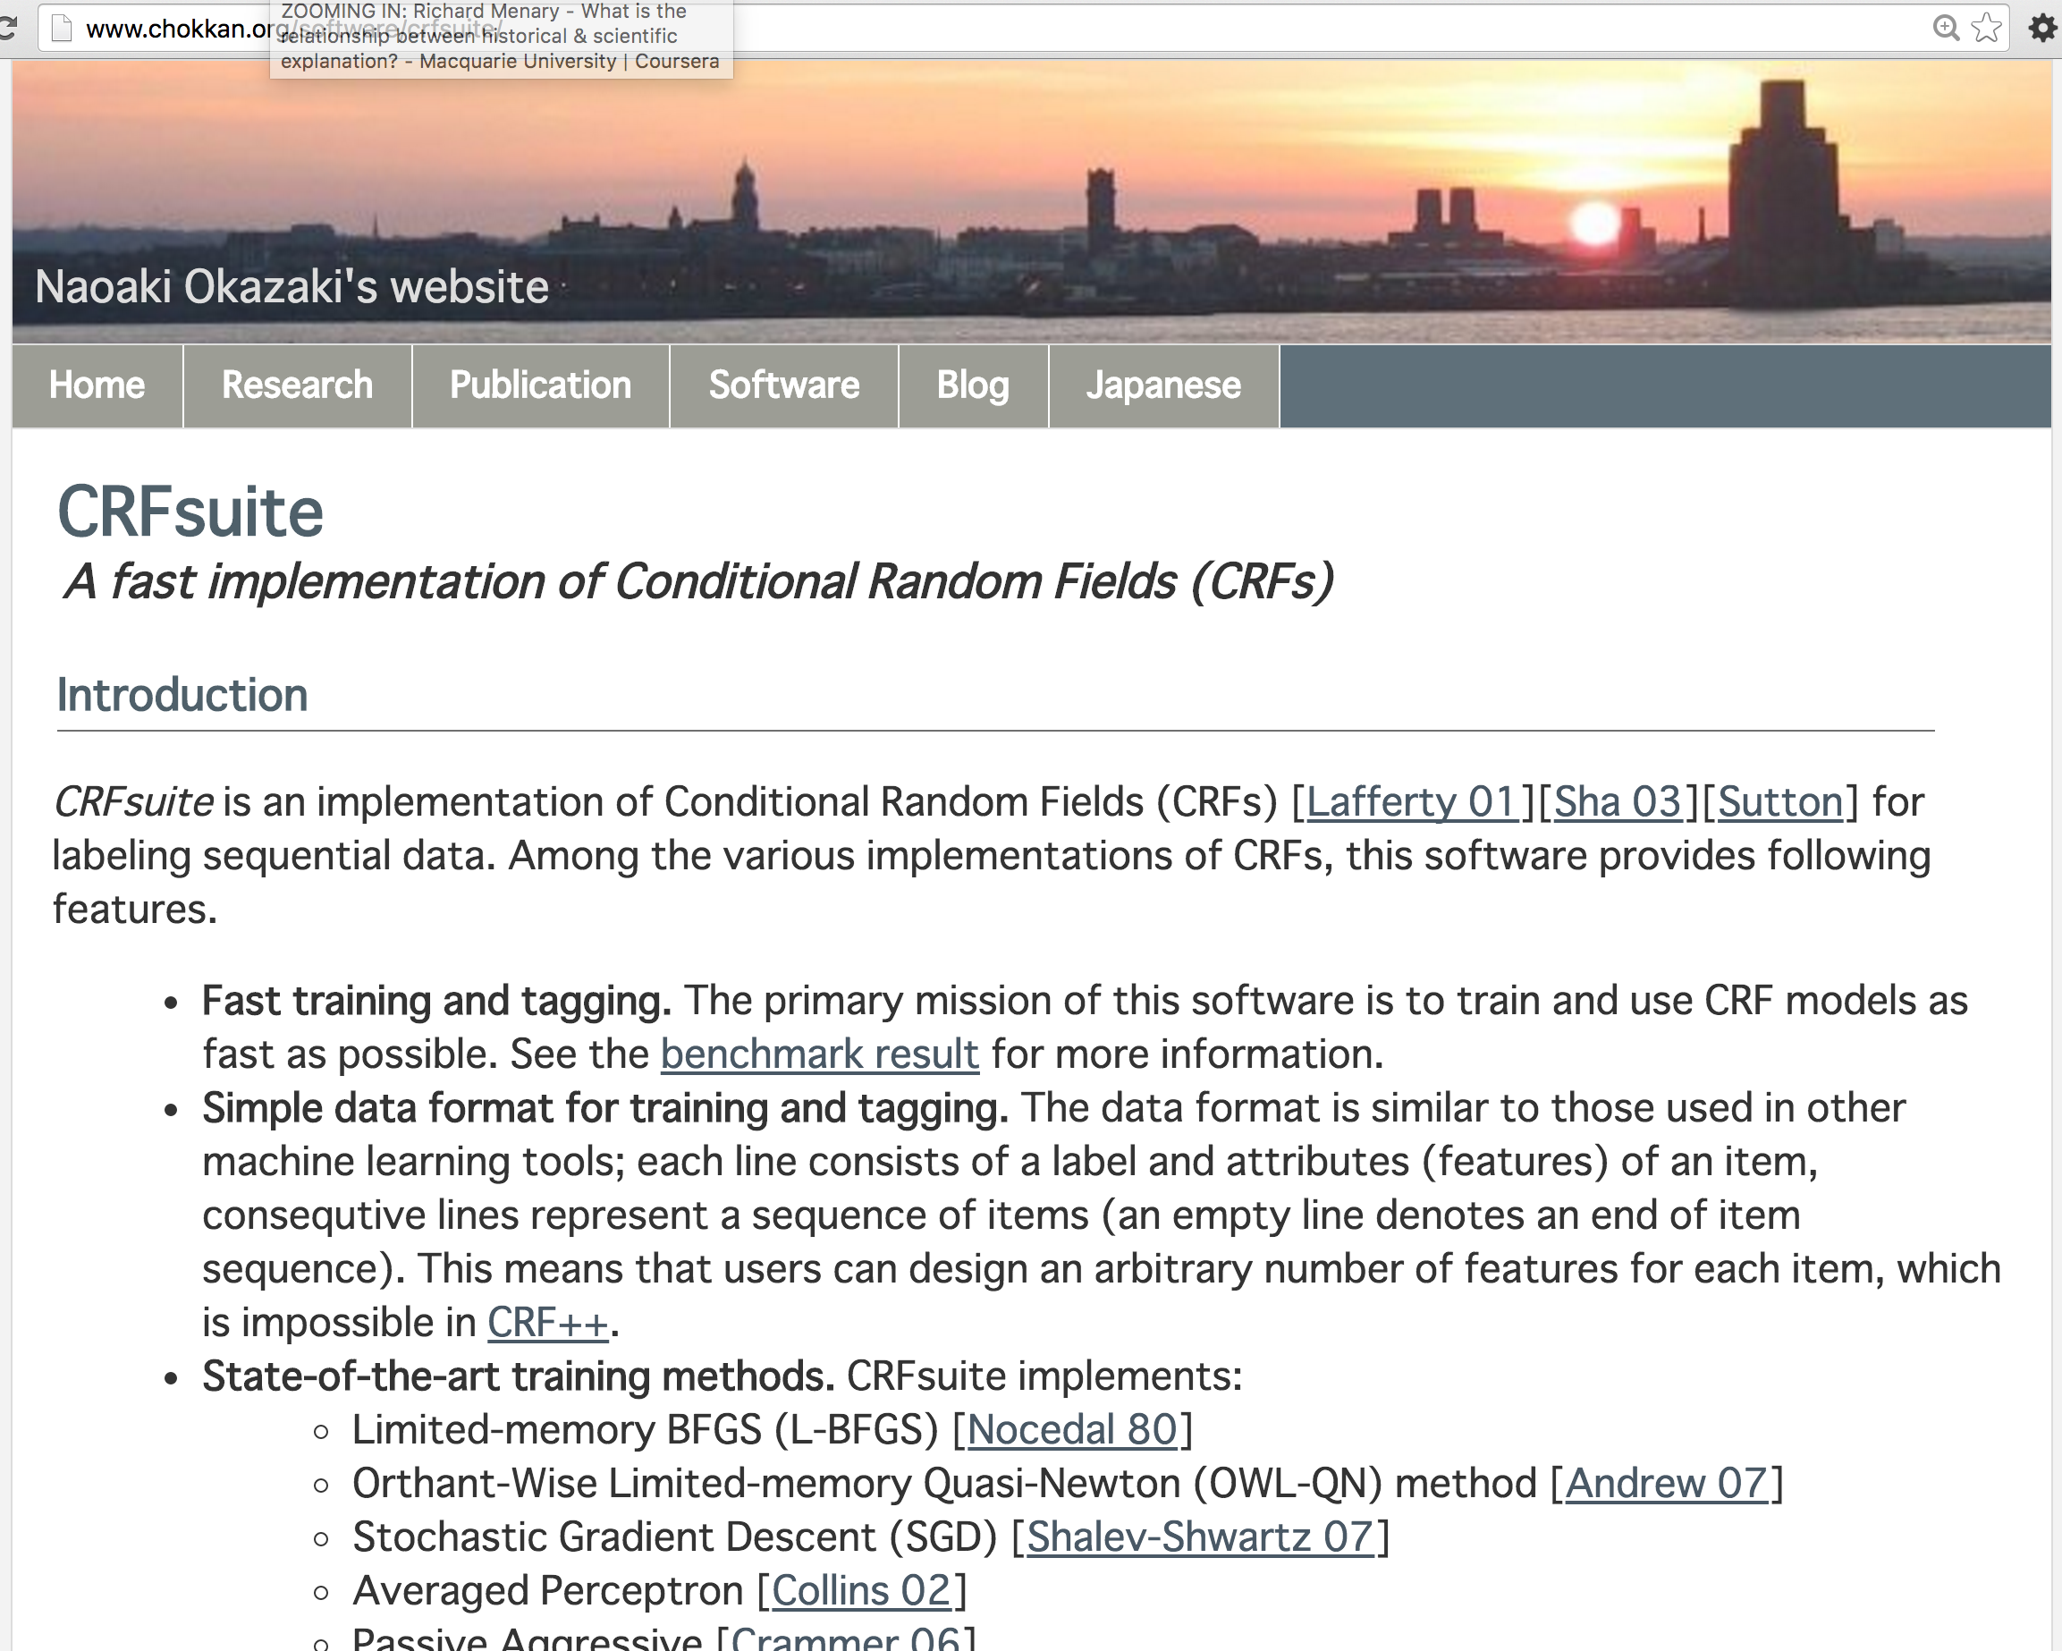
Second try: CRF

Slide 15
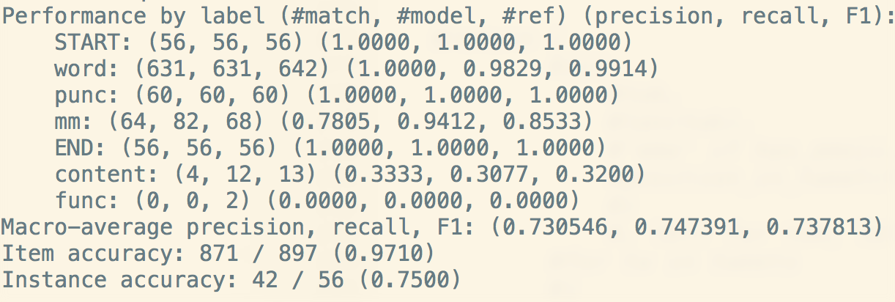
Baseline demo: token + is_emoji?
(best results with Averaged Perceptron)

Slide 16
Baseline demo: token + is_emoji?
(best results with Averaged Perceptron)

Slide 17
Baseline demo: token + is_emoji?
(best results with Averaged Perceptron)

Slide 18
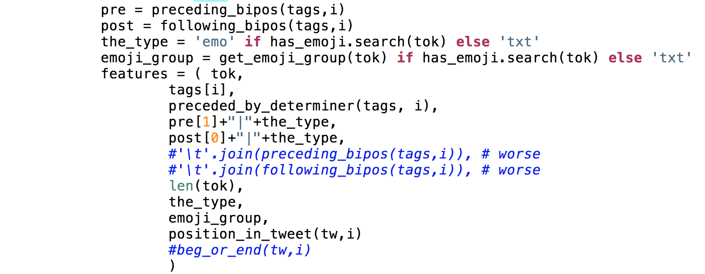
Feature engineering

Slide 19
Feature engineering

Slide 20
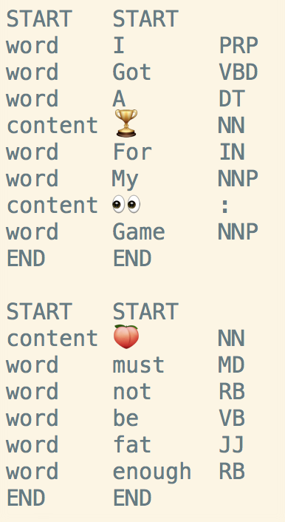
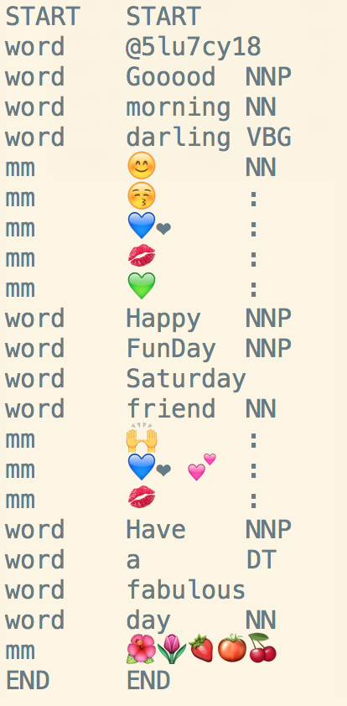
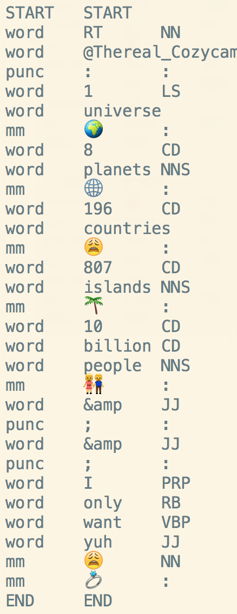
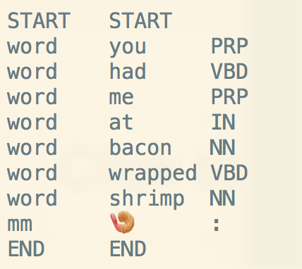

Slide 21
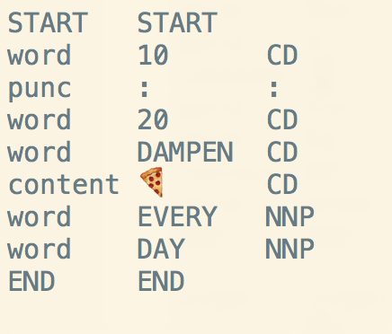

Slide 22
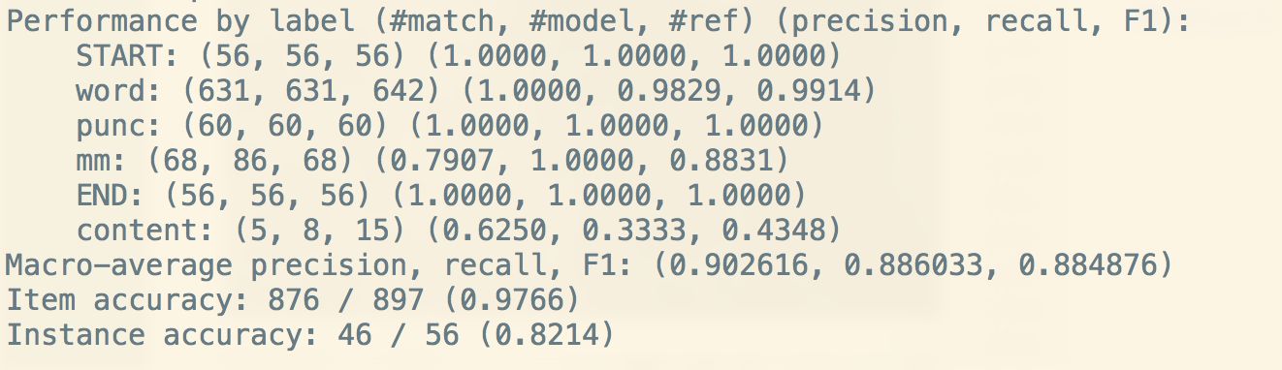
Add POS, collapse func and content:

Slide 23
Add POS:

Slide 24
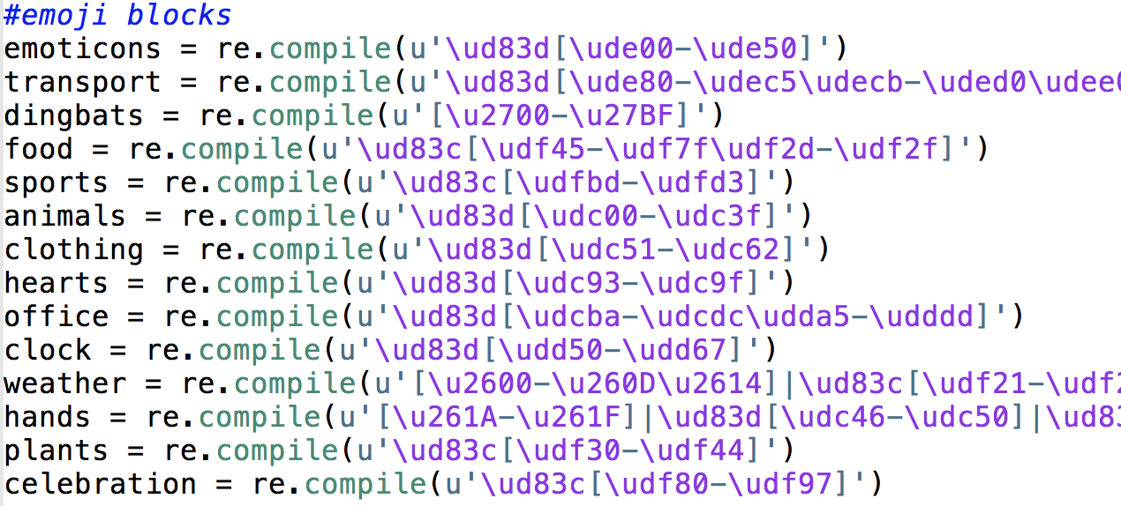
Character class as a feature
http://apps.timwhitlock.info/emoji/tables/unicode

Slide 25
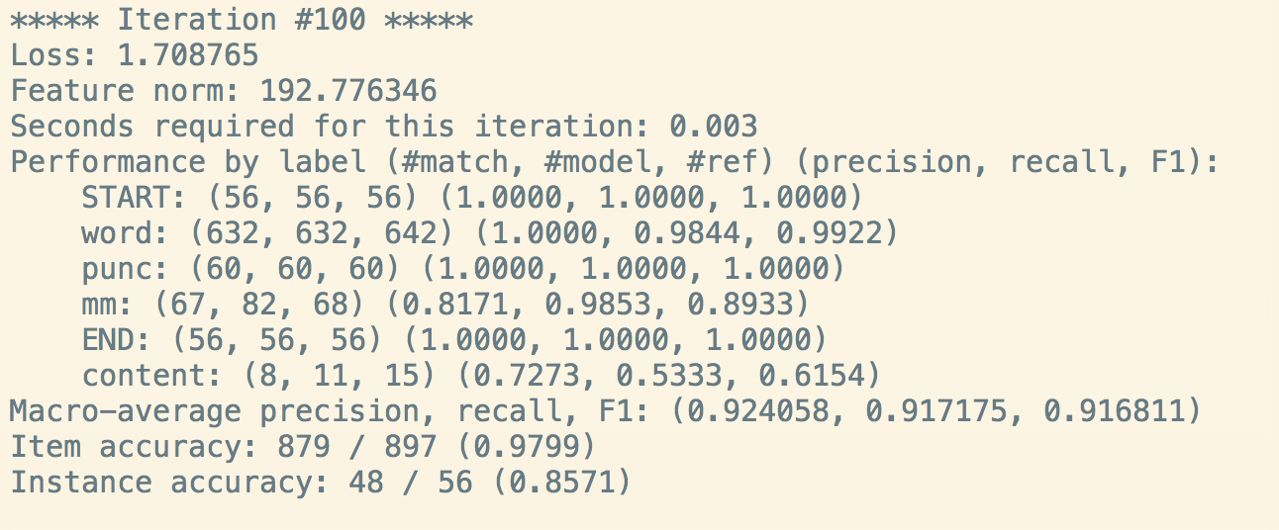
Add Emoji class

Slide 26
Add Emoji class

Slide 27
Add Emoji class

Slide 28
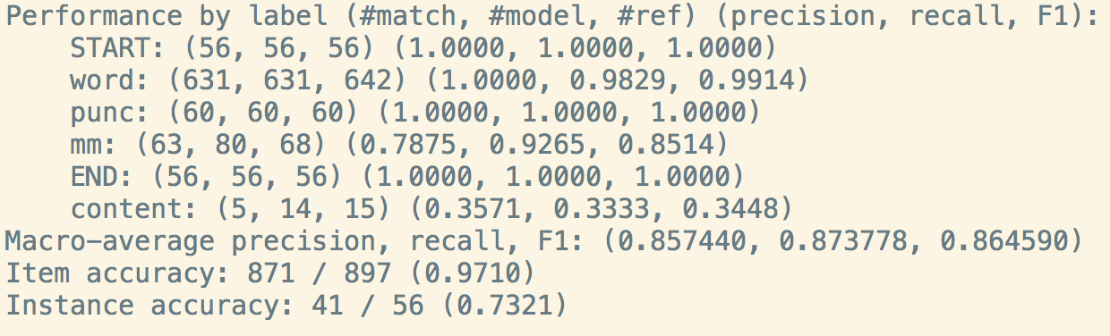
Emoji class without POS

Slide 29
Feature engineering

Slide 30
“What’s next?”
More data collection
From each emoji group (based on unicode ranges)
More content and function emojis
Subclasses of multimodal!
Annotations:
Improve guidelines
Mechanical Turk
Annotators should be Twitter users
More feature engineering
Create a thesaurus for emojis
WSD
Sentiment analysis

Slide 31


Slide 32
