Slide 1
Title TBD
By Caden Ziskie and Branden Husted

Slide 2
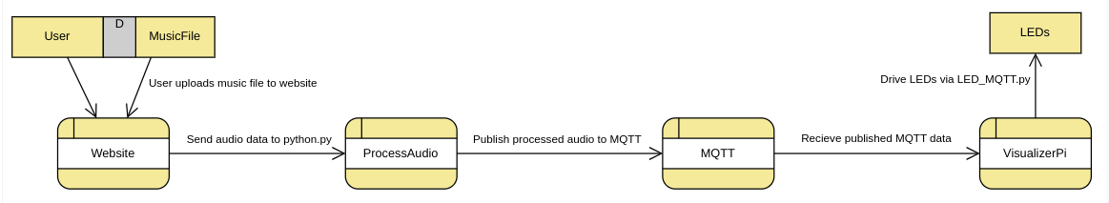
Data Flow Diagram

Slide 3
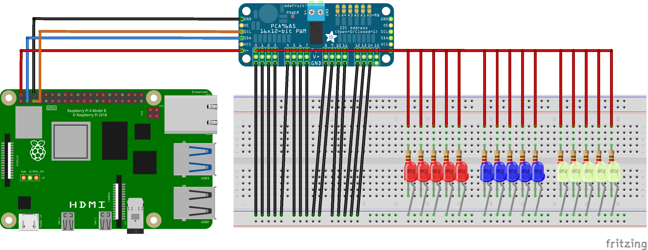
Fritzz Diagram

Slide 4
Software Libraries
Time: timeouts
Numpy: math calculations
Simpleaudio: play audio files
Array: arrays
Pydub: audio sampling
Json # might be removed
Busio: connects the SCL and SDA pins to the PWM
Paho.mqtt: MQTT (we all know what this is by now)
Adafruit_pca9685: communicates with the PWM
Board: helps to access the SCL and SDA pins on the Pi board

Slide 5
Software Design
Index.html
The website that plays & pauses the music file.
Python.py
Processes the audio from the website and publishes it to the MQTT.
LED_MQTT.py
Takes in the MQTT data and converts it to values for the LEDs and lights them up.

Slide 6
Demo

Slide 7
Design Norms
Transparency (Safety): seizure possibility
Trust (Security): secure MQTT; passwords and usernames left out of git repo
Privacy: doesn’t save/collect data
Stewardship: extra resistors, LEDs, and PWM are not RoHS compliant
Justice: could allow for the play-back of pirated music files

Slide 8
It’s wonderful to be here
It’s certainly a thrill
You’re such a lovely audience
We’d like to take you home with us
We’d love to take you home
Thank You!

