Slide 1
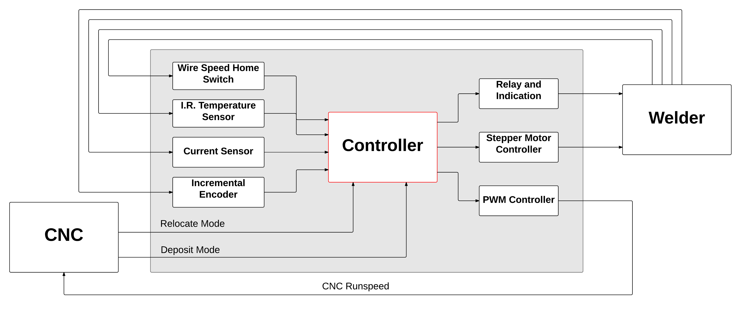
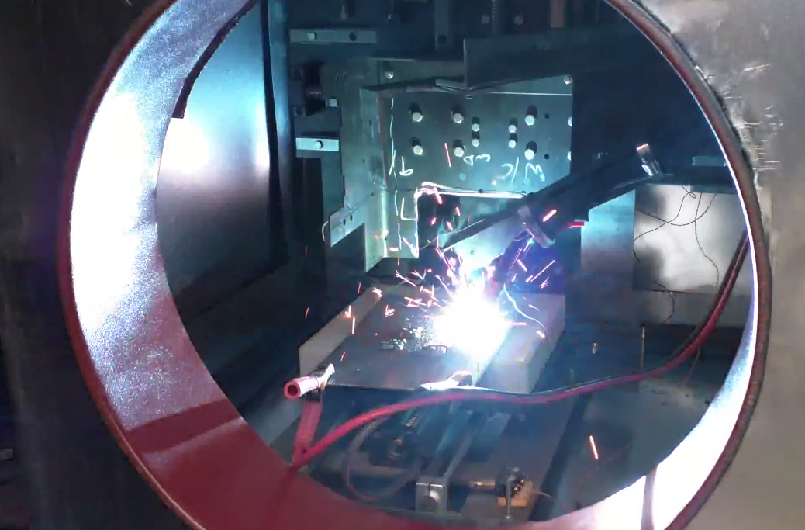
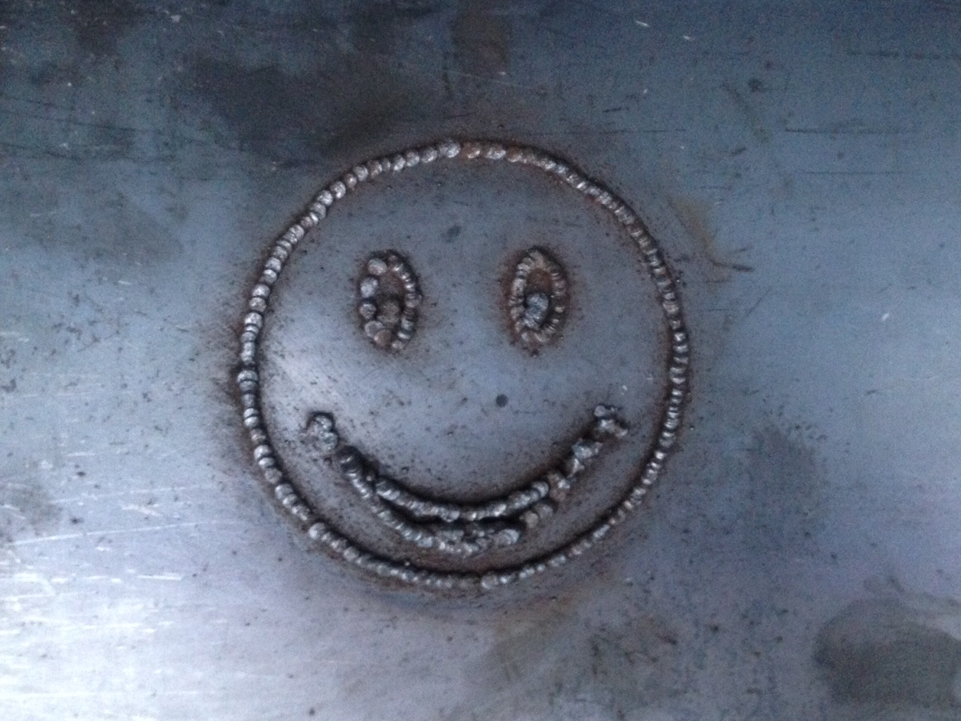

3D Metal Printing
Team Members – Brian Andrews, Branden Driver, Cameron Tribe, Ahmad Qazi
Faculty Advisor – Marek Perkowski
Industry Sponsor – Aram Kasparov
Project and Motivation
The purpose of this project is to create an alternative to the metal casting process, which can be expensive and result in long lead times. The goal is to create a 3D metal printer that is capable of quickly creating metal components at a lower cost. The final products of this printer will be used in industrial water pumps that must be precision machined after the fact, so accuracy of the print is not a major concern for this project.
We will combine a CNC machine with a MIG (metal inert gas) welder and use the welder to deposit material. Building upon previous layers of deposition, we will be able to print 3D metal objects.
Goals
Interface the MIG welder with CNC machine.
Determine quality of deposition based on temperature and current.
Control the MIG welder based on quality of deposition.
Allow for future expandability
Control System
Control of the system is done using a PCI Express DAQ board from Sensoray, Inc. The board has 48 digital I/O pins, sixteen 16-bit analog inputs, eight 16-bit analog outputs, and six counter channels.
Results and Testing
Testing was done throughout the project. The most important tests were done to determine:
Droplet spacing
Wire feed speed
Stepper motor driver control position
While this project was for all intents and purposes a proof of concept, as a group we would have liked to have implemented all the sensors and feedback controls discussed. We accomplished the proof of concept and implemented a basic feedback loop which controls the wire feed speed. Other options, such as the starting current for the welder as well as the torch routine to warm the baseplate to the proper temperature, are completed manually. The control program does include error checks, such as the welder running out of wire or the temperature falling below the desired threshold, but the whole system is not yet in place to correct these errors and guard against them.
The welder is controlled by interpreting information from the following feedback and control elements:
Current Sensor
Data from the current sensor gives an idea of the precision of the deposition. The current sensor is placed in-line with the ground connection of the welder. When the wire of the welder completes the circuit, it melts the wire and creates a small droplet of molten metal that is shown as a spike in current. Using a peak detection algorithm, the frequency of droplets being deposited can be determined. Comparing these values to a nominal value, found through testing, the wire speed knob is adjusted.
Relay and Indication:
The CNC machine has two movement modes: relocation and deposition. Each movement mode has its own digital signal, which are read by the controller. The controller uses these signals to activate or deactivate a relay, which bypasses the mechanical switch on the welder gun. This relay module also includes visual indication of the current CNC movement mode.
Incremental Encoder
Attached to the wire feed drive pulley inside the welder is an incremental encoder that is used to calculate the actual wire speed. During testing, this sensor was used to find ideal wire and CNC speed pairs. At the beginning of each print, a user inputs the CNC speed that the machine will be running at and the system sets up the appropriate initial wire speed. This is done via a process that sends the wire speed adjustment knob to a home position and measures the wire speed at that position. This provides an offset which is used in all proceeding wire speed calculations.
I.R. Temperature Sensor
An infrared temperature sensor is used to provide a reading of temperature prior to depositing material. When the temperature of the weld is outside of the allowed range, the system will pause. If is it too hot, the system waits for the deposition to cool and if it is too cold, a hand held torch is used to manually heat the part.
Special thanks to Jim Lamberson at Sensoray
Department of Electrical and Computer Engineering

