Slide 1
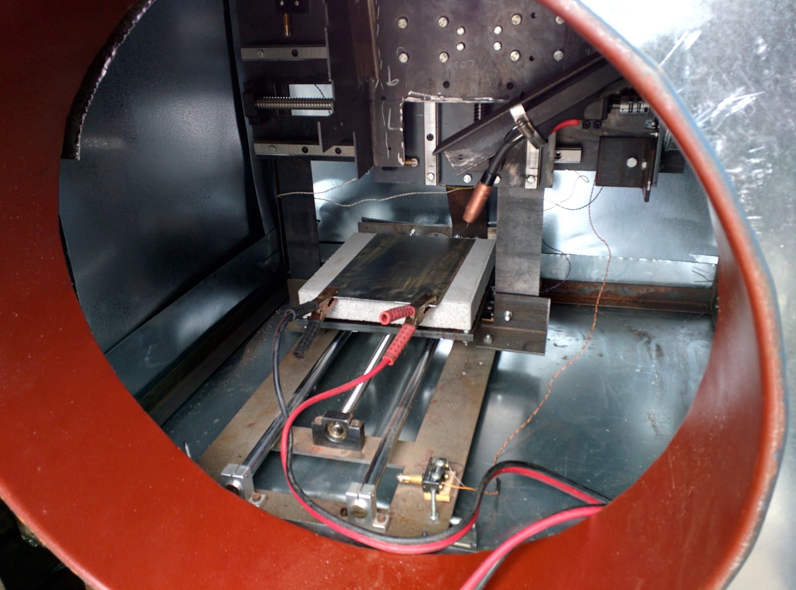
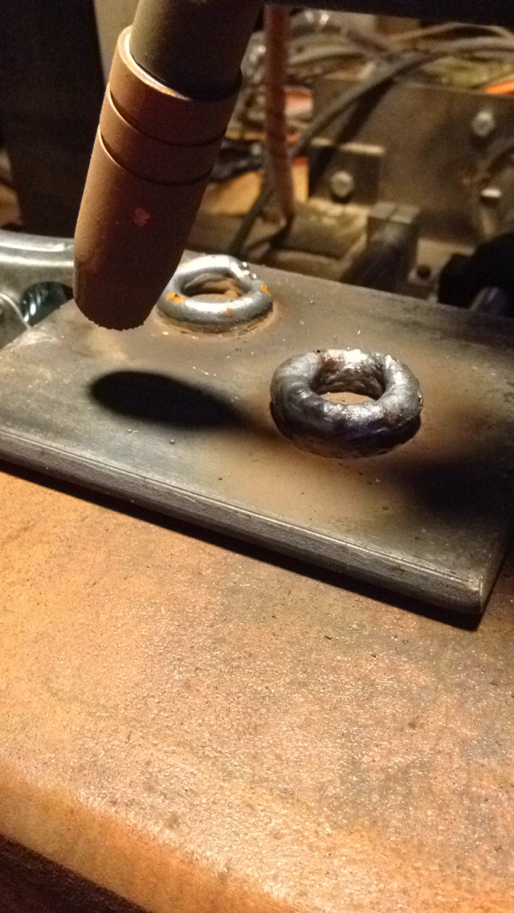
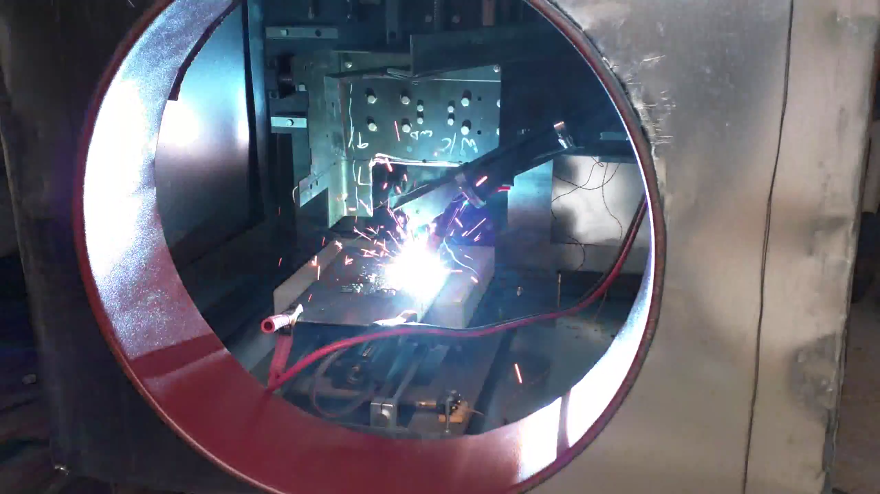

3D Metal Printer
Some crap here
Last bit of crap here
More crap here
Department of Electrical and Computer Engineering

