Slide 1
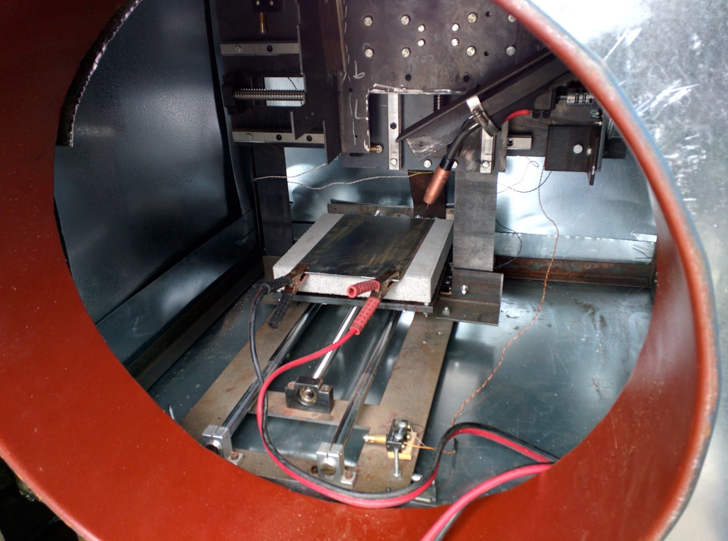
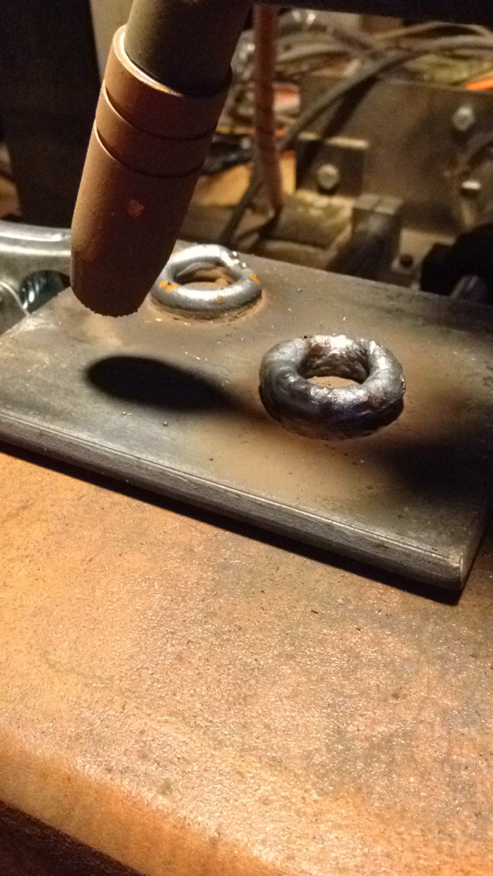
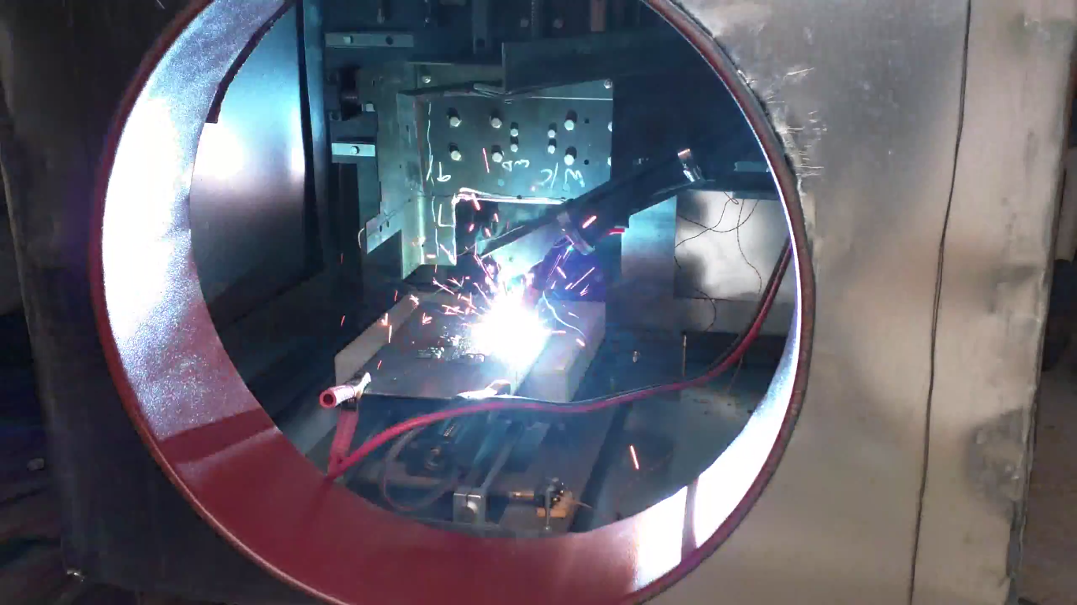

3D Metal Printer
Introduction
The purpose of our project is to create a cheaper 3D metal printer following the design of plastic 3D printers. We will combine a CNC machine with a MIG (metal inert gas) welder and use the welder to deposit wire. Building upon previous layers of deposition, we will be able to print 3D metal objects. The final products that this printer will be producing will be internal components of industrial water pumps. Because of their use, all parts will be precision honed, so highly accurate prints are not a concern for this project.
Results and Testing
Testing was done throughout the project. The most important tests were done to determine:
Droplet spacing
Wire feed speed
Stepper motor driver control position
While this project was for all intents and purposes a proof of concept, as a group we would have liked to have implemented all the sensors and feedback controls discussed. We accomplished the proof of concept and implemented a basic feedback loop which controls the wire feed speed. Other options, such as the starting current for the welder as well as the torch routine to warm the baseplate to the proper temperature, are completed manually. The control program does include error checks, such as the welder running out of wire or the temperature falling below the desired threshold, but the whole system is not yet in place to correct these errors and guard against them.
Control System Description
Although we weren’t concerned with an extremely accurate print, we still wanted the final product to be as accurate as the system would allow. This meant that we needed to monitor and control the quality of the weld in real time to be able to adjust settings during the deposition process. Our main source of feedback was the spacing of the droplets occurring during the weld. When using a MIG welder, a wire is fed out the end of the welding nozzle. When this wire comes into contact with a metal plate that is also connected to the ground terminal of the welder, the circuit is completed and the high current melts the wire. The current is so high, that the wire melts past the point of contact, which then creates an open circuit, until the wire again reaches the ground plane and the circuit is again completed. Looking at this process closely, it can be seen that the deposition of the wire isn’t continuous, but rather a bunch of tiny droplets. We call this droplet spacing, and used it extensively throughout the remainder of our project. Through testing we determined that the average droplet spacing for a good weld was around 50 milliseconds (although this would change if the input current were to change drastically). Our control program looks at half a second time period, determines the average droplet spacing, and makes corrections to either increase or decrease wire speed accordingly. To know how to correct the weld, we ran a series of tests and created a lookup table of what we determined to be an ideal weld.
Department of Electrical and Computer Engineering

Slide 2
3D Metal Printer
Introduction
The purpose of our project is to create a cheaper 3D metal printer following the design of plastic 3D printers. We will combine a CNC machine with a MIG (metal inert gas) welder and use the welder to deposit wire. Building upon previous layers of deposition, we will be able to print 3D metal objects. The final products that this printer will be producing will be internal components of industrial water pumps. Because of their use, all parts will be precision honed, so highly accurate prints are not a concern for this project.
Results and Testing
Testing was done throughout the project. The most important tests were done to determine:
Droplet spacing
Wire feed speed
Stepper motor driver control position
While this project was for all intents and purposes a proof of concept, as a group we would have liked to have implemented all the sensors and feedback controls discussed. We accomplished the proof of concept and implemented a basic feedback loop which controls the wire feed speed. Other options, such as the starting current for the welder as well as the torch routine to warm the baseplate to the proper temperature, are completed manually. The control program does include error checks, such as the welder running out of wire or the temperature falling below the desired threshold, but the whole system is not yet in place to correct these errors and guard against them.
Control System Description
Although we weren’t concerned with an extremely accurate print, we still wanted the final product to be as accurate as the system would allow. This meant that we needed to monitor and control the quality of the weld in real time to be able to adjust settings during the deposition process. Our main source of feedback was the spacing of the droplets occurring during the weld. When using a MIG welder, a wire is fed out the end of the welding nozzle. When this wire comes into contact with a metal plate that is also connected to the ground terminal of the welder, the circuit is completed and the high current melts the wire. The current is so high, that the wire melts past the point of contact, which then creates an open circuit, until the wire again reaches the ground plane and the circuit is again completed. Looking at this process closely, it can be seen that the deposition of the wire isn’t continuous, but rather a bunch of tiny droplets. We call this droplet spacing, and used it extensively throughout the remainder of our project. Through testing we determined that the average droplet spacing for a good weld was around 50 milliseconds (although this would change if the input current were to change drastically). Our control program looks at half a second time period, determines the average droplet spacing, and makes corrections to either increase or decrease wire speed accordingly. To know how to correct the weld, we ran a series of tests and created a lookup table of what we determined to be an ideal weld.
Results and Testing
Testing was done throughout the project. The most important tests were done to determine:
Droplet spacing
Wire feed speed
Stepper motor driver control position
While this project was for all intents and purposes a proof of concept, as a group we would have liked to have implemented all the sensors and feedback controls discussed. We accomplished the proof of concept and implemented a basic feedback loop which controls the wire feed speed. Other options, such as the starting current for the welder as well as the torch routine to warm the baseplate to the proper temperature, are completed manually. The control program does include error checks, such as the welder running out of wire or the temperature falling below the desired threshold, but the whole system is not yet in place to correct these errors and guard against them.
Department of Electrical and Computer Engineering

