Slide 1
Greenfox
A schema language for
validating file systems
Hans-Jürgen Rennau, parsQube GmbH
Presented at xmlprague 2020, February 15, 2020
Notes:
XML technology is very powerful, but also very limited. The more you are aware of the power, the keener your interest in reducing the limitations. A key problem is rooted in the very paradigm of XML, which is tree-structured information. This leads to the challenge of combining XML tree technology with RDF graph technology.

Slide 2
Greenfox: definition
Greenfox is a language for validating
file system trees* against a set of conditions.
[*file system tree =
A folder + folders and files directly or indirectly contained]

Slide 3
File system validation
Why?
What, precisely?
How?

Slide 4
File system validation – WHY?
Real-world systems:
If reflected by file system contents
Then validated by validating …
file system contents
Perform 10000 checks …
… and let each check leave a trace in the file system
A file / folder created / extended unconditionally
A file / folder created / extended if check OK
A file / folder created / extended if check NOTOK
=> CHECK THE FILE SYSTEM CONTENT

Slide 5
What, precisely?
Folder contents
File contents
Schema-valid (XSD, JSON Schema, SHACL, …)
Rules conformant („If contains Foo, contains Bar“)
Folder/file content dependencies:
File A exists => file B exists
File A exists => file B contains Bar
File A contains Foo => file B exists
File A contains Foo => file B contains Bar

Slide 6
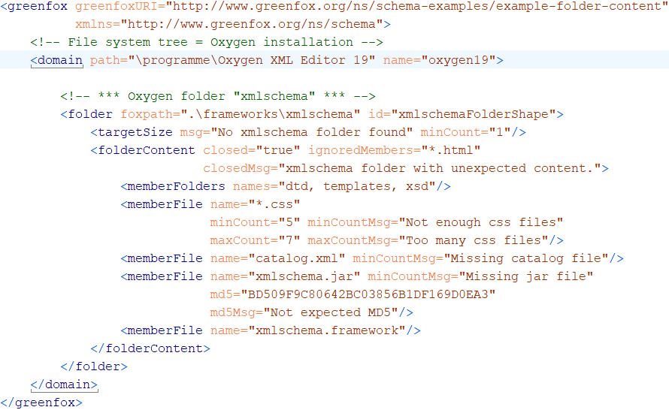
A first schema, with a folder shape
Folder content constraints

Slide 7
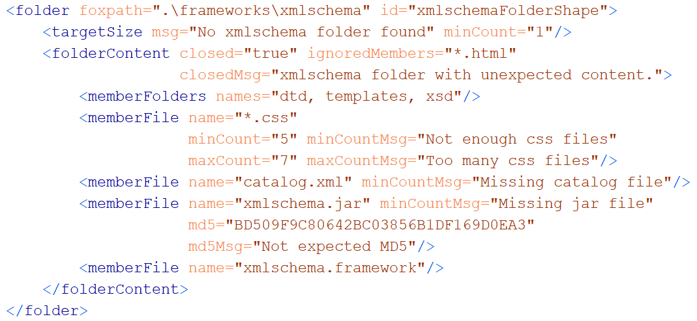
A folder shape

Slide 8
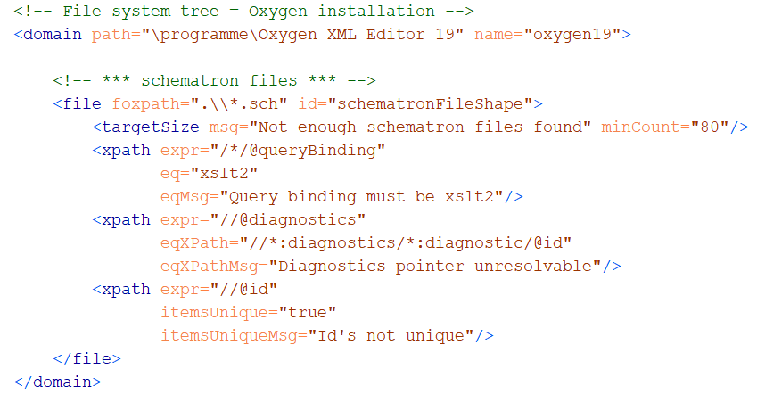
A file shape, containing value shapes

Slide 9
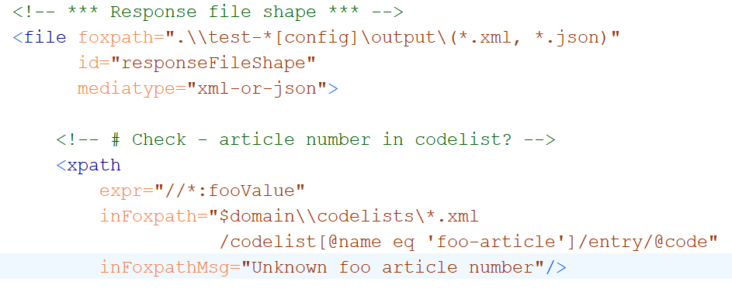
Cross-boundary navigation

Slide 10
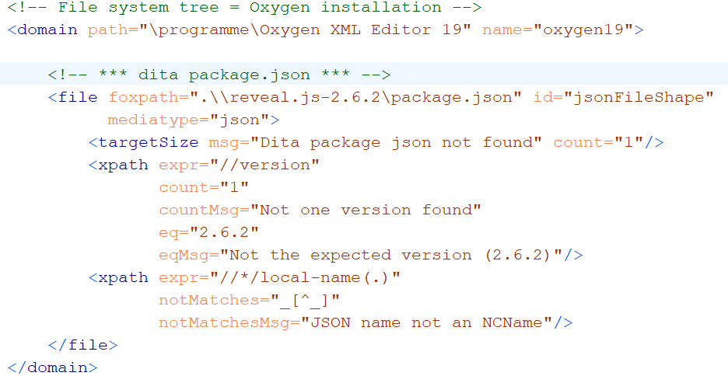
Validating JSON contents

Slide 11
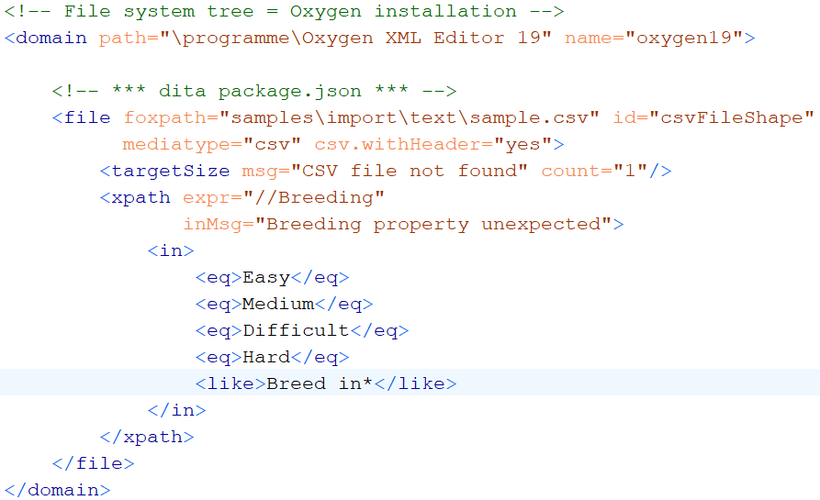
Validating CSV contents

Slide 12
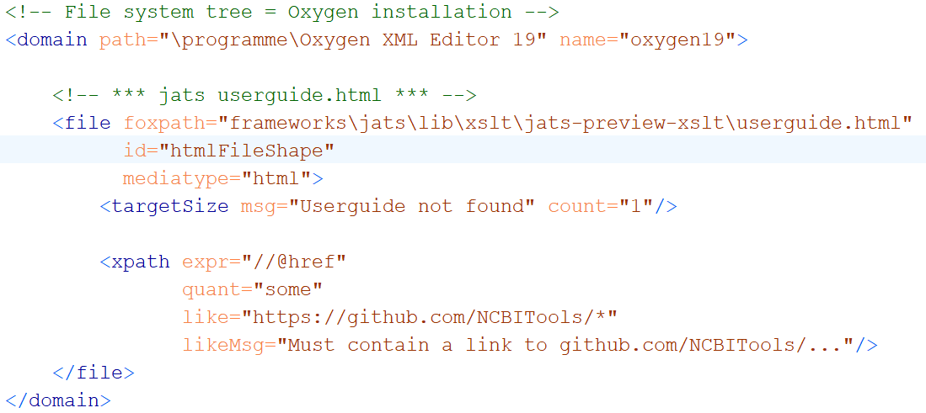
Validating HTML contents

Slide 13
Key feature #1 Navigation skills
Between resources
Within resources
Multi-mediatype
Cross-boundary:
Start inside file, …………… || …… arrive at a file-or-folder
Start at a file-or-folder, …… || …… arrive inside file
Start inside file A, ……....... || …… arrive inside file B
foxpath
XPath
XPath - extensions
foxpath

Slide 14
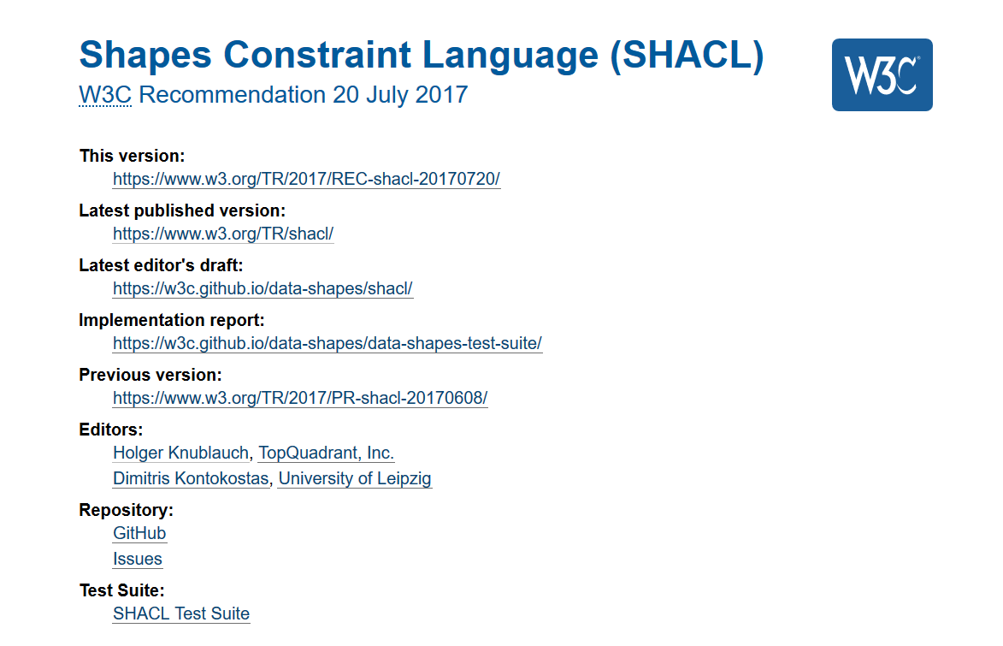
Key feature #2 Validation concept

Slide 15

Concepts
Resource file, folder
Shape a set of constraints
Resource shape checks a resource
Target declaration selects resources
Constraints check resource properties
Value shape checks a resource value
Expression constructs a resource value
Constraints check the resource value

Slide 16
Validation chemistry
Validation report = union of validation results
Validation result = outcome of validating …
ONE resource against ONE constraint
Result
. Conforms (boolean)
. ResourceIRI (file path)
. ConstraintComponentIRI (identifies semantics)
. ConstraintParameters (name-value pairs)
. Details (name-value pairs)

Slide 17

The water of validity

Slide 18
A check is always a check against a constraint !
Constraint declaration
Identifies a constraint component
Supplies parameter values
What is checked?
resource property
intrinsic – e.g. "LastModified" , "FileSize", "Mediatype"
resource value
extrinsic – obtained from arbitrary expression

Slide 19
What a constraint perceives
Constraint
Resource properties
- intrinsic, predefined
Resource values
extrinsic, expression defined
may reflect content
may reflect surroundings
Resource

Slide 20
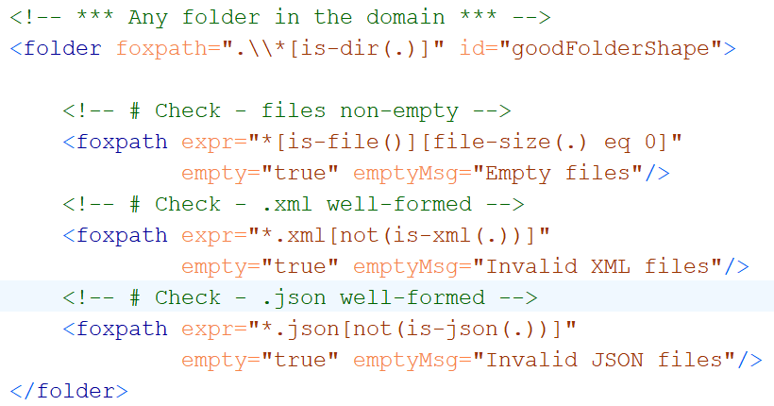
Folder resource values using foxpath
Resource value no empty files
Resource value no ill-formed XML
Resource value no ill-formed JSON

Slide 21
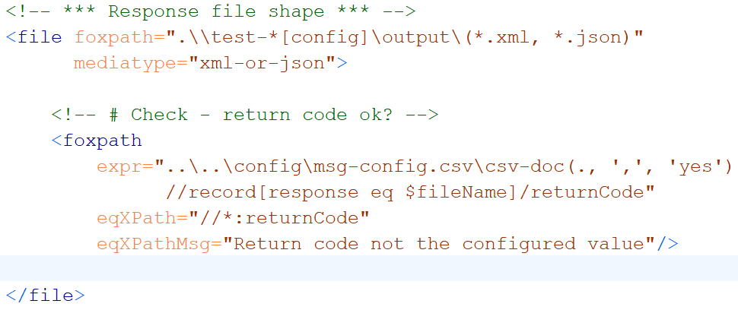
File resource values using foxpath
Resource value expected return code,
fetched from a distant CSV

Slide 22
Exploring files with shifting focus nodes

Slide 23
User-defined constraints

Slide 24
Unification of mediatypes – XDM node trees

Slide 25
Unification of navigation – f o x p a t h

Slide 26
Extensibility
New Constraint components
Core
User-defined
New Resource value mappers
SPARQL ?
Python ?

Slide 27
ABCDEFGreenfox
Unified view
A – XML datamodel (XDM)
+ B – XML technology (XPath, XQuery)
+ C – XML technology-extrapolated (foxpath)
+ D – RDF datamodel
+ E – RDF technology (not yet – future?)
+ F – RDF/SHACL validation model
=
Greenfox
Extensibility

Slide 28
Constraint component
Like a library function
Signature
Implementation („Validator“)

Slide 29

...
XML
RDF
Notes:
The more you think about it, the more amazing the complementary character of XML and RDF becomes. It is mind-boggling. There is so much promise in combining the two intelligently.

Slide 30
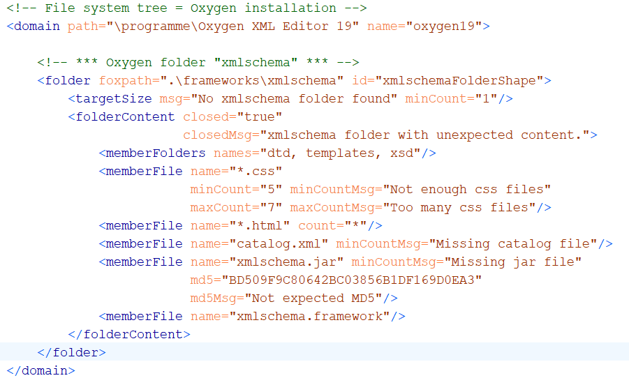
Example: constraining folder content

Slide 31
Complementary
Complementary
XML RDF
+
-
The art of addressing information
A graph is a labyrinth
-
+
The bias of containment
The art of relating information
Notes:
The power of XML technology is based on an ingenious concept of addressing information, XPath. It presupposes tree structure. On the one hand, this is no problem, as trees are ubiquitous. On the other hand, we should remember that trees are based on the containment relationship – for example, a book element contains author elements., and containment is pretty arbitrary. Is it not the other way around, an author should contain books? It depends on the focus of your interest, on where you stand. Like in real life, where the tree is behind the house, but the house is behind the tree. This means that XML structure is tied to specific perspectives and may be not appropriate for enterprise modeling and for enterprise data repositories. This cuts XML off from realizing its full potential. Enters RDF, which excels in relating information without assuming containment. The RDF model is fit for capturing the complex reality of an enterprise, and RDF triple stores may be used as a single point of truth, servicing a wide range of information needs. However, what you get is a graph, and graphs are hard to understand and process. Conclusion: XML and RDF are complementary.

Slide 32
Integration
RDF
What does integration mean?
Transformation
RDF => XML e.g. RDF-based msgs
XML => RDF e.g. msg-based RDF update
Mutual support (sharing functionality)
- XML document URIs provided by SPARQL
- RDF graphs constructed by XSLT
Notes:
What does their integration mean? Above all, two things: free transformation between the two formats, and mutual support – one technology using functionality offered by the other. For example, an XQuery processor might launch SPARQL queries in order to discover relevant document URIs. But the heart of integration is, I think, transformation. It enables us to use RDF triple stores as a single point of truth which communicates with the world via tree-structured messages.

Slide 33
Equivalent
XML RDF
Information object
Element Resource
ChildItem foo Property foo
ChildItem bar Property bar
<Customer CustomerID="o:AL999">
<LastName>Perez</LastName>
<FirstName>Deborah</FirstName>
<LoyaltyProg>900</LoyaltyProg>
</Customer>
o:AL900
e:LastName "Perez";
e:LastName "Deborah";
e:LoyaltyProg 800 .
Notes:
How to approach the challenge of transformation? Let us start by exploring the intrinsic relationship between the two. In spite of their outward differences, XML and RDF are built on common ground - a common abstraction – which I suggest to call an information object. It is a container of named values, which may be atomic (like strings or numbers) or themselves containers of named values. RDF calls the containers and their values: resources and their properties. XML calls them elements and their child elements and attributes. I call it an information object and its properties.

Slide 34
What to expect
Integrate graph and tree – why? how?
SHACL - new RDF schema language (W3C)
SHAX - XML syntax for SHACL
SHAX = abstract modeling language
= describing RDF, XML, JSON, ...
Notes:
A brief look at what to expect. I shall start with an argument why the integration of graph and tree is so compelling a challenge. We shall glance at SHACL, the new schema language for RDF, and then I shall introduce you to SHAX, an XML syntax for SHACL. In the end, I shall argue that SHAX is not only an XML syntax for SHACL, but a data modeling language in its own right, an abstract language which cannot only validate RDF, but also XML and JSON data.

Slide 35
Constraint
Constraint declaration
Like a function call:
IRI
Parameters
Implicit input:
resource property (intrinsic – e.g. „LastModified“)
resource value (extrinsic – produced by expression)
LastModifiedGe
<lastModified ge="2020-01-01"/>
<xpath expr="//returnCode"
eq="OK" />
ExprValueEq

Slide 36
Generic mapping (= canonical transformation)
RDF XML
==========================================================
Resource node Complex element
Blank node Complex element without @rdf:about
Literal Simple element content or attribute value
Resource IRI Value of attribute @rdf:about;
Alternative: value found at a configurable XPath
Property IRI Element name, attribute name
Notes:
This perception leads immediately to a generic mapping between RDF and XML data – a canonical transformation!

Slide 37
Theory, and practise
Usually, ...
the Generic Mapping needs tweaking
in order to satisfy real world requirements
We need models ...
=
knowledge, where to expect what
renames
filtering
Additional grouping
Notes:
In theory, we are almost done: we can translate the generic mapping into generic code, and then we have a transformation machine for XML and RDF. But usually the result of our generic mapping will fail to meet the real world requirement to be focussed, intuitive and elegant. Think of a message – we want it to look purpose-built, and not like a translation of something else. As in natural language, a translation betraying its being a translation is ugly. We need to tweak the model, and to do so we must know exactly where to expect what. Which is another way of saying: we need models – on both sides of the wall.

Slide 38
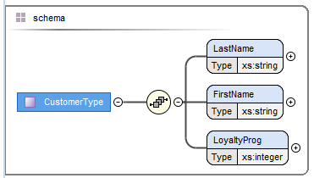
Transformation
XML RDF
D A T A
Element Resource
<Customer>
<LastName>Perez</LastName>
<FirstName>Deborah</FirstName>
<LoyaltyProg>900</LoyaltyProg>
</Customer>
o:AL900 e:FirstName "Deborah";
e:LastName "Perez";
e:LoyaltyProg 800 .
Transformation
Element model
Resource model
XSD
?
M O D E L
Notes:
On the XML side, we have XSD, which gives us what we need – a prcise picture of the grammatical structure. With the RDF side, we have a problem. OWL, the main modeling language of RDF, is designed for inference, not for validation and prediction. OWL models cannot tell us exactly where to expect what. They are not appropriate for guiding transformation.

Slide 39
Alignment
XML RDF
D A T A
Element Resource
<Customer>
<LastName>Perez</LastName>
<FirstName>Deborah</FirstName>
<LoyaltyProg>900</LoyaltyProg>
</Customer>
o:AL900 e:FirstName "Deborah";
e:LastName "Perez";
e:LoyaltyProg 800 .
Transformation
Element model
Resource model
Alignment
XSD
SHACL
M O D E L
Notes:
Fortunately, last year a new schema language for RDF has appeared – SHACL. Like XSD, SHACl can describe the data grammar precisely, and thus we have two models which can be aligned. This should enable high quality transformation of data.

Slide 40
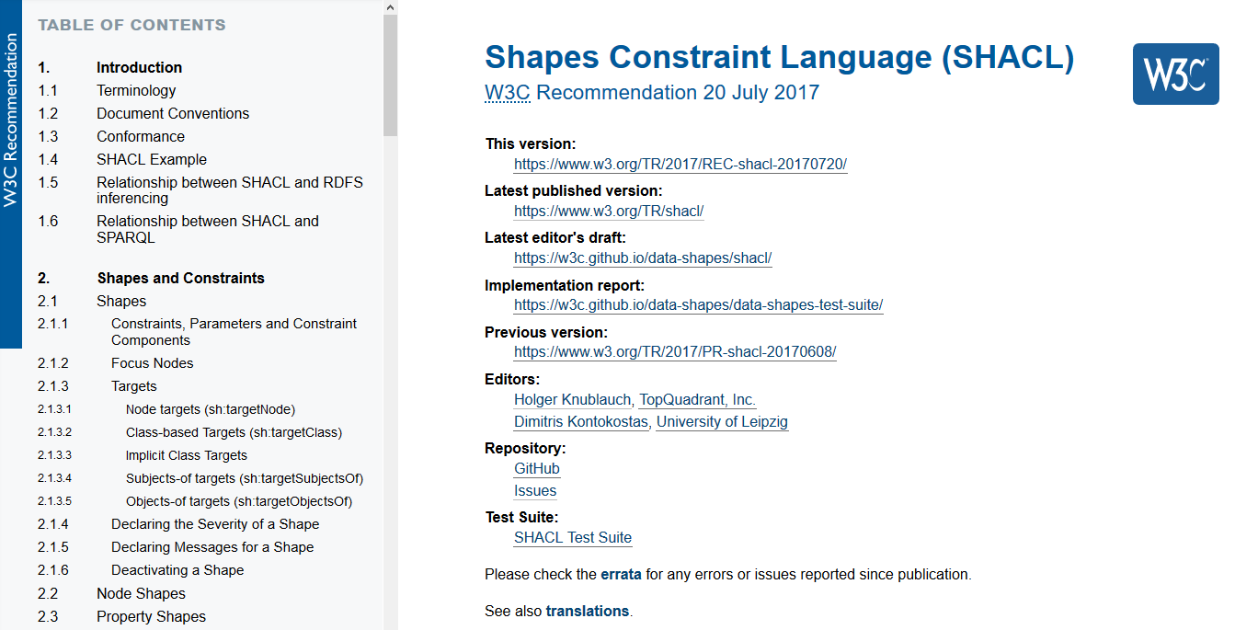
SHACL
This document specifies SHACL (Shapes Constraint Language),
a language for describing and validating RDF graphs.
Notes:
SHACL is a W3C recommendation. The first sentence of the spec characterizes the language as a language for describing and validating RDF graphs.

Slide 41
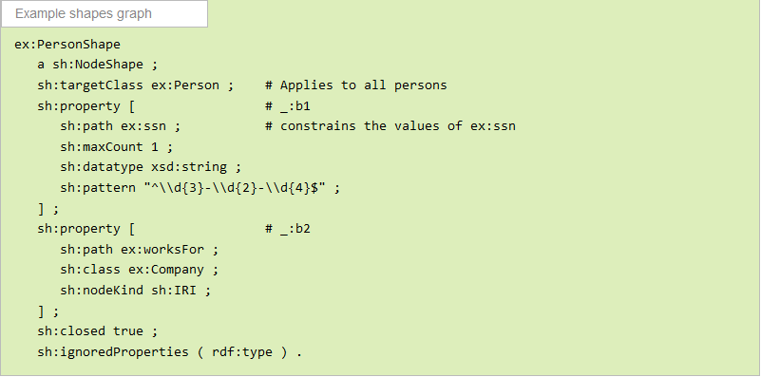
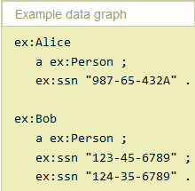
SHACL
≈ XSD ...
≈ XSD
Notes:
The first thing to notice is that SHACL is itself an RDF vocabulary – just like XSD is an XML vocabulary. This little model (taken from the introduction of the spec) describes resources belonging to the RDF class „Person“. According to the model, such resources have two properties – a social security number and the companies the person works for. The model names the properties and constrains their cardinality and data types. On the right-hand side you see RDF data which belong to the Person class. They have the expected properties, and yet they violate the shape – in one case, a regex pattern, in the other a cardinality constraint. The model describes and validates the RDF data exactly like an XSD describes and validates XML data. At a first and superficial glance, SHACL is XSD for graphs.

Slide 42
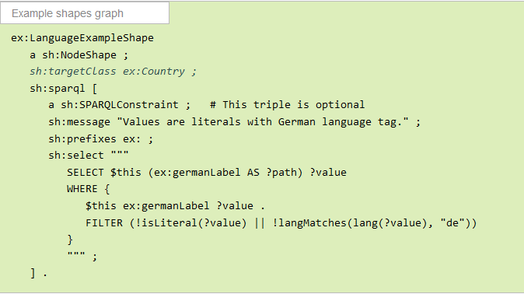
SHACL
≈ XSD
+ Schematron
≈ Schematron
Notes:
But SHACL has also features similar to Schematron. So a short formular for SHACL is XSD + Schematron for RDF.

Slide 43
SHACL – a breakthrough for integration?
Upside
RDF data can be validated (at last!)
RDF data can be modelled for dev purposes =
exact picture where to expect what
Issues
RDF syntax ...
Few professionals are familiar
Very limited tool support
Grammatical structure not always explicit
(No explicit support for choice groups )
Notes:
Now – is SHACL a breakthrough for the integration of XML and RDF? I think it is a significant and necessary step. At last, RDF data can be modelled in a way which gives an exact picture where to expect what. But there are also issues...

Slide 44
Why SHAX (XML syntax for SHACL)
Simplicity
Simple to write and read
Simple to transform and process
Simple to generate (e.g. from XSD)
Abstraction
More abstract representation of grammatical intent
Single source for multiple model styles
Unification
SHAX => SHACL, XSD, JSON Schema
Notes:
The solution to these problems might be XML – an XML syntax for SHACL, which I call SHAX. It promises benefits which I divide into three categories. Let us check to which degree SHAX realizes these potential benefits.

Slide 45
<shax:model xmlns:shax="http://shax.org/ns/model" xmlns:e="http://..."
<shax:objectType name="e:PersonShape" targetClass="e:Person"> <e:ssn base="xsd:string" pattern="^\\d{3}-\\d{2}-\\d{4}$" card="?"/> <e:worksFor class="e:Company" card="*"/> </shax:objectType>
</shax:model>
SHAX
SHACL
Notes:
To get started, this slide shows a SHAX representation of the trivial SHACL model shown before. A resource is modelled by an objectType element. Its child elements represent the properties of the resource, after which they are named. Their attributes specify cardinality constraints and type details. In order to get a better impression of SHAX, let us evolve our model a little...

Slide 46
<shax:model xmlns:shax="http://shax.org/ns/model" xmlns:e="http://..."
<shax:objectType name="e:PersonShape" targetClass="e:Person"> <e:ssn base="xsd:string" pattern="^\\d{3}-\\d{2}-\\d{4}$" card="?"/> <e:worksFor type="e:CompanyShape" card="*"/> </shax:objectType>
<shax:objectType name="e:CompanyShape" targetClass="e:Company"> <e:companyName type="xsd:string"/> <e:companyCode type="xsd:string"/> </shax:objectType>
</shax:model>
SHAX
Notes:
First we notice that the second property of a person does not yet specify type information – what is the structure of a company? We introduce a second object type describing company resources, and we let the worksFor property element reference that type definition via an @type attribute.

Slide 47
<shax:model xmlns:shax="http://shax.org/ns/model" xmlns:e="http://..."
<shax:objectType name="e:PersonShape" targetClass="e:Person"> <e:ssn base="xsd:string" pattern="^\\d{3}-\\d{2}-\\d{4}$" card="?"/> <e:worksFor type="e:CompanyShape" card="?"/> </shax:objectType>
<shax:objectType name="e:CompanyShape" targetClass="e:Company"> <e:companyName type="xsd:string"/> <shax:choice> <e:companyCode type="xsd:string"/> <shax:pgroup> <e:repoCode type="xsd:integer"/> <e:repoEntryNumber type="xsd:integer"/> </shax:pgroup> </shax:choice> </shax:objectType>
</shax:model>
SHAX
Notes:
Then we add a little grammar – our company model contains a choice of properties. This is straightforward, using a shax:choice element, whose child elements represent the choice branches. If a branch contains several properties, they are wrapped in a shax:pgroup element.

Slide 48
<shax:model xmlns:shax="http://shax.org/ns/model" xmlns:e="http://..."
<shax:objectType name="e:PersonShape" targetClass="e:Person"> <e:ssn type="e:SsnShape" card="?"/> <e:worksFor type="e:CompanyShape" card="*"/> </shax:objectType>
<shax:objectType name="e:CompanyShape" targetClass="e:Company"> <e:companyName type="xsd:string"/> <shax:choice> <e:companyCode type="xsd:string"/> <shax:pgroup> <e:repoCode type="xsd:integer"/> <e:repoEntryNumber type="xsd:integer"/> </shax:pgroup> </shax:choice> </shax:objectType>
<shax:dataType name="e:SsnShape"
base="xsd:string"
pattern="^\\d{3}-\\d{2}-\\d{4}$"/>
</shax:model>
SHAX
Notes:
Now we get rid of the local declaration of a simple data type – we introduce a global data type definition which is referenced by the property element again via @type attribute.

Slide 49
<shax:model xmlns:shax="http://shax.org/ns/model" xmlns:e="http://..."
<shax:objectType name="e:PersonShape" targetClass="e:Person"> <e:ssn type="e:SsnShape" card="?"/> <e:worksFor type="e:CompanyShape" card="*" ordered="true"/> </shax:objectType>
<shax:objectType name="e:CompanyShape" targetClass="e:Company"> <e:companyName type="xsd:string"/> <shax:choice> <e:companyCode type="xsd:string"/> <shax:pgroup> <e:repoCode type="xsd:integer"/> <e:repoEntryNumber type="xsd:integer"/> </shax:pgroup> </shax:choice> </shax:objectType>
<shax:dataType name="e:SsnShape"
base="xsd:string"
pattern="^\\d{3}-\\d{2}-\\d{4}$"/> </shax:model>
SHAX
Notes:
Finally, we introduce order into our model – we want the values of the worksFor property to be an ordered list. To achieve this, we just add an @ordered attribute to the property element.

Slide 50
@prefix sh: <http://www.w3.org/ns/shacl#> . @prefix shax: <http://shax.org/ns/model#> . @prefix _e: <http://shax.org/ns/model/element-equivalent#> . @prefix xsd: <http://www.w3.org/2001/XMLSchema#> . @prefix e: <http://example.org/ns/model#> . e:PersonShape a sh:NodeShape; sh:targetClass e:Person; sh:property [ sh:path e:ssn; sh:maxCount 1; sh:node e:SsnShape; ]; sh:property [ sh:path e:worksFor; sh:node shax:ListType; sh:property [ sh:path ([sh:zeroOrMorePath rdf:rest] rdf:first); sh:node e:CompanyShape; ]; ]. e:CompanyShape a sh:NodeShape; sh:targetClass e:Company; sh:property [ sh:path e:companyName; sh:minCount 1; sh:maxCount 1; sh:datatype xsd:string; ]; sh:xone ( [ a sh:NodeShape ; sh:not [ a sh:NodeShape; sh:or ( [ sh:path e:repoCode ; sh:minCount 1 ; ] [ sh:path e:repoEntryNumber ; sh:minCount 1 ; ] ); ] ;
sh:property [ sh:path e:companyCode; sh:minCount 1; sh:maxCount 1; sh:datatype xsd:string; ] ; ] [ a sh:NodeShape ; sh:not [ sh:path e:companyCode; sh:minCount 1; ] ; sh:property [ sh:path e:repoCode; sh:minCount 1; sh:maxCount 1; sh:datatype xsd:integer; ] ; sh:property [ sh:path e:repoEntryNumber; sh:minCount 1; sh:maxCount 1; sh:datatype xs:integer; ] ; ] ). e:SsnShape a sh:NodeShape; sh:datatype xsd:string; sh:pattern "^\\d{3}-\\d{2}-\\d{4}$". shax:ListType a sh:NodeShape ; sh:xone ( [ a sh:NodeShape ; sh:in (rdf:nil) ; ] [ a sh:NodeShape ; sh:property [ sh:path rdf:first ; sh:minCount 1; sh:maxCount 1; ] ; sh:property [ sh:path rdf:rest ; sh:minCount 1; sh:maxCount 1; ] ] ) .
SHACL
Notes:
For comparison, here is the SHACL code into which our SHAX model is compiled. It think it is more difficult to read and to write, and probably more difficult to process or generate.

Slide 51
SHAX – summary
XSD equivalent
Building blocks
objectType ~ xs:complexType
dataType ~ xs:simpleType
property ~ xs:element (top-level)
import ~ xs:import, xs:include
Advanced features
Union types ~ xs:union
Type extension ~ xs:extension
Substitution groups ~ @substitutionGroup
Notes:
After the example, a brief summary of SHAX – its building blocks and advanced features. The example showed objectTypes and dataTypes. We also saw properties, but they were locally defined within the objectType. Properties can also be globally defined and referenced within the object types. Global properties are equivalent to top-level element declarations in XSD.

Slide 52
SHAX is an abstract language
SHACL
RDF
SHAX
XSD
XML
translates into
JSON
JSON
constrains
Schema
≈ is equivalent
Notes:
SHAX can be translated into SHACL – but also into XSD and JSON Schema. Thus SHAX can be viewed as an abstract modeling language: used to build abstract data models which constrain structures and data types, and yet do not presuppose a particular data representation language (XML, RDF, JSON). The next slides give you an impression of SHAX and its translations.

Slide 53
<shax:model xmlns:shax="http://shax.org/ns/model" xmlns:e="http://..."
<shax:objectType name="e:PersonShape" targetClass="e:Person"> <e:ssn type="e:SsnShape" card="?"/> <e:worksFor type="e:CompanyShape" card="*" ordered="true"/> </shax:objectType>
<shax:objectType name="e:CompanyShape" targetClass="e:Company"> <e:companyName type="xsd:string"/> <shax:choice> <e:companyCode type="xsd:string"/> <shax:pgroup> <e:repoCode type="xsd:integer"/> <e:repoEntryNumber type="xsd:integer"/> </shax:pgroup> </shax:choice> </shax:objectType>
<shax:dataType name="e:SsnShape"
base="xsd:string"
pattern="^\\d{3}-\\d{2}-\\d{4}$"/>
</shax:model>
SHAX
Notes:
First, once more, our little SHAX model.

Slide 54
<xs:schema xmlns:a="http://example.org/ns/model"
xmlns:xs="http://www.w3.org/2001/XMLSchema"
targetNamespace="http://example.org/ns/model"
elementFormDefault="qualified"> <xs:complexType name="PersonShape"> <xs:sequence> <xs:element name="ssn" type="a:SsnShape" minOccurs="0"/> <xs:element name="worksFor" type="a:CompanyShape" minOccurs="0"
maxOccurs="unbounded" </xs:sequence> </xs:complexType> <xs:complexType name="CompanyShape"> <xs:sequence> <xs:element name="companyName" type="xs:string"/> <xs:choice> <xs:element name="companyCode" type="xs:string"/> <xs:sequence> <xs:element name="repoCode" type="xs:integer"/> <xs:element name="repoEntryNumber" type="xs:integer"/> </xs:sequence> </xs:choice> </xs:sequence> </xs:complexType> <xs:simpleType name="SsnShape"> <xs:restriction base="xs:string"> <xs:pattern value="\\d{3}-\\d{2}-\\d{4}"/> </xs:restriction> </xs:simpleType> </xs:schema>
XSD
Notes:
It can be translated into this XSD ....

Slide 55
{ "$schema":"http://json-schema.org/draft-04/schema#", "type":"object", "properties":{ "Person":{ "type":"object", "properties":{ "ssn":{ "$ref":"#/definitions/a:SsnShape" }, "worksFor":{ "type":"array", "maxItems":999, "items":{ "type":"object", "properties":{ "companyName":{ "$ref":"#/definitions/xs:string" }, "companyCode":{ "$ref":"#/definitions/xs:string" }, "repoCode":{ "$ref":"#/definitions/xs:integer" }, "repoEntryNumber":{ "$ref":"#/definitions/xs:integer" } }, "additionalProperties":false, "required":[ "companyName" ],
"oneOf":[ { "required":[ "companyCode" ] }, { "required":[ "repoCode", "repoEntryNumber" ] } ] } } }, "additionalProperties":false } }, "definitions":{ "a:SsnShape":{ "type":"string", "pattern":"^\\\\d{3}-\\\\d{2}-\\\\d{4}$" }, "xs:integer":{ "type":"integer" }, "xs:string":{ "type":"string" } } }
JSON Schema
Notes:
.... or into this JSON schema.

Slide 56
@prefix sh: <http://www.w3.org/ns/shacl#> . @prefix shax: <http://shax.org/ns/model#> . @prefix _e: <http://shax.org/ns/model/element-equivalent#> . @prefix xsd: <http://www.w3.org/2001/XMLSchema#> . @prefix e: <http://example.org/ns/model#> . e:PersonShape a sh:NodeShape; sh:targetClass e:Person; sh:property [ sh:path e:ssn; sh:maxCount 1; sh:node e:SsnShape; ]; sh:property [ sh:path e:worksFor; sh:node shax:ListType; sh:property [ sh:path ([sh:zeroOrMorePath rdf:rest] rdf:first); sh:node e:CompanyShape; ]; ]. e:CompanyShape a sh:NodeShape; sh:targetClass e:Company; sh:property [ sh:path e:companyName; sh:minCount 1; sh:maxCount 1; sh:datatype xsd:string; ]; sh:xone ( [ a sh:NodeShape ; sh:not [ a sh:NodeShape; sh:or ( [ sh:path e:repoCode ; sh:minCount 1 ; ] [ sh:path e:repoEntryNumber ; sh:minCount 1 ; ] ); ] ;
sh:property [ sh:path e:companyCode; sh:minCount 1; sh:maxCount 1; sh:datatype xsd:string; ] ; ] [ a sh:NodeShape ; sh:not [ sh:path e:companyCode; sh:minCount 1; ] ; sh:property [ sh:path e:repoCode; sh:minCount 1; sh:maxCount 1; sh:datatype xsd:integer; ] ; sh:property [ sh:path e:repoEntryNumber; sh:minCount 1; sh:maxCount 1; sh:datatype xs:integer; ] ; ] ). e:SsnShape a sh:NodeShape; sh:datatype xsd:string; sh:pattern "^\\d{3}-\\d{2}-\\d{4}$". shax:ListType a sh:NodeShape ; sh:xone ( [ a sh:NodeShape ; sh:in (rdf:nil) ; ] [ a sh:NodeShape ; sh:property [ sh:path rdf:first ; sh:minCount 1; sh:maxCount 1; ] ; sh:property [ sh:path rdf:rest ; sh:minCount 1; sh:maxCount 1; ] ] ) .
SHACL
Notes:
Or into this SHACL.

Slide 57
SHAX can be generated ...
from XSD
Notes:
SHAX is easy to read and write. But even more easy it is to generate them – from XSD. Thus tons of modeling work can be launched into the RDF space.

Slide 58
SHAX processor
SHAX => SHACL
SHAX => XSD
SHAX => JSON Schema
XSD => SHAX
https://github.com/hrennau/shax
call shax "shacl?shax=person.shax" > person.shacl.ttl
call shax "xsd ?shax=person.shax" > person.xsd
call shax "jsch ?shax=person.shax" > person.jschema
call shax "shax ?xsd=person.xsd" > person.shax
Notes:
The translation work is accomplished by a SHAX processor. A prototype is available at github. Disclaimer: the translation into JSON Schema is still work in progress and will be released by the end of the month.

Slide 59
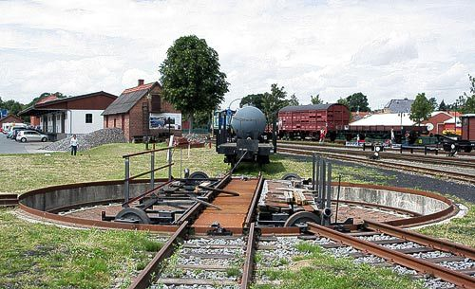
SHAX as a pivot?
SHAX
JSON
XML
RDF
Notes:
So I wonder if SHAX might be used as a pivot, a turning point where to bring your model work in order to let it travel into a different country. Much work ahead, to make everything as robust and comprehensive as needed, but I think the concept has been proved. Anybody showing interest – reporting bugs or requesting features – would help enormously.

Slide 60
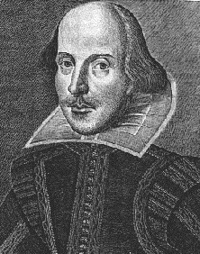
Idea still in need of other minds ...
Shaxpeare
Notes:
In particular conceptionally, I feel that SHAX is an idea which is still in need of other minds. Perhaps someone will join me who shares my interest in elaborating the concept of an abstract modeling language – in connecting the seemingly unconnected. Could this be YOU?

Slide 61
Thank you !
SHACL~~~XSD~~~JSON Schema
XSD~~~JSON Schema~~~SHACL
SHAX
JSON Schema~~~SHACL~~~XSD
SHAX
SHACL~~~XSD~~~JSON Schema
XSD~~~JSON Schema~~~SHACL
JSON Schema~~~SHACL~~~XSD

