Slide 1
Greenfox
A schema language for
validating file systems
Hans-Jürgen Rennau, parsQube GmbH
Presented at xmlprague 2020, February 15, 2020
Notes:
This is an introduction to greenfox, a schema language for validating file systems.

Slide 2
Greenfox: definition
Greenfox is a language for validating
file system trees* against a set of conditions.
*[
file system tree =
a folder + all folders and files directly or indirectly contained
]
Notes:
Upfront, it is important to understand that the scope is not the file system as a whole – as investigated by a Virenscanner. No – the scope is a file system tree, consisting of an arbitrarily selected root folder and any folders and files directly or indirectly contained.

Slide 3
File system validation
Why?
What, precisely?
How?
Notes:
Let us start with considering why one might be interested in file system validation; then ask what „validation“ exactly means in this context; and then look at how it is done.

Slide 4
Conventional validation – some basic limitations
Limitation 1:
Expectations about resources are static –
ignoring dependence on other resources (their presence and contents)
Limitation 2:
Files are the input – their presence or absence is out of scope -
whereas the real problem may be the absence of a file
Limitation 3:
The limit of declarativeness is a set of tightly coupled schemas
describing a set of related document types
Notes:
We are used to validation of an individual file against a schema, like XSD, JSON Schema or Schematron. And we know how such validation can be crucial for ensuring reliability, interoperability, etc. But any non-trivial project is represented by many resources – especially files and folders. From this perspective, the validation of single files is a piece from a jigsaw puzzle. Or not event that – as the whole may be more than the sum of its parts. Often, validation of one resource must be performed in a different way, dependent on the presence and contents of other resources, whereas our jigsaw puzzle pieces are unconcerned with such dependencies. And it is also important that the absence of a file may be the real problem, but this is out of scope for conventional validation, which is conditional on the presence of its input. Finally, considering the huge value of declarativeness, it is frustrating to note that the limit of declarativeness in conventional validation is a set of tightly coupled schemas describing a set of related document types. In short – we SHOULD be able to perform file system validation, to validate the contents of a file system tree in a comprehensive way, honouring dependencies, checking the occurrence of files and producing a single, comprehensive report.

Slide 5
What, precisely?
Folder/file properties (e.g. last modification date)
Folder contents
File contents
Schema-valid (XSD, JSON Schema, SHACL, …)
Rules conformant („If contains Foo, contains Bar“)
Folder/file content dependencies:
File A exists => file B exists
File A exists => file B contains Bar
File A contains Foo => file B exists
File A contains Foo => file B contains Bar
Notes:
What does „file system validation“ mean? … How can a schema express such constraints and bring them into a clear structure?

Slide 6
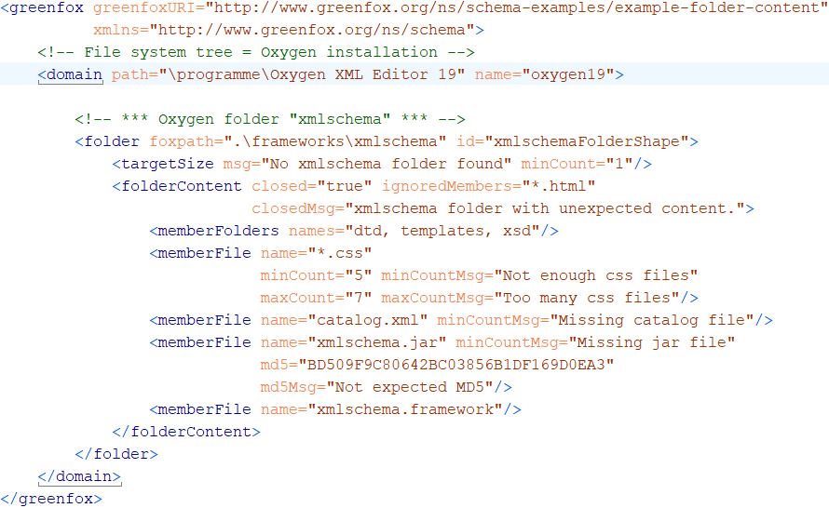
A first schema, with a folder shape
Folder content constraints
Notes:
Here comes a first, simple, yet complete, example. This schema describes the contents of a single folder. A greenfox schema has a <greenfox> root element, assigning to the schema a URI for identification and reference. The <domain> element identifies the root folder of the file system tree. The contents of the <domain> element describe the contents of the file system tree. In this case, the description is limited to a single folder shape represented by a <folder> element. A folder shape does not necessarily describe a single folder. It may describe many folders, or even no folder it all. What it describes is the set of all folders which are in its target. The target is defined by a target declaration. Let‘s take a closer look.

Slide 7
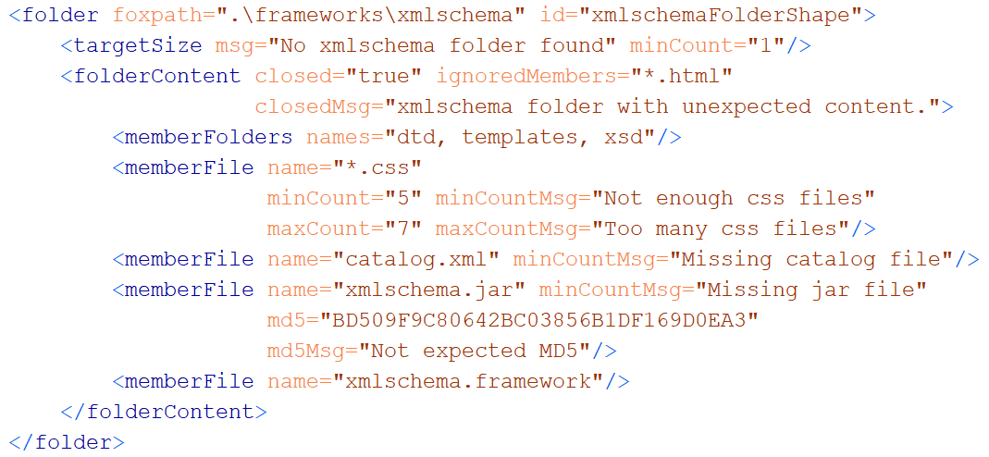
A folder shape
Features to remember
(a) wildcards + min/maxCount (b) hash keys (c) closed?
Notes:
The foxpath attribute is the target declaration. Foxpath is an extended version of XPath 3.0, supporting file system navigation and also the mixing of node tree and file system navigation within a single expression. The language is very convenient for selecting a target for validation in the most flexible way. We‘ll take a closer look at target declarations in a moment. For now, it suffices to understand that a folder shape declares constraints which are applied to every folder selected by the target declaration. Look at the <folderContent> element, which describes the folder contents. Perhaps you expected such a content description to be a list of folder and file names, not more. However, folder contents can be constrained in a more flexible way. Note for example the wildcards, combined with cardinality constraints. Also note that a file may be associated with an expected hash key. The „closed“ attribute declares the folder to be closed - only folders and files as described by the child elements and the „ignoredMembers“ attribute may appear in the folder.

Slide 8
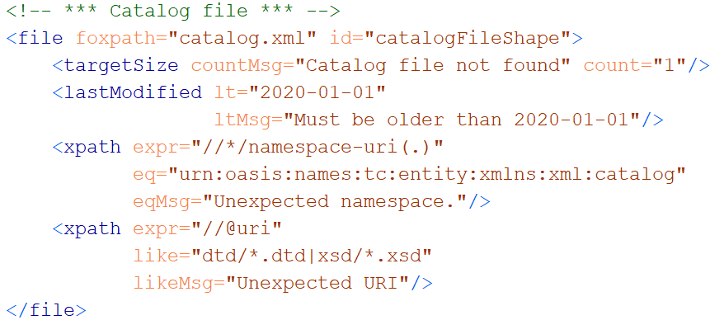
A file shape
Notes:
Now we take a look at a file shape. A file shape describes all files selected by its target declaration. As this file shape will be placed within the folder shape we just looked at, the foxpath expression is evaluated in the context of any folder in the target of the containing folder. Here it simply means that the described file is contained by the xmlschema folder. As mentioned before, a shape is a collection of constraints. Here, we have a LastModified constraint, with obvious semantics. The <xpath> elements are, formally speaking, not constraints, but value shapes. A value shape combines an expression mapping the resource to an XDM value, with constraints applied to that value. The first value shape maps the file to a sequence of all namespace URIs used. The constraint applied to this value is an ExpressionValueEqual constraint: every item of the expression value must be equal to the string given by the @eq attribute. The second value shape maps the file to a sequence of all URIs found in @uri attributes. This value is submitted to an ExpressionValueLike constraint – every item must match the pattern provided by the @like attribute.

Slide 9
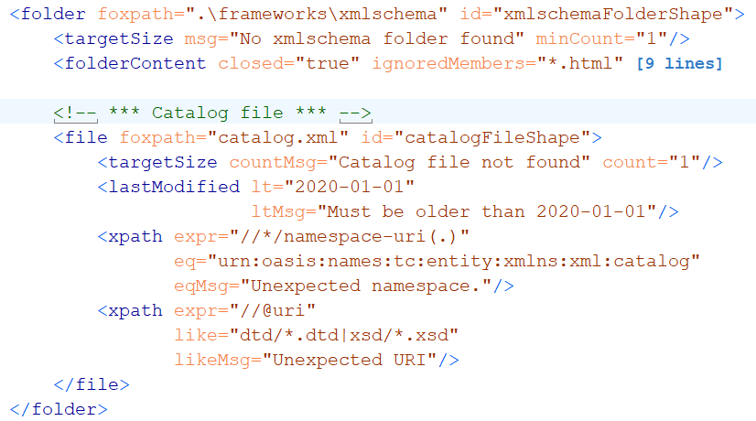
A folder shape, containing a file shape
Notes:
We place the file shape inside the folder shape. What does that mean? Every folder in the target of the folder shape is validated against the folder shape. For every folder in the target of the folder shape, the target of the contained file shape is evaluated, and every file in that target is validated against the file shape. Compare this to an XPath expression, where every step is evaluated in the context of the preceding step. Here, every shape is evaluated in the context of the containing shape, which means that the own target declaration is evaluated in the context of every resource selected by the containing resource. Note that the resources selected by the nested shape are not necessarily found within the resources selected by the containing shape, as the target declaration may contain, for example, upward navigation. The following slide illustrates the flexibility of target declarations.

Slide 10
Target declarations (foxpath expressions)
Target declaration | Selection
catalog.xml | The catalog.xml file in the current folder
.\\catalog.xml | catalog.xml files under the current folder
.\\*[xsd[is-dir()]]\catalog.xml | As before, but only files in a folder containing an xsd folder considered
..\projects\\catalog.xml | All catalog.xml files in or under the projects sibling of the current folder
..\projects\\catalog.xml [//@rewritePrefix] | As before, but only files with a document containing @rewritePrefix considered
..\projects\\catalog.xml [//@rewritePrefix]\..\VERSION | First find files as described in the prece- ding row, then select the VERSION sibling
ancestor~::resources[1] \..\projects\\catalog.xml [string(file-date(.))] < '2020'] | Files found by first navigating up to the first resources ancestor, into its projects sibling, then down into all catalog.xml files, ignoring older files
Notes:
In this table, the term „current folder“ means a folder in the target of the shape containing the shape with the target declarations shown. The examples show that foxpath enables target declarations which are highly specific.

Slide 11
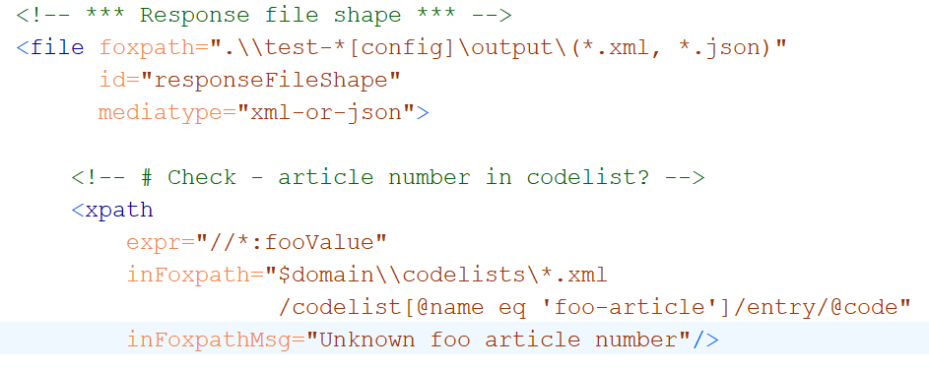
Cross-boundary navigation
Notes:
The folder and file shapes which we saw so far described the contents of the folder or file in question, and checking did not require knowledge about the surrounding world. This is not necessarily so - constraints may relate to information outside of the resource under investigation. In this example, we have a value shape selecting as value the fooValue elements in the current file. The constraint is that the value of all such elements are included in a codelist defined in a file found by a navigation across the file system.

Slide 12
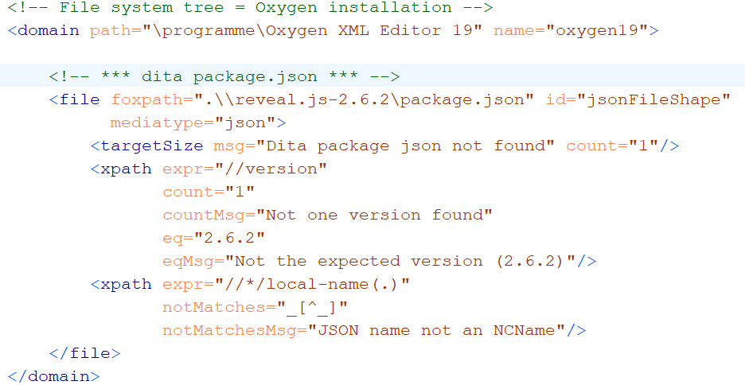
Validating JSON contents
Notes:
We have seen that greenfox allows you to constrain file contents using XPath expressions. Such constraints can also be used for non-XML files: JSON files, CSV files, HTML files. This example shows how a mediatype annotation suffices to make a JSON file accessible to XPath. The XML representation to which the XPath is applied is the XML representation as defined by BaseX. This is a format marked by great similarity with the original JSON, so that XPath expressions can be easily written, looking at the original JSON.

Slide 13
First impressions - summarized
File system validation can be described as:
Moving around …
Between the file system resources
within file contents
Comparing what is found to some constraints
Notes:
After these first impressions, let me emphasize key features of greenfox. As a starting point, consider this summary of first impressions.

Slide 14
Key feature #1 - XDM based
Value = XDM value
Value = sequence of items
Item
Atomic value (with a type from xsd)
XDM node (element, attribute, …)
Map or array (rarely used)
Function item (currently not used)
Notes:
So we need a data model suitable to support complex navigation and sophisticated value checking. Greenfox is based on the XDM data model. Every value describing or constraining a resource is an XDM value. Reminder: according to the model, a value is a sequence of items, and an item is either an atomic value, or an XDM node, or a map, or an array. (Function items, the last item type, is not considered by greenfox.)

Slide 15
Key feature #2 Navigation skills
Between resources
Within resources
Multi-mediatype
Cross-boundary:
Start inside file, …………… || …… arrive at a file-or-folder
Start at a file-or-folder, …… || …… arrive inside file
Start inside file A, ……....... || …… arrive inside file B
foxpath
XPath
XPath - extensions
foxpath
Notes:
Second key feature: advanced navigation skills.

Slide 16
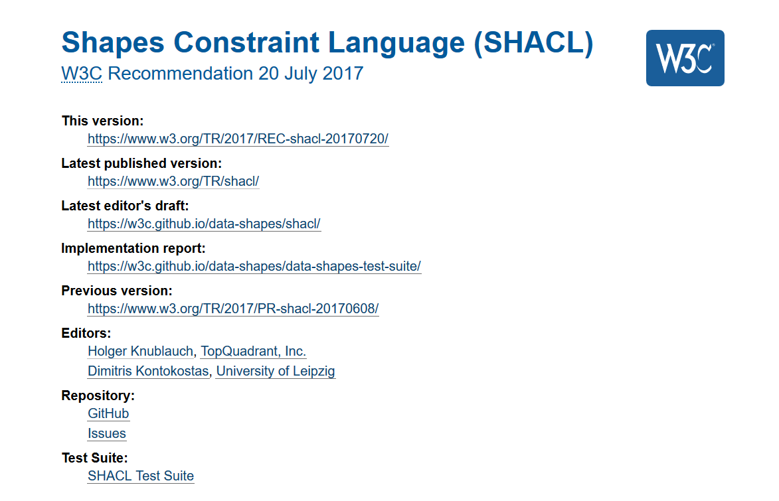
Key feature #3 Validation concept
Guided
by
SHACL
Notes:
The examples shown so far may have convinced you that the navigational skills are a sound base for designing a file system validation language. But there is a serious danger in losing oneself in a wealth of possibilities, ending up with a tangled heap of features added for the sake of checking this or checking that. Such an ill-designed language could not be really useful for more than a couple of people, knowing the tangled rules by heart. There would be little perspective for an evolution of the language, as further increases of functionality would likely make everything increasingly unmanegeable. In short – a file system validation language requires a solid base of clear concepts. Essentially, I found the concepts I needed in SHACL, the new validation language of RDF. Some additional abstraction allowed me to detach the basic SHACL concepts completely from RDF and make them ready for re-attachment to file system resources.

Slide 17

Concepts
Resource file, folder
Shape a set of constraints
Resource shape checks a resource
Target declaration selects resources
Constraints check resource properties
Value shape checks a resource value
Expression constructs a resource value
Constraints check the resource value
Notes:
Here they are, the key concepts.

Slide 18
Validation, decomposed
A decomposition in steps:
File system against schema
File system against single shape
Focus resources against a single shape
Focus resource against a single constraint

Slide 19
Validation, re-composed
An aggregation in steps:
File system against schema
File system against single shape
Focus resources against a single shape
Focus resource against a single constraint

Slide 20
Validation chemistry
Validation report = union of validation results
Validation result = outcome of validating …
ONE resource against ONE constraint
Result
. Conforms (boolean)
. ResourceIRI (file path)
. ConstraintComponentIRI (identifies semantics)
. ConstraintParameters (name-value pairs)
. Details (name-value pairs)
Notes:
So we have a validation chemistry of sorts, where every validation process is composed of elementary building blocks, which are the validation of a single resource against a single constraint. The result of file system validation is therefore just a collection of uniform building blocks, which are objects describing the validation of a single resource against a single constraint. These objects are uniform – structured according to a generic vocabulary, although allowing constraint specific extensions. And note that the result description is not tied to a mediatype. Rather, it is an RDF vocabulary mapped to an XML representation.

Slide 21

Pouring waters of validity
Notes:
The conceptual framework enables a rigorous definition of file system validation. Validation of the file system can be decomposed in several, clearly defined steps until you arrive at a collection of those base activities – validation of a single resource against a single constraint. Let us look at the formal definition, which is but a modified copy of the formal definition found in the SHACL spec. The result of validating a file system tree against a greenfox schema can be viewed as collecting drops of information and pouring them into a glass which is the overall validation result.

Slide 22
A check is always a check against a constraint !
Constraint declaration
Identifies a constraint component
Supplies parameter values
What is checked?
resource property
intrinsic – e.g. "LastModified" , "FileSize", "Mediatype"
resource value
extrinsic – obtained from arbitrary expression
Notes:
Understanding the basic idea of greenfox requires a clear understand what is checked, if a resource is checked. The abstract model of greenfox validation distinguishes resourcej properties and resource values. Properties are obvious – aspects like file size or last modification date. Resource values, on the other hand, are not predefined – they are obtained from an expression applied to the resource.

Slide 23
What a constraint perceives
Constraint
Resource properties
- predefined
Resource values
expression defined
may reflect content
may reflect surroundings
Resource
Notes:
The abstract metamodel does not prescribe how resource values are obtained – it does not prescribe a concrete expression language. Greenfox selected XPath and foxpath, which are not arbitrary expression languages, but fit like no other language I ever heard of to described navigation within and among resources. I believe that file system navigation is typically a set of activities which have a close relationship to navigation. Note one aspect: a resource value may express some quality found within the resource – e.g. within the contents of a folder, or within the node tree representing file content. But, very importantly, the values may also lie on the outside, e.g. be found in different files, or different folders, or different files found in different folders.

Slide 24
Example resource values
Expression | Expression lang | Meaning
count(airport) | XPath | # airport elements
exists(//airport) |  | Flag – with airport elements?
//airport[@href and *] | XPath | Selected airport elements
//airport/@href /resolve-uri(., ..)/doc(.) | XPath | Documents obtained resolving href links
.\\*.json | foxpath | File system paths of JSON files in the context folder
..\\*.json | foxpath | File paths of JSON files in a context-sibling folder
*.csv\csv-doc(., ',', 'yes') //Term => distinct-values() | foxpath | Distinct values extracted from CSV files in the current folder
..\\*.htm?[html-doc(.) //@href[contains(.,'niem'‚)]] | foxpath | File paths of HTML files referencing NIEM sites
Notes:
As you remember, the resource values are created by expressions found in values shapes. As the expression languages XPath and foxpath are supported, there are two kinds of value shapes – XPath shapes and foxpath shapes. Let us look at a few expressions creating resource values. Any XPath expression please imagine to be the value of an @expr attribute of an XPath value shape. Likewise, any foxpath expression imagine to the value of an @expr attribute of a foxpath value shape.

Slide 25
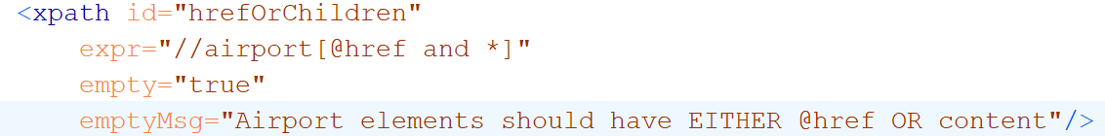
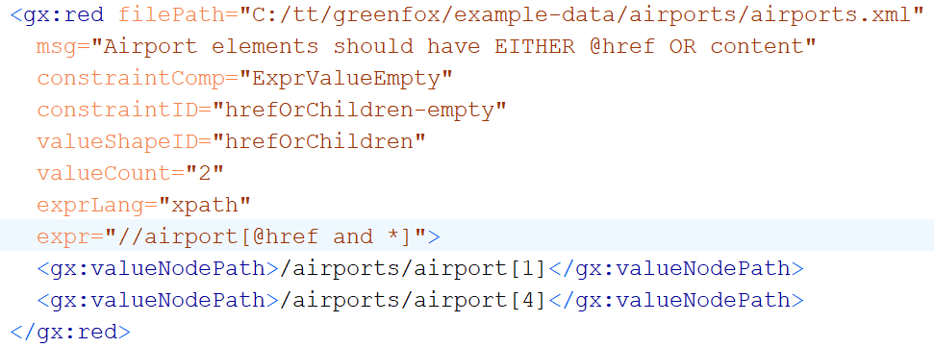
Constraining resource values
Constraint
Validation result
Notes:
And here a simple demonstration of how a value shape creates and constrains a resource value. In this example, the value is defined to be the list of all <airport> elements with an @href attribute and also child elements. The constraint disallows such elements, that is – an <airport> element should either have an @href, or have child elements, not both. Formally, the constraint can be expressed as an ExpressionValueEmpty constraint. This slide shows the value shape, and below a validation result reporting violations. The definition of validation results is closely aligned with the corresponding definitions from the SHACL spec, with some inevitable deviations caused by the very different material being validated.

Slide 26
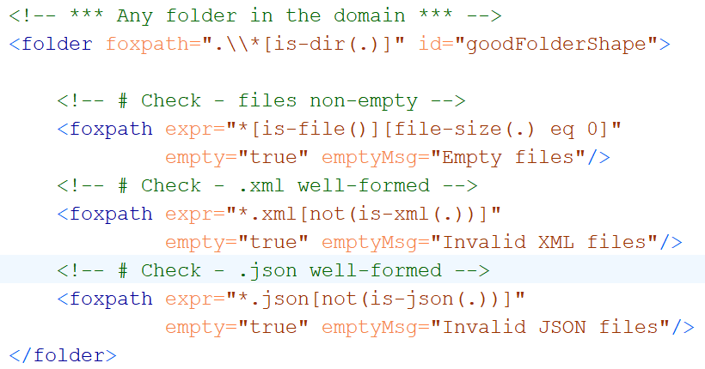
Folder resource values using foxpath
Resource value no empty files
Resource value no ill-formed XML
Resource value no ill-formed JSON
Notes:
Here comes an example of a folder using foxpath value shapes for ensuring some basic qualities. The resource values defined are: (a) empty files; (b) ill-formed XML files; (c) ill-formed JSON files. In all cases the value is submitted to the EmptyExpressionValue constraint. Violations will be listed in the validation results.

Slide 27
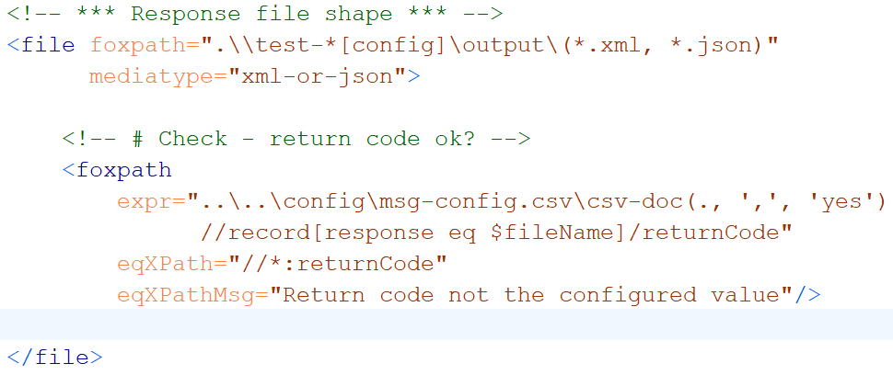
File resource values using foxpath
Resource value expected return code,
fetched from a distant CSV
Notes:
And here comes an example demonstrating how also file shapes may use foxpath shapes in order to define and check values found outside of the file itself. The foxpath expression returns the expected return code, fetched from the appropriate cell in a CSV file found in a distant folder. This external resource value is constrained to match an internal value, which is the actual return code.

Slide 28
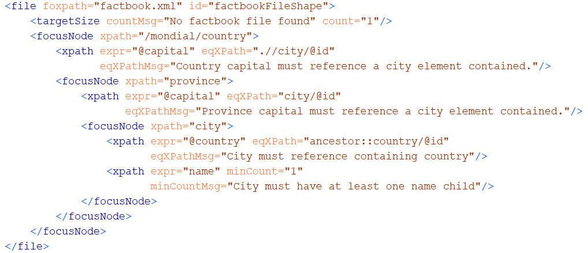
Exploring files with shifting focus nodes
Notes:
The definition of focus nodes enables a nicely structured validation of XDM contents – alternate steps of navigation selecting nodes of interest, and validation of these nodes. Each <focusNode> element defines a new validation context, which is the set of items selected by ist xpath or foxpath expression. The value shapes are re-evaluated for each item selected by the focus node, using this item as context item.

Slide 29
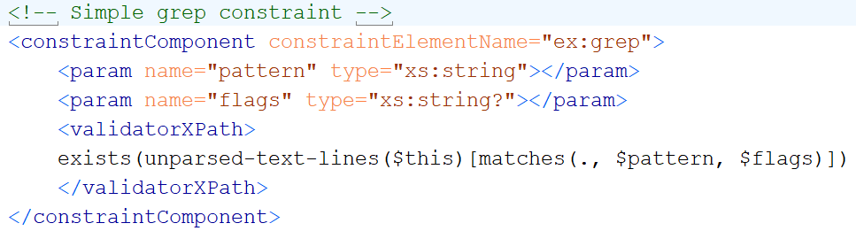
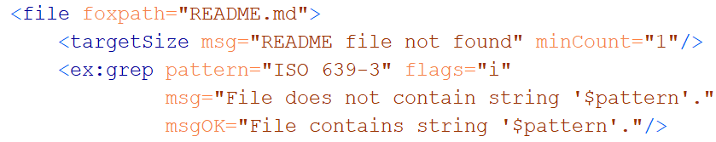
User-defined constraints
Constraint definition
Constraint declaration
Notes:
Another thing learned from SHACL how to support user-defined constraints. The concept is a constraint component, defined in terms of a name, a signature and a validator, which is code executing the validation. It is very easily done. The meta schema of greenfox, against which any schema is validated under the hood, consists in large parts of calls of such user-defined constraint components.

Slide 30

...
XML
RDF
Notes:
The more you think about it, the more amazing the complementary character of XML and RDF becomes. It is mind-boggling. There is so much promise in combining the two intelligently.

Slide 31
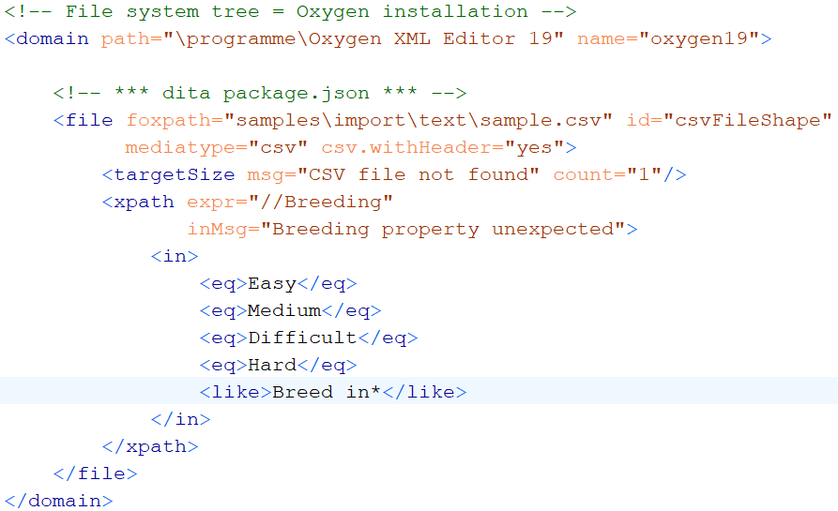
Validating CSV contents

Slide 32
Extensibility
New Constraint components
Core
User-defined
New Resource value mappers
SPARQL ?
Python ?

Slide 33
Unification of mediatypes – XDM node trees
XDM node trees supported for
XML
JSON foxpath function: json-doc()
HTML foxpath function: html-doc()
CSV foxpath function: csvdoc()
File shape attributes inform the processor
mediatype="json|html|csv|xml-or-json„
csv.separator="|"
csv.withHeader= "yes"

Slide 34
Validating JSON contents

Slide 35
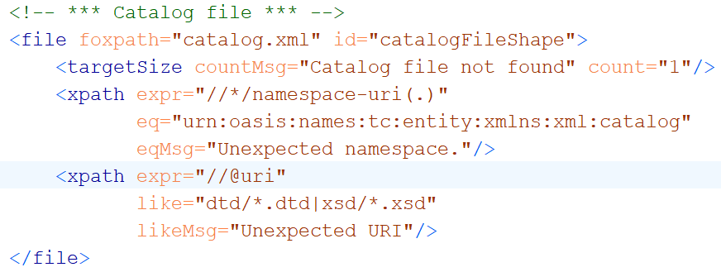
A file shape

Slide 36
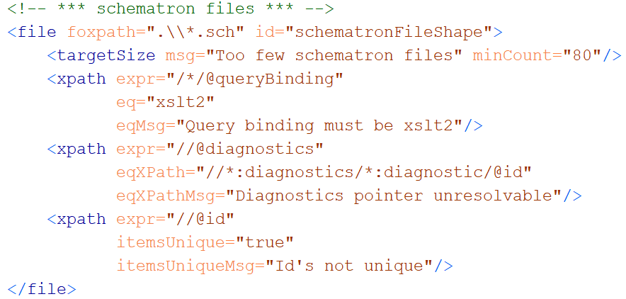
A file shape

Slide 37
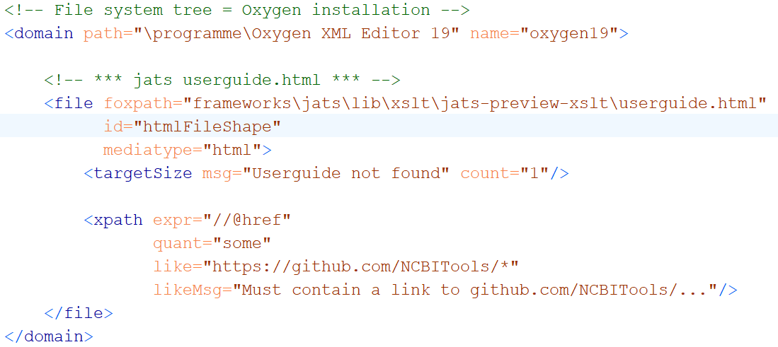
Validating HTML contents

Slide 38
File system validation – WHY?
Real-world systems:
If reflected by file system contents
Then validated by validating …
file system contents
Perform 10000 checks …
… and let each check leave a trace in the file system
A file / folder created / extended unconditionally
A file / folder created / extended if check OK
A file / folder created / extended if check NOTOK
=> CHECK THE FILE SYSTEM CONTENT
Notes:
We are used to validation of an individual file against a schema, like XSD, JSON Schema or Schematron. And we know how such validation can be crucial for ensuring quality, reliability, interoperability, etc. But any non-trivial project is represented by many file system resources – files and folders. In this context, the validation of single files is a piece from a jigsaw puzzle. I think we should be able to validate large and heterogeneous groups of resources in an integrated way, obtaining a single, comprehensive report. And we should be able to do so declaratively. That‘s what greenfox is intended to support. And also note that a file system tree may already exist, but it may also be deliberately produced as a representation of an arbitrary real-world system, receiving the output of numerous applications somehow investigating the system. The ability to validate such a file system representation means the ability of validating the real world system itself – if only in a limited way. Remember – before there is file system validation, the border of declarativeness is a single schema targeting a single document type. File system schemas overcome this limitation.

Slide 39
Unification of navigation – f o x p a t h

Slide 40
ABCDEFGreenfox
Unified view
A – XML datamodel (XDM)
+ B – XML technology (XPath, XQuery)
+ C – XML technology-extrapolated (foxpath)
+ D – RDF datamodel
+ E – RDF technology (not yet – future?)
+ F – RDF/SHACL validation model
=
Greenfox
Extensibility

Slide 41
Constraint component
Like a library function
Signature
Implementation („Validator“)

Slide 42
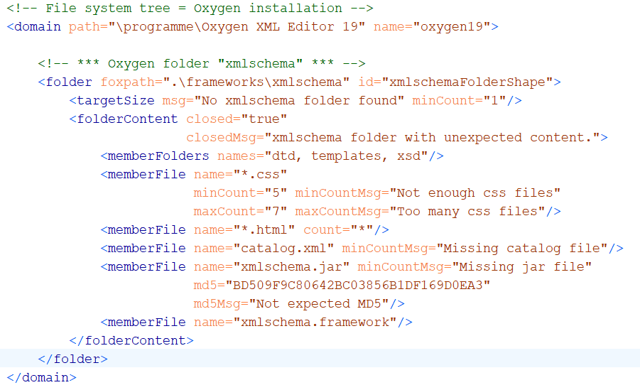
Example: constraining folder content

