Slide 1
Greenfox
A schema language for
validating file systems
Hans-Jürgen Rennau, parsQube GmbH
Presented at xmlprague 2020, February 15, 2020
Notes:
XML technology is very powerful, but also very limited. The more you are aware of the power, the keener your interest in reducing the limitations. A key problem is rooted in the very paradigm of XML, which is tree-structured information. This leads to the challenge of combining XML tree technology with RDF graph technology.

Slide 2
Greenfox: definition
Greenfox is a language for validating
file system trees* against a set of conditions.
*[
file system tree =
a folder + all folders and files directly or indirectly contained
]

Slide 3
File system validation
Why?
What, precisely?
How?

Slide 4
File system validation – WHY?
Real-world systems:
If reflected by file system contents
Then validated by validating …
file system contents
Perform 10000 checks …
… and let each check leave a trace in the file system
A file / folder created / extended unconditionally
A file / folder created / extended if check OK
A file / folder created / extended if check NOTOK
=> CHECK THE FILE SYSTEM CONTENT

Slide 5
What, precisely?
Folder contents
File contents
Schema-valid (XSD, JSON Schema, SHACL, …)
Rules conformant („If contains Foo, contains Bar“)
Folder/file content dependencies:
File A exists => file B exists
File A exists => file B contains Bar
File A contains Foo => file B exists
File A contains Foo => file B contains Bar

Slide 6
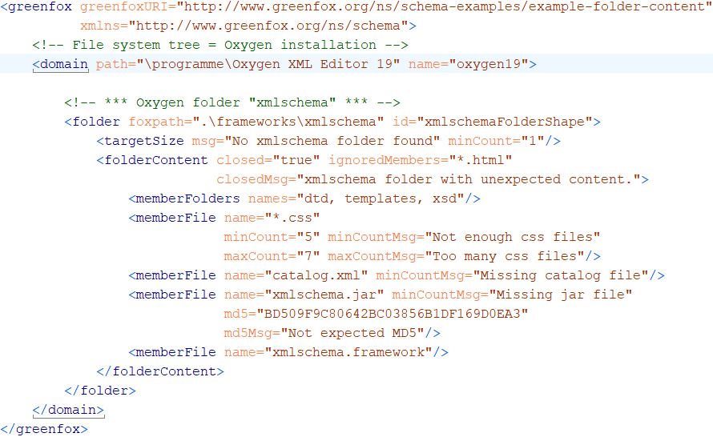
A first schema, with a folder shape
Folder content constraints

Slide 7
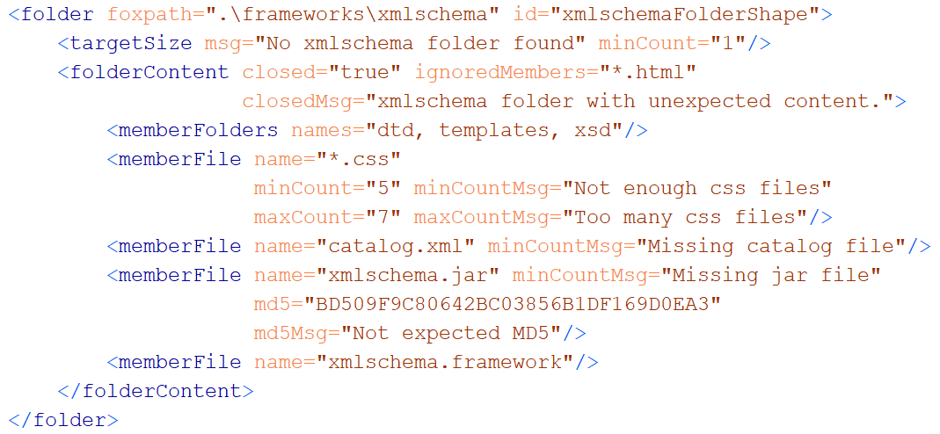
A folder shape
Features to remember
(a) wildcards + min/maxCount (b) hash keys (c) closed?

Slide 8
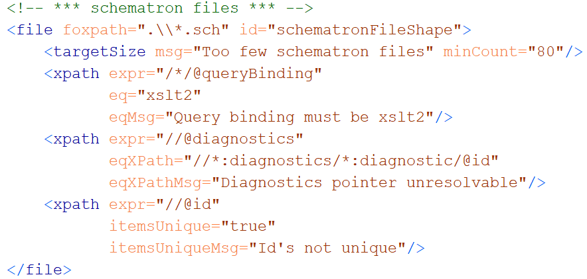
A file shape

Slide 9
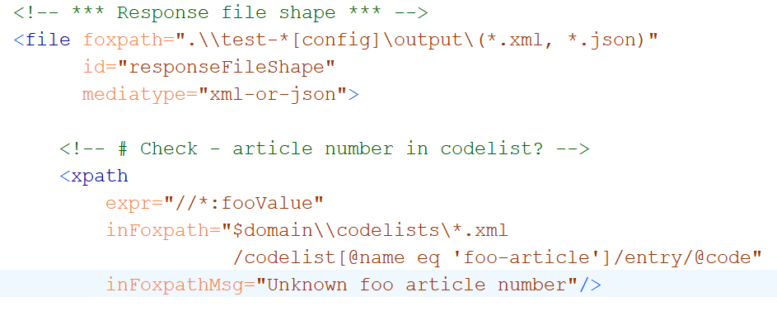
Cross-boundary navigation

Slide 10
Key feature #1 - XDM based
Value = XDM value
Value = sequence of items
Item
Atomic value (with a type from xsd)
XDM node (element, attribute, …)
Map or array (rarely used)

Slide 11
Key feature #2 Navigation skills
Between resources
Within resources
Multi-mediatype
Cross-boundary:
Start inside file, …………… || …… arrive at a file-or-folder
Start at a file-or-folder, …… || …… arrive inside file
Start inside file A, ……....... || …… arrive inside file B
foxpath
XPath
XPath - extensions
foxpath

Slide 12
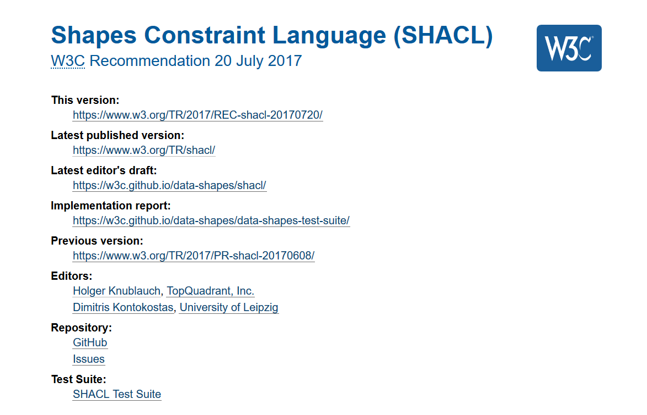
Key feature #3 Validation concept
Guided
by
SHACL

Slide 13

Concepts
Resource file, folder
Shape a set of constraints
Resource shape checks a resource
Target declaration selects resources
Constraints check resource properties
Value shape checks a resource value
Expression constructs a resource value
Constraints check the resource value

Slide 14
Validation chemistry
Validation report = union of validation results
Validation result = outcome of validating …
ONE resource against ONE constraint
Result
. Conforms (boolean)
. ResourceIRI (file path)
. ConstraintComponentIRI (identifies semantics)
. ConstraintParameters (name-value pairs)
. Details (name-value pairs)

Slide 15

Pouring waters of validity

Slide 16
A check is always a check against a constraint !
Constraint declaration
Identifies a constraint component
Supplies parameter values
What is checked?
resource property
intrinsic – e.g. "LastModified" , "FileSize", "Mediatype"
resource value
extrinsic – obtained from arbitrary expression

Slide 17
What a constraint perceives
Constraint
Resource properties
- predefined
Resource values
expression defined
may reflect content
may reflect surroundings
Resource

Slide 18
Example resource values
Expression | Expression lang | Meaning
count(airport) | XPath | # airport elements
exists(//airport) |  | Flag – with airport elements?
//airport[@href and *] | XPath | Selected airport elements
//airport/@href /resolve-uri(., ..)/doc(.) | XPath | Documents obtained resolving href links
.\\*.json | foxpath | File system paths of JSON files in the context folder
..\\*.json | foxpath | File paths of JSON files in a context-sibling folder
*.csv\csv-doc(., ',', 'yes') //Term => distinct-values() | foxpath | Distinct values extracted from CSV files in the current folder
..\\*.htm?[html-doc(.) //@href[contains(.,'niem'‚)]] | foxpath | File paths of HTML files referencing NIEM sites

Slide 19
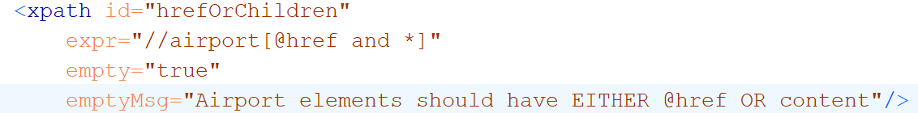
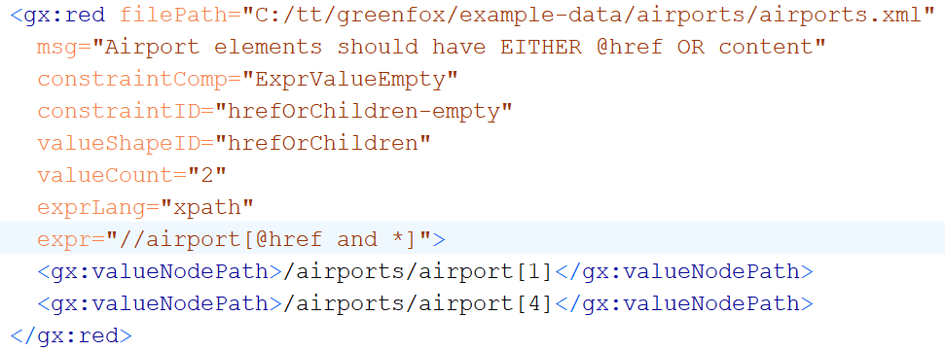
Constraining resource values
Constraint
Validation result

Slide 20
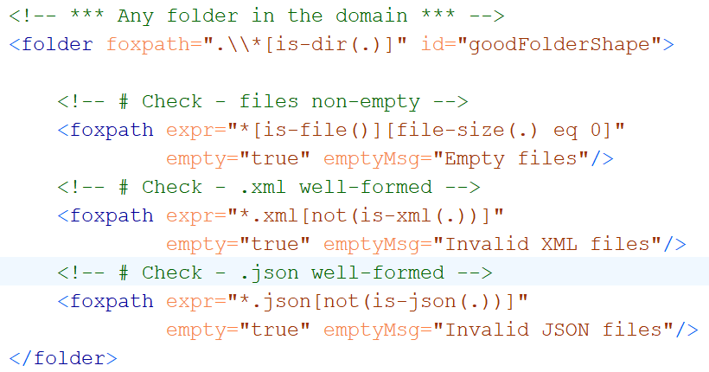
Folder resource values using foxpath
Resource value no empty files
Resource value no ill-formed XML
Resource value no ill-formed JSON

Slide 21
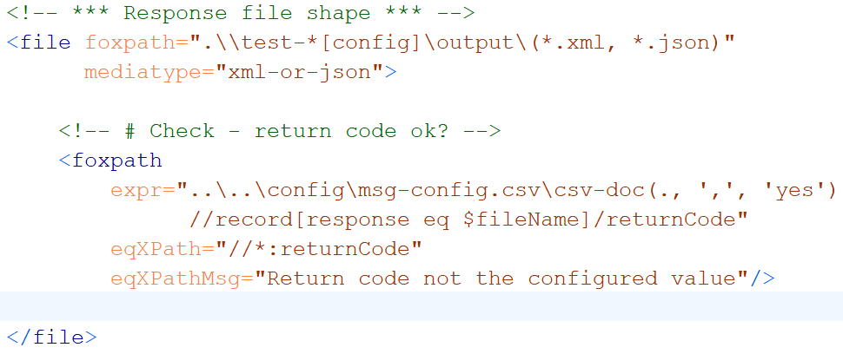
File resource values using foxpath
Resource value expected return code,
fetched from a distant CSV

Slide 22
Exploring files with shifting focus nodes

Slide 23
User-defined constraints

Slide 24
Unification of mediatypes – XDM node trees
XDM node trees supported for
XML
JSON foxpath function: json-doc()
HTML foxpath function: html-doc()
CSV foxpath function: csvdoc()
File shape attributes inform the processor
mediatype="json|html|csv|xml-or-json„
csv.separator="|"
csv.withHeader= "yes"

Slide 25
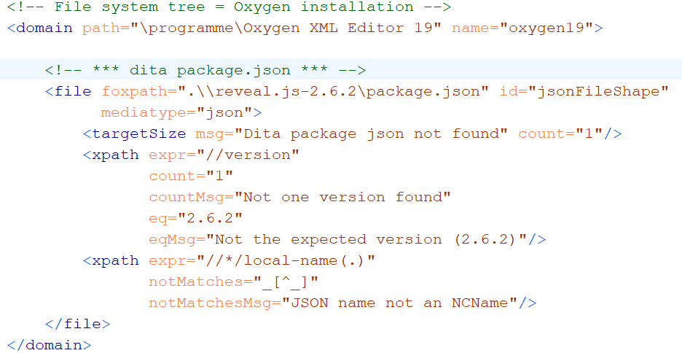
Validating JSON contents

Slide 26
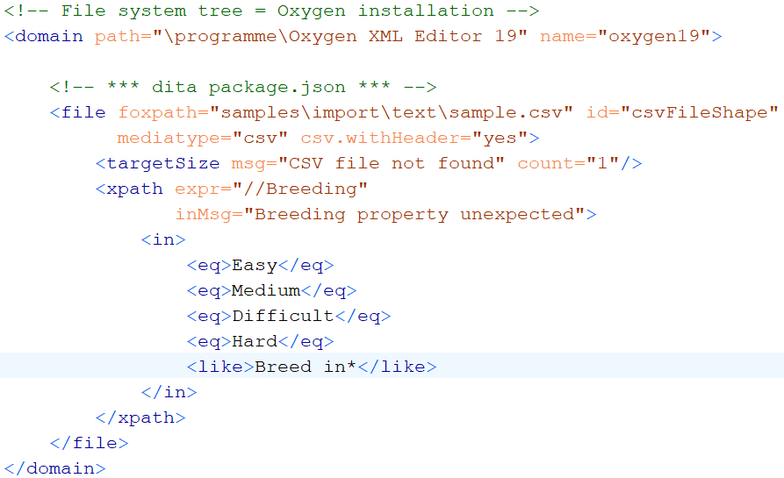
Validating CSV contents

Slide 27
Extensibility
New Constraint components
Core
User-defined
New Resource value mappers
SPARQL ?
Python ?

Slide 28

...
XML
RDF
Notes:
The more you think about it, the more amazing the complementary character of XML and RDF becomes. It is mind-boggling. There is so much promise in combining the two intelligently.

Slide 29
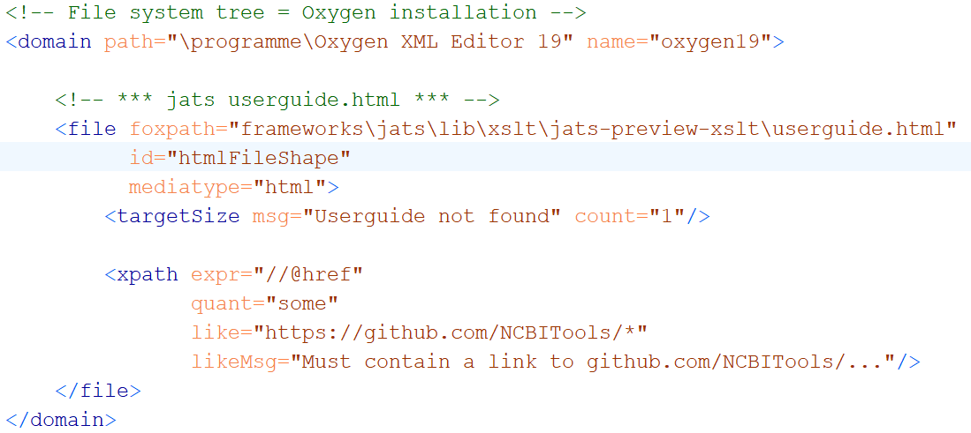
Validating HTML contents

Slide 30
Unification of navigation – f o x p a t h

Slide 31
ABCDEFGreenfox
Unified view
A – XML datamodel (XDM)
+ B – XML technology (XPath, XQuery)
+ C – XML technology-extrapolated (foxpath)
+ D – RDF datamodel
+ E – RDF technology (not yet – future?)
+ F – RDF/SHACL validation model
=
Greenfox
Extensibility

Slide 32
Constraint component
Like a library function
Signature
Implementation („Validator“)

Slide 33
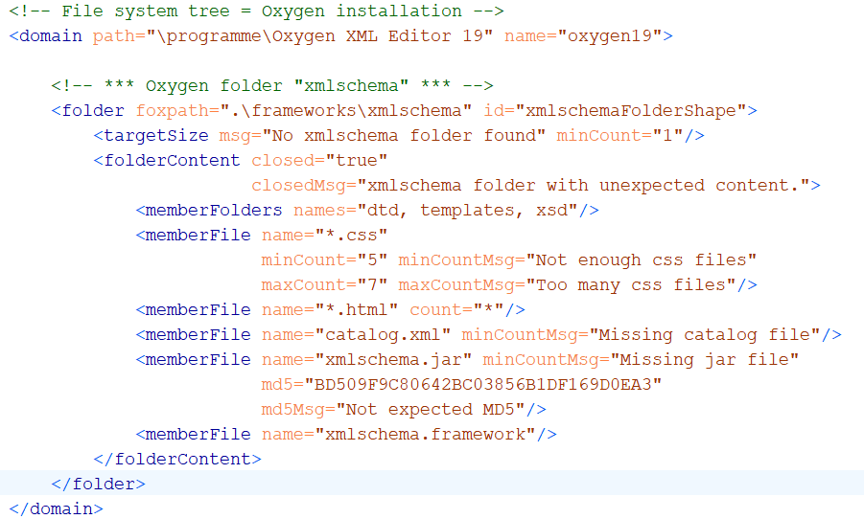
Example: constraining folder content

