Slide 1
Greenfox
A schema language for
validating file systems
Hans-Jürgen Rennau, parsQube GmbH
Presented at xmlprague 2020, February 15, 2020
Notes:
This is an introduction to greenfox, a schema language for validating file systems.

Slide 2
Greenfox: definition
Greenfox is a language for validating
file system trees* against a set of conditions.
*[
file system tree =
a folder + all folders and files directly or indirectly contained
]
Notes:
Upfront, it is important to understand that the scope is not the file system as a whole – as investigated by a Virenscanner. No – the scope is a file system tree, consisting of a root folder and any folders and files directly or indirectly contained.

Slide 3
File system validation
Why?
What, precisely?
How?
Notes:
Let us start with considering why one might be interested in file system validation; then ask what exactly „validation“ may mean in this context; and then look at how it is done.

Slide 4
Conventional validation – some basic limitations
Limitation 1:
Expectations about resources are static –
ignoring dependence on other resources (their presence and contents)
Limitation 2:
Files are the input – their presence or absence is out of scope -
whereas the real problem may be the absence of a file
Limitation 3:
The limit of declarativeness is a set of tightly coupled schemas
describing a set of related document types
Notes:
We are used to validation of an individual file against a schema, like XSD, JSON Schema or Schematron. And we know how such validation can be crucial for ensuring reliability, interoperability, etc. But any non-trivial project is represented by many file system resources – files and folders. In this context, the validation of single files is a piece from a jigsaw puzzle. Or not event that – as the whole may be more than the sum of its parts. Often, validation of one resource must be performed in a different way, dependent on the presence and contents of other resources, whereas our jigsaw puzzle pieces are unconcerned with such dependencies. And it is also important that the absence of a file may be the real problem, but this is out of scope for conventional validation, which is conditional on the presence of its input. Finally, considering the huge value of declarativeness, it is frustrating to note that the limit of declarativeness in conventional validation is a set of tightly coupled schemas describing a set of related document types. In short – we SHOULD be able to perform file system validation, to validate the contents of a file system tree in a comprehensive way, honouring dependencies, checking the occurrence of files and producing a single, comprehensive report.

Slide 5
What, precisely?
Folder contents
File contents
Schema-valid (XSD, JSON Schema, SHACL, …)
Rules conformant („If contains Foo, contains Bar“)
Folder/file content dependencies:
File A exists => file B exists
File A exists => file B contains Bar
File A contains Foo => file B exists
File A contains Foo => file B contains Bar
Notes:
What does „file system validation“ mean?

Slide 6
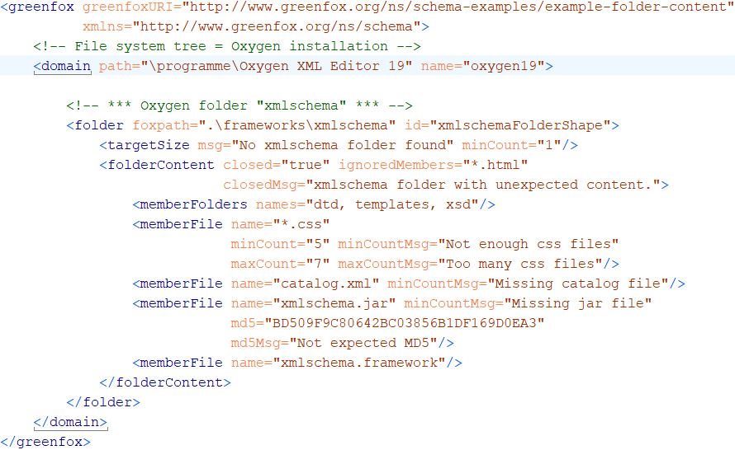
A first schema, with a folder shape
Folder content constraints
Notes:
Here comes a first, simple, yet complete, example. It is a schema describing the contents of a single folder. A greenfox schema has a <greenfox> root element, assigning to the schema a URI for identification and reference. The <domain> element identifies the root folder of the file system tree. The contents of the <domain> element describe the contents of the file system tree. In this case, the description is limited to a single folder shape represented by a <folder> element. A folder shape does not necessarily describe a single folder. It may describe many folders, or even no folder it all. What it describes is the set of all folders which are in its target. The target is defined by a target declaration. Let‘s take a closer look.

Slide 7
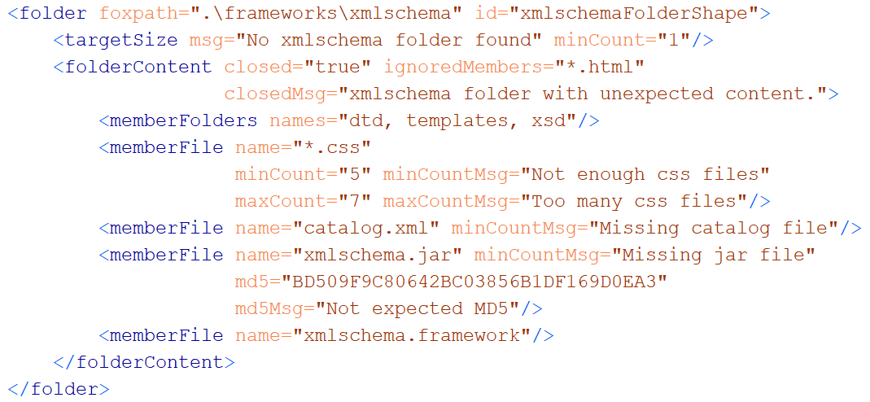
A folder shape
Features to remember
(a) wildcards + min/maxCount (b) hash keys (c) closed?
Notes:
The foxpath attribute is the target declaration. Foxpath is an extended version of XPath 3.0, supporting file system navigation and also the mixing of node tree and file system navigation within a single expression. The language is very convenient for selecting a target for validation in the most flexible way. We‘ll take a closer look at target declarations in a moment. For now, it suffices to understand that a folder shape declares constraints which are applied to every folder selected by the target declaration. Look at the <folderContent> element. It describes the folder contents. Perhaps you expected such a content description to be a list of folder and file names, not more. However, folder contents can be constrained in a more flexible way. Note for example the wildcards, combined with cardinality constraints. Also note that a file may be associated with an expected hash key. And note the „closed“ attribute, which declares the folder to be closed - only folders and files as described by the child elements and the „ignoredMembers“ may appear in the folder.

Slide 8
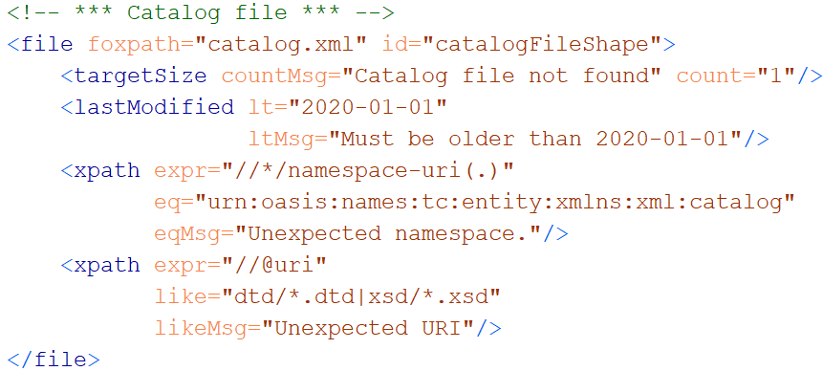
A file shape

Slide 9
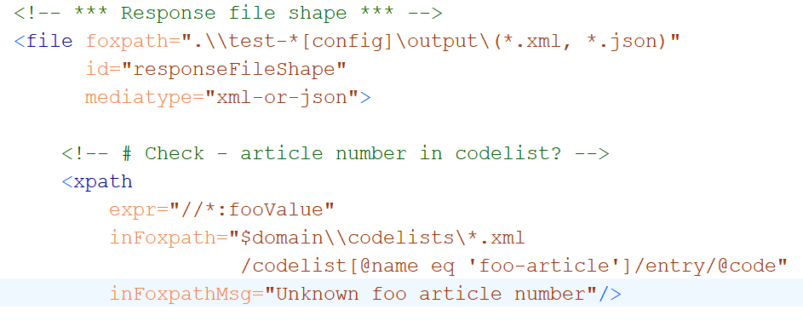
Cross-boundary navigation

Slide 10
Key feature #1 - XDM based
Value = XDM value
Value = sequence of items
Item
Atomic value (with a type from xsd)
XDM node (element, attribute, …)
Map or array (rarely used)

Slide 11
Key feature #2 Navigation skills
Between resources
Within resources
Multi-mediatype
Cross-boundary:
Start inside file, …………… || …… arrive at a file-or-folder
Start at a file-or-folder, …… || …… arrive inside file
Start inside file A, ……....... || …… arrive inside file B
foxpath
XPath
XPath - extensions
foxpath

Slide 12
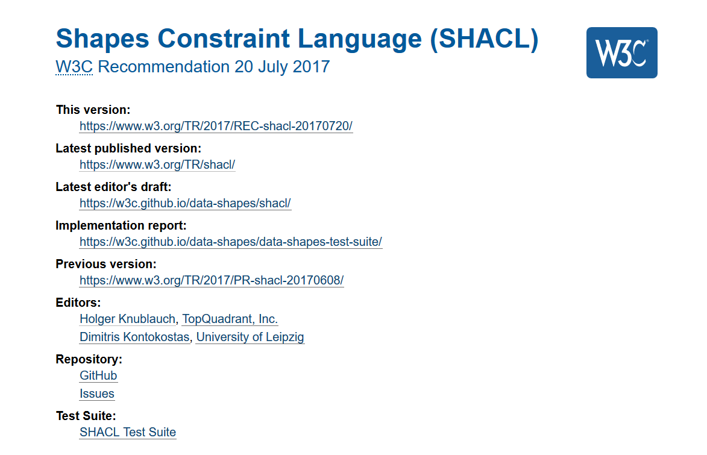
Key feature #3 Validation concept
Guided
by
SHACL

Slide 13

Concepts
Resource file, folder
Shape a set of constraints
Resource shape checks a resource
Target declaration selects resources
Constraints check resource properties
Value shape checks a resource value
Expression constructs a resource value
Constraints check the resource value

Slide 14
Validation chemistry
Validation report = union of validation results
Validation result = outcome of validating …
ONE resource against ONE constraint
Result
. Conforms (boolean)
. ResourceIRI (file path)
. ConstraintComponentIRI (identifies semantics)
. ConstraintParameters (name-value pairs)
. Details (name-value pairs)

Slide 15

Pouring waters of validity

Slide 16
A check is always a check against a constraint !
Constraint declaration
Identifies a constraint component
Supplies parameter values
What is checked?
resource property
intrinsic – e.g. "LastModified" , "FileSize", "Mediatype"
resource value
extrinsic – obtained from arbitrary expression

Slide 17
What a constraint perceives
Constraint
Resource properties
- predefined
Resource values
expression defined
may reflect content
may reflect surroundings
Resource

Slide 18
Example resource values
Expression | Expression lang | Meaning
count(airport) | XPath | # airport elements
exists(//airport) |  | Flag – with airport elements?
//airport[@href and *] | XPath | Selected airport elements
//airport/@href /resolve-uri(., ..)/doc(.) | XPath | Documents obtained resolving href links
.\\*.json | foxpath | File system paths of JSON files in the context folder
..\\*.json | foxpath | File paths of JSON files in a context-sibling folder
*.csv\csv-doc(., ',', 'yes') //Term => distinct-values() | foxpath | Distinct values extracted from CSV files in the current folder
..\\*.htm?[html-doc(.) //@href[contains(.,'niem'‚)]] | foxpath | File paths of HTML files referencing NIEM sites

Slide 19
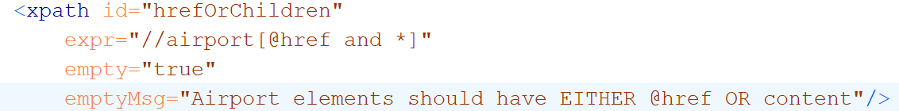
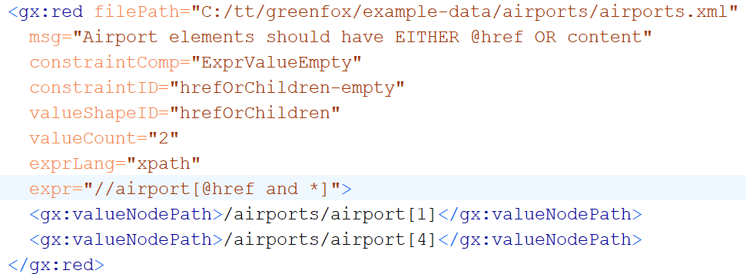
Constraining resource values
Constraint
Validation result

Slide 20
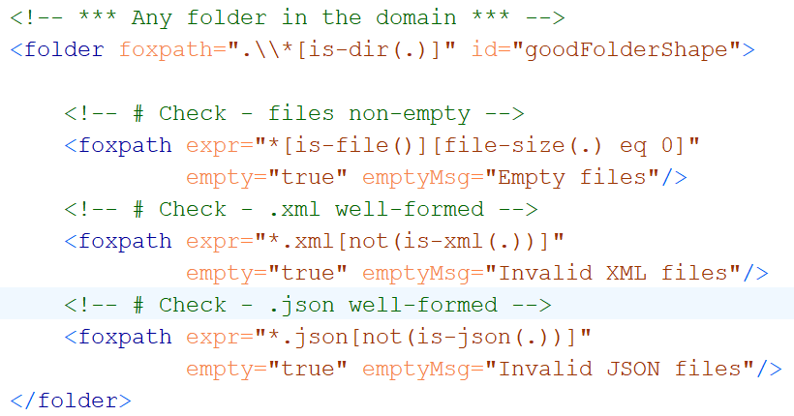
Folder resource values using foxpath
Resource value no empty files
Resource value no ill-formed XML
Resource value no ill-formed JSON

Slide 21
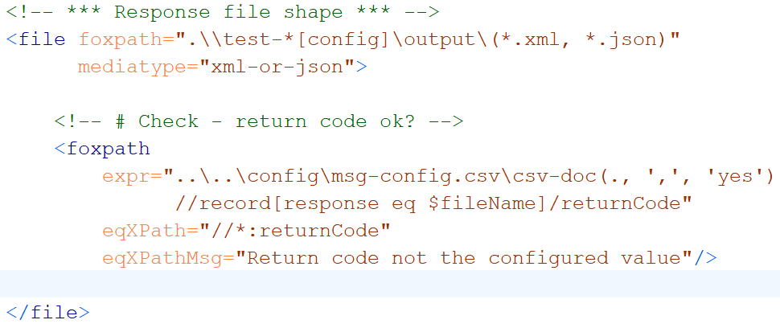
File resource values using foxpath
Resource value expected return code,
fetched from a distant CSV

Slide 22
Exploring files with shifting focus nodes

Slide 23
User-defined constraints

Slide 24
Unification of mediatypes – XDM node trees
XDM node trees supported for
XML
JSON foxpath function: json-doc()
HTML foxpath function: html-doc()
CSV foxpath function: csvdoc()
File shape attributes inform the processor
mediatype="json|html|csv|xml-or-json„
csv.separator="|"
csv.withHeader= "yes"

Slide 25
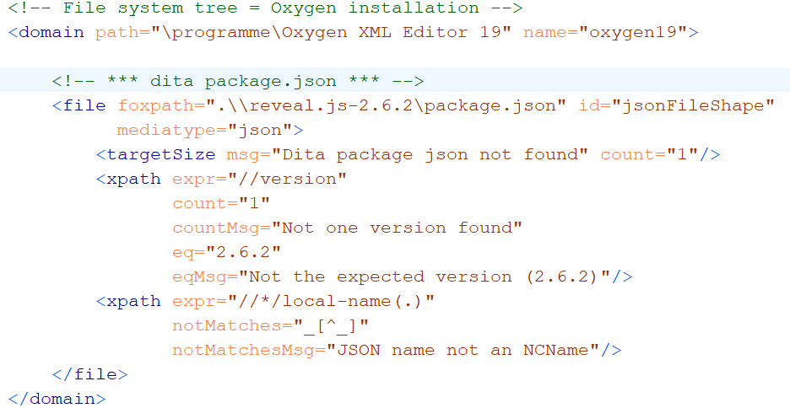
Validating JSON contents

Slide 26
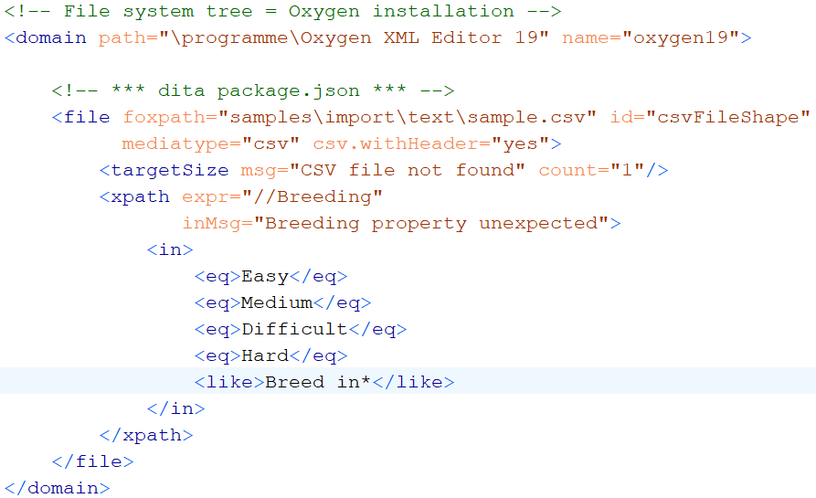
Validating CSV contents

Slide 27
Extensibility
New Constraint components
Core
User-defined
New Resource value mappers
SPARQL ?
Python ?

Slide 28

...
XML
RDF
Notes:
The more you think about it, the more amazing the complementary character of XML and RDF becomes. It is mind-boggling. There is so much promise in combining the two intelligently.

Slide 29
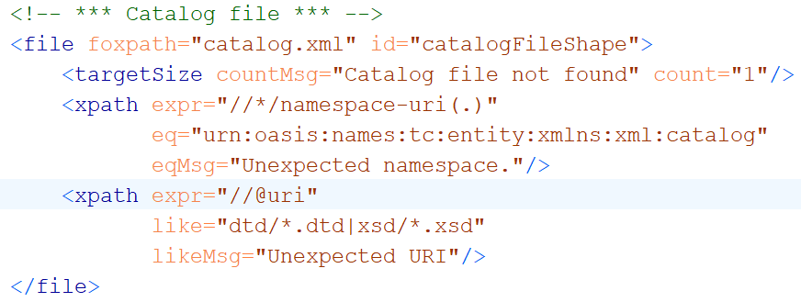
A file shape

Slide 30
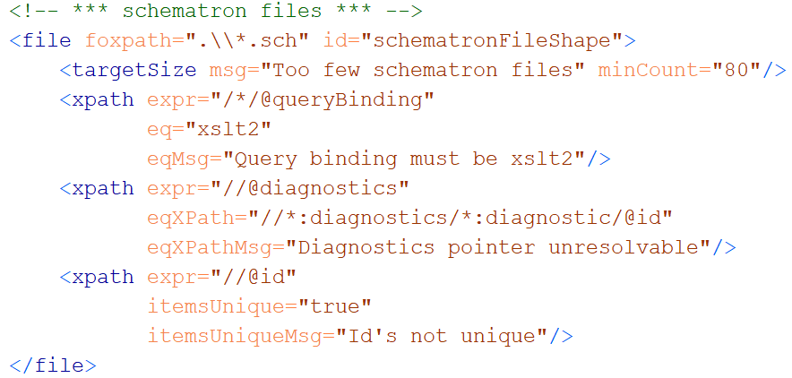
A file shape

Slide 31
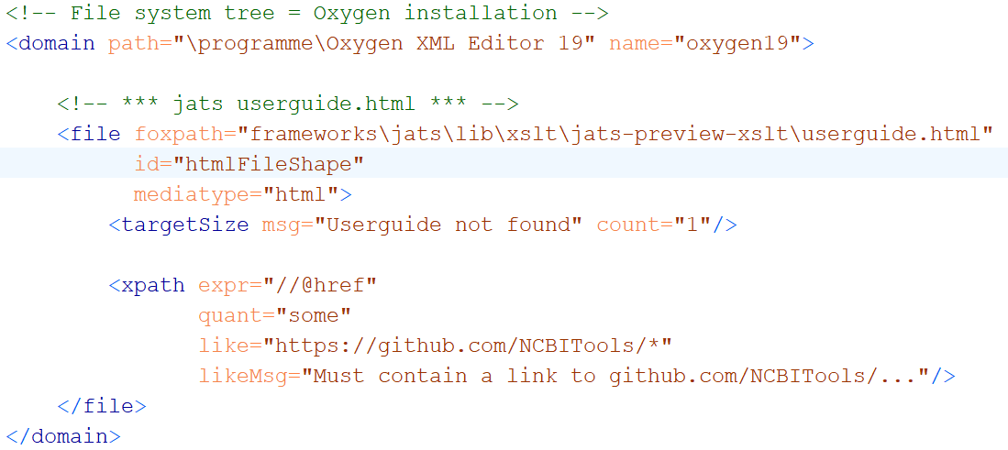
Validating HTML contents

Slide 32
File system validation – WHY?
Real-world systems:
If reflected by file system contents
Then validated by validating …
file system contents
Perform 10000 checks …
… and let each check leave a trace in the file system
A file / folder created / extended unconditionally
A file / folder created / extended if check OK
A file / folder created / extended if check NOTOK
=> CHECK THE FILE SYSTEM CONTENT
Notes:
We are used to validation of an individual file against a schema, like XSD, JSON Schema or Schematron. And we know how such validation can be crucial for ensuring quality, reliability, interoperability, etc. But any non-trivial project is represented by many file system resources – files and folders. In this context, the validation of single files is a piece from a jigsaw puzzle. I think we should be able to validate large and heterogeneous groups of resources in an integrated way, obtaining a single, comprehensive report. And we should be able to do so declaratively. That‘s what greenfox is intended to support. And also note that a file system tree may already exist, but it may also be deliberately produced as a representation of an arbitrary real-world system, receiving the output of numerous applications somehow investigating the system. The ability to validate such a file system representation means the ability of validating the real world system itself – if only in a limited way. Remember – before there is file system validation, the border of declarativeness is a single schema targeting a single document type. File system schemas overcome this limitation.

Slide 33
Unification of navigation – f o x p a t h

Slide 34
ABCDEFGreenfox
Unified view
A – XML datamodel (XDM)
+ B – XML technology (XPath, XQuery)
+ C – XML technology-extrapolated (foxpath)
+ D – RDF datamodel
+ E – RDF technology (not yet – future?)
+ F – RDF/SHACL validation model
=
Greenfox
Extensibility

Slide 35
Constraint component
Like a library function
Signature
Implementation („Validator“)

Slide 36
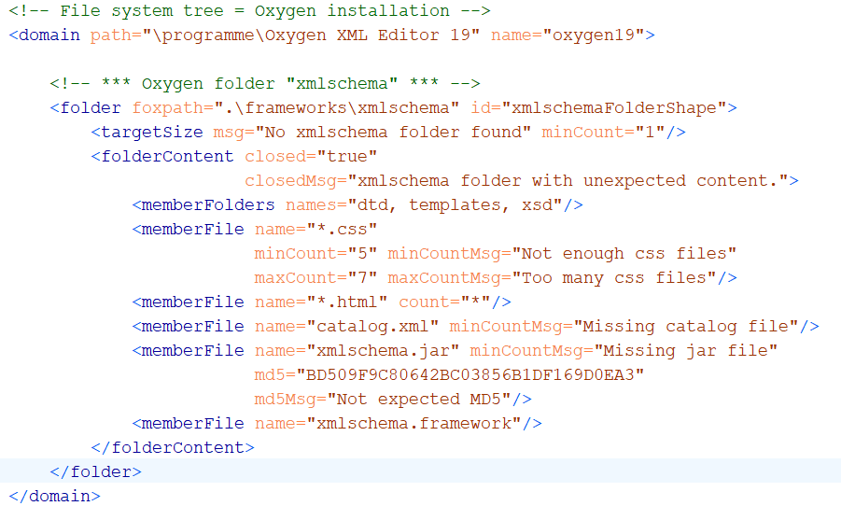
Example: constraining folder content

