Slide 1

An introduction to Greenfox
A schema language describing
file system contents -
hands-on tutorial
Hans-Jürgen Rennau, parsQube GmbH
Presented at Declarative Amsterdam 2020, October 8, 2020
Notes:
This is an introduction to greenfox, a schema language for validating file systems.

Slide 2
File system tree validation
File system tree =
some folder +
all folders/files directly or indirectly contained
Validation =
check: conformance to a set of constraints =
a „schema“
Validation result =
the outcome of one check:
single resource checked against a single constraint
Validation report =
collected validation results,
mapped to something palatable

Slide 3
Why might you care?
What we are used to:
declarative validation of single files against schemas
(XSD, RelaxNG, JSON Schema, SHACL, …)
Real interest: validity of systems, not individual files
Single file: a tiny jigsaw piece in the picture of system validity
File system trees are simply larger parts of the picture; examples:
A product to be shipped
A set of applications in use
Critical components of infrastructure
Data sources and assets
Complex test results, logs, monitoring results
SAMPLE WORRIES
No file forgotten?
File versions correct?
Log files removed?
Documentation complete?
All translations included?
All links updated? Etc. etc.

Slide 4
Outline
Guided tour – hands-on impressions
Big Picture – concepts and major features
Overview of available constraint types

Slide 5
Getting started …
A guided tour:
„A trivial file system tree
Validated against a
non-trivial schema
Developed in seven steps
Source of all airport data: https://openflights.org/data.html

Slide 6

(having made up his mind to participate
In the Greenfox tutorial at Decl. Amst. 2020)
(Jodle will join us, coming straight from the pencil of Cédric Philippe)
http://cedricphilippe.com/section_me.html

Slide 7
Part 2: Big picture
The key to understanding Greenfox is knowing
SEVEN THINGS

Slide 8
SEVEN THINGS
Resources
Constraints
Shapes
Target declarations
Link definitions
Results & Reports

Slide 9
RESOURCES
Resources = files & folders
Now that was easy!

Slide 10

Constraints
A constraint is a function:
Selection of the resource is not part of the constraint –
that‘s the business of the containing shape
Schema representation: XML element + attributes + children
Maps a resource to a validation result
= pass|failure + details

Slide 11
Constraints II
Type, parameters, constraint component
The type is identified by the XML element name
The parameters are provided by attributes / child elements
The constraint component depends on a key parameter
Example: Constraint #1
Type: Value
Parameters: exprXP, minCount, minCountMsg
Key parameter: MinCount
Constraint Component: ValueMinCount

Slide 12
Constraints III
Example: Constraint #2
Type: Value
Parameters: exprXP, distinct
Key parameter: distinct
ConstraintComponent: ValueDistinct

Slide 13
Constraints IV
Categorization:
Unary - targets single resource
e.g. <value>, <valuePair>, <docTree>
Binary - targets a pair of resources
e.g. <valueCompared>, <docSimilar>
Categorization:
Closed - excludes impact from other resources
e.g. <value>, <valueCompared>
Open - allows impact from other resources
e.g. <foxvalue>, <foxvalueVair>, <links>

Slide 14
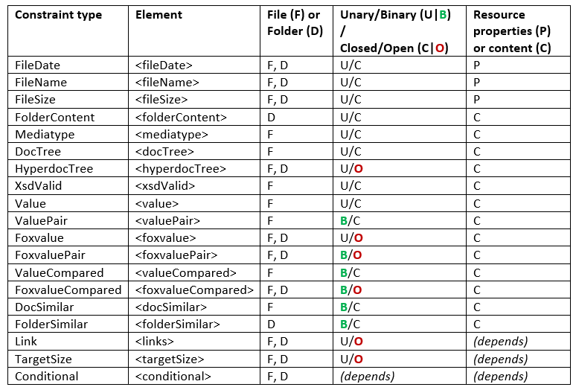
Constraint types

Slide 15
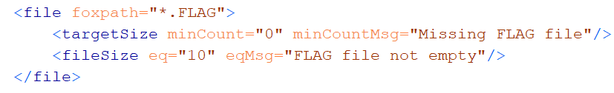
Shapes
Shape is two things:
Set of constraints
Target declaration
Target declaration:
„The constraints apply to these resources: (a selector)“
Schema representation of a shape: <file> or <folder>
Element name: the kind of resources
Attributes: target declaration
Child elements: constraints

Slide 16

Target declaration
A target declaration is a function:
Schema representation: attributes of the shape element
Maps a resource to a set of resources
* Input resource =
a resource from the target of the parent shape
* Output resources=
the target of this shape

Slide 17
Link definition
A Link Definition is a function:
Schema representation:
Either: <linkDef> element
Or: Attributes and child elements of a „link using element“
Link using elements:
Shapes <file>, <folder>
Links constraint <links>
Binary <valueCompared>, <docSimilar>, …
Hyperdoc constraints <hyperdocTree>
Maps a resource to a set of resources

Slide 18
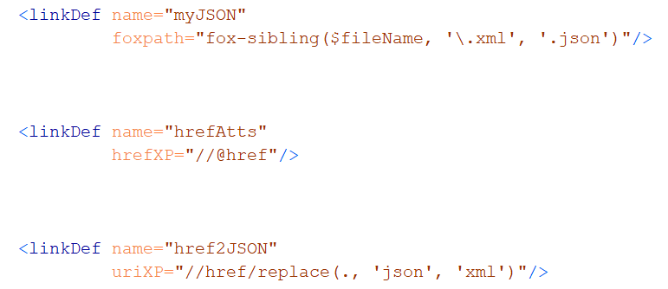
Link Definition: connector types
Connecter: foxpath
Connecter: href-expression
Connecter: URI-expression

Slide 19

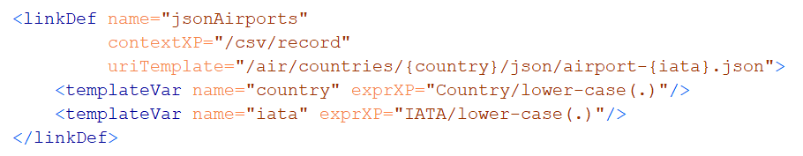
Global Link Definitions <linkDef>
Connecter: mirror
Connecter: URI-template

Slide 20
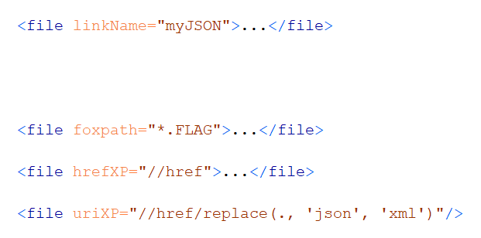
Target Declaration references or contains a Link Definition
Link Definition referenced (@linkName)
Link Definition local (@foxpath, @hrefXP, @uriXP, …)

Slide 21
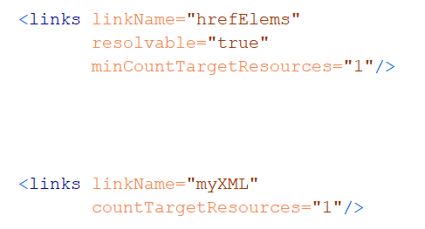
Link constraints
Links resolvable and yield at least one link target resource
Exactly one link target resource

Slide 22
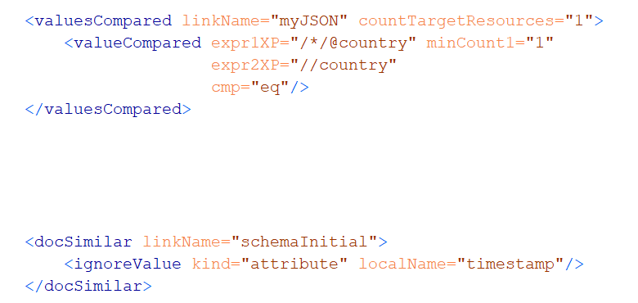
Link using elements: binary constraints
ValueCompared
DocSimilar

Slide 23
Intermezzo (interfoxo)
Please take note of the amazing fox – take a look at
$greenfox/declarative-amsterdam-2020/the-amazing-fox/the-amazing-fox.txt
For example, node tree and file system navigation can be freely mixed, e.g.
fox "ancestor~::decl*//*.gfox.xml[\\*:docSimilar]"
selects files based on their structured XML content. Or
fox "ancestor~::decl*//airport-*.json/jdoc(.)[\\iata eq 'WAT']"
selects files base on their structured JSON content.
NOTE: In Greenfox, the roles of / and \ are reversed. If you use fox with option –b, it behaves like Greenfox.

Slide 24
Results & Reports
Validation result =
Outcome of checking a single resource against a single constraint
XML element <red>, <green>
Attributes and child elements …
Identify the resource
Identify the constraint component
Constraint location in the schema
Selected constraint parameters
Observations

Slide 25
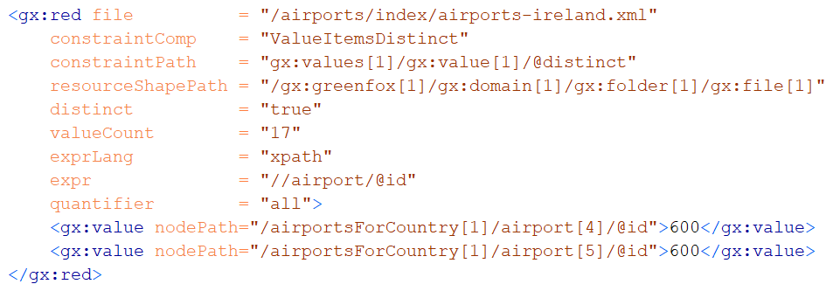
Validation result: example

Slide 26
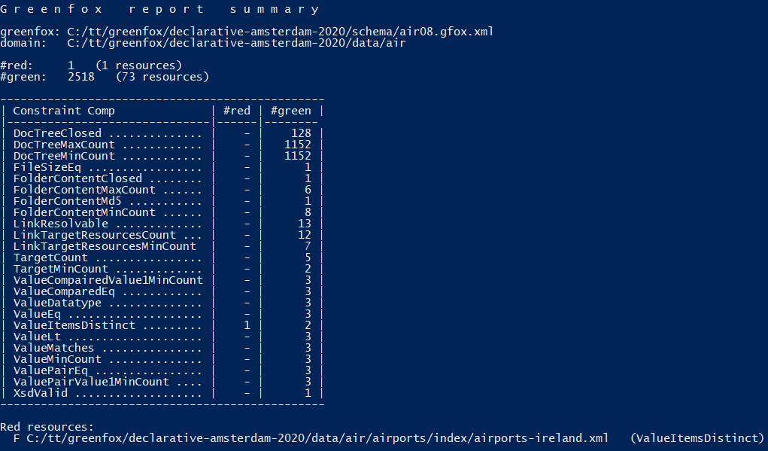
Validation report: example

Slide 27
Constraint types

Slide 28
Important, but only mentioned (see paper for details)
<focusNode> - changing evaluation context
Variable bindings in XPath and Foxpath (e.g. $fileName)
Dealing with archives
JSON, CSV, HTML, .txt – see also demo-mediatype
Context & schema parameters

Slide 29
What have you missed?
Composite schemas – no imports yet
Variables declared within the schema
Formated validation results
Support for …
schematron, JSON Schema, SHACL
Please fill in here: ______________________

Slide 30
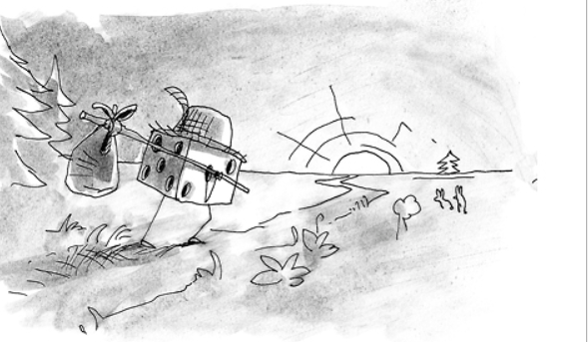
Thank you, Jodle and all others, for your kind attention!
(Jodle returning to Prague, straight to the pencil of Cédric Philippe)
http://cedricphilippe.com/section_me.html

