Slide 1
Greenfox
A schema language for
validating file systems
Hans-Jürgen Rennau, parsQube GmbH
Presented at xmlprague 2020, February 15, 2020
Notes:
This is an introduction to greenfox, a schema language for validating file systems.

Slide 2
Greenfox: definition
Greenfox is a language for validating
file system trees* against a set of conditions.
*file system tree =
a folder + all folders and files directly or indirectly contained
Notes:
Upfront, it is important to understand that the scope is not the file system as a whole – as investigated by an anti-virus program. No – the scope is a file system tree, consisting of an arbitrarily selected root folder and all folders and files directly or indirectly contained.

Slide 3
File system validation
Why?
What, precisely?
How?
Notes:
Let us start with considering why one might be interested in file system validation; then ask what „validation“ exactly means in this context; and then look at how it is done.

Slide 4
Conventional validation – some basic limitations
Limitation 1:
The scope is limited to a set of related document types,
belonging to a single mediatype
Limitation 2:
Files are the input – their presence or absence is out of scope,
whereas the real problem may be the absence of a file
Limitation 3:
Expectations about resources are static –
ignoring dependence on other resources (their presence and contents)
Notes:
We are used to validation of an individual file against a schema, like an XSD. A key advantage is its declarative nature. The file is part of a system, and what we are ultimately interested in is the validity of the system. Why can‘t we use schemas at a larger scale, validating complex sets of resources? This question highlights a few basic limitations of conventional schema validation… (read slide). I feel that overcoming such limitations, being able to describe whole systems with schemas, is a very desirable goal. Hence my interest in validating file system trees. Nearly any system can be represented by a file system tree.

Slide 5
What, precisely?
Folder contents
File contents
Schema-valid (XSD, JSON Schema, SHACL, …)
Rules conformant („If contains Foo, contains Bar“)
Folder/file content dependencies:
File A exists <=> file B exists
File A exists <=> file B contains <Bar>
File A contains <Foo> <=> file B contains <Bar>
Notes:
What does „file system validation“ mean? … How can a schema express our expectations concerning folder contents, file contents and content dependencies?

Slide 6
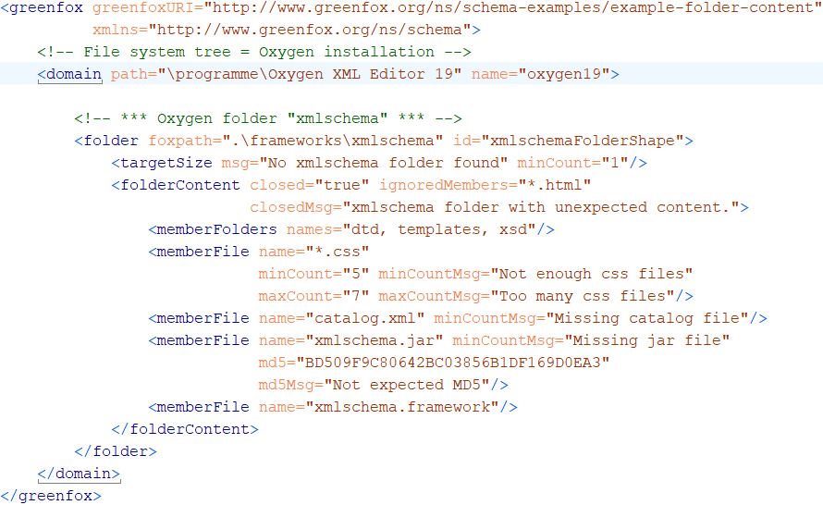
A first schema, with a folder shape
Notes:
Here comes a first, simple example. This schema describes the contents of a single folder. A schema has a <greenfox> root element. The <domain> element identifies the root folder of the file system tree. The contents of the <domain> element describe the contents of the file system tree. In this case, the description is limited to a single folder shape represented by a <folder> element. A folder shape has a target, which is a set of folders to which the shape applies.

Slide 7
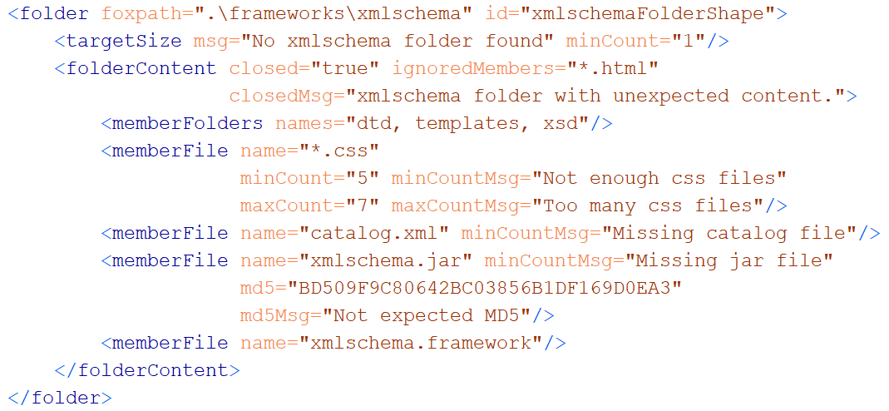
A folder shape
Features to remember
(a) wildcards + min/maxCount (b) hash keys (c) closed?
Notes:
The target is defined by a target declaration. Here it is a foxpath expression, provided by the @foxpath attribute. Foxpath is an extended version of XPath 3.0, supporting file system navigation and also the mixing of node tree and file system navigation within a single expression. The language is very convenient for selecting a target for validation in the most flexible way. A folder shape declares constraints which apply to every folder selected by the target declaration. Look at the <folderContent> element, which describes the folder contents. Folder contents can be constrained in a flexible way. For example, you can use wildcards and cardinality constraints, specify an expected hash key and declare the folder to be closed or open.

Slide 8
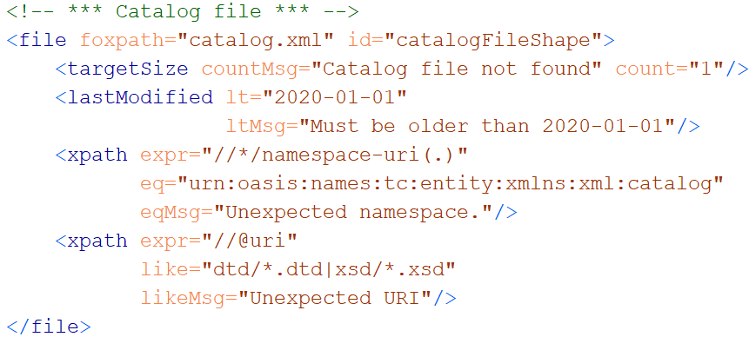
A file shape
Notes:
Like a folder shape, a file shape is a collection of constraints, combined with a target declaration. Here, we have a LastModifiedLessThan constraint, with obvious semantics. The <xpath> elements are called value shapes. A value shape does two things: it maps the resource to a value, and it declares constraints against which the value shall be checked. Here, the value is defined by an XPath expression. The first value shape maps the file to a sequence of element namespaces. The value must be checked against an ExpressionValueEqual constraint, declared by the @eq attribute: every item of the expression value must be equal to the value of the attribute. The second value shape maps the file to a sequence of @uri attributes. The @like attribute declares an ExpressionValueLike constraint – every value item must match the pattern provided by the @like attribute.

Slide 9
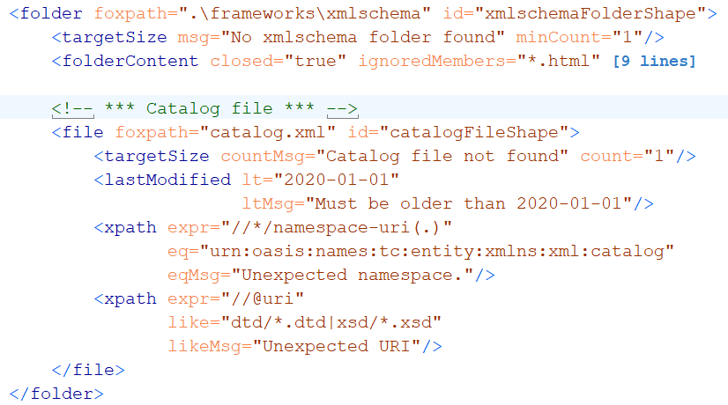
A folder shape, containing a file shape
Notes:
We place the file shape inside the folder shape. What does that mean? The target declaration of the file shape is re-evaluated in the context of every folder in the target of the containing folder shape. But don‘t be deceived – a target declaration does not necessarily select children or descendants. It can move sideways or upward, too.

Slide 10
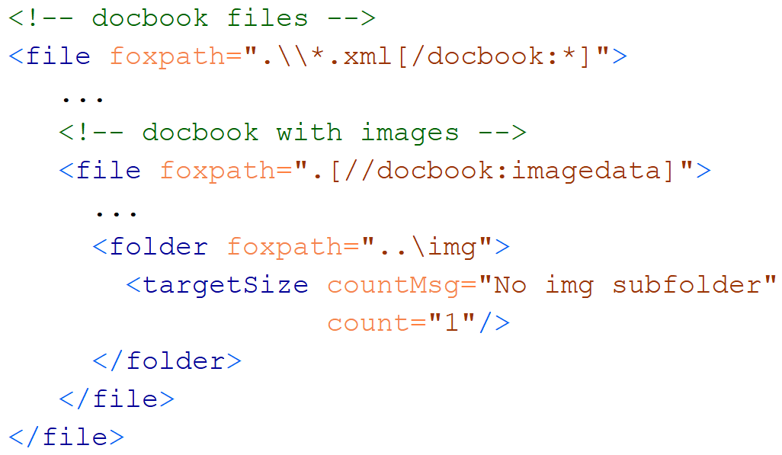
Nesting shapes
Notes:
You may be tempted to think that shape nesting is only for describing the hierarchy of folders and files. But it can be used for describing other relationships, too: subsetting, and conditional occurrence. Subsetting: the nested file shape is only evaluated for each docbook file.

Slide 11
Nesting shapes
Notes:
The nested file shape in turn contains a nested folder shape. The nested folder shape describes a mandatory image folder. It is evaluated for each docbook with images – and only for them.

Slide 12
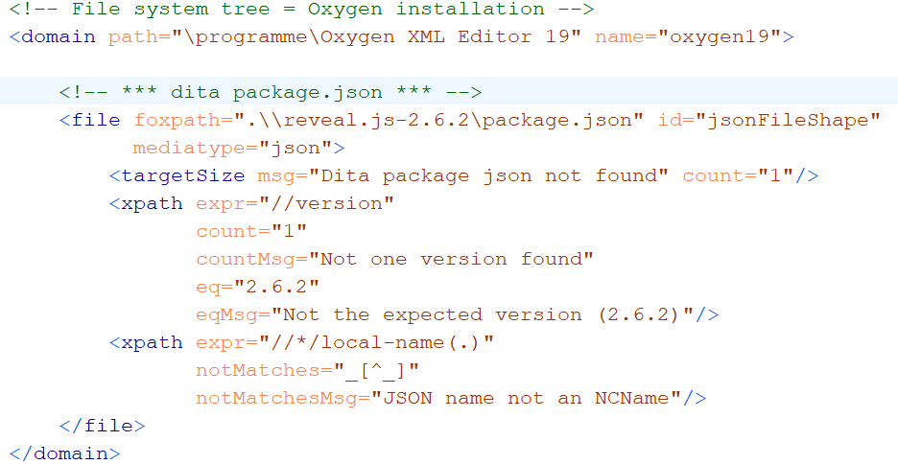
Validating JSON contents
Notes:
As you have seen, file contents can be constrained using XPath expressions. Such constraints can also be used for non-XML files: JSON files, CSV files, HTML files. This example shows how a mediatype annotation suffices to make a JSON file accessible to XPath.

Slide 13
Key feature #1 - XDM based
Value = XDM value
Value = sequence of items
Item
Atomic value (with a type from xsd)
XDM node (element, attribute, …)
Map or array (rarely used)
Function item (currently not used)
Notes:
Having given some first impressions, I want to define key features of the greenfox language. Feature one: greenfox is based on the XDM data model. Every value describing or constraining a resource is an XDM value, which means it is a sequence of zero or more items, which may be atomic values, nodes, maps or arrays.

Slide 14
Key feature #2 Navigation skills
Between resources
Within resources
Multi-mediatype
Cross-boundary:
Start inside file, …………… || …… arrive at a file-or-folder
Start at a file-or-folder, …… || …… arrive inside file
Start inside file A, ……....... || …… arrive inside file B
foxpath
XPath
XPath - extensions
foxpath
Notes:
Second key feature: advanced navigation skills. In order to describe a file system tree, you may navigate between resources (using foxpath), within resources (using XPath or foxpath), in non-XML resources (using XPath extensions) and across resource boundaries (using foxpath).

Slide 15
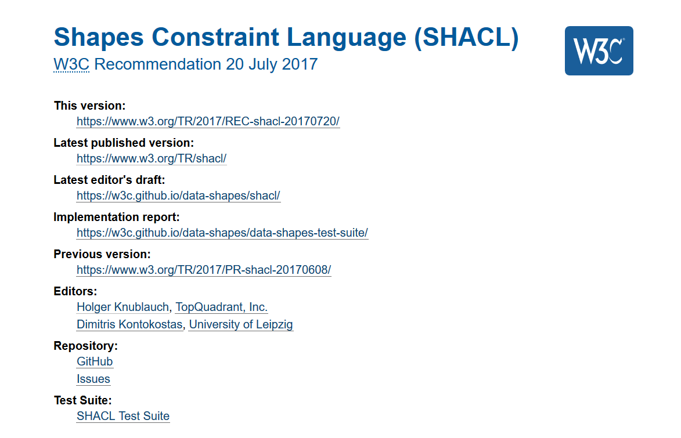
Key feature #3 Validation concept
Notes:
Strong navigational skills are a sound base for designing a file system validation language. But there is a serious danger in losing oneself in a wealth of possibilities, adding adhoc features in an uncontrolled way, ending up with a messy toolkit, not a language. A file system validation language requires a solid base of clear concepts. The key concepts of greenfox have been derived from the key concepts of SHACL, the new validation language for RDF. Some additional abstraction allowed me to detach the SHACL concepts from RDF and re-attach them to file system resources.

Slide 16

Concepts
Resource
property !
Resource
value !
Resource file, folder
Shape a set of constraints
Constraint a condition to be checked
Resource shape checks a resource
Target declaration selects resources
Constraints check resource properties
Value shape checks a resource value
Expression constructs a resource value
Constraints check the resource value
Notes:
Here they are, the key concepts. Let us begin with three most basic terms: resource, shape, constraint. A resource shape checks predefined properties of a resource, like last modification date, file size or child resource names. These constraints apply to a target, a set of resources selected by the target declaration. Do we already have everything we need? What about constraints which must be applied to the value of an XPath expression? The expression value is not a predefined resource property. We introduce a second kind of shape, called a value shape. A value shape combines an expression with a set of constraints against which to check the expression value. The expression is evaluated in the context of the resource, thus maps it to a value which is called a resource value. Now we are complete: any constraint applies either to a predefined resource property, or to a resource value created by an expression.

Slide 17
Constraints
A constraint is declared by a shape
Constraint declaration: like a function call
„function name“ = Constraint Component name
„call parameters“ = Constraint Parameter values
Validation:
Input:
parameter values
resource or resource value
Output: validation result
Notes:
Every constraint is a condition which a resource either satisfies or violates. Every constraint is declared by a shape. A constraint declaration is like a function call: it identifies the kind of check to be performed, and it supplies parameter values. Every available kind of check is called a Constraint Component. The check operation has an input consisting of the parameter values and a resource or a resource value; the output is a validation result.

Slide 18
What a constraint perceives
Constraint
Resource properties
- predefined
Resource values
expression defined
may reflect content
may reflect surroundings
Resource
Notes:
So what does it mean that a resource is validated against a constraint? What is really checked is always a value. It is either the value of a predefined resource property, or a resource value, created by an expession. A resource value can be anything expressable in XDM. Usually it captures some kind of content, something found within the resource. But it may as well reflect something found in the surroundings of the resource, for example a file in a sibling folder, or content in a distant file.

Slide 19
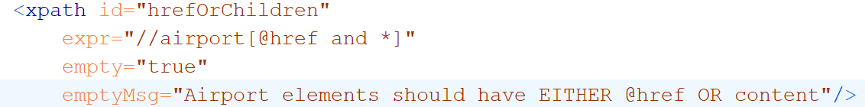
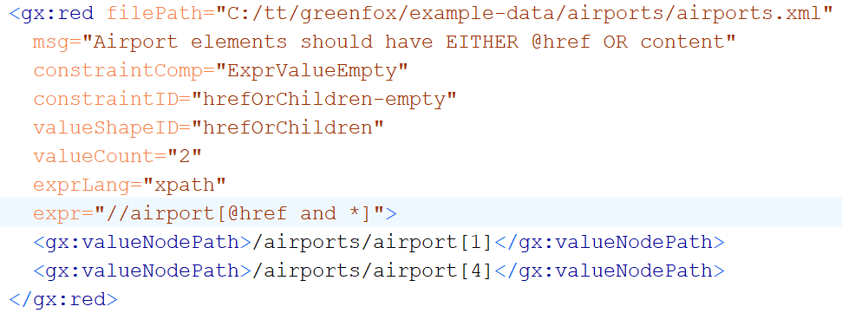
Constraining resource values
Value shape, declaring a constraint
Validation result
Notes:
A close look at how a value shape creates and constrains a resource value. In this example, the value is the sequence of all <airport> elements with an @href attribute and also child elements. The @empty attribute declares an ExpressionValueEmpty constraint. This means that the resource value must be the empty sequence. If the value is non-empty, a red validation result is created., otherwise a green one. The validation result is a standardized dataset identifying resource (@filePath) and constraint (@constraintComp) and reporting the violation (@valueCount and „valueNodePath“ elements).

Slide 20
Constraint componets usable in value shapes
No parameters
empty exists itemsUnitue
Literal parameters
count minCount maxCount
datatype
eq ne gt ge lt le
matches notMatches
like notLike
Expression valued parameters
eqFoxpath neFoxpath ltFoxpath leFoxpath gtFoxpath geFoxpath
eqXPath neXPath ltXPath leXPath gtXPath geXPath
inFoxpath containsFoxpath
inXPath containsXPath

Slide 21
Example resource values
Expression | Expression lang | Meaning
count(//airport) | XPath | # airport elements
exists(//airport) | XPath | Flag – with airport elements?
//airport[@href and *] | XPath | Selected airport elements
.\\*.json | foxpath | File system paths of JSON files under the context folder
..\config\\*.json | foxpath | File paths of JSON files in a context-sibling folder
*.csv\csv-doc(., ',', 'yes') //Term => distinct-values() | foxpath | Distinct values extracted from CSV files in the current folder
Notes:
Resource values can be created by an XPath or foxpath expression. Let us look at a few expressions creating resource values.

Slide 22
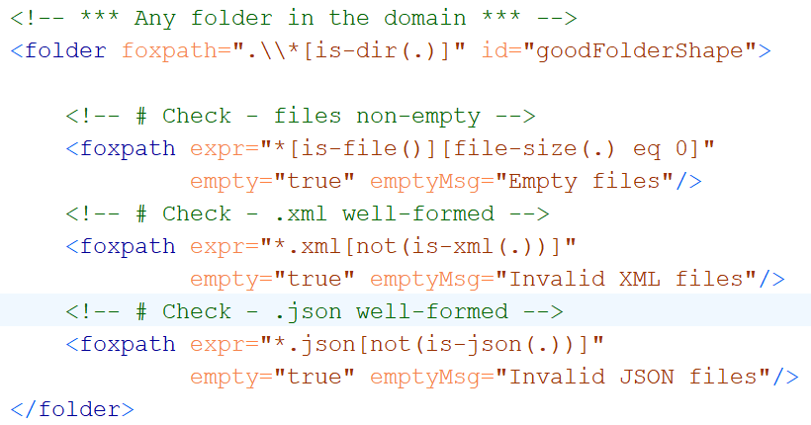
Example: folder resource values
Resource value empty files
Resource value ill-formed XML
Resource value ill-formed JSON
Good folder shape
Notes:
Here comes an example of a folder using foxpath value shapes for ensuring some basic qualities. The resource values defined are: (a) empty files; (b) ill-formed XML files; (c) ill-formed JSON files. In all cases the value is submitted to the EmptyExpressionValue constraint. Violations will be listed in the validation results.

Slide 23
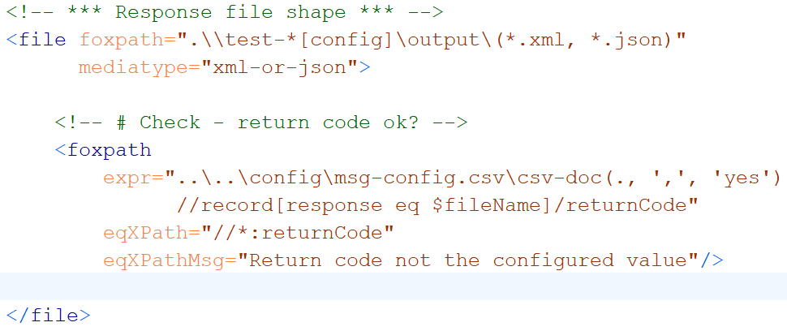
Example: external resource value
Resource value expected return code,
fetched from a distant CSV
Notes:
And here comes an example of an external resource value – a value found outside of the resource. The foxpath expression returns the expected return code, fetched from the appropriate cell in a CSV file found in the environment of the resource being validated.

Slide 24
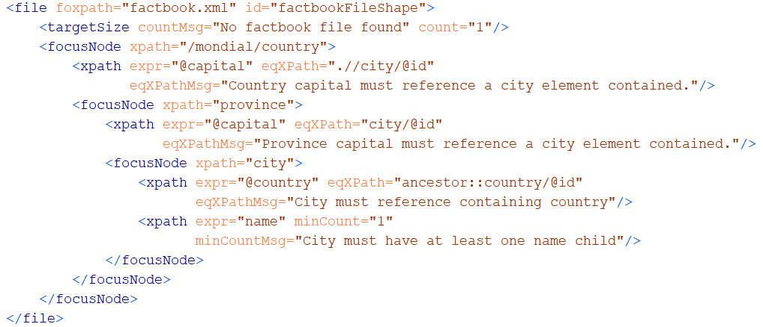
Exploring files with shifting focus nodes
Notes:
By default, the resource value expression is evaluated in the context of the target resource. This may be inconvenient, for example if you would like to check several attributes on an element selected by a non-trivial selection. This selection would have to be repeated as part of the expressions returning those attributes. You can avoid this by using <focusNode>s, which select the context nodes to be used by the value shapes which they contain. As focus nodes may be nested, value shapes can be arranged in a tree of <focusNode>s describing a traversal of the target resource.

Slide 25
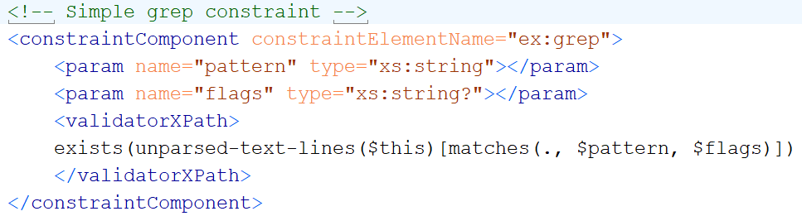
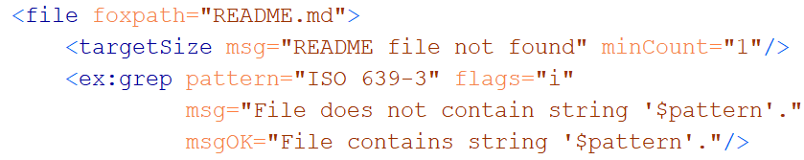
User-defined constraints
Constraint definition
Constraint declaration
Notes:
The greenfox schema language enables the definition of new constraint components which can be used like built-in components. The component is defined by a <constraintComponent> element with attributes and child elements specifying the component name and the parameter names and types.
The definition includes a validator, which is an XPath or foxpath expression performing the validation of a resource or resource value against the constraint. The expression references the parameter values via pre-bound variables. How is the component then used? As you remember, constraints are declared, and constraint declarations resemble function calls – they identify the constraint component and provide the parameter values. This is accomplished following simple syntax rules. User-defined components thus hide the complexity of the validating expression behind a declarative interface which is a set of constraint parameters.

Slide 26
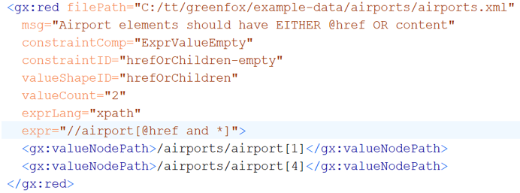
Validation chemistry
Validation report = Σ Validation results
Validation result = outcome of validating …
ONE resource against ONE constraint
Notes:
The key concepts of resources, shapes and constraints define a validation chemistry of sorts. Every validation process is composed of elementary operations – the validation of a single resource against a single constraint. Consequently, the result of any validation is a collection of elementary building blocks, describing the validation of a single resource against a single constraint. These building blocks are uniform, as they use a common vocabulary.

Slide 27

Pouring waters of validity
Notes:
It follows that a formal definition of file system validation is trivial. Remember: a schema is a collection of shapes. A shape is applied to a target which is a collection of resources. A shape is a collection of constraints. The validation report is an integration over all shapes, for each shape over all focus resources, for each focus resource and shape over all constraints.

Slide 28
Implementation
https://github.com/hrennau/greenfox
Apologies for the incomplete documentation –
extension under construction.

Slide 29
Greenfox – a summary
Goal: validation of a file system tree
Based on XDM
Powered by XPath and foxpath
Inspired by SHACL
Mediatypes hidden behind XDM node trees
Resource boundaries hidden by foxpath navigation
Producing structured information
Extensible

Slide 30
+
Thank you.

Slide 31
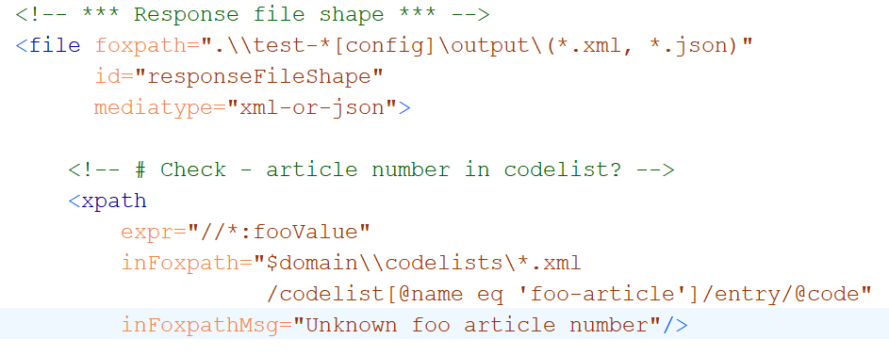
Cross-boundary navigation
Notes:
The folder and file shapes which we saw so far described the contents of the target resources, and checking did not require knowledge about the surrounding world. This is not necessarily so - constraints may relate to information outside of the resource under investigation. In this example, the resource value is given by the fooValue elements found in the document. They are checked against a codelist defined in a file found by a navigation across the file system. The constraint is expressed by a foxpath.

Slide 32
Target declarations (foxpath expressions)
Target declaration | Selection
catalog.xml | The catalog.xml file in the current folder
.\\catalog.xml | catalog.xml files under the current folder
..\projects\\catalog.xml | All catalog.xml files in or under the projects sibling of the current folder
..\projects\\catalog.xml [parent~::xsd] | As before, but filtering by name of containing folder
..\projects\\catalog.xml [parent~::xsd] [//@rewritePrefix] | As before, but filtering also by file content
Notes:
The target declaration in the first row selects a child resource. In the second row, descendant resources are selected. In the third row, navigation into a sibling folder is followed by downward navigation. In the last two rows conditions are added, referring to the containing folder name and even file contents.

