Slide 1
Greenfox
A schema language for
validating file systems
Hans-Jürgen Rennau, parsQube GmbH
Presented at xmlprague 2020, February 15, 2020
Notes:
This is an introduction to greenfox, a schema language for validating file systems.

Slide 2
Greenfox: definition
Greenfox is a language for validating
file system trees* against a set of conditions.
*[
file system tree =
a folder + all folders and files directly or indirectly contained
]
Notes:
Upfront, it is important to understand that the scope is not the file system as a whole – as investigated by an anti-virus program. No – the scope is a file system tree, consisting of an arbitrarily selected root folder and all folders and files directly or indirectly contained.

Slide 3
File system validation
Why?
What, precisely?
How?
Notes:
Let us start with considering why one might be interested in file system validation; then ask what „validation“ exactly means in this context; and then look at how it is done.

Slide 4
Conventional validation – some basic limitations
Limitation 1:
The scope is limited to a set of related document types,
belonging to a single mediatype
Limitation 2:
Files are the input – their presence or absence is out of scope,
whereas the real problem may be the absence of a file
Limitation 3:
Expectations about resources are static –
ignoring dependence on other resources (their presence and contents)
Notes:
We are used to validation of an individual file against a schema, like an XSD. But usually the file is part of a system, and what we are ultimately interested in is the validity of the system – for instance, we may ask if an application has been installed successfully and is ready for productive use. Most systems are large and heterogeneous sets of resources. Therefore, when asking about the validity of the sytem, schema validation gives us just pieces from a jigsaw puzzle. This fact highlights a few basic limitations of conventional schema validation… (read slide). I feel that overcoming such limitations, being able to describe whole systems with schemas, is a very desirable goal. Hence my interest in validating file system trees, as nearly any system can be represented by a file system tree.

Slide 5
What, precisely?
Folder contents
File contents
Schema-valid (XSD, JSON Schema, SHACL, …)
Rules conformant („If contains Foo, contains Bar“)
Folder/file content dependencies:
File A exists => file B exists
File A exists => file B contains Bar
File A contains Foo => file B exists
File A contains Foo => file B contains Bar
Notes:
What does „file system validation“ mean? … How can a schema express our expectations concerning folder contents, file contents and content dependencies?

Slide 6
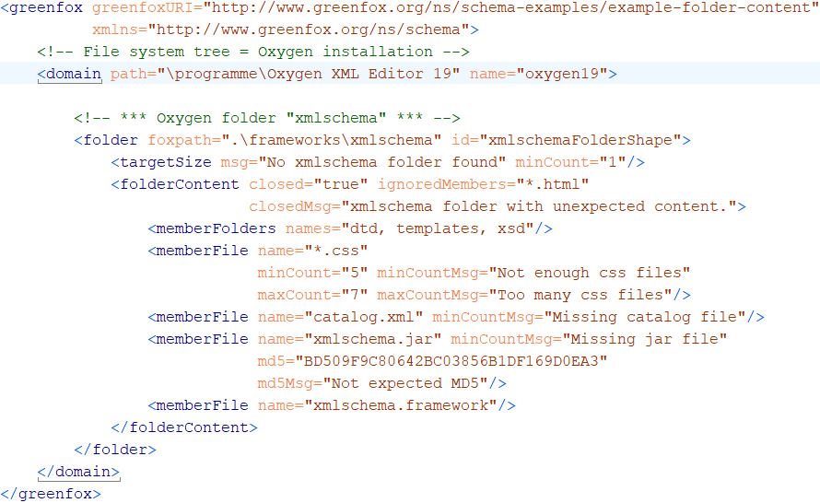
A first schema, with a folder shape
Folder content constraints
Notes:
Here comes a first, simple, yet complete, example. This schema describes the contents of a single folder. A greenfox schema has a <greenfox> root element, assigning to the schema a URI for identification and reference. The <domain> element identifies the root folder of the file system tree. The contents of the <domain> element describe the contents of the file system tree. In this case, the description is limited to a single folder shape represented by a <folder> element. A folder shape has a target, which is a set of folders to which the shape applies. The target is defined by a target declaration, an expression selecting the appropriate folders. Let‘s take a closer look.

Slide 7
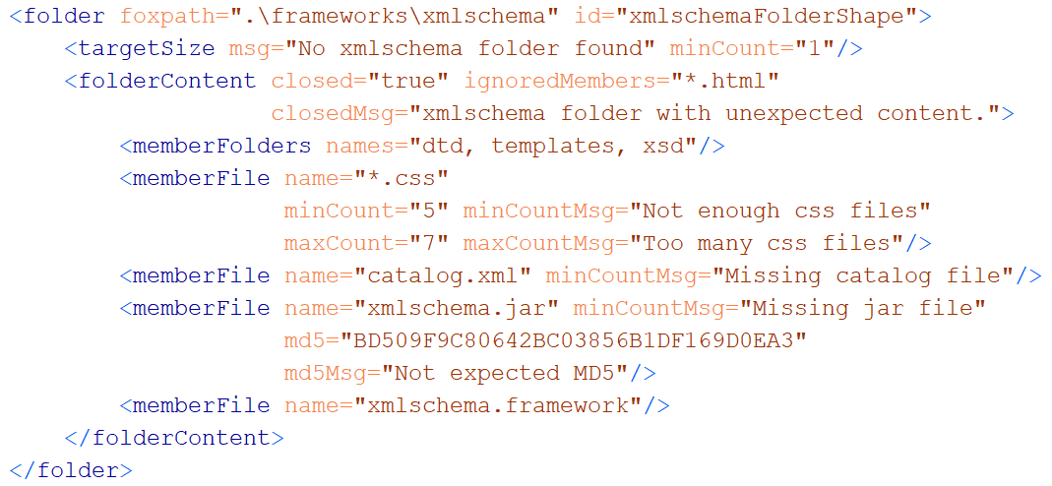
A folder shape
Features to remember
(a) wildcards + min/maxCount (b) hash keys (c) closed?
Notes:
Here, the target declaration is a foxpath expression, provided by the @foxpath attribute. Foxpath is an extended version of XPath 3.0, supporting file system navigation and also the mixing of node tree and file system navigation within a single expression. The language is very convenient for selecting a target for validation in the most flexible way. We‘ll take a closer look at target declarations in a moment. A folder shape declares constraints which are applied to every folder selected by the target declaration. Look at the <folderContent> element, which describes the folder contents. Perhaps you expected such a content description to be a list of folder and file names, not more. However, folder contents can be constrained in a more flexible way. Note for example the wildcards, combined with cardinality constraints. Also note that a file may be associated with an expected hash key. The „closed“ attribute declares the folder to be closed - only folders and files as described by the child elements and the „ignoredMembers“ attribute may appear in the folder.

Slide 8
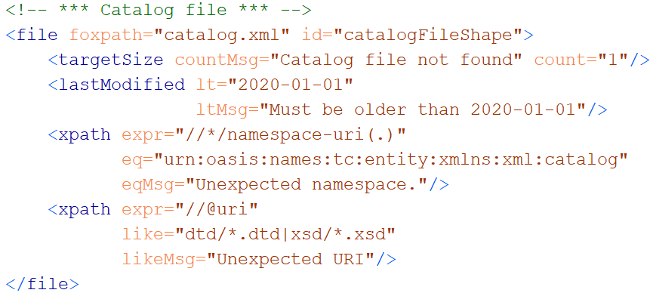
A file shape
Notes:
Now we take a look at a file shape. Like a folder shape, a file shape is a collection of constraints, and the files to which they apply are selected by a target declaration. Here, we have a LastModified constraint, with obvious semantics. The <xpath> elements are called value shapes. A value shape does two things: it maps the resource to a value, and it declares constraints against which the value shall be checked. Here, the value is defined by an XPath expression. The first value shape maps the file to a sequence of all namespace URIs used. The value must be checked against an ExpressionValueEqual constraint, declared by the @eq attribute: every item of the expression value must be equal to the value of the attribute. The second value shape maps the file to a sequence of all URIs found in @uri attributes. The @like attribute declares an ExpressionValueLike constraint – every value item must match the pattern provided by the @like attribute.

Slide 9
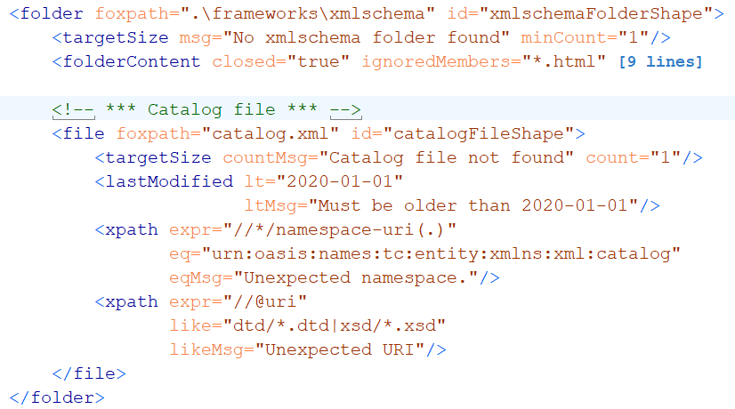
A folder shape, containing a file shape
Notes:
We place the file shape inside the folder shape. What does that mean? The target declaration of the file shape is re-evaluated in the context of every folder in the target of the containing folder shape. Note that target declarations do not necessarily select a child of descendant of the current resource. The following slide illustrates the flexibility of target declarations.

Slide 10
Target declarations (foxpath expressions)
Target declaration | Selection
catalog.xml | The catalog.xml file in the current folder
.\\catalog.xml | catalog.xml files under the current folder
.\\*[xsd[is-dir()]]\catalog.xml | As before, but only files in a folder containing an xsd folder considered
..\projects\\catalog.xml | All catalog.xml files in or under the projects sibling of the current folder
..\projects\\catalog.xml [//@rewritePrefix] | As before, but only files with a document containing @rewritePrefix considered
Notes:
The target declaration in the first row selects a child resource. In the second row, descendant resources are selected. In the third row, navigation into a sibling folder is followed by downward navigation. The last row illustrates that the selection of file system resources may involve predicates with XPath expressions.

Slide 11
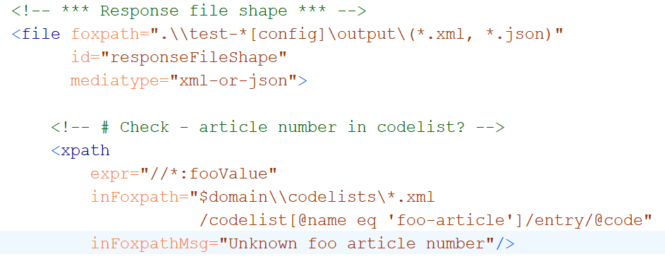
Cross-boundary navigation
Notes:
The folder and file shapes which we saw so far described the contents of the folder or file in question, and checking did not require knowledge about the surrounding world. This is not necessarily so - constraints may relate to information outside of the resource under investigation. In this example, the resource value is given by the fooValue elements found in the document. They are checked against a codelist defined in a file found by a navigation across the file system.

Slide 12
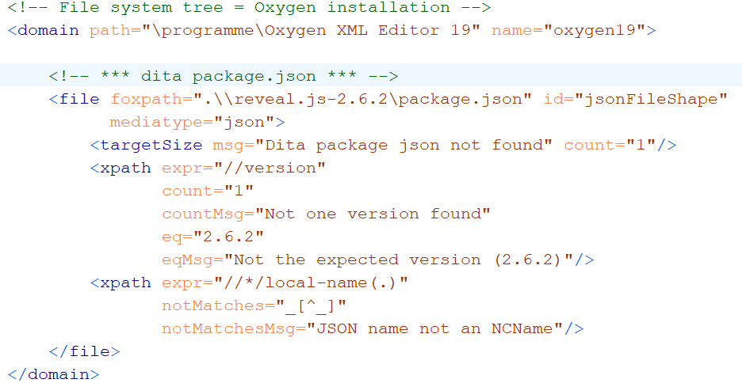
Validating JSON contents
Notes:
As you have seen, file contents can be constrained by XPath expressions. Such constraints can also be used for non-XML files: JSON files, CSV files, HTML files. This example shows how a mediatype annotation suffices to make a JSON file accessible to XPath.

Slide 13
Key feature #1 - XDM based
Value = XDM value
Value = sequence of items
Item
Atomic value (with a type from xsd)
XDM node (element, attribute, …)
Map or array (rarely used)
Function item (currently not used)
Notes:
Having given some first impressions, I want to define key features of the greenfox language. Feature one: greenfox is based on the XDM data model. Every value describing or constraining a resource is an XDM value. Reminder: according to the model, a value is a sequence of items, and an item is either an atomic value, or an XDM node, or a map, or an array. (Function items, the last item type, is not considered by greenfox.)

Slide 14
Key feature #2 Navigation skills
Between resources
Within resources
Multi-mediatype
Cross-boundary:
Start inside file, …………… || …… arrive at a file-or-folder
Start at a file-or-folder, …… || …… arrive inside file
Start inside file A, ……....... || …… arrive inside file B
foxpath
XPath
XPath - extensions
foxpath
Notes:
Second key feature: advanced navigation skills.

Slide 15
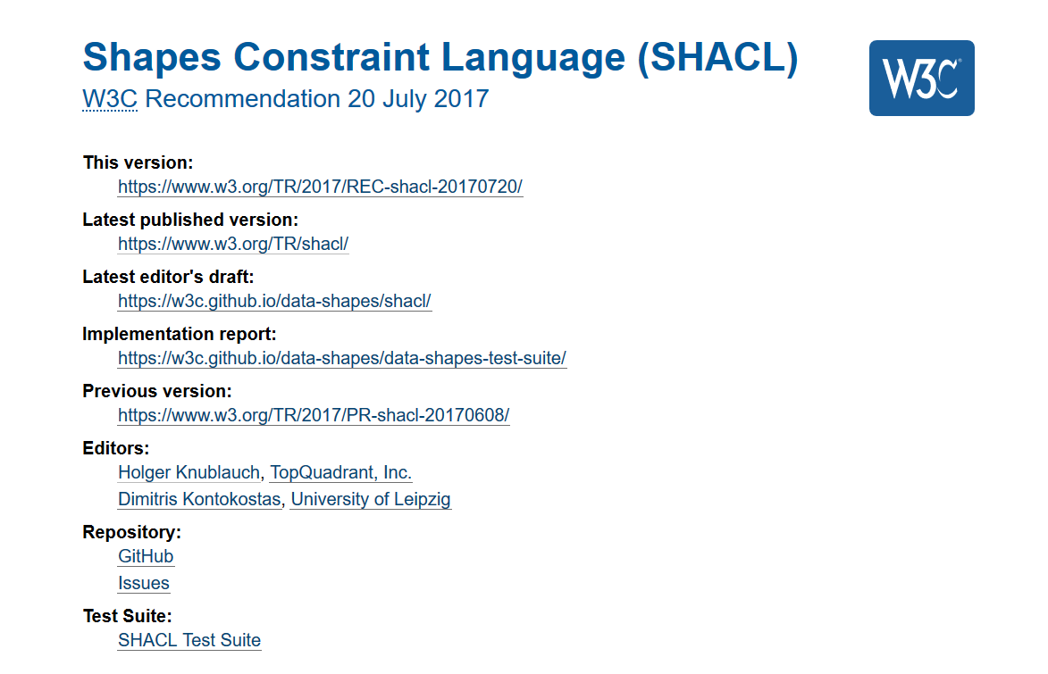
Key feature #3 Validation concept
Guided
by
SHACL
Notes:
Strong navigational skills are a sound base for designing a file system validation language. But there is a serious danger in losing oneself in a wealth of possibilities, adding adhoc features in an uncontrolled way, ending up with a messy toolkit, not a language. A file system validation language requires a solid base of clear concepts. The key concepts of greenfox have been derived from the key concepts of SHACL, the new validation language of RDF. Some additional abstraction allowed me to detach the SHACL concepts from RDF and make them ready for re-attachment to file system resources.

Slide 16

Concepts
Resource
property !
Resource
value !
Resource file, folder
Shape a set of constraints
Constraint a condition
Resource shape checks a resource
Target declaration selects resources
Constraints check resource properties
Value shape checks a resource value
Expression constructs a resource value
Constraints check the resource value
Notes:
Here they are, the key concepts. Let us begin with three most basic terms: resource, shape, constraint. A resource shape checks predefined properties of a resource, like file size or last modification date. As we have seen, a resource shape is a kind of package, associating a set of constraints with a target. Do we already have everything we need? What about constraints which must be applied to the value of an XPath expression? We introduce a second kind of shape, called a value shape. A value shape packages an expression with a set of constraints against which to check the expression value. The expression value is called a resource value. Now we are complete: any constraint targets either a predefined resource property, or a resource value created by an expression. Constraints targeting a resource value are packaged in a value shape providing the resource value.

Slide 17
Constraints
A constraint is declared by a shape
Constraint declaration: like a function call
Identifies a kind of checking =
Constraint Component IRI
Provides constraint parameter values
Validation against a constraint:
Input: parameter values + resource or resource value
Output: validation result
Notes:
A constraint is declared by a shape. A constraint declaration is like a function call: it identifies the kind of check to be performed, and it supplies parameter values. Every available kind of check is called a Constraint Component. The check has an input consisting of the parameter values and a resource or a resource value; the output is a validation result.

Slide 18
What a constraint perceives
Constraint
Resource properties
- predefined
Resource values
expression defined
may reflect content
may reflect surroundings
Resource
Notes:
A constraint assesses a resource. What it responds to is either a predefined resource property or a resource value, generated by an expression. A resource value may capture some kind of content, something found within the resource. But it may as well reflect something found in the surroundings of the resource, for example a file in a sibling folder.

Slide 19
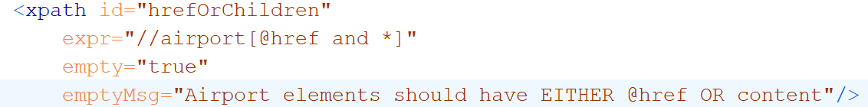
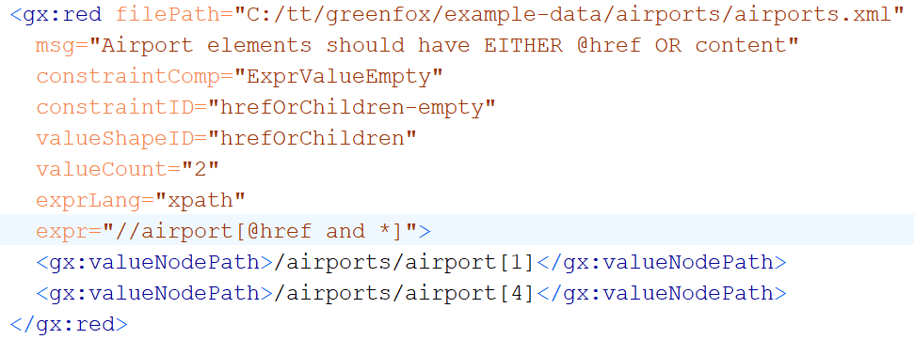
Constraining resource values
Value shape, declaring a constraint
Validation result
Notes:
And here a simple demonstration of how a value shape creates and constrains a resource value. In this example, the value is defined to be the list of all <airport> elements with an @href attribute and also child elements. The constraint disallows such elements. The @empty attribute declares an ExpressionValueEmpty constraint. The validation result is a dataset identifying resource (@filePath) and constraint (@constraintComp) and reporting the violation (@valueCount and „valueNodePath“ elements).

Slide 20
Constraining resource values
Value shape, declaring a constraint
Validation result
Notes:
And here a simple demonstration of how a value shape creates and constrains a resource value. In this example, the value is defined to be the list of all <airport> elements with an @href attribute and also child elements. The constraint disallows such elements. The @empty attribute declares an ExpressionValueEmpty constraint. The validation result is a dataset identifying resource (@filePath) and constraint (@constraintComp) and reporting the violation (@valueCount and „valueNodePath“ elements).

Slide 21
Example resource values
Expression | Expression lang | Meaning
count(airport) | XPath | # airport elements
exists(//airport) |  | Flag – with airport elements?
//airport[@href and *] | XPath | Selected airport elements
.\\*.json | foxpath | File system paths of JSON files in the context folder
..\\*.json | foxpath | File paths of JSON files in a context-sibling folder
*.csv\csv-doc(., ',', 'yes') //Term => distinct-values() | foxpath | Distinct values extracted from CSV files in the current folder
Notes:
As you remember, the resource values are created by expressions found in values shapes. As the expression languages XPath and foxpath are supported, there are two kinds of value shapes – XPath shapes and foxpath shapes. Let us look at a few expressions creating resource values.

Slide 22
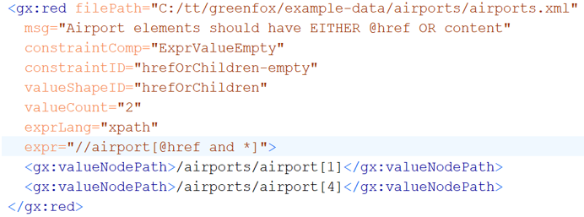
Validation chemistry
Validation report = union of validation results
Validation result = outcome of validating …
ONE resource against ONE constraint
Notes:
The key concepts of resources, shapes and constraints define a validation chemistry of sorts. Every validation process is composed of elementary building blocks – the validation of a single resource against a single constraint. The result of file system validation is a collection of uniform building blocks, which are objects describing the validation of a single resource against a single constraint. The objects are uniform, as validation results use a common vocabulary.

Slide 23

Pouring waters of validity
Notes:
From what has been said so far it follows that a formal definition of file system validation is trivial. Remember: a schema is a collection of shapes. A shape is applied to a target which is a collection of resources. A shape is a collection of constraints.

Slide 24
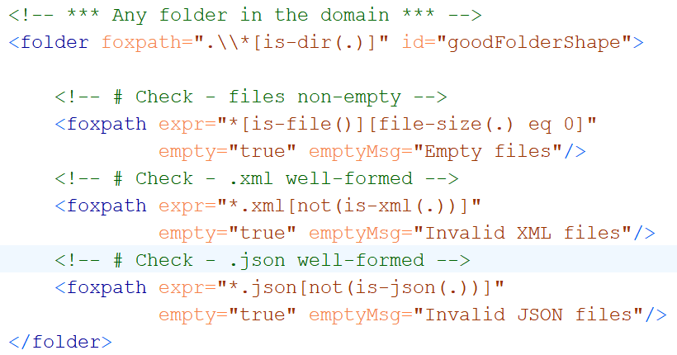
Folder resource values using foxpath
Resource value no empty files
Resource value no ill-formed XML
Resource value no ill-formed JSON
Notes:
Here comes an example of a folder using foxpath value shapes for ensuring some basic qualities. The resource values defined are: (a) empty files; (b) ill-formed XML files; (c) ill-formed JSON files. In all cases the value is submitted to the EmptyExpressionValue constraint. Violations will be listed in the validation results.

Slide 25
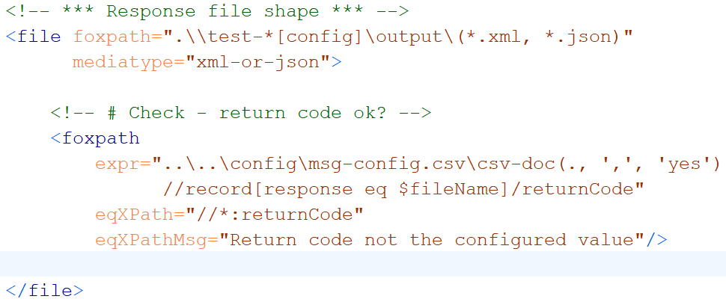
File resource values using foxpath
Resource value expected return code,
fetched from a distant CSV
Notes:
And here comes an example of an external resource value – a value found outside of the resource. The foxpath expression returns the expected return code, fetched from the appropriate cell in a CSV file found in a distant folder.

Slide 26
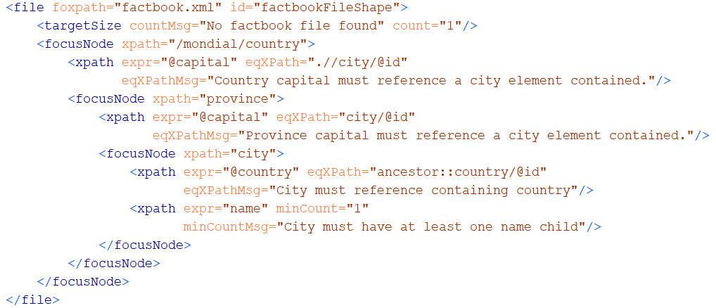
Exploring files with shifting focus nodes
Notes:
The definition of focus nodes enables a nicely structured validation of XDM contents – alternate steps of navigation and validation. Each <focusNode> element defines a new validation context, which is the set of items selected by its XPath or foxpath expression. The value shapes are re-evaluated for each item selected by the parent focus node, using this item as context item.

Slide 27
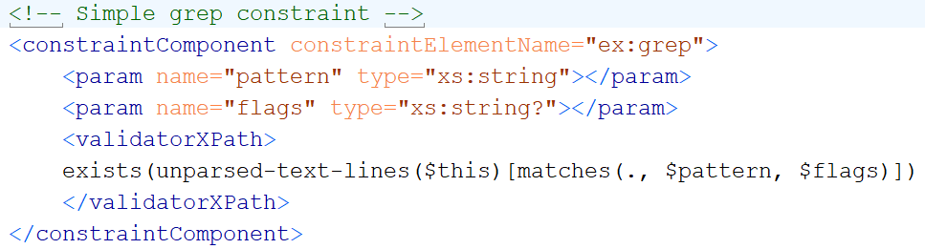
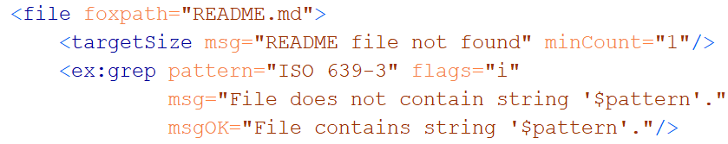
User-defined constraints
Constraint definition
Constraint declaration
Notes:
The greenfox schema language enables the definition of new constraint components. As this slide illustrates, the definition of a component is not difficult: you specify a constraint name and the names and types of constraint parameters. The validator is provided by an XPath or foxpath expression, which references the parameter values via prebound variables. Simple rules guide the mapping of the expression value to a validation result. User-defined components hide the complexity of the validating expression behind a declarative interface which is a set of constraint parameters.

Slide 28
Greenfox – a summary
Goal: validation of a file system tree
Based on XDM
Powered by XPath and foxpath
Inspired by SHACL
Mediatypes hidden behind XDM node trees
Resource boundaries hidden by foxpath navigation
Producing structured information
Extensible

Slide 29
Thank you.

Slide 30

...
XML
RDF
Notes:
Greenfox is based on XML technology and in parts inspired by RDF technology.

Slide 31
Validation, decomposed
A decomposition in steps:
File system against schema
File system against single shape
Focus resources against a single shape
Focus resource against a single constraint
Notes:
These concepts allow a decomposition of validation in steps, arriving at a smallest unit which is the validation of a single resource against a single constraint.

Slide 32
Target declarations (foxpath expressions)
Target declaration | Selection
catalog.xml | The catalog.xml file in the current folder
.\\catalog.xml | catalog.xml files under the current folder
.\\*[xsd[is-dir()]]\catalog.xml | As before, but only files in a folder containing an xsd folder considered
..\projects\\catalog.xml | All catalog.xml files in or under the projects sibling of the current folder
..\projects\\catalog.xml [//@rewritePrefix] | As before, but only files with a document containing @rewritePrefix considered
..\projects\\catalog.xml [//@rewritePrefix]\..\VERSION | First find files as described in the prece- ding row, then select the VERSION sibling
ancestor~::resources[1] \..\projects\\catalog.xml [string(file-date(.))] < '2020'] | Files found by first navigating up to the first resources ancestor, into its projects sibling, then down into all catalog.xml files, ignoring older files
Notes:
In this table, the term „current folder“ means a folder in the target of the shape containing the shape with the target declarations shown. The examples show that foxpath enables target declarations which are highly specific.

Slide 33
A check is always a check against a constraint !
Constraint declaration
Identifies a constraint component
Supplies parameter values
What is checked?
resource property
intrinsic – e.g. "LastModified" , "FileSize", "Mediatype"
resource value
extrinsic – obtained from arbitrary expression
Notes:
We said – a constraint is applied to a resource property or a resource value. But what is it, a constraint? A constraint is like a function call. A function call presupposes a function with a name and a signature, and it provides parameter values to be passed to the parameters defined by the function. The function call is called a constraint declaration. The function name is called a constraint component. The function call parameter values are the constraint parameter values.
Understanding the basic idea of greenfox requires a clear understanding what is checked, if a resource is checked. The abstract model of greenfox validation distinguishes resource properties and resource values. Properties are obvious – aspects like file size or last modification date. Resource values, on the other hand, are not predefined – they are obtained from an expression applied to the resource.

Slide 34
Validation, re-composed
An aggregation in steps:
File system against schema
File system against single shape
Focus resources against a single shape
Focus resource against a single constraint
Notes:
Looking in the opposite direction, validation of a file system tree is a composition of such smallest units.

Slide 35
First impressions - summarized
File system validation can be described as:
Moving around …
Between the file system resources
within file contents
Comparing what is found to some constraints
Notes:
After these first impressions, let me emphasize key features of greenfox. As a starting point, consider this summary of first impressions.

Slide 36
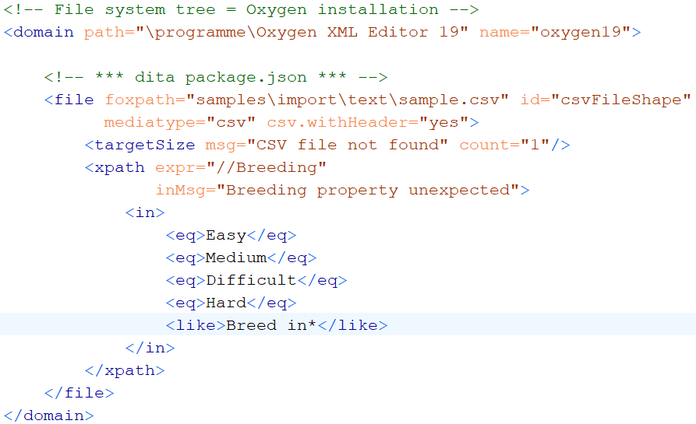
Validating CSV contents

Slide 37
Extensibility
New Constraint components
Core
User-defined
New Resource value mappers
SPARQL ?
Python ?

Slide 38
Unification of mediatypes – XDM node trees
XDM node trees supported for
XML
JSON foxpath function: json-doc()
HTML foxpath function: html-doc()
CSV foxpath function: csvdoc()
File shape attributes inform the processor
mediatype="json|html|csv|xml-or-json„
csv.separator="|"
csv.withHeader= "yes"

Slide 39
Validating JSON contents

Slide 40
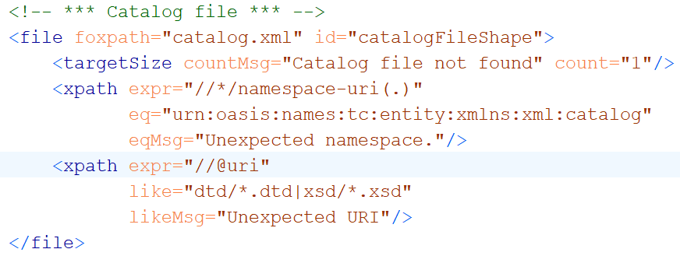
A file shape

Slide 41
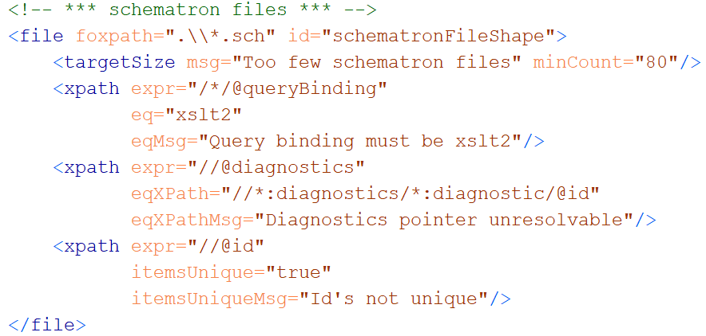
A file shape

Slide 42
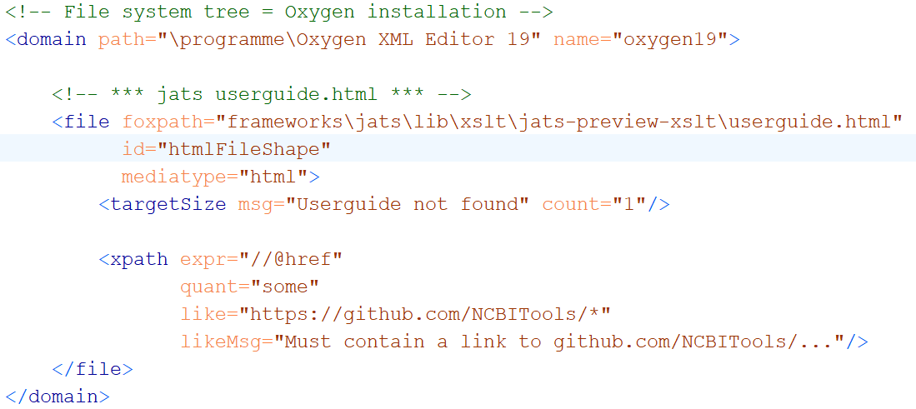
Validating HTML contents

Slide 43
File system validation – WHY?
Real-world systems:
If reflected by file system contents
Then validated by validating …
file system contents
Perform 10000 checks …
… and let each check leave a trace in the file system
A file / folder created / extended unconditionally
A file / folder created / extended if check OK
A file / folder created / extended if check NOTOK
=> CHECK THE FILE SYSTEM CONTENT
Notes:
We are used to validation of an individual file against a schema, like XSD, JSON Schema or Schematron. And we know how such validation can be crucial for ensuring quality, reliability, interoperability, etc. But any non-trivial project is represented by many file system resources – files and folders. In this context, the validation of single files is a piece from a jigsaw puzzle. I think we should be able to validate large and heterogeneous groups of resources in an integrated way, obtaining a single, comprehensive report. And we should be able to do so declaratively. That‘s what greenfox is intended to support. And also note that a file system tree may already exist, but it may also be deliberately produced as a representation of an arbitrary real-world system, receiving the output of numerous applications somehow investigating the system. The ability to validate such a file system representation means the ability of validating the real world system itself – if only in a limited way. Remember – before there is file system validation, the border of declarativeness is a single schema targeting a single document type. File system schemas overcome this limitation.

Slide 44
Unification of navigation – f o x p a t h

Slide 45
ABCDEFGreenfox
Unified view
A – XML datamodel (XDM)
+ B – XML technology (XPath, XQuery)
+ C – XML technology-extrapolated (foxpath)
+ D – RDF datamodel
+ E – RDF technology (not yet – future?)
+ F – RDF/SHACL validation model
=
Greenfox
Extensibility

Slide 46
Constraint component
Like a library function
Signature
Implementation („Validator“)

Slide 47
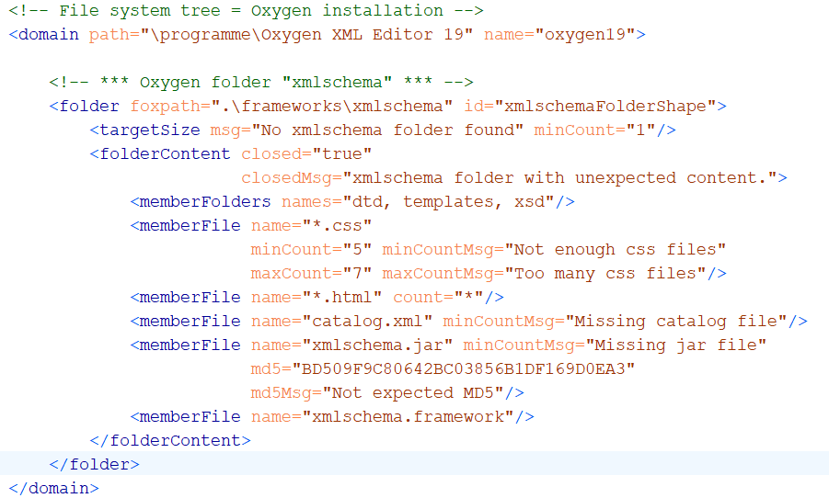
Example: constraining folder content

