Slide 1

An introduction to Greenfox
A schema language describing
file system contents -
hands-on tutorial
Hans-Jürgen Rennau, parsQube GmbH
Presented at Declarative Amsterdam 2020, October 8, 2020
Notes:
This is an introduction to greenfox, a schema language for validating file systems.

Slide 2
File system tree validation
File system tree =
some folder +
all folders/files directly or indirectly contained
Validation =
check: conformance to a set of constraints =
a „schema“
Validation result =
the outcome of one check:
single resource checked against a single constraint
Validation report =
collected validation results,
mapped to something palatable

Slide 3
Why might you care?
What we are used to:
declarative validation of single files against schemas
(XSD, RelaxNG, JSON Schema, SHACL, …)
Real interest: validity of systems, not individual files
Single file: a tiny jigsaw piece in the picture of system validity
File system trees are simply larger parts of the picture; examples:
A product to be shipped
A set of applications in use
Critical components of infrastructure
Data sources and assets
Complex test results, logs, monitoring results
SAMPLE WORRIES
No file forgotten?
File versions correct?
Log files removed?
Documentation complete?
All translations included?
All links updated? Etc. etc.

Slide 4
Outline
Guided tour – hands-on impressions
Big Picture – concepts and major features
Overview of available constraint types
Zooming in - look at a few constraint types
What now – an outlook

Slide 5
Getting started …
A guided tour:
„A trivial file system tree
Validated against a
non-trivial schema
Developed in seven steps

Slide 6
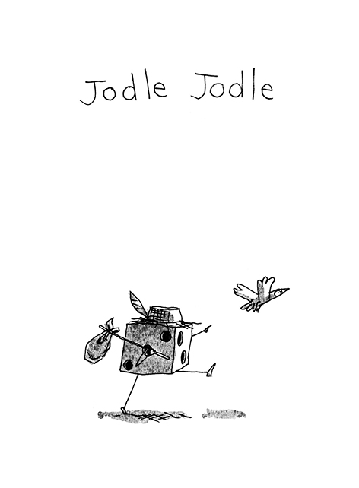
(having made up his mind to participate
In the Greenfox tutorial at Decl. Amst. 2020)
By Cédric Philippe

Slide 7
Part 2: Big picture
The key to understanding Greenfox is knowing
SEVEN THINGS

Slide 8
SEVEN THINGS
Resources
Constraints
Shapes
Target declarations
Link definitions
Results & Reports

Slide 9
RESOURCES
Resources = files & folders
Now that was easy!

Slide 10

Constraints
A constraint is a function:
Selection of the resource is not part of the constraint –
that‘s the business of the containing shape
Schema representation: XML element + attributes + children
Maps a resource to a validation result
= pass|failure + details

Slide 11
Constraints II
A constraint has a type, a set of parameters, a facet
The type is identified by the XML element name
The parameters are provided by attributes / child elements
The facet is the name of the key parameter used
Example: Constraint #1
Type: Value
Parameters: exprXP, minCount, minCountMsg
Facet: MinCount
ConstraintComponent: ValueMinCount

Slide 12
Constraints III
A constraint has a type, a a set of parameters, a facet
The type is identified by the XML element name
The parameters are provided by attributes / child elements
The facet is the name of the key parameter used
Example: Constraint #2
Type: Value
Parameters: exprXP, distinct
Facet: Distinct
ConstraintComponent: ValueDistinct

Slide 13
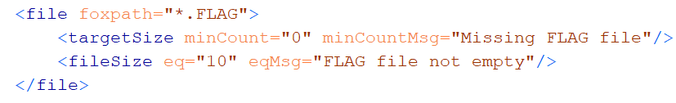
Shapes
Shape is two things:
Set of constraints
Target declaration
Target declaration:
„The constraints apply to these resources: (a selector)“
Schema representation of a shape: <file> or <folder>
Element name: the kind of resources
Attributes: target declaration
Child elements: constraints

Slide 14

Target declaration
A target declaration is a function:
Schema representation: attributes of the shape element
Maps a resource to a set of resources
* Input resource =
a resource from the target of the parent shape
* Output resources=
the target of this shape

Slide 15
Link definition
A Link Definition is a function:
Schema representation:
Either: <linkDef> element
Or: Attributes and child elements of a „link using element“
Link using elements:
Shapes <file>, <folder>
Links constraint <links>
Pair-based constraints <valueCompared>, <docSimilar>, …
Hyperdoc constraints <hyperdocTree>
Maps a resource to a set of resources

Slide 16
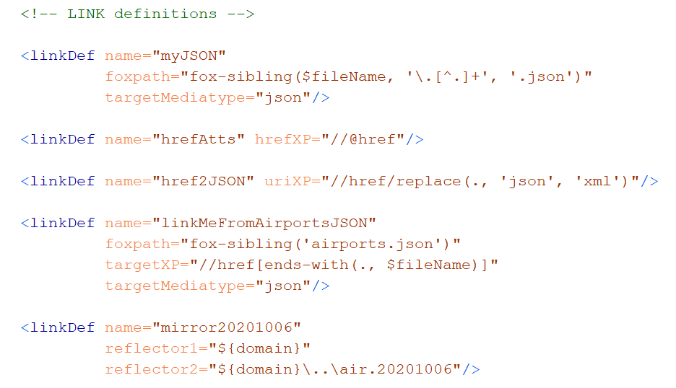
Link Definition elements <linkDef>

Slide 17
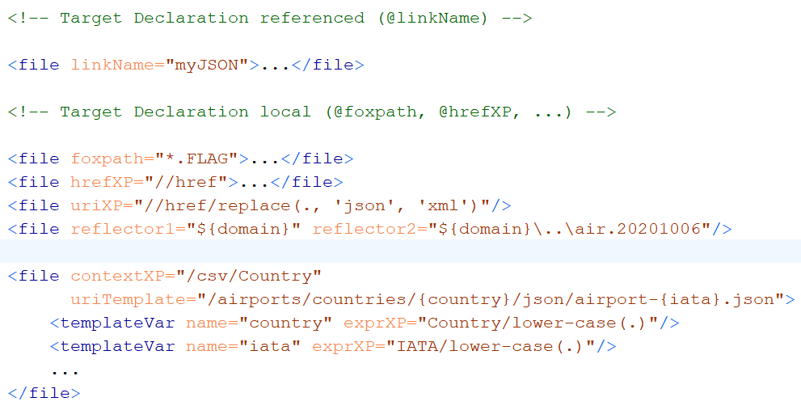
Target Declaration: a Link Definition (local | referenced)

Slide 18
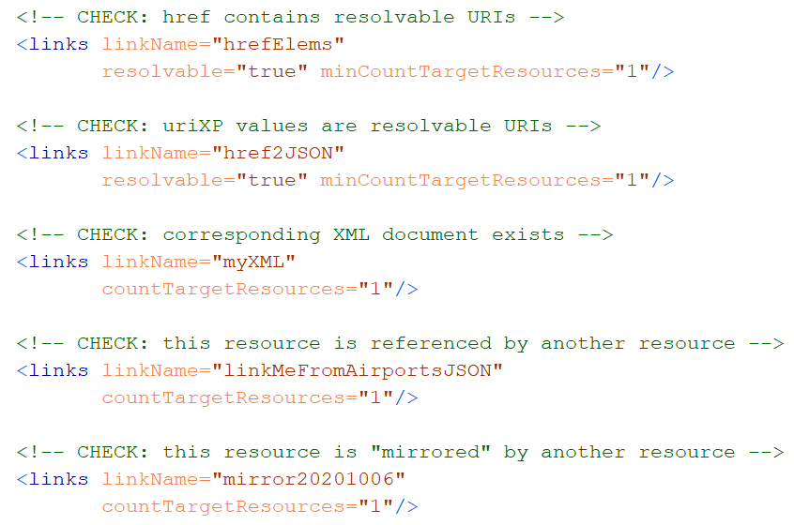
Link using element: <links> constraints

Slide 19
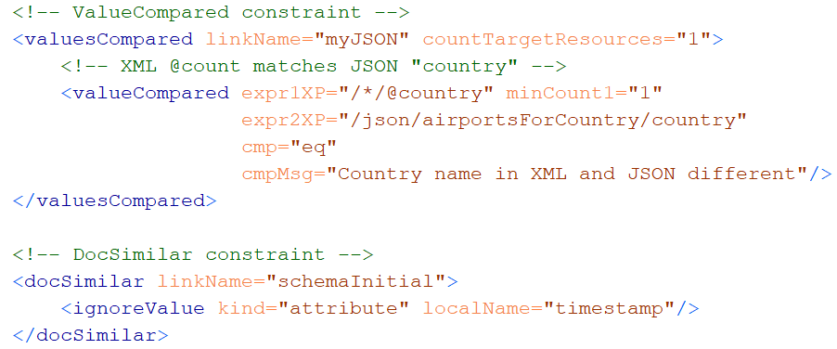
Link using elements: pair-based constraints

Slide 20
Results & Reports
Validation result =
Outcome of checking a single resource against a single constraint
XML element <red>, <green>
Attributes and child elements …
Identify the resource
Identify the constraint component
Constraint location in the schema
Selected constraint parameters
Observations

Slide 21
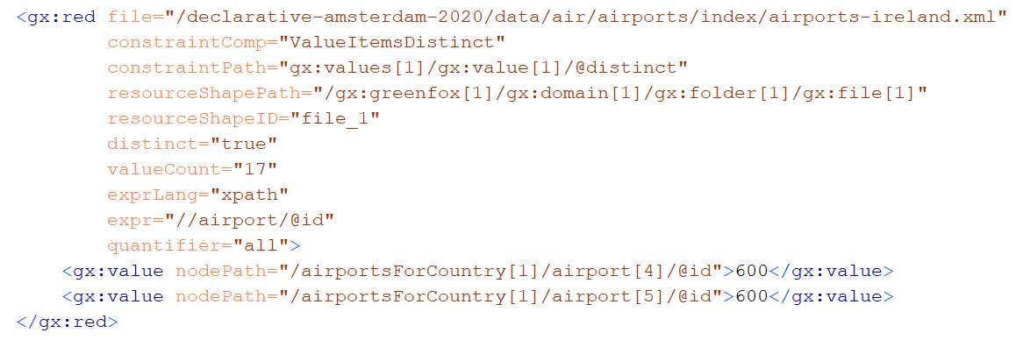
Validation result: example

Slide 22
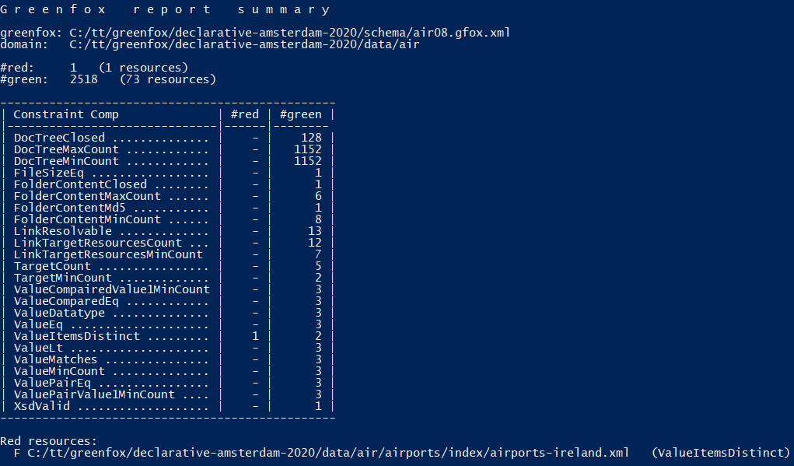
Validation report: example

Slide 23
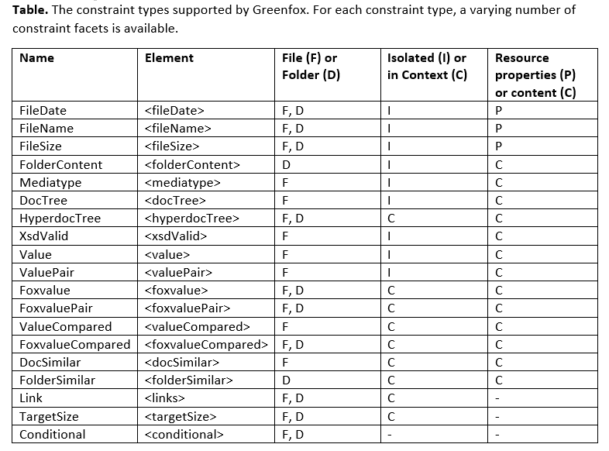
Constraint types

Slide 24
(on his way home, returning from the
Greenfox tutorial at Decl. Amst. 2020)
By Cédric Philippe

