Slide 1
Capstone: Women, Labor, & Education
Brandie Hatch, Data Scientist
U.S. Census

Slide 2
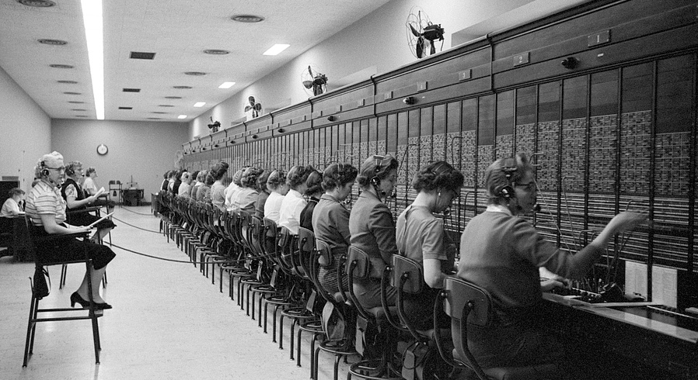
Overview
The U.S. Census Bureau definition of sex is based on the biological attributes of men and women:
chromosomes
anatomy
hormones
Females account for 50.5% of the U.S. 331,449,281 total population estimates as collected in the April 1, 2020, Census.
Women working at the U.S. Capitol switchboard, Washington, D.C. (Library of Congress)
Notes:
https://www.census.gov/topics/population/age-and-sex/about.html

Slide 3
Introduction
College-educated Workforce:
According to a 2019 study from Pew Research, which analyzed data from the U.S. Bureau of Labor Statistics, women 25 and older now make up 50.2% of the college-educated work force.
Women earn about 57% of bachelor’s degrees (2019)
In STEM Occupations → Women account for:
25% of college-educated workers in computer jobs
15% of college-educated workers in engineering jobs
Majority of college-educated workers in office, administrative support, and health care practitioners or technicians
And yet….
Women make 84% of what men earn
Notes:
Women have been the majority of college-educated adults for more than a decade. (1981-82) https://www.pewresearch.org/fact-tank/2019/06/20/u-s-women-near-milestone-in-the-college-educated-labor-force/
Women earned 84% of what men earned, according to a Pew Research Center analysis of median hourly earnings of both full- and part-time workers.
Based on this estimate, it would take an extra 42 days of work for women to earn what men did.
Gender bias within schools and classrooms may also reinforce messages that affect girls’ ambitions, their own perceptions of their roles in society, and produce labor market engagement disparities and occupational segregation. When gender stereotypes are communicated through the design of school and classroom learning environments or through the behavior of faculty, staff, and peers in a child’s school, it goes on to have sustained impact on academic performance and choice of field of study, especially negatively affecting young women pursuing science, technology, engineering, and mathematics (STEM) disciplines.
Poverty is one of the most important factors for determining whether a girl can access and complete her education. Studies consistently reinforce that girls who face multiple disadvantages — such as low family income, living in remote or underserved locations or who have a disability or belong to a minority ethno-linguistic group — are farthest behind in terms of access to and completion of education.

Slide 4
Introduction
Significance of Women and Girl’s Participation in Education
Regain $15-30 trillion in lost lifetime productivity and earnings
Child marriage rates decline
Child mortality rates fall
Maternal mortality rates fall
National growth rates rise
Female earnings dramatically increase
Notes:
A recent World Bank study estimates that the “limited educational opportunities for girls, and barriers to completing 12 years of education, cost countries between US$15 trillion1 and $30 trillion in lost lifetime productivity and earnings.” All these factors combined can help lift house holds, communities, and countries out of poverty. https://www.worldbank.org/en/topic/girlseducation
Globally, primary, and secondary school enrollment rates are getting closer to equal for girls and boys (90% male, 89% female). But while enrollment rates are similar – in fact, two-thirds of all countries have reached gender parity in primary school enrollment – completion rates for girls are lower in low-income countries where 63% of female primary school students complete primary school, compared to 67% of male primary school students. In low-income countries, secondary school completion rates for girls also continue to lag, with only 36% of girls completing lower secondary school compared to 44% of boys. Upper secondary completion rates have similar disparities in lower income countries, the rate is 26% for young men and 21% for young women.
Gender bias within schools and classrooms may also reinforce messages that affect girls’ ambitions, their own perceptions of their roles in society, and produce labor market engagement disparities and occupational segregation. When gender stereotypes are communicated through the design of school and classroom learning environments or through the behavior of faculty, staff, and peers in a child’s school, it goes on to have sustained impact on academic performance and choice of field of study, especially negatively affecting young women pursuing science, technology, engineering, and mathematics (STEM) disciplines.
Poverty is one of the most important factors for determining whether a girl can access and complete her education. Studies consistently reinforce that girls who face multiple disadvantages — such as low family income, living in remote or underserved locations or who have a disability or belong to a minority ethno-linguistic group — are farthest behind in terms of access to and completion of education.

Slide 5
Question, Problem, and Goal
Topic: Gender Gaps in Labor & Education, United States
Question: As females attain higher levels of education (literacy), how does women’s participation in labor change?
Problem Statement (Hypothesis):
The average difference in the years of education attained between gender=1, gender=0 is zero.
The average difference in the years of education attained between gender=1, gender=0 is not zero.
Gender 1 = male | Gender 2 = female
Goal: Create a model that predicts whether the survey respondent is male, or female based on labor market, income, and education features.

Slide 6

Data Introduction
Collected from the U.S. Census' American Community Survey (ACS) Public Use Microdata Sample (PUMS) files.
"The PUMS files allow users to create estimates for user-defined characteristics. The files contain a sample of responses to the ACS. The PUMS files include variables for nearly every question on the ACS survey. Additional variables are also created from other recoded PUMS variables to provide data users with useful derived variables (such as poverty status) while protecting confidentiality and providing consistency within the PUMS files.”
AMERICAN COMMUNITY SURVEY 2016-2020 5-YEAR PUMS
Prepared by American Community Survey Office, U.S. Census Bureau March 31, 2022
Notes:
Non-aggregated data
American Community Survey
Public Use Microdata Sample

Slide 7
Data Collection
The data came from using the Census API in a Jupyter Notebook to pull a json file. The initial data set included 3,239,553 observations and 26 variables.
Age: 1 to 99 years
Citizenship status
Class of worker
Ability to speak English
Employment status recode
Yearly food stamp/Supplemental Nutrition Assistance Program (SNAP) recipient
Language other than English spoken at home
Marital Status
Multigenerational household
Number of own children in household (unweighted)
Occupation recode for 2018 and later based on 2018 OCC codes
Total person's income
Income-to-poverty ratio recode
Recoded detailed race code
School Enrollment
Grade Level Attending
Educational Attainment
Field of degree science and engineering flag - NSF definition
Field of degree science and engineering related flag - NSF definition
Self-employment income past 12 months
Sex
Wages or salary income past 12 months (use ADJINC to adjust WAGP to constant dollars)
Work experience of householder and spouse
When last worked
Worked last week
State code based on 2010 Census Definition

Slide 8
Cleaning & Data Exploration
Males | Females
49.0294% | 50.9706%
Dataset was balanced in that it had almost the same number of male responses as female responses.
The Male to Female ratio was very close to the U.S. Census estimate as of April 1, 2020, where females accounted for 50.5% of the population.
Males in this data set are approximately two years younger than females.
Notes:
Assuming all else is constant, males in this data set are approximately two years younger than females on average.

Slide 9
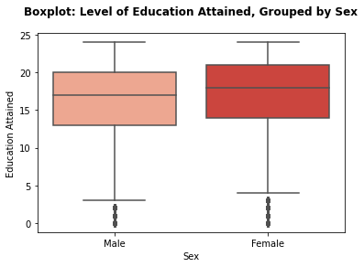
Cleaning & Data Exploration
Interesting Findings
Gradual increase of grade levels
Outliers below grade five for both sexes
Income belongs mostly to people above 18 years old
Income increases during young to midlife and tapers off late life
People over 18 have a balanced overall range of grade level
Many adults never attain more than a high school degree
Notes:
Most of the income in the dataset belongs to people above 18 years old.
The income increases during young to midlife (20-65) and started to taper off as people hit retirement age.
Gradual increase of grade levels during youth until about 18 years old.
People over 18 have a balanced overall range of grade level attainment.
Though, there is a line above high school range that distinguishes the number of adults who never attain more than a high school degree.

Slide 10
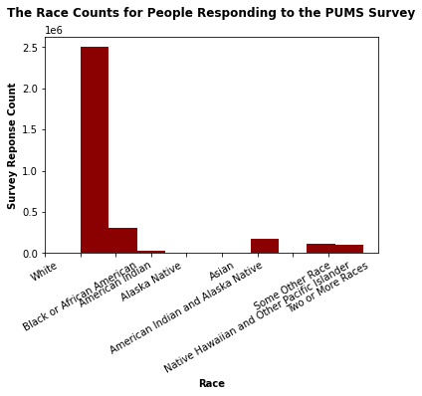
Submissions Based on Race

Slide 11
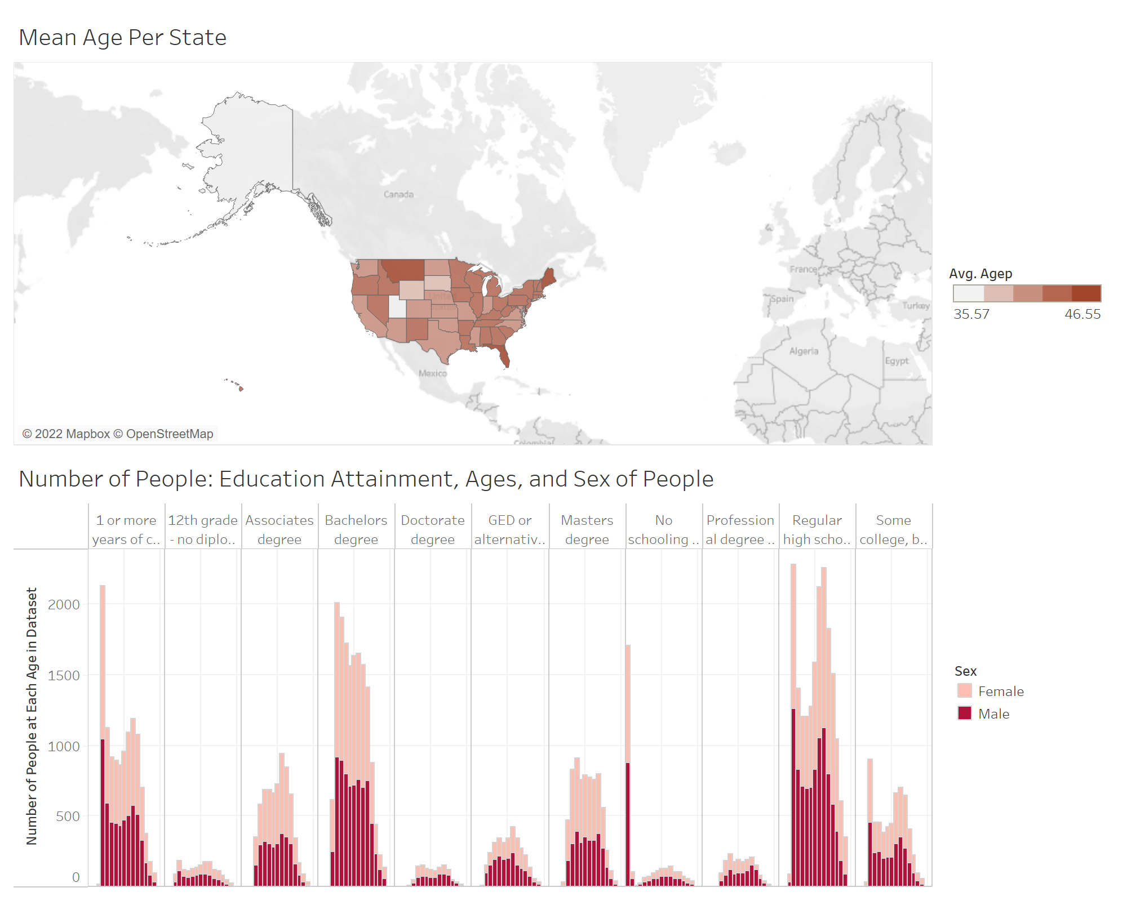
Alaska has the youngest population
Maine has the oldest population
Females over 18 have attained a slightly higher level of education
Notes:
according to the 2019 U.S. Bureau of Labor Statistics, women earn about 57% of Bachelor's degrees
- Males over 18 earn about 43% of Bachelor's degrees

Slide 12
Modeling
Supervised Classification:
Explored quick models to see which one performed the best at predicting male or female based on features.
Logistic Regression
Naive Bayes
Random Forest Classifier
Logistic Regression had the best score, so I used it to model further.

Slide 13
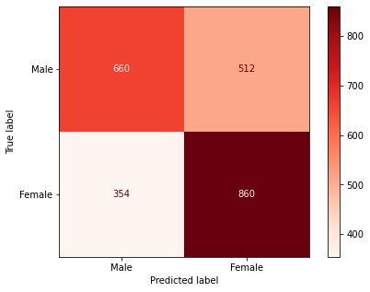
Logistic Regression

Slide 14
Best Model Findings
Best Score | Train Score | Test Score | Accuracy | Recall | Precision | Specificity | F1
0.6255166217430368 | 0.62785265049416 | 0.6370494551550713 | 0.6357709543381819 | 0.5631399317406144 | 0.650887573964497 | 0.5631399317406144 | 0.6038426349496798

Slide 15
Question, Problem, and Goal
Topic: Gender Gaps in Labor & Education, United States
Question: As females attain higher levels of education (literacy), how does women’s participation in labor change?
Problem Statement (Hypothesis):
The average difference in the years of education attained between gender=1, gender=0 is zero.
The average difference in the years of education attained between gender=1, gender=0 is not zero.
Gender 1 = male | Gender 2 = female
Goal: Create a model that predicts whether the survey respondent is male, or female based on labor market, income, and education features.

Slide 16
Implications
Problem Statement (Hypothesis):
The average difference in the years of education attained between gender=1, gender=0 is zero.
The average difference in the years of education attained between gender=1, gender=0 is not zero.
Gender 1 = male | Gender 2 = female
The Null Hypothesis is accurate because the average difference in years of education between males and females is not zero. The difference is 0.186681

Slide 17
Conclusion
In conclusion, women are getting more degrees than men.
They are still paid less than men.

Slide 18
Next Steps
Make sure that though females are getting more degrees than males, they can make the same amount of money.
Dive deeper into different forms of classification models to continue to explore the differences between males & females.

Slide 19
Questions
Brandie Hatch
in/brandiehatch/

Slide 20
Sources
List the resources you used for your research:
U.S. Census
Source #2
Source #3

Slide 21
Appendix

