Slide 1
Capstone: Women, Labor, & Education
Brandie Hatch, Data Scientist
U.S. Census

Slide 2
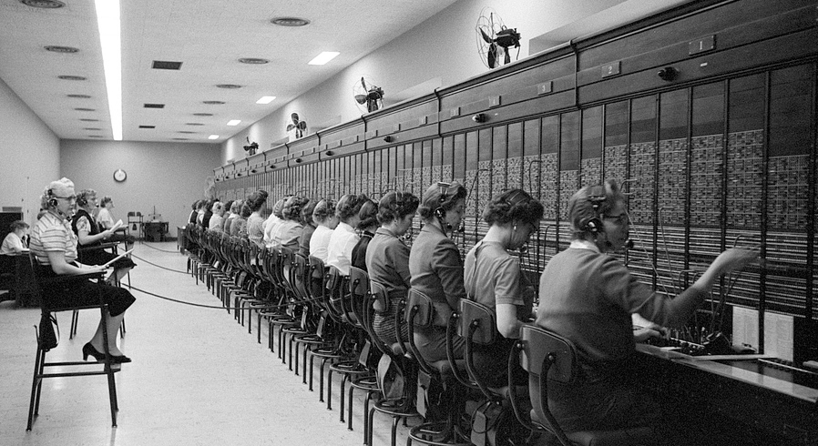
Overview
The U.S. Census Bureau definition of sex is based on the biological attributes of men and women:
chromosomes
anatomy
hormones
Females account for 50.5% of the U.S. 331,449,281 total population estimates as collected in the April 1, 2020, Census.
Women working at the U.S. Capitol switchboard, Washington, D.C. (Library of Congress)
Notes:
https://www.census.gov/topics/population/age-and-sex/about.html

Slide 3
Introduction
College-educated Workforce:
According to a 2019 study from Pew Research, which analyzed data from the U.S. Bureau of Labor Statistics, women 25 and older now make up 50.2% of the college-educated work force.
Women earn about 57% of bachelor’s degrees (2019)
In STEM Occupations → Women account for:
25% of college-educated workers in computer jobs
15% of college-educated workers in engineering jobs
Majority of college-educated workers in office, administrative support, and health care practitioners or technicians
And yet….
Women make 84% of what men earn
Notes:
Women have been the majority of college-educated adults for more than a decade. (1981-82) https://www.pewresearch.org/fact-tank/2019/06/20/u-s-women-near-milestone-in-the-college-educated-labor-force/
Women earned 84% of what men earned, according to a Pew Research Center analysis of median hourly earnings of both full- and part-time workers.
Based on this estimate, it would take an extra 42 days of work for women to earn what men did.
Gender bias within schools and classrooms may also reinforce messages that affect girls’ ambitions, their own perceptions of their roles in society, and produce labor market engagement disparities and occupational segregation. When gender stereotypes are communicated through the design of school and classroom learning environments or through the behavior of faculty, staff, and peers in a child’s school, it goes on to have sustained impact on academic performance and choice of field of study, especially negatively affecting young women pursuing science, technology, engineering, and mathematics (STEM) disciplines.
Poverty is one of the most important factors for determining whether a girl can access and complete her education. Studies consistently reinforce that girls who face multiple disadvantages — such as low family income, living in remote or underserved locations or who have a disability or belong to a minority ethno-linguistic group — are farthest behind in terms of access to and completion of education.

Slide 4
Introduction
Significance of Women and Girl’s Participation in Education
Regain $15-30 trillion in lost lifetime productivity and earnings
Child marriage rates decline
Child mortality rates fall
Maternal mortality rates fall
National growth rates rise
Female earnings dramatically increase
Notes:
A recent World Bank study estimates that the “limited educational opportunities for girls, and barriers to completing 12 years of education, cost countries between US$15 trillion1 and $30 trillion in lost lifetime productivity and earnings.” All these factors combined can help lift house holds, communities, and countries out of poverty. https://www.worldbank.org/en/topic/girlseducation
Globally, primary, and secondary school enrollment rates are getting closer to equal for girls and boys (90% male, 89% female). But while enrollment rates are similar – in fact, two-thirds of all countries have reached gender parity in primary school enrollment – completion rates for girls are lower in low-income countries where 63% of female primary school students complete primary school, compared to 67% of male primary school students. In low-income countries, secondary school completion rates for girls also continue to lag, with only 36% of girls completing lower secondary school compared to 44% of boys. Upper secondary completion rates have similar disparities in lower income countries, the rate is 26% for young men and 21% for young women.
Gender bias within schools and classrooms may also reinforce messages that affect girls’ ambitions, their own perceptions of their roles in society, and produce labor market engagement disparities and occupational segregation. When gender stereotypes are communicated through the design of school and classroom learning environments or through the behavior of faculty, staff, and peers in a child’s school, it goes on to have sustained impact on academic performance and choice of field of study, especially negatively affecting young women pursuing science, technology, engineering, and mathematics (STEM) disciplines.
Poverty is one of the most important factors for determining whether a girl can access and complete her education. Studies consistently reinforce that girls who face multiple disadvantages — such as low family income, living in remote or underserved locations or who have a disability or belong to a minority ethno-linguistic group — are farthest behind in terms of access to and completion of education.

Slide 5
Question, Problem, and Goal
Topic: Gender Gaps in Labor & Education, United States
Question: As females attain higher levels of education (literacy), how does women’s participation in labor change?
Problem Statement (Hypothesis):
The average difference in the years of education attained between gender=1, gender=0 is zero.
The average difference in the years of education attained between gender=1, gender=0 is not zero.
Goal: Create a model that predicts whether the survey respondent is male, or female based on labor market, income, and education features.

Slide 6

Data Introduction
Collected from the U.S. Census' American Community Survey (ACS) Public Use Microdata Sample (PUMS) files.
"The PUMS files allow users to create estimates for user-defined characteristics. The files contain a sample of responses to the ACS. The PUMS files include variables for nearly every question on the ACS survey. Additional variables are also created from other recoded PUMS variables to provide data users with useful derived variables (such as poverty status) while protecting confidentiality and providing consistency within the PUMS files.”
AMERICAN COMMUNITY SURVEY 2016-2020 5-YEAR PUMS
Prepared by American Community Survey Office, U.S. Census Bureau March 31, 2022
Notes:
Non-aggregated data
American Community Survey
Public Use Microdata Sample

Slide 7
Data Collection
Make a timeline of the important historical events or list historical contributions made by women.
1st Event | 2nd Event | 3rd Event | 4th Event | 5th Event | 6th Event
Date | Date | Date | Date | Date | Date
Description | Description | Description | Description | Description | Description

Slide 8
Cleaning & Data Exploration
List some interesting facts about Women's History Month. Here are a few examples:
First women’s-rights convention meets in Seneca Falls, New York, 1848.
Wyoming Territory is first to grant women the vote in 1869.
The 19th Amendment is passed in 1920, giving women the right to vote in the US.

Slide 9
EDA
Choose three notable people from women’s history using Bing.com and discuss their lives and accomplishments. Here are some examples:
Sojourner Truth was an American abolitionist and women's rights activist. Truth is best known for her speech on racial inequalities, "Ain't I a Woman?" in 1851.
Elizabeth Cady Stanton was an abolitionist and helped launch the American women's rights movement. She co-wrote the Declaration of Sentiments, a sharp critique of gender inequality in the U.S, in 1848.
Victoria Claflin Woodhull was an American leader of the women's suffrage movement and the first female candidate for president of the United States in the 1872 election.

Slide 10
Modeling
Provide examples of art and literature that are significant to Women's History Month. Here are a few examples:
The writing of Virginia Woolf
The music of Nina Simone
The artwork of Frida Kahlo

Slide 11
Model Findings
List some ways you can celebrate Women's History Month. Here are a few examples:
Discover female artists
Read female authors
Listen to female musicians
Learn about women in history

Slide 12
Implications

Slide 13
Conclusion
Provide a brief summary of your presentation. Remind the audience what you covered in the previous slides.
Take the Bing quiz and test your knowledge about the contributions of some amazing women, past and present.

Slide 14
Next Steps
Typy

Slide 15
Questions
Brandie Hatch
in/brandiehatch/

Slide 16
Sources
List the resources you used for your research:
U.S. Census
Source #2
Source #3

Slide 17
Appendix

