Slide 1


Capstone: Problem, EDA, and Dataset
Brandie Hatch

Slide 2

Topic 1: Questions, Problem, Goal
Topic: Gender Gaps in International Education & Labor
Question: As the gender gap in education (literacy) decreases, how does women’s participation in labor change?
Audience: The United Nations Entity for Gender Equality and the Empowerment of Women (UN Women)
Problem Statement (Hypothesis):
The average difference in the years of education attained between gender=1, gender=0 is zero.
The average difference in the years of education attained between gender=1, gender=0 is not zero.
Goal: Create a model that classifies a woman’s participation in the labor market based on education attained.
Notes:
https://www.unwomen.org/en

Slide 3
Topic 1: Data Set
Data Source: Gender Statistics from The World Bank using the wbdata API
Features: expected years of school (female/male), learning-adjusted years of school (female/male), country, GDP (current US$), literacy rate – adult (female/male %), Gini index, employment to population ratios, wage and salaried workers, employment in industry (female/male), etc.
EDA plan: Nulls, General Stats, Histogram, Outliers, Check % characters, and others as identified

Slide 4
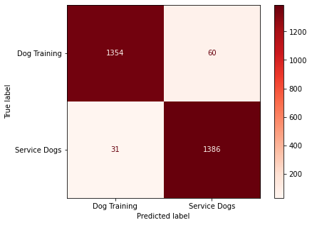
Topic 1: Success Metrics
Classification model
Aim for an even variable balance
Use Accuracy as main success metric
Consider other confusion matrix metrics along
Make sure to look at F1 Score
Create ROC Curve
Confusion Matrix

Slide 5
Topic 2: Questions, Problem, Goal
Topic: Gender Gaps in International Education
Question: How does women’s education levels and literacy change related to the country’s GDP, childhood mortality rate, and other factors?
Audience: The United Nations Entity for Gender Equality and the Empowerment of Women (UN Women)
Problem Statement (Hypothesis):
The average difference in the years of education attained between gender=1, gender=0 is zero.
The average difference in the years of education attained between gender=1, gender=0 is not zero.
Goal: Create a model that predicts the year of school a woman will attain dependent on various factors.
Notes:
Time series?
Is there a way to use a model to identify which factors predict education years?
Model that predicts what year of school a female will reach depending on various factors
Clustering? Another model that we have not learned yet?

Slide 6
Topic 2: Data Set
Data Source: Gender Statistics from The World Bank using the wbdata API
Features: expected years of school (female/male), learning-adjusted years of school (female/male), country, GDP (current US$), literacy rate – adult (female/male %), childhood mortality rate, etc.
EDA plan: Nulls, General Stats, Histogram, Outliers, Check % characters, and others as identified

Slide 7
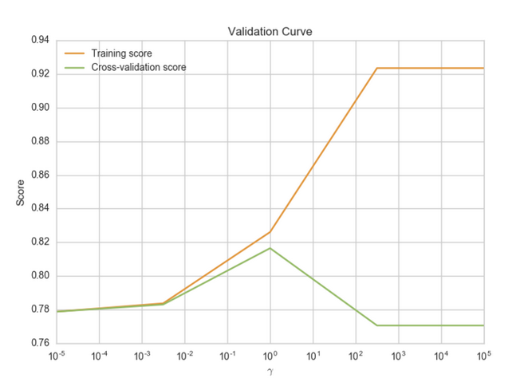
Topic 2: Success Metrics
Utilize the Six Regression Metrics
Compare to Baseline Score
Hypothesis Testing
Cross Validation
Coeff_
Prediction Error Plots

Slide 8
Topic 3: Questions, Problem, Goal
Topic: Student Loan Repayment
Question: As student income increases, how does student loan repayment change?
Audience: Student loan borrowers, political lobbyist groups
Problem Statement: Student loan borrowers are not able to complete repayment plans quickly, even if their income increases quickly after graduation. Focus in on marginalized communities
Goal: Create a classification or regression model that classifies student loan repayment completion based on
Notes:
Time series?

Slide 9
Topic 3: Data Set
Data Source: College Scorecard
Features:
Unit ID for institution
8-digit OPE ID for institution
6-digit OPE ID for institution
Institution name
City
State postcode
ZIP code
Accreditor for institution
Highest degree awarded
Flags for HBCU, tribal college/university, Hispanic-serving, Native American non-tribal, men-only, women-only, religious
Data on student completion, debt and repayment, earnings, and more.
EDA plan: Nulls, General Stats, Histogram, Outliers, Check % characters, and others as identified

Slide 10
Topic 3: Success Metrics
Utilize the Six Regression Metrics
Compare to Baseline Score
Hypothesis Testing
Cross Validation
Coeff_
Prediction Error Plots
Classification model
Aim for an even variable balance
Use Accuracy as main success metric
Consider other confusion matrix metrics along
Make sure to look at F1 Score
Create ROC Curve
Confusion Matrix

