Slide 1
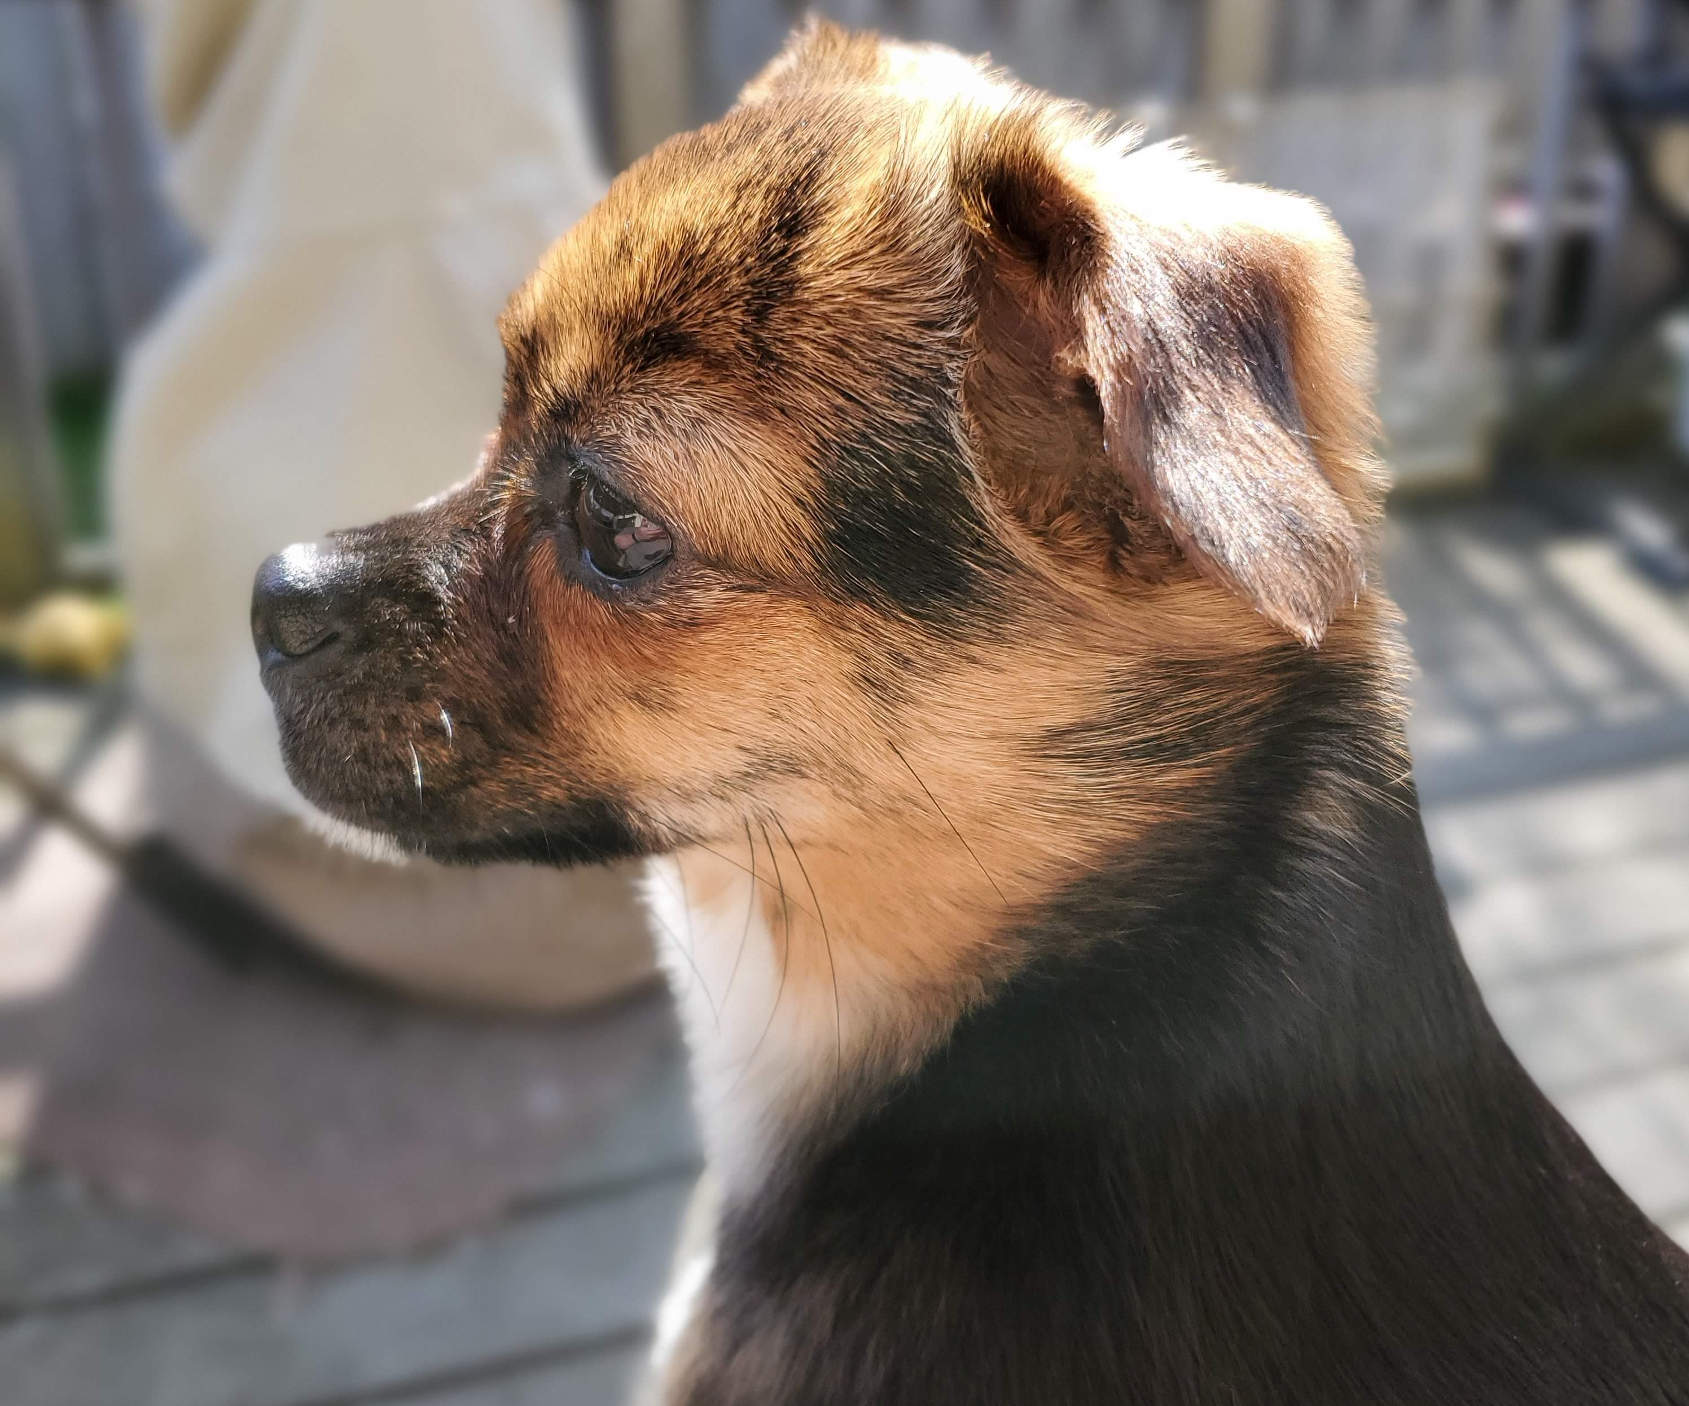
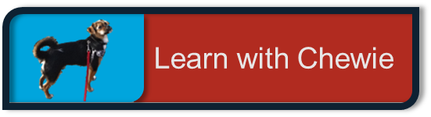
API & NLP
Brandie Hatch

Slide 2
Problem & Goals
Notes:
Introduce problem statement

Slide 3
chewie
Video of Chewie learning
Ten-pound rescue pup who loves everyone and plans to be a therapy dog once the AKC Canine Good Citizen test is passed.
Notes:
Grab the audience’s attention

Slide 4
Background
Cite outside sources and talk about the project direction as a result of those sources
Communicate what the goal is if someone has already tackled this problem before and how we decided to approach in making a model better (e.g. feature selection, what are we doing differently from other people before?)
Inference - we want, by the end of the presentation, to communicate strengths of relationships and effect on y variable (classification of plant)
Notes:
Key takeaway: Research gathered and how this may dictate our own modeling.
Attempts at this study have been made
We’re adapting the previous study approaches for inference

Slide 5
EDA/Cleaning
Checking null values, dtypes, class imbalance, outliers
Distribution of the y and the features
Histograms
Box Plots

Slide 6
Investigative Process
Notes:
Use visuals (2 max) to show inputs and outputs
High-level to communicate to a non-technical audience
Key takeaway: Reinforce problem statement so audience understands the ‘why’ and ‘how’
Logistic
Stratify if class imbalance
Checking:
Assumptions:
Linearity
Independence of features
Independence of Errors
Distribution of Errors
Residuals
Multicollinearity

Slide 7
Risk exposure
Model evaluation metrics (and what they mean)
Implications of “failure” to the model to predict properly
How impactful this slide is - dependent on the how we will use this data post-presentation
Notes:
Key takeaway: What happens if we mess this up and what are the chances that happens?
Assumptions
Good metrics:
R2
Root Mean Squared Error

Slide 8
Hypothesis Testing
Establishing null hypothesis
Evaluating P-value
Statistical difference between features
Confidence Intervals

Slide 9
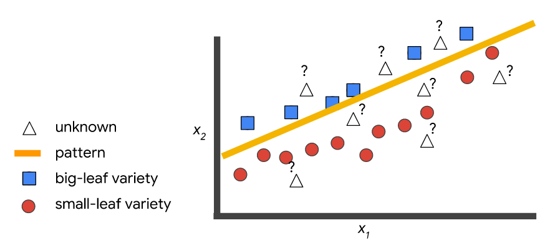
Inferences
Explanation of coefficients by units of measure
Interpretation of strongest coefficients - the significance of those coefficients in relation to our data.
What that means for us
Visual showing result:
Notes:
Key takeaways: Explanations both visually and verbally
Statistical significance of coefficients
Interpretation:
For every 1 unit increase, how does that affect y?

Slide 10
recommendations
Next Steps
Implications
Notes:
Next steps
What do we do with this information?
Implications: How can this connect to a study from Stanford University using a similar model to detect skin cancer in images?
Re-address problem statement and findings
Were we able to come up with a solution.

Slide 11
Questions
Notes:
Image of authors
Emails
LinkedIn URLs

Slide 12
Index

Slide 13
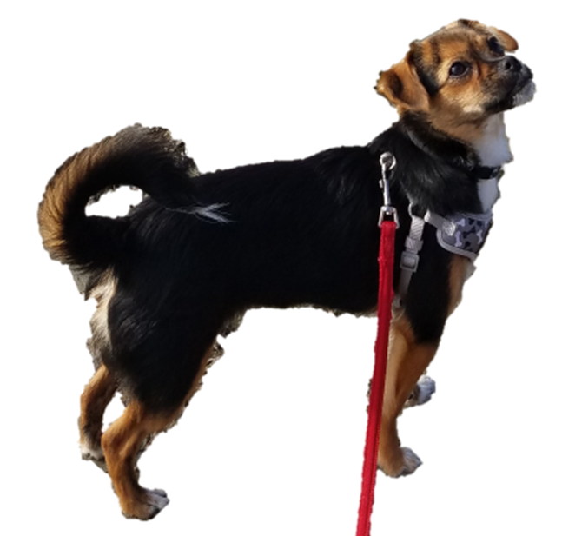

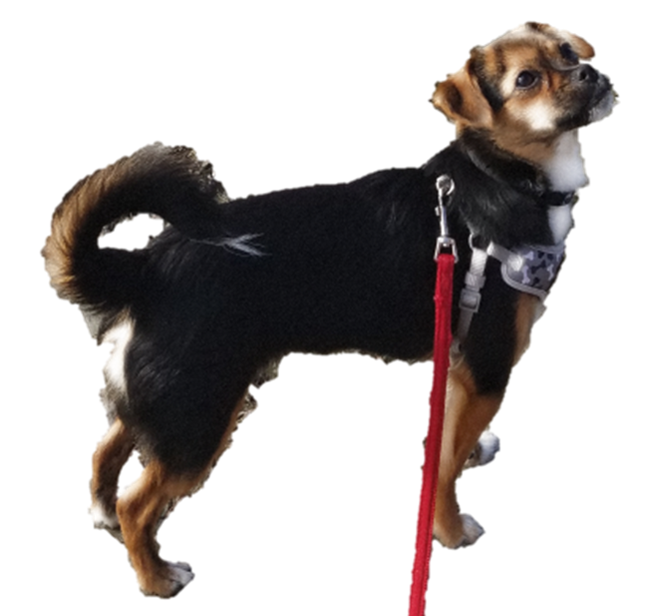
Sources

