Slide 1



Reliability-Aware Multimodal Fusion for Irregular Time Series: Extending IMM-TSF from Forecasting to Classification
Chad Bishop, Nnenna Ifeanyi, & Brandi Jones

Slide 2
Introduction
Real-world time series data is rarely, if ever, clean, fully observed, and made of regularly sampled sequences
Prior research:
Traditional time series approaches require non-uniformly sampled data be converted into uniform or textual data but these transformations face interpretability results
Missingness in time series is especially informative in real world time series data and should not be discarded
Text alignment with LLMs is known to improve prediction accuracy and enhance interpretability
Gated recurrent neural networks (RNN-GRU) can model consecutive data due to update and reset gates
Determine the necessary information to be kept in the memory
RNN-GRU is a simpler structure of long short-term memory (RNN-LSTM)
t-PatchGNN, designed specifically for application in irregular multivariate time-series, provides better forecasting

Slide 3
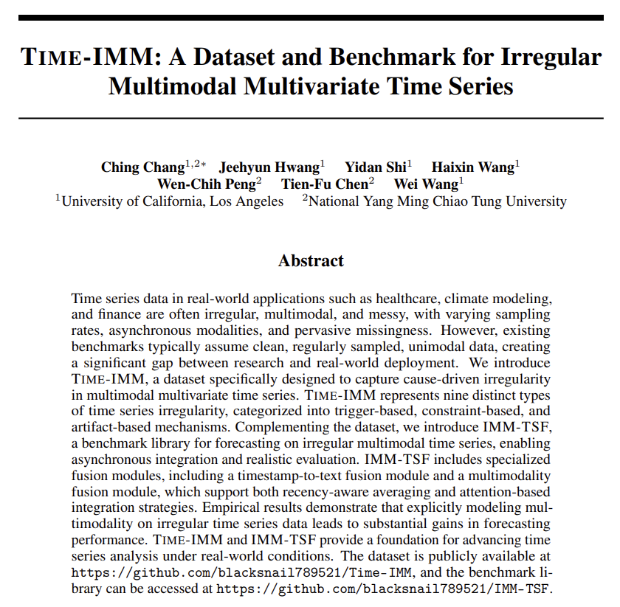
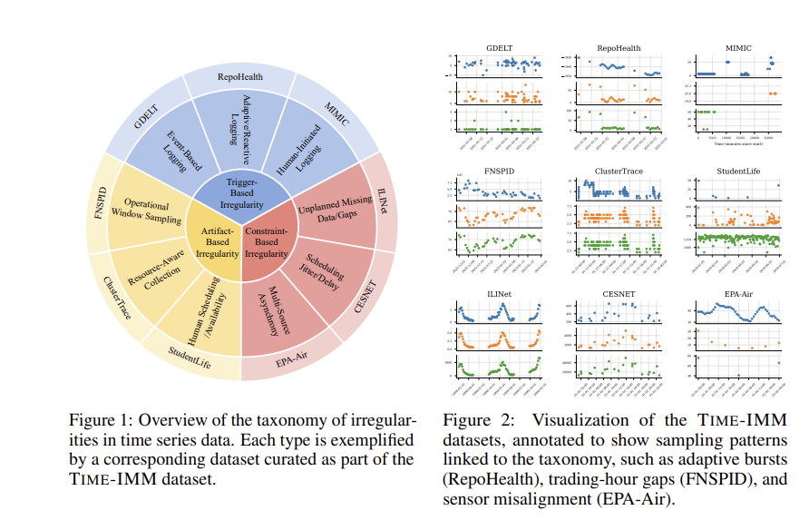
Introduction
The need for modeling frameworks that utilize irregular, asynchronous, multimodal, and missing-rich data was the motivation for:
Chang, C. et al. (2025). Time-IMM: A dataset and benchmark for irregular multimodal multivariate time series. arXiv. https://doi.org/10.48550/arXiv.2506.10412
The paper defines 3 types of irregularity mechanisms:
Trigger based
Artifact based
Constraint based
The purpose of this project was:
First, to develop a reliability-aware gated fusion (RA-GRAdd) variant of the IMM-TSF framework.
Weighting asynchronous text relative to irregular time-series observations
Taking text recency, density in time, alignment, and missingness into account prior to inclusion
Second, our study altered the original

Slide 4

Methods
Reproduced Chang et al. (2025) IMM-TSF methods for:
GDELT: Trigger Based
FNSPID: Artifact Based
CESNET: Constraint Based
ClusterTrace: Artifact Based
MIMIC-IV: Trigger Based
Developed reliability-aware gate for multimodal fusion in IMM-TSF framework to make text inclusion more explicit
Forecasting head exchanged for binary classification head
Binary cross entropy loss for classification
*GPT-2, t-PatchGNN used for reproduction and extensions

Slide 5
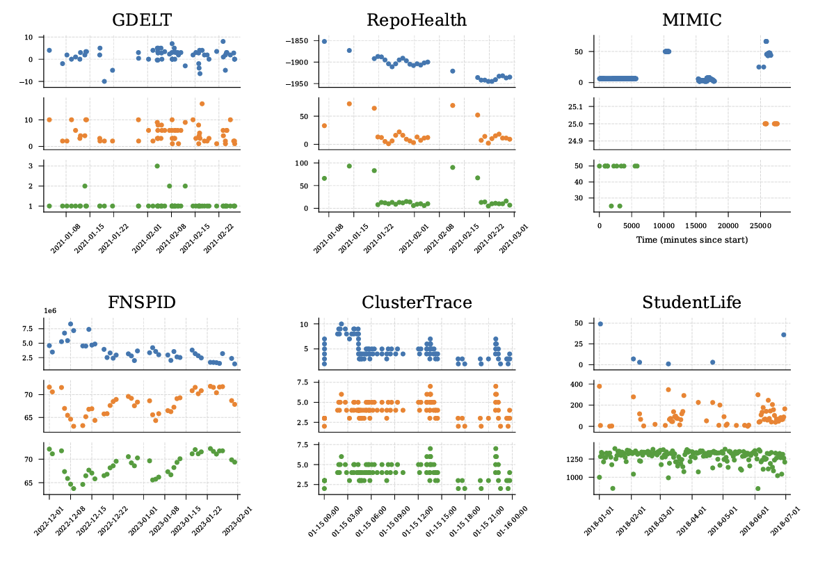
Datasets for Extensions:
MIMIC-IV is a large, deidentified electronic health record database with patients treated at Beth Israel Deaconess Medical Center (2008-2019)
N=299,712 patients and 431,231 hospital admissions
It contains multimodal clinical information including demographics, diagnoses, procedures, medications, laboratory results, ICU charted measurements, and linked clinical notes
Trigger based irregularity based on Chang et al.
Chosen because it provides both irregular structured time-series data and text data that can be fused in a single modeling pipeline
Allows modeling in the context of real-world complexity seen in health data
FNSPID is a finance-oriented multimodal dataset that combines structured financial time-series information with text-based financial news (1999 to 2023)
N=29.7 million stock price records, 15.7 million time-aligned financial news records covering 4,775 S&P 500 companies
Artifact based irregularity based on Chang et al.
For studying irregular multimodal forecasting and classification in a non-clinical domain.
For our project, FNSPID functions allows us to test whether the same multimodal fusion extensions that work in healthcare also transfer to market prediction tasks where asynchronous text and numeric signals are common

Slide 6
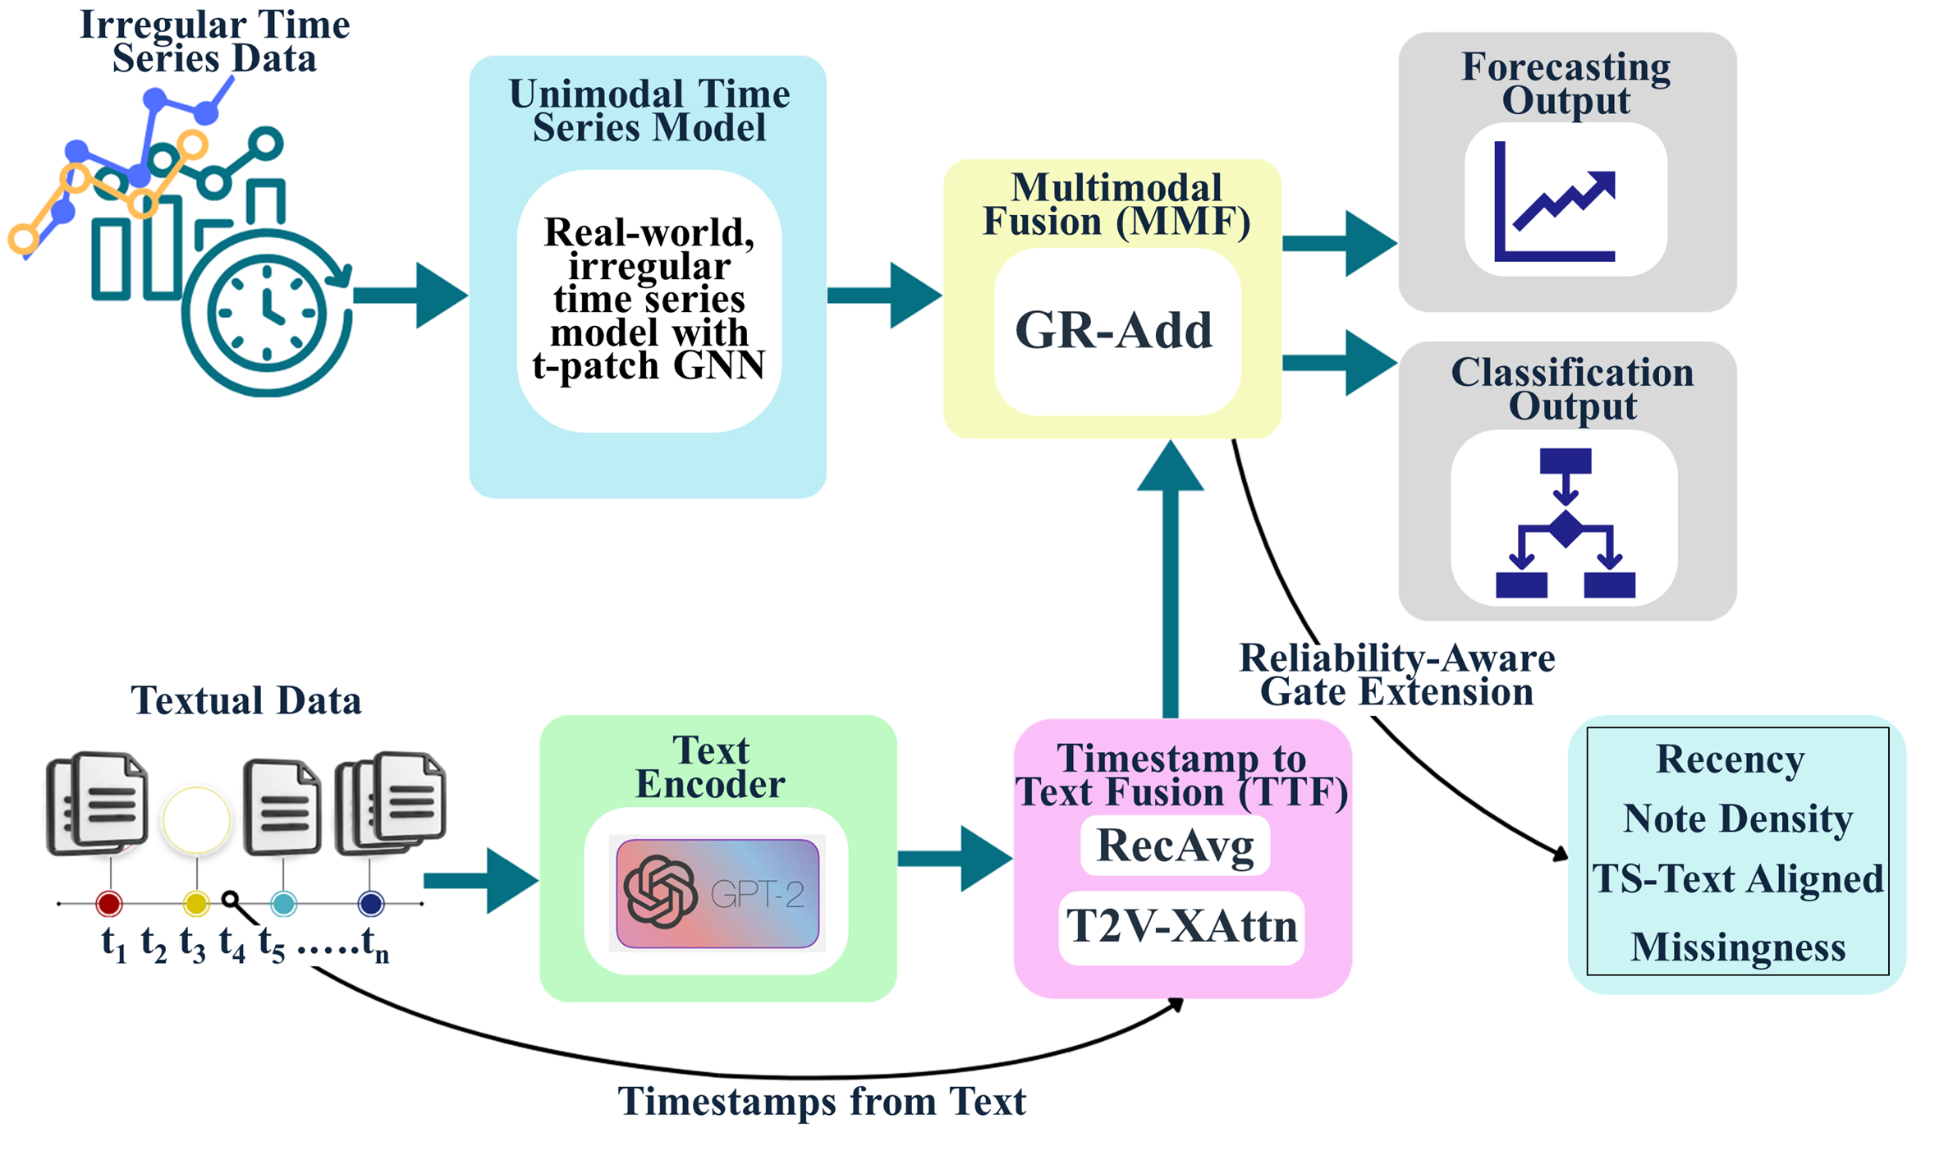
Our Irregular Time Series Framework Extensions

Slide 7
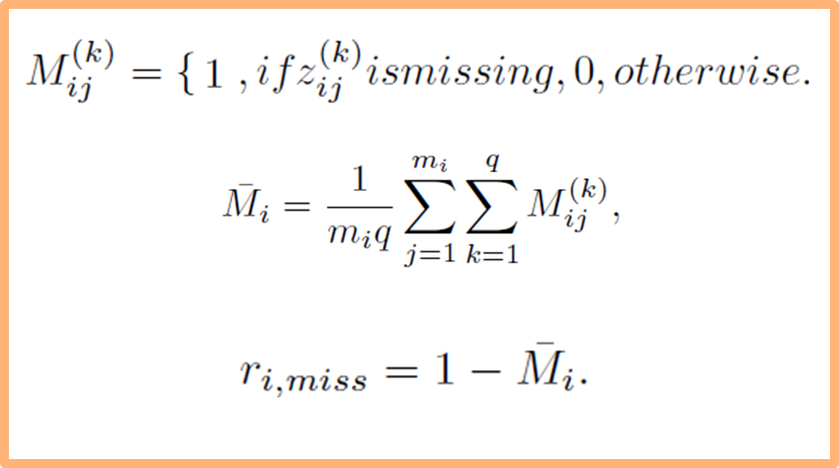
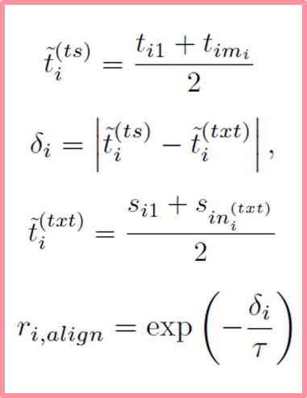
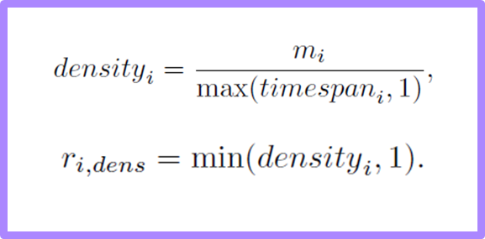
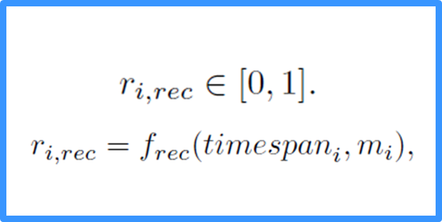

Missingness
Text-TS Alignment
Note Density
Recency
RA-GRAdd Extension:
Making text inclusion for forecasting more explicit/smarter

Slide 8
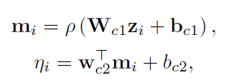




Classification Extension:
After fusion, latent vector is passed through multilayer perception:
Predicted Event Probability:
To Account for Class Imbalance Binary Cross Entropy Loss Used:
Final Decision Threshold Tuned By Maximizing Validation F1:

Slide 9
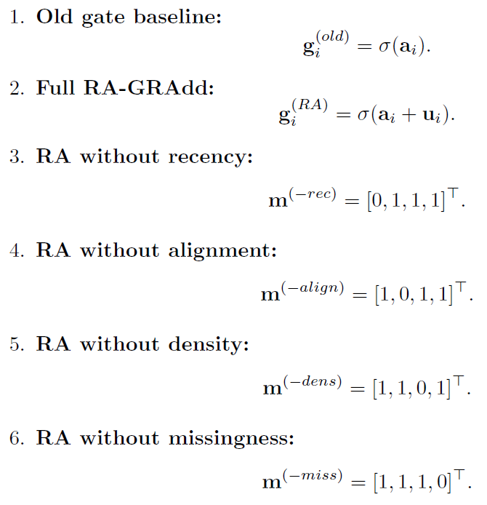
Forecast and Classification Runs:
Ablation study used to assess one gate extension at a time
Ablation used in both forecasting and classification models
Forecasting and Classification models run for MIMIC and FNSPID

Slide 10
Reproduction of Paper Results
Model Reproduction Results |  | Multimodal MSE |  | Unimodal MSE
Dataset | Irregularity Type | Paper | Ours | Paper | Ours
GDELT | Trigger-Based (Event-Based Logging) | 1.03 | 1.02 | 1.03 | 1.04
FNSPID | Artifact-Based (Operational Window Sampling ) | 0.12 | 0.16 | 0.12 | 0.16
CLUSTER TRACE | Artifact-Based (Resource-Aware Collection) | 0.61 | 0.85 | 0.98 | 0.87
CESNET | Constraint-Based (Scheduling Jitter / Delay) | 0.91 | 0.96 | 0.98 | 1.03
MIMIC-IV | Trigger-Based (Event-Based Logging) | 0.77 | 0.74 | 0.73 | 0.74
We reproduced IMM-TSF results for 5 of the benchmark datasets across the 3 types of proposed irregularity
GDELT: Trigger Based
FNSPID: Artifact Based
CESNET: Constraint Based
ClusterTrace: Artifact Based
MIMIC-IV: Trigger Based
Using GPT-2 and t-PatchGNN
Table 1. Model performance comparisons for reproduction results from
Chang et al., 2025 IMM-TSF

Slide 11
Results: Classification
MIMIC mortality classification cohort was restricted to:
adult patients older than 15 years,
single-admission subjects,
admissions with length of stay greater than 30 days, and
admissions with available chart events / structured time-series data sufficient to build the multimodal representation.
N=1108
FNSPID dataset is extremely large, analytic classification sample is a processed subset:
usable structured market time-series segment
corresponding time-aligned text/news information, and
sufficient processed information to construct the multimodal input used by the t-PatchGNN plus fusion architecture.
N=678

Slide 12
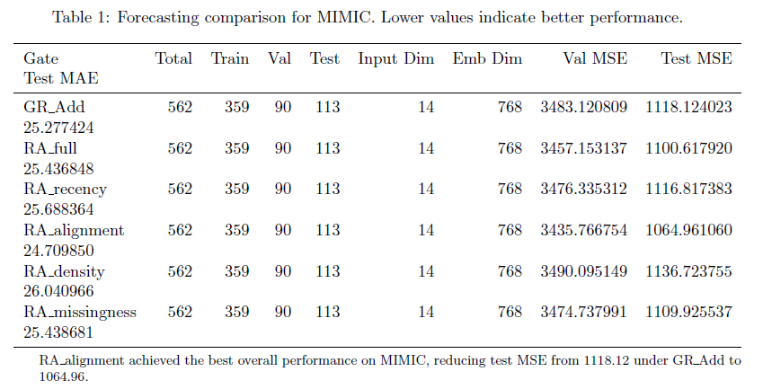
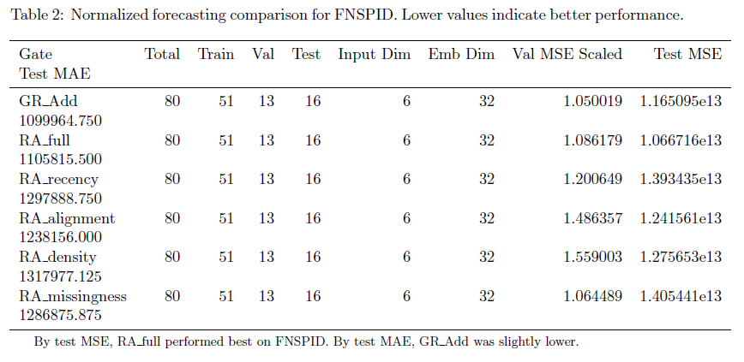
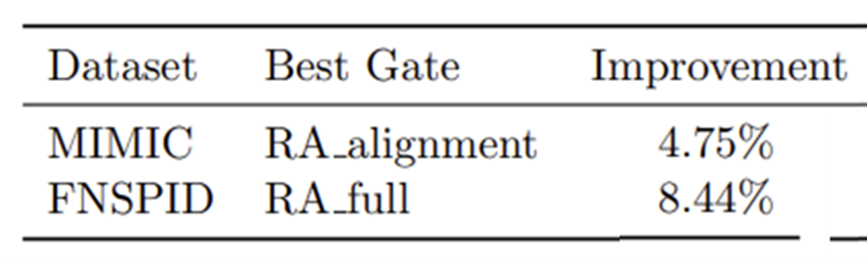
Results:
Forecasting

Slide 13
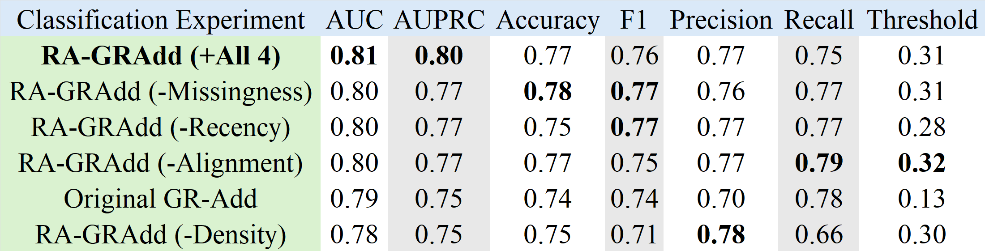
Results:
Classification
Table 3. Final Financial Classification Model Results
Table 4 . Final Mortality Classification Model Results

Slide 14
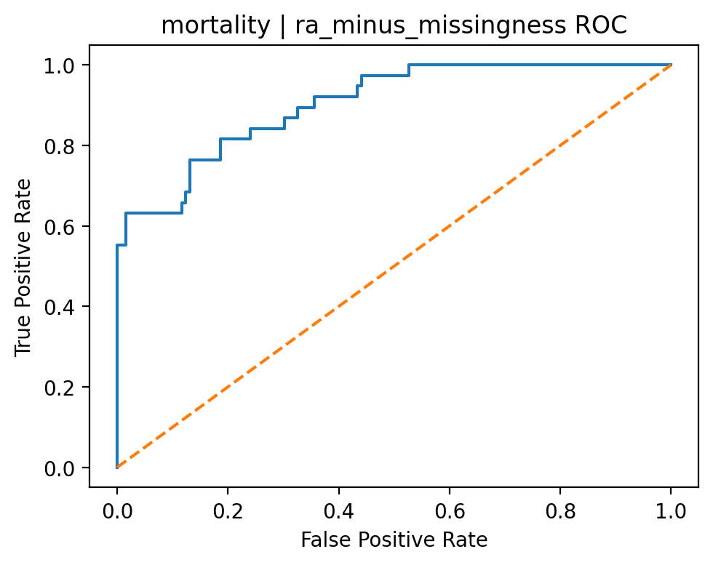
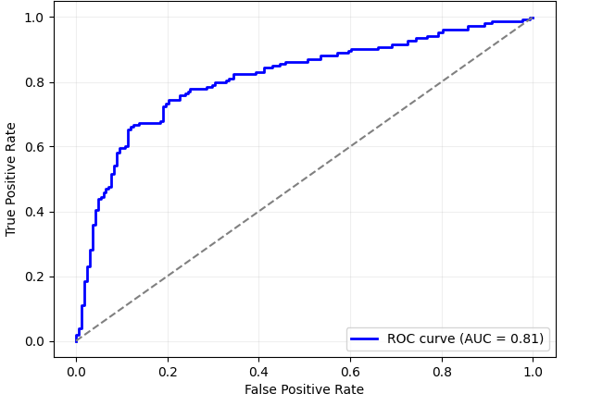
Results
Figure 4. Best Model: Mortality RA-GRAdd Classification AUROC
Figure 5. Best Model: Financial RA-GRAdd Classification AUROC

Slide 15
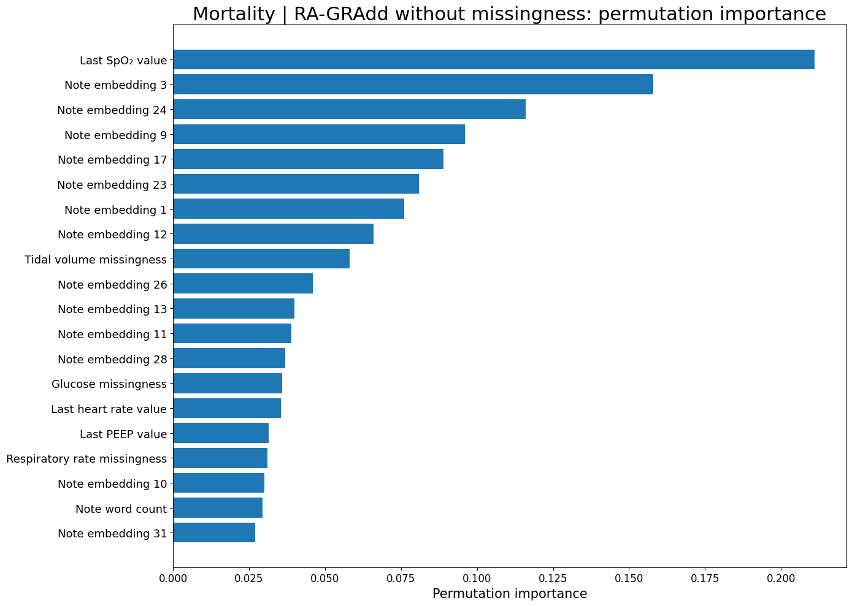
Permutation Feature Importance for Mortality Prediction from Text Embeddings
Figure 3. Permutation Feature Importance from Mortality Classification with Text Embedding Interpretations

Slide 16
Conclusions
Overall, we demonstrated feasible and effective extension of the Time-IMM/IMM-TSF framework from forecasting to binary classification.
The proposed RA-GRAdd extension improved multimodal fusion making the model more responsive to differences in information quality across modalities.
Incorporating reliability-aware gating produced stronger and more stable classification performance than baseline fusion alone, while also preserving the interpretability of the multimodal design.
Future work should evaluate the proposed framework extensions in a distributed Spark-based environment to assess scalability on larger multimodal datasets to determine whether methods remain efficient as sample size, feature dimensionality, and text volume increase.
Taken together, our findings indicate that better handling of irregularity and cross-modal quality can strengthen forecasting as well as classification performance, while preserving the flexibility and interpretability of multimodal fusion.

Slide 17
References:
Chang, C., Hwang, J., Shi, Y., Wang, H., Peng, W.-C., Chen, T.-F., & Wang, W. (2025). Time-IMM: A Dataset and Benchmark for Irregular Multimodal Multivariate Time Series. arXiv.
Che, Z., Purushotham, S., Cho, K., Sontag, D., & Liu, Y. (2018). Recurrent neural networks for multivariate time series with missing values. Scientific Reports, 8, 6085.
Hassaan, Z. A., Yacoub, M. H., & Said, L. A. (2025). Gated recurrent unit accelerators for financial time series prediction on field-programmable gate array. Engineering Applications of Artificial Intelligence, 162(Part E), 112534. https://doi.org/10.1016/j.engappai.2025.112534
Sarkar, M. R., Anavatti, S. G., Dam, T., Ferdaus, M. M., Tahtali, M., Ramasamy, S., & Pratama, M. (2024). GATE: A guided approach for time series ensemble forecasting. Expert Systems with Applications, 235, 121177. https://doi.org/10.1016/j.eswa.2023.121177
Wang, H., Yang, Z., Yu, Q., Hong, T., & Lin, X. (2018). Online reliability time series prediction via convolutional neural network and long short term memory for service-oriented systems. Knowledge-Based Systems, 159, 132–147. https://doi.org/10.1016/j.knosys.2018.07.006
Zhang, W., Chen, X., Zhang, Y., & collaborators. (2024). Irregular Multivariate Time Series Forecasting: A Transformable Patching Graph Neural Networks Approach.
MIMIC-IV: Johnson, A. E. W., Bulgarelli, L., Pollard, T. J., Horng, S., Celi, L. A., & Mark, R. G. MIMIC-IV, a freely accessible electronic health record dataset.
FNSPID: Dong, Z., Fan, X., & Peng, Z. FNSPID: A Comprehensive Financial News Dataset in Time Series.
Portions of the coding pipeline were developed with assistance from ChatGPT (OpenAI), which was used to help draft, debug, and refine code structure. All code was reviewed, tested, and adapted by the author for the final analysis. OpenAI. (2026, April 21). ChatGPT (GPT-5.4 Thinking) [Large language model]. https://chatgpt.com/

