Slide 1
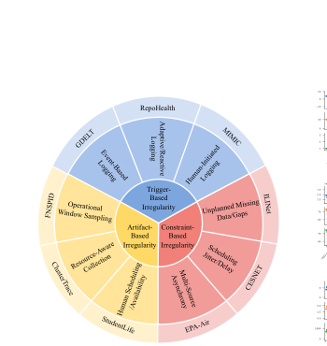
TIME-IMM Project Proposal
Brandi Jones
Chad Bishop
Nnenna Ifeanyi
Motivating paper:
Introduces TIME-IMM, a dataset designed to reflect realistic multimodal multivariate time series data, and IMM-TSF, a benchmark library for forecasting
Problem framing
• Real-world time series are irregular, asynchronous,
multimodal, and missing-rich.
• TIME-IMM contributes 9 datasets and the IMM-TSF
library, making reproduction, application, and extension all
feasible.
Original Paper Goal: Build deep learning architectures that can handle complex temporal dynamics and multimodal interactions
Our Project Goal:
A
B
C
TIME-IMM taxonomy: 9 datasets across trigger-based, constraint-based, and artifact-based irregularity.
Reproduction
Application
Extension
Replicate the paper’s IMM-TSF results with released code and matched settings.
Use MIMIC as the healthcare case and analyze when notes help forecasting most.
Add a reliability-aware gate so text changes the forecast only when it is useful.
Code: github.com/blacksnail789521/Time-IMM + IMM-TSF
Notes:
Slide 1 script: This project uses TIME-IMM because it naturally covers all three assignment options. The paper focuses on irregular, asynchronous, multimodal time series, which is exactly the kind of realistic longitudinal setting the class project is pushing us toward. My plan is to first reproduce the benchmark with the official code, then apply it in a healthcare-focused setting using MIMIC, and finally add a methodological extension: a reliability-aware fusion gate that decides when text should influence the forecast. The central hypothesis is that text is useful, but not uniformly useful, so adaptive fusion should outperform a fixed fusion rule. [Sources] - User-uploaded paper: Time-IMM.pdf, pages 1-3 and 6-9 (benchmark motivation, 9 datasets, IMM-TSF modules, multimodal gains, and fusion ablation). - User-uploaded class slides: Class Project.pptx, slides titled “Anchor Paper: TIME-IMM (2025)”, “Project Tracks”, and “Proposal & Weekly Progress Check”. - OpenReview page for the paper confirming public dataset and code URLs: https://openreview.net/forum?id=yeqrrn51TL - GitHub repositories: https://github.com/blacksnail789521/Time-IMM and https://github.com/blacksnail789521/IMM-TSF

Slide 2
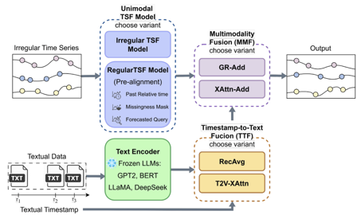
Data, methods, and execution plan
Replicate the paper first, then address a realistic healthcare research question through one architectural innovation.
Method extension: Reliability-Aware GR-Add (RA-GRAdd)
Replication + healthcare use case
Reproduce and Expand Time-IMM + IMM-TSF
Keep the paper’s IMM-TSF pipeline but replace the final fusion step with a smarter gate that decides when text should change the forecast.
ClusterTrace
CESNET
MIMIC
FNSPID
GEDT
• Reproduce benchmark results with a subset
of datasets from the original 9, using the
paper’s chronological 60/20/20 split, sliding
windows, and MSE.
• Healthcare application: test when clinical
text helps most in MIMIC by note density,
forecast horizon, and missingness.
Recency
Note density
Missingness
TS-text alignment
• Goal: improve over GR-Add and XAttn-Add by using text selectively.
• Evaluation: MSE, MAE, reproduced-vs-reported trends, and full
ablation study.
• Ablation ladder: recency only → +note density → +missingness → full
reliability gate.
Replicate RecAvg, T2V-XAttn, GR-Add, and XAttn-Add, using TSF backbones including the t-PatchGNN as in the original paper.
GR-Add already learns how to blend text into the forecast, but it does so implicitly from hidden features. Our extension would make that gating decision more explicit by providing the gate with reliability signals that reflect whether the note stream is likely to be useful at that forecast time.
Notes:
Slide 2 script: On the execution side, I will keep the project staged. First, I will replicate the official benchmark on a small but diverse subset of TIME-IMM, probably MIMIC, ClusterTrace, and one of FNSPID or EPA-Air. I will follow the paper’s split, sliding-window setup, and core fusion baselines so the reproduction is faithful. Second, I will frame the application around healthcare by asking when clinical text helps most in MIMIC. Third, I will implement RA-GRAdd, a reliability-aware version of the paper’s GR-Add fusion that uses recency, note density, missingness, and time-series/text alignment to decide how much text should affect the forecast. Evaluation will use MSE first, then MAE and ablation studies. [Sources] - User-uploaded paper: Time-IMM.pdf, pages 2-9 (dataset taxonomy, IMM-TSF architecture, TTF/MMF variants, experimental setup, and ablation findings). - User-uploaded class slides: Class Project.pptx, slides titled “Proposal & Weekly Progress Check”, “Final Project Report”, and “Code”. - GitHub README for IMM-TSF documenting main.py, compute_text_embeddings.py, main_all.sh, and MIMIC preprocessing: https://github.com/blacksnail789521/IMM-TSF - GitHub README for Time-IMM documenting the released 8 datasets and local MIMIC preprocessing requirement: https://github.com/blacksnail789521/Time-IMM

Slide 3
Preliminary Results from Original Methods Reproduction:
Current Results (04/02/2026) |  | Multimodal MSE |  | Unimodal MSE
Dataset | Irregularity Type | Paper | Ours | Paper | Ours
GDELT | Trigger-Based (Event-Based Logging) | 1.03 | 1.02 | 1.03 | 1.04
FNSPID | Artifact-Based (Operational Window Sampling ) | 0.12 | 0.16 | 0.12 | 0.16
CLUSTERTRACE | Artifact-Based (Resource-Aware Collection) | 0.61 | 0.85 | 0.98 | 0.87
CESNET | Constraint-Based (Scheduling Jitter / Delay) | 0.91 | 0.96 | 0.98 | 1.03
FNSPID, ClusterTrace, and CESNET discrepancies likely reflect differences in preprocessing, data splits, tuning, and environment stability.
MIMIC III embeddings produced and baseline reproduction runs initiated
Computational resources issues, Google Colab reliance
Literature review for project expansion methodology (option C)
Apr 2
Apr 9
Apr 16
Apr 23
May 4
Project Milestones
proposal
first repro
results progress
present results
final report + code

