Slide 1
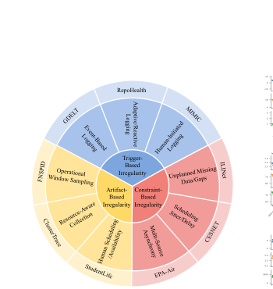
TIME-IMM Project Proposal
Brandi Jones
Chad Bishop
Nnenna Ifeanyi
Motivating paper:
Introduces TIME-IMM, a dataset designed to reflect realistic multimodal multivariate time series data, and IMM-TSF, a benchmark library for forecasting
Problem framing
• Real-world time series are irregular, asynchronous,
multimodal, and missing-rich.
Original Paper Goal: Build deep learning architectures that can handle complex temporal dynamics and multimodal interactions
Our Project Goal:
A
B
C
Reproduction
Application
Extension
Replicate the paper’s IMM-TSF results with released code and matched settings.
Use MIMIC as the healthcare case and analyze when notes help forecasting most.
Add a reliability-aware gate so text changes the forecast only when it is useful. Extend to classification: ICU Readmission
TIME-IMM taxonomy: 9 datasets across trigger-based, constraint-based, and artifact-based irregularity.
Code: github.com/blacksnail789521/Time-IMM + IMM-TSF

Slide 2
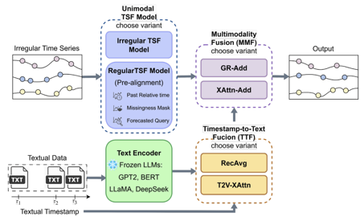
Data, methods, and execution plan
Replicate the paper first, then address a realistic healthcare research question through one architectural innovation.
Method extension: Reliability-Aware GR-Add (RA-GRAdd)
Replication + healthcare use case
Reproduce and Expand Time-IMM + IMM-TSF
Keep the paper’s IMM-TSF pipeline but replace the final fusion step with a smarter gate that decides when text should change the forecast.
ClusterTrace
CESNET
MIMIC
FNSPID
GEDT
• Reproduce benchmark results with a subset
of datasets from the original 9, using the
paper’s chronological 60/20/20 split, sliding
windows, and MSE.
• Healthcare application: test when clinical
text helps most in MIMIC by note density,
forecast horizon, and missingness.
Recency
Note density
Missingness
TS-text alignment
• Goal: improve over GR-Add and XAttn-Add by using text selectively.
• Evaluation: MSE, MAE, reproduced-vs-reported trends, and full
ablation study.
• Ablation ladder: recency only → +note density → +missingness → full
reliability gate.
Replicate RecAvg, T2V-XAttn, GR-Add, and XAttn-Add, using TSF backbones including the t-PatchGNN as in the original paper.
Notes:
Slide 2 script: On the execution side, I will keep the project staged. First, I will replicate the official benchmark on a small but diverse subset of TIME-IMM, probably MIMIC, ClusterTrace, and one of FNSPID or EPA-Air. I will follow the paper’s split, sliding-window setup, and core fusion baselines so the reproduction is faithful. Second, I will frame the application around healthcare by asking when clinical text helps most in MIMIC. Third, I will implement RA-GRAdd, a reliability-aware version of the paper’s GR-Add fusion that uses recency, note density, missingness, and time-series/text alignment to decide how much text should affect the forecast. Evaluation will use MSE first, then MAE and ablation studies. [Sources] - User-uploaded paper: Time-IMM.pdf, pages 2-9 (dataset taxonomy, IMM-TSF architecture, TTF/MMF variants, experimental setup, and ablation findings). - User-uploaded class slides: Class Project.pptx, slides titled “Proposal & Weekly Progress Check”, “Final Project Report”, and “Code”. - GitHub README for IMM-TSF documenting main.py, compute_text_embeddings.py, main_all.sh, and MIMIC preprocessing: https://github.com/blacksnail789521/IMM-TSF - GitHub README for Time-IMM documenting the released 8 datasets and local MIMIC preprocessing requirement: https://github.com/blacksnail789521/Time-IMM

Slide 3
Our Project Methods Alteration and Extension:
First, the original TIME-IMM/ IMM-TSF forecasting framework was reproduced
Using the official repository structure, preserving the modular pipeline consisting of an irregular time-series backbone, a timestamp-to-text fusion module, and a multimodality fusion module.
The addition of a reliability aware MMF gate, altering the GR-Add gate to make
Second, framework extended from irregular multimodal forecasting to binary ICU readmission classification
On MIMIC-IV (with clinical notes)
Retaining core multimodal learning strategy
Replacing the forecasting head with a binary classification head.

Slide 4
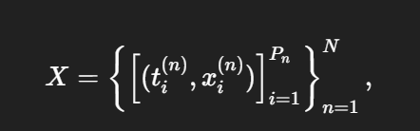


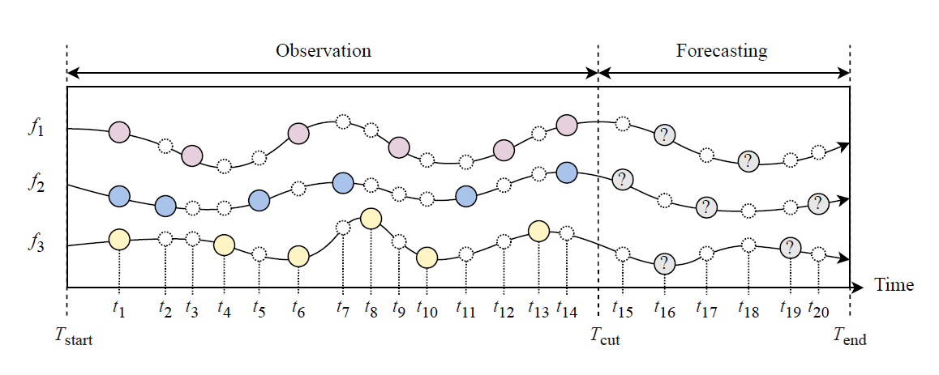
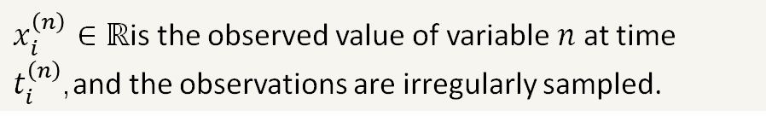
Forecasting:
Text Stream:
Original Forecasting Objective:
$x_{i}^{\left(n\right)}∈ℝ$is the observed value of variable $n$ at time $t_{i}^{\left(n\right)}$,and the observations are irregularly sampled.
The github based python reproduction workflow is:
Define experiment settings with ReproRunConfig.
Set filesystem paths with RepoPaths.
Build dataset- and model-specific CLI commands.
Execute the official forecasting run with run_one().
Parse metrics from logs using parse_metrics_from_log().
Aggregate all runs with collect_results().
Compare MIMIC reproduction outputs against the paper using build_mimic_comparison_table().
Notes:
the original TIMEIMM
/ IMM-TSF forecasting framework was reproduced as closely as possible
using the official repository structure, preserving the modular pipeline consisting
of an irregular time-series backbone, a timestamp-to-text fusion module, and
a multimodality fusion module. Second, this framework was extended from
irregular multimodal forecasting to binary ICU readmission classification on
MIMIC by retaining the core multimodal representation learning strategy while
replacing the forecasting head with a binary classification head.
Let
X = {(ti, xi,mi)}T
i=1
denote the irregular structured time-series history for a patient window, where
ti is the observation time, xi ∈ RF is the feature vector, and mi ∈ {0, 1}F is
the observation mask. Let
S = {(τj , sj)}L
j=1
denote the asynchronous clinical text stream, where τj is the note time and sj
is either raw text or a precomputed text embedding. In the original forecasting
formulation, the model learns a function
gθ(X, S,Q) → Y,
where Q denotes forecast query times and Y denotes future target values. In
the proposed classification extension, the forecasting target is replaced with a
binary readmission indicator:
hθ(X, S,Z) → r, r ∈ {0, 1},
where Z denotes optional static covariates and r is the ICU readmission label.

Slide 5
Paper Methods Reproduction: (04/09/2026)
Reproduced results for 5 datasets covering the 3 types of time-series irregularity identified in the paper
Current Results (t-PatchGNN) |  | Multimodal MSE (GPT-2) |  | Unimodal MSE
Dataset | Irregularity Type | Paper | Ours | Paper | Ours
GDELT | Trigger-Based (Event-Based Logging) | 1.03 | 1.02 | 1.03 | 1.04
FNSPID | Artifact-Based (Operational Window Sampling ) | 0.12 | 0.16 | 0.12 | 0.16
CLUSTERTRACE | Artifact-Based (Resource-Aware Collection) | 0.61 | 0.85 | 0.98 | 0.87
CESNET | Constraint-Based (Scheduling Jitter / Delay) | 0.91 | 0.96 | 0.98 | 1.03
MIMIC | Trigger-Based (Event-Based Logging) | 0.77 | 0.74 | 0.73 | 0.74

Slide 6
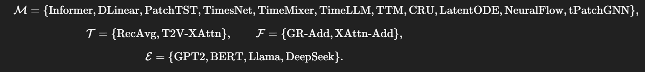
GR-Add to RA-GRAdd:
Recency
Methods Alteration:
Note density
TS-text alignment
Missingness
GR-Add already learns how to blend text into the forecast, but it does so implicitly from hidden features. Our extension would make that gating decision more explicit by providing the gate with reliability signals that reflect whether the note stream is likely to be useful at that forecast time.

Slide 7

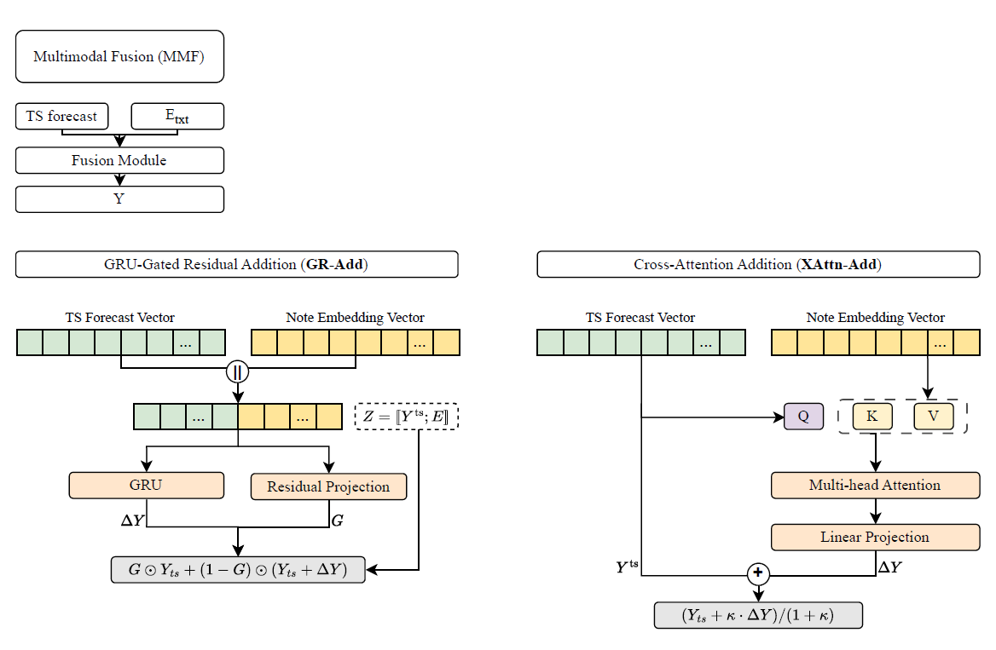



The GR-Add module formed a residual update to the structured representation.
The pair (hts, htxt) was processed sequentially through a recurrent unit:
A residual candidate was computed:
A gate learned from the concatenated
modalities:
Fused Representation:

Slide 8
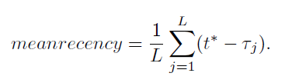



Extension introduced an explicit reliability-aware gate:
Instead of letting the gate depend only on latent structured and text features, it additionally incorporates observable indicators describing whether the note stream should influence prediction. The reliability vector:
Compute residual candidate r from recurrent multimodal interaction compute gate:
The reliability features were projected into a latent space:
Fuse modalities in same way as paper:

Slide 9


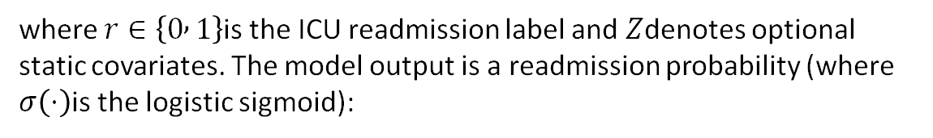
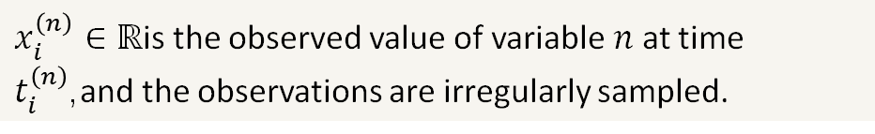
Forecasting Extension to ICU Readmission Classification:
Text Stream:
Original Forecasting Objective:
$x_{i}^{\left(n\right)}∈ℝ$is the observed value of variable $n$ at time $t_{i}^{\left(n\right)}$,and the observations are irregularly sampled.
New objective for classification becomes:
where $r∈\left\{0 , 1\right\}$is the ICU readmission label and $Z$denotes optional static covariates. The model output is a readmission probability (where $σ\left(⋅\right)$is the logistic sigmoid):

Slide 10
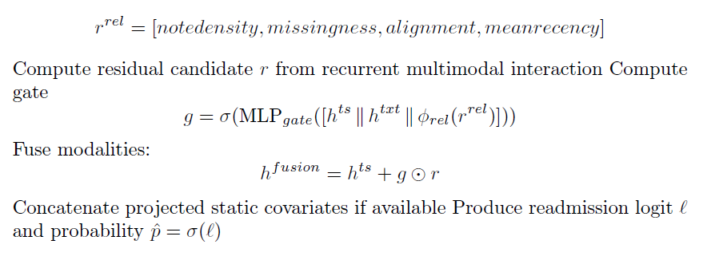


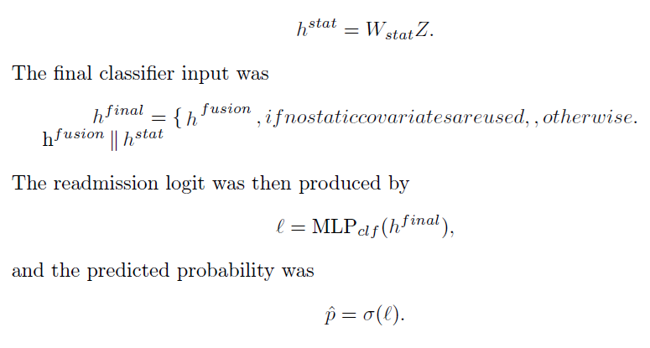
Extension to ICU Readmission Classification:
Binary cross-entropy loss on logits. For
patient i, with observed label y_{i} and predicted probability ˆp_{i}, the loss becomes:
With Batch Loss:

Slide 11
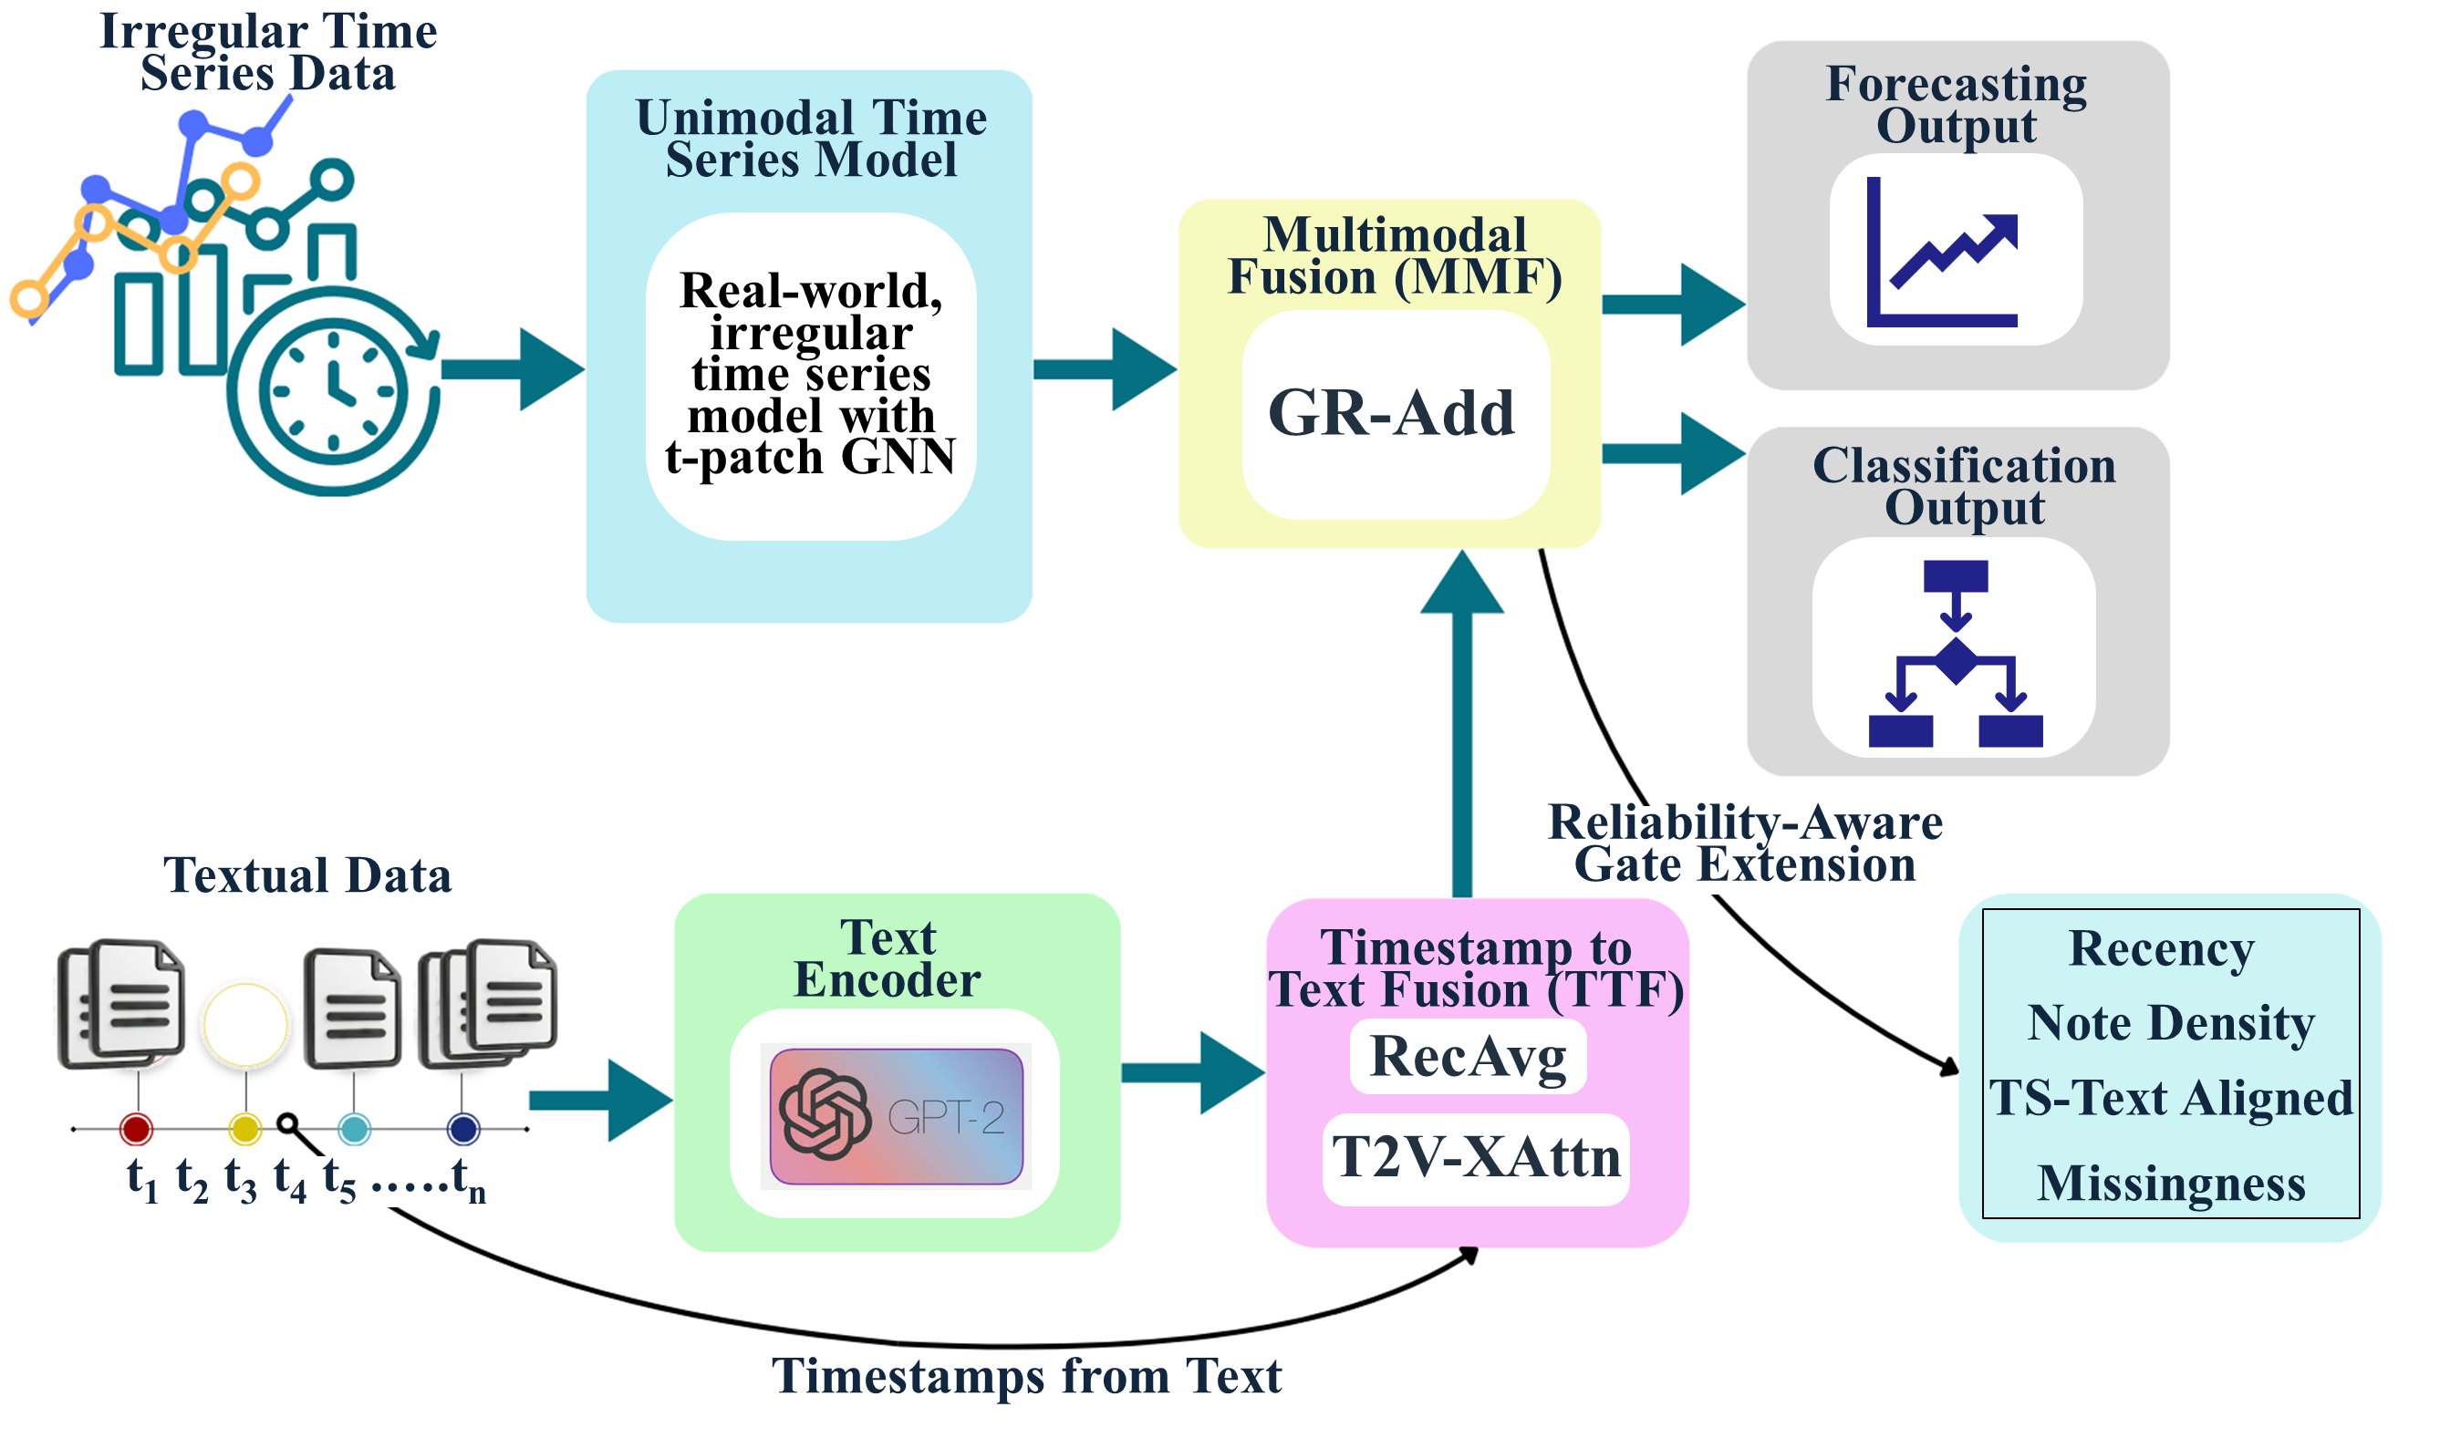
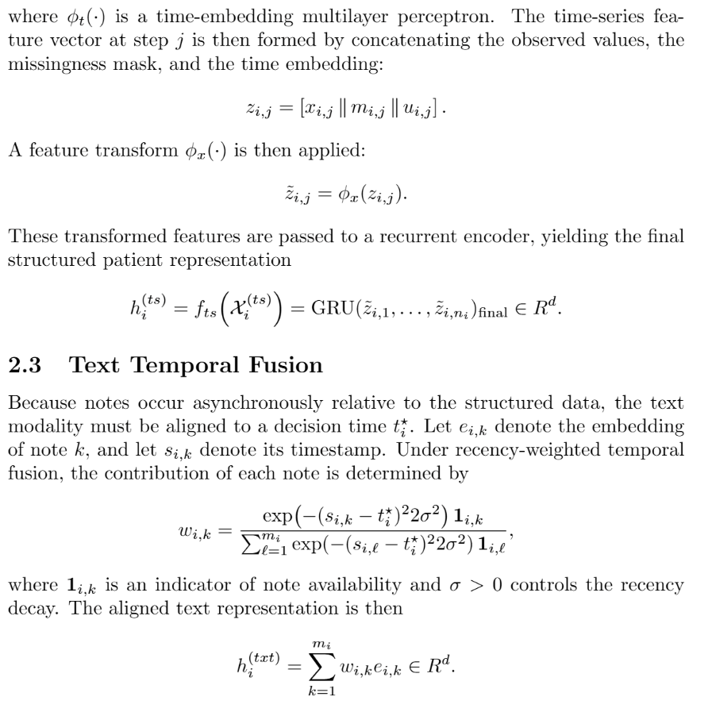
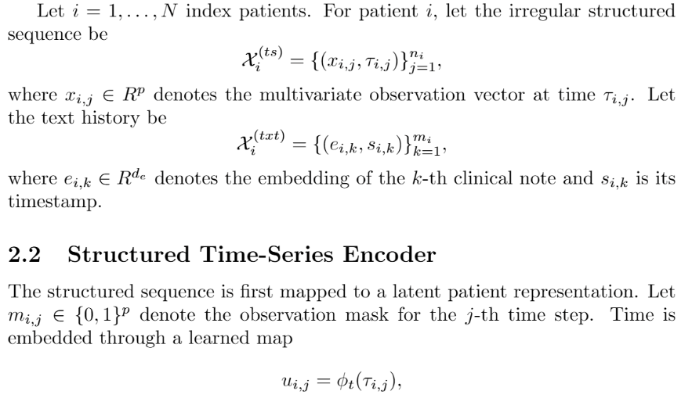

Slide 12
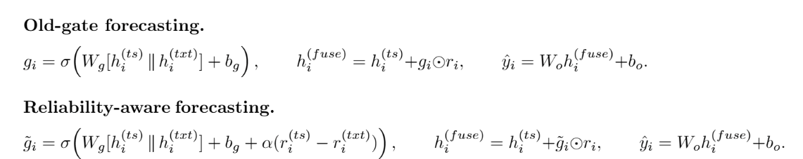
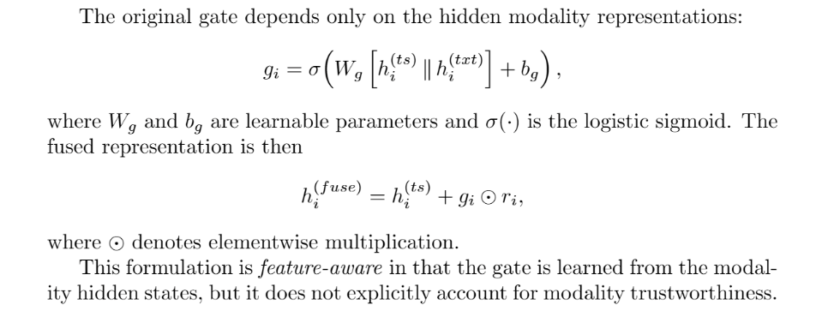
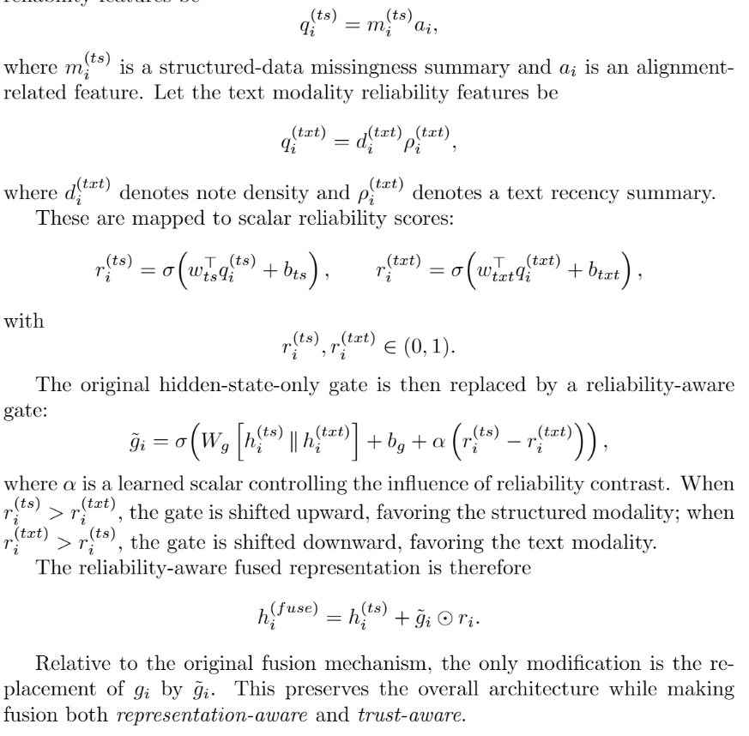

Slide 13
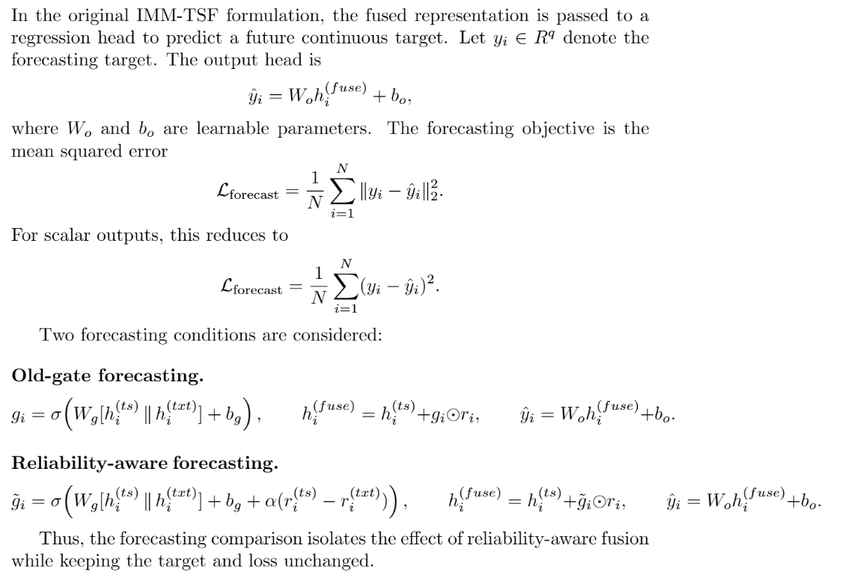

Slide 14
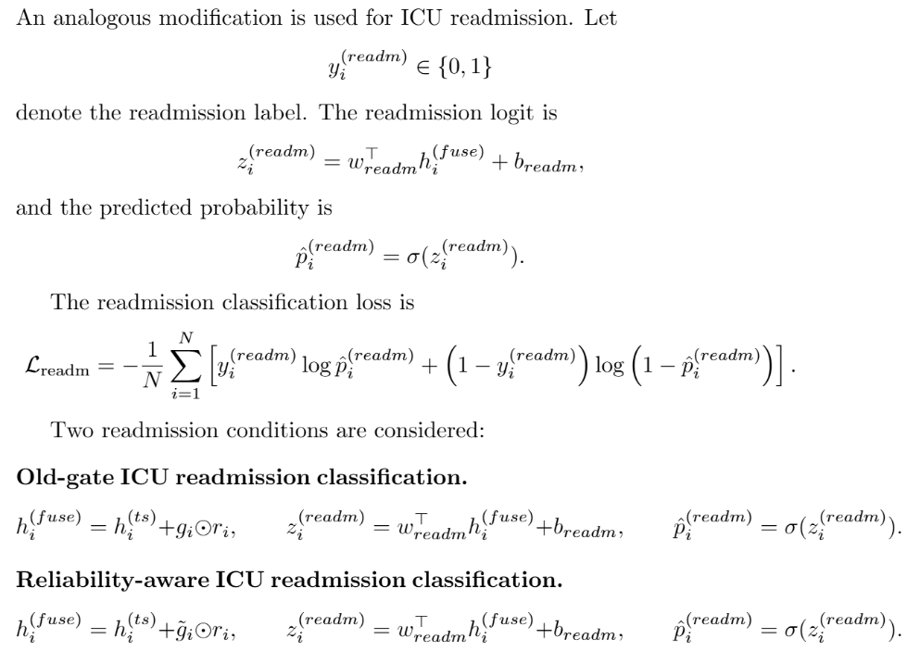

Slide 15


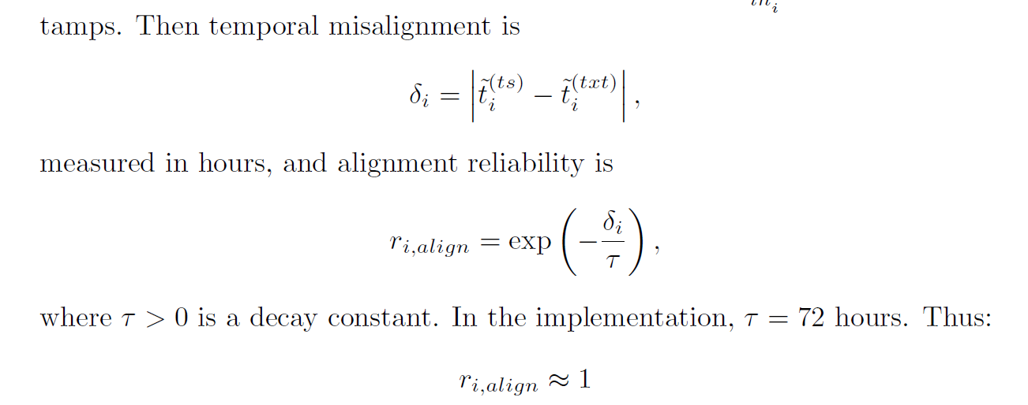

Slide 16
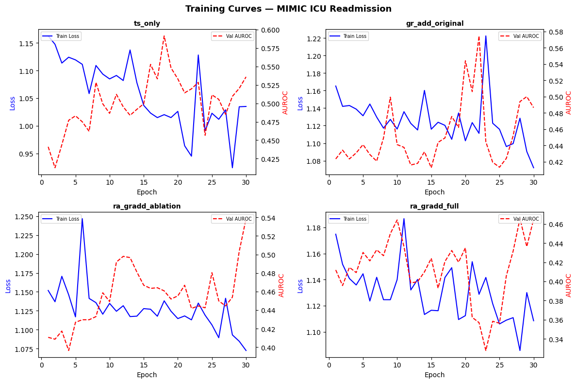

Slide 17
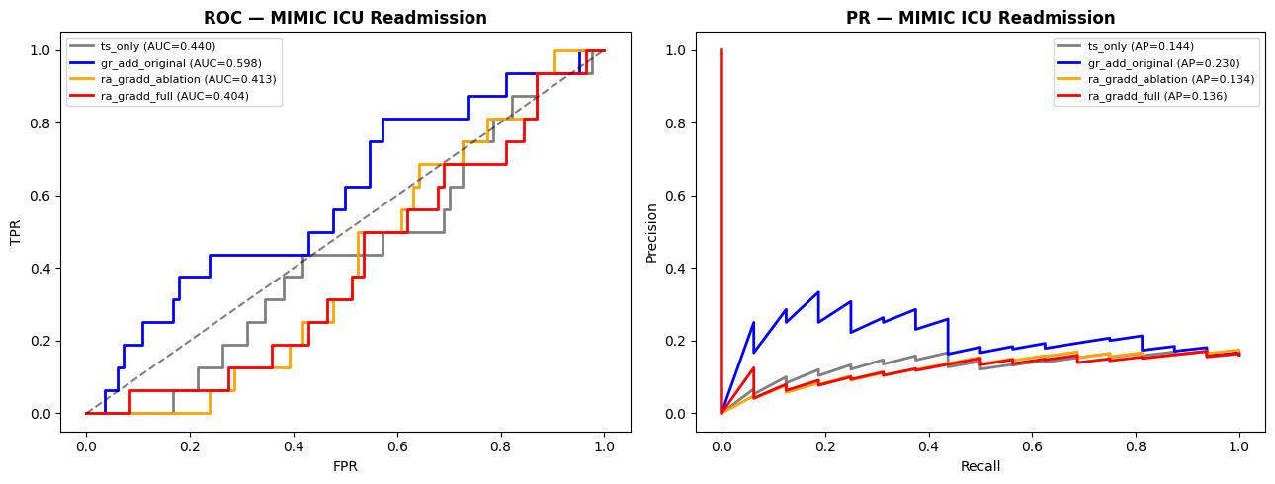
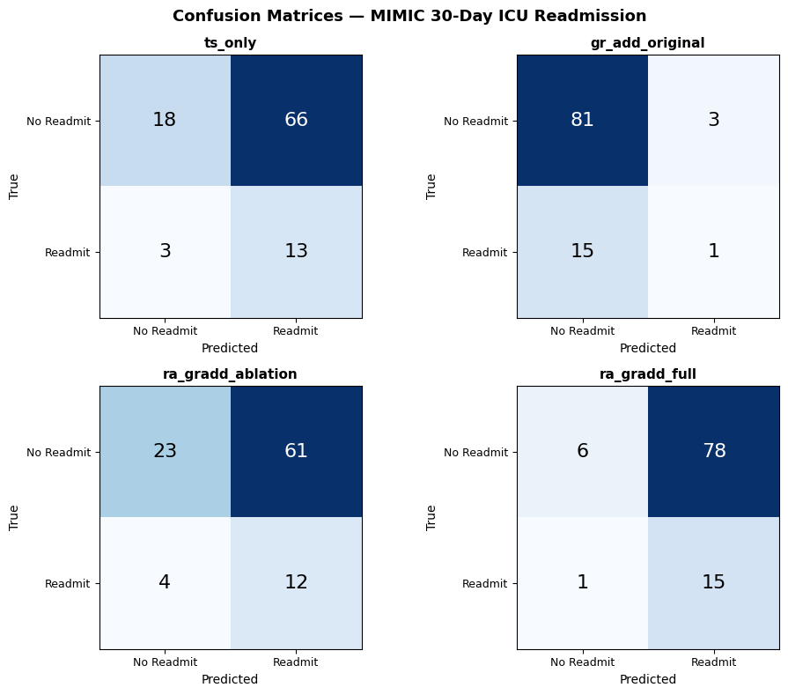

Slide 18
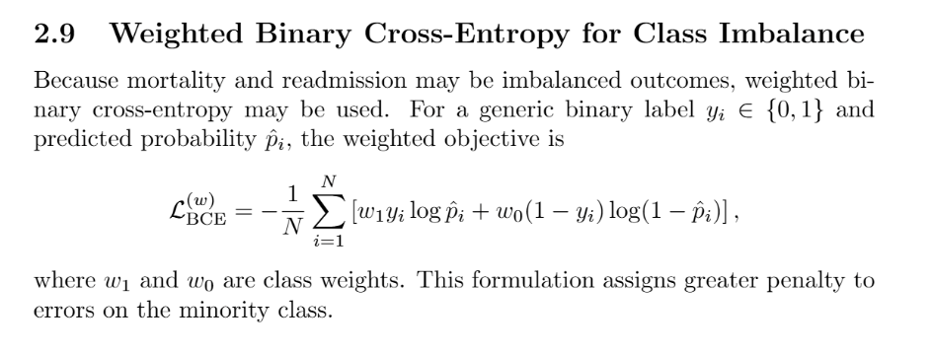

Slide 19
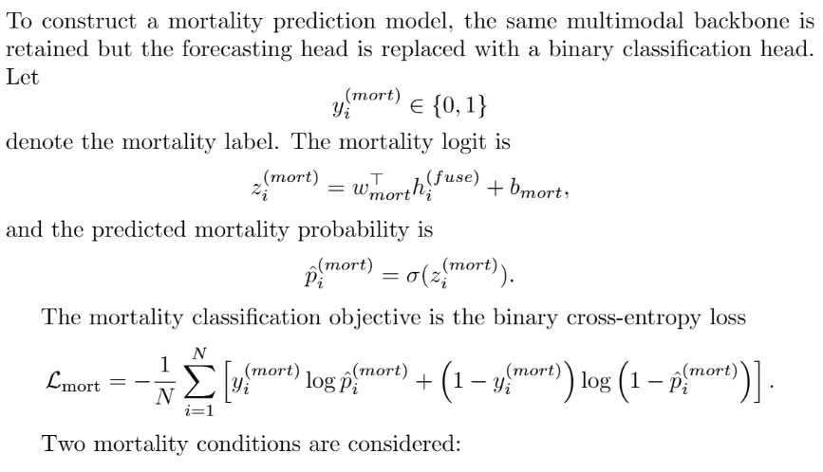
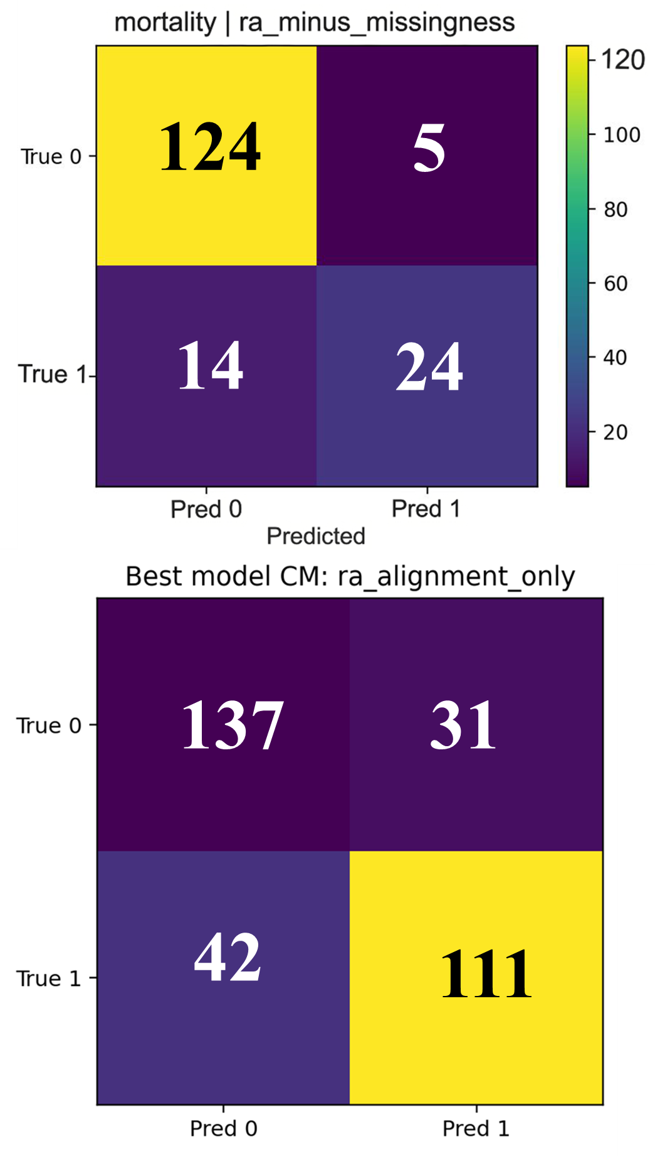
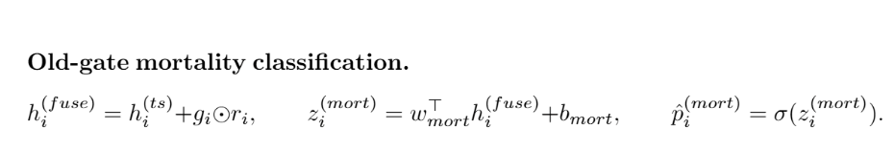
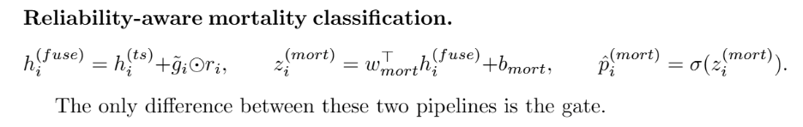

Slide 20
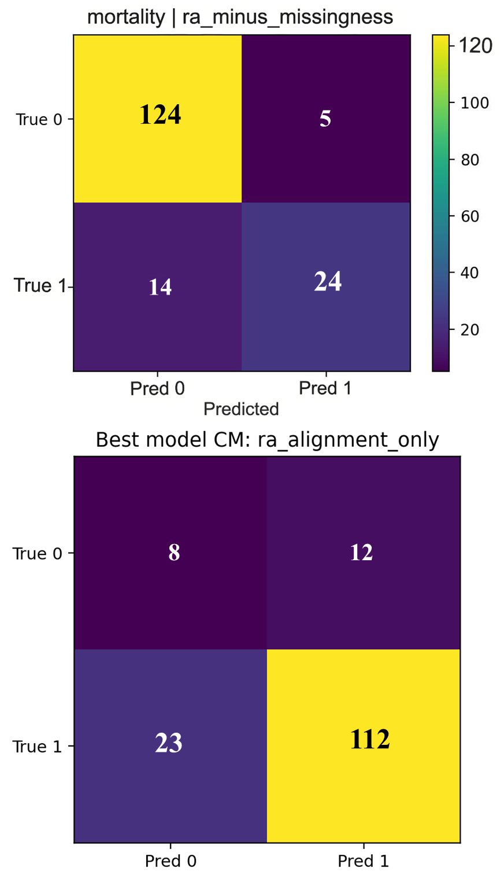
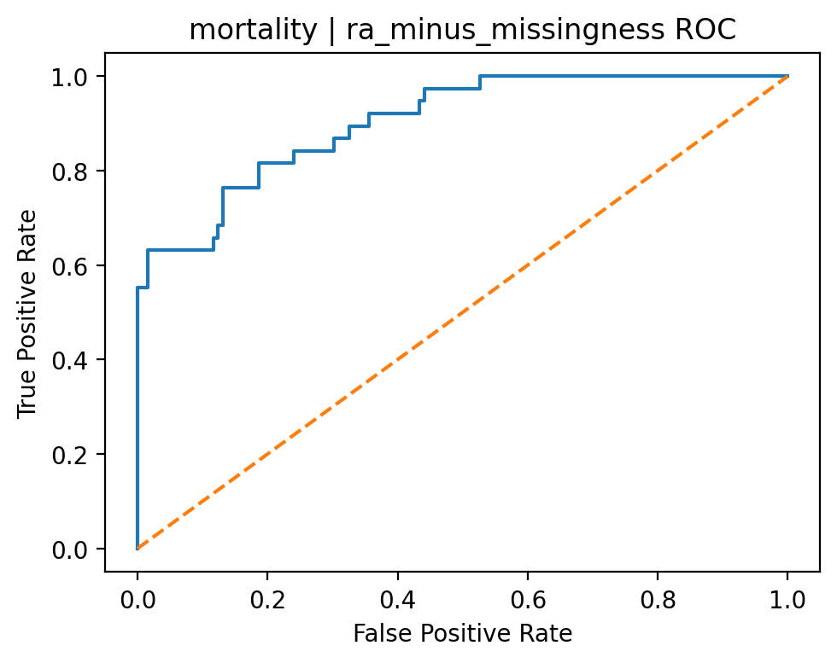
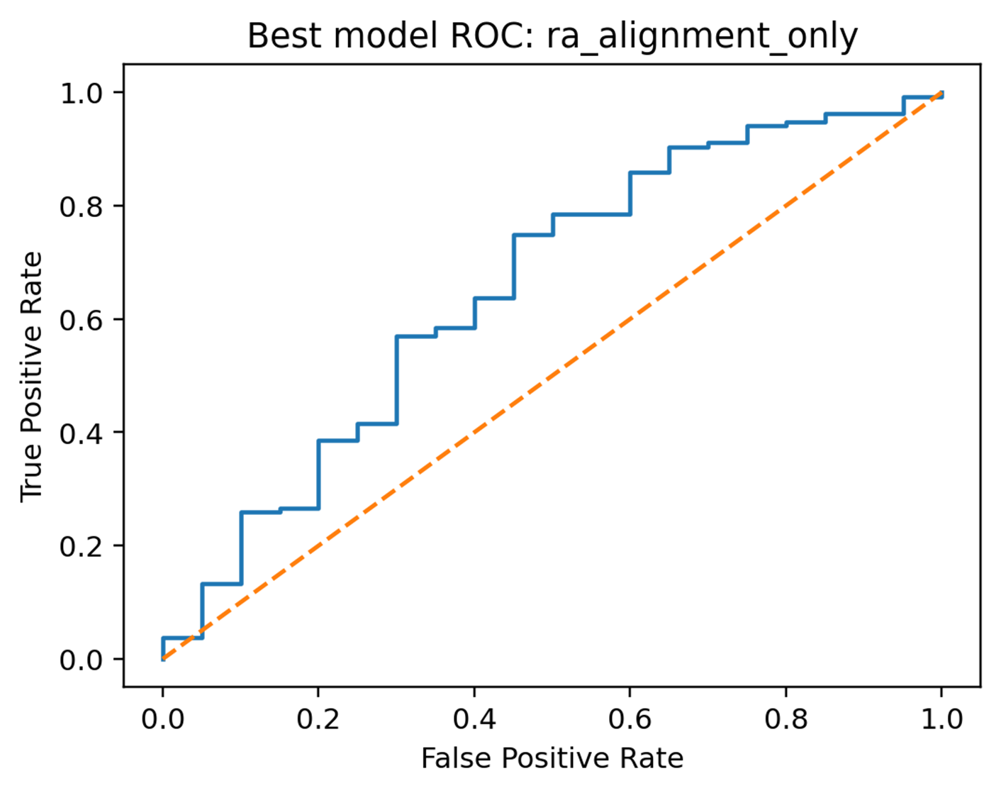
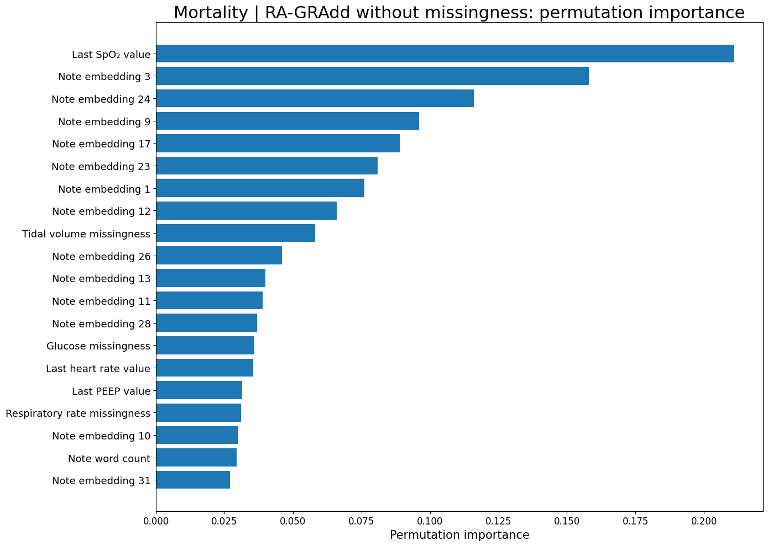
Model Reproduction Results |  | Multimodal MSE |  | Unimodal MSE
Dataset | Irregularity Type | Paper | Ours | Paper | Ours
GDELT | Trigger-Based (Event-Based Logging) | 1.03 | 1.02 | 1.03 | 1.04
FNSPID | Artifact-Based (Operational Window Sampling ) | 0.12 | 0.16 | 0.12 | 0.16
CLUSTER TRACE | Artifact-Based (Resource-Aware Collection) | 0.61 | 0.85 | 0.98 | 0.87
CESNET | Constraint-Based (Scheduling Jitter / Delay) | 0.91 | 0.96 | 0.98 | 1.03
MIMIC-IV | Trigger-Based (Event-Based Logging) | 0.77 | 0.74 | 0.73 | 0.74
Table 1. Model performance comparisons for reproduction results from Chang et al., 2025 IMM-TSF
Figure 1. Irregular time series model framework with RA-GRAdd and Classifier Extensions of Chang et al., 2025 IMM-TSF
Figure 2. Confusion Matrices for Classification of 1.Mortality and 2.Financial Return Binary Direction
Figure 5. Best Model: Financial RA-GRAdd Classification AUROC
Figure 4. Best Model: Mortality RA-GRAdd Classification AUROC
Figure 3. Permutation Feature Importance from Mortality Classification with Text Embedding Interpretations
Table 3. Final Mortality Classification Model Results
Table 2. Final Financial Classification Model Results

