Slide 1




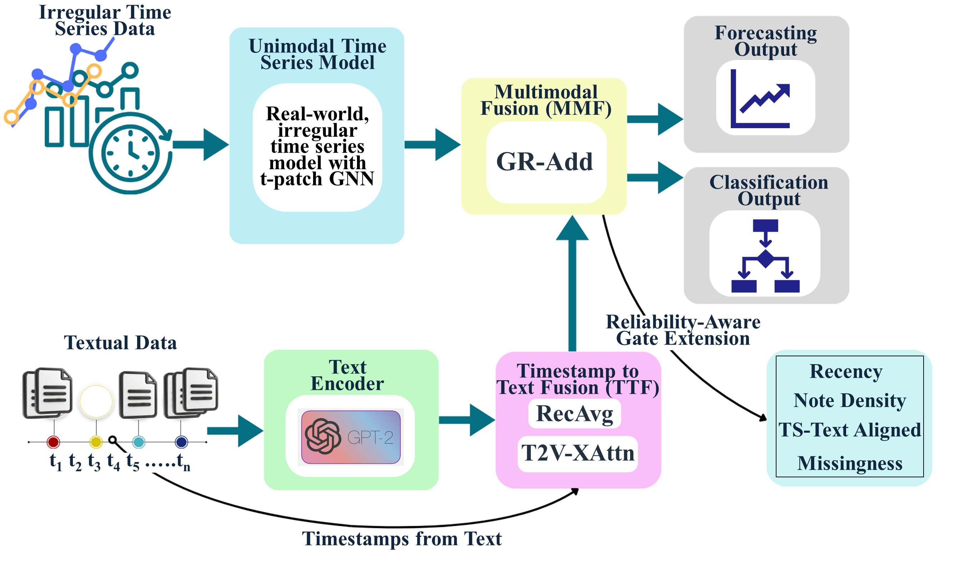
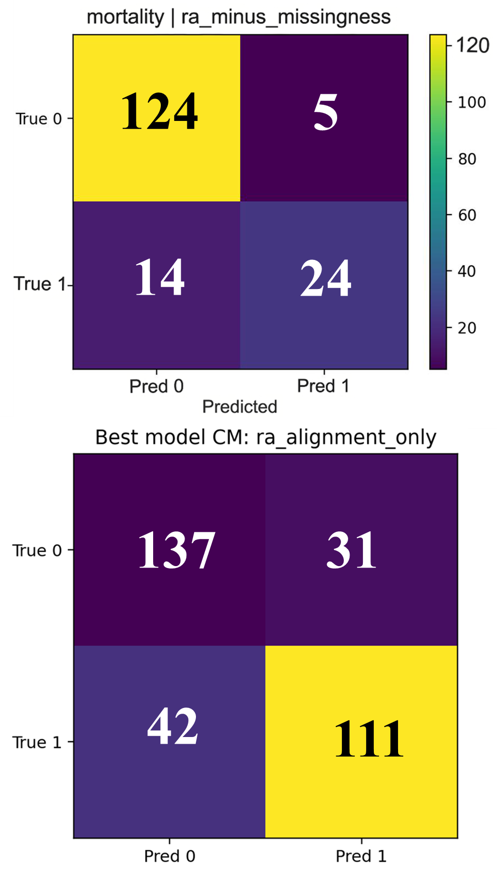
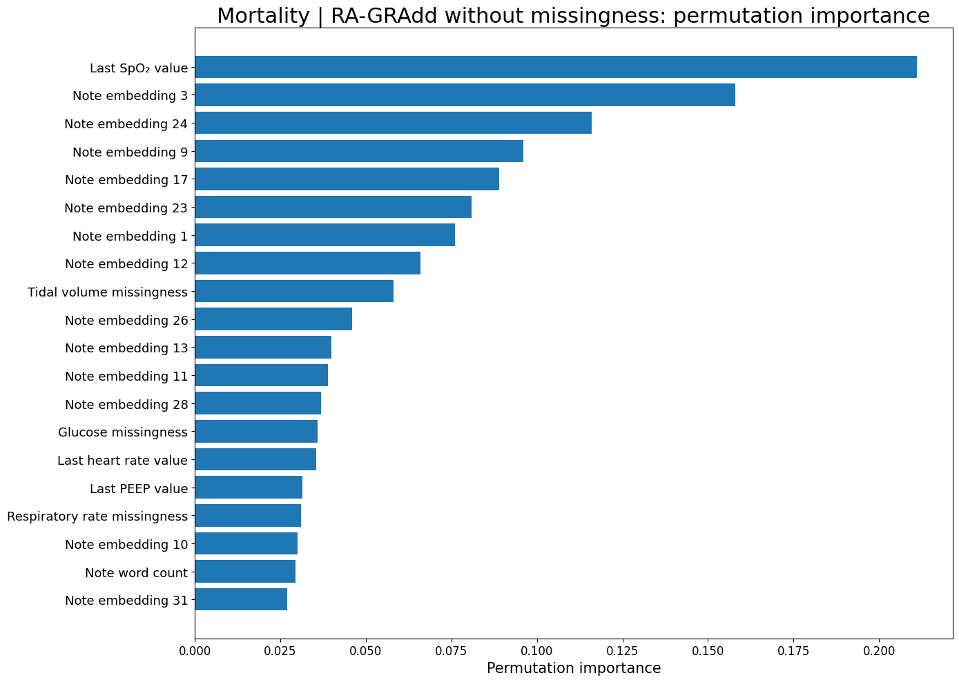
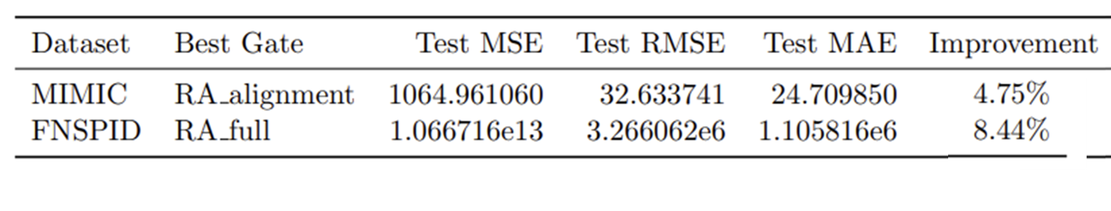
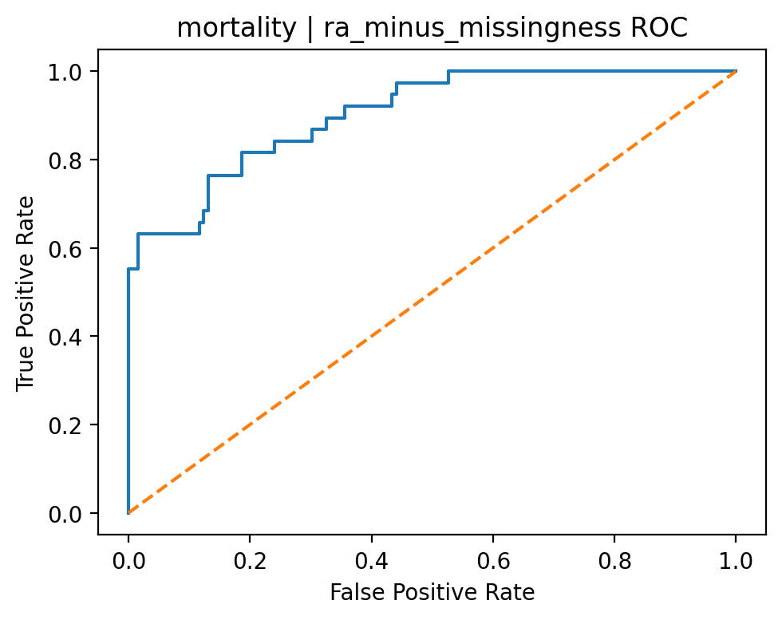
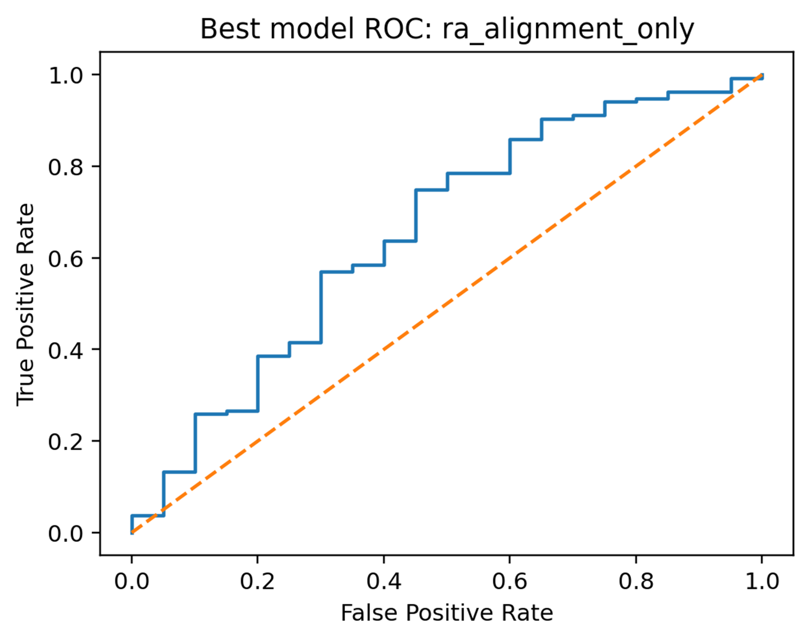

Recency-Aware Multimodal Fusion for Irregular Time Series: Extending IMM-TSF from Forecasting to Classification
Chad Bishop, Nnenna Ifeanyi, & Brandi Jones
Advisor: Dr. Bin Luo, PhD
Nnenna Brandi Chad
INTRODUCTION
Real-world time series data, like that found in large medical and financial market settings, are irregular, asynchronous, multimodal, and missing-rich.
Textual data can provide context not present in structured, tabular time series features.
IMM-TSF provides an irregular, multimodal time series framework benchmark for forecasting under these conditions, combining irregular numeric streams with temporally aligned text.
The purpose of this study was:
First, to develop a recency-aware gated fusion (RA-GRAdd) variant of the IMM-TSF framework.
Weighting asynchronous text relative to irregular time-series observations
Taking text recency, density in time, alignment, and missingness into account prior to inclusion
Second, our study altered the original forecasting framework for downstream binary classification.
Model Reproduction Results |  | Multimodal MSE |  | Unimodal MSE
Dataset | Irregularity Type | Paper | Ours | Paper | Ours
GDELT | Trigger-Based (Event-Based Logging) | 1.03 | 1.02 | 1.03 | 1.04
FNSPID | Artifact-Based (Operational Window Sampling ) | 0.12 | 0.16 | 0.12 | 0.16
CLUSTER TRACE | Artifact-Based (Resource-Aware Collection) | 0.61 | 0.85 | 0.98 | 0.87
CESNET | Constraint-Based (Scheduling Jitter / Delay) | 0.91 | 0.96 | 0.98 | 1.03
MIMIC-IV | Trigger-Based (Event-Based Logging) | 0.77 | 0.74 | 0.73 | 0.74
137
Figure 1. Irregular time series model framework with RA-GRAdd and Classifier Extensions of Chang et al., 2025 IMM-TSF
Table 1. Model performance comparisons for reproduction results from Chang et al., 2025 IMM-TSF
METHODS
Figure 2. Confusion Matrices for Classification of 1.Mortality and 2.Financial Return Binary Direction
Motivating Paper
Chang, C. et al. (2025). Time-IMM: A dataset and benchmark for irregular multimodal multivariate time series. arXiv. https://doi.org/10.48550/arXiv.2506.10412
Benchmark reproduced for subset of datasets from the IMM-TSF study across types of irregularity (Table 1)
RA-GRAdd
Decomposes multimodal weighting into interpretable irregularity components to make text inclusions smarter (Figure 1)
Datasets for Classification Experiments
Healthcare application: MIMIC-IV, a large deidentified database containing ICU and ER data with structured measurements and clinical text notes
Financial market application: FNSPID, a large-scale dataset integrating stock prices and time-aligned news for S&P 500 companies
n=1108 mortality sample, n=678 financial sample
Modeling
Fused latent state replaced forecasting head with a binary classification head
LLM: GPT-2
Architecture: t-Patch GNN
Binary cross-entropy loss
IMM-TSF extensions evaluated for baseline and RA-GRAdd ablation forecasting and classification
Performance was evaluated using held-out validation and test sets (60%/20%/20%)
Permutation importance estimates evaluated the importance of a given feature by shuffling and measuring drop in predictive performance (Figure 3)
Table 2. Forecasting Best Models: RA-GRAdd vs GR-Add
Figure 4. Best Model: Mortality RA-GRAdd Classification AUROC
Figure 3. Permutation Feature Importance from Mortality Classification with Text Embedding Interpretations
Figure 5. Best Model: Financial RA-GRAdd Classification AUROC
Table 2. Final Financial Classification Model Results
Table 3. Final Mortality Classification Model Results
CONCLUSIONS
IMM-TSF successfully extended from irregular multimodal forecasting to downstream binary classification in both healthcare and financial settings.
RA-GRAdd runs demonstrated that incorporating text reliability signals before fusion improved asynchronous clinical and financial note usage, while maintaining strong predictive performance and interpretability (Table 2-3, Figure 2-5).
These results suggest that recency-aware gating in multimodal fusion is a promising strategy for extracting clinically and operationally meaningful signals from irregular, asynchronous, and missing-rich time series tabular and textual data, which can be used in both forecasting and classification tasks.
REFERENCES

