Slide 1
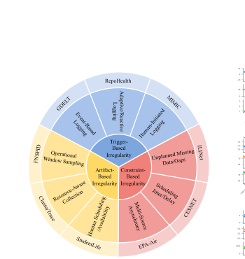
TIME-IMM Project Proposal
Brandi Jones
Chad Bishop
Nnenna Ifeanyi
Motivating paper:
Introduces TIME-IMM, a dataset designed to reflect realistic multimodal multivariate time series data, and IMM-TSF, a benchmark library for forecasting
Problem framing
• Real-world time series are irregular, asynchronous,
multimodal, and missing-rich.
• TIME-IMM contributes 9 datasets and the IMM-TSF
library, making reproduction, application, and extension all
feasible.
Original Paper Goal: Build deep learning architectures that can handle complex temporal dynamics and multimodal interactions
Our Project Goal:
A
B
C
TIME-IMM taxonomy: 9 datasets across trigger-based, constraint-based, and artifact-based irregularity.
Reproduction
Application
Extension
Replicate the paper’s IMM-TSF results with released code and matched settings.
Use MIMIC as the healthcare case and analyze when notes help forecasting most.
Add a reliability-aware gate so text changes the forecast only when it is useful.
Code: github.com/blacksnail789521/Time-IMM + IMM-TSF

Slide 2
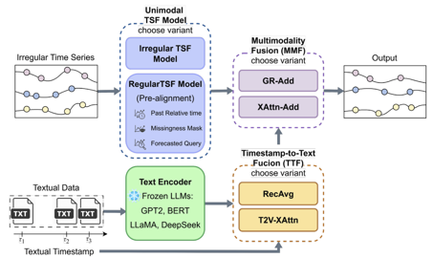
Data, methods, and execution plan
Replicate the paper first, then address a realistic healthcare research question through one architectural innovation.
Method extension: Reliability-Aware GR-Add (RA-GRAdd)
Replication + healthcare use case
Reproduce and Expand Time-IMM + IMM-TSF
Keep the paper’s IMM-TSF pipeline but replace the final fusion step with a smarter gate that decides when text should change the forecast.
ClusterTrace
CESNET
MIMIC
FNSPID
GEDT
• Reproduce benchmark results with a subset
of datasets from the original 9, using the
paper’s chronological 60/20/20 split, sliding
windows, and MSE.
• Healthcare application: test when clinical
text helps most in MIMIC by note density,
forecast horizon, and missingness.
Recency
Note density
Missingness
TS-text alignment
• Goal: improve over GR-Add and XAttn-Add by using text selectively.
• Evaluation: MSE, MAE, reproduced-vs-reported trends, and full
ablation study.
• Ablation ladder: recency only → +note density → +missingness → full
reliability gate.
Replicate RecAvg, T2V-XAttn, GR-Add, and XAttn-Add, using TSF backbones including the t-PatchGNN as in the original paper.
GR-Add already learns how to blend text into the forecast, but it does so implicitly from hidden features. Our extension would make that gating decision more explicit by providing the gate with reliability signals that reflect whether the note stream is likely to be useful at that forecast time.
Notes:
Slide 2 script: On the execution side, I will keep the project staged. First, I will replicate the official benchmark on a small but diverse subset of TIME-IMM, probably MIMIC, ClusterTrace, and one of FNSPID or EPA-Air. I will follow the paper’s split, sliding-window setup, and core fusion baselines so the reproduction is faithful. Second, I will frame the application around healthcare by asking when clinical text helps most in MIMIC. Third, I will implement RA-GRAdd, a reliability-aware version of the paper’s GR-Add fusion that uses recency, note density, missingness, and time-series/text alignment to decide how much text should affect the forecast. Evaluation will use MSE first, then MAE and ablation studies. [Sources] - User-uploaded paper: Time-IMM.pdf, pages 2-9 (dataset taxonomy, IMM-TSF architecture, TTF/MMF variants, experimental setup, and ablation findings). - User-uploaded class slides: Class Project.pptx, slides titled “Proposal & Weekly Progress Check”, “Final Project Report”, and “Code”. - GitHub README for IMM-TSF documenting main.py, compute_text_embeddings.py, main_all.sh, and MIMIC preprocessing: https://github.com/blacksnail789521/IMM-TSF - GitHub README for Time-IMM documenting the released 8 datasets and local MIMIC preprocessing requirement: https://github.com/blacksnail789521/Time-IMM

Slide 3
Preliminary Results from Original Methods Reproduction:
Current Results (04/09/2026) |  | Multimodal MSE |  | Unimodal MSE
Dataset | Irregularity Type | Paper | Ours | Paper | Ours
GDELT | Trigger-Based (Event-Based Logging) | 1.03 | 1.02 | 1.03 | 1.04
FNSPID | Artifact-Based (Operational Window Sampling ) | 0.12 | 0.16 | 0.12 | 0.16
CLUSTERTRACE | Artifact-Based (Resource-Aware Collection) | 0.61 | 0.85 | 0.98 | 0.87
CESNET | Constraint-Based (Scheduling Jitter / Delay) | 0.91 | 0.96 | 0.98 | 1.03
MIMIC | Trigger-Based (Event-Based Logging) | 0.77 | 0.74 | 0.73 | 0.74
FNSPID, ClusterTrace, and CESNET discrepancies likely reflect differences in preprocessing, data splits, tuning, and environment stability.
MIMIC IV embeddings produced and baseline reproduction runs initiated
Computational resources issues, Google Colab reliance
Literature review for project expansion methodology (option C)
Apr 2
Apr 9
Apr 16
Apr 23
May 4
Project Milestones
proposal
first repro
results progress
present results
final report + code

Slide 4
Our Project Methods Alteration and Extension:
First, the original TIME-IMM/ IMM-TSF forecasting framework was reproduced
Using the official repository structure, preserving the modular pipeline consisting of an irregular time-series backbone, a timestamp-to-text fusion module, and a multimodality fusion module.
The addition of a reliability aware MMF gate, altering the GR-Add gate to make
Second, framework extended from irregular multimodal forecasting to binary ICU readmission classification
On MIMIC-IV (with clinical notes)
Retaining core multimodal learning strategy
Replacing the forecasting head with a binary classification head.

Slide 5
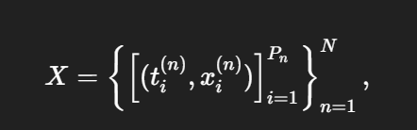


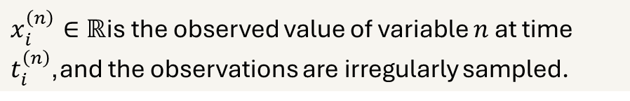
Forecasting:
Text Stream:
Original Forecasting Objective:
$x_{i}^{\left(n\right)}∈ℝ$is the observed value of variable $n$ at time $t_{i}^{\left(n\right)}$,and the observations are irregularly sampled.
The github based python reproduction workflow is:
Define experiment settings with ReproRunConfig.
Set filesystem paths with RepoPaths.
Patch evaluation.py using patch_evaluation_for_empty_splits() to safely handle empty validation or test splits.
Build dataset- and model-specific CLI commands with build_main_command().
Execute the official forecasting run with run_one().
Parse metrics from logs using parse_metrics_from_log().
Aggregate all runs with collect_results().
Compare MIMIC reproduction outputs against the paper using build_mimic_comparison_table().

Slide 6
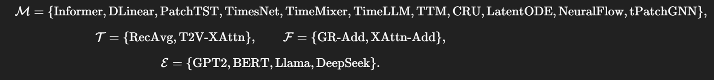
GR-Add to RA-GRAdd:
Recency
Methods Alteration:
Note density
TS-text alignment
Missingness
GR-Add already learns how to blend text into the forecast, but it does so implicitly from hidden features. Our extension would make that gating decision more explicit by providing the gate with reliability signals that reflect whether the note stream is likely to be useful at that forecast time.

Slide 7




The GR-Add module formed a residual update to the structured representation.
The pair (hts, htxt) was processed sequentially through a recurrent unit:
A residual candidate was computed:
A gate learned from the concatenated modalities:
Fused Representation:

Slide 8
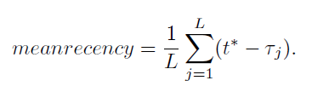



Extension introduced an explicit reliability-aware gate:
Instead of letting the gate depend only on latent structured and text features, it additionally incorporates observable indicators describing whether the note stream should influence prediction. The reliability vector:
Compute residual candidate r from recurrent multimodal interaction compute gate:
The reliability features were projected into a latent space:
Fuse modalities in same way as paper:

Slide 9
Paper Methods Reproduction: (04/09/2026)
Reproduced results for 5 datasets covering the 3 types of time-series irregularity identified in the paper
Current Results (t-PatchGNN) |  | Multimodal MSE (GPT-2) |  | Unimodal MSE
Dataset | Irregularity Type | Paper | Ours | Paper | Ours
GDELT | Trigger-Based (Event-Based Logging) | 1.03 | 1.02 | 1.03 | 1.04
FNSPID | Artifact-Based (Operational Window Sampling ) | 0.12 | 0.16 | 0.12 | 0.16
CLUSTERTRACE | Artifact-Based (Resource-Aware Collection) | 0.61 | 0.85 | 0.98 | 0.87
CESNET | Constraint-Based (Scheduling Jitter / Delay) | 0.91 | 0.96 | 0.98 | 1.03
MIMIC | Trigger-Based (Event-Based Logging) | 0.77 | 0.74 | 0.73 | 0.74

Slide 10


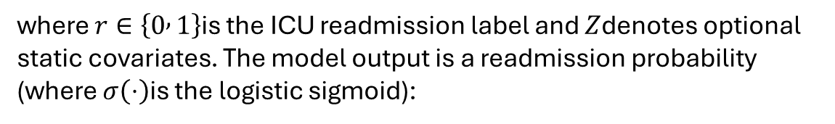
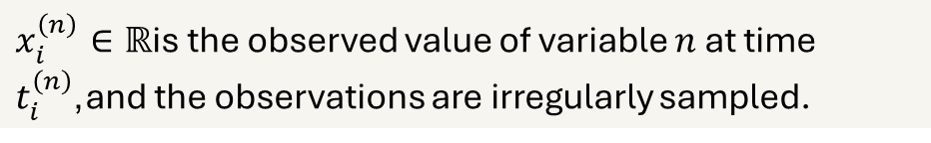
Forecasting Extension to ICU Readmission Classification:
Text Stream:
Original Forecasting Objective:
$x_{i}^{\left(n\right)}∈ℝ$is the observed value of variable $n$ at time $t_{i}^{\left(n\right)}$,and the observations are irregularly sampled.
New objective for classification becomes:
where $r∈\left\{0 , 1\right\}$is the ICU readmission label and $Z$denotes optional static covariates. The model output is a readmission probability (where $σ\left(⋅\right)$is the logistic sigmoid):

Slide 11
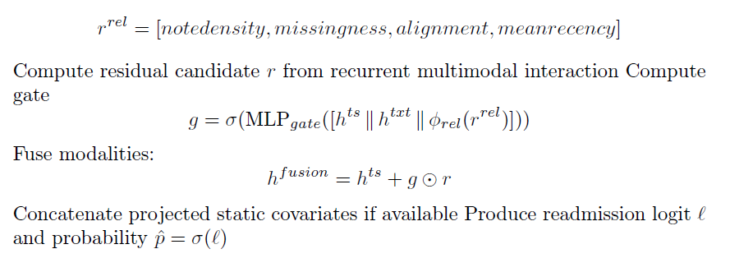


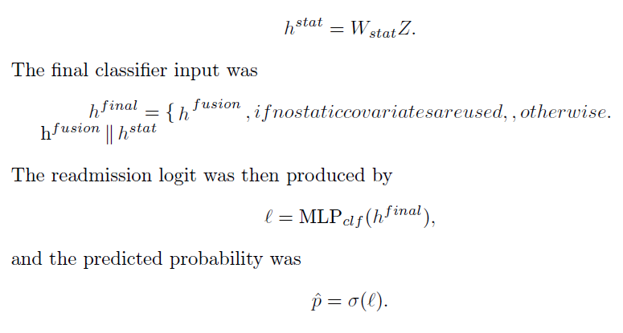
Extension to ICU Readmission Classification:
Binary cross-entropy on logits. For
patient i, with observed label y_{i} and predicted probability ˆp_{i}, the loss was

