Slide 1

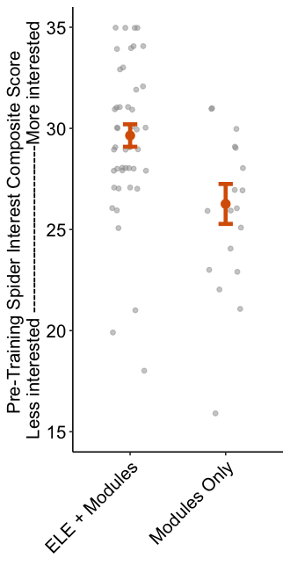
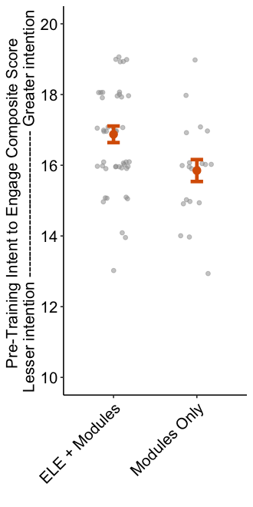

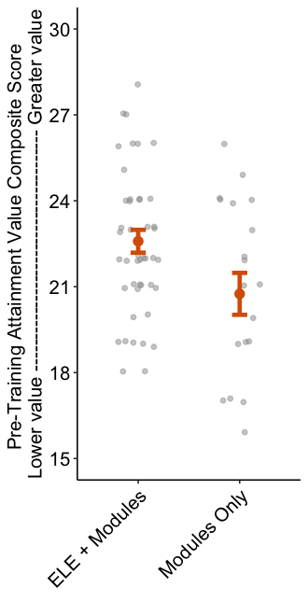
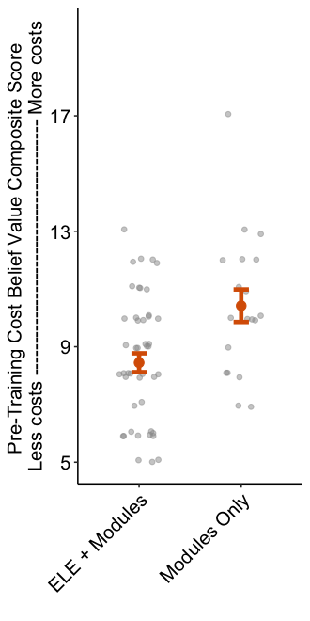
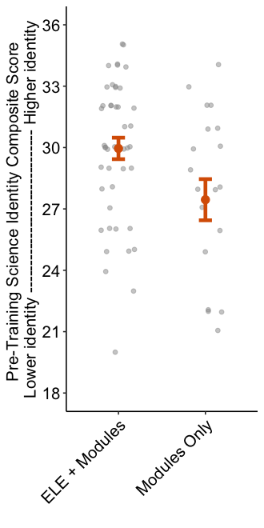
A
B
C
**
*
*
48
19
48
20
46
20
D
E
**
*
47
19
46
20

Slide 2
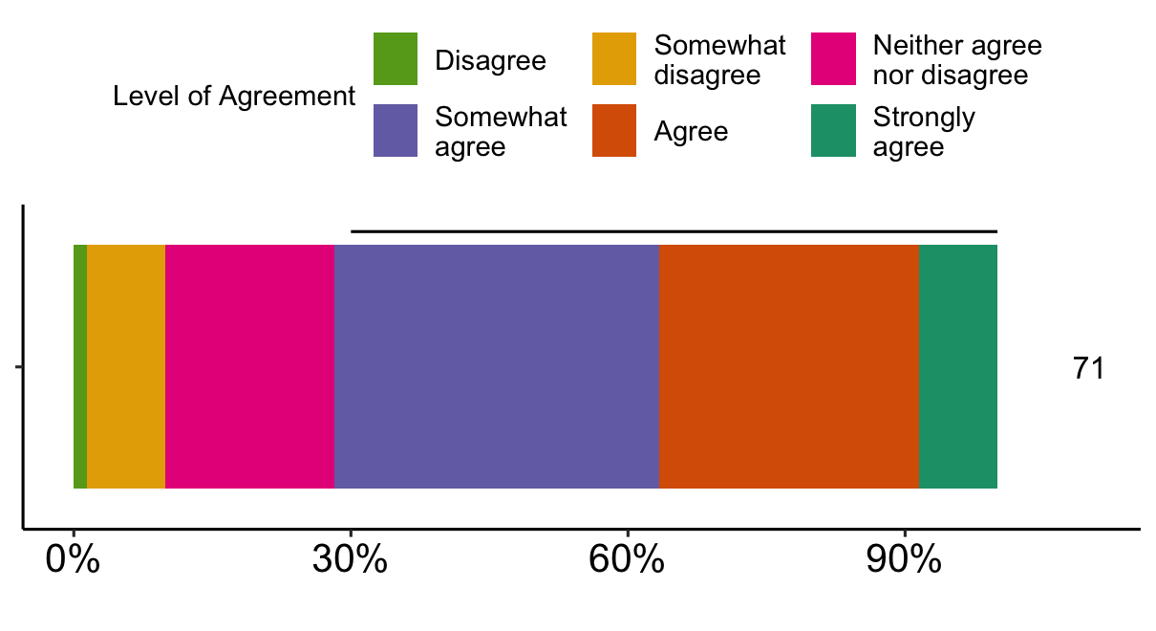
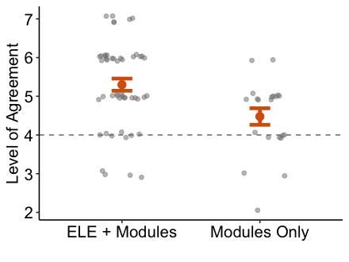
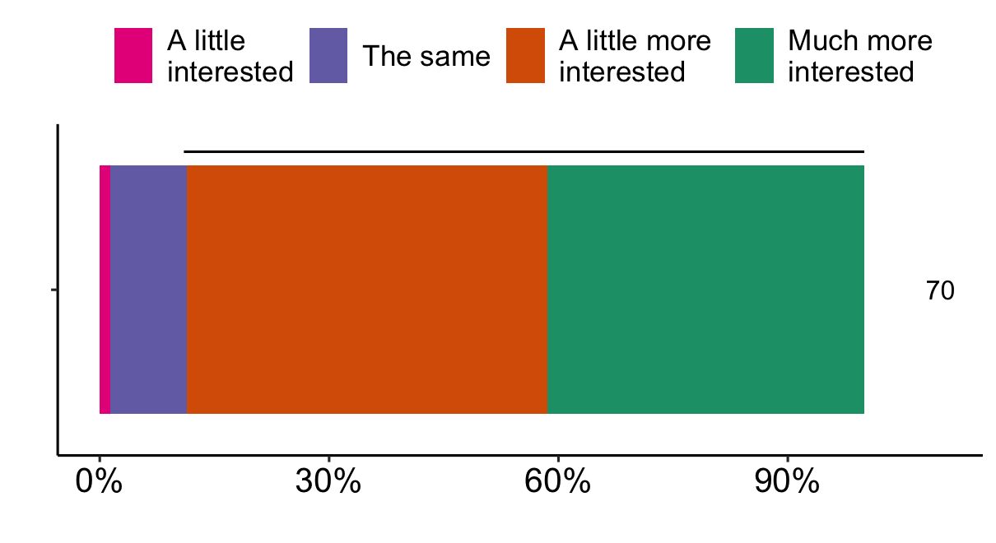
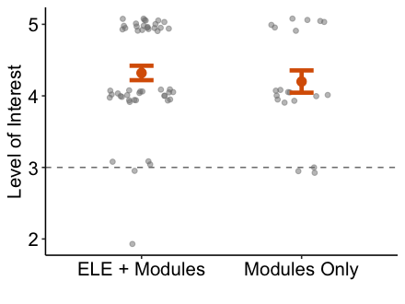
Participating in these workshops and activities has changed my attitudes toward spiders.
A
B
**
70% Agree
50
21
After participating in the training and events, how much more or less interested are you in conveying science to the general public?
C
D
NS
89% More Interested
50
20

Slide 3
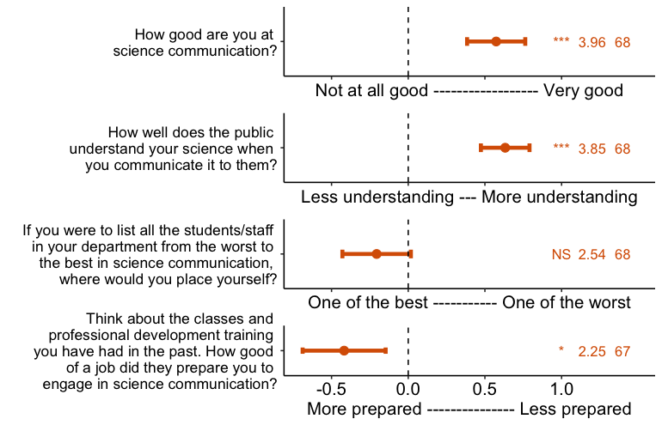
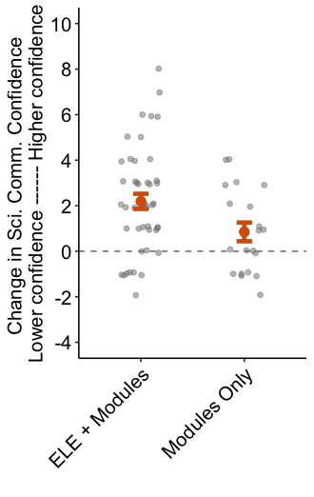
A
B
*
47
20

Slide 4
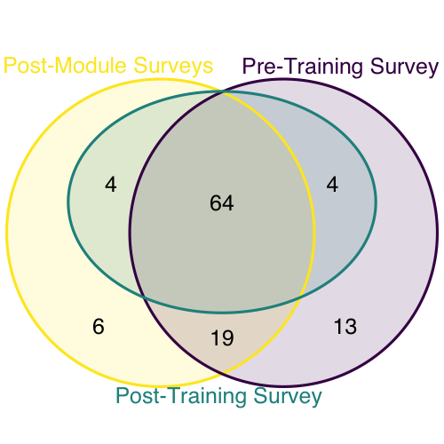

Slide 5
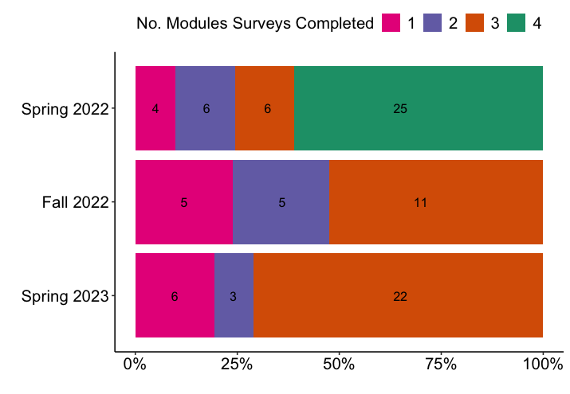
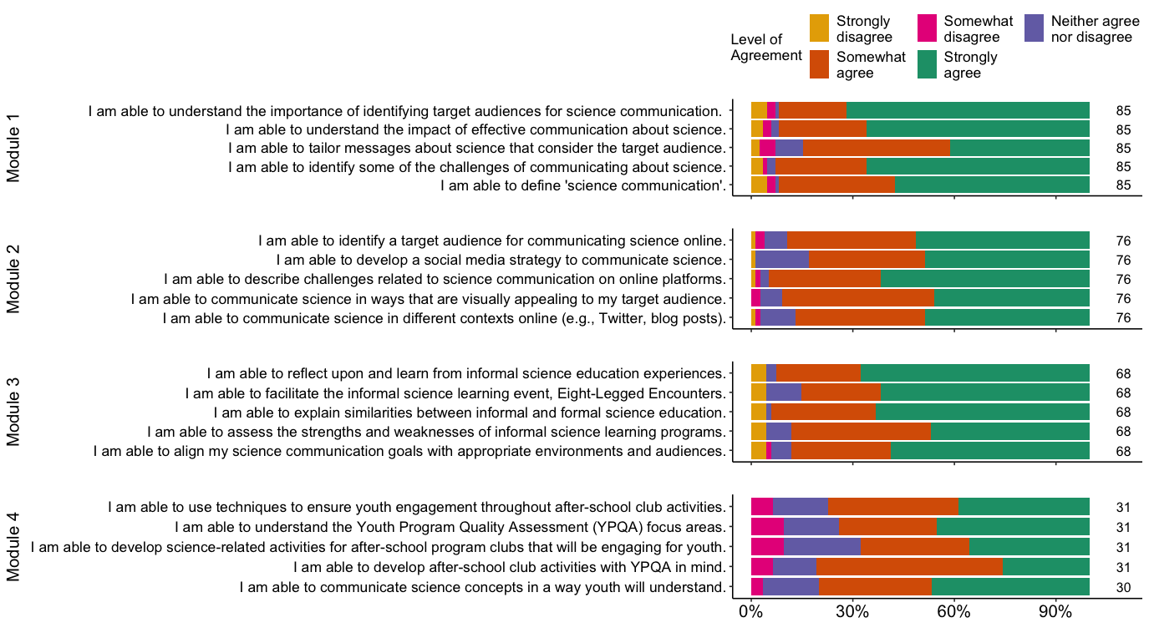
A
B

Slide 6
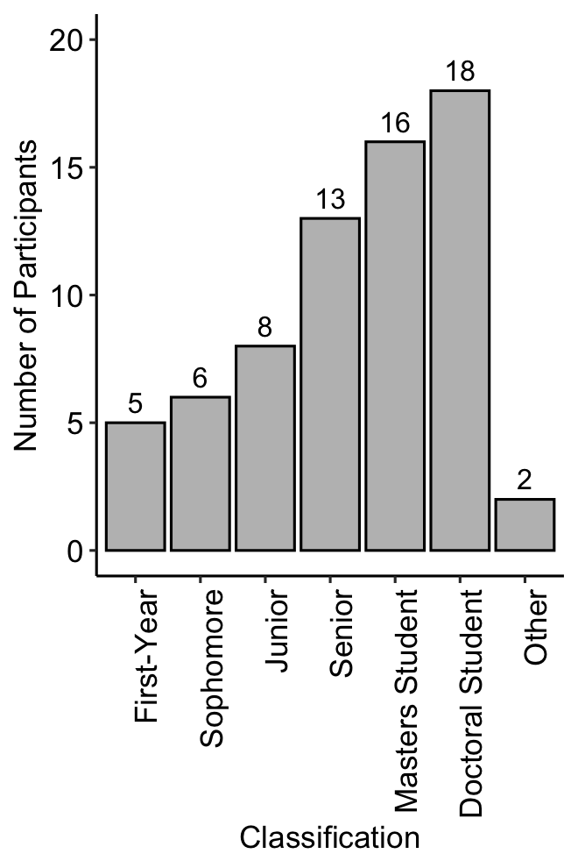
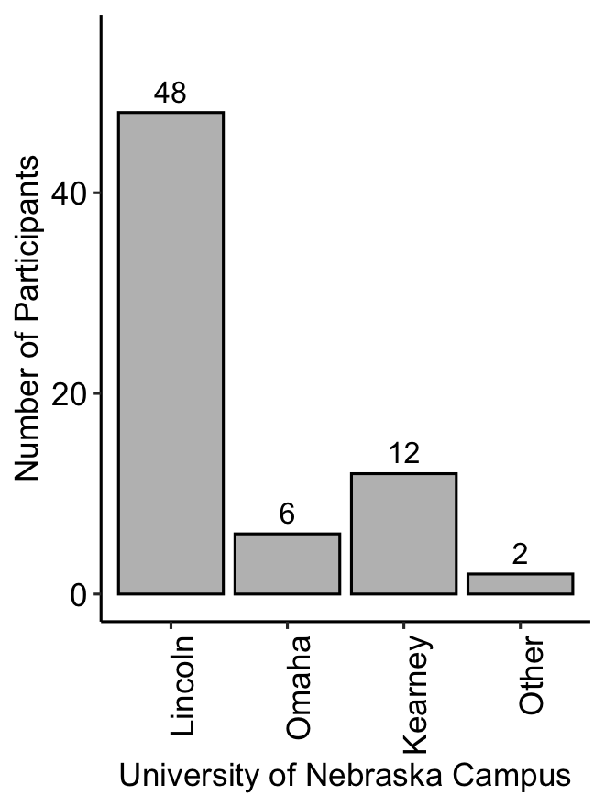
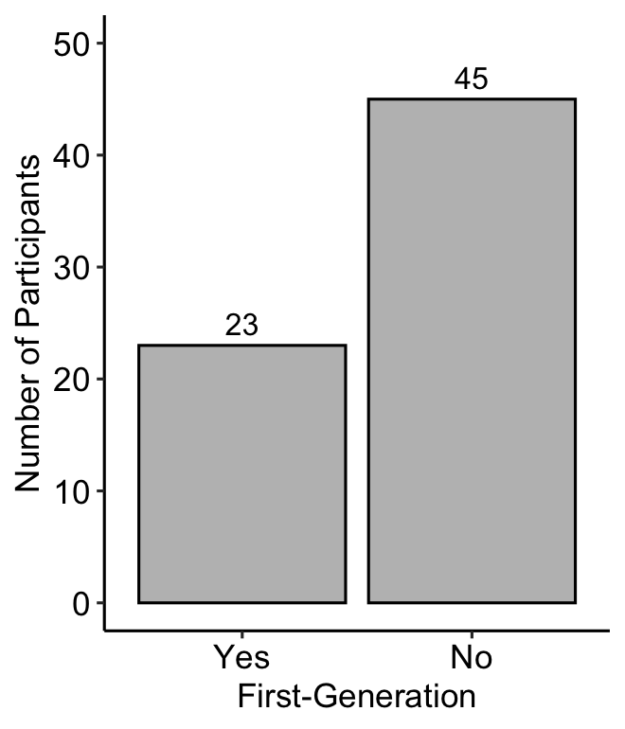
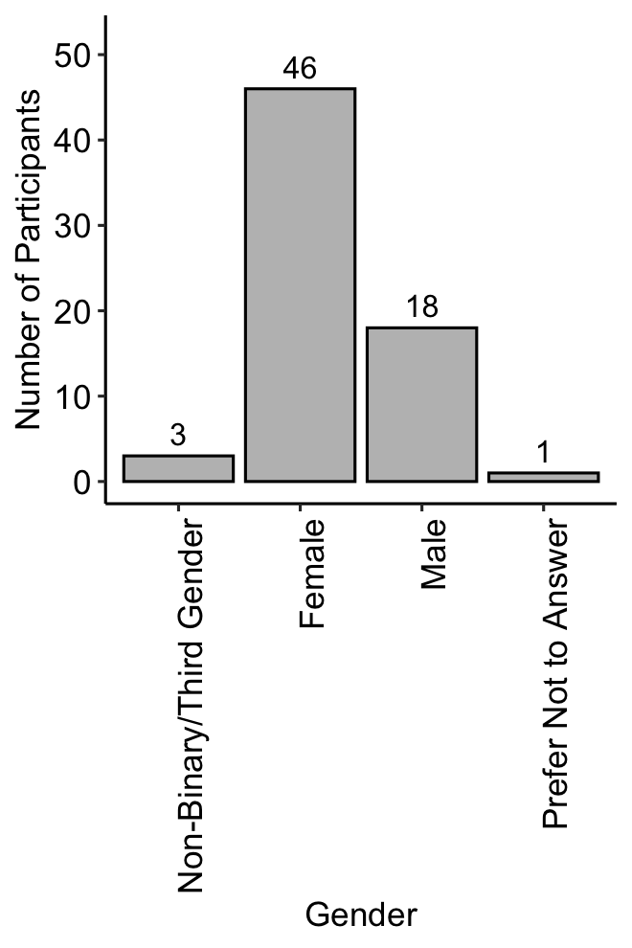
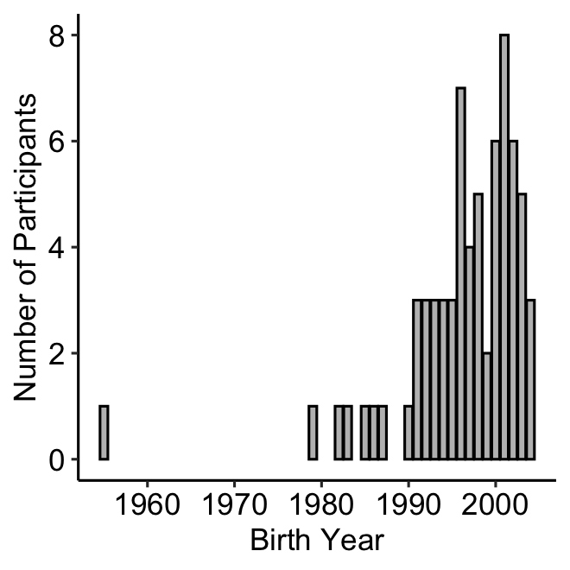
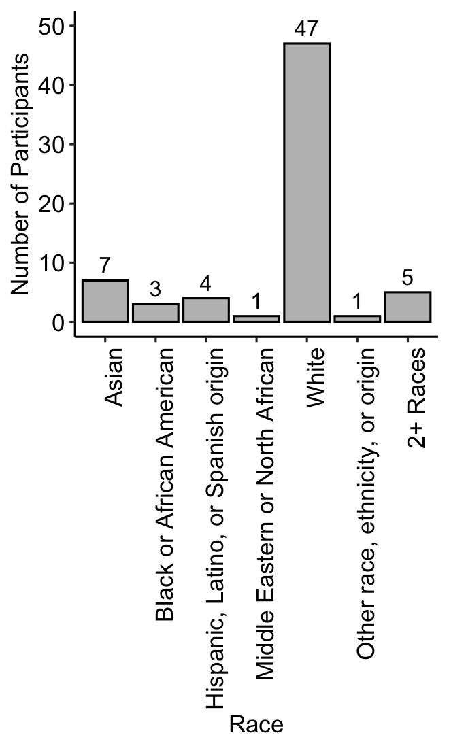
A
B
C
D
E
F

Slide 7
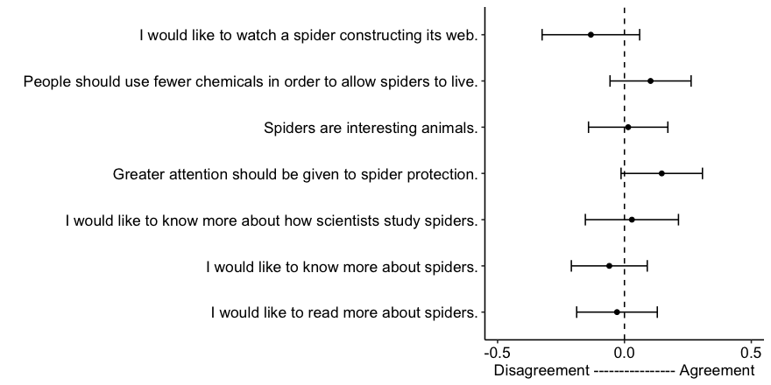
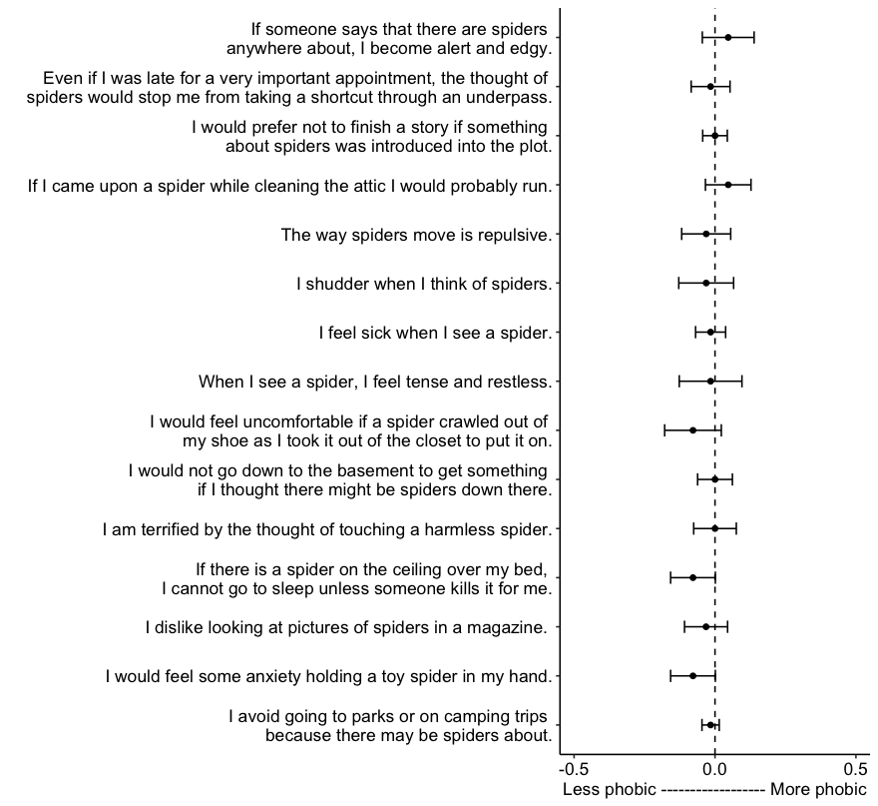
A
Spider Interest
Pre Mean | Post Mean | t | DF | p | Bonf. p
4.294 | 4.162 | 1.350 | 67 | 0.182 | 1.000
4.074 | 4.176 | -1.263 | 67 | 0.211 | 1.000
4.338 | 4.353 | -0.184 | 67 | 0.854 | 1.000
4.044 | 4.191 | -1.796 | 67 | 0.077 | 0.538
4.059 | 4.088 | -0.314 | 67 | 0.754 | 1.000
4.000 | 3.940 | 0.782 | 66 | 0.437 | 1.000
3.794 | 3.765 | 0.363 | 67 | 0.718 | 1.000
B
Spider Phobia
Pre Mean | Post Mean | t | DF | p | Bonf. p
0.281 | 0.328 | -1.000 | 63 | 0.321 | 1.000
0.094 | 0.078 | 0.444 | 63 | 0.658 | 1.000
0.016 | 0.016 | 0.000 | 63 | 1.000 | 1.000
0.109 | 0.156 | -1.136 | 63 | 0.260 | 1.000
0.156 | 0.125 | 0.704 | 63 | 0.484 | 1.000
0.188 | 0.156 | 0.629 | 63 | 0.531 | 1.000
0.047 | 0.031 | 0.574 | 63 | 0.568 | 1.000
0.266 | 0.250 | 0.275 | 63 | 0.784 | 1.000
0.750 | 0.672 | 1.523 | 63 | 0.133 | 1.000
0.062 | 0.062 | 0.000 | 63 | 1.000 | 1.000
0.234 | 0.234 | 0.000 | 63 | 1.000 | 1.000
0.328 | 0.250 | 1.930 | 63 | 0.058 | 0.872
0.143 | 0.111 | 0.814 | 62 | 0.419 | 1.000
0.125 | 0.047 | 1.930 | 63 | 0.058 | 0.872
0.062 | 0.047 | 1.000 | 63 | 0.321 | 1.000

Slide 8
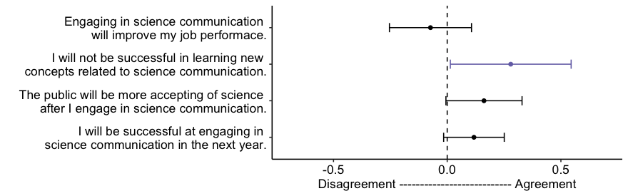
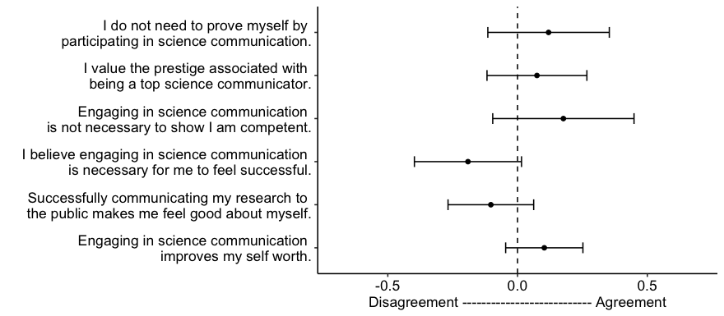
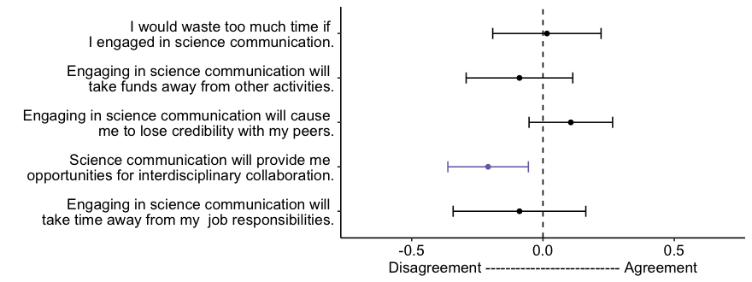
A
Intent to Engage
Pre Mean | Post Mean | t | DF | p | Bonf. p
4.353 | 4.279 | 0.799 | 67 | 0.427 | 1.000
1.691 | 1.971 | -2.062 | 67 | 0.043 | 0.173
3.765 | 3.926 | -1.894 | 67 | 0.062 | 0.250
4.147 | 4.265 | -1.730 | 67 | 0.088 | 0.353
B
Attainment Value
Pre Mean | Post Mean | t | DF | p | Bonf. p
3.045 | 3.164 | -1.000 | 66 | 0.180 | 1.000
3.657 | 3.731 | -0.760 | 66 | 0.450 | 1.000
2.941 | 3.118 | -1.271 | 67 | 0.208 | 1.000
3.926 | 3.735 | 1.816 | 67 | 0.074 | 0.443
4.412 | 4.309 | 1.223 | 66 | 0.226 | 1.000
4.000 | 4.103 | -1.355 | 67 | 0.180 | 1.000
C
Cost Belief Value
Pre Mean | Post Mean | t | DF | p | Bonf. p
1.701 | 1.716 | -0.142 | 66 | 0.888 | 1.000
2.045 | 1.955 | 0.864 | 66 | 0.391 | 1.000
1.455 | 1.561 | -1.307 | 65 | 0.196 | 0.979
4.522 | 4.313 | ª231.0 | 66 | ª0.011 | ª0.055
2.313 | 2.224 | 0.695 | 66 | 0.490 | 1.000
ª Results from Wilcoxon Signed-Rank test where test statistic is the W statistic.

Slide 9
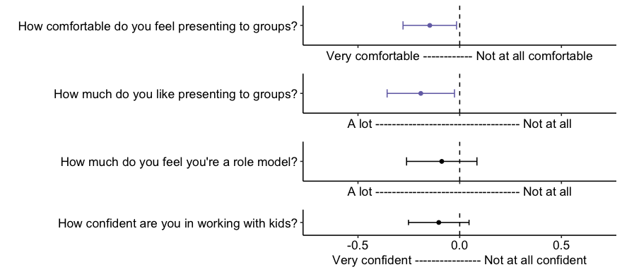
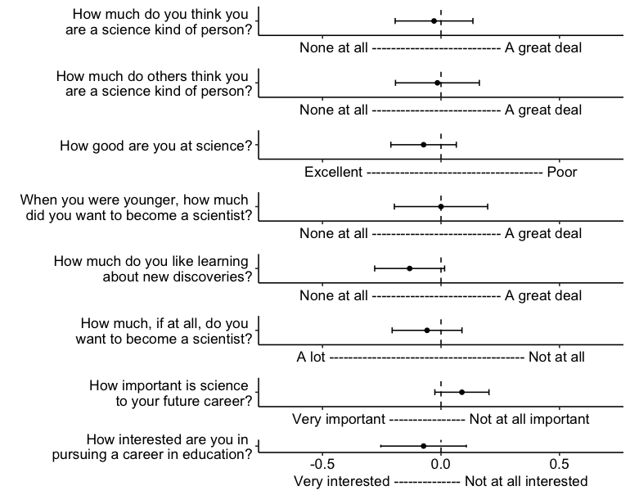
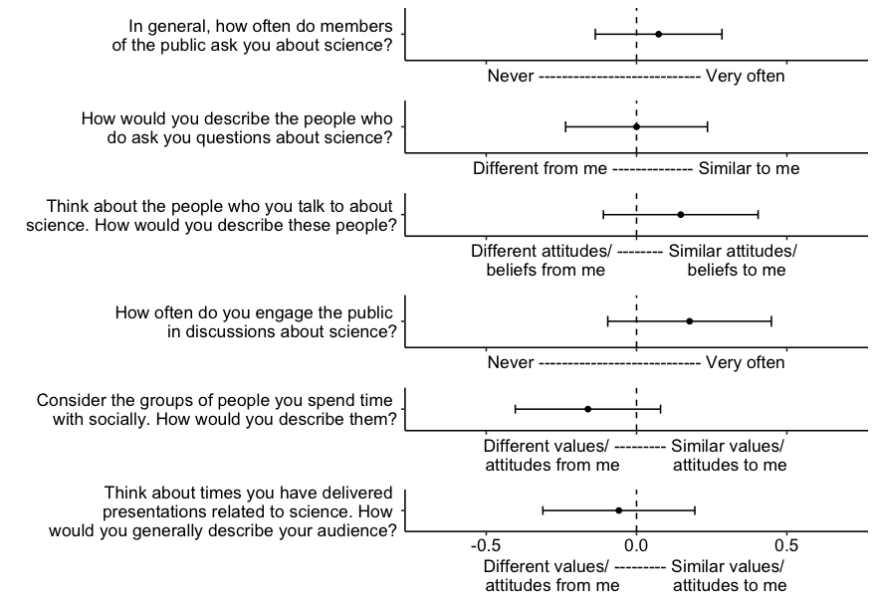
A
Communication Confidence
Pre Mean | Post Mean | t | DF | p | Bonf. p
1.985 | 1.838 | 2.191 | 67 | 0.032 | 0.128
2.265 | 2.074 | 2.263 | 67 | 0.027 | 0.108
2.176 | 2.088 | 1.000 | 67 | 0.321 | 1.000
1.956 | 1.853 | 1.355 | 67 | 0.180 | 0.719
B
Science Identity
Pre Mean | Post Mean | t | DF | p | Bonf. p
4.206 | 4.176 | 0.351 | 67 | 0.726 | 1.000
4.030 | 4.015 | 0.168 | 65 | 0.867 | 1.000
1.956 | 1.882 | 1.043 | 67 | 0.301 | 1.000
3.412 | 3.412 | 0.000 | 67 | 1.000 | 1.000
4.515 | 4.382 | 1.758 | 67 | 0.083 | 0.666
1.691 | 1.632 | 0.782 | 67 | 0.437 | 1.000
1.191 | 1.279 | -1.514 | 66 | 0.135 | 1.000
2.044 | 1.971 | 0.799 | 67 | 0.427 | 1.000
C
Echo Chambers
Pre Mean | Post Mean | t | DF | p | Bonf. p
3.250 | 3.324 | -0.684 | 67 | 0.496 | 1.000
3.368 | 3.368 | 0.000 | 67 | 1.000 | 1.000
3.191 | 3.338 | -1.120 | 67 | 0.267 | 1.000
2.985 | 3.162 | -1.271 | 67 | 0.208 | 1.000
3.912 | 3.750 | 1.312 | 67 | 0.194 | 1.000
3.603 | 3.544 | 0.456 | 67 | 0.650 | 1.000

Slide 10


A
B
Pre-Training Survey
Post-Training Survey

