Slide 1
IS452: Week 1

Slide 2
Your instruction team
Elizabeth Wickes, Lecturer, iSchool
Formerly Data Curation Specialist at UIUC Library, iSchool MSLIS grad, and Curation Manager Wolfram|Alpha
TAs:
Ankush Agrawal, MS student in Statistics
Shaneen Braswell, PhD student in ECE
Halle Burns, MS student in LIS
They will be doing grading, communication, tech help, etc!

Slide 3
A few notes
Please send me any DRES letters you have and let me know how I can help.
I am a mandated reporter for assault and harassment, but I can help you find an exempt person if you need it.

Slide 4
What is 452?
This is a grad level introduction to programming course
We’ll cover:
The basics of programming in Python in the first half
Other core data processing tools and applications in the second half
Not all intro to programming courses are the same
We’re going to focus on programming for data processing
Versus: games, large software engineering, data analytics
There will be some explicit omissions: object oriented design, scientific programming, pandas, graphical interfaces, games, etc.
If you’ve taken an intro to programming class in the last few years you likely don’t need this class and should email me. This isn’t always the case, which is why you should contact me directly.

Slide 5
Learning goals
Minimal wins:
Evaluate programming book search results and/or bookstore selections
Understand some memes you didn’t before
Run a reference interview for a patron who comes to you wanting to learn how to program
Critically evaluate or write a reality-based technical job description
Speak confidently about technical concepts and tools in consultations or job interviews

Slide 6
Learning goals
Moderate wins:
Hold stronger/more productive conversations with developers
Act as a bridge between programmers and non-programmers
Feel more confident to engage with developers and other IT staff with technical jargon and detail
Detect vendor hand waving and other bulls**t
Evaluate the usefulness and applicability of potential technical tools (e.g. an open source command line tool)

Slide 7
Learning goals
Major wins:
Identify a programming problem and take steps toward writing a program to solve it.
Make use of more technical tools, or technical features of tools you currently use (e.g. SQL in Access, RegEx in text editors, etc.)
Continue self study of programming
Succeed in further programming coursework
Do some coding!

Slide 8
Why does this class exist?
Maybe I’m the only one who keeps getting asked why the class I teach exists?
Because being able to directly interact with data and digital files is powerful and sometimes the only way to get the job done
As current/future information professionals, you know that data and digital formats are constantly changing. So you need to be prepared for anything.
Which means you need to be prepared to learn anything. This class isn’t to make you a Python dev, it’s to give you programming fundamentals so you can:
Recognize a programming problem when you have one
Assess how to tackle it
And be able to do it yourself (and know when it’s time to say no)
Be able to research and communicate about tech things

Slide 9
I’m not going to read the syllabus to you
You’re adults and can read it on your own
(and need to for the syllabus quiz!)
5:30pm-7:30pm Monday for AO
7:30-8:30pm Monday in BBC class room is lab/office hours
Overview of assignments:
Short weekly quizzes on that week’s content (10 questions, 3 attempts)
Weekly homework assignments
2 of 3 research essays due periodically (semi-flex due dates)
Midterm programming project
Final project

Slide 10
More info on the assignments
Weekly quizzes
These are multiple choice questions based on the readings, and are designed to have you review essentials before class. You can take them up to three times (as needed).
Weekly homeworks
These will consist of problems found in the textbook and problems I’ve written and are described in moodle. I will often add elements or requirements in the moodle assignment.
Midterm project:
A larger programming project (Dracula) you should be working on through the course of the first section of class.
Two (pick two of three) research essays
Three essay topics will be offered, so you can pick two to do or do all three to replace a grade you don’t like. These have a default due date that you may request to change within a certain window of time.
Final project
Proposals will be submitted around midterms, which gives you 8 weeks to spread the work out. Lots of options, including non-coding options.

Slide 11
Pardon our dust!
We’re changing a few things up based on feedback from students
Essays:
The semi-flex due date system is new
We’re rewriting the prompts
Midterm:
Discussion problems taken out (shifted to essays)
A new week of content
We’ve taken out the week on while loops and adding a week on working with JSON and CSV data
We need to make all these materials, so it looks rather empty in there.

Slide 12
That’s a lot of homework
I respect that you have lives and other classes and a personal life
Your grade doesn’t depend on a single weekly homework assignment and there will be plenty of extra credit so you can keep your grade up even when things have gone poorly
I don’t expect that you’ll get 100% on every homework, so the weighting and extra credit allow a buffer for you to maintain an A even if you stumble on a few homework assignments.
Presuming that you can maintain 100% on the other areas, you just need to maintain at least a ~76% average on the weekly homework to keep your A. There’s plenty of extra credit to keep that score up.
But this does require a steady amount of time.

Slide 13
Late and extension polices
All homework is due at 11:55pm on Saturdays, but anything before 8am is fine. Each assignment type has its own policy on late work.
The following things only apply to the weekly homework:
You also can use up to 3 extensions which give you through Wednesday to turn it in and not incur a penalty. You don’t need to explain why you need to use them.
You must have these extension requests in by the end of Monday.

Slide 14
Homework schedule
Saturday 11:55pm
weekly homework due
Monday 11:55pm
last chance for late submission for the 10% late penalty from the max homework points
deadline to request an extension.
Tuesday 11:55pm
last chance for the late submission, with a 30% penalty from the max homework points.
Any homeworks without an extension will be given a 0.
Wednesday 11:55pm
due date for homeworks on an extension.
Any homeworks on extension not submitted by this time will be given a 0.

Slide 15
Other policies
Extra credit will only apply to your weekly homework grade.
Your final homework grade will be capped at 100% of the max possible without extra credit.
You must complete the midterm and final to pass the class. Skipping (or receiving a 0 on) either will result in an F no matter what your other calculated grades are.
I do the final grade calculations based on the points you have, and there are a few things Moodle does strangely. So don’t depend on moodle’s final grade for you.
I likely won’t give out any A+ grades.

Slide 16
My promises to you
I’m going to mess some things up
But I’ll be honest about it
And if my mess up causes a severe and negative impact on the entire class, I’ll fix it
I will take your feedback seriously
I will listen and help as much as I can
I will be flexible for you

Slide 17
This class requires time
452 requires consistent time throughout each week to be successful
Everything is doable!
You will survive
You will do well
You will learn a lot
Let’s go over some strategies for success

Slide 18
Suggestions for success
Communication
I’m definitely going to mess some things up along the way or miss emails. Data entry errors will also happen. Everything is fixable as long as we know it is a problem.
I’m pretty fast with email, but mostly on my phone.
Phone friendly email == speedy reply.
Ping me on any email that has gone for more than 1 business day without answer and it was an urgent question. You may need to give me 1-3 days if it is less urgent.
Anything beyond 3 days has been lost! PLEASE email me again!

Slide 19
Suggestions for success
Start early!
Give yourself a steady amount of time each day for this. You’ll need between 5-15 hours a week for this class.
These readings aren’t the kind of thing you can skim before class and be done with. I assign the readings to help you complete the homework and be successful with the assignments. I don’t require anything that isn’t directly relevant to your homework.
Read the homework problems before you do the reading. This helps you know where to focus your reading and flag relevant examples.
Do not fear the math. You can largely ignore any math you see in the book. I’ve selected homework problems that should not require advanced math ability to complete, and added help in the moodle.

Slide 20
Suggestions for success
Reading more materials or rereading the book is not the answer if you are having trouble. You need to do the programming to understand it.
Everything you need for the homework should be in the materials I give you, but you can still seek out information online like Stack Overflow, etc.
Follow the 2 hour rule:
Stop working on it if you aren’t making progress after an hour.
Take at least a 30 minute break
Give it another hour.
Stop and email me if you still aren’t making progress after another hour.
DO NOT SPEND AN ENTIRE DAY ON ONE HW PROBLEM. That is not the intent of them.

Slide 21
Computing expectations
I expect all students to be capable of the following computing activities:
Install programs
Unzip and zip files
Take screenshots
Send emails with attachments
Know how to navigate your file system, opening folders and moving around you directory, etc.
Be comfortable interacting in Blackboard Collaborate
Be able to share your screen in Blackboard

Slide 22
Participation and attendance
I expect you to talk and participate during class and online in discussion boards. This is a bit more important for the online section. There will be discussion prompts each week to help start a conversation.
Two classes are excused:
One “life happens” time. You don’t need to tell me what’s going on, just email me that you need(ed) to use it
One scheduled event, like a job interview or conference. You must email me about this to make arrangements
Contact me if you need to miss more than 2 classes.
Childcare problems? I love babies and kids. Get it touch and we’ll work something out.
AO section: I can accommodate occasional work things if you let me know what’s going on.

Slide 23
Communication and asking questions
Administrative questions
Just about you (like a question about your grade)
Me and/or the TA who graded it
About the entire class (like when grades will be posted)
To the discussion board for that week, office hours, or email
I’ll usually open with admin updates and reminders at the opening of each class
I can address some of these questions in class, but that can eat up time, so I’ll be using emails and such for much of that.
Content questions
Don’t post your solutions in the forums, but you can ask questions about the homework in the forums.

Slide 24
How class normally works
All the lectures will be pre-written and available before class in the class github repo. You can, but aren’t required to, read the lecture notes before class. I sometimes am tweaking the notes just before class, so don’t depend on it being accurate until just before class.
I live code everything, so I will be demonstrating things live based on those lecture notes. The AO class recordings will be available to all AG and AO sections.
Focus on taking notes of the concepts and patterns that I use, but keep in mind that (nearly) all the examples will be in the notes. So don’t use your time trying to desperately copy everything I type.
Listen, observe, make the connections. Pay attention the best way you can, just don’t be disruptive to others.

Slide 25
Installation
The link is in the moodle.
Carefully and completely follow the directions.
Nothing in there is optional, nothing in there is because I think that writing directions is fun.
We’ll be using:
Anaconda
which will install python for you
PyCharm Education Edition
which will be the environment where you will write and run python

Slide 26
Moodle
You’re going to be a moodle pro after this class
Let’s do a tour and talk about where to find stuff

Slide 27
Backboard ground rules
Keep the side chatter in the chat to a minimum, but feel free to put questions in.
Question tips:
go for specific questions about the topic at hand.
keep a running list of questions about things you hope I'll get to
This seems a little cruel, but it keeps things on pace. Constantly reading questions and replying "We'll be talking about that soon" eats away at the little class time we have.
Feel free to email me things you'll hope we cover in class or other types of questions.
When we start digging in more I'll have polls for class questions.

Slide 28
Learning Strategies for Technical Skills,
Or: learning how to learn programming

Slide 29
Less why; more how
We spend a lot of time talking about how to:
Read for grad school
Find funding
Write publications
Etc.
So much support for the essential scholarly work, but little prep for learning tech things.

Slide 30
Effort versus hardship
We don’t mean impossible
When we say that programming is hard
We mean that it requires effort
will have to think hard
but you should experience hardship
Crying can be normal but should never be expected as a hazing ritual
It shouldn’t make an instructor feel good
It’s a signal that you need a break

Slide 31
But this seems harder than it should be
And you’re right
Most of us (including me) aren't from a computer science or STEM background
But most materials and instructors expect this, thus there's a lot of disconnect
“You mean you don’t like physics puzzles?”
Their expectations for a baseline are not our actual baseline

Slide 32
Specialization
Each of us has specialized learning skills
Going through graduate programs solidifies those skills and perspectives even more
An awkward date:
Me: In Sociology there is no real right answer. You come to a conclusion and justify it.
Him: Don't you feel freaked out by not knowing what the right answer should be?
Me: Don't you find that painfully restricting?

Slide 33
We forget we had to learn how to learn
The higher we get in our home domains, the more that methodology seems to be a part of us and how we see the world.
We also forget learning some things as we move further from that experience and begin building our knowledge webs ever deeper.
Do you remember learning how to read and that it sucked?

Slide 34
Until we move into foreign domains
Our knowledge web breaks apart and we have a set of incomplete and unconnected nodes
A lack of learning schemas creates undue difficulty
We aren't lacking the skills to succeed; we're lacking the experience to make us efficient learners
And we’re used to being efficient. I argue that this is the inspiration for the crying
If all materials start at square 5, but you're at square 1

Slide 35
How do humanities skills fit into writing code?

Slide 36
Programs as research papers
What are you writing?
Short, to the point
Single task
Make this into that
Long, lots of dependencies
Making a nuanced point
handles lots of options, problems, threads, etc.

Slide 37
Iteration
Writing a paper requires:
a thesis statement
doing some research
finding supportive evidence
making your point
Writing a program requires
defining a problem to solve
doing some research
finding supportive frameworks and tools
making your deliverable

Slide 38
Iteration
Writing a paper requires:
a thesis statement
doing some research
finding supportive evidence
making your point
Writing a program requires
defining a problem to solve
doing some research
finding supportive frameworks and tools
making your deliverable
Hmmmmmm…

Slide 39
Neither is written from start to finish
Even though the final product doesn't look like that
We outline, develop, reevaluate, and trash
Sometimes we need to kill it with fire and start again in the morning
Think of errors as writing group partners
Sure, sometimes you’ll end up with a jerk
But remember that the critical feedback is a major part of why you’re there in the first place

Slide 40
Critical feedback is your friend
Success comes through failures
Take time to reflect on them so you learn and improve
Failure doesn’t have to be a four letter word
Embrace revisions
It's still hard to take criticism, but we accept that it is necessary, grit our teeth, and slog through
Error messages are no different
They are not the universe casting judgement on your soul and finding you wanting
They're a slightly impersonal method of the computer being confused

Slide 41
Debugging as spell checking
Debugging
Error is reported--go find it
Look at your spelling
Check your punctuation balance
Check your containers and whitespace
Make sure you said what you meant to say
Proofreading
Error is reported--go find it
Look at your spelling
Check your punctuation balance
Check your containers and whitespace
Make sure you said what you meant to say

Slide 42
Debugging as spell checking
Debugging
Error is reported--go find it
Look at your spelling
Check your punctuation balance
Check your containers and whitespace
Make sure you said what you meant to say
Proofreading
Error is reported--go find it
Look at your spelling
Check your punctuation balance
Check your containers and whitespace
Make sure you said what you meant to say
Hmmmmmm…

Slide 43
Be okay not knowing the road you’ll travel
You will find the road
You will make it to the other side
Impossible to know exactly how to get there without stepping a foot out the door
So you want to write a poem…
Do you know how it’ll end when you start it?
Should you?
This idea of prescriptive solutions is both dishonest and not correct

Slide 44
Necessary uncertainty
Simple battle plan:
Receive input
Do magic
Profit
Data battle plan
Read in the data somehow
Investigate what it needs
Somehow do what it needs
Produce glorious outputs somehow
https://en.wikipedia.org/wiki/Gnomes_(South_Park)#/media/File:Gnomes_plan.png

Slide 45
Archival research
Who here has done research in the archives?
Sometimes you need one specific shiny thing
Most of the time you know that what you need is in there somewhere
So you visit to sort out where it is and collect it into a useful format
This ‘browsing’ activity also happens in writing code

Slide 46
OK, that was the hard sell on approaches toward getting stuff done, let's shift to more tangible details

Slide 47
Taking notes
What you're learning about isn't linear, so think outside the linear piece of paper
There are certainly linear aspects, but there's nothing linear about "first we learn about hair colors, then vegetable names, then about cars, then geography." in languages
When you take notes, focus on capturing the concepts and patterns
It's easier to fill in or look up a missing piece of syntax than it is a missing concept.
Consider using a mindmap-like tool to synthesize your notes.
We’ll be building on info a lot, so leave space to expand info.
Group in three categories: reference, concept, and pattern.

Slide 48
Taking notes
Be comfortable not knowing the full score as you’re moving forward
I know it can be hard, but really just turn that page and move forward
You’ll want to revisit things and add clarification as we build up our knowledge
Drawing your notes in clusters and using a notebook you can add paper to or move things around is great.
Don’t be a stenographer. Class is already being recorded.
Mark areas where you have questions so you know to revisit.

Slide 49
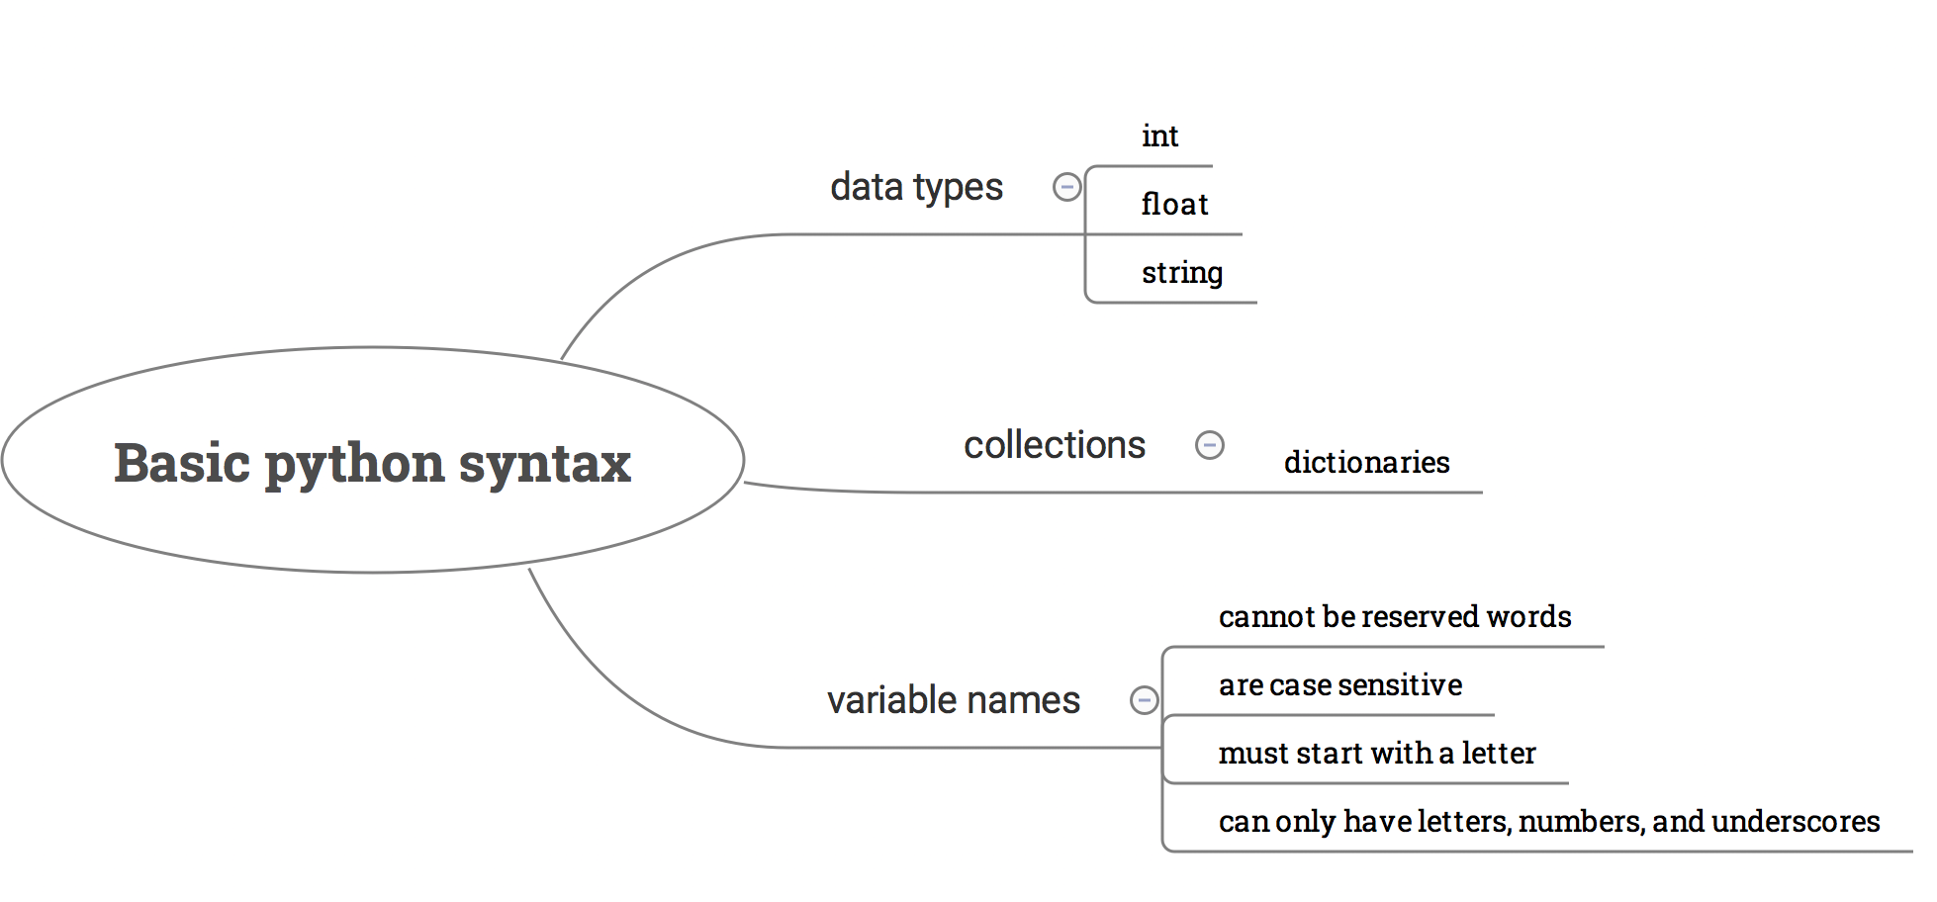
Taking notes

Slide 50
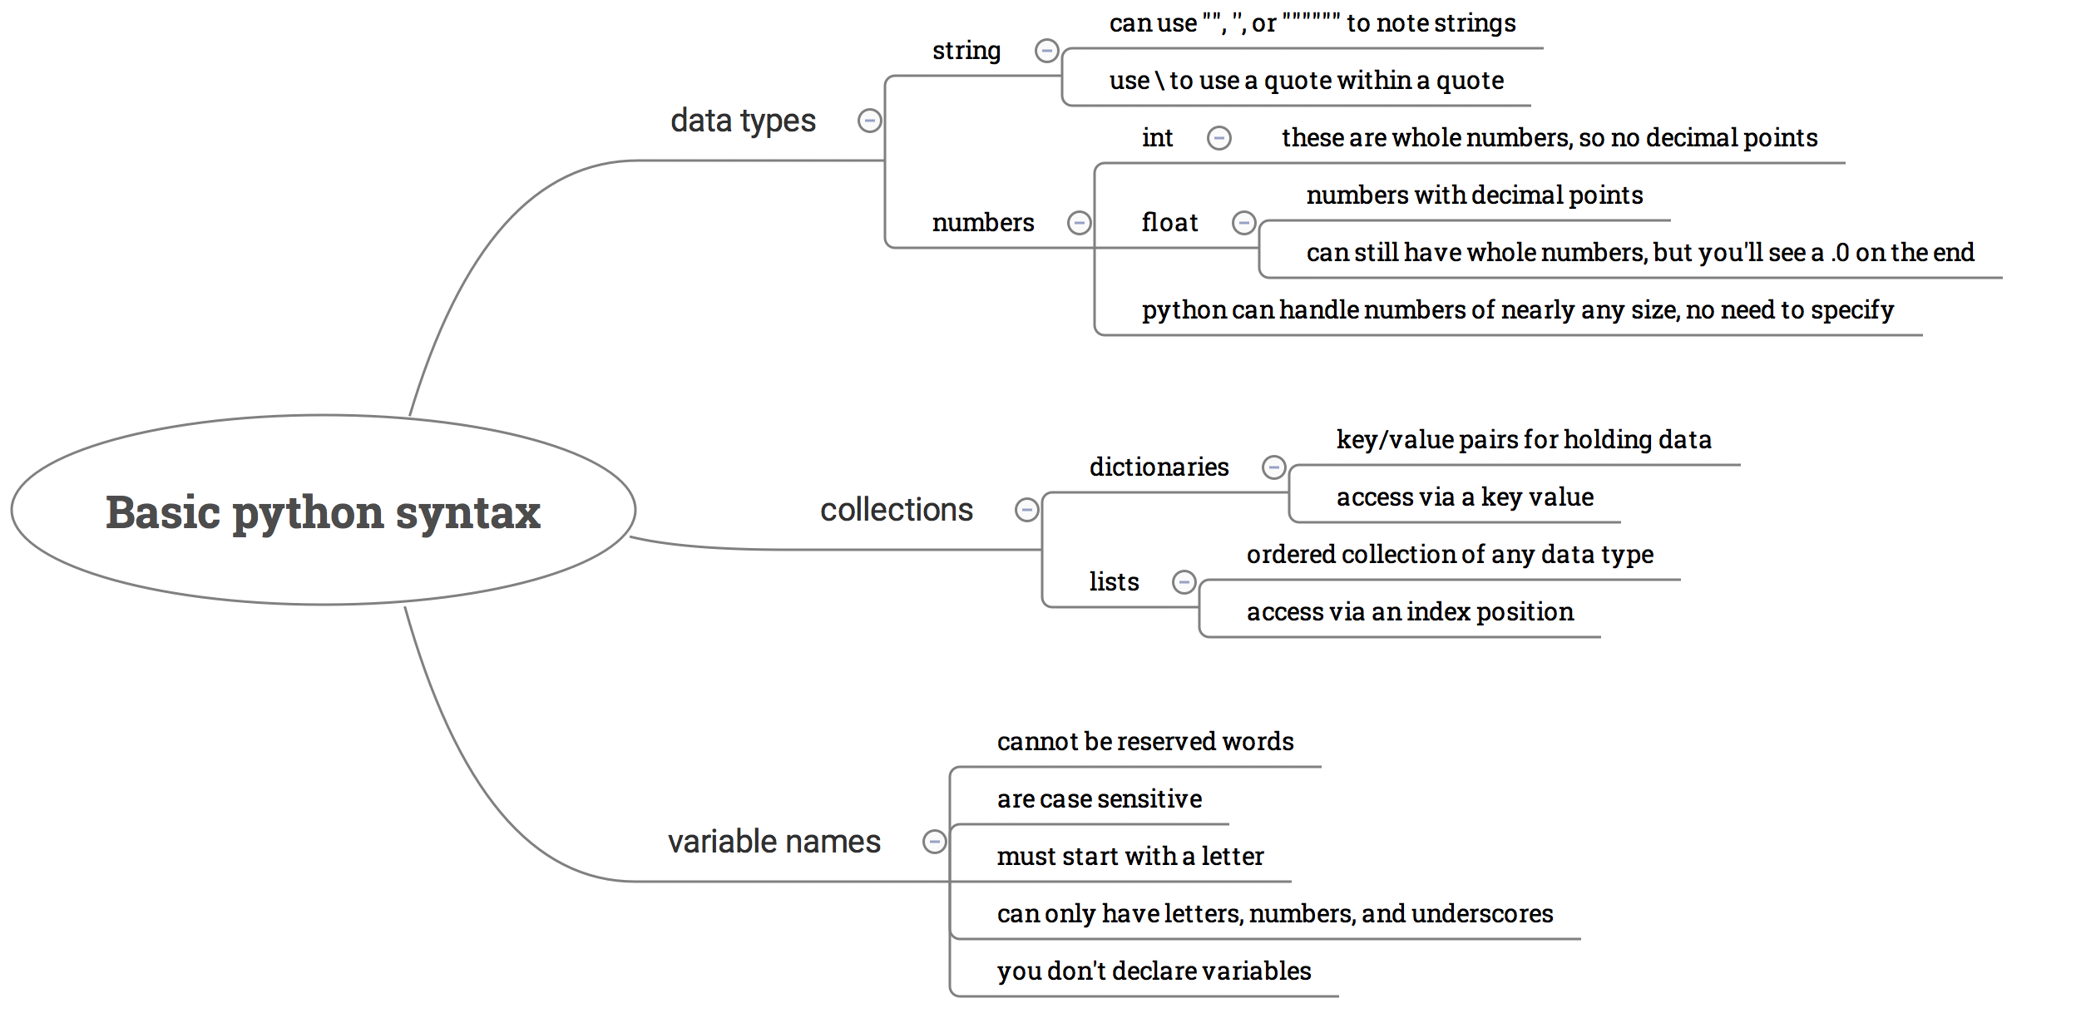
Taking notes

Slide 51
Enough of this
Let’s do some python

