Slide 1
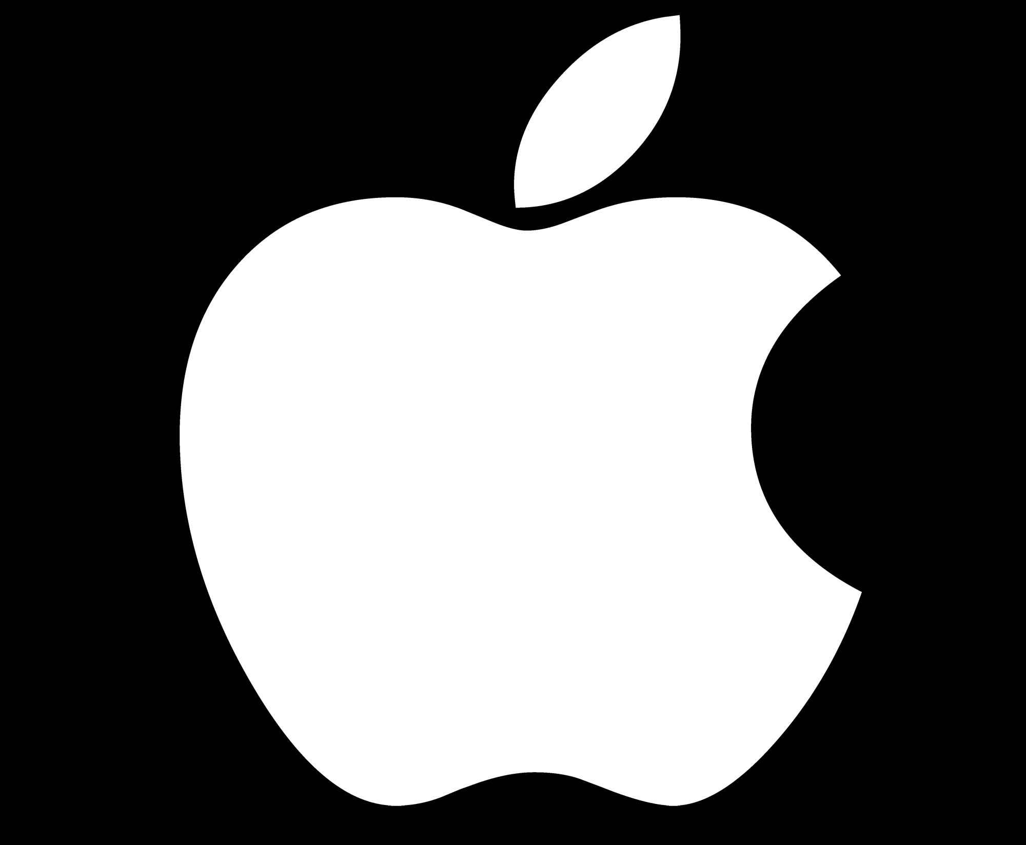

Sentiments towards Apple @ SXSW Conference 2011
Identification of Twitter Users With Neutral vs Non-Neutral Opinions towards Apple
By: Brandon Menendez
Nazar Mohl
June 24, 2022

Slide 2
Agenda
Big Picture
Key Finding
Data Preprocessing and Analysis
Model Results
Recommendations

Slide 3
Big Picture
Stakeholder:
Apple Social Media Advertising Team
Business Need:
Model that analyzes the sentiment of tweets.
Identify users for targeted ads (Only neutral tweets).
Not interested in negative or positive tweets.

Slide 4
Executive Summary
Importance of Twitter in reaching customers
80.9 Million Users in US
34% of Americans who use Twitter earn $75k+
$0.50 to $2.00 per click
Created model to identify “low hanging fruit”
Able to correctly identify 69% of target customers

Slide 5
Exploratory Data Analysis (EDA)
SXSW Conference 2011 Data from CrowdFlower via data.world.
Over 9,000 Tweets – used around 5,200 (Apple only)
Previously generated sentiments

Slide 6
Data Assessment
Ratings Assessment:
Positive?
RT @mention Don't worry you guys, found an iPhone charger. WHAT'S THE DEAL WITH HIPSTERS AND BEARDS, RIGHT?!?! #sxsw
Apple?
Back in the big apple! Need to wean off my new foursquare addiction thanks to #sxsw
Negative?
Bad news update: the pop-up Apple Store is out of iPads! Not sure if they will have more by tomorrow. #SXSW

Slide 7
Preprocessing - Cleaning
Removed:
Null records, noisy characters, irrelevant/common words
@mentions, links (Kept hashtags)
Examples:
‰÷¼ We love 2 entertain you‰Û_Please don‰Ûªt be grateful! ‰÷_ {link} ‰ã_ #edchat #musedchat #sxsw #sxswi #classical #newTwitter
@teachntech00 New iPad Apps For #SpeechTherapy And Communication Are Showcased At The #SXSW Conference http://ht.ly/49n4M #iear #edchat #asd

Slide 8
Preprocessing – New Features
Created 2 ratings categories:
Neutral rating
Aggregate of Positive or Negative rating
Examples:
The best! RT @mention Ha! First in line for #ipad2 at #sxsw &quot;pop-up&quot; Apple store was an event planner #eventprofs #pcma #engage365
@sxsw I hope this year's festival isn't as crashy as this year's iPhone app. #sxsw
Does your #SmallBiz need reviews to play on Google Places...We got an App for that..{link} #seo #sxsw

Slide 9
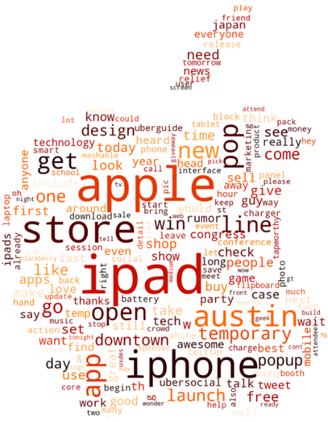
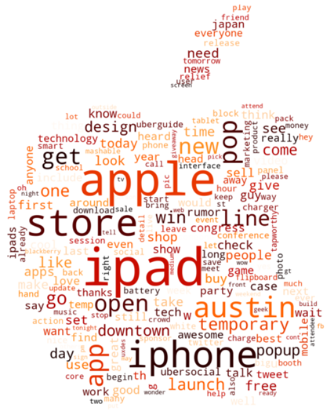
Preprocessing
Analyzed:
Retweets
Emojis
Calculated:
Frequency / distribution of words
Ratio of capital to lowercase letters
Count of “!” and “?” characters

Slide 10
Modeling Process / Evaluation metrics
Models Applied:
Decision Tree
Multinomial Naive Bayes
Evaluation metrics
Recall – Provides Insight into False Positives
Precision – Provides Insight into False Negatives

Slide 11
Model Results
Better model: Multinomial Naive Bayes
Recall: 69%
69% of target customers can be correctly identified
Precision: 63%
63% of budget is correctly applied
Notes:
Recall = Ratio of (True Neutral) / (True Neutral + False Non-Neutral)
Precision = Ratio of (True Neutral) / (True Neutral + False Neutral)

Slide 12
Moving Forward
Recommendation:
Use this model to inform targeted ad campaigns using twitter
Next Steps:
Examine retweets
Emoji analysis
Sentiments on individual products/services

Slide 13

Q & A
Thank You!
Brandon Menendez:
bmenendez94@gmail.com
http://linkedin.com/in/brandon-menendez/
http://github.com/brandmend
Nazar Mohl:
https://github.com/NazarMohl
https://www.linkedin.com/in/nazar-mohl/
nazar.mohl@gmail.com

