Slide 1

IAQ TECHNOLOGY INTERNATIONAL SDN BHD
Master template
Seventeen layouts to build a new slide from. Each one is shown filled, then empty with a line in every box.
01
Title
Open a deck or a chapter of one.
02
Section divider
Open a new part of the deck.
03
Statement
One argument, said plainly, with a photograph.
04
Highlights
Three or four figures that carry the page.
05
Icon cards
A set of capabilities, services or principles.
06
Comparison
Two or three options read side by side.
07
Org chart · reporting tree
Who reports to whom, three levels at most.
08
Org chart · flat team band
A team of peers, no hierarchy implied.
09
Org chart · group structure
A holding company and the businesses under it.
10
Process
Stages that run in order, start to finish.
11
Timeline
Dates in order, with what happened at each.
12
Infographic
One visual in the middle, the parts around it.
13
Image and specs
One project or product, pictured and specified.
14
Programme
Work packages against a calendar.
15
Table
Rows and columns, where the detail has to be exact.
16
Full-bleed image
Let one photograph carry the page.
17
Closing
End the deck: the ask, and how to reach you.
18
Agenda
What the deck covers, before it covers it.
19
Quote
Let a client, or the board, say it instead of you.
20
Before and after
Two states of the same thing, side by side.
00
CONTENTS

Slide 2

01
IAQ TECHNOLOGY INTERNATIONAL SDN BHD
CAPABILITY STATEMENT · 2026
Engineering the facilities advanced industry runs on.
Cleanroom critical delivery for semiconductor, data centre, EV battery, pharmaceutical and energy.
PREPARED FOR · CLIENT NAME · OCTOBER 2026
01
TITLE

Slide 3
01
IAQ TECHNOLOGY INTERNATIONAL SDN BHD
KICKER · TWO OR THREE WORDS
The one line this deck is about, eight words or fewer.
A sentence under it saying who it is for and what it covers.
PREPARED FOR · CLIENT · DATE
02
TITLE

Slide 4
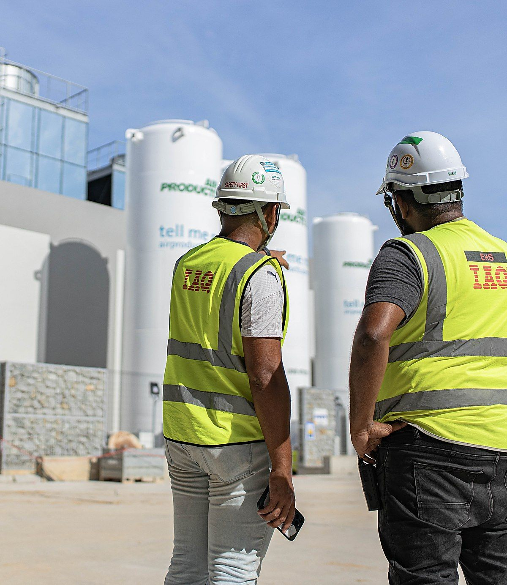
02
PART 02 · PROJECT REFERENCES
02
PART 02 OF 03
Project References
SECTIONS 02.1 TO 02.47
235+ projects completed across three regions
Over 1.5 million m² of cleanroom built
03

Slide 5
02
SECTION NAME
00
PART 00 OF 00
Section name
WHAT THIS PART COVERS
A fact worth leading with
A second fact, the same length
04

Slide 6
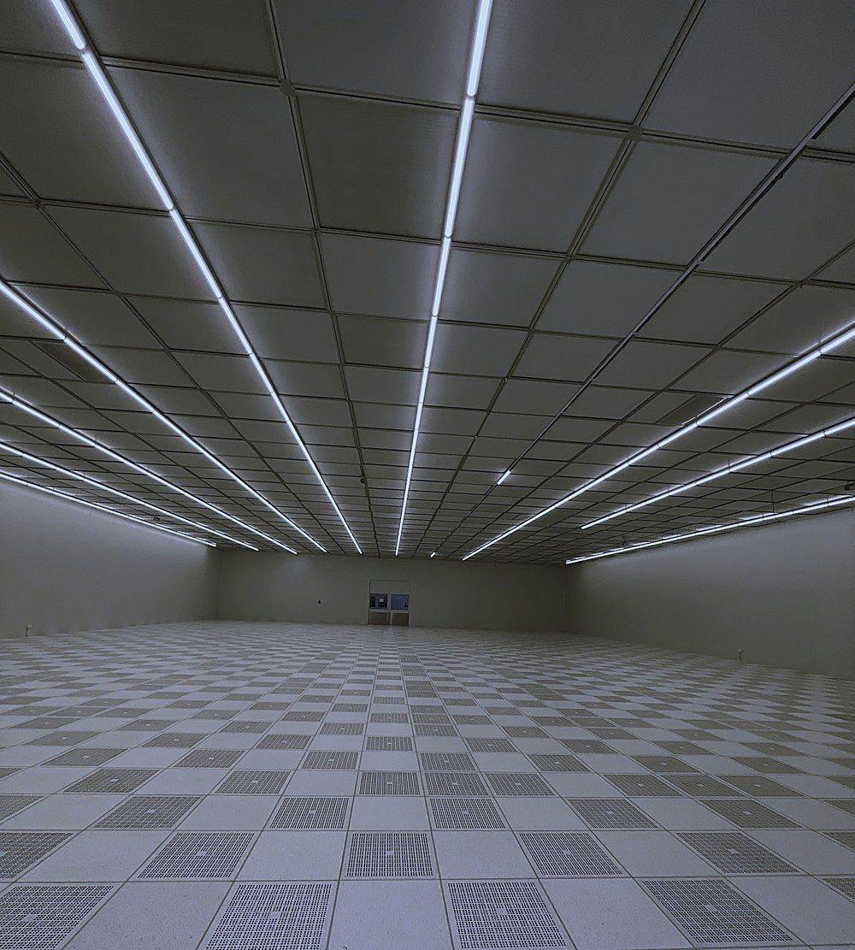
03
PART 01 · THE COMPANY
Why IAQ
The case in one line, and what stands behind it.
Thirty-one years of building the rooms that cannot fail.
Cleanrooms, process utilities and tool hookup for the industries where contamination control, precision and compliance are absolute. Self-performed, under one contract.
05
STATEMENT

Slide 7
03
SECTION NAME
Page title
One line under it saying what the page is for.
The statement, two lines at most, said plainly.
Two or three sentences carrying the argument. Say what is true, what it is worth, and leave the rest to the next page.
06
STATEMENT

Slide 8
04
PART 01 · THE COMPANY
The year in four numbers
Where the work went in 2026.
DELIVERED
BUILT
PEOPLE
REACH
235+
1.5mil m²
530+
7
Projects completed since 1995
Cleanroom built-up area
Engineers, supervisors and crew
Offices across three continents
07
HIGHLIGHTS

Slide 9
04
SECTION NAME
Page title
One line under it saying what the page is for.
LABEL
LABEL
LABEL
LABEL
00+
00unit
00%
00
What the figure counts, one line
What the figure counts, one line
What the figure counts, one line
What the figure counts, one line
08
HIGHLIGHTS

Slide 10






05
PART 01 · THE COMPANY
What we self-perform
Six packages under one contract.
01
02
03
Engineering design
Electrical systems
Cleanroom systems
CSA and MEP, to specification
Up to 33kV substations
ISO 3 to ISO 8
04
05
06
Commissioning
Maintenance
Energy management
Testing and handover
Operate, service, optimise
Carbon and cost reduction
09
ICON CARDS

Slide 11
05
SECTION NAME
Page title
One line under it saying what the page is for.
01
02
03
Item name
Item name
Item name
What it covers, four or five words
What it covers, four or five words
What it covers, four or five words
04
05
06
Item name
Item name
Item name
What it covers, four or five words
What it covers, four or five words
What it covers, four or five words
10
ICON CARDS

Slide 12
06
PART 01 · THE COMPANY
Three ways to contract the work
The same crews, scoped three ways.
MODEL 01
MODEL 02
MODEL 03
EPCM
EPCC
EFM
Management of engineering, procurement and construction.
Full turnkey from conception to operation.
Energy and facility management after handover.
Client holds the trade contracts
IAQ holds every contract
Planned and reactive maintenance
IAQ manages delivery
One programme, one accountability
Energy and carbon reduction
Fastest route to a fab ramp
Fixed scope, fixed completion
Operates the asset for its life
Best where scope is still moving
Best where the brief is settled
Best where uptime decides value
11
COMPARISON

Slide 13
06
SECTION NAME
Page title
One line under it saying what the page is for.
OPTION 01
OPTION 02
OPTION 03
First option
Second option
Third option
One sentence saying what it is.
One sentence saying what it is.
One sentence saying what it is.
A point of difference
A point of difference
A point of difference
A second point
A second point
A second point
A third point
A third point
A third point
When to choose it
When to choose it
When to choose it
12
COMPARISON

Slide 14
07
PART 01 · THE COMPANY
How the company is run
Board, executive and the four lines.
CHAIRMAN
Board of Directors
Governance and strategy
MANAGING DIRECTOR
DIRECTOR
DIRECTOR
DIRECTOR
Group MD
Engineering
Commercial
HSE and Quality
Operations and delivery
Design and method
Cost, contracts and risk
Standards and audit
13
ORG CHART · REPORTING TREE

Slide 15
07
SECTION NAME
Page title
One line under it saying what the page is for.
ROLE
Name or function
What they are accountable for
ROLE
ROLE
ROLE
ROLE
Name or function
Name or function
Name or function
Name or function
One line
One line
One line
One line
14
ORG CHART · REPORTING TREE

Slide 16

08
PART 01 · THE COMPANY
The project team
Who the client deals with, day to day.
PROJECT DIRECTOR
CONSTRUCTION MANAGER
LEAD ENGINEER
QA / QC MANAGER
HSE MANAGER
Name here
Name here
Name here
Name here
Name here
Single point of contact
Site and programme
Design and method
Inspection and records
Safety on every shift
15
ORG CHART · FLAT TEAM BAND

Slide 17

08
SECTION NAME
Page title
One line under it saying what the page is for.
ROLE
ROLE
ROLE
ROLE
ROLE
Name
Name
Name
Name
Name
What they own
What they own
What they own
What they own
What they own
16
ORG CHART · FLAT TEAM BAND

Slide 18
09
PART 01 · THE COMPANY
The group
One holding company, four operating businesses.
HOLDING
IAQ Technology International Sdn Bhd
Incorporated 1995 · 200001031412
COMPANY 01
COMPANY 02
COMPANY 03
COMPANY 04
IAQ Solutions
IAQ Utility Solutions
IAQ Energy Facility Management
IAQ Europe
Cleanroom systems
Process utilities
District cooling
Gigafactories
CSA and MEP
Tool hookup
Chiller plants
Wafer fabs
Malaysia and Singapore
EPCM packages
Operate and maintain
Sweden, Germany, France
17
ORG CHART · GROUP STRUCTURE

Slide 19
09
SECTION NAME
Page title
One line under it saying what the page is for.
HOLDING
Parent company name
Incorporated 0000
COMPANY 00
COMPANY 00
COMPANY 00
COMPANY 00
Business name
Business name
Business name
Business name
What it does
What it does
What it does
What it does
What it does
What it does
What it does
What it does
Where it works
Where it works
Where it works
Where it works
18
ORG CHART · GROUP STRUCTURE

Slide 20





10
PART 01 · THE COMPANY
How a package is delivered
Five stages, one accountability.
THE DELIVERY CYCLE
Every package runs the same five stages, whoever holds the contract.
01
02
03
04
05
Engineering
Procurement
Construction
Testing
Maintenance
Design and consultation
Sourcing and supply chain
Self-performed packages
Commissioning and handover
Operate, service, optimise
19
PROCESS

Slide 21

10
SECTION NAME
Page title
One line under it saying what the page is for.
PROCESS NAME
One sentence saying what the process is and where it starts.
01
02
03
04
05
Stage name
Stage name
Stage name
Stage name
Stage name
Three or four words
Three or four words
Three or four words
Three or four words
Three or four words
20
PROCESS

Slide 22
11
PART 01 · THE COMPANY
Thirty-one years
The turns that made the company.
Founded
Largest DCC plant
Three continents
Incorporated as a cleanroom specialist
KLCC district cooling, a national first
India, the United States and Ireland open
1995
2008
2016
2021
2026
Class 10 cleanroom
Four fab expansions
Western Digital PJ, a first in the region
SilTerra, Soitec, Infineon, Microsoft
21
TIMELINE

Slide 23
11
SECTION NAME
Page title
One line under it saying what the page is for.
Event
Event
Event
One line on what happened
One line on what happened
One line on what happened
0000
0000
0000
0000
0000
Event
Event
One line on what happened
One line on what happened
22
TIMELINE

Slide 24


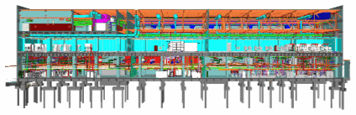




12
PART 01 · THE COMPANY
What goes into the building
Six systems, one model, one contract.
01
04
Structure
Process utilities
Greenfield and brownfield CSA
Water, chemical, gas, exhaust
ONE MODEL, SIX SYSTEMS
02
05
Electrical
Monitoring
Up to 33kV substations
FMCS, BMS, PA
Every system on this page is installed in the same building, by IAQ’s own crews, under one programme.
03
06
Cleanroom
Tool hookup
ISO 3 to ISO 8
Progressive install
23
INFOGRAPHIC

Slide 25

12
SECTION NAME
Page title
One line under it saying what the page is for.
01
04
Part name
Part name
What it covers, four words
What it covers, four words
CAPTION OVER THE VISUAL
02
05
Part name
Part name
What it covers, four words
What it covers, four words
One sentence under the visual saying what the whole thing adds up to.
03
06
Part name
Part name
What it covers, four words
What it covers, four words
24
INFOGRAPHIC

Slide 26
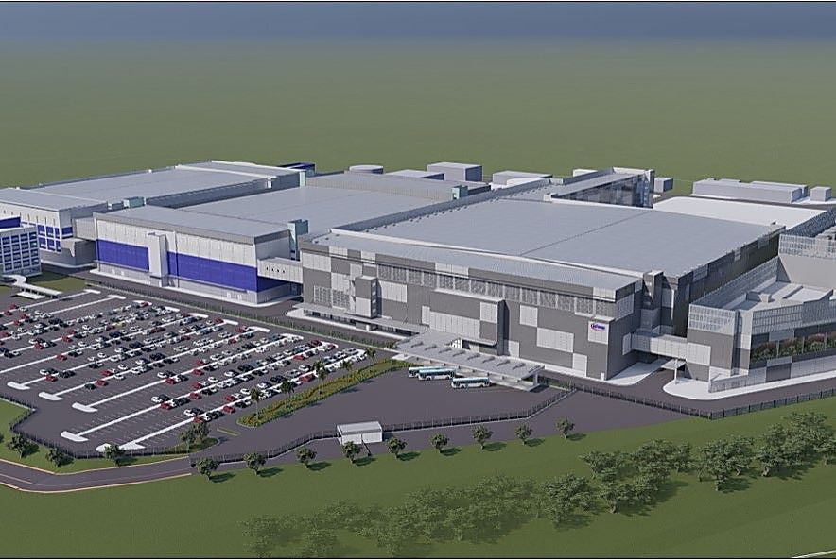
13
PART 02 · PROJECT REFERENCES
Project reference
One project, what it was and what it took.
KULIM, KEDAH · GREENFIELD WAFER FAB
Infineon Kulim Wafer Fab 3
EPCC & DESIGN BUILD
CLEANROOM SYSTEMS
ACMV & MECHANICAL
DESCRIPTION
General contractor for WP06, KLM3 Expansion, 36,000 m² cleanroom area
SCOPE
PCC for cleanroom and mechanical works
CLEANROOM
ISO 4 to 7 · Class 10 to 100 to 10K
COMPLETED
2024
25
IMAGE AND SPECS

Slide 27
13
SECTION NAME
Page title
One line under it saying what the page is for.
LOCATION · WHAT KIND OF FACILITY
Project or product name
SERVICE LINE
SERVICE LINE
SERVICE LINE
DESCRIPTION
One sentence on what the job was
SCOPE
What was in the contract
CLEANROOM
Class or grade, if it applies
COMPLETED
Year
26
IMAGE AND SPECS

Slide 28
14
PART 01 · THE COMPANY
Indicative programme
Six quarters, from award to handover.
Q1 26
Q2 26
Q3 26
Q4 26
Q1 27
Q2 27
Engineering design
8 weeks
CSA and MEP to IFC
Long lead procurement
AHUs, switchgear, chillers
Civil and structural
Foundations to envelope
Cleanroom build
Walls, ceilings, flooring
Process utilities
Water, gas, chemical, exhaust
Testing and handover
Handover
Classification and C&Q
27
PROGRAMME

Slide 29
14
SECTION NAME
Page title
One line under it saying what the page is for.
PERIOD
PERIOD
PERIOD
PERIOD
PERIOD
PERIOD
Work package
Milestone
What is in it
Work package
What is in it
Work package
What is in it
Work package
What is in it
Work package
What is in it
Work package
Milestone
What is in it
28
PROGRAMME

Slide 30
15
PART 01 · THE COMPANY
Cleanroom classes we build to
What each grade means and where it is used.
CLASS
ISO GRADE
PARTICLES PER M³
TYPICAL USE
DELIVERED
Class 1
ISO 3
≤ 1,000 at 0.1 µm
Advanced-node lithography
Yes
Class 10
ISO 4
≤ 10,000 at 0.1 µm
Wafer fabrication
Yes
Class 100
ISO 5
≤ 3,520 at 0.5 µm
Photomask, test and assembly
Yes
Class 1K
ISO 6
≤ 35,200 at 0.5 µm
Medical device, parenteral
Yes
Class 10K
ISO 7
≤ 352,000 at 0.5 µm
Pharmaceutical, GMP
Yes
Class 100K
ISO 8
≤ 3.5 m at 0.5 µm
Packaging and support areas
Yes
29
TABLE

Slide 31
15
SECTION NAME
Page title
One line under it saying what the page is for.
COLUMN
COLUMN
COLUMN
COLUMN
COLUMN
Row label
Value
Value
Value
Called out
Row label
Value
Value
Value
Called out
Row label
Value
Value
Value
Called out
Row label
Value
Value
Value
Called out
Row label
Value
Value
Value
Called out
Row label
Value
Value
Value
Called out
30
TABLE

Slide 32

16
IAQ TECHNOLOGY INTERNATIONAL SDN BHD
The rooms that cannot fail.
Thirty-one years of cleanroom critical delivery, on three continents.
31
FULL-BLEED IMAGE

Slide 33
16
IAQ TECHNOLOGY INTERNATIONAL SDN BHD
One line over the photograph.
A sentence under it, if the line needs support. Otherwise leave it out.
32
FULL-BLEED IMAGE

Slide 34
17
IAQ TECHNOLOGY INTERNATIONAL SDN BHD
Let us look at your facility.
Tell us the class, the programme and the constraint. We will tell you what it takes.
ENQUIRIES
business@iaqtechnology.com.my
TELEPHONE
+603 5131 9999
HEAD OFFICE
12, Jalan Sungai Jeluh 32/192, Shah Alam, Selangor
ONLINE
iaqtechnology.com.my
33
CLOSING

Slide 35
17
IAQ TECHNOLOGY INTERNATIONAL SDN BHD
The closing line, six words or fewer.
A sentence saying what you want to happen next.
LABEL
The detail
LABEL
The detail
LABEL
The detail
LABEL
The detail
34
CLOSING

Slide 36
18
PART 01 · THE COMPANY
What follows
Three parts, and what each one answers.
01
02
03
The Company
Project References
Safety, Quality and ESG
01.1
Who we are and what we build
02.1
How the portfolio breaks down
03.1
The commitments we hold
01.2
The numbers behind it
02.2
Semiconductor and display
03.2
Certifications and licences
01.3
Thirty-one years of milestones
02.3
Data centre and EV battery
03.3
Builder of the Year 2024
01.4
Where we work
02.4
The full reference list
03.4
How we are assessed
35
AGENDA

Slide 37
18
SECTION NAME
Page title
One line under it saying what the page is for.
01
02
03
Part name
Part name
Part name
01.1
What this section answers
02.1
What this section answers
03.1
What this section answers
01.2
What this section answers
02.2
What this section answers
03.2
What this section answers
01.3
What this section answers
02.3
What this section answers
03.3
What this section answers
01.4
What this section answers
02.4
What this section answers
03.4
What this section answers
36
AGENDA

Slide 38
19
PART 02 · PROJECT REFERENCES
In their words
What the people who hired us say about it.
“
They self-performed the packages that usually slip. That is the whole reason the fab opened on time.
Name of the person
ROLE · CLIENT ORGANISATION
37
QUOTE

Slide 39
19
SECTION NAME
Page title
One line under it saying what the page is for.
“
The quotation, two lines at most. Cut it back until only the part worth repeating is left.
Name of the person
ROLE · ORGANISATION
38
QUOTE

Slide 40
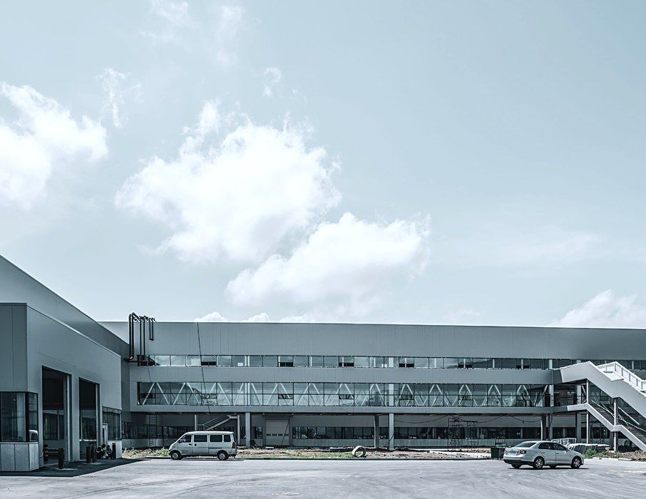
20
PART 02 · PROJECT REFERENCES
What changed
The same hall, before handover and in production.
BEFORE
AFTER
Shell and core
ISO 5 in production
Structure complete, services roughed in, no classification yet.
Classified, commissioned and handed over to the client’s team.
39
BEFORE AND AFTER

Slide 41
20
SECTION NAME
Page title
One line under it saying what the page is for.
BEFORE
AFTER
What it was
What it became
One or two sentences on the state it started in.
One or two sentences on the state it ended in.
40
BEFORE AND AFTER

