Slide 1
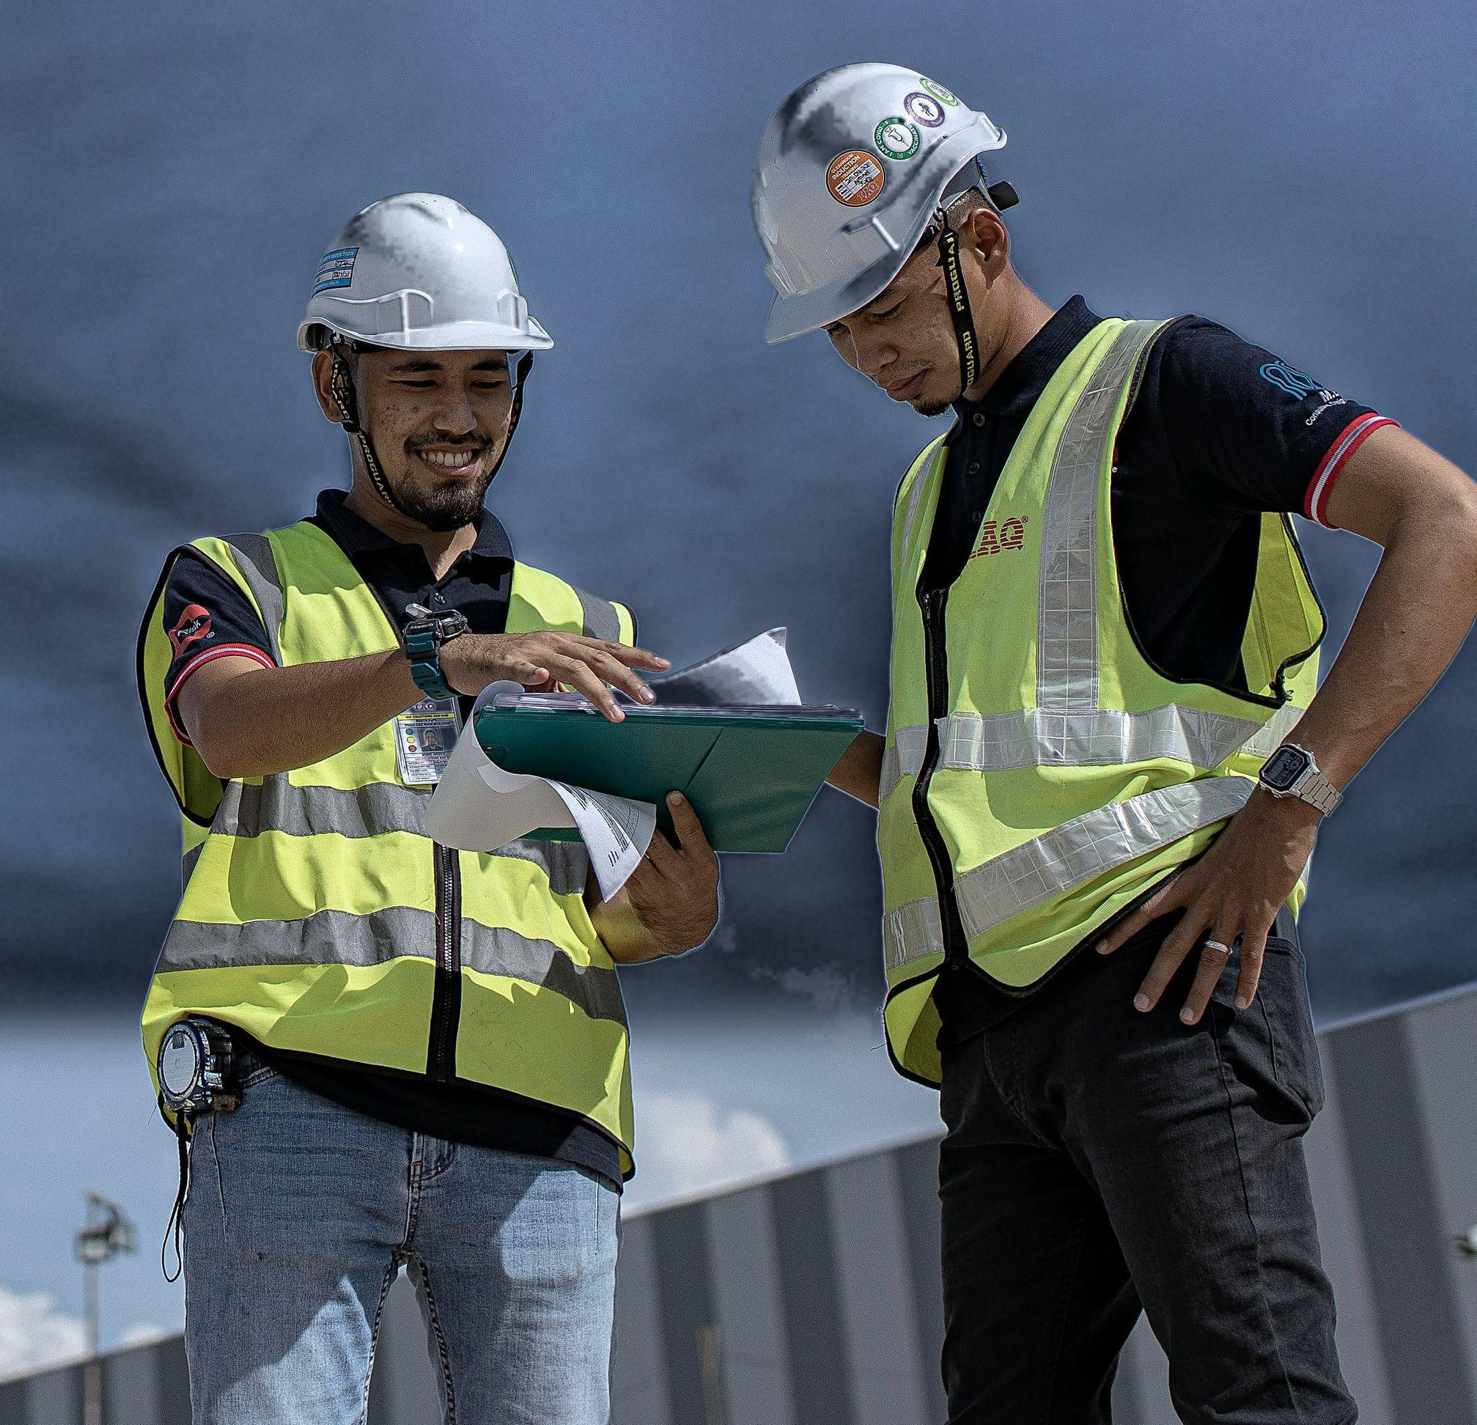

IAQ TECHNOLOGY INTERNATIONAL SDN BHD
31
years of delivery
since 1995
Engineering the facilities
advanced industry runs on.
EPC
Process Critical Utilities & Total Tool Installation Solutions
Energy Management
For cleanroom critical industries: semiconductor, data centre, EV battery, pharmaceutical and energy.
ISO 9001 · ISO 14001 · ISO 45001 · CIDB G7
PRESENTATION SLIDE · EDITION 2026

Slide 2
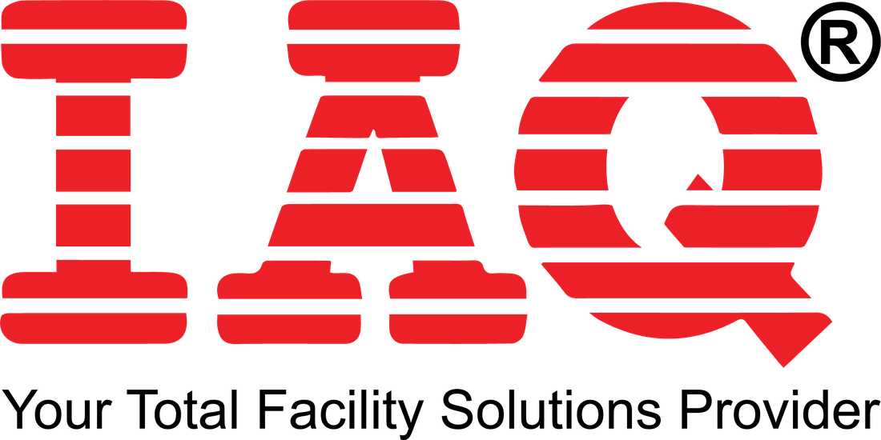
IAQ TECHNOLOGY INTERNATIONAL SDN BHD
Contents
Three parts. Every section is numbered, named and opens with a one-line summary.
01
The Company
02
Project References
03
Safety, Quality & ESG
Who we are, how we are built, and what we deliver.
The work itself, grouped by industry and region.
The standards every project is held to.
01.1
About IAQ
02.1
Portfolio Overview
03.1
ESG Commitments
01.2
IAQ at a Glance
02.2
Semiconductor · Malaysia
03.2
Certifications
01.3
Milestones
02.3
Semiconductor · Singapore
03.3
Builder of the Year 2024
01.4
Global Footprint
02.4
Data Centre
03.4
Safety & Recognition
01.5
Core Values
02.5
EV Battery · Europe
03.5
Closing
01.6
Business Units
02.6
Semiconductor · Europe & Morocco
03.6
Contacts
01.7
Delivery Models
02.7
Semiconductor & Display · China
01.8
Scope of Services
02.8
Photovoltaics
01.9
Industry Focus
02.9
Pharmaceutical & Medical
02.10
District Cooling & Energy
02.11+
Full Project Reference List
02 / 67
CONTENTS

Slide 3
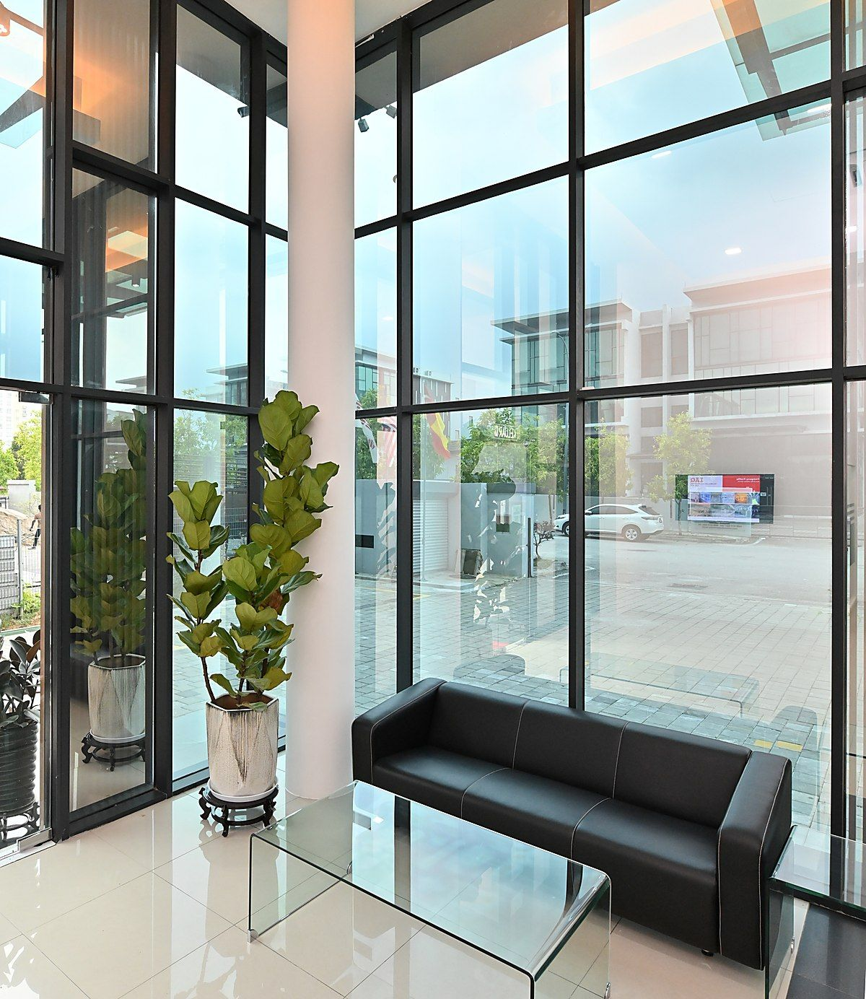
PART 01 · THE COMPANY
01
PART 01 OF 03
The Company
SECTIONS 01.1 TO 01.9
Established 1995 · 31 years in total facility solutions
530+ people across 7 global offices
ISO 9001 · ISO 14001 · ISO 45001 certified
03 / 67

Slide 4
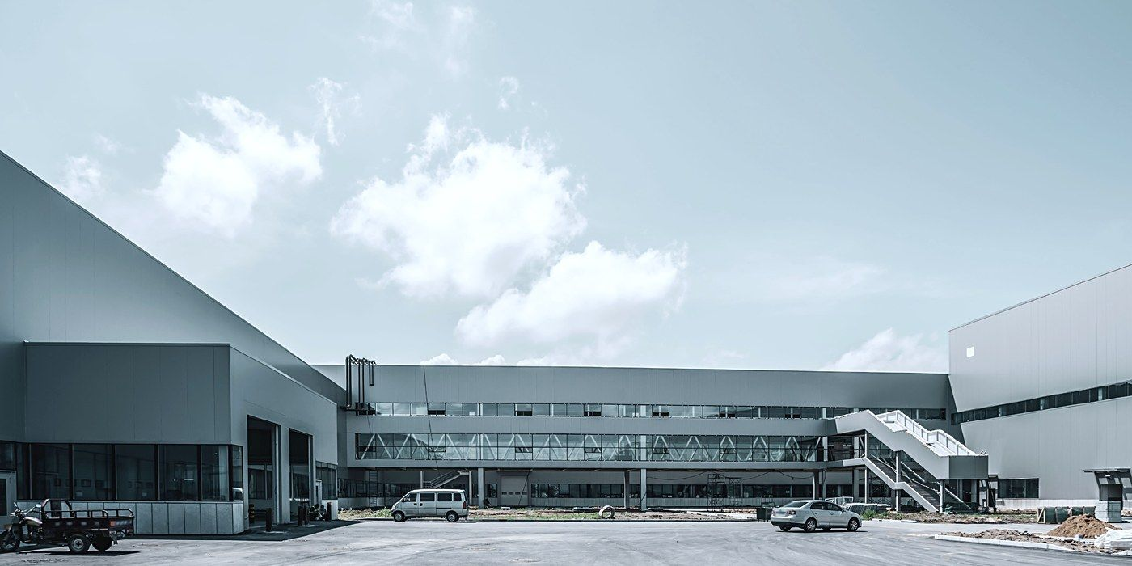


01.1
PART 01 · THE COMPANY
About IAQ
Who we are and what we build. The delivery models are in 01.7.
Established 1995.
A trailblazer in total facility solutions.
Engineering, procurement, construction and maintenance for the industries where contamination, uptime and safety decide the outcome, from semiconductor wafer fabs to gigafactories, data centres and pharmaceutical plants.
REGISTERED NAME
IAQ Technology International Sdn Bhd
REGISTRATION NO.
200001031412 (534019-T)
Vision
Mission
To be a regional facility solutions provider with engineering excellence that facilitates technological innovation and advancement in quality of life.
Providing innovative, sustainable facility and engineering solutions benefitting our clients and stakeholders, driven by our leadership, employees and partners globally.
04 / 67
THE COMPANY

Slide 5











01.2
PART 01 · THE COMPANY
IAQ at a Glance
The company in six numbers, the delivery cycle behind them, and the certifications that stand behind both.
31
530+
235+
1.5mil m²
7
20t / yr
YEARS EXPERIENCE
EMPLOYEES
PROJECTS COMPLETED
CLEANROOM BUILT-UP AREA
GLOBAL OFFICES
CARBON FOOTPRINT REDUCED
THE DELIVERY CYCLE
A proudly Malaysian company on three continents, delivering mission-critical cleanroom facilities where contamination control, precision and compliance are absolute.
01
02
03
04
05
Engineering
Procurement
Construction
Testing
Maintenance
Design & consultation
Sourcing & supply chain
Self-performed packages
Commissioning & handover
Operate, service, optimise
CERTIFICATION & RECOGNITION
INTERTEK ISO 9001:2015
INTERTEK ISO 14001:2015
INTERTEK ISO 45001:2018
CIDB GRADE G7
PKK GRADE G7
HIGHWIRE SAFETY GOLD AWARD
MCIEA 2024 BUILDER OF THE YEAR
05 / 67
THE COMPANY

Slide 6










01.3
PART 01 · THE COMPANY
Milestones
IAQ's own timeline, 1995 to 2026: the offices opened along the way, and the projects that marked each year.
OFFICES OPENED
Malaysia
Morocco
China
Poland
France
Sweden
Singapore
Germany
United States
India
1995
2000
2006
2007
2008
2020
2023
2025
2026
2026
EPCC PROJECTS
ENERGY PROJECTS
TOOL UTILITY PROJECTS
(PCC) MRT Project tunnel station M&E
(EPC) Infineon MKZ, Class 1K cleanroom
(PCC) Microsoft Data Center
(EPCC) SilTerra FAB
(GC / D&B) SilTerra expansion
(D&B) Tata Dholera DF1
(PCC) Rapid Project Siemens powerplant piping works
(EPCM / D&B) Soitec PR1A expansion
(EPCM / HU) Micron MSH
Established as a cleanroom specialist
(PCC) Western Digital PJ, Class 10 cleanroom
(BOT) Pagoh Edu Hub DCS
(GC) Ain Medicare
(GC / EPCM) Infineon IFKM3 expansion
(GC / D&B) Progressive Build P Project
(EPCC) GDC Putrajaya chiller upgrading
1995
2000
2008
2009
2013
2016
2017
2020
2021
2022
2024
2025
2026
(EPCC) ST Microelectronics, Class 10K cleanroom
(GC / D&B) MEMC Ipoh, Class 1 cleanroom
(GC) KLCC DCC Plant, largest DCC plant in Malaysia
(GC) Vital HC
(GC / D&B) XFAB 40K expansion
(GC / D&B) Hasegawa
(GC / PCC) Robert Bosch
(PCC) 160MW hyperscale data centre
(GC / PCC) P Project
(EPCC) ESCM Germany
(EPCC) KLCC DCS chiller upgrading
06 / 67
THE COMPANY

Slide 7

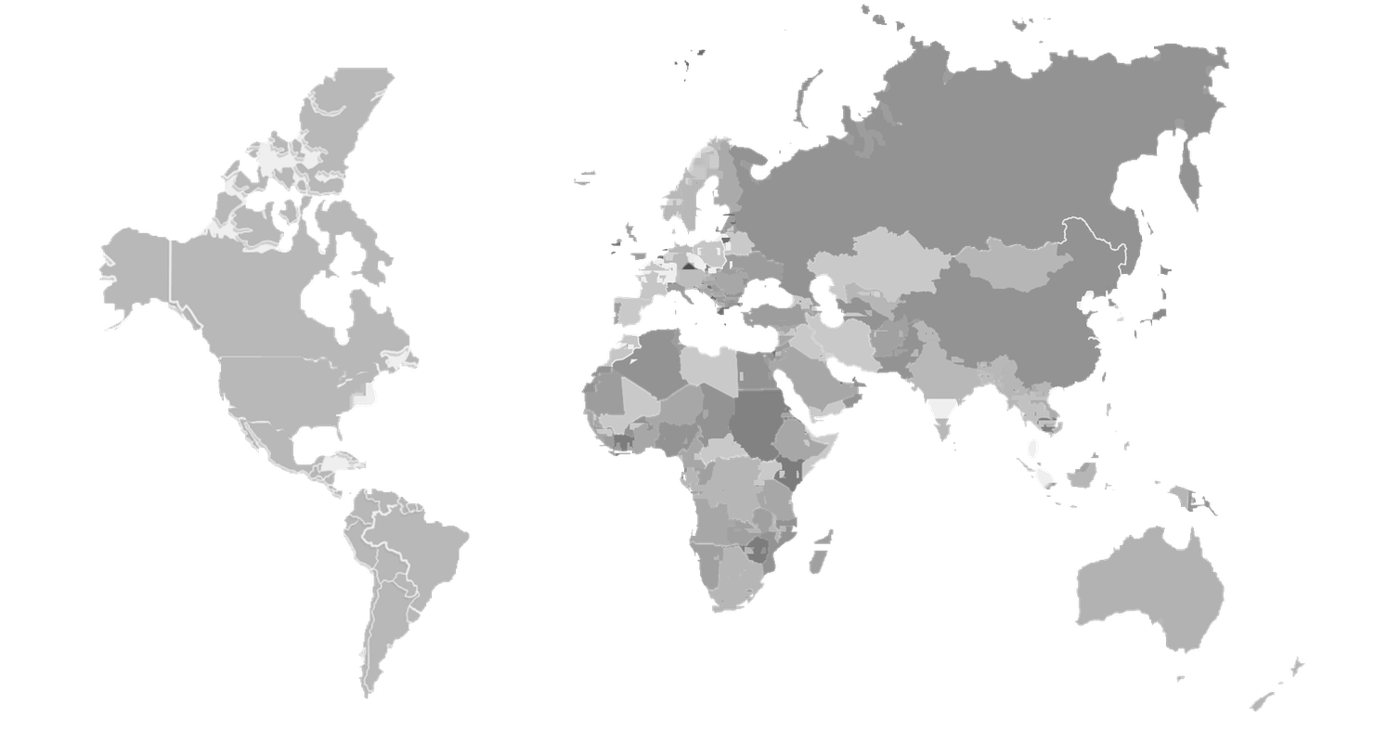






01.4
PART 01 · THE COMPANY
Global Footprint
Seven markets, from the Malaysian headquarters outward.
1995
Malaysia
Turnkey design, procurement, construction and commissioning for hi-tech clients. Selangor (HQ), Penang, Johor and Kuching.
2020
Sweden
SWEDEN
Gigafactory construction for EV battery manufacture, part of Europe’s clean and digital transition.
IRELAND
2023
Singapore
GERMANY
Design & build EPCM services to global clients in the semiconductor industry.
UNITED STATES
MALAYSIA
2025
Germany
INDIA
EPCC services following the semiconductor industry expansion in Europe.
SINGAPORE
2026
India
D&B turnkey delivery for India’s first wafer fab.
2026
United States
Entry to the US following the localisation of advanced technology facilities.
2026
Ireland
Incorporated to support a client’s wafer fabrication project.
07 / 67
THE COMPANY

Slide 8
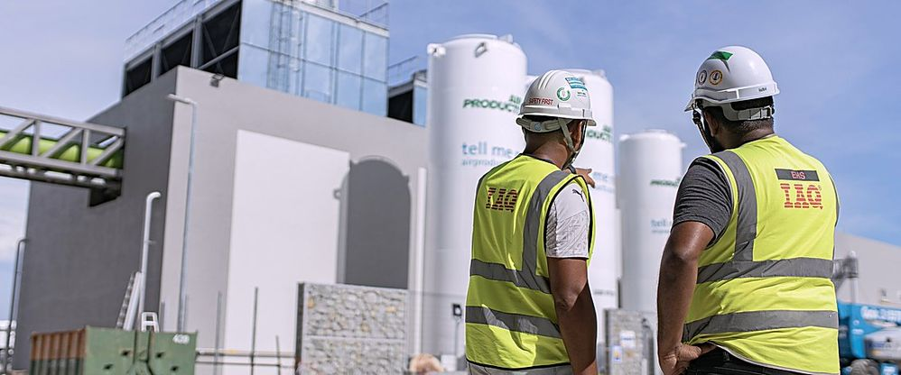
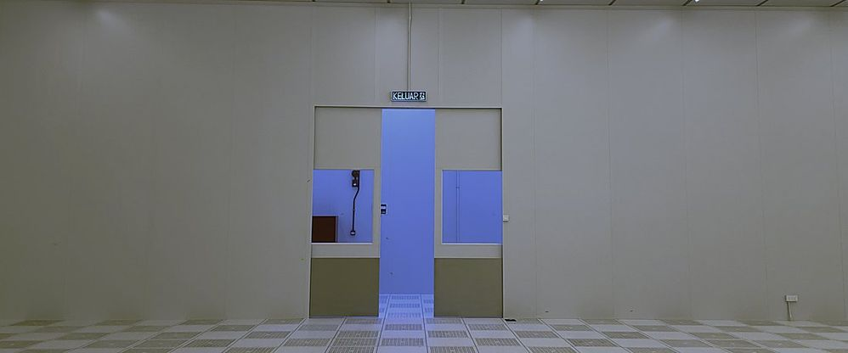




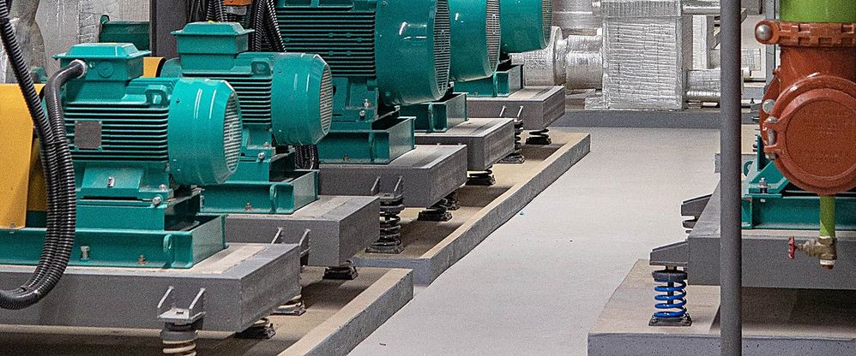





01.5
PART 01 · THE COMPANY
Core Values
Six commitments that govern how every project is run. Not words, but working rules.
01
02
03
Safety First
Quality Consistency
Honesty and Integrity
Our services and works are carried out to the highest standard of safety and ethics.
We take pride in the quality of solutions delivered, to achieve maximum client satisfaction.
Our core code of conduct, fostering trust, accountability, professionalism and ethical practice.
04
05
06
Efficiency & Proficiency
Engineering Capabilities
Pursuit of Excellence
Committed to maximising available resources to achieve the best result collectively.
Our way of working revolves around engineering principles, developing precise and sustainable solutions.
Devoted to excellence in all our works, providing sustainable solutions to complex challenges.
08 / 67
THE COMPANY

Slide 9
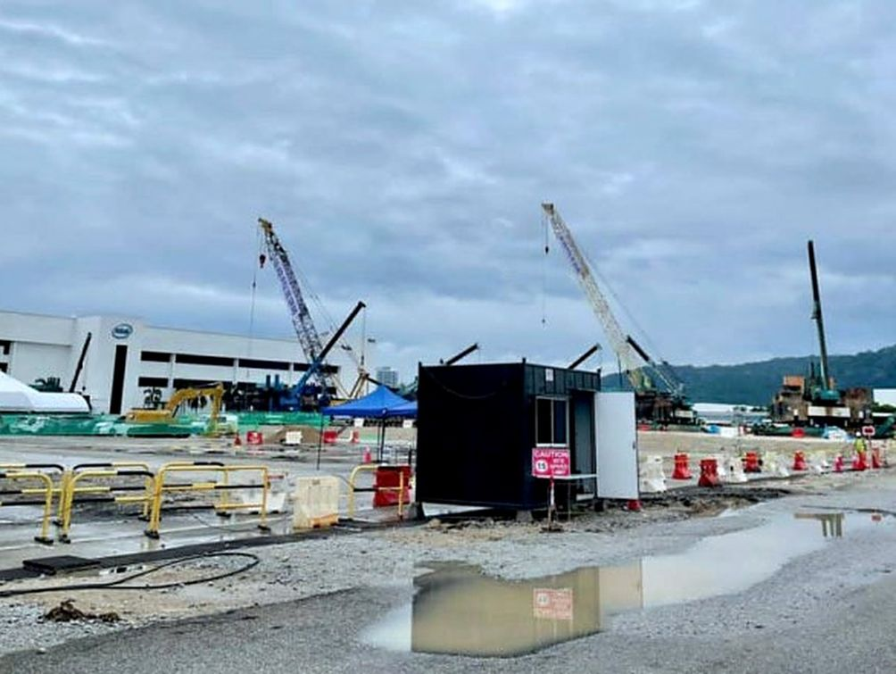
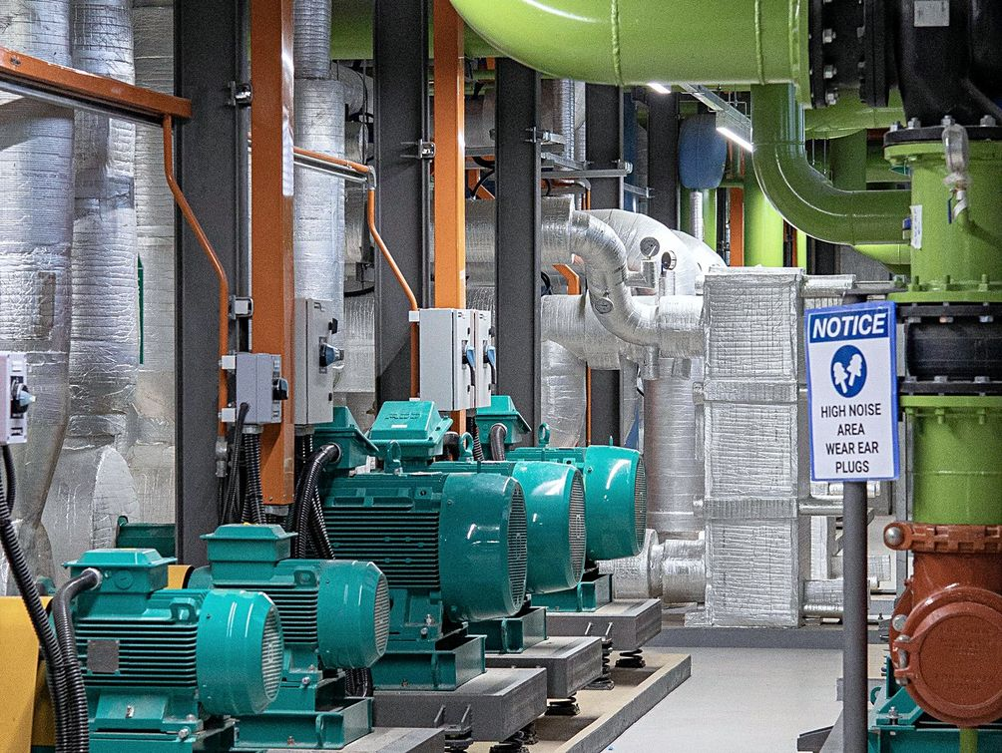
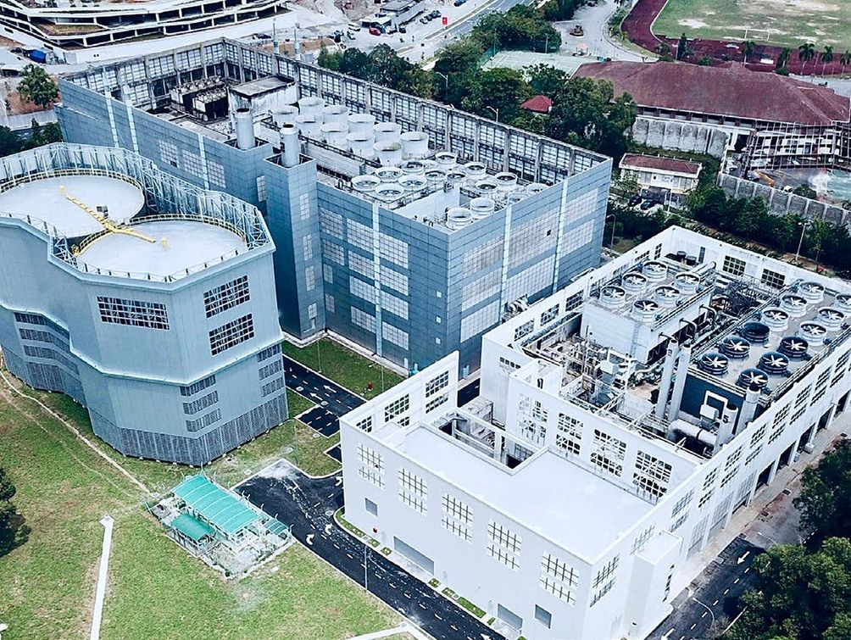
01.6
PART 01 · THE COMPANY
Business Units
Three delivery capabilities under one group, covering the full chain.
01
02
03
IAQ SOLUTIONS SDN BHD
IAQ UTILITY SOLUTIONS SDN BHD
IAQ ENERGY FACILITY MANAGEMENT SDN BHD
Engineering, Procurement and Construction (EPC)
Process Critical Utilities & Total Tool Installation Solutions
Energy Management
Energy management solutions that optimise operations and reduce carbon footprint, keeping facilities running at the highest levels of efficiency and sustainability.
EPCC from conception to operation, completion and maintenance. Every stage managed, from initial design through commissioning, so clients in hi-tech industries can bring their visions to life.
EPCM partner for semiconductor manufacturing: process-critical utility infrastructure and total tool installation, bridging facility readiness and manufacturing start-up to accelerate fab ramp-up.
09 / 67
THE COMPANY

Slide 10
01.7
PART 01 · THE COMPANY
Delivery Models
The three models IAQ contracts under, across the full life of a facility.
Engineering, Procurement & Construction Management
EPCM
Management of engineering, procurement and construction for semiconductor manufacturing, bridging facility readiness and manufacturing start-up to accelerate fab ramp-up.
ENGINEERING
PROCUREMENT
CONSTRUCTION
COMMISSIONING
OPERATION
SilTerra expansion · Soitec PR1A expansion · Infineon IFKM3 expansion · Micron MSH
Engineering, Procurement, Construction & Commissioning
EPCC
Full turnkey delivery from conception to operation, completion and maintenance, with every stage managed from initial design through commissioning.
ENGINEERING
PROCUREMENT
CONSTRUCTION
COMMISSIONING
OPERATION
ST Microelectronics · SilTerra FAB · ESCM Germany · KLCC DCS chiller upgrading
Energy Facility Management
EFM
Ongoing energy and facility management that optimises operations and reduces carbon footprint, keeping facilities at the highest levels of efficiency.
ENGINEERING
PROCUREMENT
CONSTRUCTION
COMMISSIONING
OPERATION
KLCC DCC Plant · GDC Putrajaya chiller upgrading · Pagoh Edu Hub DCS
10 / 67
THE COMPANY

Slide 11













01.8
PART 01 · THE COMPANY
Scope of Services
Eight packages self-performed under one contract, and the process utilities behind them.
01
02
03
04
Civil, Structural & Architectural
Air Conditioning System
HT & LV Electrical System
Fire Protection System
Greenfield and brownfield CSA
ACMV, make-up air, recirculation
Up to 33kV substations
Detection, suppression, compliance
05
06
07
08
Cleanroom System
Process Utilities
Facility Monitoring & Control
Tools Hookup
ISO 3 to ISO 8 · Class 1 to Class 100K
Water, chemical, gas and exhaust systems
FMCS, BMS, PA
Progressive tool install and hookup
PROCESS CRITICAL UTILITIES
Delivered by IAQ Utility Solutions as an EPCM package: the utility infrastructure a fab runs on, and the tool installations that bring it to production.
Water Solutions
Chemical & Slurry Solutions
Gas Solutions
Process Exhaust Solutions
Tool Installations
UPW plant & distribution
Bulk chemical
Bulk gas
General and acid
Progressive hook up
Process waste drains, WWT
Blending systems
Specialty gas & abatement
Caustic and solvent
Gas detection & monitoring
Reclaim and ZLD
Dispense systems
Bunker: NH₃, SiH₄, H₂
Calamity exhaust
Electrical power & controls
Chemical storage & dispensing
Liquid dispense system
11 / 67
THE COMPANY

Slide 12
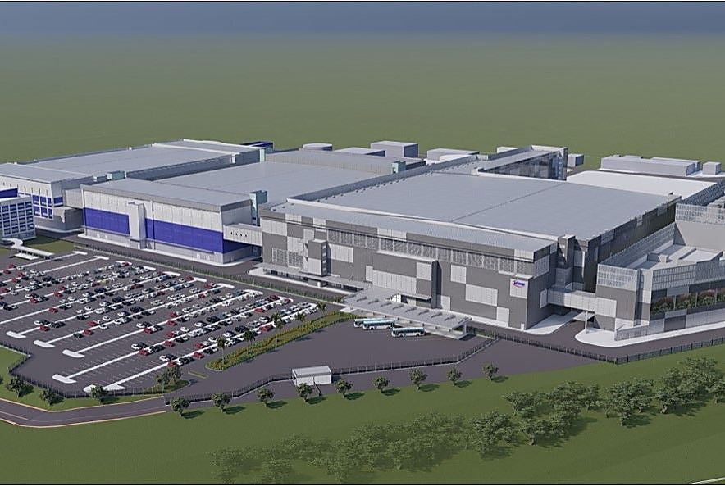
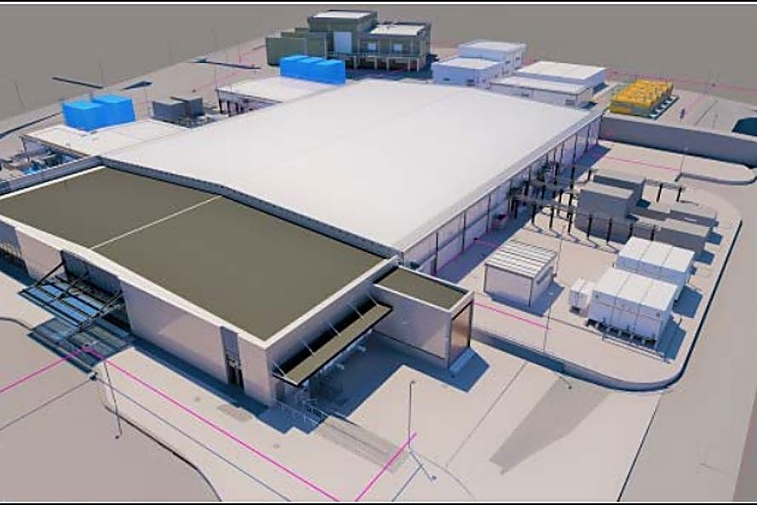
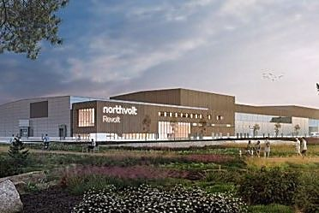
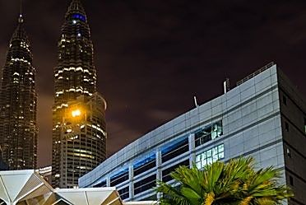




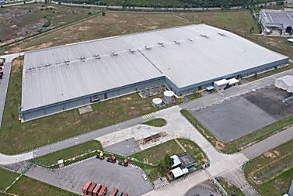
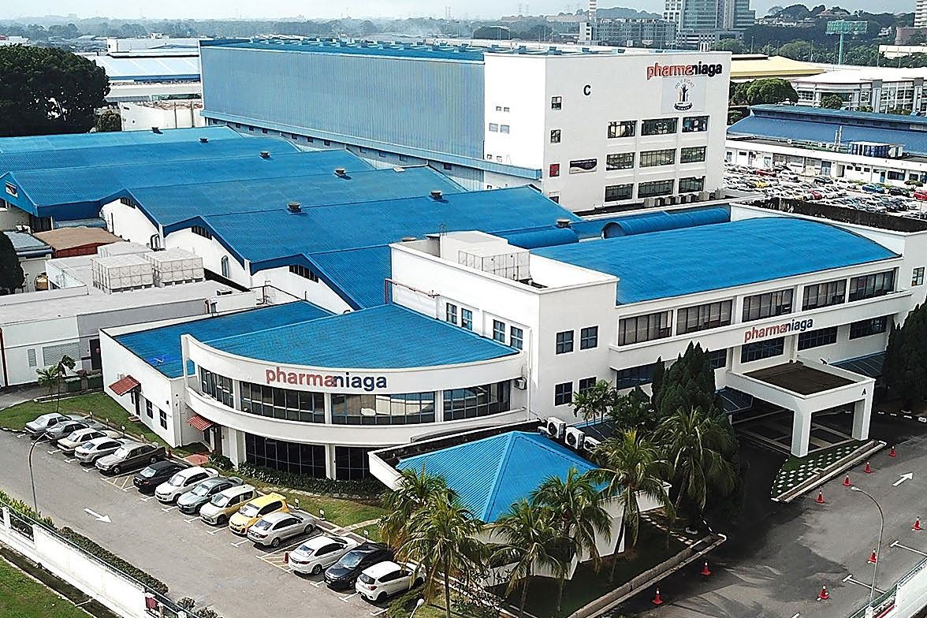
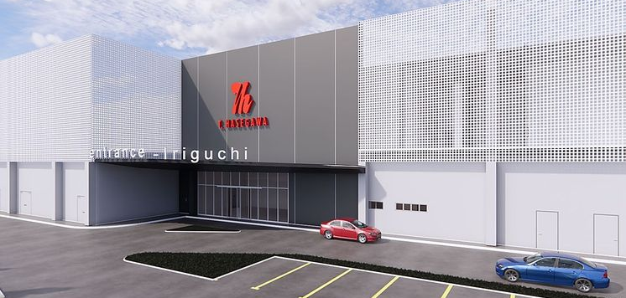




01.9
PART 01 · THE COMPANY
Industry Focus
Seven sectors, one discipline: contamination control under code and class.
Semiconductor
Data Centre
EV Battery
District Cooling & Heating
Wafer fab, advanced packaging, test & assembly
Hyperscale cooling, security, uptime
Dry rooms, moisture control, explosion proofing
Urban energy plant and distribution
Your facility next
Total facility solutions, end to end.
Photovoltaics
Pharmaceuticals & Hospitals
Food & Beverage
Cell and module lines, toxic material handling
GMP grades, regulated environments
Hygienic design, quality and safety standards
12 / 67
THE COMPANY

Slide 13
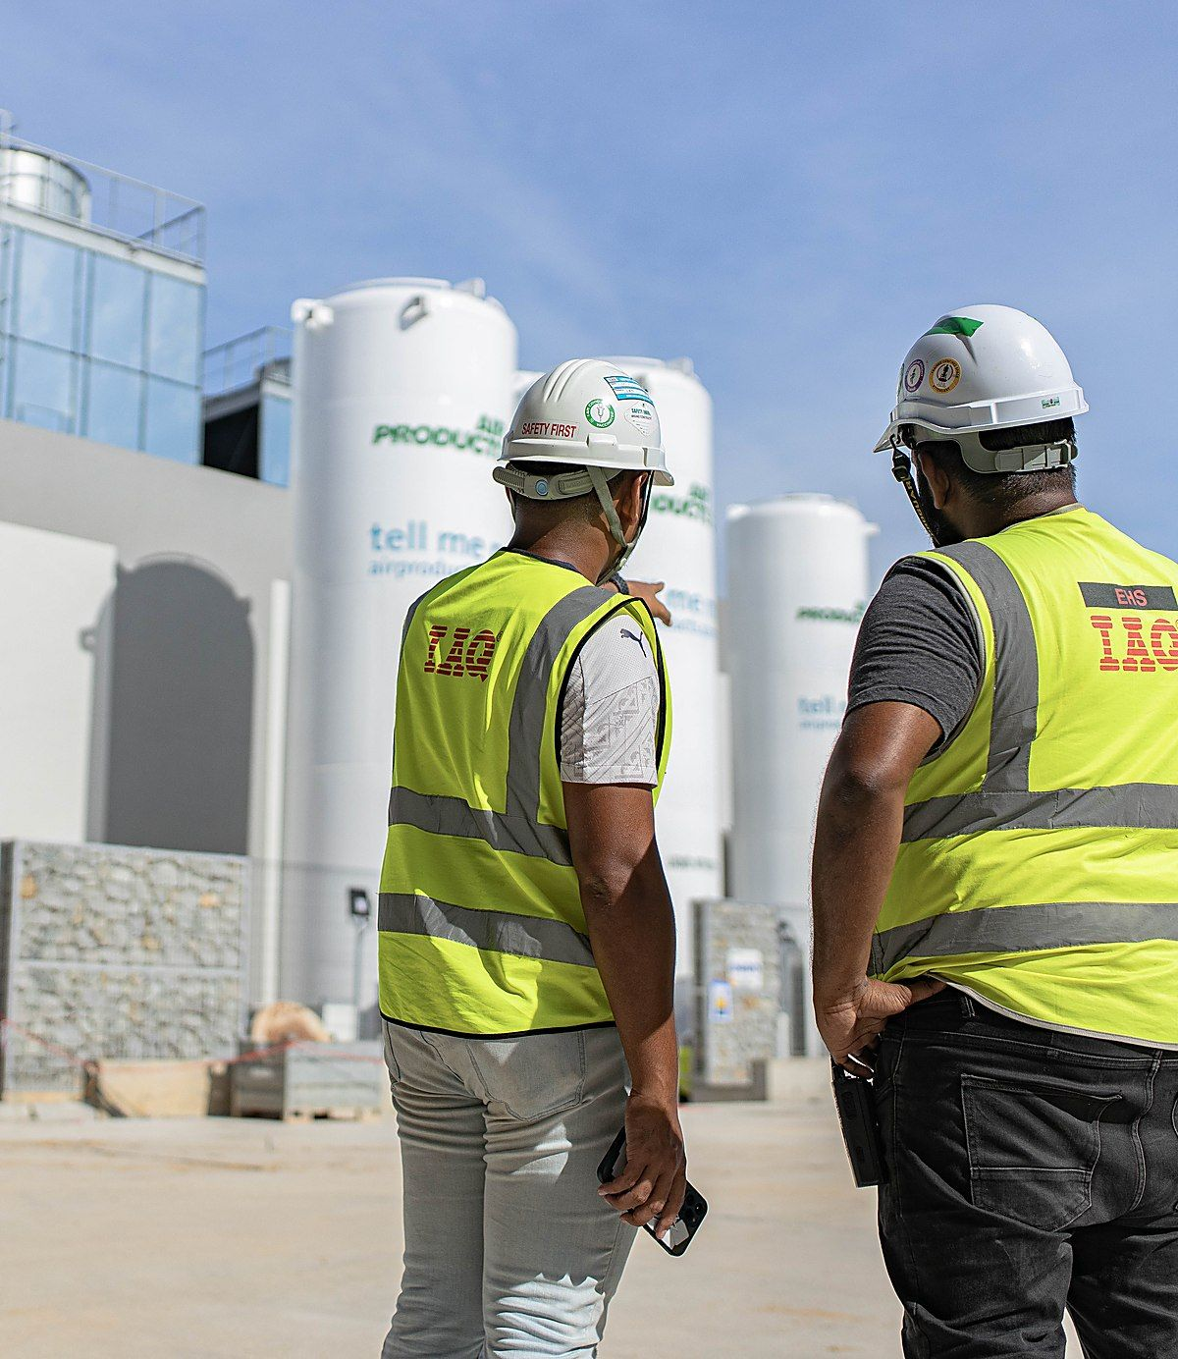
PART 02 · PROJECT REFERENCES
02
PART 02 OF 03
Project References
SECTIONS 02.1 TO 02.47
235+ projects completed across three regions
Over 1.5 million m² of cleanroom built
ISO 3 to ISO 8 · Class 1 to Class 100K
13 / 67

Slide 14
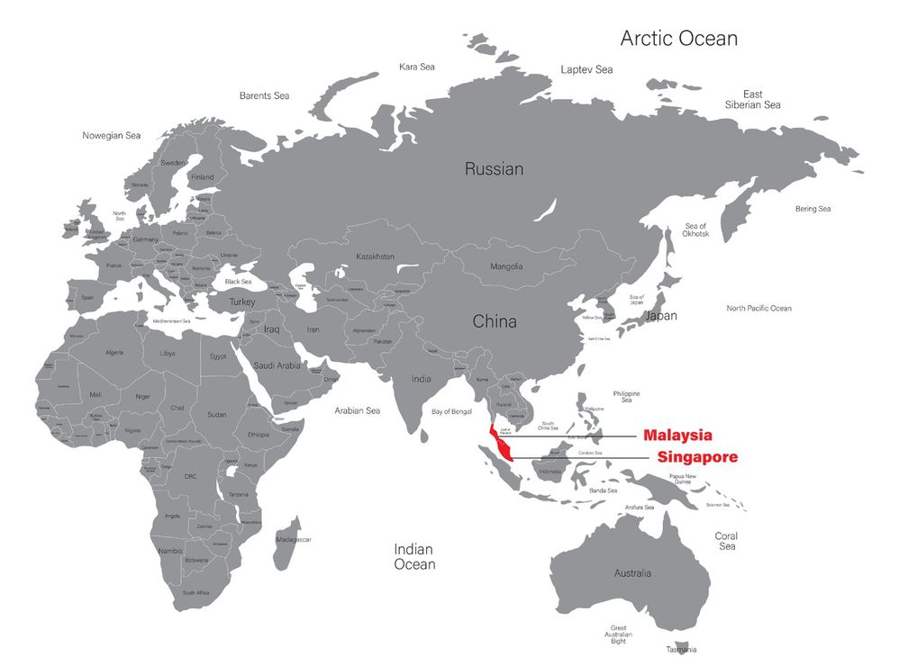
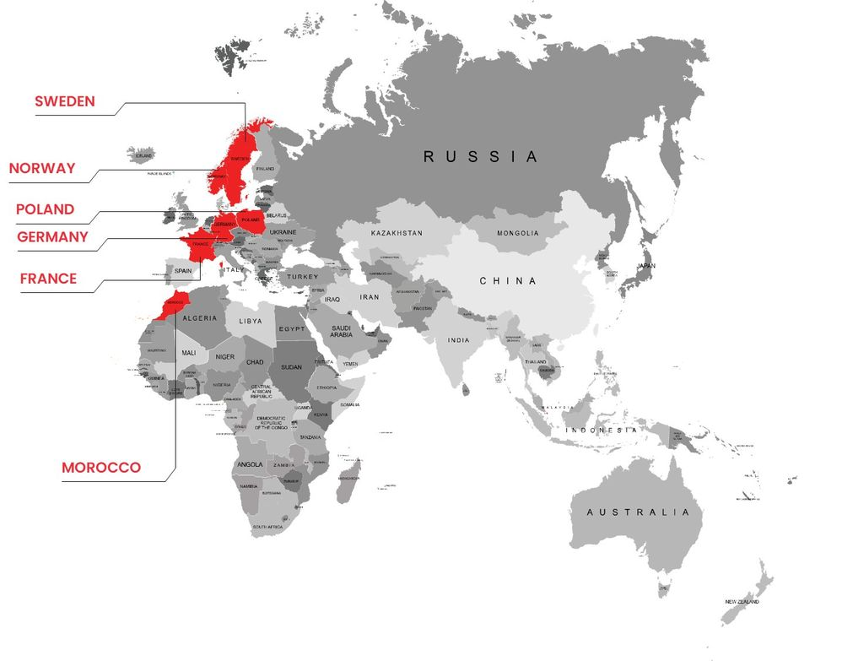
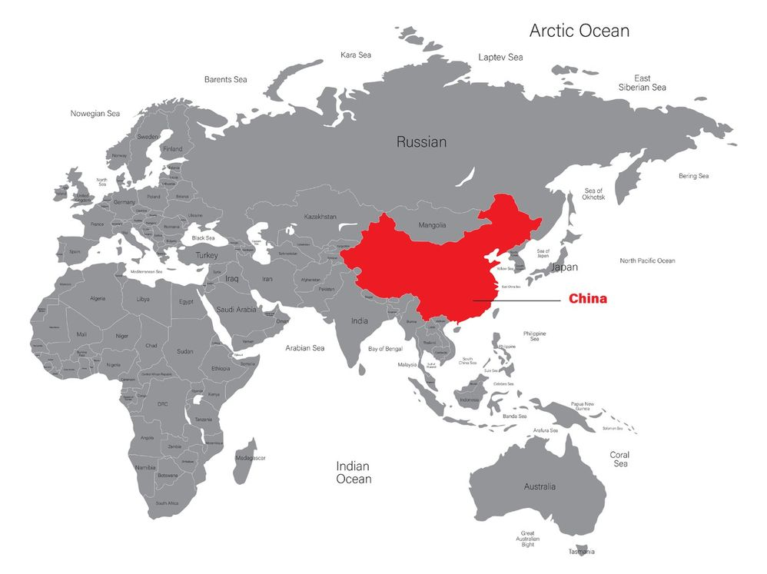
02.1
PART 02 · PROJECT REFERENCES
Portfolio Overview
How the reference book breaks down by region, and which sections cover what.
02.2 TO 02.4 · 02.8 TO 02.10
02.5 TO 02.6
02.7
Malaysia & Singapore
Europe & Morocco
China
Semiconductor, data centre, pharmaceutical, photovoltaics, district cooling and energy.
EV battery gigafactories, wafer fabs and advanced semiconductor in Sweden, Norway, France, Poland and Morocco.
Semiconductor, display, pharmaceutical, automotive and R&D facilities.
235+
1.5mil m²
5
PROJECTS COMPLETED
CLEANROOM BUILT
CONTRACT MODELS
GC · EPCC · EPCM · PCC · Tool Hookup
14 / 67
PROJECT REFERENCES

Slide 15
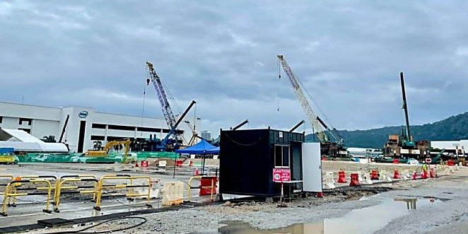
02.2
PART 02 · PROJECT REFERENCES
Semiconductor · Malaysia
Wafer fab, advanced packaging, test and assembly. The full reference list follows from 02.11.
KULIM, KEDAH · GREENFIELD WAFER FAB
ADVANCED PACKAGING · 75,000 M²
Infineon Kulim Wafer Fab 3
P Project
EPCC & DESIGN BUILD
CLEANROOM SYSTEMS
ACMV & MECHANICAL
CLEANROOM SYSTEMS
EPCC & DESIGN BUILD
PROCESS UTILITIES
DESCRIPTION
General contractor for WP06, KLM3 Expansion, 35,000 m² cleanroom area
DESCRIPTION
Progressive-built EPCM contract model for the client's advanced packaging facility
SCOPE
PCC for cleanroom and mechanical works
SCOPE
Design & build GC: CSA, MEP, process utilities, chemical & gases system, waste treatment
CLEANROOM
ISO 4 · 5 · 6 · 7 (CLASS 10 · 100 · 1K · 10K)
CLEANROOM
ISO 4 TO 7 (CLASS 10 TO 10K)
15 / 67
SEMICONDUCTOR · MALAYSIA

Slide 16
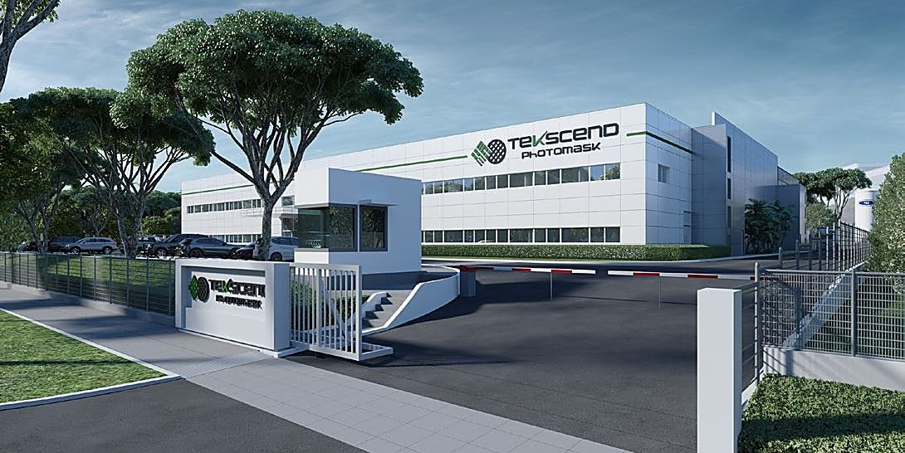
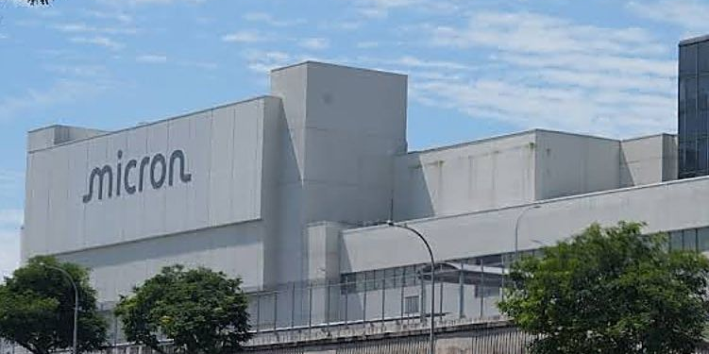
02.3
PART 02 · PROJECT REFERENCES
Semiconductor · Singapore
Design & build EPCM in Singapore since 2023.
PHOTOMASK FACILITY
PROGRESSIVE TOOL HOOKUP
Teksend Photomask
Micron MSH Tool HU
EPCC & DESIGN BUILD
CLEANROOM SYSTEMS
PROCESS UTILITIES
TOOL HOOK UP
DESCRIPTION
Addition and alteration to an existing two-storey building with cleanroom facilities and ancillary office
DESCRIPTION
2,000 progressive tool hookup services for MSH
SCOPE
Progressive tool hook up
SCOPE
EPCC for cleanroom, ACMV, electrical, process utility, BMS, PA, WWT, UPW, tool hookup
CLEANROOM
CLASS 1 TO CLASS 10K
16 / 67
SEMICONDUCTOR · SINGAPORE

Slide 17
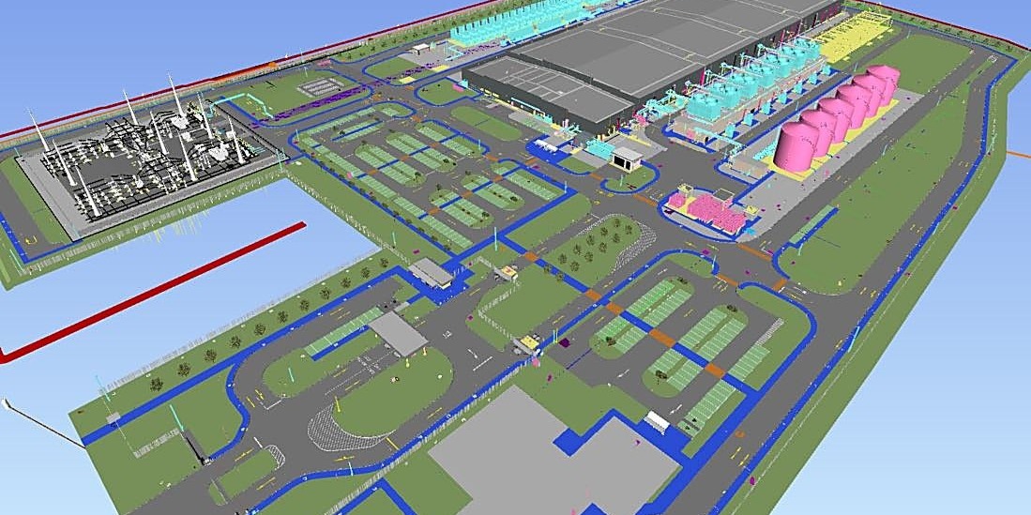
02.4
PART 02 · PROJECT REFERENCES
Data Centre
Hyperscale and colocation, 9.6 MW to 160 MW.
CLIENT CONFIDENTIAL · 160 MW
KUL03 PHASE 1 · 9.6 MW
Hyperscale Data Centre
Microsoft DTC-KUL 03
ACMV & MECHANICAL
EPCC & DESIGN BUILD
ACMV & MECHANICAL
DESCRIPTION
Office, data halls and mechanical utility building
DESCRIPTION
9.6 MW data centre
SCOPE
Construction, completion, testing & commissioning for mechanical packages 1 & 2
SCOPE
PCC for CHW and CW piping works
17 / 67
DATA CENTRE

Slide 18
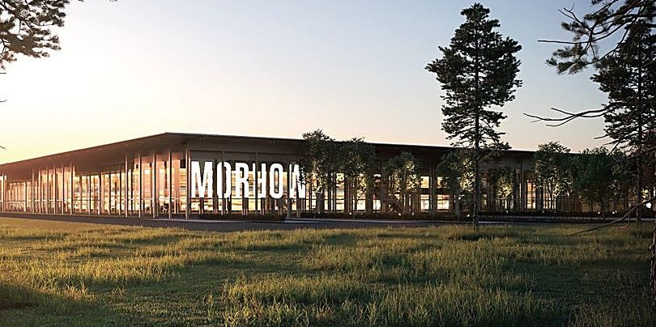
02.5
PART 02 · PROJECT REFERENCES
EV Battery · Europe
Dry rooms for the gigafactories: moisture control and contamination control at scale.
SKELLEFTEÅ, SWEDEN · 62,000 M²
NORWAY · BATTERY COAST · 8,600 M²
Northvolt AB Gigafactory
Morrow Batteries
CLEANROOM SYSTEMS
ARCHITECTURE & FIT OUT
CLEANROOM SYSTEMS
ACMV & MECHANICAL
ARCHITECTURE & FIT OUT
DESCRIPTION
Europe gigafactory for lithium-ion battery manufacture
DESCRIPTION
Norway's Battery Coast project
SCOPE
Cleanroom and dry room architecture works
SCOPE
Cleanroom and dry room architectural system, ACMV
ENVIRONMENT
DRY ROOM
ENVIRONMENT
DRY ROOM
18 / 67
EV BATTERY · EUROPE

Slide 19
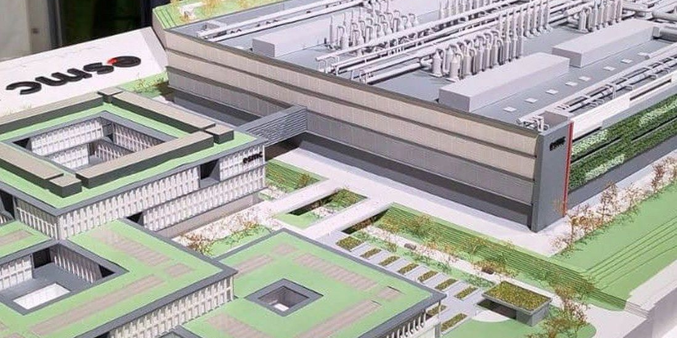
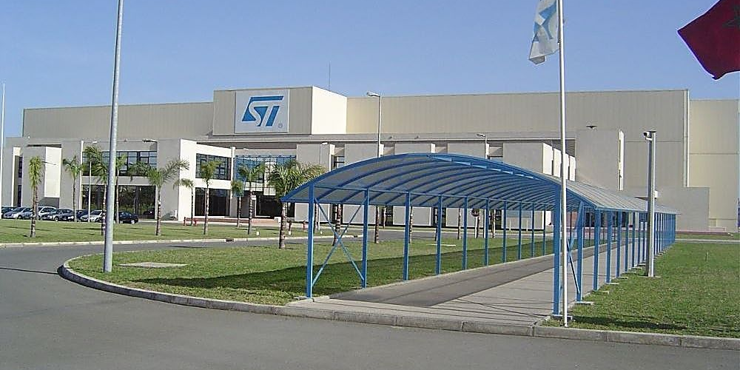
02.6
PART 02 · PROJECT REFERENCES
Semiconductor · Europe & Morocco
Following the fabs into Europe: advanced-node cleanrooms and progressive hookup.
CLIENT CONFIDENTIAL · WAFER FAB
CASABLANCA, MOROCCO · 60,000 M²
28/22nm CMOS · 16/12nm FinFET Plant
STMicroelectronics
EPCC & DESIGN BUILD
CLEANROOM SYSTEMS
ACMV & MECHANICAL
CLEANROOM SYSTEMS
PROCESS UTILITIES
TOOL HOOK UP
DESCRIPTION
Design, supply, installation & commissioning of cleanroom facilities
DESCRIPTION
Built-up area up to 60,000 m²
SCOPE
Cleanroom & mechanical general contractor
SCOPE
Cleanroom, mechanical, electrical, process utilities and hookup works
CLEANROOM
CLASS 1 TO CLASS 10K
CLEANROOM
ISO 5 (CLASS 100)
19 / 67
SEMICONDUCTOR · EUROPE

Slide 20
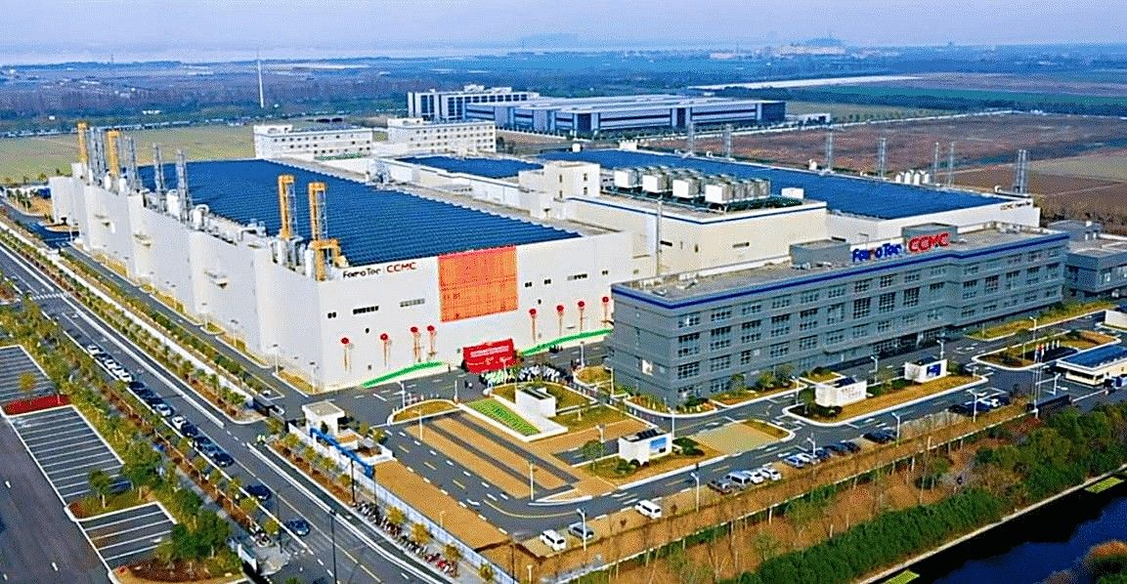
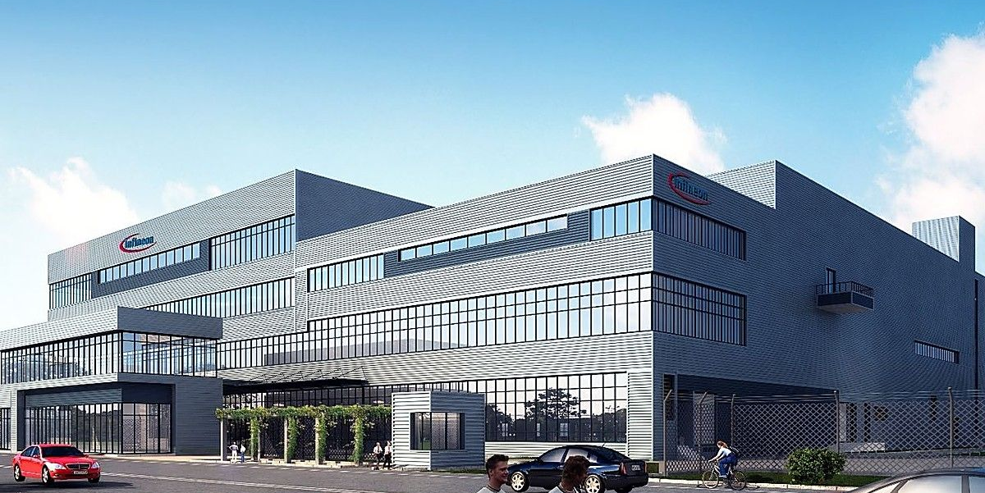
02.7
PART 02 · PROJECT REFERENCES
Semiconductor & Display · China
EPCC across semiconductor, display and precision manufacturing.
HANGZHOU · 23,400 M²
WUXI · 8,000 M²
Ferrotec Semiconductor
Infineon Technologies
EPCC & DESIGN BUILD
CLEANROOM SYSTEMS
TOOL HOOK UP
EPCC & DESIGN BUILD
CLEANROOM SYSTEMS
TOOL HOOK UP
DESCRIPTION
Built-up area up to 23,400 m²
DESCRIPTION
Built-up area up to 8,000 m²
SCOPE
EPCC for cleanroom, mechanical, electrical and plumbing works and hookup
SCOPE
EPCC for cleanroom, mechanical, electrical and plumbing works and hookup
CLEANROOM
ISO 4 · 5 (CLASS 10 & 100)
CLEANROOM
ISO 5 (CLASS 100)
20 / 67
CHINA

Slide 21
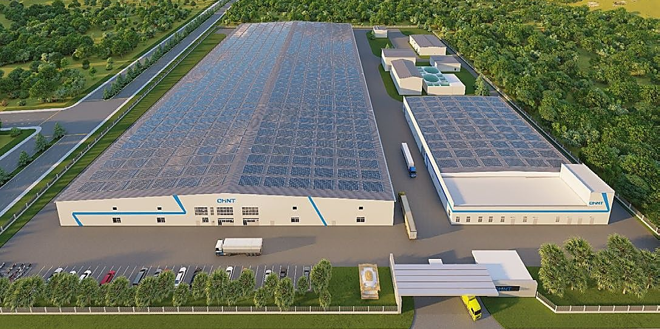
02.8
PART 02 · PROJECT REFERENCES
Photovoltaics
Solar cell and module manufacturing, including toxic material and waste handling.
KULIM, MALAYSIA
CHINA · 57,000 M²
First Solar Malaysia
Chint Solar Technology
EPCC & DESIGN BUILD
ACMV & MECHANICAL
ELECTRICAL & INSTRUMENTATION
CLEANROOM SYSTEMS
PROCESS UTILITIES
TOOL HOOK UP
DESCRIPTION
First Solar KMW building in Kulim
DESCRIPTION
Built-up area up to 57,000 m²
SCOPE
PCC for mechanical & electrical, KMW building; CSA and M&E for forming gas plant; M&E for SCO1
SCOPE
Cleanroom system, ACMV, process utilities and tools hookup
CLEANROOM
ISO 8 (CLASS 100K)
21 / 67
PHOTOVOLTAICS

Slide 22
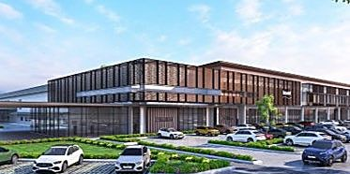
02.9
PART 02 · PROJECT REFERENCES
Pharmaceutical & Medical
GMP grades and regulated environments, from parenteral facilities to medical device plants.
GREENFIELD · MEDICAL DEVICE
PUCHONG, SELANGOR
Insulet
Pharmaniaga
EPCC & DESIGN BUILD
CLEANROOM SYSTEMS
ACMV & MECHANICAL
CLEANROOM SYSTEMS
ACMV & MECHANICAL
DESCRIPTION
Electronic medical device manufacturing plant, greenfield project
DESCRIPTION
Small volume parenteral facility
SCOPE
Design and build mechanical, cleanroom & electrical package
SCOPE
Cleanroom system, air conditioning and mechanical ventilation
CLEANROOM
ISO 8 (CLASS 100K)
CLEANROOM
ISO 5 · 7 · 8 (CLASS 100 · 10K · 100K)
22 / 67
PHARMACEUTICAL & MEDICAL

Slide 23
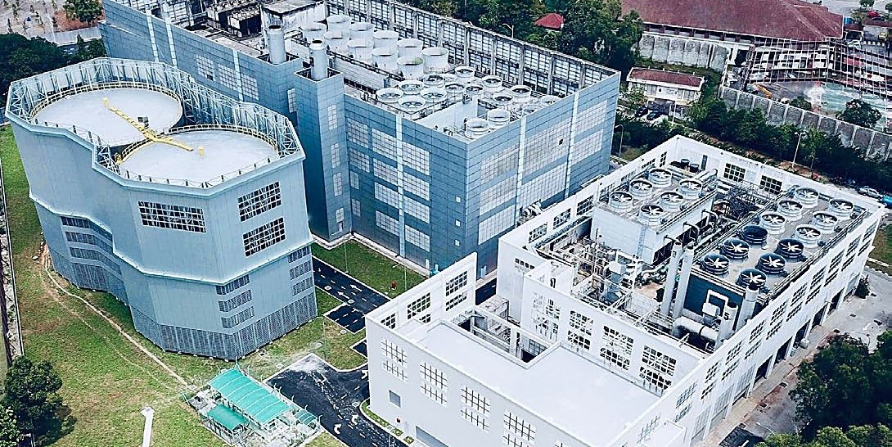
02.10
PART 02 · PROJECT REFERENCES
District Cooling & Energy
Plant, chillers and co-generation for urban and industrial energy.
GAS DISTRICT COOLING (M) SDN BHD
PICC PLANT, PUTRAJAYA
KLCC District Cooling Plant
GDC Putrajaya
PROCESS UTILITIES
ACMV & MECHANICAL
ELECTRICAL & INSTRUMENTATION
EPCC & DESIGN BUILD
ACMV & MECHANICAL
ELECTRICAL & INSTRUMENTATION
DESCRIPTION
LARGEST DISTRICT COOLING CENTRE IN MALAYSIA
DESCRIPTION
For the Putrajaya International Convention Centre (PICC) plant
SCOPE
ACMV, electrical & instrumentation, fire protection, process utility, plumbing & sanitary, water treatment, CSA
SCOPE
EPCC of plant electrification, chiller replacement and associated works at Gas District Cooling Putrajaya
23 / 67
DISTRICT COOLING & ENERGY

Slide 24
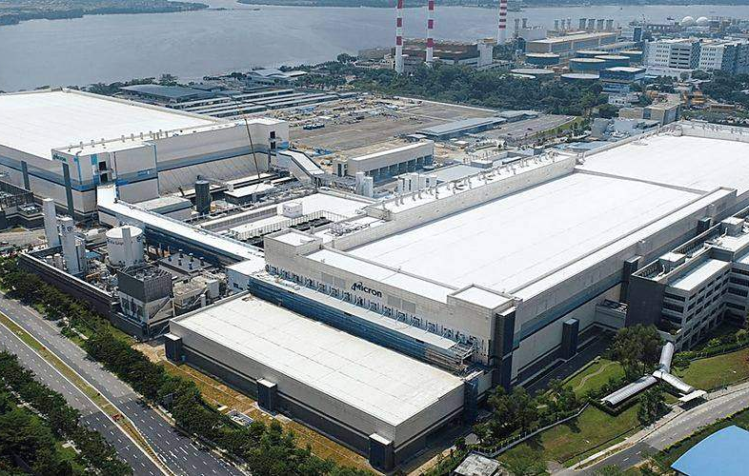
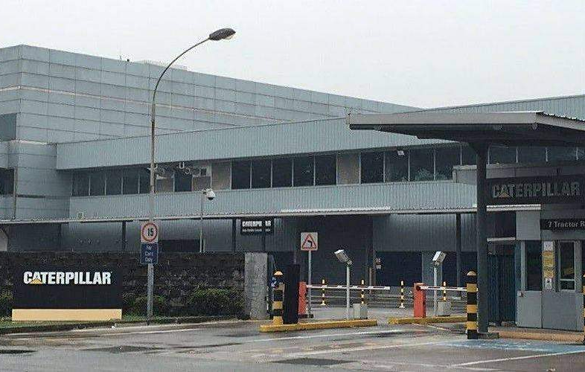
02.11
PART 02 · PROJECT REFERENCES
Malaysia & Singapore
Projects 1–2 of 73 from IAQ’s own reference list.
SINGAPORE
MALAYSIA
Micron F10A & F10NX
Caterpillar Asia
ACMV & MECHANICAL
ARCHITECTURE & FIT OUT
ARCHITECTURE & FIT OUT
SCOPE
Interior design & mechanical fit out, F10NX office optimisation
SCOPE
Three storey office renovation, 7T office
24 / 67
PROJECT REFERENCES

Slide 25
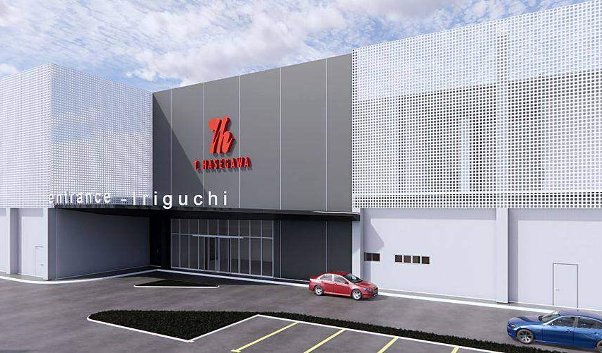
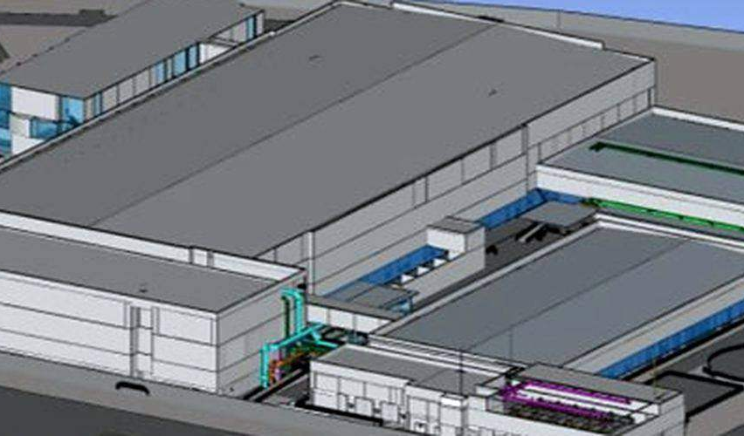
02.12
PART 02 · PROJECT REFERENCES
Malaysia & Singapore
Projects 3–4 of 73 from IAQ’s own reference list.
MALAYSIA
MALAYSIA
M Project
XFAB Kuching 40K Expansion
EPCC & DESIGN BUILD
CLEANROOM SYSTEMS
EPCC & DESIGN BUILD
ARCHITECTURE & FIT OUT
SCOPE
Design & build GC, greenfield food flavouring plant, 40,000 m²
SCOPE
Design and build, wafer fab extension, 30K to 40K capacity, 40,000 m²
CLEANROOM
ISO 5, 6 & 7
25 / 67
PROJECT REFERENCES

Slide 26
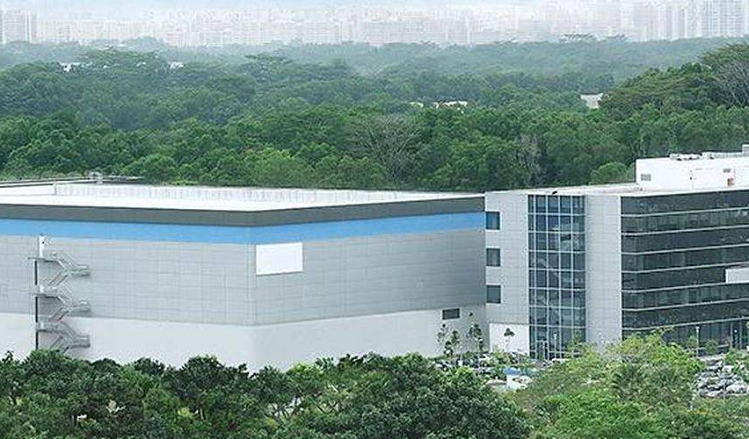
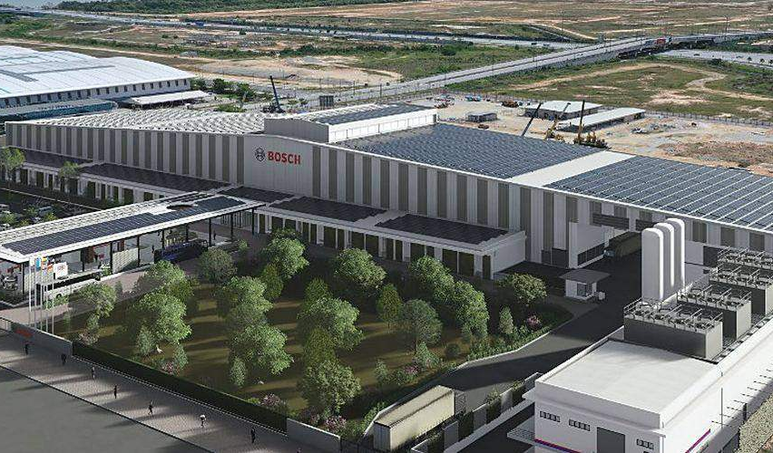
02.13
PART 02 · PROJECT REFERENCES
Malaysia & Singapore
Projects 5–6 of 73 from IAQ’s own reference list.
MALAYSIA
MALAYSIA
SOITEC PR1A Expansion
Robert Bosch Testing Manufacturing Plant
CLEANROOM SYSTEMS
EPCC & DESIGN BUILD
CLEANROOM SYSTEMS
EPCC & DESIGN BUILD
SCOPE
EPCM consultant, new greenfield plant, 45,000 m²
SCOPE
GC, greenfield testing and manufacturing plant, 25,000 m²
CLEANROOM
ISO 4, 5, 6 & 7
CLEANROOM
ISO 6, 7
26 / 67
PROJECT REFERENCES

Slide 27
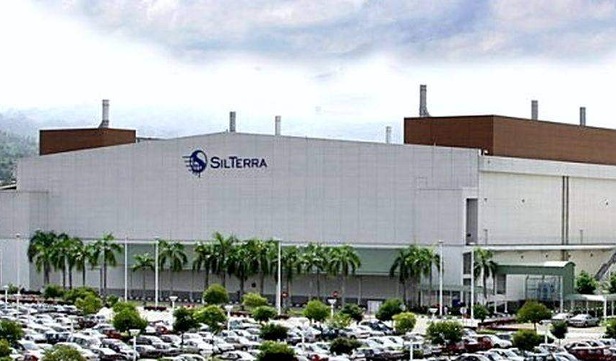
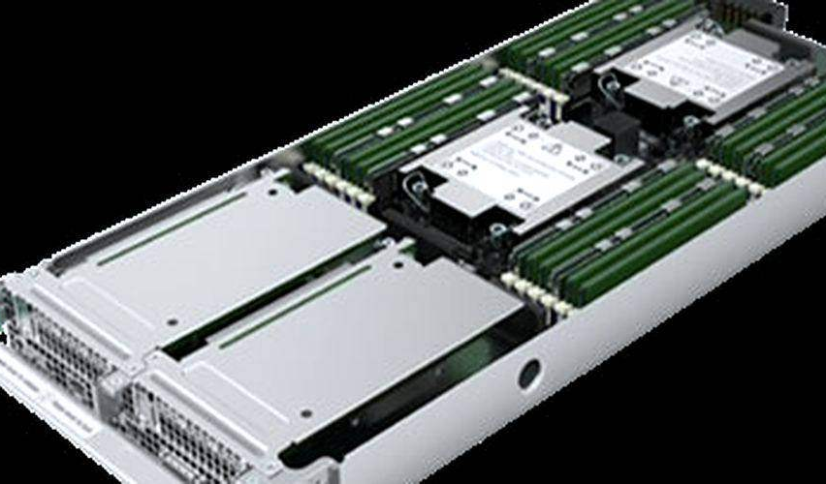
02.14
PART 02 · PROJECT REFERENCES
Malaysia & Singapore
Projects 7–8 of 73 from IAQ’s own reference list.
MALAYSIA
MALAYSIA
Wafer Fab Facility & Expansion
P Project – MEP Works
CLEANROOM SYSTEMS
EPCC & DESIGN BUILD
SPECIALIST CONTRACTING
SCOPE
EPCC and design & build, FAB1E A/B expansion, new CUB 5,000 m²
SCOPE
Retrofit existing office into mega lab, 7,000 m²
CLEANROOM
ISO 5 (CLASS 100)
27 / 67
PROJECT REFERENCES

Slide 28
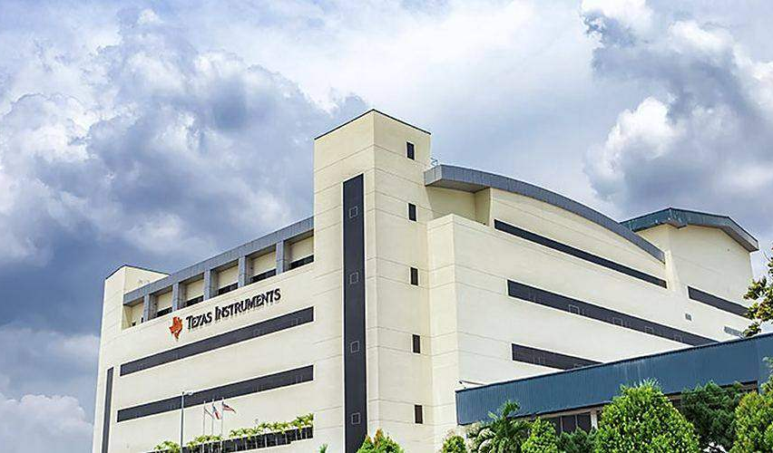
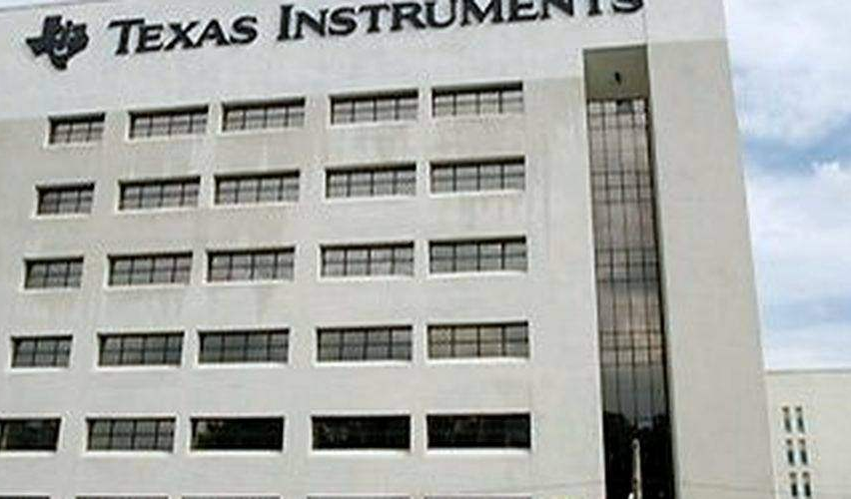
02.15
PART 02 · PROJECT REFERENCES
Malaysia & Singapore
Projects 9–10 of 73 from IAQ’s own reference list.
MALAYSIA
KUALA LUMPUR
Texas Instrument, Melaka
Texas Instrument (M) Sdn Bhd
CLEANROOM SYSTEMS
CLEANROOM SYSTEMS
SCOPE
Facilitation works for residual management, 32,000 m²
SCOPE
DLP cleanroom project
CLEANROOM
ISO 5, 6, 7
CLEANROOM
ISO 5, 6, 7
28 / 67
PROJECT REFERENCES

Slide 29
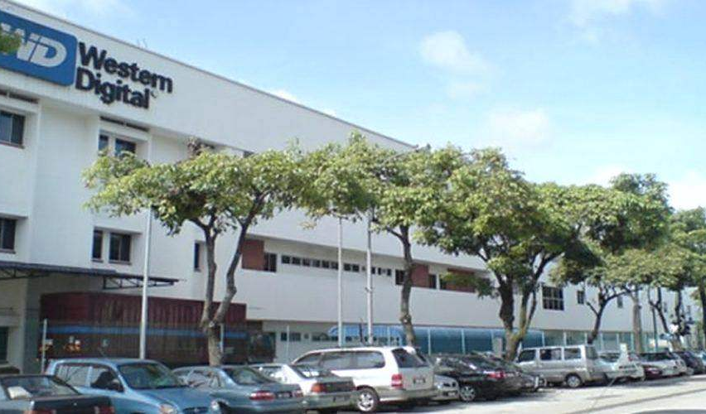
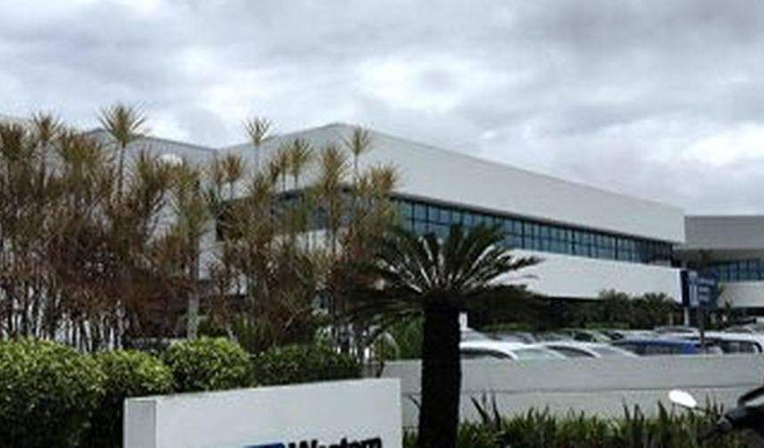
02.16
PART 02 · PROJECT REFERENCES
Malaysia & Singapore
Projects 11–12 of 73 from IAQ’s own reference list.
PETALING JAYA
PENANG
Western Digital (M) Sdn Bhd
WD Media (M) Sdn Bhd
CLEANROOM SYSTEMS
ACMV & MECHANICAL
ELECTRICAL & INSTRUMENTATION
EPCC & DESIGN BUILD
CLEANROOM SYSTEMS
TOOL HOOK UP
SCOPE
Phase 2 and 3 renovation, mechanical, electrical and cleanroom
SCOPE
PCC, MA 28 & MA 29, cleanroom, HVAC, FMCS, hookup
CLEANROOM
ISO 6 (CLASS 1K)
29 / 67
PROJECT REFERENCES

Slide 30
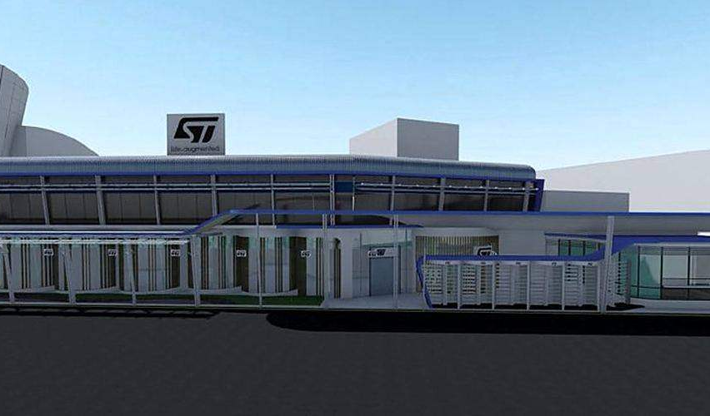
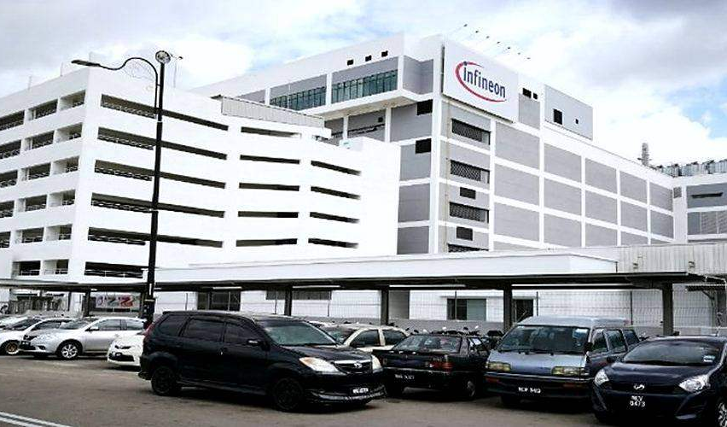
02.17
PART 02 · PROJECT REFERENCES
Malaysia & Singapore
Projects 13–14 of 73 from IAQ’s own reference list.
JOHOR
MELAKA
STMicroelectronics Sdn Bhd
Infineon Technologies (M) Sdn Bhd
CLEANROOM SYSTEMS
ACMV & MECHANICAL
CLEANROOM SYSTEMS
EPCC & DESIGN BUILD
SCOPE
3 storey production factory, cleanroom and ACMV
SCOPE
EPCM-GMP, Block 8 testing, probe & assembly, 43,000 m²
CLEANROOM
ISO 7 (CLASS 10K)
CLEANROOM
ISO 6, 7
30 / 67
PROJECT REFERENCES

Slide 31
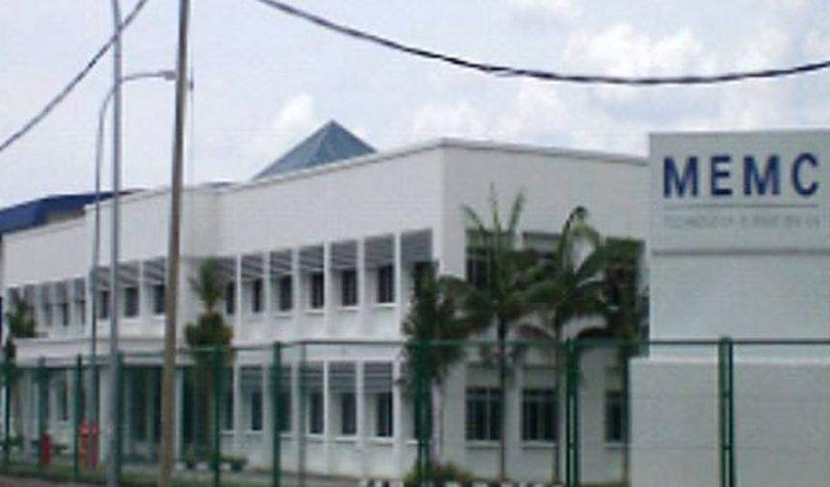
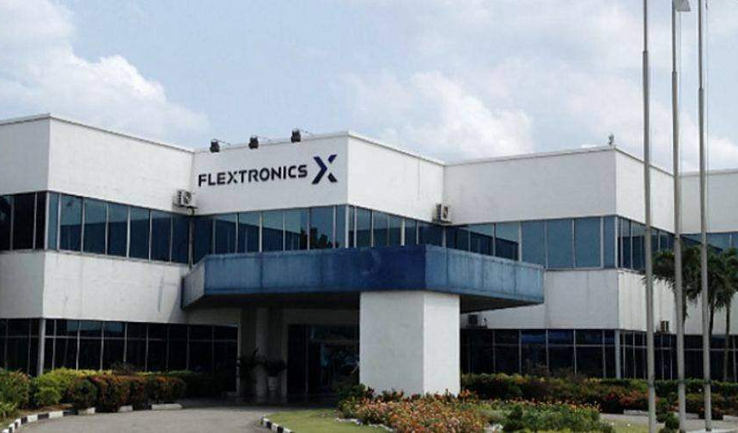
02.18
PART 02 · PROJECT REFERENCES
Malaysia & Singapore
Projects 15–16 of 73 from IAQ’s own reference list.
MALAYSIA
MALAYSIA
MEMC Ipoh Sdn Bhd
Flextronic Shah Alam Sdn Bhd
CLEANROOM SYSTEMS
TOOL HOOK UP
ARCHITECTURE & FIT OUT
EPCC & DESIGN BUILD
CLEANROOM SYSTEMS
ACMV & MECHANICAL
SCOPE
Greenfield project, MEP, cleanroom, FMCS, CSA and tools hookup
SCOPE
PCC, 33kV substation, mechanical, cleanroom, civil and structural
CLEANROOM
ISO 3 TO 7 (CLASS 1–10K)
CLEANROOM
ISO 7 (CLASS 10K)
31 / 67
PROJECT REFERENCES

Slide 32


02.19
PART 02 · PROJECT REFERENCES
Malaysia & Singapore
Projects 17–18 of 73 from IAQ’s own reference list.
MALAYSIA
MALAYSIA
AUO Sunpower Melaka
Vital Healthcare Sdn Bhd
ACMV & MECHANICAL
ELECTRICAL & INSTRUMENTATION
ARCHITECTURE & FIT OUT
CLEANROOM SYSTEMS
EPCC & DESIGN BUILD
SCOPE
Fab 3A solar cell manufacturing, CSA, utilities, HVAC, electrical
SCOPE
GC, medical device plant, 33kV substation, MEP
CLEANROOM
ISO 8 (CLASS 100K)
32 / 67
PROJECT REFERENCES

Slide 33


02.20
PART 02 · PROJECT REFERENCES
Malaysia & Singapore
Projects 19–20 of 73 from IAQ’s own reference list.
MALAYSIA
MALAYSIA
Ain Medicare Sdn Bhd
Elegant Aura (M) Sdn Bhd
EPCC & DESIGN BUILD
CLEANROOM SYSTEMS
ARCHITECTURE & FIT OUT
EPCC & DESIGN BUILD
CLEANROOM SYSTEMS
ACMV & MECHANICAL
SCOPE
EPCC, CSA, cleanroom and M&E, pharmaceutical building
SCOPE
PCC for HVAC and cleanroom system
CLEANROOM
ISO 8 (CLASS 100K)
CLEANROOM
GMP GRADE D
33 / 67
PROJECT REFERENCES

Slide 34


02.21
PART 02 · PROJECT REFERENCES
Malaysia & Singapore
Projects 21–22 of 73 from IAQ’s own reference list.
SINGAPORE
MALAYSIA
National University of Singapore
Matrix (M) Sdn Bhd
CLEANROOM SYSTEMS
EPCC & DESIGN BUILD
PROCESS UTILITIES
ACMV & MECHANICAL
SCOPE
M&E and cleanroom, tissue culture laboratory
SCOPE
PCC, CSA, HVAC, electrical, fire protection and process utilities
CLEANROOM
ISO 6 & 7
34 / 67
PROJECT REFERENCES

Slide 35


02.22
PART 02 · PROJECT REFERENCES
Malaysia & Singapore
Projects 23–24 of 73 from IAQ’s own reference list.
MALAYSIA
MALAYSIA
T Hasegawa
KLCC KGP KL
ACMV & MECHANICAL
ARCHITECTURE & FIT OUT
EPCC & DESIGN BUILD
ACMV & MECHANICAL
ELECTRICAL & INSTRUMENTATION
SCOPE
Spray dryer & microwave tunnel renovation, MDR mechanical, ACMV
SCOPE
EPCC of two electrical centrifugal chillers, KLCC district cooling
35 / 67
PROJECT REFERENCES

Slide 36


02.23
PART 02 · PROJECT REFERENCES
Malaysia & Singapore
Projects 25–26 of 73 from IAQ’s own reference list.
MALAYSIA
MALAYSIA
Rapid MCD Chemical Plant
Pagoh Education Hub
ACMV & MECHANICAL
EPCC & DESIGN BUILD
SCOPE
Field erection of mechanical piping system
SCOPE
EPCC, operation and maintenance of DCS
36 / 67
PROJECT REFERENCES

Slide 37


02.24
PART 02 · PROJECT REFERENCES
Malaysia & Singapore
Projects 27–28 of 73 from IAQ’s own reference list.
MALAYSIA
FRANCE
Rapid Petronas Pengerang Co-gen Plant
Envision
ACMV & MECHANICAL
CLEANROOM SYSTEMS
ARCHITECTURE & FIT OUT
SCOPE
Mechanical erection, BoP piping & WCCT, first co-gen plant in SEA
SCOPE
Cleanroom, dry room architecture works
CLEANROOM
DRY ROOM
37 / 67
PROJECT REFERENCES

Slide 38


02.25
PART 02 · PROJECT REFERENCES
Europe & Morocco
Projects 29–30 of 73 from IAQ’s own reference list.
FRANCE
FRANCE
ACC Phase 1
Soitec Semiconductor, Paris
CLEANROOM SYSTEMS
ARCHITECTURE & FIT OUT
EPCC & DESIGN BUILD
CLEANROOM SYSTEMS
SCOPE
Greenfield, 8,000 m² dry room architectural system, 35,000 m²
SCOPE
EPCC cleanroom and MEP, 11,000 m²
CLEANROOM
DRY ROOM
38 / 67
PROJECT REFERENCES

Slide 39


02.26
PART 02 · PROJECT REFERENCES
Europe & Morocco
Projects 31–32 of 73 from IAQ’s own reference list.
FRANCE
MOROCCO
Xfab Semiconductor, Paris
Nemotek, Rabat
CLEANROOM SYSTEMS
TOOL HOOK UP
EPCC & DESIGN BUILD
CLEANROOM SYSTEMS
SCOPE
Cleanroom, MEP and tools hookup, progressive hookup, 5,000 m²
SCOPE
EPCC cleanroom and MEP works, 11,000 m²
CLEANROOM
ISO 5 (CLASS 100)
CLEANROOM
ISO 5 (CLASS 100)
39 / 67
PROJECT REFERENCES

Slide 40


02.27
PART 02 · PROJECT REFERENCES
Europe & Morocco
Projects 33–34 of 73 from IAQ’s own reference list.
POLAND
POLAND
Kimoto
Sumika
CLEANROOM SYSTEMS
ACMV & MECHANICAL
ELECTRICAL & INSTRUMENTATION
CLEANROOM SYSTEMS
ACMV & MECHANICAL
ELECTRICAL & INSTRUMENTATION
SCOPE
Cleanroom, mechanical & electrical system
SCOPE
Cleanroom architecture, mechanical & electrical system
CLEANROOM
ISO 5 (CLASS 100)
CLEANROOM
ISO 5 (CLASS 100)
40 / 67
PROJECT REFERENCES

Slide 41


02.28
PART 02 · PROJECT REFERENCES
China
Projects 35–36 of 73 from IAQ’s own reference list.
CHINA
CHINA
All-Cent RF Technology (Wuxi) Co., Ltd
SMIC, Ningbo
CLEANROOM SYSTEMS
EPCC & DESIGN BUILD
CLEANROOM SYSTEMS
EPCC & DESIGN BUILD
SCOPE
EPCC for MEP works, 25,600 m²
SCOPE
EPCC for MEP works, 22,000 m²
CLEANROOM
ISO 5 & 6
CLEANROOM
ISO 5 & 6
41 / 67
PROJECT REFERENCES

Slide 42


02.29
PART 02 · PROJECT REFERENCES
China
Projects 37–38 of 73 from IAQ’s own reference list.
CHINA
CHINA
Kunshan Visionox Display Co., Ltd
GS Magic Drive Inc.
EPCC & DESIGN BUILD
CLEANROOM SYSTEMS
TOOL HOOK UP
EPCC & DESIGN BUILD
CLEANROOM SYSTEMS
SCOPE
PCC cleanroom, MEP and hookup works, 27,000 m²
SCOPE
PCC cleanroom and MEP works, 68,000 m²
CLEANROOM
ISO 5, 6, 7
CLEANROOM
ISO 4, 5, 6
42 / 67
PROJECT REFERENCES

Slide 43


02.30
PART 02 · PROJECT REFERENCES
China
Projects 39–40 of 73 from IAQ’s own reference list.
CHINA
CHINA
STS Microelectronics (Shenzhen) Co., Ltd
Shantou Goworld Display Co., Ltd
CLEANROOM SYSTEMS
CLEANROOM SYSTEMS
SCOPE
Cleanroom Class 1K system, 4,800 m²
SCOPE
Cleanroom and MEP works, 14,300 m²
CLEANROOM
ISO 6 (CLASS 1K)
CLEANROOM
ISO 5, 6, 7
43 / 67
PROJECT REFERENCES

Slide 44


02.31
PART 02 · PROJECT REFERENCES
China
Projects 41–42 of 73 from IAQ’s own reference list.
CHINA
CHINA
CSR Zhuzhou Electric Locomotive Research Institute
M-Flex (Suzhou) Co., Ltd
CLEANROOM SYSTEMS
CLEANROOM SYSTEMS
SCOPE
Cleanroom and MEP works, 22,000 m²
SCOPE
Cleanroom and MEP works, 25,000 m²
CLEANROOM
ISO 5, 6, 7
CLEANROOM
ISO 5, 6, 7
44 / 67
PROJECT REFERENCES

Slide 45


02.32
PART 02 · PROJECT REFERENCES
China
Projects 43–44 of 73 from IAQ’s own reference list.
CHINA
CHINA
Maxtor Technology (Suzhou) Co., Ltd
MMI Industries (Wuxi) Co., Ltd
CLEANROOM SYSTEMS
CLEANROOM SYSTEMS
SCOPE
Cleanroom and MEP works, 95,000 m²
SCOPE
Cleanroom and MEP works, 7,200 m²
CLEANROOM
ISO 5 & 6
CLEANROOM
ISO 5, 6, 7
45 / 67
PROJECT REFERENCES

Slide 46


02.33
PART 02 · PROJECT REFERENCES
China
Projects 45–46 of 73 from IAQ’s own reference list.
CHINA
CHINA
Snap On Asia Manufacturing (Kunshan) Co., Ltd
Huawei Technologies Co., Ltd
EPCC & DESIGN BUILD
ARCHITECTURE & FIT OUT
CLEANROOM SYSTEMS
SCOPE
General contractor, CSA, steel structure and MEP, 4,800 m²
SCOPE
Cleanroom and MEP works, 3,400 m²
CLEANROOM
ISO 6 & 7
46 / 67
PROJECT REFERENCES

Slide 47


02.34
PART 02 · PROJECT REFERENCES
China
Projects 47–48 of 73 from IAQ’s own reference list.
CHINA
CHINA
Suzhou Golden Concord Technology Co., Ltd
Shanghai Roche Pharmaceuticals Ltd.
EPCC & DESIGN BUILD
CLEANROOM SYSTEMS
EPCC & DESIGN BUILD
CLEANROOM SYSTEMS
SCOPE
PCC cleanroom and MEP works, 38,500 m²
SCOPE
PCC cleanroom and MEP works, 5,000 m²
CLEANROOM
ISO 5 (CLASS 100)
CLEANROOM
ISO B (CLASS 100)
47 / 67
PROJECT REFERENCES

Slide 48


02.35
PART 02 · PROJECT REFERENCES
China
Projects 49–50 of 73 from IAQ’s own reference list.
CHINA
CHINA
Forecyte Bio Limited (Shanghai) Co., Ltd
Suzhou Ascentage Pharma Co., Ltd
CLEANROOM SYSTEMS
CLEANROOM SYSTEMS
SCOPE
Cleanroom and MEP works, 13,800 m²
SCOPE
Cleanroom and MEP works, 25,800 m²
CLEANROOM
ISO C & D
CLEANROOM
ISO C & D
48 / 67
PROJECT REFERENCES

Slide 49


02.36
PART 02 · PROJECT REFERENCES
China
Projects 51–52 of 73 from IAQ’s own reference list.
CHINA
CHINA
Jiangsu Genscript Biotech Co., Ltd
Mindray Group Co., Ltd
CLEANROOM SYSTEMS
CLEANROOM SYSTEMS
SCOPE
Cleanroom and MEP works, 6,000 m²
SCOPE
Cleanroom and MEP works, 12,000 m²
CLEANROOM
ISO C & D
CLEANROOM
ISO C & D
49 / 67
PROJECT REFERENCES

Slide 50


02.37
PART 02 · PROJECT REFERENCES
China
Projects 53–54 of 73 from IAQ’s own reference list.
CHINA
CHINA
EpimAb Biotechnology Su Zhou Co., Ltd
Longxiang Pharma Science and Technology Co., Ltd
CLEANROOM SYSTEMS
CLEANROOM SYSTEMS
SCOPE
Cleanroom and MEP works, 5,200 m²
SCOPE
Cleanroom and MEP works, 46,000 m²
CLEANROOM
ISO C & D
CLEANROOM
ISO B, C & D
50 / 67
PROJECT REFERENCES

Slide 51


02.38
PART 02 · PROJECT REFERENCES
China
Projects 55–56 of 73 from IAQ’s own reference list.
CHINA
CHINA
Sumitomo Medical (Suzhou) Co., Ltd
Suzhou Capsugel Co., Ltd
CLEANROOM SYSTEMS
CLEANROOM SYSTEMS
SCOPE
Cleanroom and MEP works, 3,000 m²
SCOPE
Cleanroom and MEP works, 21,500 m²
CLEANROOM
ISO 7 & 8
CLEANROOM
ISO 7 (CLASS 10K)
51 / 67
PROJECT REFERENCES

Slide 52


02.39
PART 02 · PROJECT REFERENCES
China
Projects 57–58 of 73 from IAQ’s own reference list.
CHINA
CHINA
AW (Suzhou) Co., Ltd
AAM Automobile (Changshu) Co., Ltd
ELECTRICAL & INSTRUMENTATION
ACMV & MECHANICAL
ELECTRICAL & INSTRUMENTATION
SCOPE
Electrical system, 45,000 m²
SCOPE
EPC for mechanical & electrical system, 18,000 m²
52 / 67
PROJECT REFERENCES

Slide 53


02.40
PART 02 · PROJECT REFERENCES
China
Projects 59–60 of 73 from IAQ’s own reference list.
CHINA
CHINA
ZF (China) Investment Co., Ltd
Umicore Automotive Catalyst (Su Zhou) Co., Ltd
ELECTRICAL & INSTRUMENTATION
ACMV & MECHANICAL
ELECTRICAL & INSTRUMENTATION
SCOPE
Electrical system, 44,000 m²
SCOPE
EPC for mechanical & electrical system, 6,800 m²
53 / 67
PROJECT REFERENCES

Slide 54


02.41
PART 02 · PROJECT REFERENCES
China
Projects 61–62 of 73 from IAQ’s own reference list.
CHINA
CHINA
Mary Kay (China) Cosmetics Co., Ltd
Celestica (Dongguan-SSL) Technology Co., Ltd
ACMV & MECHANICAL
ELECTRICAL & INSTRUMENTATION
EPCC & DESIGN BUILD
SCOPE
EPC for mechanical and electrical system, 26,000 m²
SCOPE
General contractor, 13,000 m²
54 / 67
PROJECT REFERENCES

Slide 55


02.42
PART 02 · PROJECT REFERENCES
China
Projects 63–64 of 73 from IAQ’s own reference list.
CHINA
CHINA
Intercos Cosmetics (Suzhou) Co., Ltd
Voith Fabric (Kunshan) Co., Ltd
ACMV & MECHANICAL
ELECTRICAL & INSTRUMENTATION
ACMV & MECHANICAL
ELECTRICAL & INSTRUMENTATION
SCOPE
EPC for mechanical and electrical system, 30,000 m²
SCOPE
EPC for mechanical and electrical system, 11,000 m²
55 / 67
PROJECT REFERENCES

Slide 56


02.43
PART 02 · PROJECT REFERENCES
China
Projects 65–66 of 73 from IAQ’s own reference list.
CHINA
CHINA
HVOLT Lithium-ion Battery Co., Ltd
Jiang Su Senior Technology Co., Ltd
CLEANROOM SYSTEMS
CLEANROOM SYSTEMS
PROCESS UTILITIES
TOOL HOOK UP
SCOPE
Air-conditioning system, 79,000 m²
SCOPE
Cleanroom, ACMV, process utilities and tools hookup, 70,000 m²
CLEANROOM
ISO 7 (CLASS 10K)
CLEANROOM
ISO 7 & 8
56 / 67
PROJECT REFERENCES

Slide 57


02.44
PART 02 · PROJECT REFERENCES
China
Projects 67–68 of 73 from IAQ’s own reference list.
CHINA
CHINA
Jin Neng Clean Energy Technology Co., Ltd
Juli New Energy Co., Ltd
CLEANROOM SYSTEMS
CLEANROOM SYSTEMS
PROCESS UTILITIES
TOOL HOOK UP
SCOPE
Cleanroom system, 20,000 m²
SCOPE
Cleanroom, ACMV, process utilities and tools hookup, 9,600 m²
CLEANROOM
ISO 8 (CLASS 100K)
CLEANROOM
ISO 6 & 7
57 / 67
PROJECT REFERENCES

Slide 58


02.45
PART 02 · PROJECT REFERENCES
China
Projects 69–70 of 73 from IAQ’s own reference list.
CHINA
CHINA
Baoding Fengfan Storage Battery Co., Ltd
Unilever R&D Center
CLEANROOM SYSTEMS
ACMV & MECHANICAL
ELECTRICAL & INSTRUMENTATION
SCOPE
Cleanroom system, 4,000 m²
SCOPE
Mechanical and electrical system, 37,000 m²
CLEANROOM
ISO 7 (CLASS 10K)
58 / 67
PROJECT REFERENCES

Slide 59


02.46
PART 02 · PROJECT REFERENCES
China
Projects 71–72 of 73 from IAQ’s own reference list.
CHINA
CHINA
GE (China) R&D Center
Dow Shanghai R&D Center
ACMV & MECHANICAL
ELECTRICAL & INSTRUMENTATION
ACMV & MECHANICAL
ELECTRICAL & INSTRUMENTATION
SCOPE
Mechanical and electrical system, 36,000 m²
SCOPE
Mechanical and electrical system, 100,000 m²
59 / 67
PROJECT REFERENCES

Slide 60

02.47
PART 02 · PROJECT REFERENCES
China
Project 73 of 73 from IAQ’s own reference list.
CHINA
Rohm and Haas (China) R&D Center
ACMV & MECHANICAL
ELECTRICAL & INSTRUMENTATION
SCOPE
Mechanical and electrical system, 27,000 m²
60 / 67
PROJECT REFERENCES

Slide 61

PART 03 · SAFETY, QUALITY & ESG
03
PART 03 OF 03
Safety, Quality & ESG
SECTIONS 03.1 TO 03.6
Highwire Gold safety award
ISO 45001:2018 occupational health & safety
20 tons per annum carbon footprint reduction
61 / 67

Slide 62



03.1
PART 03 · SAFETY, QUALITY & ESG
ESG Commitments
Three pillars, applied to operations and to every project we take on.
E
S
G
Environmental Responsibility
Social Accountability
Corporate Governance
Minimising environmental footprint through sustainable design and construction. Energy-efficient solutions and eco-friendly technologies, prioritised at design stage.
The well-being and safety of employees and communities first. A diverse, inclusive work environment and ethical labour practices.
Transparency, accountability and ethical decision-making, with the highest standards of compliance, building trust with clients, partners and stakeholders.
62 / 67
SAFETY, QUALITY & ESG

Slide 63




03.2
PART 03 · SAFETY, QUALITY & ESG
Certifications
Every management system independently registered, and every licence current.
ISO 9001:2015
ISO 14001:2015
ISO 45001:2018
Quality Management
Environmental Management
Occupational Health & Safety
Intertek · valid to June 2029
Intertek · valid to June 2029
Intertek · valid to June 2029
CIDB Grade G7
PKK Grade G7
Highwire Gold
Energy Commission Class B
bizSAFE Level 3
Unlimited tender capacity
Government works registration
Contractor safety performance
Suruhanjaya Tenaga, Malaysia
WSH Council, Singapore
63 / 67
SAFETY, QUALITY & ESG

Slide 64

03.3
PART 03 · SAFETY, QUALITY & ESG
MALAYSIAN CONSTRUCTION INDUSTRY EXCELLENCE AWARDS
2024
Builder of the Year
The Construction Industry Development Board’s highest recognition for a contractor. Recipients are judged across company performance, project management, technical expertise, innovation, quality, safety and sustainability.
AWARDED TO
IAQ Solutions Sdn Bhd
CONFERRED BY
CIDB Malaysia
64 / 67
SAFETY, QUALITY & ESG

Slide 65

03.4
PART 03 · SAFETY, QUALITY & ESG
Safety & Recognition
How our standards are independently verified and recognised.
Judged on the things
that actually matter.
MCIEA recipients are assessed by CIDB against seven criteria. They are the same ground our clients audit us on.
01
Company performance
02
Project management
03
Technical expertise
04
Innovation
05
Quality
06
Safety
07
Sustainability
65 / 67
SAFETY, QUALITY & ESG

Slide 66
03.5
PART 03 · SAFETY, QUALITY & ESG
Closing
Engineering the facilities advanced industry runs on.
We infuse safety, quality, efficiency and excellence into every project.
From engineering design and project management to construction and maintenance, across semiconductor manufacturing, clean energy and every environment in between. IAQ is your trusted partner for total facility solutions.
66 / 67
SAFETY, QUALITY & ESG

Slide 67






03.6
PART 03 · SAFETY, QUALITY & ESG
Contacts
For inquiry and business opportunity.
Engineering, procurement, construction and energy management for the industries where contamination, uptime and safety decide the outcome. Established 1995.
BUSINESS DEVELOPMENT DIRECTOR
SENIOR ENGINEER, BUSINESS DEVELOPMENT
TO BE CONFIRMED
ROLE TO BE ADVISED
Nelson Tan Wee Keong
Sunny Lim Qin Xiang
Name to be advised
nelsontan@iaqtechnology.com.my
qinxiang.lim@iaqtechnology.com.my
name@iaqtechnology.com.my
+6012-372 7329
+6016-442 4578
+60
WEBSITE
LINKEDIN
iaqtechnology.com.my
IAQ Group of Companies
REGISTERED NAME
IAQ Technology International Sdn Bhd
REGISTRATION NO.
200001031412 (534019-T)
BUSINESS ENQUIRIES
business@iaqtechnology.com.my
HEAD OFFICE
12, Jalan Sungai Jeluh 32/192, Kawasan Perindustrian Kemuning, Seksyen 32, 40460 Shah Alam, Selangor, Malaysia
67 / 67
SAFETY, QUALITY & ESG

