Slide 1

Learning to make abstracting in an end-to-end fashion
By Brando Miranda

Slide 2
Recall task: synthesize holes in partial proofs
Problem: sometimes when doing proofs – one requires an additional Lemma to solve the proof
Good typical example: Generalization of Induction Hypothesis (can provide concrete example later)
<Ideal>: Thus ideally, we want to have a synthesis system that would synthesize useful Coq term that would help close the proof of a theorem
(Currently, this is what I call a lemma, but it we can chat more about what means later
Thus, approximate <Ideal> with:
<Task>: Given a set of theorems with proofs with holes/partial proofs, predict the term that goes in the hole (Coq Term) to complete the proof
So <Task> satisfies some properties of <Ideal>
A. The prediction of the coq term is known to close some proof because that is how it was extracted by the task definition
Remark: one could imagine calling this synthesis system during proof search for some prover in Coq
E.g. Tactician, MathZero, CoqGym’s prover etc.
Next: How to formalize the task?
Notes:
I am using the word synthesis system to be more general than model. I am thinking of this rough approximation:
Synthesis system = (NN) Model + Search
e.g. typical examples
1. NN recognition model + Enumeration
2. Transformer/foundation Model (Generator) + Beam Search
Useful Coq term = term that was actually used to complete the proof of some theorem

Slide 3

Formalization of Task
Recall
<Ideal>: synthesize useful Coq term that helps close some proof of the target theorem
<Task>: Given a target theorem with a partial proof => predict the helper term (e.g. lemma) that helps proof get closed
Formalizing it:
Data set X for task
Input x:
Target theorem, t
Proof state before requiring helper term, ps
Partial tactic proof, ptp
Partial proof term, ppt
Output y:
helper term used to at that proof state, ht
$X={\left\{ x_{i}=<t_{i}, ps_{i}, ptp_{i}, ppt_{i}>, y_{i}={ht}_{i}\right\}}_{i=1}^{\left|X\right|}$
Note: helper term is includes the concept of “lemma” – which usually is more attached with the concept of types

Slide 4


Recall Chosen Formulation ala $EC^{2}$ (Ours)
Showing $EC^{2}$ parallel to give context
Reason for choosing: Simplest first step & allows to focus on compression (main interest/innovations)
Via 3 steps
1. Conjecture (Explore): $L_{X}←{GetLemmas(L}_{x}^{∗}|D)$ (get ground truth lemmas from data set)
2. Learn (Compile): $θ_{EG}=argmax_{θ_{EG}}\{\sum_{x∈X}{\sum_{l∈L_{x}}{Loss\left(EGen_{θ_{EG}} \left(x\right), l\right)}}\}$
3. Compress:
$D′=argmax_{D∈DSLs}\{\sum_{x∈X}{\sum_{l∈L_{x}}{size_{ast}(l)}}\}$ (compress DSL)
$L_{X}^{′}←CompressLemmas(L_{X}|D′)$ (compress batch)
$θ_{EG}=argmax_{θ_{EG}}\{\prod_{x ∈X}{\sum_{l∈L_{x}^{′}}{Loss\left(EGen_{θ_{EG}} \left(x\right), l\right)\}}}$ (re-learn examples)

Slide 5
End-to-end learning to create abstractions
Idea:
Have a large transformer/foundation model learn to do abstraction from large human data
Take advantage that all code is compositionally built to create a “reverse-bert” like training!
Predict
1. what to mask
2. the content of the mask and
3. the identifier (ID) name
Why like this?
1. helps to have a model learn what part of the code to abstract out
2. helps model what the content of the abstraction is + train a generator for free
3. No real reason besides the observation in foundation models that the more tasks (data) they solve the more emergent behaviour they seem to get

Slide 6
End-to-end learning to create abstractions & compress
Goal: Predict what to mask and the content of the mask
Input:
term with NO mask
Output:
1. predict which part of the term gets masks
2. the content inside the mask
3. (and the name for the identifier)
1
2
3
term
term masked out
mask
ID
Decoder
Decoder
Decoder
<abs> +
<gen> +
<id> +
Give the model token <abs>, <gen>, <id> so that it knows what we want it to do
E.g. if at test time we give it the <abs> token model know it’s supposed to be masking etc.
Encoder
term
Notes:
Q: How do we put this end-to-end abstractor learner inside the EC^2 framework such that it can learn from scratch?

Slide 7
What next given the proposed abstraction learning?
1. Can we use this for a learner that learns from scratch? (like EC^2/DC)
2. Other options?
I will explain next first
1. Other options
2. ideas on how to learn from scratch ala EC^2/DC

Slide 8
Other options besides learning from scratch – Learning-to-learn how to abstract from an initial seed
Problem: the end-to-end abstraction learning objective is really good for the model to produce abstractions & terms given a ground truth of what these should be
But if we don’t a good “enumerator/search” procedure to generate them to boostrap then what do we do?
One option is to take the meta-learning/few shot learning approach
1. Have a large meta-train set of tasks were the model learns to abstract
2. At test time then given a new task (with an optional support/train set), see how good the DSL & abstractor model you learn is!
Possible complaint: but it doesn’t learn from scratch! 😭
However, I want to posit that this is hyped/overrated.
We have massive amounts of data on the internet for many tasks.
Why don’t we focus on how to leverage that initial seed to have a model that then learns to do things “from scratch” after that?

Slide 9
Learning-to-learn how to abstract from an initial seed
Scenario: we have a large seed to meta-learn to abstract and basically synthesize terms/lemmas
Test time: test how good the model is at filling holes/lemmas with this knowledge
Data sets:
Meta-train: set of Coq libraries & proof scripts with human abstractions
Meta-test: a set of separate tasks to test how good we synthesize
Task = a library/collection of related scripts (e.g. analysis, algebra, comp-cert, SF) or a proof script divided in 1:2 ratio
Specific scenarios:
1. On meta-train set - Pre-train/meta-train/co-train the model(s) to meta-learn to abstract & compress
2. Then, test meta-learning capabilities on meta-test
A. given a new task, how many holes/proofs do we fill with no support/train set?
B. given a new task, how many holes/proofs do we fill with a support/train set?
C. given a new task in an online fashion (or curriculum), do we fill the hole in the proof?

Slide 10
Learning-to-learn how to abstract from an initial seed
Simplest actionable version
1. Meta-train the abstractor in an end-to-end fashion on the meta-train set (a set of coq scripts with human abstractions)
Output: DSL & AbsGen, ExGen
2. Meta-test the abstractor with no fine-tuning, how good is the DSL & Generators at filling holes?
Count # holes filled that move proof forward
Count # entire proofs completed
Code Lib
DSL
Meta-Training
NN Model
AbsGen, ExGen
Notes:
Green = Symbolic
Orange = Neural

Slide 11
How to generate a DSL given a Abstraction Generator model?
Problem: given a model that is capable of generating abstractions, how do we generate an DSL using it?
E.g. for an initial seed DSL or one from support set
Idea: use the Abstraction Generator to select abstraction that help the synthesizer generate helper terms more
Idea:
Run the Abstraction Generator on the data set indicate what terms to abstract
Use an objective

Slide 12
TODO:
After generation of DSL, you need to fine-tune the generator to use this DSL

Slide 13
Let’s go back to learning from scratch – Like DC/EC^2
Question: how do we go back to a way to have it learn from scratch like Dream Coder?
Ideas:
1. have a (hardcoded) search/enumerator that helps create the abstractions, then “one shot” these predictions with the end-to-end abstraction training suggested previously (“compiling the abstractor”)
This way is similar to the enumerator + neural recognition model but for compression
Previous ideas with 4 optimization (subset selections) ideas could be a start
Probably what Armando is doing
2. Learn to generate abstractions with the end-to-end abstraction training scheme I suggest but give rewards instead of using human labels – using an objective to bias the abstractor
Objective probably needs:
1. Compression of using sub terms (in a batch of terms)
2. But also re-occurrence – to make compression help many terms and avoid memorization
3. Encourage generalization & productivity of new terms
4. Encourage easier search for synthesizer
3. Sketch SGD? TODO
4. TODO: other ideas?
Notes:
Now that we have a end-to-end way to train an abstractor, how do we include it in an algorithm like EC^2 s.t. it can learn from scratch?

Slide 14
TODO
Now that we have a end-to-end way to train an abstractor, how do we include it in an algorithm like EC^2 s.t. it can learn from scratch?

Slide 15
TODO: how do we actually grow (or merge) the DSL?
TODO: how do we actually grow the DSL – i.e. select what things from the abstractor to use to insert into the DSL?
Feed all data and then choose the abstractions the model likes the most or something?
THINK!

Slide 16
New Innovations
TODO
Learning how to do abstractions end-to-end without hard coding!

Slide 17
Hypothesis on Generalization, Interpolation & Extrapolation
It is hard to know if the behavior the NNs are learning is capable of extrapolating – meaning dealing with truly new unknown scenarios
My hypothesis is this:
Incremental learning is important for extrapolating
Some type of “hardcoded” search is unavoidable – just like humans also do it e.g. when they think & explore different options guided by biological neural network
But when we reason we evaluate different options, approximating “search”
Search forces to consider novel options, NNs helps guide it
Thus: Search + NN + Incremental ==> Deductive Extrapolation
Only: NN + Big Data ==> Very nuanced & powerful generalizing interpolation
Perhaps this is the role of Neurosymbolic AI!
Hypothesis: Neurosymbolic == Extrapolation?
Generalization:
1. Interpolating Generalization: Classical Generalization with a related distribution or tasks
2. Extrapolating Generalization: New task is related but truly novel (e.g. moving from algebra to analysis), the model has to explicitly learn how to use it’s knowledge to search through the space and incrementally get better

Slide 18
Baselines
Abstractor with foundation model with it’s own DSL
Abstractor with foundation model with no DSL
Abstractor with foundation model with handcrafted DSL
Cognitive biased model/EC^2 like model

Slide 20
Appendix

Slide 21
Sketching: a cognitively inspired Program Synthesis method for helper terms & lemmas in Coq
Problem: given a proof search (or prover) procedure, there are moments in proof (e.g. tactics) that the prover might need to generate lemmas to move proof forward.
How do we learn to synthesize such terms efficiently?
Possible Solution: have a generative language model that learns to predict helper terms & lemmas and a way to learn a DSL to make the synthesis tractable.

Slide 22
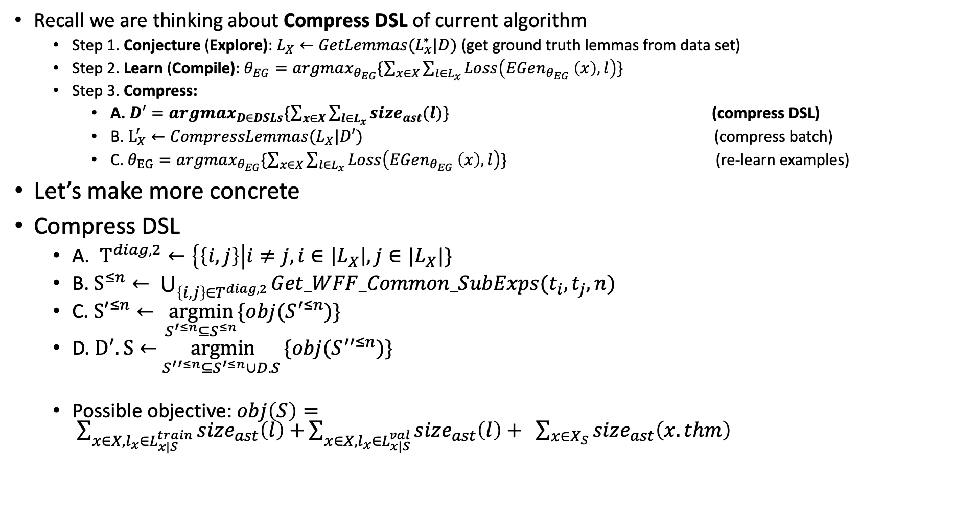
My current & 1st Idea for doing compression
Recall we are thinking about Compress DSL of current algorithm
Step 1. Conjecture (Explore): $L_{X}←{GetLemmas(L}_{x}^{∗}|D)$ (get ground truth lemmas from data set)
Step 2. Learn (Compile): $θ_{EG}=argmax_{θ_{EG}}\{\sum_{x∈X}{\sum_{l∈L_{x}}{Loss\left(EGen_{θ_{EG}} \left(x\right), l\right)}}\}$
Step 3. Compress:
A. $D′=argmax_{D∈DSLs}\{\sum_{x∈X}{\sum_{l∈L_{x}}{size_{ast}(l)}}\}$ (compress DSL)
B. $L_{X}^{′}←CompressLemmas(L_{X}|D′)$ (compress batch)
C. $θ_{EG}=argmax_{θ_{EG}}\{\sum_{x∈X}{\sum_{l∈L_{x}}{Loss\left(EGen_{θ_{EG}} \left(x\right), l\right)}}\}$ (re-learn examples)
Let’s make more concrete
Compress DSL
A. $T^{diag,2}←\left\{\left\{i, j\right\}\right|i≠j, i∈\left|L_{X}\right|, j∈|L_{X}|\}$
B. $S^{≤n}← \bigcup_{\left\{i, j\right\}∈T^{diag, 2}}{Get_WFF_Common_SubExps(t_{i}, t_{j}, n)}$
C. ${S′}^{≤n}← \underset{S^{′≤n}⊆S^{≤n}}{argmin}{\{obj(S^{′≤n})\}}$
D. $D^{′}.S←$ $\underset{S^{′′≤n}⊆S^{′≤n}∪D.S }{argmin}{\{obj(S^{′′≤n})\}}$
Possible objective: $obj\left(S\right)= \sum_{x∈X,l_{x}∈L_{x|S}^{train}}{size_{ast}\left(l\right)+}\sum_{x∈X, l_{x}∈L_{x|S}^{val}}{size_{ast}\left(l\right)+ }\sum_{x∈X_{S}}{size_{ast}\left(x.thm\right) }$
Notes:
Q: why can’t we have neural recognition model & a search procedure guiding the compression like we had in synthesis/enumeration

Slide 23
What is the essence of the problem of abstraction and compression?
What is the essence that any algorithm has to solve to do compression & abstraction well?
(implicitly [end-to-end] or explicitly [with more cognitive priors])
Essence 1
1. Select common WFFF sub-expressions from a large batch of terms
2. Select the ones the improve objective most
3. Merge the current sub-expressions with the ones in the DSL
Essence 2 abstraction/compression of DSL
A. select pair of entire terms to compare
B. select common WFF sub-expressions between terms to use
C. select from common sub-expressions, ones that improve some objective
(e.g. generalizes, compress & helps produce new terms)
D. from the selected common sub-expressions, merge them with the current ones in the DSL according to objective
Notes:
WFF = well formed formula

