Slide 1

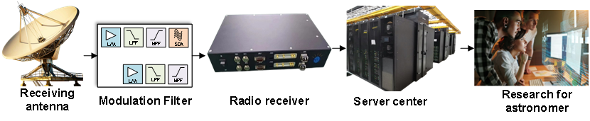
INTRODUCTION
Team Member Names Font: Times New Roman Size:12
Title :
Font：Times New Roman Size：24
OpenHW2025
作品实物缩略图
Font: Calibri(Body) Size:11 Size:11
On board test by AMD ZYNQ7000
Radio telescopes use wireless radio reception, measurement, and analysis of celestial radio signals to explore the radio window of celestial bodies after the optical window.
A typical radio telescope system consists of an antenna system, a receiver analog front-end system, a data processing and recording system. Most of the current receiver systems have the capability of accumulate integration, FFT transformation, and correlation calculation, but cannot retain the raw data of the radio signals, Lost a lot of temporal information.
Key technical issues addressed:
1. Signal acquisition, High-performance ADC (Analog-to-Digital Converter) device.
2. Data receiving and processing, AMD-Xilinx 7 series Zynq System on a Chip (SoC) devices.
3. Data transmitting, SERDES (Serializer/Deserializer) Interface with GTX for 10G linerate.
4. Data storing, Dedicated server with disk array and RNIC support.
作品测试平台信息
C
R
R
E
The completed work has verified the architecture of using a high-performance ADC (Analog-to-Digital Converter) to acquire multiple beams from a radio reception antenna.
The system is composed of independent components, with a flexible and highly scalable architecture. It is based on FPGA's logic programmability and serdes technology support, which enables it to meet higher performance requirements.
E
S
A
T
U
I
L
Typical application case
系统框图，创新点
V
T
System Architecture
E
Optical Communication Receiver Card:
1. Communicating with the acquisition card;
2. Receiving and Handling data from SFP+ with protocol such as Ethernet, Aurora and so on;
3. Acting as an assistant to speed up the data processing workflow;
4. Collaborating with the server for data uplink and downlink;
D
E
SFP+ interface is driven directly by GTX, can be programmed by users to support various communication protocols. This high degree of programmability ensures maximum compatibility with both existing and future communication devices, thereby reducing the cost of device deployment and iterative updates.
Raw data storage requires a significant amount of storage bandwidth. The limitations of current storage devices necessitate the need to build disk arrays that can support high-bandwidth data storage.
S
I
背景，简介摘要
N
G
High-speed Acquisition Card:
1. Sampling and Quantization of Analog Signals;
2. Receiving and Handling data from ADC;
3. Transporting data to next work platform;
测试结果，性能，展望

Slide 2

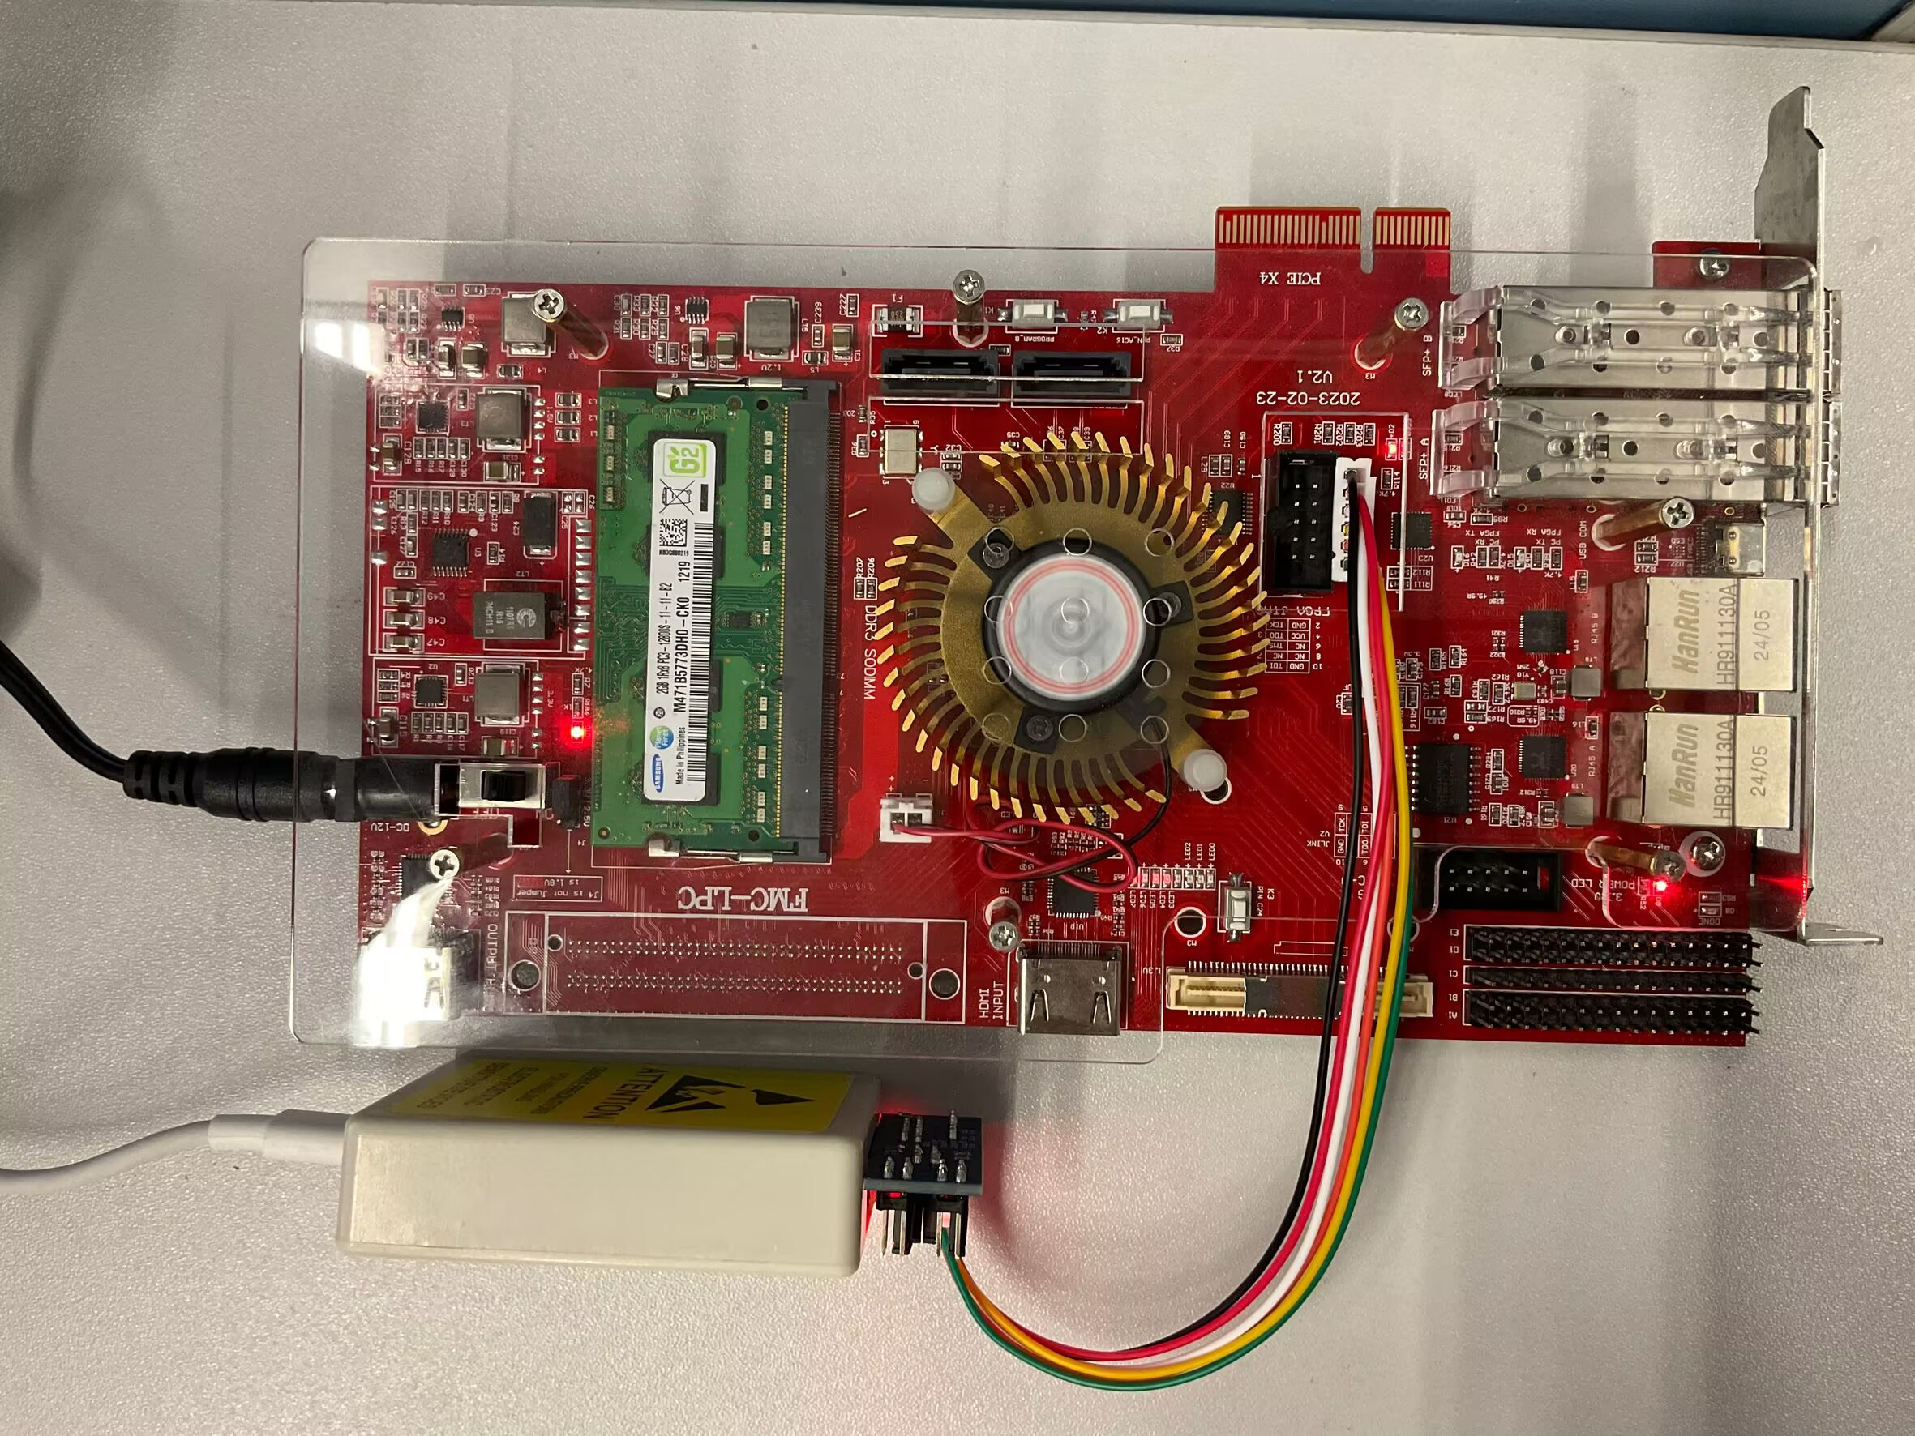
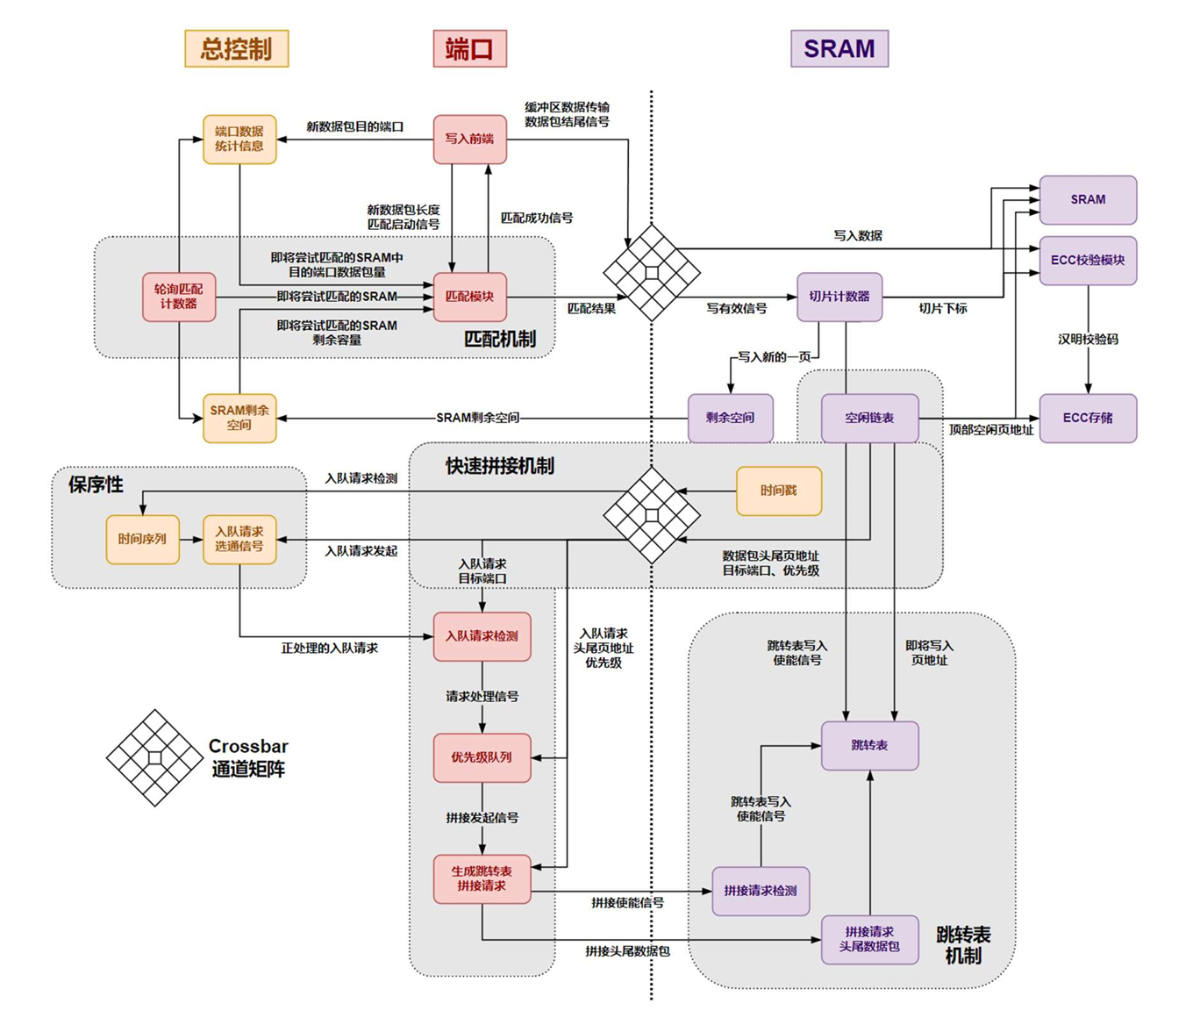


INTRODUCTION
Hydra: A high-speed multi-port shared cache management module
Dasu Yan, Yixuan Lu, Bohan Li
South China University of Technology
OpenHW2024
A network switch links devices in a LAN, directing data to the right place. It handles multiple connections at once, prioritizes important data, and manages packets of different sizes for smooth communication.
Typical switches, once networking essentials, now show limits under modern demands. Rigid caching and static memory allocation reduce adaptability to dynamic traffic, while weak multi-port parallelism, inadequate priority management, and limited error detection hinder high-performance networking.
Key technical issues addressed:
Supports dynamic memory sharing across ports and queues, optimizing resource usage in real-time.
Enables 4 ports to operate simultaneously with up to 4 Gbps bandwidth per port.
Provides 4 priority queues per port for precise traffic prioritization and enhanced QoS
Supports variable-length packet buffering (64–1024 bytes), ensuring efficient and flexible data handling.
Integrates ECC and CRC mechanisms, ensuring reliable and error-free data transmission.
On board test by AMD ZYNQ7000
C
Data
Data
R
The completed work has verified the architecture of Hydra, a high-speed multi-port shared cache management module for routing devices.
Hydra manages 16 SRAM units providing 1Mbits of total storage. It supports simultaneous read and write operations on 4+ ports with 4Gbps bandwidth per port. Featuring dynamic priority queuing, packet-level caching and scheduling and fully dynamic multi-port, multi-queue shared caching.
E
R
PC
Switch
PC
A
E
Typical application case
T
S
System Architecture
I
U
V
L
Highlights & Innovations
Optimized Crossbar Design: Resolves key inefficiencies of traditional switches.
Efficient Priority Queues: Reduces resource use with jump table optimization.
Advanced Read-Write: Supports fast splicing, breakpoint resumption, and packet-level operations.
Dynamic Allocation: Integrates dynamic and static resource matching for flexibility.
Reliable Data Handling: Ensures efficiency with optimized encoding-decoding and low-complexity WRR.
E
T
D
E
S
Hydra, our high-speed multi-port shared cache management module, not only fulfills basic switch functions but also offers strong scalability and performance, surpassing current market products.
With the rapid rise of 3D ICs and M3D technology, Hydra’s 16×32 Crossbar architecture is well-positioned for future high-dimensional designs. As 3D integration advances, Hydra could evolve into higher-dimensional structures, unlocking unparalleled performance for 5G and 6G network applications. This is the future we aim for.
I
N
G

