Slide 1
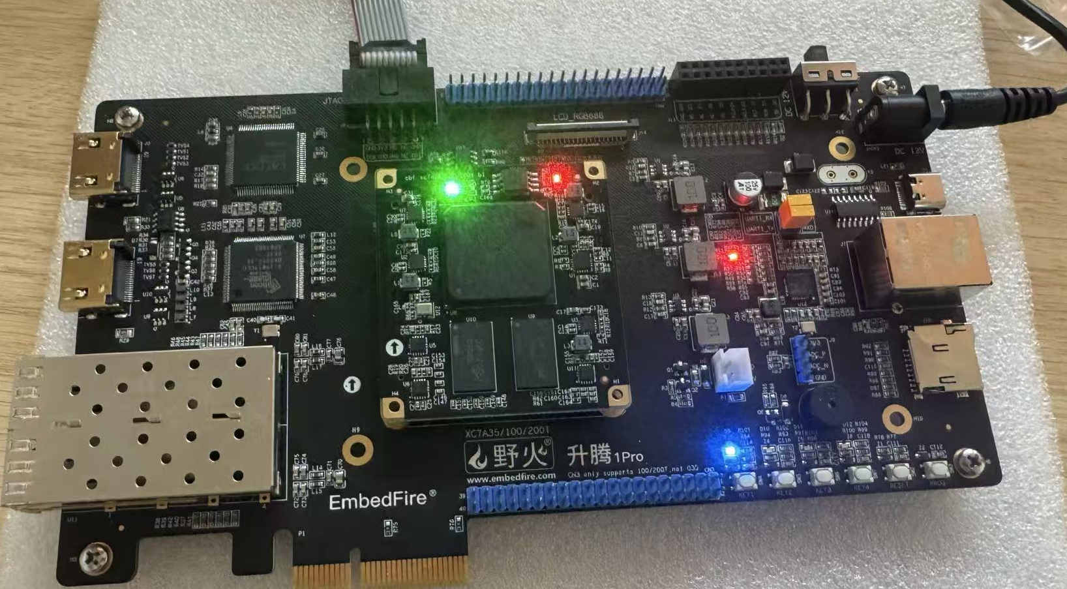

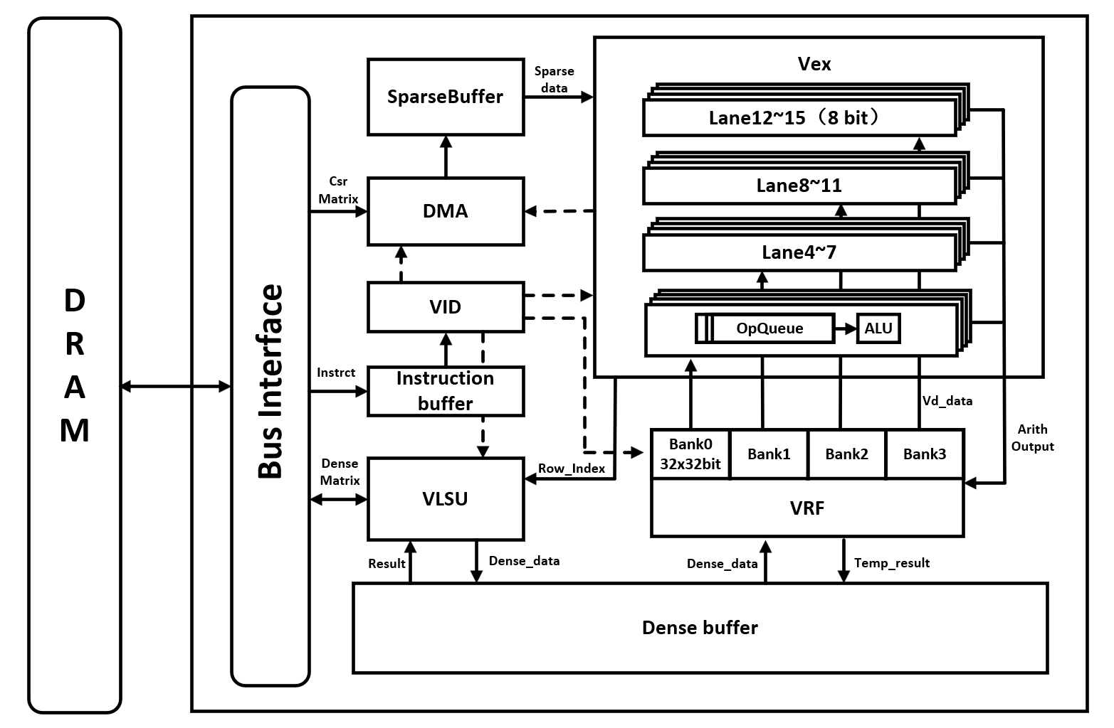
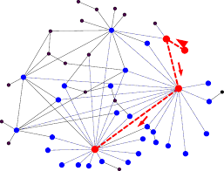
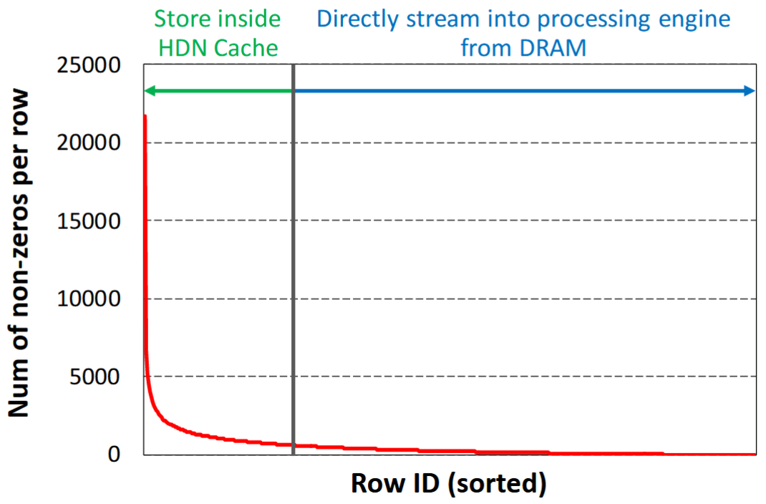
INTRODUCTION
SpMM Vector Processor for GNN Based on RISC-V Instructions
OpenHW2025
The power-law distribution of real-world graphs leads to extreme sparsity and highly uneven connectivity. This irregularity becomes a critical computational bottleneck for Graph Neural Networks (GNNs), as it impedes the efficiency of the fundamental SpMM operations during inference.
Traditional general-purpose processors show limitations when handling sparse matrix computations in GNNs. Fixed memory architectures struggle to adapt to irregular sparse data access patterns and inadequate data reuse mechanisms.
Key technical issues addressed:
Supports custom RISC-V based SpMM instruction set with dual-issue capability, enabling computation and data loading parallelism
Implements dynamic memory access optimization specifically for power-law graph characteristics, enabling efficient handling of irregular memory access patterns
Provides fixed-row caching mechanism achieving ≥80% hit rate for frequently accessed hub node data
On board test by AMD Artix-7
C
R
This project has successfully designed and implemented a specialized vector processor for sparse matrix computations, employing a three-stage pipeline architecture that validates the custom instruction set and hardware acceleration scheme for SpMM operations.
The processor core integrates a vector execution unit, multi-level buffer hierarchy, and dual-issue control mechanism to efficiently handle sparse matrix operations in graph neural networks.
E
R
A
E
T
S
System Architecture
I
U
V
L
Custom RISC-V Vector Extension: 8 new SpMM instructions for efficient sparse matrix computation.
Power-Law Optimized Cache: Developed fixed-row caching in VRF that achieves >60% hit rate for hub nodes in power-law graphs.
Dual-Issue Parallelism: Enabled simultaneous computation and data loading.
Hardware Prefetching: DMA controller prefetches sparse data during computation to hide memory latency.
Customized Data Access: DMA for sparse matrix data and VLSU for dense feature data, each optimized for their specific access patterns.
E
T
Graph and Power Law Distribution
Highlights & Innovations
D
E
Our innovative vector processing architecture, delivers breakthrough performance in SpMM acceleration while achieving scalability and power efficiency that surpasses all conventional processor designs.
As the demands of graph neural networks and sparse computing evolve, our design’s multi-level caching hierarchy and custom instructions provide a valuable reference for next-generation AI workloads.
S
I
N
G

