Slide 1
Tech Talk: Service Workers
February 2017 – brandon Pereira

Slide 2
What they are
Service Workers allow you to run Javascript code outside of the main process.
This opens the door to new possibilities which don’t require user interaction/a browser.
Based heavily off of Promises

Slide 3
Some potential use cases
It’s official… we are in the future.
Offline Support
Push Notifications
Background Sync
Programmatic Caching / Preloading
Periodic Syncing
Geo-fencing
Proxy Resources

Slide 4
What it can’t do
It can’t solve world hunger :(
Service Workers run on an isolated thread. This can be restricting.
Can’t access the DOM
Run indefinitely (subject to garbage collection)

Slide 5
What About App Cache?
App Cache comes with a number of Gotchas. These include:
Blah blah
http://alistapart.com/article/application-cache-is-a-douchebag
Service Workers attempt to solve this by:
Giving the developer complete control over cache structure/logic

Slide 6
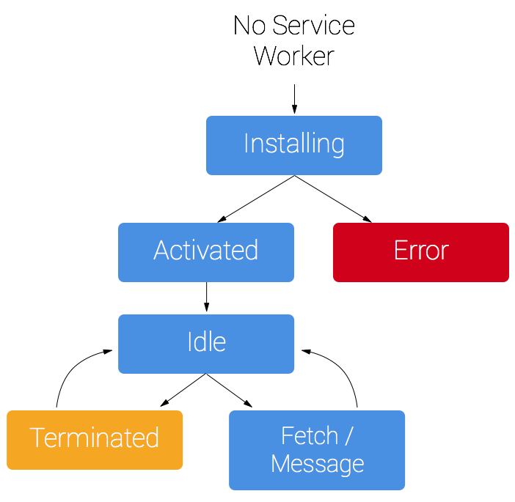
Service Worker Lifecycle

Slide 7
PROGRESSIVE WEB APPS (PWA)

Slide 8
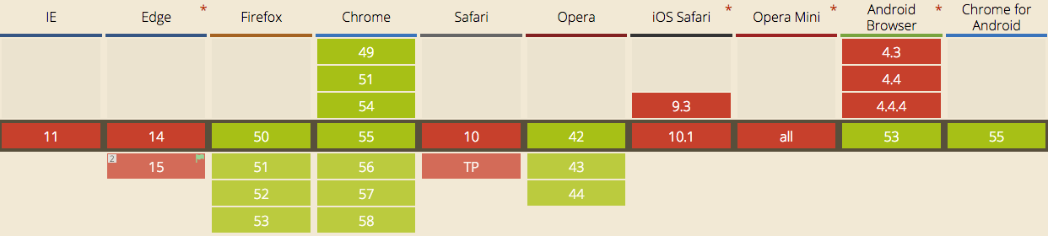
It’s not ready yet!
As you can see, Service Workers aren’t anywhere near ready. Even Chrome requires you to enable a flag.
Chrome & Firefox: Ready with basic implementation
Safari: Under consideration (Brief positive signals in five year plan)
Edge: In Development
https://jakearchibald.github.io/isserviceworkerready/

Slide 9
Prerequisites
Supported Browser
Supported Browser with good debugging tools (mainly Chrome atm)
HTTPS
Basic understanding of ES6 (this isn’t required but a lot of the examples online are using it)
Understanding of how (ES6) Promises work

Slide 10
There’s modules for it!
https://github.com/GoogleChrome/sw-precache

Slide 11
Links
https://developers.google.com/web/fundamentals/getting-started/primers/service-workers
https://googlechrome.github.io/samples/service-worker/fallback-response/
http://thecatapi.com/api/images/get?format=src&size=small

