Slide 1

2022/05/06 Side Project
許哲維
Notes:
1
1

Slide 2
Outline
Struct
Data base
Lottery
Front end

Slide 3
Struct
Back end: Django
Data base : Mongodb

Slide 4
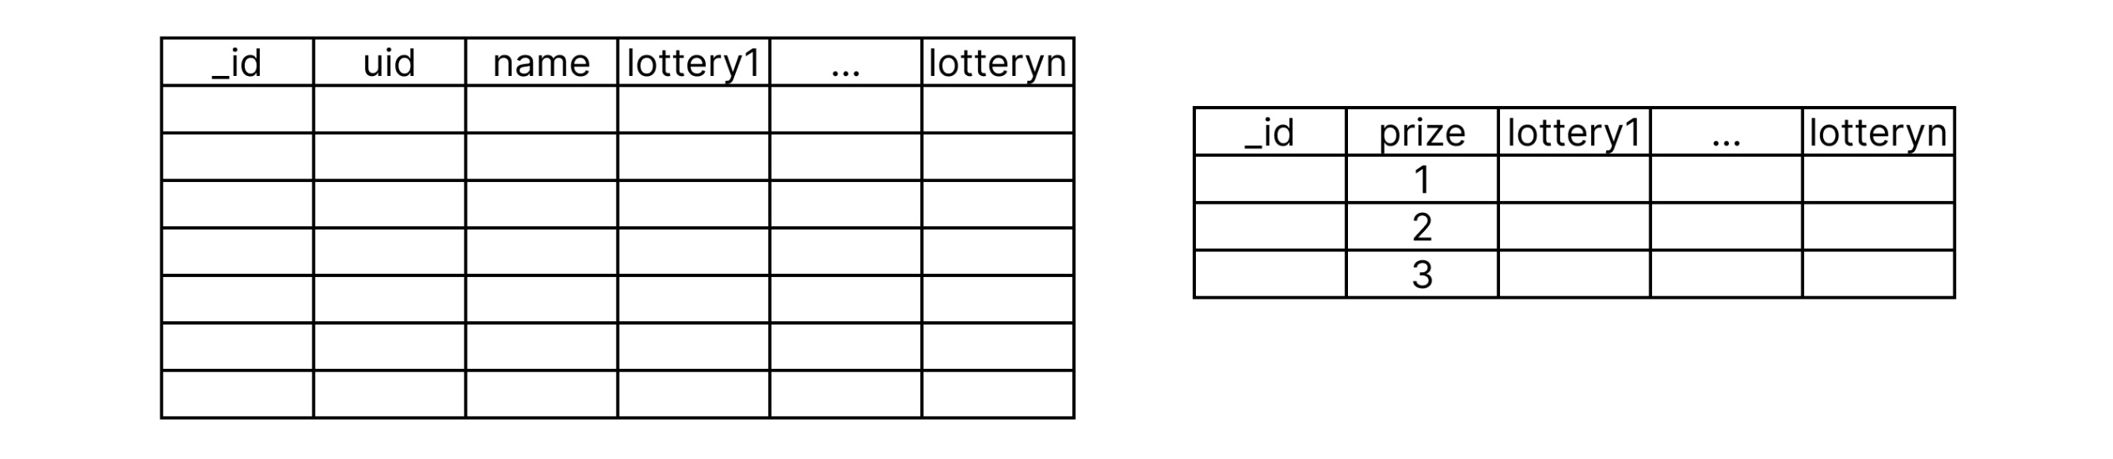
Data base
Lottery_member
Lottery_prize

Slide 5
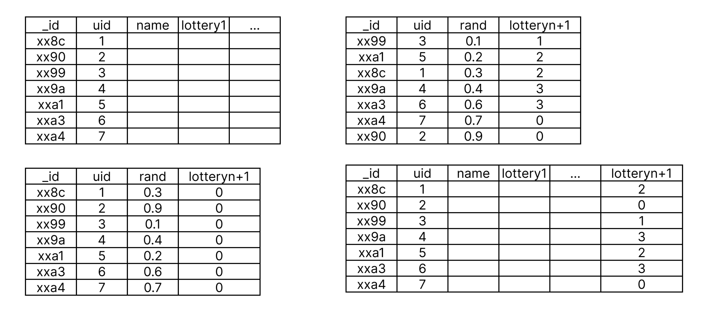
Lottery
1.sort
2.lottery

Slide 6
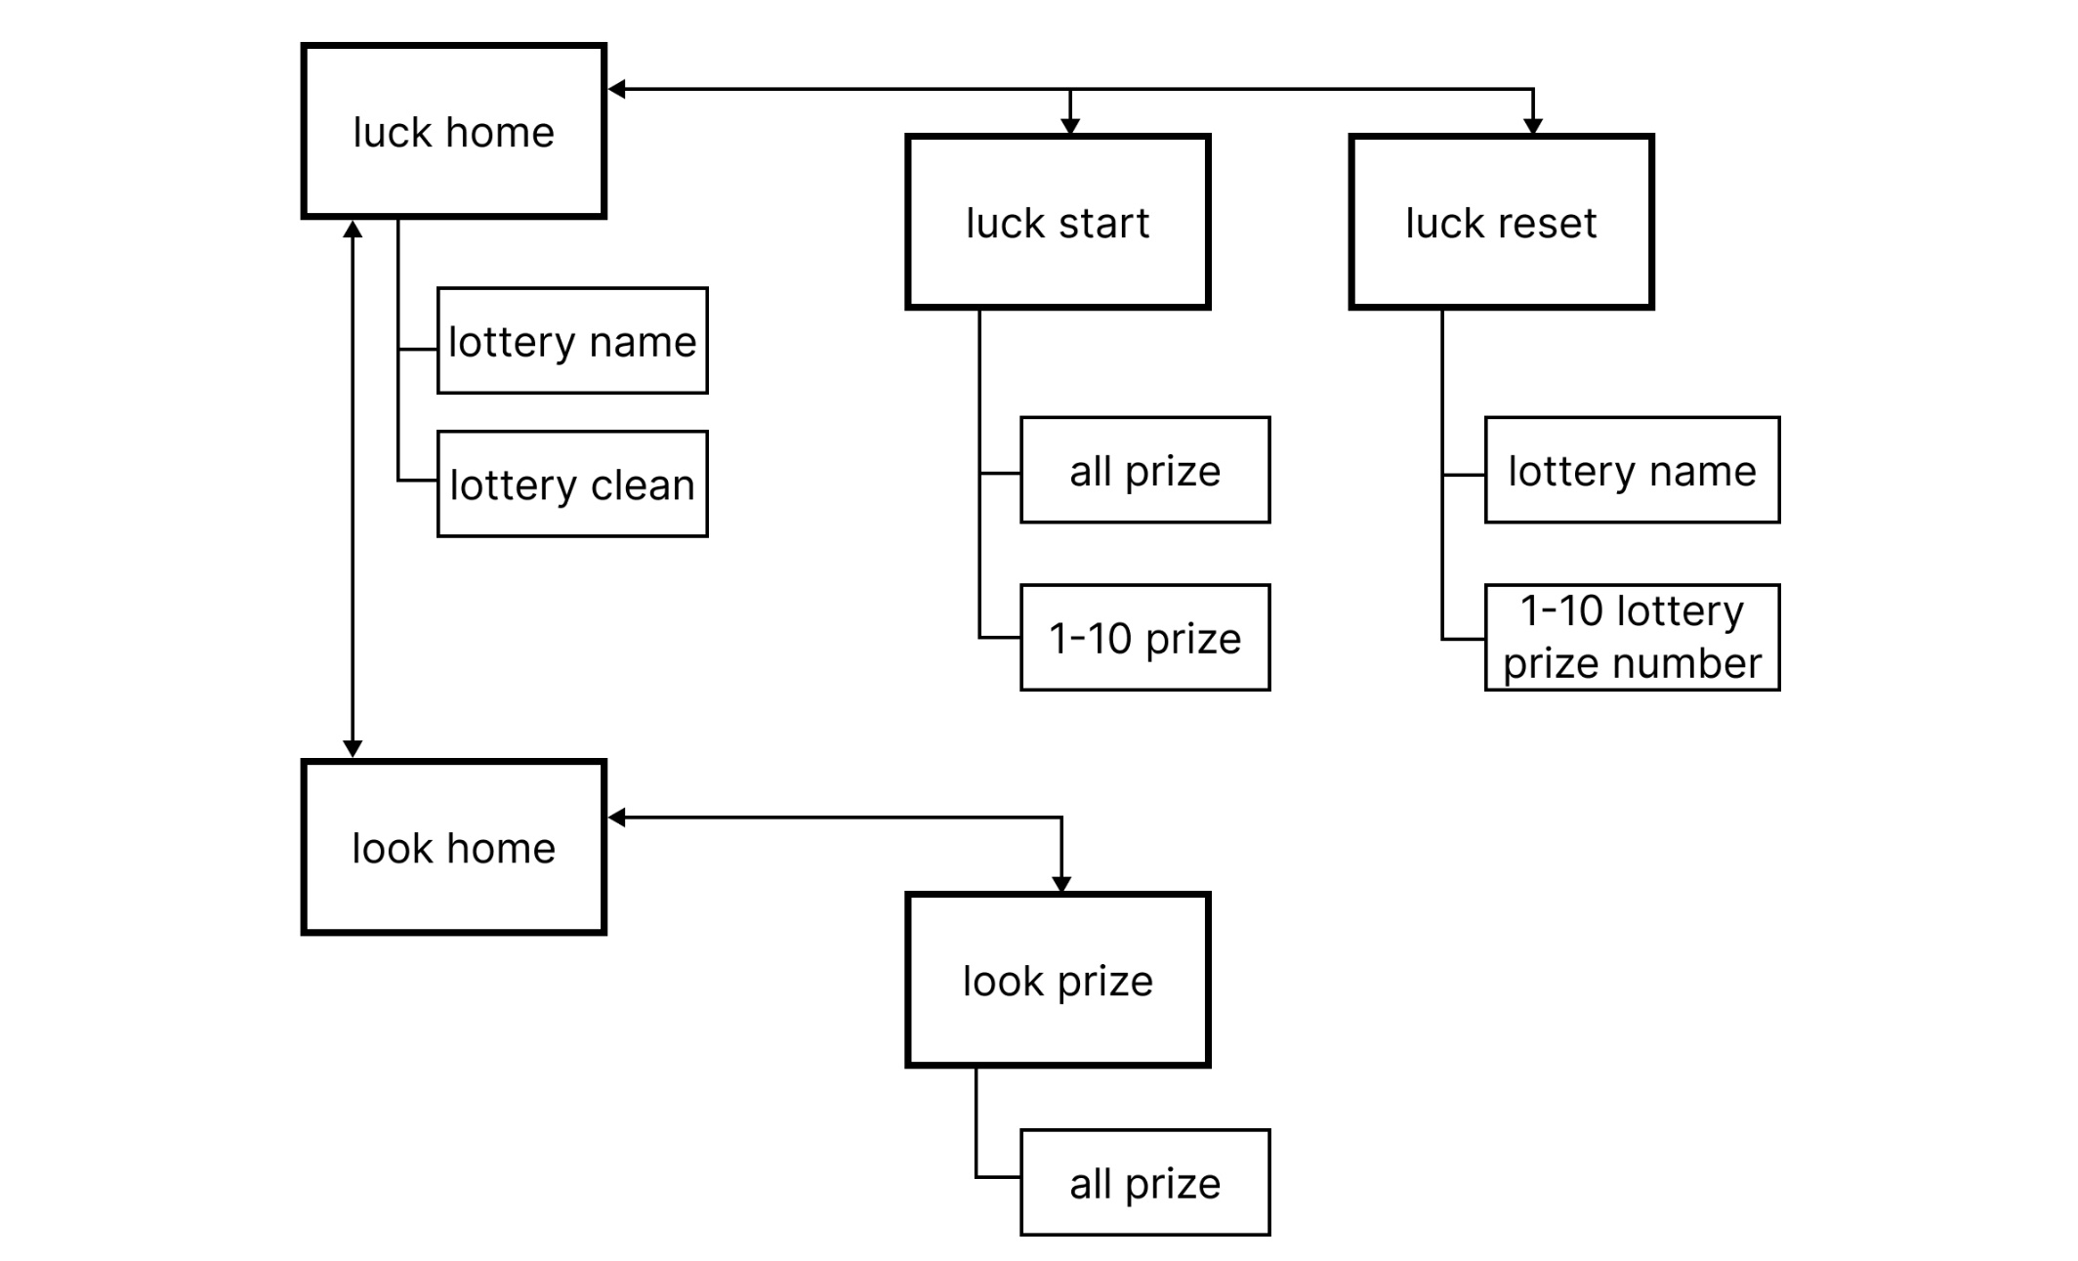
Front end

Slide 7
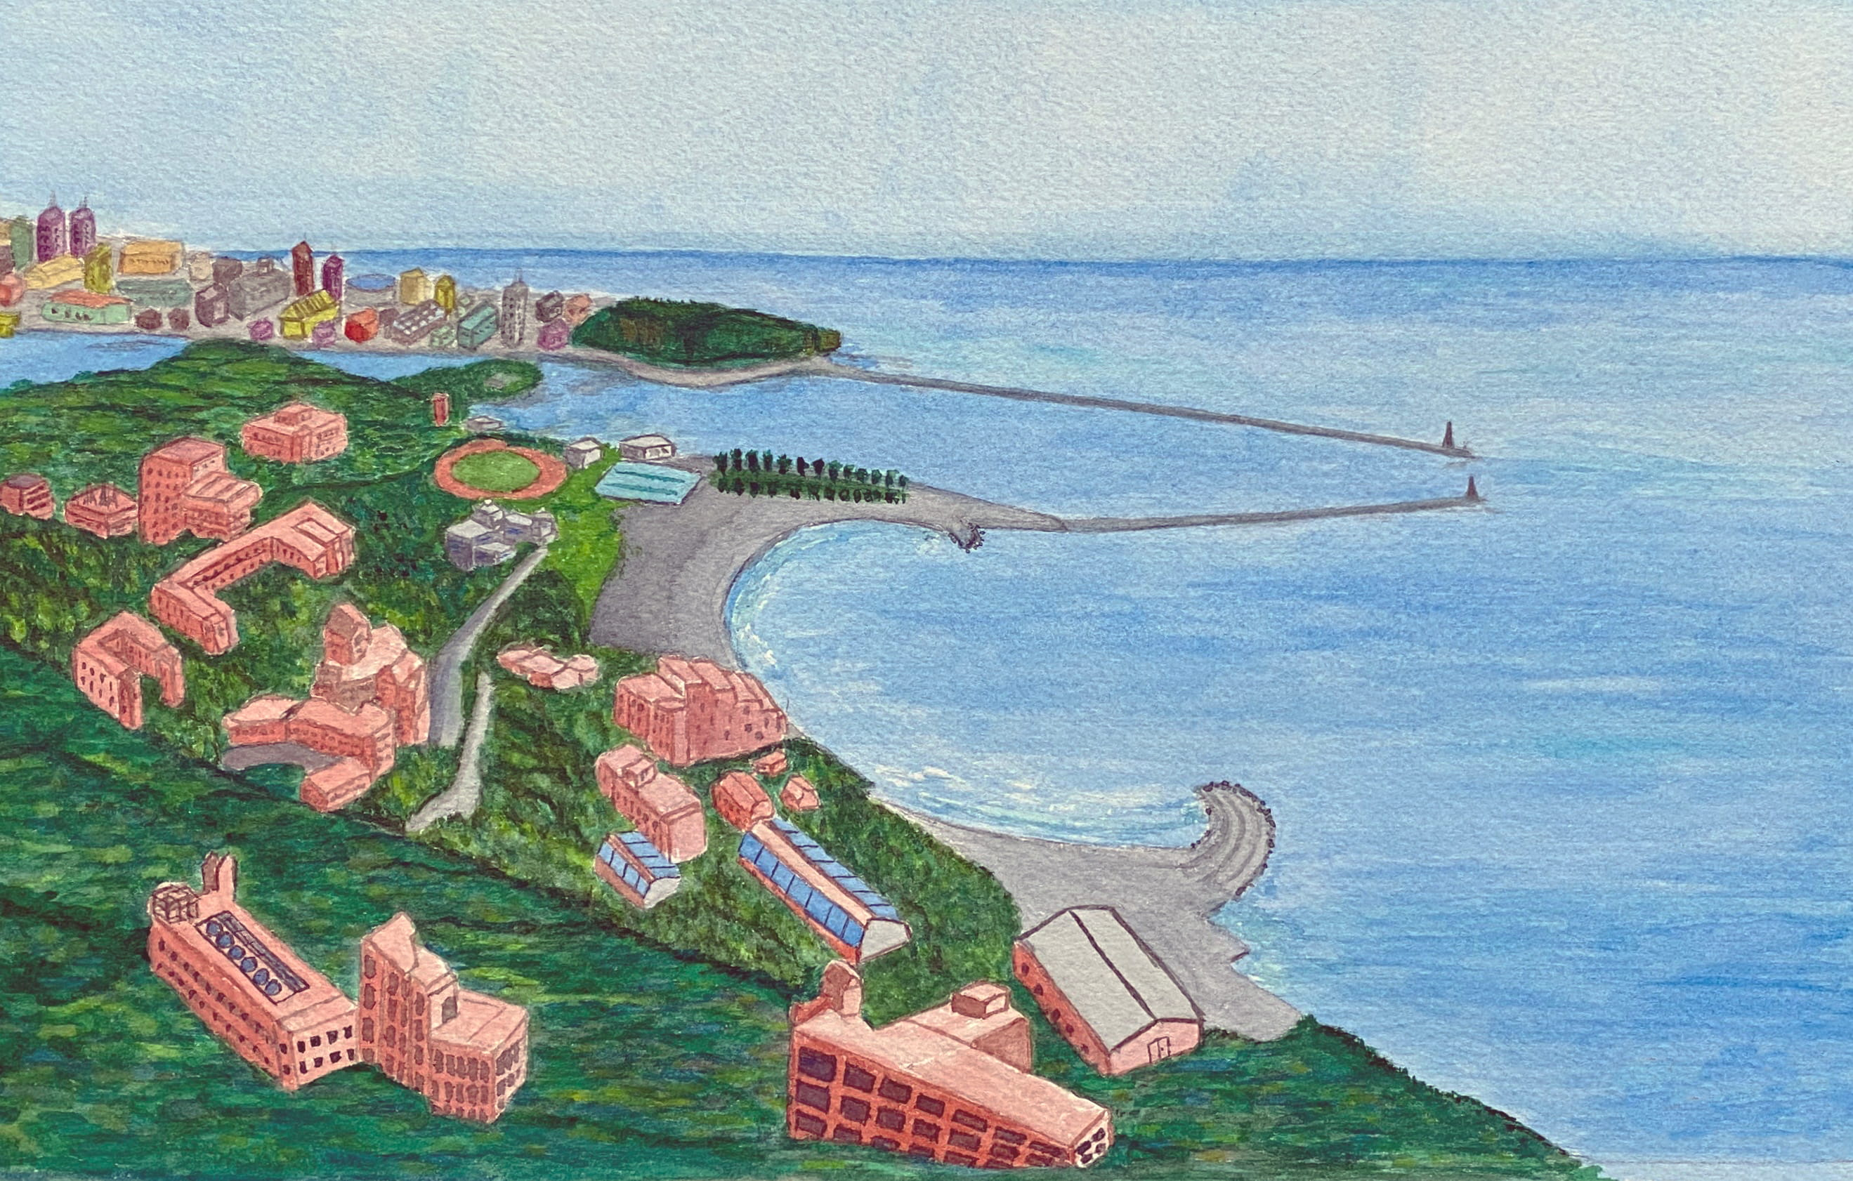
Thank You ;-)
Notes:
7
7

