Slide 1
106 Data Structure Homework 4
2017/12/26

Slide 2
建立迷宮&Min-Max heap
本此的作業希望同學運用minimum spanning tree的概念建立一個迷宮
上述的方法必定可以建立一個從起點到終點的迷宮
以建立迷宮的路徑建立Min-Max heap
包含三個功能

Slide 3
建立迷宮&Min-Max heap
1
A | B | C
D | E | F
G | H | I
以3*3的圖為例子

Slide 4
建立迷宮&Min-Max heap
2
A | B | C
D | E | F
G |  | I
隨機選取兩個點中的一個邊,如果它們不是同一個集合的話就將某一邊取走

Slide 5
建立迷宮&Min-Max heap
3
A |  | C
D | E | F
G |  | I
A |  | C
D | E
G |  | I
4
A |  | C
D | E
G
A |  | C
D | E
5
6

Slide 6
建立迷宮&Min-Max heap
7
8
 |  | C
D | A
 | A

Slide 7
建立迷宮&Min-Max heap
@ - @ - @ - @ - @ - @ - @
| | | | | | |
@ - @ - @ - @ - @ - @ - @
| | | | | | |
@ - @ - @ - @ - @ - @ - @
| | | | | | |
@ - @ - @ - @ - @ - @ - @
| | | | | | |
@ - @ - @ - @ - @ - @ - @
| | | | | | |
@ - @ - @ - @ - @ - @ - @
| | | | | | |
@ - @ - @ - @ - @ - @ - @
首先要建立6*6的迷宮要先做13*13的格子
包含柱子@,橫邊-,直邊|

Slide 8
建立迷宮&Min-Max heap
@ - @ - @ - @ - @ - @ - @
| 1 2 3 | # | 4 5 |
@ - @ @ - @ - @ - @ - @
| # | 6 | # | 7 8 9 |
@ - @ @ - @ @ - @ - @
| 10 11 | # | 12 | # | # |
@ @ - @ - @ @ - @ - @
| 13 | # | # | 14 15 16 |
@ @ - @ - @ @ @ - @
| 17 | # | 18 19 20 | # |
@ @ - @ @ - @ @ - @
| 21 22 23 | # | 24 25 |
@ - @ - @ - @ - @ - @ - @
# # # # # # # #
# 1 2 3 # 4 5 #
# # 6 # 7 8 9 #
# 10 11 # 12 # # #
# 13 # # 14 15 16 #
# 17 # 18 19 20 # #
# 21 22 23 # 24 25 #
# # # # # # # #
在完成迷宮之後依序將數字依照左邊的格式填入迷宮之中
紅字為起點以及終點
#字號為牆壁
最後將最短迷宮路徑印出
1-2-6-11-10-13-17-21-22-23-18-19-20-24-25

Slide 9
建立迷宮&Min-Max heap
@ - @ - @ - @ - @ - @ - @
| 1 2 3 | # | 4 5 |
@ - @ @ - @ - @ - @ - @
| # | 6 | # | 7 8 9 |
@ - @ @ - @ @ - @ - @
| 10 11 | # | 12 | # | # |
@ @ - @ - @ @ - @ - @
| 13 | # | # | 14 15 16 |
@ @ - @ - @ @ @ - @
| 17 | # | 18 19 20 | # |
@ @ - @ @ - @ @ - @
| 21 22 23 | # | 24 25 |
@ - @ - @ - @ - @ - @ - @
# # # # # # # #
# 1 2 3 # 4 5 #
# # 6 # 7 8 9 #
# 10 11 # 12 # # #
# 13 # # 14 15 16 #
# 17 # 18 19 20 # #
# 21 22 23 # 24 25 #
# # # # # # # #
請確保起終點連通,若是有點集合沒有和起終點路線相連通,請一樣填入數字。
完全沒有被選到過的點請填#字號
若有路徑可以連接起終點,則迷宮停止建立。

Slide 10
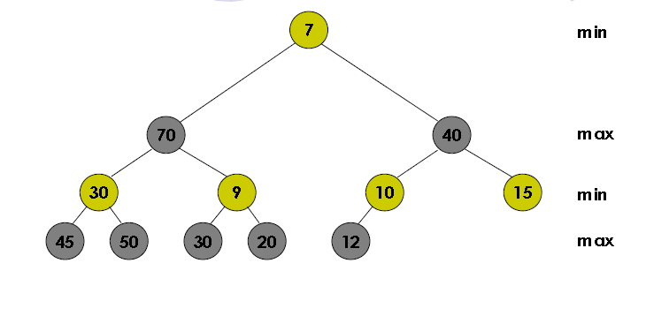
建立迷宮&Min-Max heap
接下來使用迷宮得出的路徑編號建立Min-Max heap
舉例
是一個Complete binary tree
此樹的level是以min-level與MAX-level交替出現
Root位於min-level
以40為例,40為以40為root的子樹最大的值
以7為例,7為以7為root的子樹最小的值

Slide 11
建立迷宮&Min-Max heap
Min-Max heap要包含3個功能
Insert X
Delete-min
Delete-Max
以右邊的表示法來呈現你的Min-Max heap
(7)
(70,40)
(30,9)(10,15)
(45,50)(30,20)(12)

Slide 12
建立迷宮&Min-Max heap
需求
能夠用手動輸入的方式來選擇建立迷宮的大小(50%)
E.g. 6*6
需要以右圖的方式呈現隨機生成的迷宮
以下圖的方式呈現迷宮的最短路徑(10%)
@ - @ - @ - @ - @ - @ - @
| 1 2 3 | # | 4 5 |
@ - @ @ - @ - @ @ - @
| # | 6 | # | 7 8 9 |
@ - @ @ - @ @ - @ - @
| 10 11 | # | 12 | # | # |
@ @ - @ - @ @ - @ - @
| 13 | # | # | 14 15 16 |
@ @ - @ - @ @ @ - @
| 17 | # | 18 19 20 | # |
@ @ - @ @ - @ @ - @
| 21 22 23 | # | 24 25 |
@ - @ - @ - @ - @ - @ - @
# # # # # # # #
# 1 2 3 # 4 5 #
# # 6 # 7 8 9 #
# 10 11 # 12 # # #
# 13 # # 14 15 16 #
# 17 # 19 20 21 # #
# 23 24 25 # 27 28 #
# # # # # # # #
1-2-6-11-10-13-17-23-24-25-19-20-21-27-28
1-2-6-11-10-13-17-21-22-23-18-19-20-24-25

Slide 13
建立迷宮&Min-Max heap
需求
使用迷宮得出的路徑編號建立Min-Max heap (20%)
請依照路徑的順序插入建立 heap
建立功能表可以使用三種功能
Insert X (10%)
輸入數字插入heap
Delete-min (10%)
Delete-MAX (10%)
三個功能都要用右圖的格式呈現
(1)
(23,25)
(2,10)(6,13)
(11,21)(22,18)(17,19)(20,24)
1-2-6-11-10-13-17-23-24-25-19-20-21-27-28
1-2-6-11-10-13-17-21-22-23-18-19-20-24-25

Slide 14
建立迷宮&Min-Max heap
請寫word檔說明你的作業步驟，如果你的程式不符合規定，你的word檔請寫出你做到什麼地步斟酌給分
寄信主旨請打以下格式
HW4_學號_姓名(不合規定斟酌扣分)
用ZIP壓縮word及程式碼(檔名請打你的學號)
請寄到 nchuwccclab@gmail.com
Deadline 2018/01/15
用Yahoo信箱我好像收不到
不管你要用什麼寫，請你確定可以在Dev-C++上執行再寄給我
Code請不要貼在txt或word檔，我一定扣分
抄襲嚴懲 , 請打上註解不然不計分

