Slide 1
Pipeline、layout

Slide 2
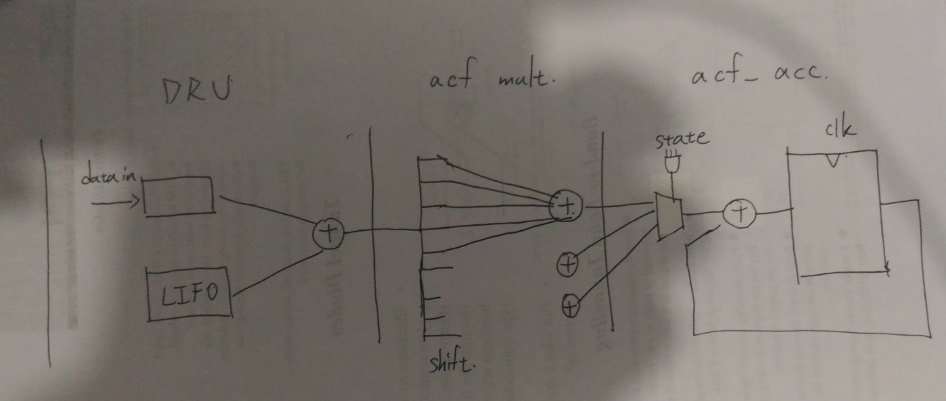
Pipeline
Regi
ster

Slide 3
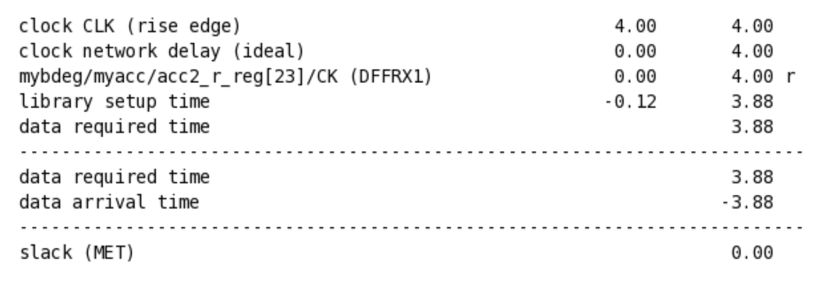
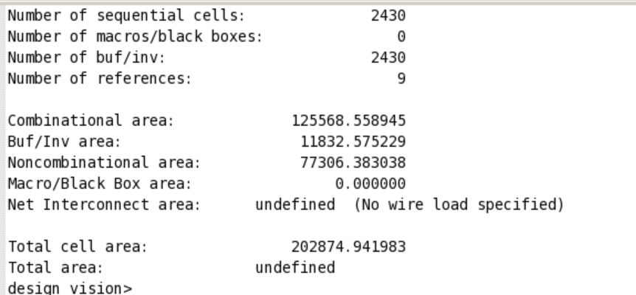
Minimum Synthesis Clock Cycle is 4ns

Slide 4
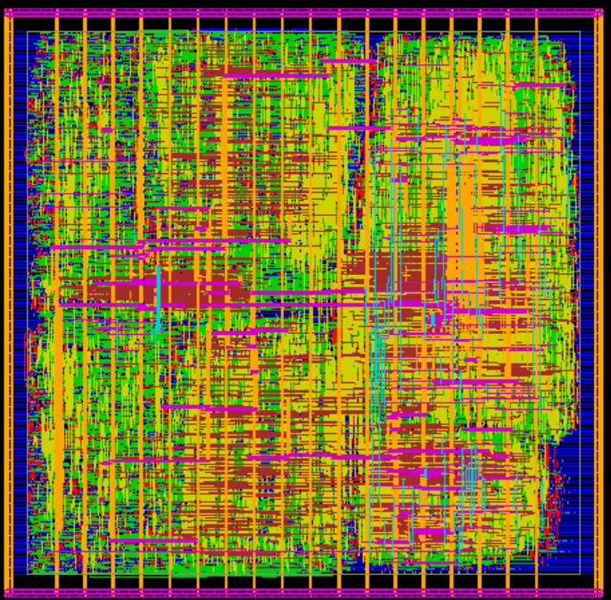
P&R

Slide 5
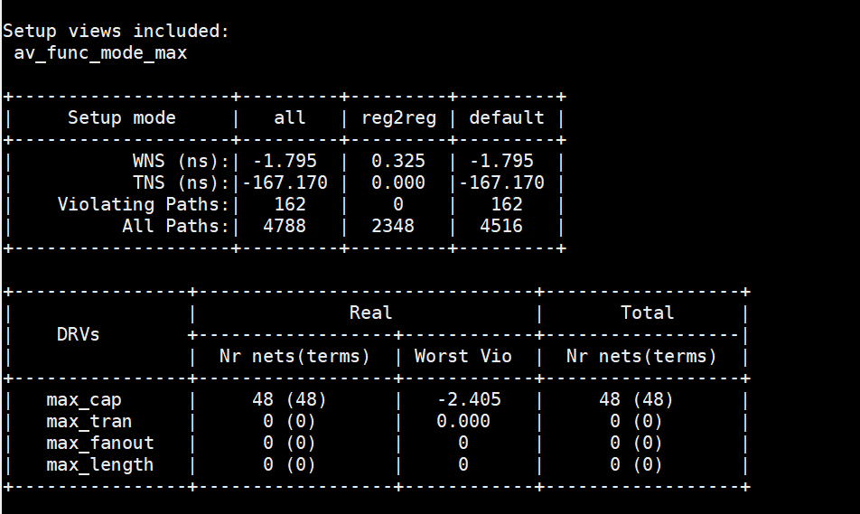
Negative P&R Slack cannot be fixed

Slide 6
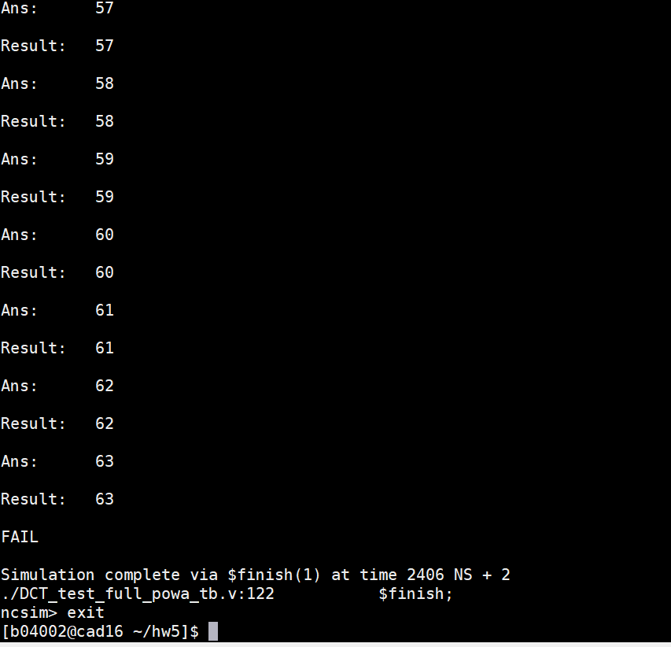
P&R simulation passes at clk cycle 6ns

