Slide 1
Goon Squad Zombie Town
Brandon Aperocho, Asmir Islamovic
Mateusz Rogozinski, Arjun Sharma, Andrew Te

Slide 2
The Team

Slide 3
The Team - Brandon
Documented all work done
Made sure all work was organized and met deadlines
Main manager for PivotalTracker
Facilitated meetings
Help implement and debug small features

Slide 4
The Team - Asmir
Designed and implemented may features in the game
The player’s rotation.
Weapon firing, reloading, switching.
Zombie’s Dancing and spawn locations.
Player and zombie interactions
Taking damage upon collision.
Bullets registering as kills and updating score.
Organized meetings

Slide 5
The Team - Mateusz
Created the Map
Developed collision detection:
Environment/Terrain
Borders
Bullets & Zombies
Helped design the UI:
Structured the menus and how they interact with each other
Implemented Main Store, In-Game Store, Controls

Slide 6
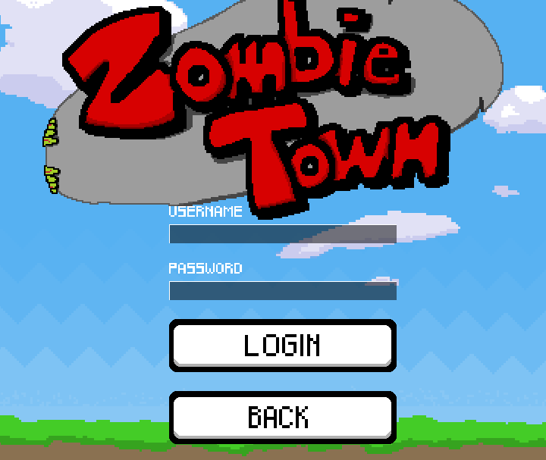
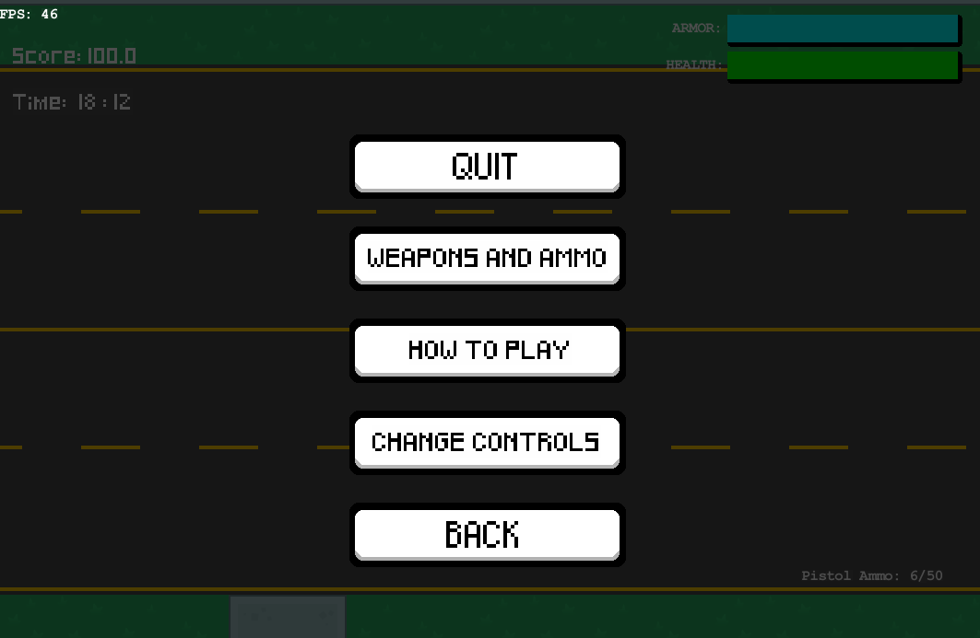
The Team - Arjun
Created and maintained the database
Ensured all account information is securely stored
Implemented many small features of the game
Ability to pause
Game music
White listing for inputs
Score implementation
Update high scores on end game

Slide 7
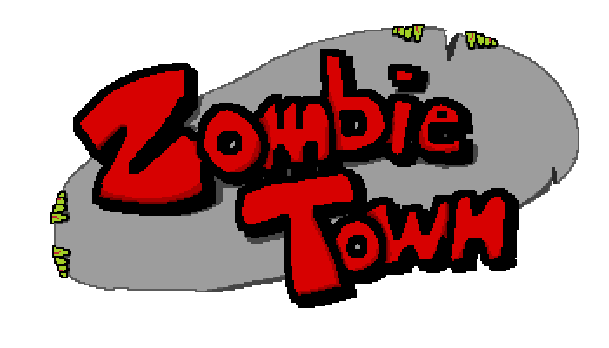

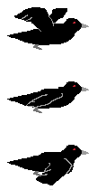



The Team - Andrew
Designed all of the artwork with the application
Made all animations
Implemented leaderboard logic
Sized game application
Created Leaderboards

Slide 8
The Process

Slide 9
Technologies Used
GitHub
PivotalTracker
Discord/Skype/Facebook

Slide 10
The Difficulties of Game Developing
Learning how to use different libraries
Not utilizing the branching feature on GitHub
Not having clear goals planned in advance
Switching ideas

Slide 11
Standards we Developed
Communicate Effectively
Inform everyone of changes desired or better ways to structure things
Inform other team member if there is a bug with what they did
Conduct meetings in due of changes and making sure every one is on the same page
Meetings were held in Discord, Skype, Facebook chat
Working as a team
Team members lend a helping hand whenever another team member needs it
Have respect in each other’s opinion/choices
No experiences in building games

Slide 12
Software Architecture

Slide 13
MVC Architecture
Model
Player, Zombie, Bullets
View
Responsible for the game window and constant rendering
Controller
Multiple controllers (dependant upon the state)

Slide 14
Software Used
Java: The whole game was coded in java
Java Libraries:
Slick2D, LWJGL (Light Weight Java Game Library)
MySQLConnection
JOGG, JORBIS
MySQL
Tiled

