Slide 1
GPU Accelerated Parameter
Estimation of Gravitational Waves
Notes:
Dr. Sandra Cruz-Pol
Electromagnetics, waveguides

Slide 2
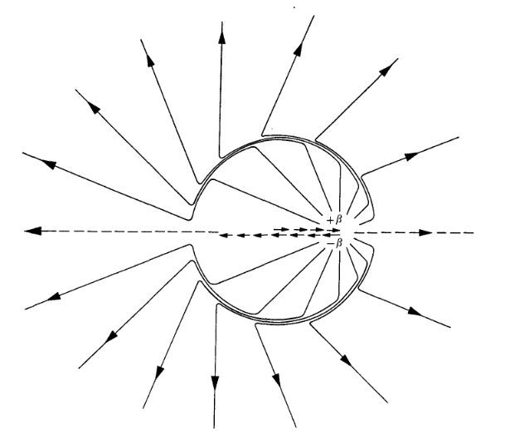
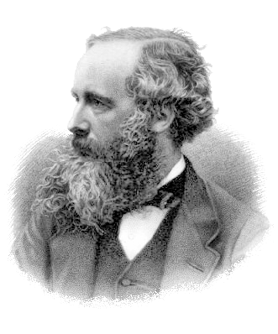
Classical Electrodynamics
ELECTRODYNAMICS
Radiation from an
Accelerating Charge
1873
Notes:
Dr. Sandra Cruz-Pol
Electromagnetics, waveguides

Slide 3
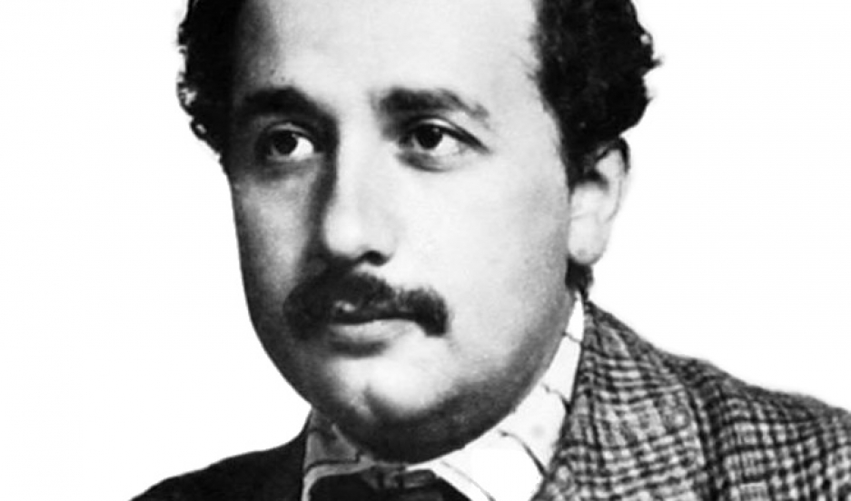
Classical Electrodynamics vs General Relativity
ELECTRODYNAMICS
GENERAL RELATIVITY
Radiation from an
Accelerating Charge
Radiation from an
Accelerating Mass?
1873
1916
Notes:
Dr. Sandra Cruz-Pol
Electromagnetics, waveguides

Slide 4
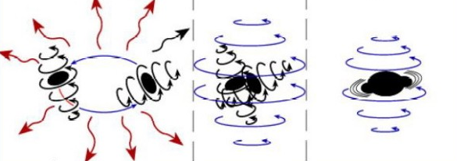
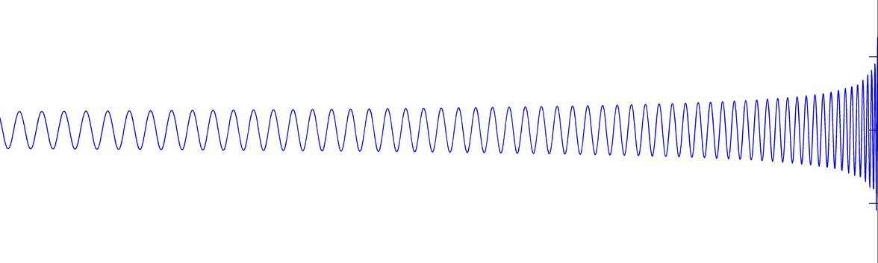
Chirps and Black Hole Binaries
A “Chirp” from a black hole binary in one dimension
+Amplitude
+Time
Notes:
Dr. Sandra Cruz-Pol
Electromagnetics, waveguides

Slide 5
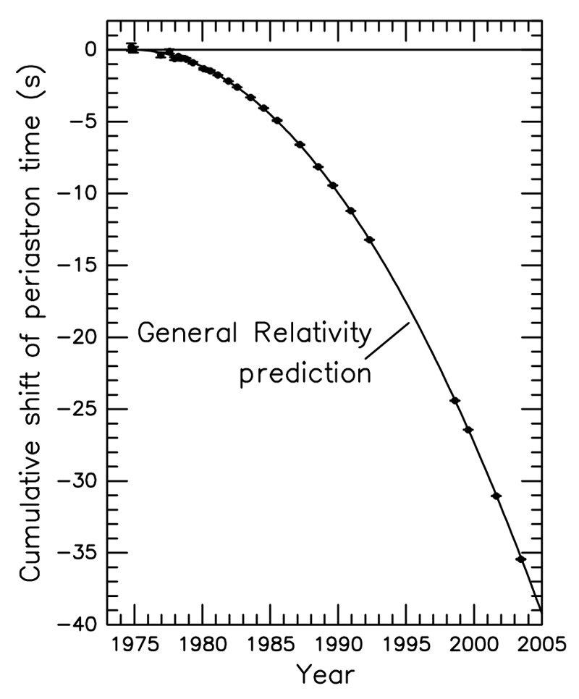
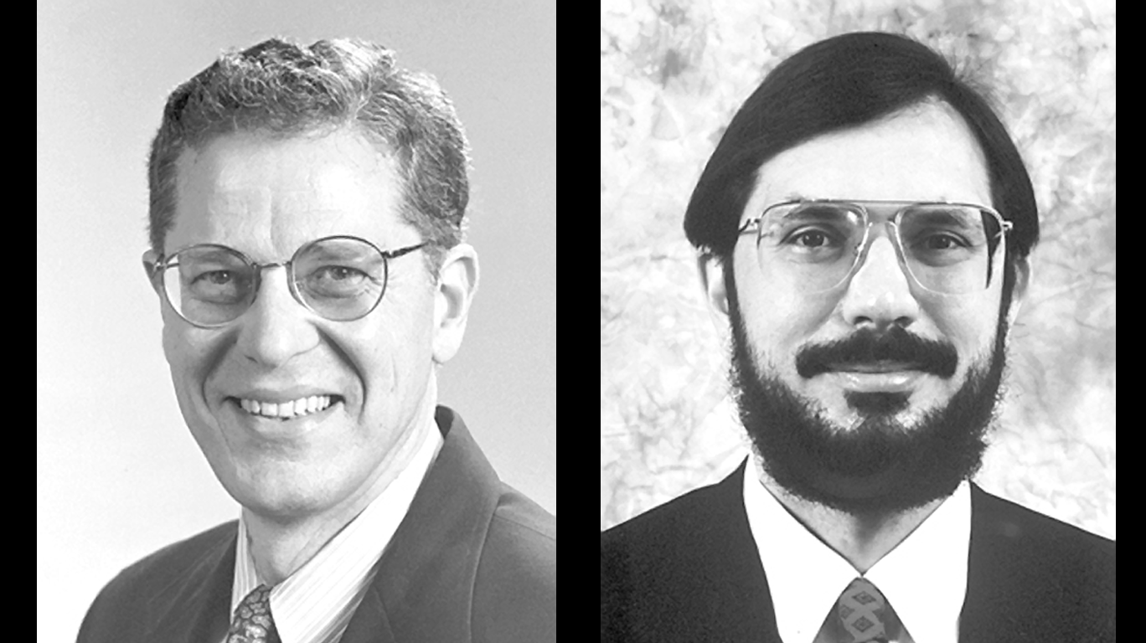
The Hulse-Taylor Binary Pulsar
1974
Notes:
Dr. Sandra Cruz-Pol
Electromagnetics, waveguides

Slide 6
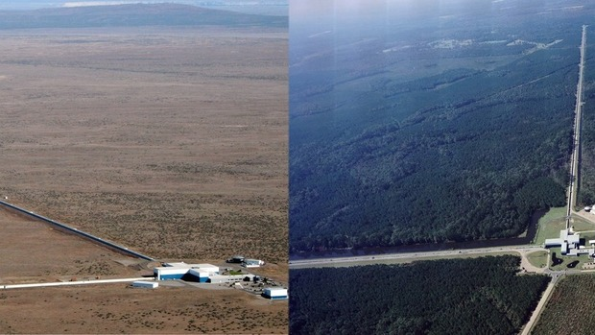
The LIGO Project
Notes:
Dr. Sandra Cruz-Pol
Electromagnetics, waveguides

Slide 7
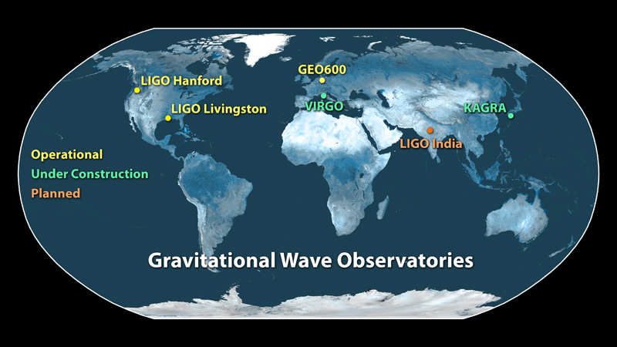
The LSC/VSC Detector Network
Notes:
Dr. Sandra Cruz-Pol
Electromagnetics, waveguides

Slide 8
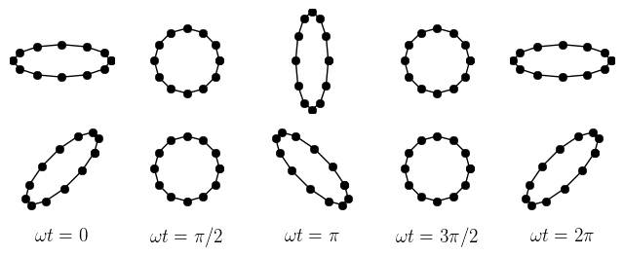
How does “Gravitational Radiation” Manifest Itself?
Waves go straight through matter.
Space between objects warped
and stretched
We need to measure the distances between things
and look for changes and oscillations
VERY tiny signal, ~
Notes:
Dr. Sandra Cruz-Pol
Electromagnetics, waveguides

Slide 9
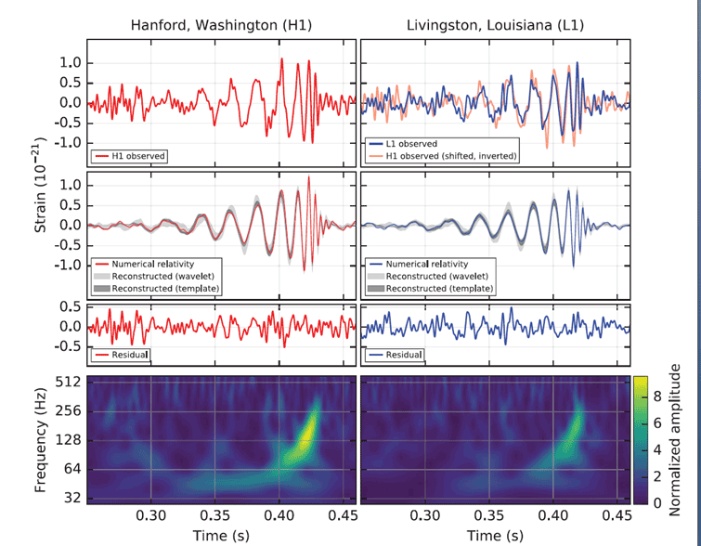
September 14th, 2015
Notes:
Dr. Sandra Cruz-Pol
Electromagnetics, waveguides

Slide 10
September 14th, 2015 – Success!
Notes:
Dr. Sandra Cruz-Pol
Electromagnetics, waveguides

Slide 11
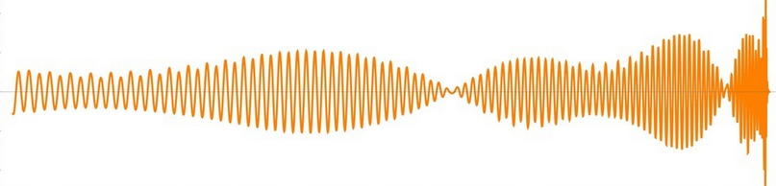
The Problem – Reverse Engineer the Parameters from the Signal
Not all Chrips are created equal!
15 independent numbers affect the shape
Mass, Spin, Separation, Location, Distance...
The list goes on!
Notes:
Dr. Sandra Cruz-Pol
Electromagnetics, waveguides

Slide 12
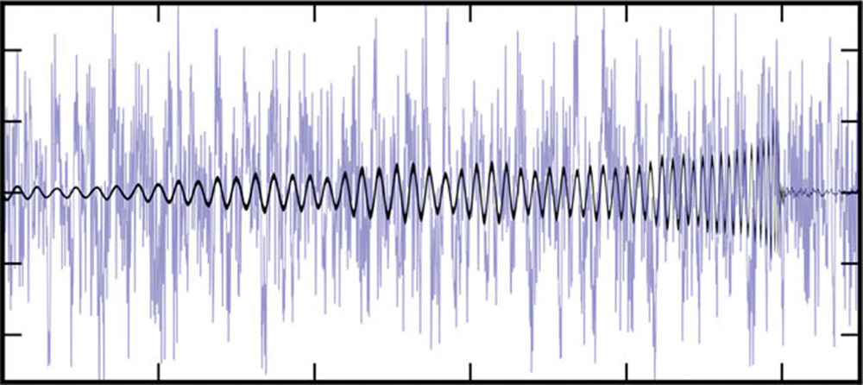
What if there's noise? (there is)
The real data (usually) looks something like this:
We need a way to make a quantitative statement about
what parameters are the “best fit” while propagating
through the uncertainty due to noise
Notes:
Dr. Sandra Cruz-Pol
Electromagnetics, waveguides

Slide 13
A Bayesian Approach
Our main tool is thus the Bayesian Posterior:
Notes:
Dr. Sandra Cruz-Pol
Electromagnetics, waveguides

Slide 14
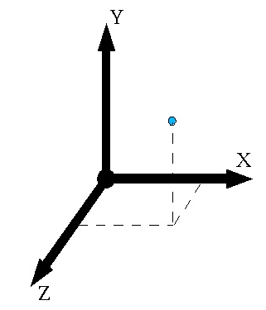

Bayes Theorem: Our Application
Think of a Gaussian!
μ
σ
Notes:
Dr. Sandra Cruz-Pol
Electromagnetics, waveguides

Slide 15
Bayes Theorem: Our Application
Notes:
Dr. Sandra Cruz-Pol
Electromagnetics, waveguides

Slide 16
Problem: Posterior Narrow, Multimodal, and 15 Dimensional!
You can miss the peak, badly! Direct computation hard
Notes:
Dr. Sandra Cruz-Pol
Electromagnetics, waveguides

Slide 17
One Solution: MCMC Sampling
Notes:
Dr. Sandra Cruz-Pol
Electromagnetics, waveguides

Slide 18
One Solution: MCMC Sampling
Notes:
Dr. Sandra Cruz-Pol
Electromagnetics, waveguides

Slide 19
One Solution: MCMC Sampling
Notes:
Dr. Sandra Cruz-Pol
Electromagnetics, waveguides

Slide 20
One Solution: MCMC Sampling
Notes:
Dr. Sandra Cruz-Pol
Electromagnetics, waveguides

Slide 21
One Solution: MCMC Sampling
Notes:
Dr. Sandra Cruz-Pol
Electromagnetics, waveguides

Slide 22
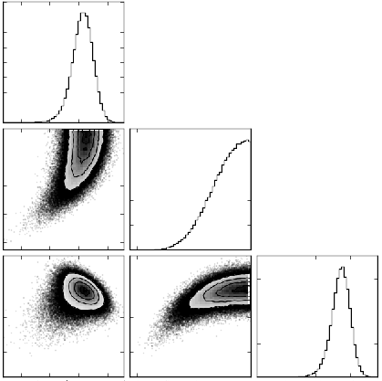
One Solution: MCMC Sampling
Can take a few days to converge
Depending on wave template, hardware
Notes:
Dr. Sandra Cruz-Pol
Electromagnetics, waveguides

Slide 23
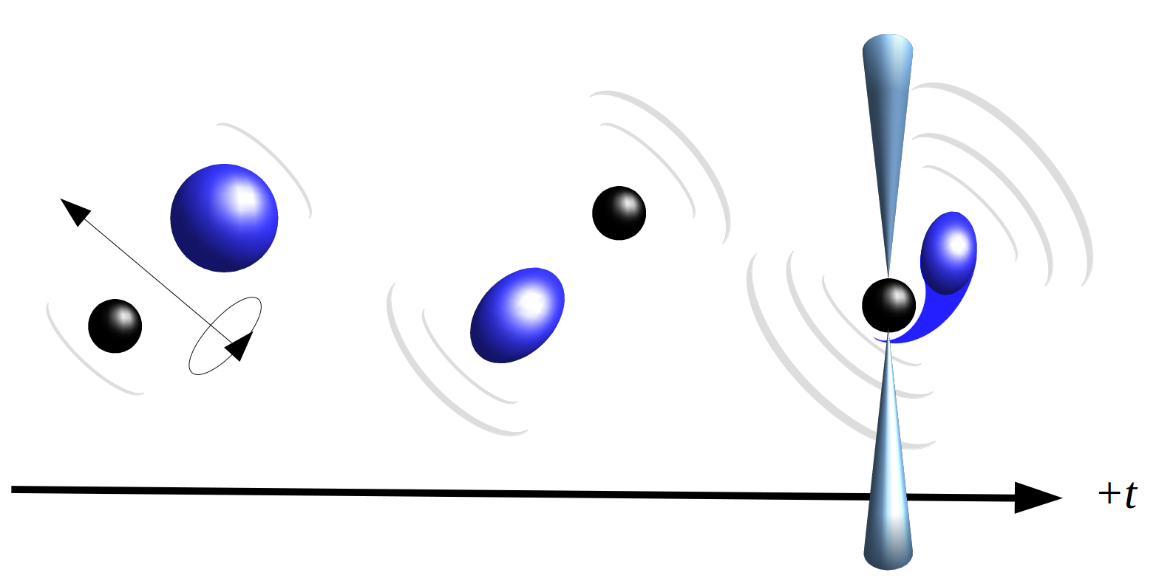
  A Brief Word About Why We Care
Low Latency Electromagnetic Follow-Up
Get the angles and orientations quickly and
you can tell EM observatories where to look
Notes:
Dr. Sandra Cruz-Pol
Electromagnetics, waveguides

Slide 24
  Playing With Bayes' Theorem
Pankow et al. 2015
Let's take a closer look at Bayes Theorem
Recastable in a slightly more useful form...
Notes:
Dr. Sandra Cruz-Pol
Electromagnetics, waveguides

Slide 25
  Playing with Bayes Theorem
Let's take a closer look at Bayes Theorem
Continuous state space case
Introduce the Likelihood Ratio
Notes:
Dr. Sandra Cruz-Pol
Electromagnetics, waveguides

Slide 26
  Converting to GW Language
Bayes Theorem transforms to become
In the language of our particular application, this is
In this case the Likelihood ratio is really
Notes:
Dr. Sandra Cruz-Pol
Electromagnetics, waveguides

Slide 27
  Probability of a Time Series
In the language of our particular application, this is
In this case the Likelihood ratio is really
Notes:
Dr. Sandra Cruz-Pol
Electromagnetics, waveguides

Slide 28
  The Harmonic Mode Decomposition
  The Harmonic Mode Decomposition
The gravitational wave signal has a Series Expansion in the
spin-weighted spherical harmonic modes
Notes:
Dr. Sandra Cruz-Pol
Electromagnetics, waveguides

Slide 29
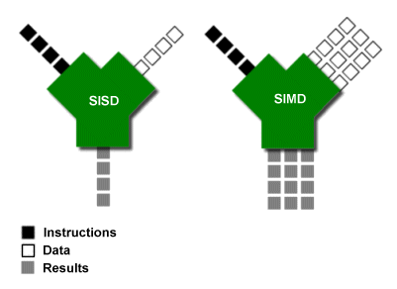
  Vectorization – Why?
Python is rather lethargic relative to lower level languages
Structures highly capable – at the expense of speed
Problem ameliorated by
libraries such as NumPy
which uses vectorized
subroutines
Reveals underlying
parallelism!
Notes:
Dr. Sandra Cruz-Pol
Electromagnetics, waveguides

Slide 30
  What can be Vectorized in our Case?
We need a few ingredients to form the complete likelihood
We will need the spherical harmonics and antenna factors
These are some of the simplest processes to translate
into vectorized operations
Notes:
Dr. Sandra Cruz-Pol
Electromagnetics, waveguides

Slide 31
  Spherical Harmonics
These are just elementwise operations on some input vectors
Easy to code and fits vectorized paradigm
Notes:
Dr. Sandra Cruz-Pol
Electromagnetics, waveguides

Slide 32
  Complex Antenna Factor
These are a fair bit trickier. Need a little theory to make it happen
In practice computed using the Detector Tensor
Contracted with the polarization matrices (wave frame)
The signal then can be cast as the linear combination:
Notes:
Dr. Sandra Cruz-Pol
Electromagnetics, waveguides

Slide 33
  Complex Antenna Factor
In practice the detector is taken as the fixed basis and the
properties of the wave are the variable across the samples
Andersen et al. 2001
Notes:
Dr. Sandra Cruz-Pol
Electromagnetics, waveguides

Slide 34
  Complex Antenna Factor
We essentially need to compute the following quantity given
a vector of vectors X and Y
Matrices fail to get the job done. We need to turn to tensors
NumPy contains
vectorized subroutines
for tensor contraction
Notes:
Dr. Sandra Cruz-Pol
Electromagnetics, waveguides

Slide 35
  Single Detector Log Likelihood
With the antenna factors and spherical harmonics in hand,
we can turn to the factored log likelihood itself.
Let's examine the first term...
But: the Q's are not single numbers! They are Time series
Notes:
Dr. Sandra Cruz-Pol
Electromagnetics, waveguides

Slide 36
  Single Detector Log Likelihood
The solution is to matrix multiply the transpose of the Q “matrix”
into the vector of spherical harmonics. For a single detector, F is a
simple scalar
Meaning the first term can be rewritten in matrix form as
Notes:
Dr. Sandra Cruz-Pol
Electromagnetics, waveguides

Slide 37
  What about the Other Terms?
The second and third terms of the single detector log likelihood:
We want these scalars. It would seem we can use the following
operation to form the same scalar:
Notes:
Dr. Sandra Cruz-Pol
Electromagnetics, waveguides

Slide 38
Part II – A GPU Implementation
Notes:
Dr. Sandra Cruz-Pol
Electromagnetics, waveguides

Slide 39
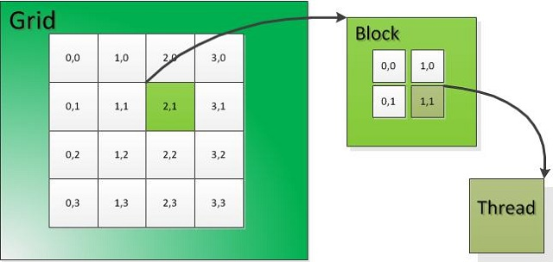
  A Little About NVIDIA CUDA C
Grids, threads, blocks!
Indices stored as local variables – for customizing thread behavior
Thread geometry should map to problem geometry
Notes:
Dr. Sandra Cruz-Pol
Electromagnetics, waveguides

Slide 40

  Memory Spaces
GPUs must work in conjunction with a CPU
CPU passes data down to RAM built into GPU
This is known as Device Global Memory
CPU Node RAM
Device
Global Memory
PCI BUS
Notes:
Dr. Sandra Cruz-Pol
Electromagnetics, waveguides

Slide 41
  Memory Spaces
GPUs must work in conjunction with a CPU
CPU passes data down to RAM built into GPU
This is known as Device Global Memory
CPU Node RAM
Device
Global Memory
PCI BUS
Shared Memory
Results
Notes:
Dr. Sandra Cruz-Pol
Electromagnetics, waveguides

Slide 42
  Our Goal: Compute L, Fast
How can we use this paradigm to compute the likelihood faster?
Let's start with the spherical harmonics again
Notes:
Dr. Sandra Cruz-Pol
Electromagnetics, waveguides

Slide 43
  The Spherical Harmonics
Notes:
Dr. Sandra Cruz-Pol
Electromagnetics, waveguides

