Slide 1
Using LSTMs to model naturalistic fMRI data
By: Akhila Sankaramanchi, Ariadne Letrou, Brandon Carone
Stegosaurus Kente/ Temporal Titans

Slide 2
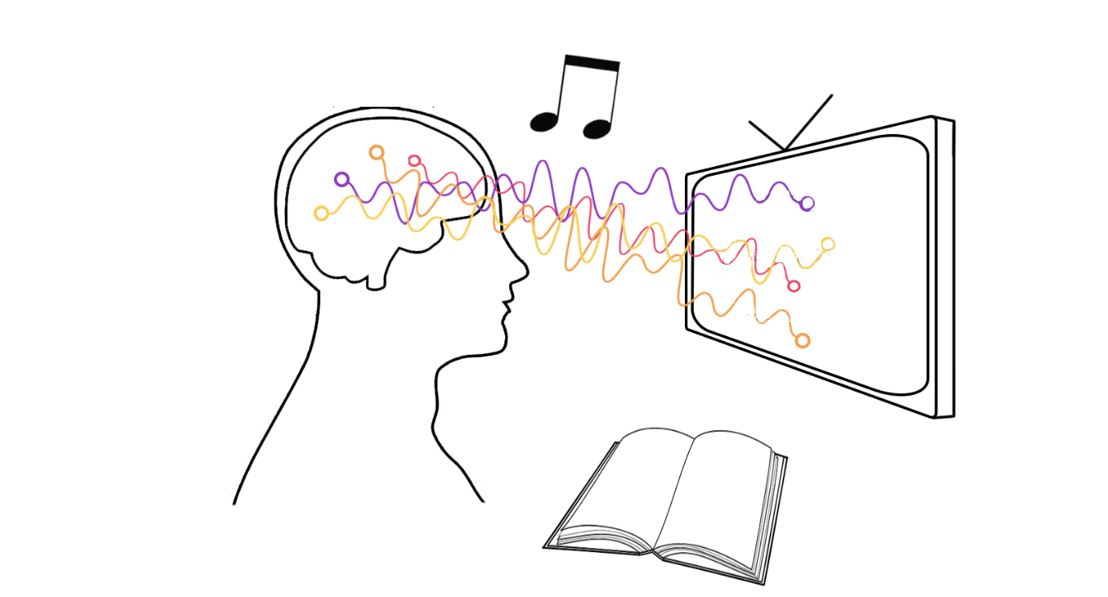
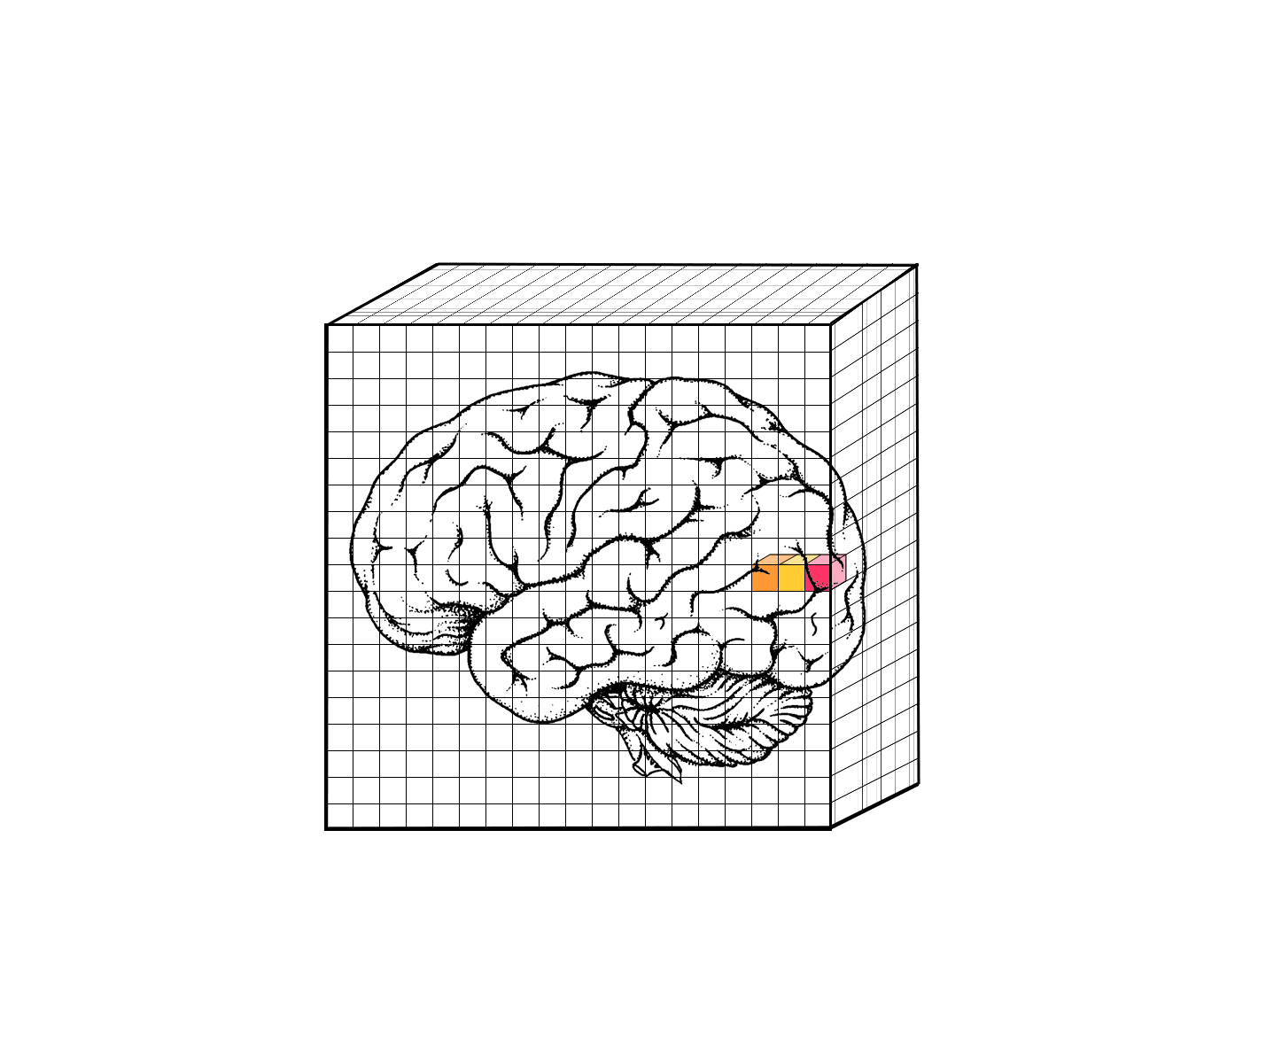
Project Questions & Aims
How can we use deep learning to model the temporal properties inherent in naturalistic fMRI?
How can this effort afford deeper insights into brain regions implicated in naturalistic tasks?
Build a model that incorporates the temporal properties of naturalistic data and use it to map brain activity to behavior.
…
Voxel in ROI
t₁
t₂
t₃
T
voxel 1
voxel 2
voxel 3
Notes:
So in a traditional fMRI experiment, you typically have someone sit in a scanner, and you measure their brain activity as they engage in a specific task. An example of a traditional task might involve a series of images flashing on the screen. In that case, each image is one trial and corresponds to a single instance in time.
But in recent years, naturalistic paradigms have become increasingly popular because they offer continuous sensory input that more closely simulates real-world experience. In a naturalistic experiment, instead of a trial being a single image, it would be a movie, or a narrative, or music — something that extends over time. Below you can see an example of how you might go about collecting this type of data. You divide the brain into tiny volumes, or cubes, and then track the activity of each volume over the course of the stimulus.
But despite their popularity, naturalistic neuroimaging data are not well-suited for traditional analysis methods because these methods are agnostic to the data’s temporal properties. In this project, our aim was to address this gap in the field by building a deep learning model that is sensitive to the temporal properties of naturalistic fMRI data and used the model to map brain activity to behavior.

Slide 3
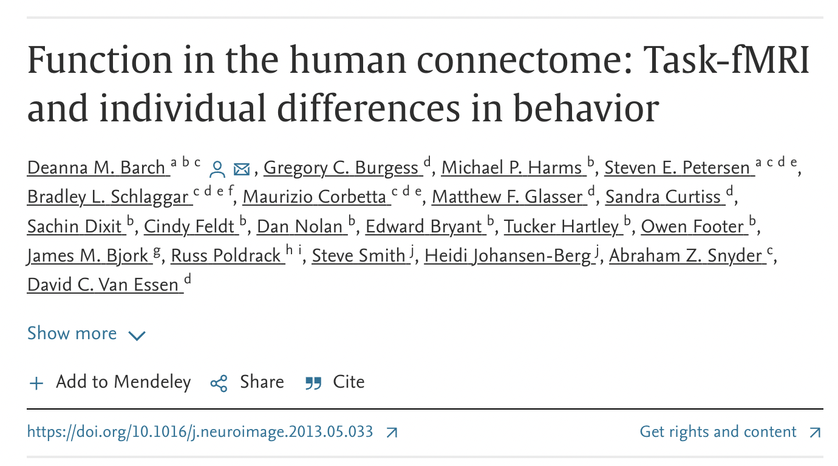
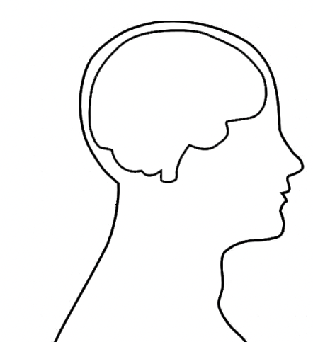
Dataset
?
Theory of Mind - ascribing mental states to others and using those mental states to explain/predict their actions
100 participants
10 videos each (5 mental, 5 random)
2 ROIs: TPOJ (Theory of Mind), early auditory (control)
Data shape: Voxels x Time
Mental
Random
Notes:
So how did we do this? We used an open-source fMRI dataset, where 100 participants performed a Theory of Mind task. The task involved watching 10 videos of different shapes moving. The shapes were either interacting in a meaningful way or moving around randomly. Participants were then asked to identify if the shapes in the video had mental states or if they were random.
We constrained our analyses to two brain regions: the TPJ, which is canonically implicated in Theory of Mind tasks, and an early auditory region, which served as a control because the movies were silent. The idea here is that if we build a model that predicts behavior from brain activity, then the predictions should be more accurate for the TPJ region, which is engaged in the task, than for the control region, which is just random noise. Brandon will now talk more about this.

Slide 4

Why LSTMs?
Hypothesis: Long Short-Term Memory (LSTM) networks can effectively decode behavior from brain activity due to their ability to track long-term dependencies in input sequences.
LSTM's capacity to track temporal dynamics makes it suitable for analyzing fMRI data.
Notes:
The core hypothesis is that LSTM networks are well-suited for this project because they can effectively process and understand the temporal dynamics of sequences by utilizing their internal memory to process arbitrary sequences of inputs, which makes them well-suited for tasks like understanding the progression of brain activity over time. Furthermore, LSTMs have the ability to selectively forget or remember information, allowing them to maintain relevant information over longer sequences, and to avoid problems like vanishing or exploding gradients that can occur with traditional RNNs.

Slide 5
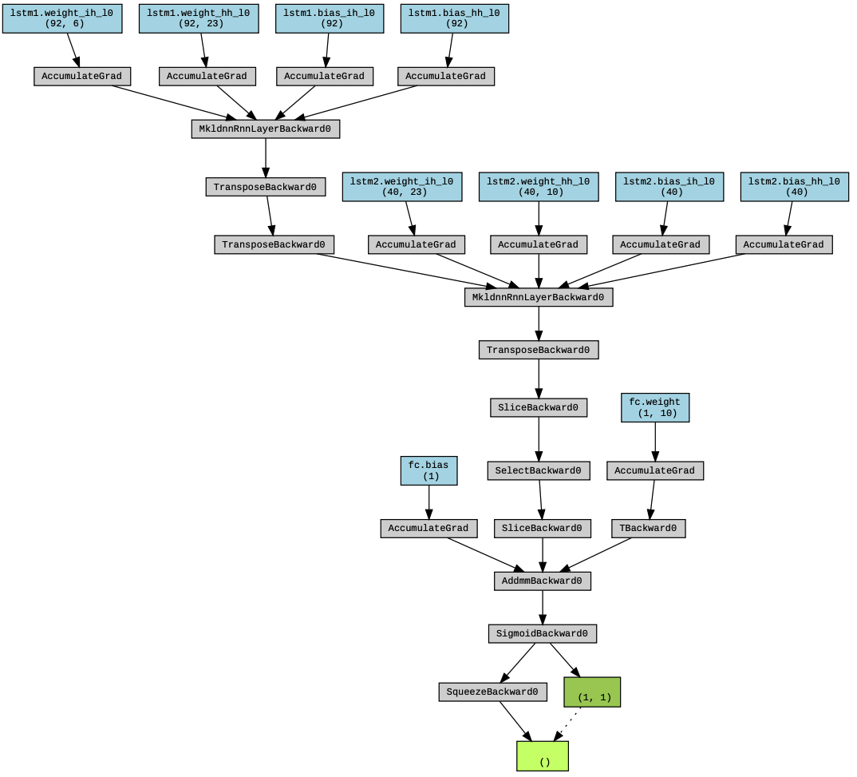
Methods
Model Architecture:
3-layer LSTM with hidden sizes of 23, 10, and 5 respectively
Dropout rate was set at 0.6
Early stopping with a patience of 10 epochs to stop training when the model stops improving
Notes:
LSTM networks were chosen because of their ability to handle sequence data, which is crucial for processing fMRI data that essentially represents a sequence of brain activity over time.
Our model configuration was determined through hyperparameter tuning. The best performing model was a 3-layer LSTM with varying hidden layer sizes.
To prevent overfitting, we used a dropout rate of 0.6, which randomly sets a fraction of input units to 0 at each update during training time.
We also implemented early stopping with a patience of 10, which means training was stopped if there was no improvement in model performance after 10 epochs. This also helps in preventing overfitting and reduces computational expense.

Slide 6
Results
Notes:
Now going into our results.

Slide 7
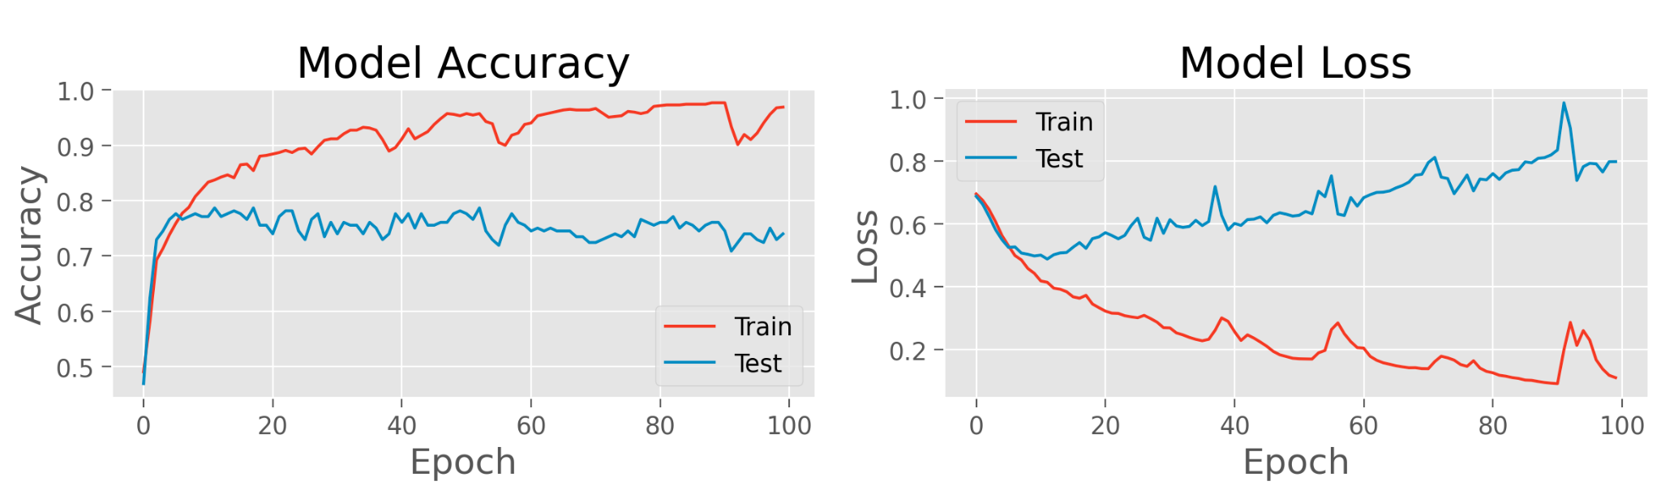
Model overfits to the data
Brain Regions: TPOJ1, TPOJ2, TPOJ3
Regularization: None
Notes:
So we first started off with an LSTM with only 2 hidden layers, given our dataset was pretty small and didn’t need to be so complex. We ran this model on the TPJ region but found that the model was overfitting to our data. This overfitting issue is common in LSTMs especially when working with small datasets. And so we sought to try regularization techniques to see if it would improve the model.

Slide 8
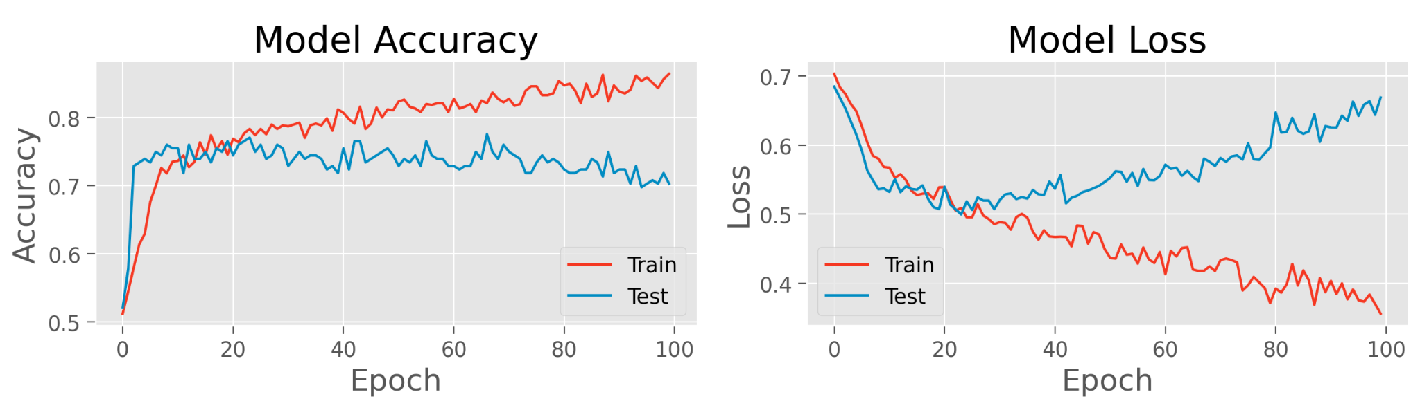
Model performance increases with regularization
Brain Regions: TPOJ1, TPOJ2, TPOJ3
Regularization: Dropout (0.6)
Notes:
First we tried the dropout method. This definitely improved the model slightly, but didn’t fix the overall overfitting issue.

Slide 9
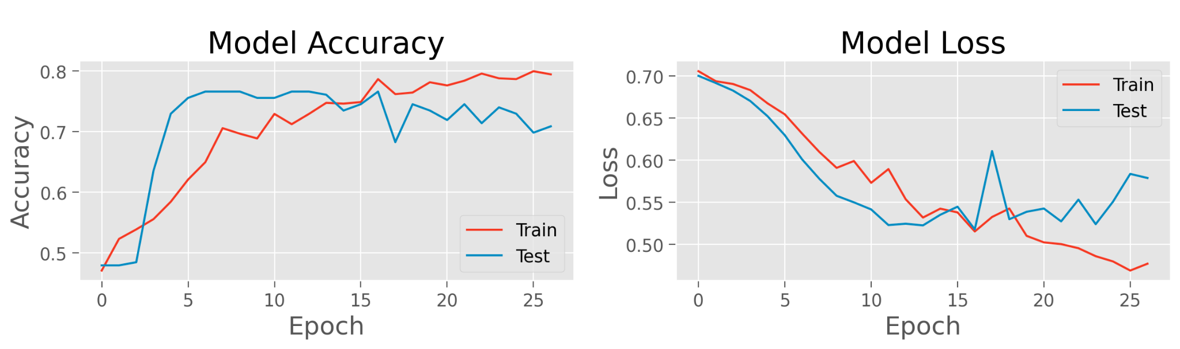
Model performance increases with regularization
Brain Regions: TPOJ1, TPOJ2, TPOJ3
Regularization: Dropout (0.6) + Early Stopping
Notes:
We next tried early stopping. This improved the model where you can see both the train and test reach almost 80% accuracy while also minimizing the loss.

Slide 10
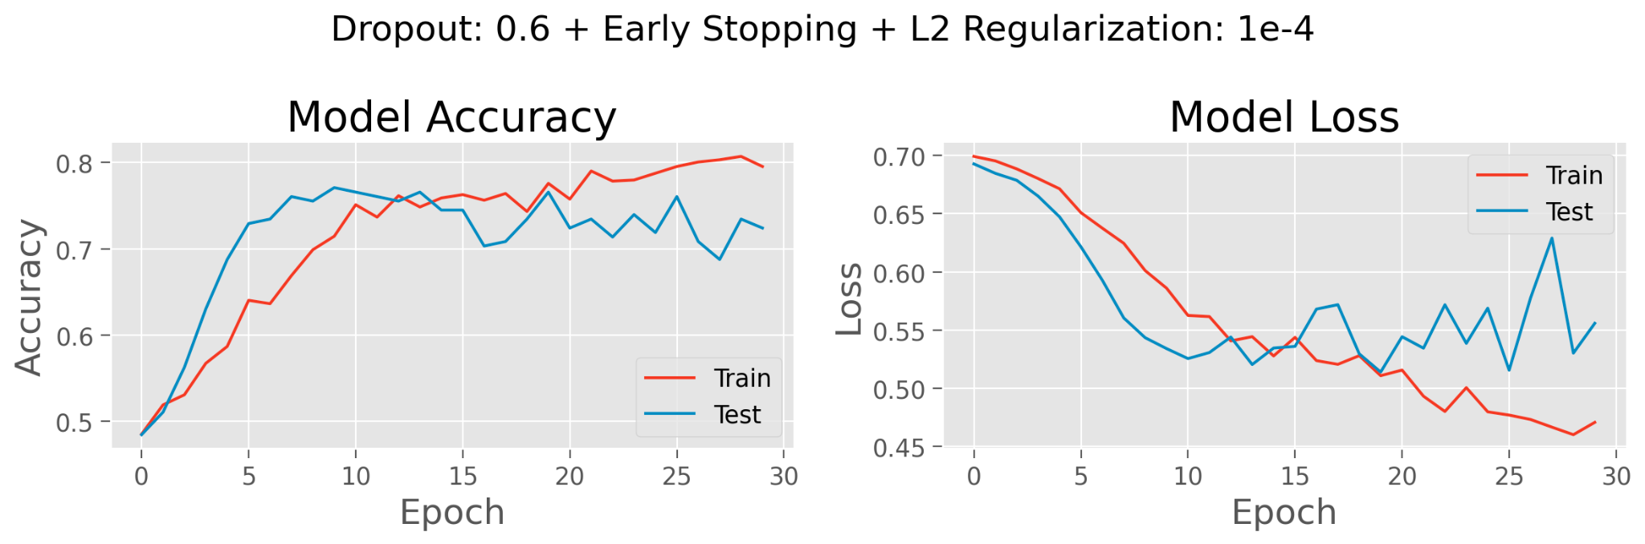
Model performance increases with regularization
Brain Regions: TPOJ1, TPOJ2, TPOJ3
Regularization: Dropout (0.6) + Early Stopping + L2 Regularization
Notes:
Next we tried L2 regularization which is where we introduce a penalty term in the loss function to reduce the size of the parameters. This method didn’t improve the model greatly so we removed it.

Slide 11
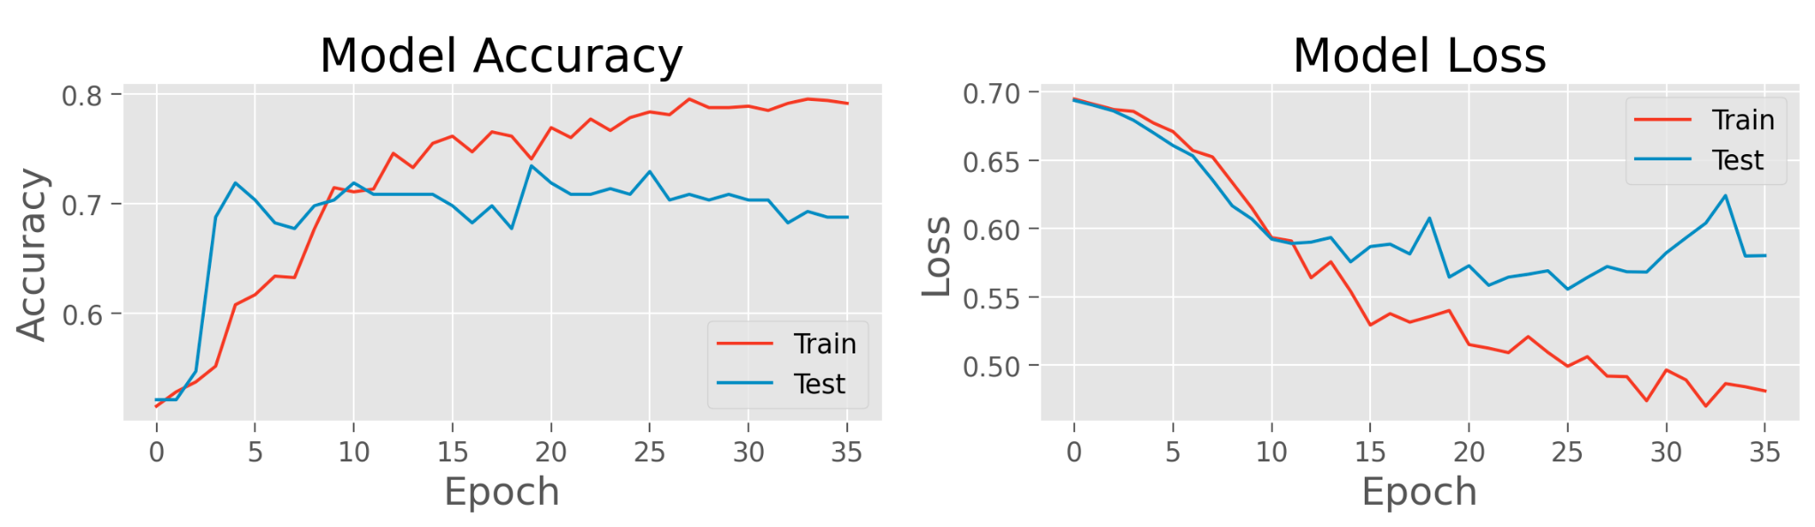
Model performance increases with regularization
Brain Regions: TPOJ1, TPOJ2, TPOJ3
Regularization: Dropout (0.6) + Early Stopping + 4 Layers
Notes:
Next we played around with the number of layers in our model. Before we had 2 hidden layers, however increasing it to 4 reintroduced the overfitting issue likely due to being overly complex.

Slide 12
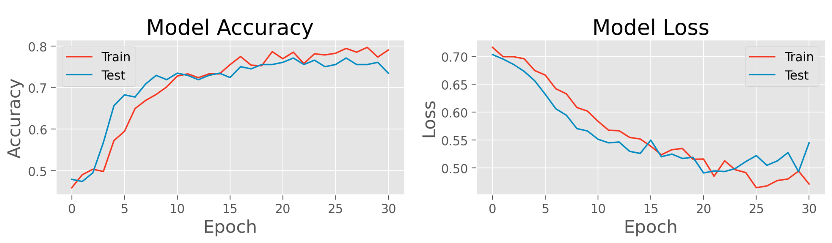
Model performance increases with regularization
Brain Regions: TPOJ1, TPOJ2, TPOJ3
Regularization: Dropout (0.6) + Early Stopping + 3 Layers
Notes:
We discovered that our optimal model had 3 layers, dropout and early stopping.

Slide 13
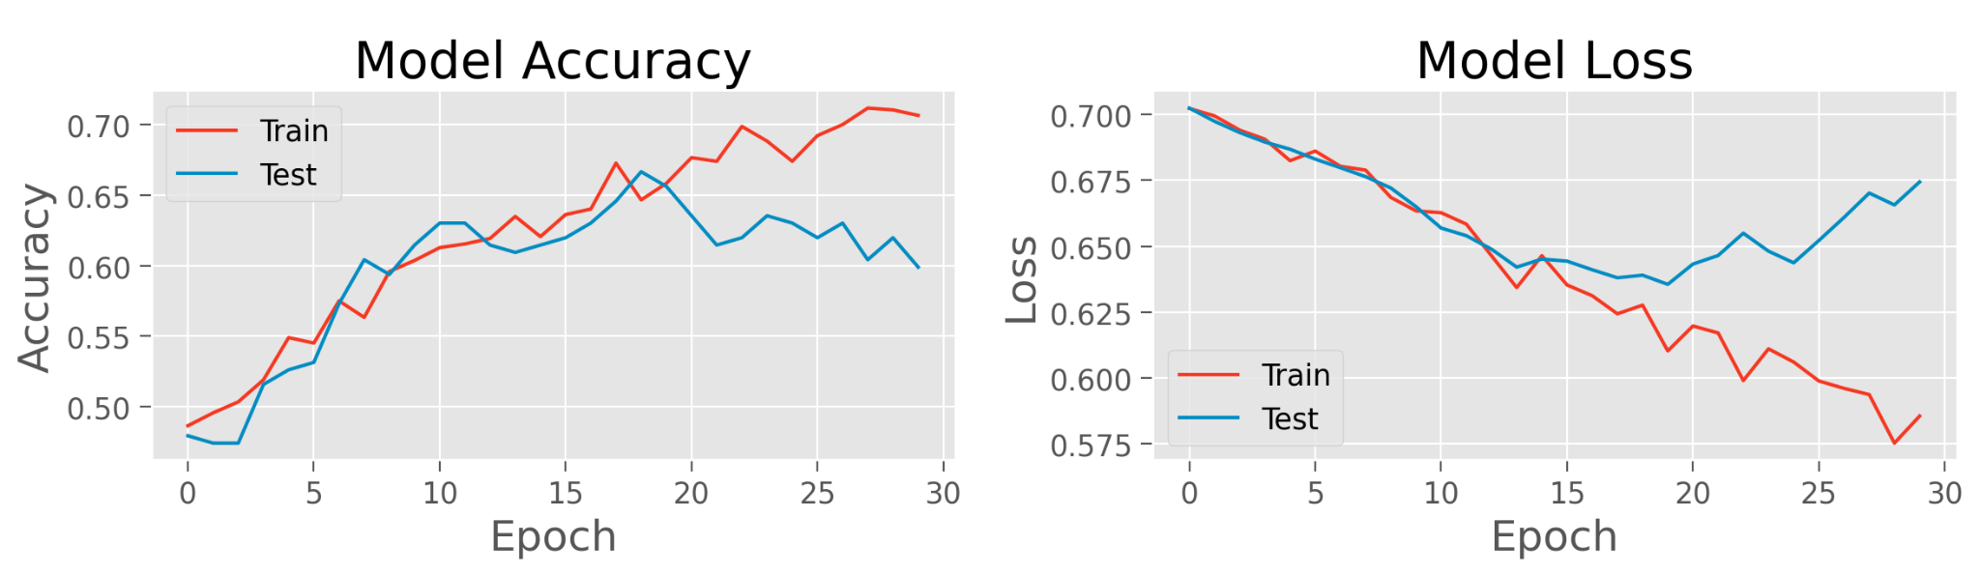
Model is selective to task related regions
Brain Regions: A1, STGa, A5
Regularization: Dropout (0.6) + Early Stopping + 3 Layers
Notes:
We next tried to validated our model. We expect the to perform poorly on brain regions that are unrelated to the task if it is actually learning something about the data and behavioral responses. We tested our model on parts of the auditory cortex since the task does not require the subject to listen to anything and found that our model performed worse. This shows that our model is actually learning about behavioral responses related to the task given the fMRI data.

Slide 14
Discussion
Here, we see that LSTM models are useful for modeling the temporal structure of naturalistic fMRI data
Our model’s performance (prediction accuracy) for different brain regions suggests that it can identified regions of interest for a certain tasks
Try other regularization techniques to generalize model: data augmentation (stretching time, filtering, adding gaussian noise, augmenting fMRI images)
Adding more data will improve the model
Notes:
Lastly, going into our discussion. Based on our results, we believe our model can be used to identify regions of interest related to tasks with naturalistic stimuli. In the future, we would like to try other regularization techniques such as data augmentation Lastly, adding more data will always improve the model.

Slide 15
References
Barch, D. M., et al. (2013). Function in the human connectome: Task-fMRI and individual differences in behavior. NeuroImage, 80, 169–189. https://doi.org/10.1016/j.neuroimage.2013.05.033
Saxe, R., & Wexler, A. (2005). Making sense of another mind: The role of the right temporo-parietal junction. Neuropsychologia, 43(10), 1391–1399. https://doi.org/10.1016/j.neuropsychologia.2005.02.013
Olszowy, W., Aston, J., Rua, C. et al. Accurate autocorrelation modeling substantially improves fMRI reliability. Nat Commun 10, 1220 (2019). https://doi.org/10.1038/s41467-019-09230-w

Slide 16
Acknowledgements
Thank you to our TAs (Ozgur & Soan),
our mentor (Di),
and our POD members (Colleen, John, Ian, Philipp & Tuga)
for their guidance!

