Slide 1
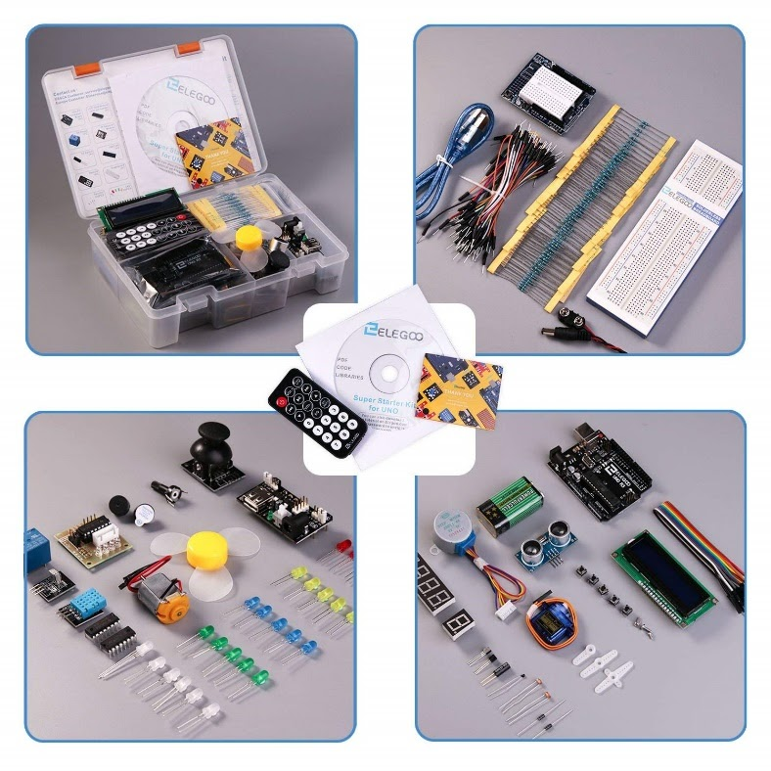
Intro to Arduino
Stepper motors, Photoresistors

Slide 2
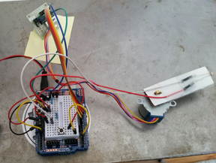
This week: Light locator
Build a device that scans 180 degrees and points to the brightest light source
We’ll use a stepper motor to move a light sensor
The light sensor will be a photoresistor

Slide 3
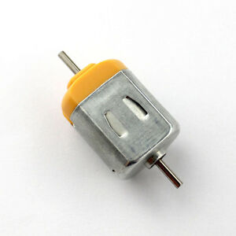
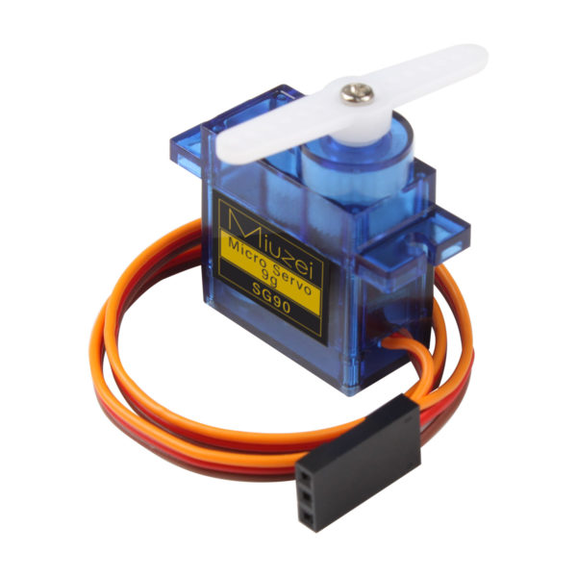
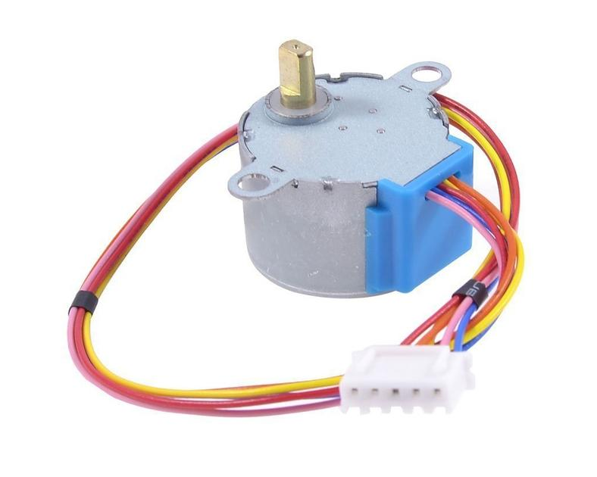
Types of Motors
Brushed motor: Spins when supplied power
Servo motor: Moves to a specific position
Stepper motor: precise control of multiple revolutions

Slide 4
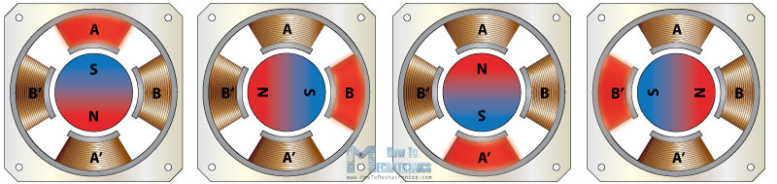
What’s a Stepper Motor?
Motor with a series of coils surrounding a magnet
The coils are energized in sequence to move the magnet
Typically have many coils so they move in small steps

Slide 5

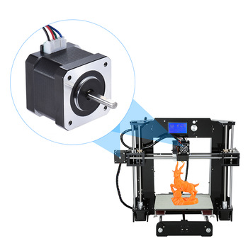
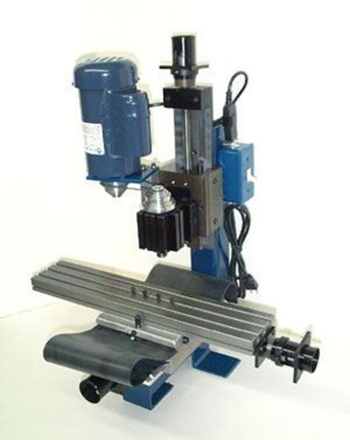
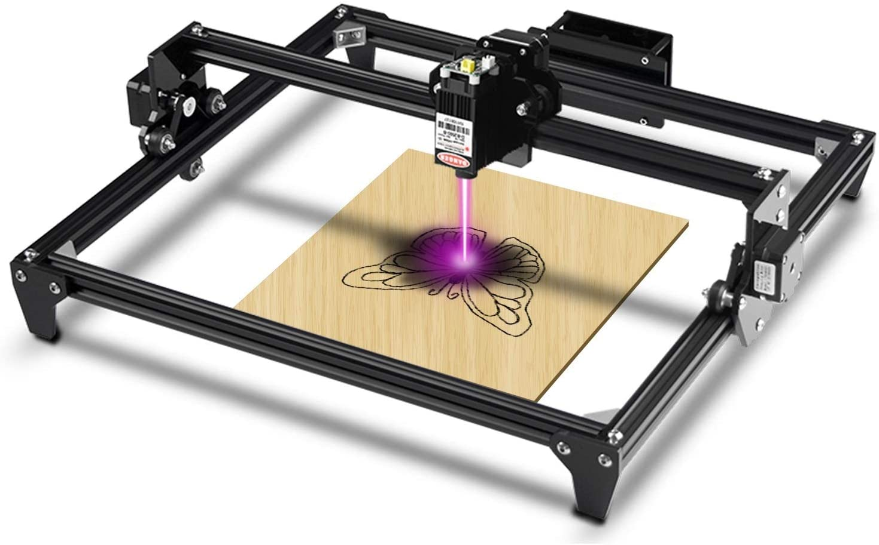
Where do we use stepper motors?
Good for precision motion
More revolutions than most servos
CNC (Computer Numeric Control) applications
Mills, lathes, laser cutters, printers
Often used with open-loop control
Feed forward: “try to go x steps”
Can miss steps if motor is over-torqued

Slide 6
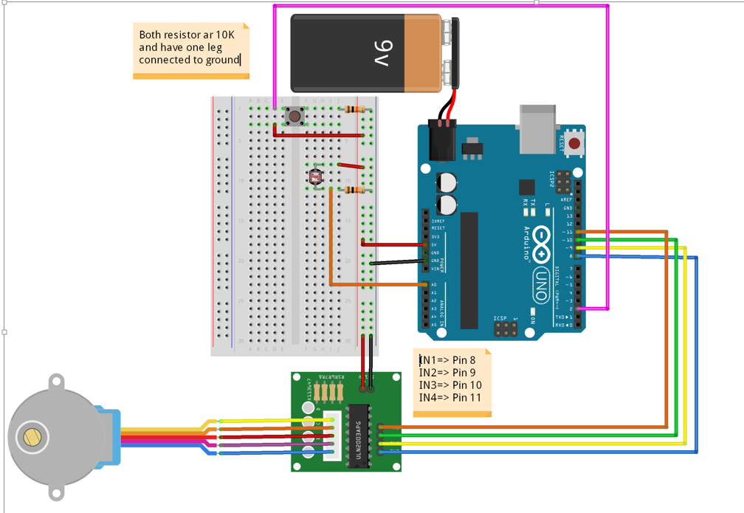
Stepper Drivers
The stepper requires the multiple internal coils to be switched on and off in a sequenced order
A stepper driver is used to control the stepper motor
Your kit comes with a ULN2003 Unipolar stepper driver

Slide 7
Test sketch
In part 1, use the demo code to test your stepper motor and driver
The code commands the motor to move 2048 steps (1 revolution) clockwise, then 1 revolution back (-2048 steps)

Slide 8
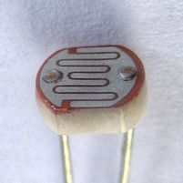
Photoresistor
Also called Photocell or Light Dependent Resistor (LDR)
Changes resistance depending on how bright the incident light is
As light gets brighter, resistance decreases
CdS - most common type, is most sensitive to visible light

Slide 9
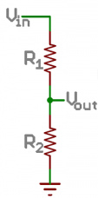
Using the photoresistor
Wire in series with a 10 kΩ resistor as shown (voltage divider circuit)
Read analog voltage (Vout) from point where the photoresistor and resistor meet in the circuit
Voltage should increase with brighter light because photoresistor resistance decreases (more voltage drop across 10kOhm resistor)

