Slide 1
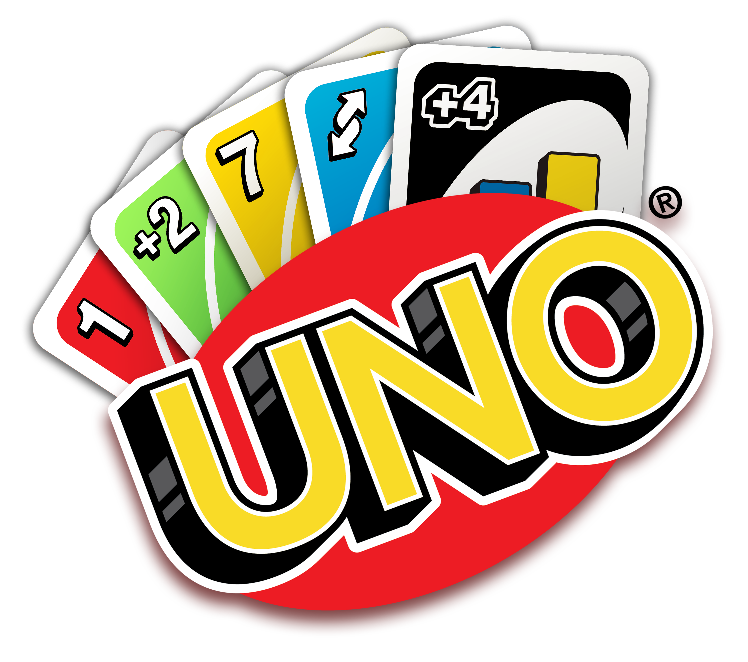
Uno
By
Brandon Chiong
Felix Chin
Rainier Hui
Daniel Nguyen

Slide 2
What‘s on the agenda
Introduction

Slide 3
Uno! No Habla Espanol!
You should, its really helpful!
No worries, its just a game =)
Goal
Be the first to have absolutely no cards!
Ok, but how?
Play the match game with the card in play.

Slide 4
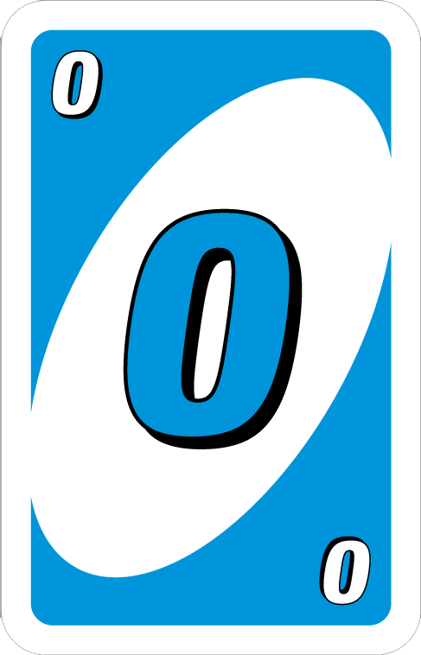
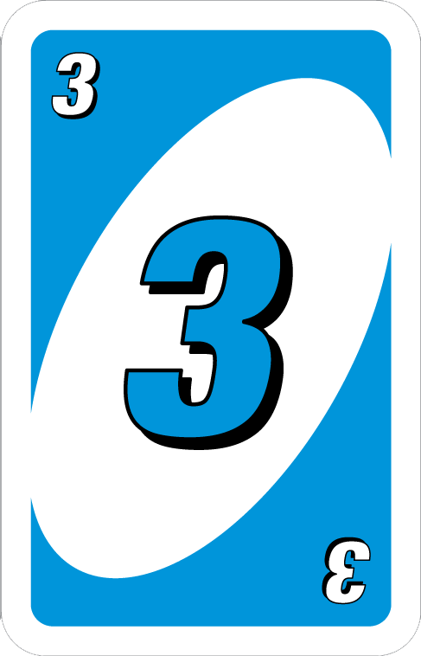
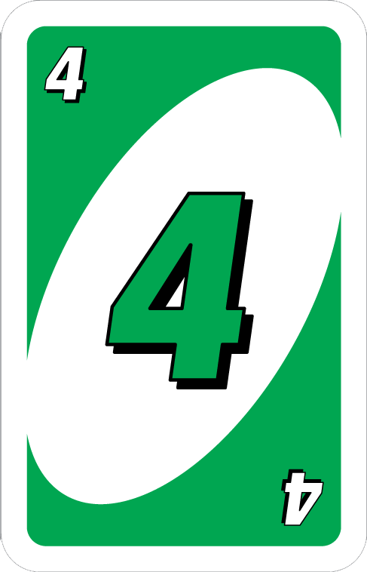
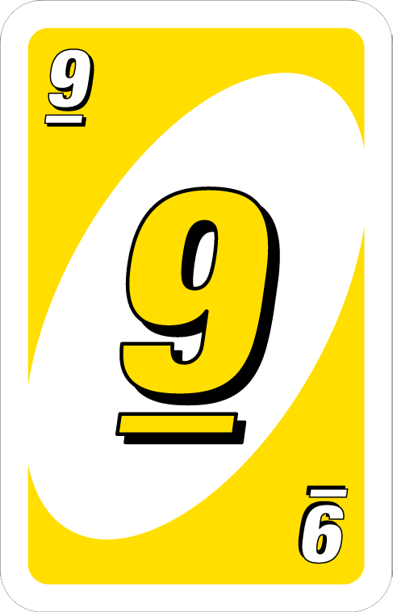
Most of the time
Match Colors

Slide 5
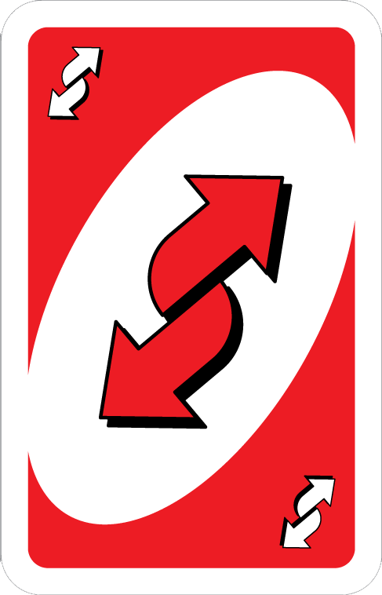

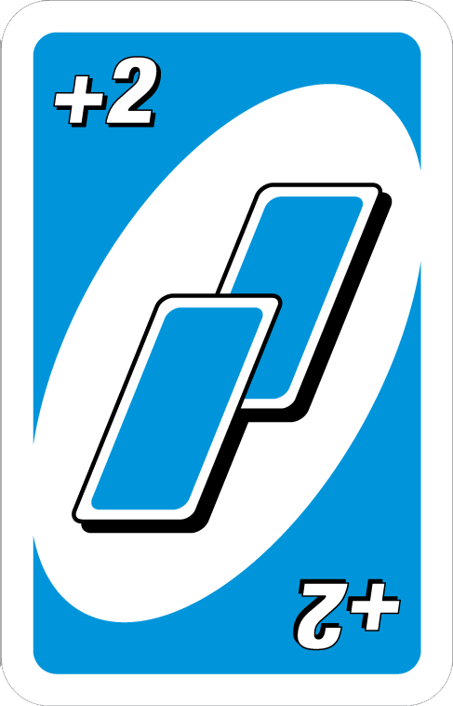
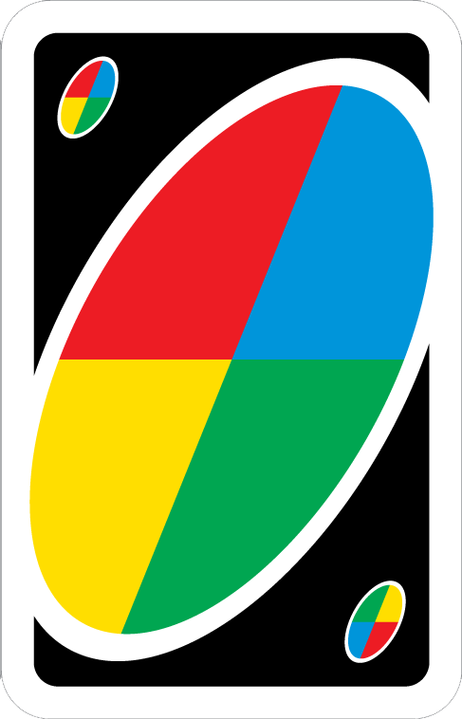
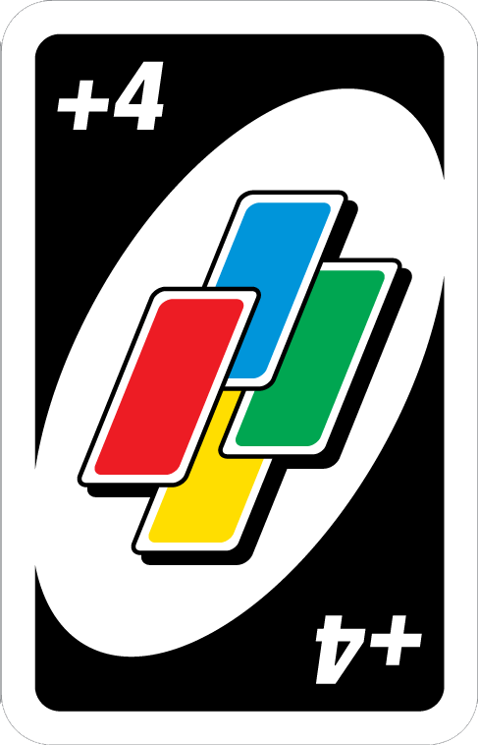
Why Uno is Fun!

Slide 6
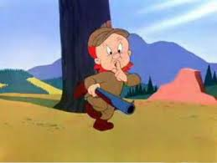
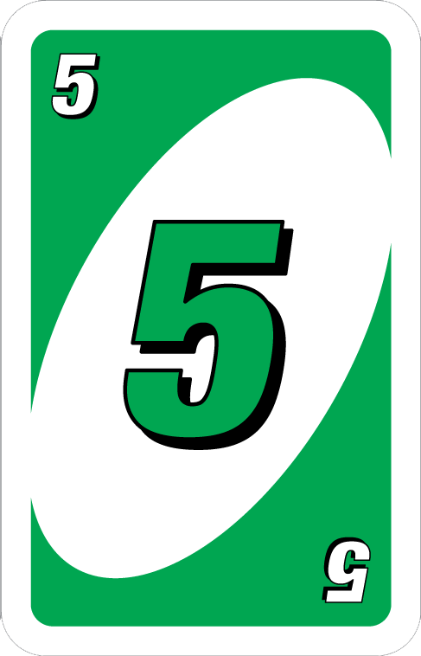
Check
Maybe nobody
Will notice
Me…
1 Card Left!!!!

Slide 7
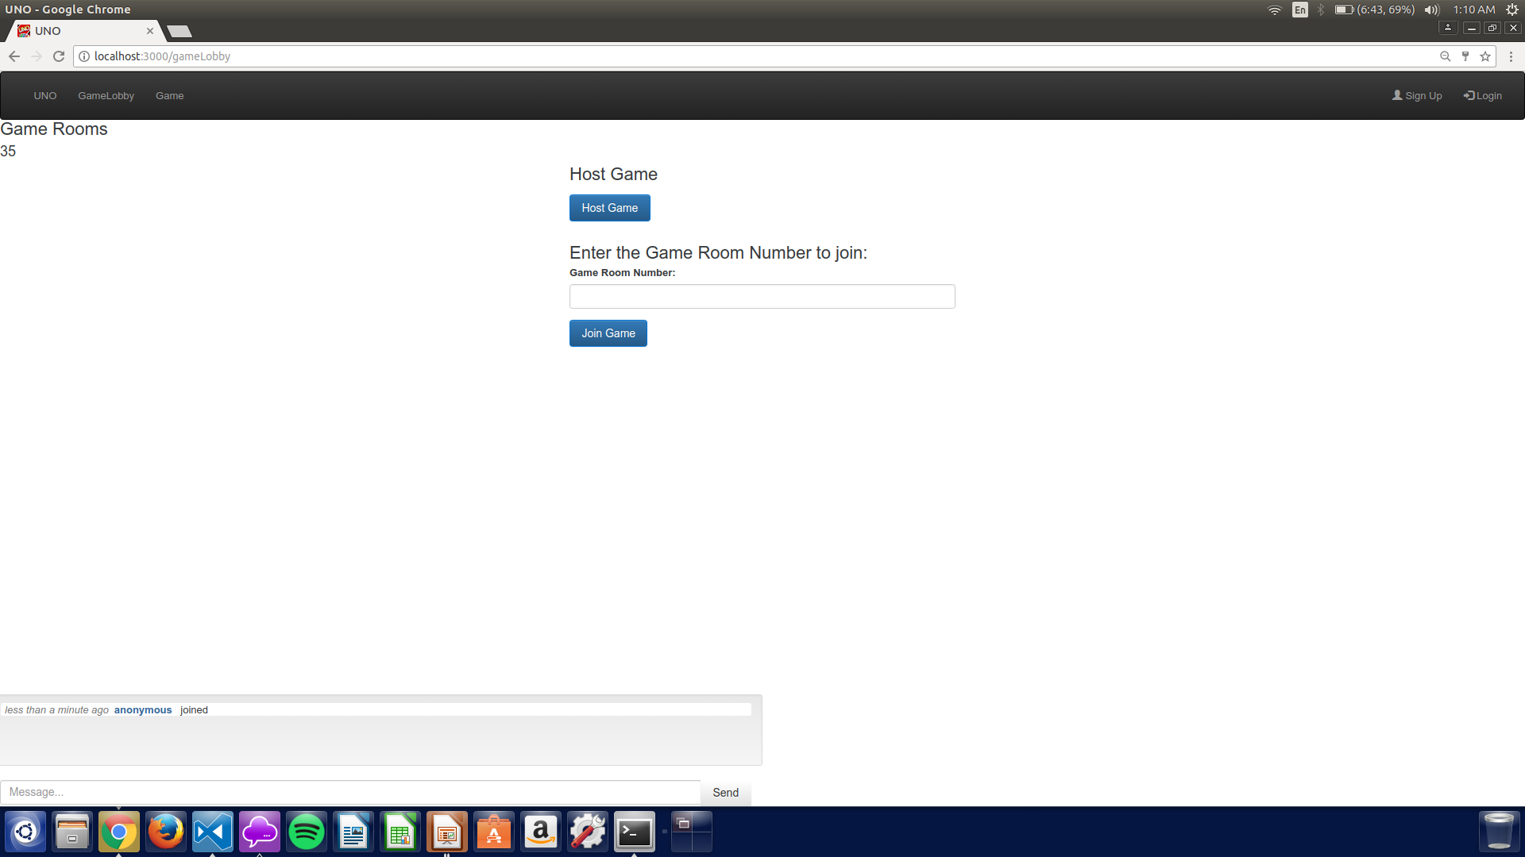
Game Lobby =(

